Slide 1
Bùi Xuân Hải
Role number​ : HE200952
Đại ​học FPT Hà Nội
Project 1
4-bit adder / subtractor with overflow

Slide 2
Operating principle
Circuit Concept:
The circuit is a 4-bit arithmetic unit capable of both addition and subtraction based on a control signal (sub).
Addition (sub = 0): Operates as a standard ripple-carry adder.
Subtraction (sub = 1): Computes A - B by utilizing two's complement (A + ~B + 1). The sub signal acts as the carry-in for the first bit.
Overflow Detection: Implemented using an XOR gate between the carry-in to the MSB (c3) and the carry-out of the MSB (c4).

Slide 3
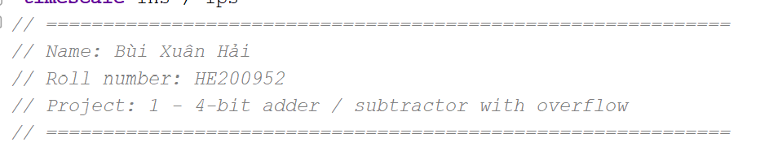
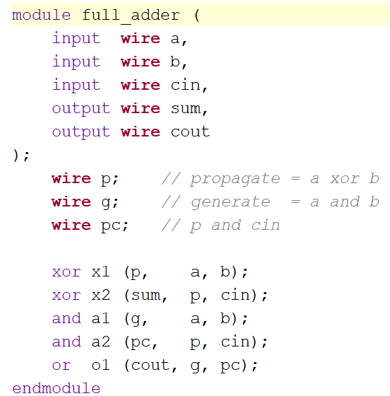
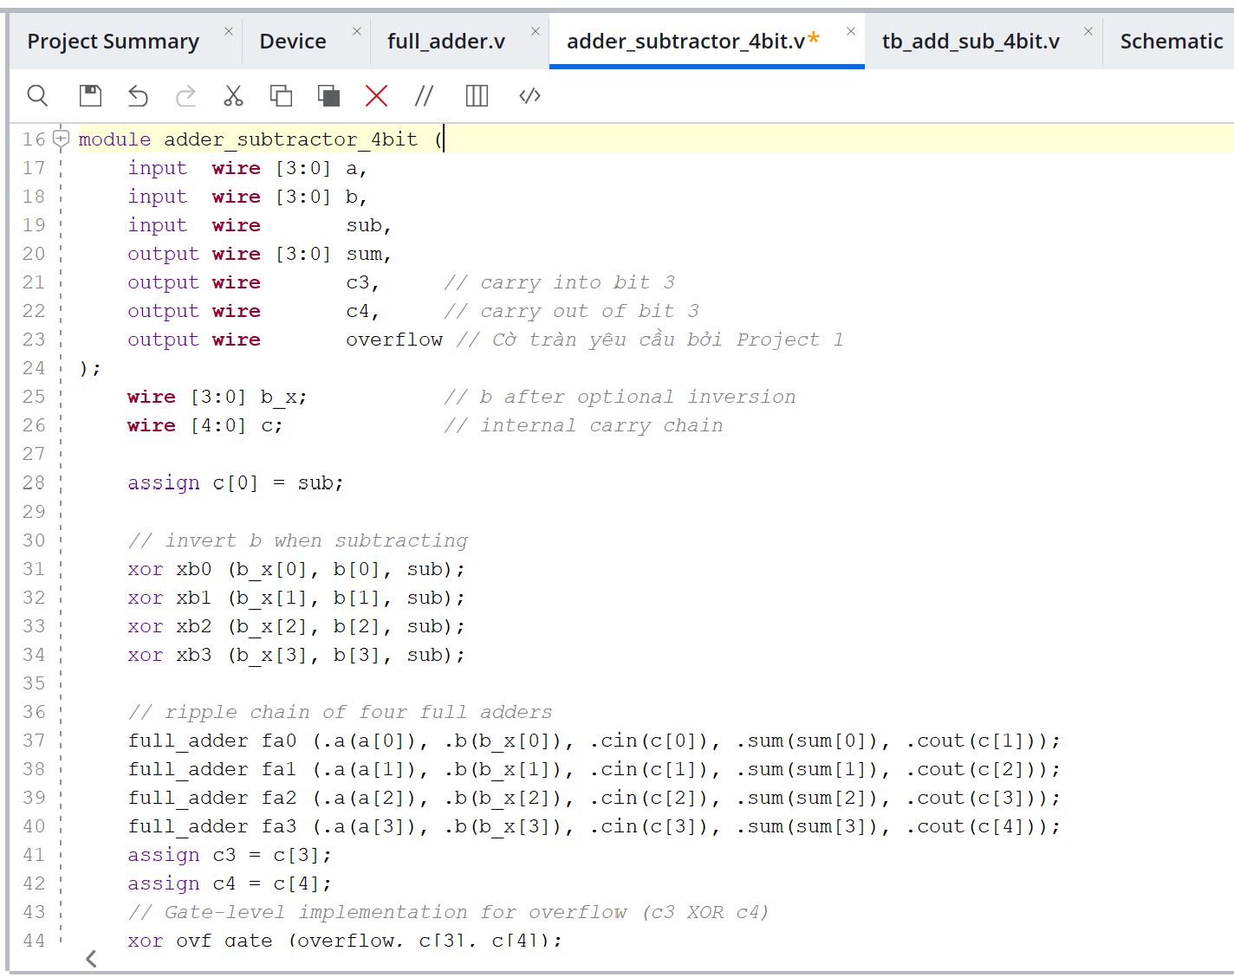
Design
Fully implemented using Gate-Level modeling (XOR, AND, OR gates).

Slide 4
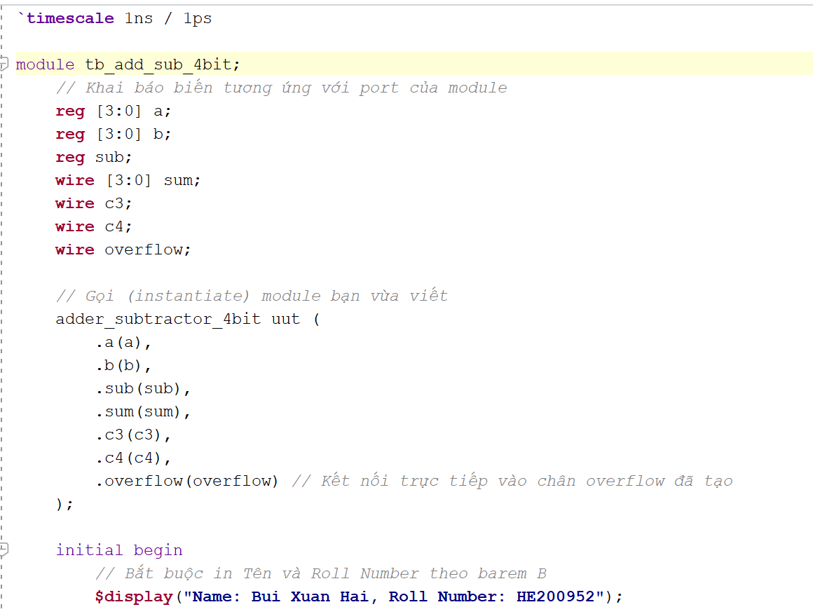
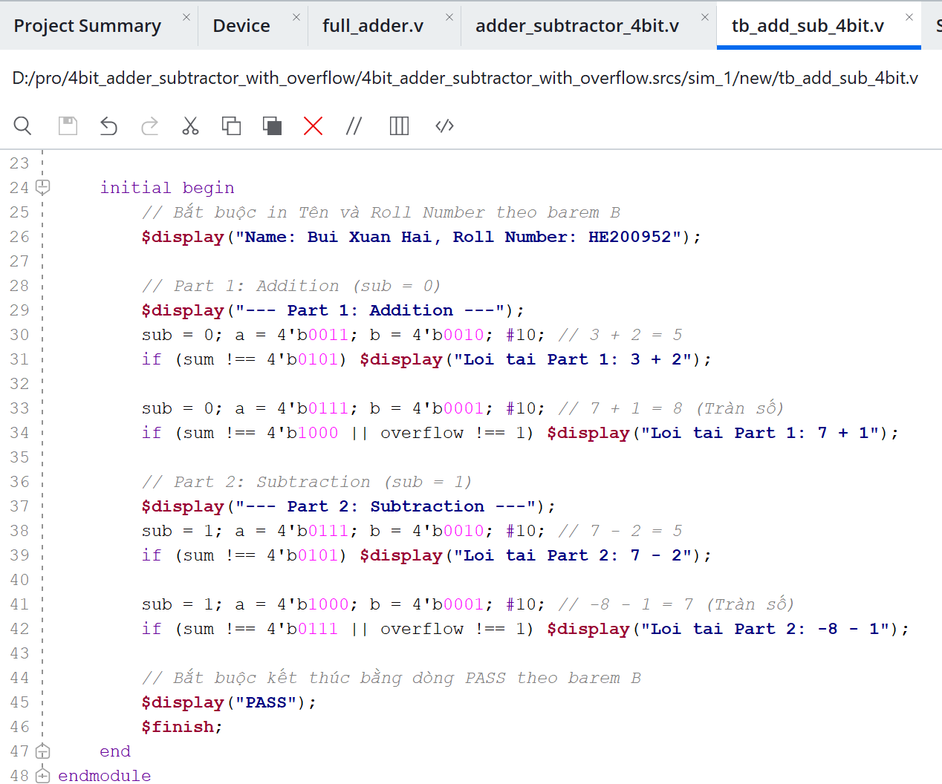
Testbench
Self-checking mechanism: Automatically verifies the output against expected values.
Divided into Part 1 (Addition) and Part 2 (Subtraction)
Prints Student Name and Roll Number to the console.
Ends execution with a "PASS" statement

Slide 5
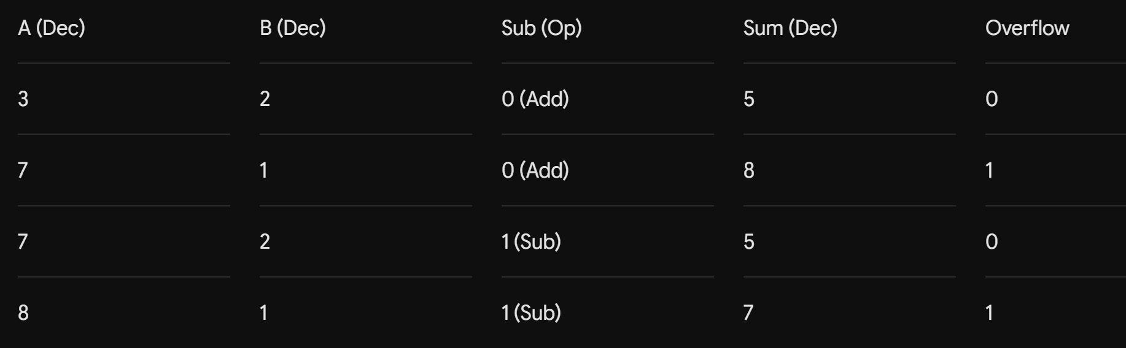
Test Case Table
This table shows four test cases for the 4-bit adder/subtractor. It verifies both addition and subtraction operations, including normal cases and overflow cases.

Slide 6
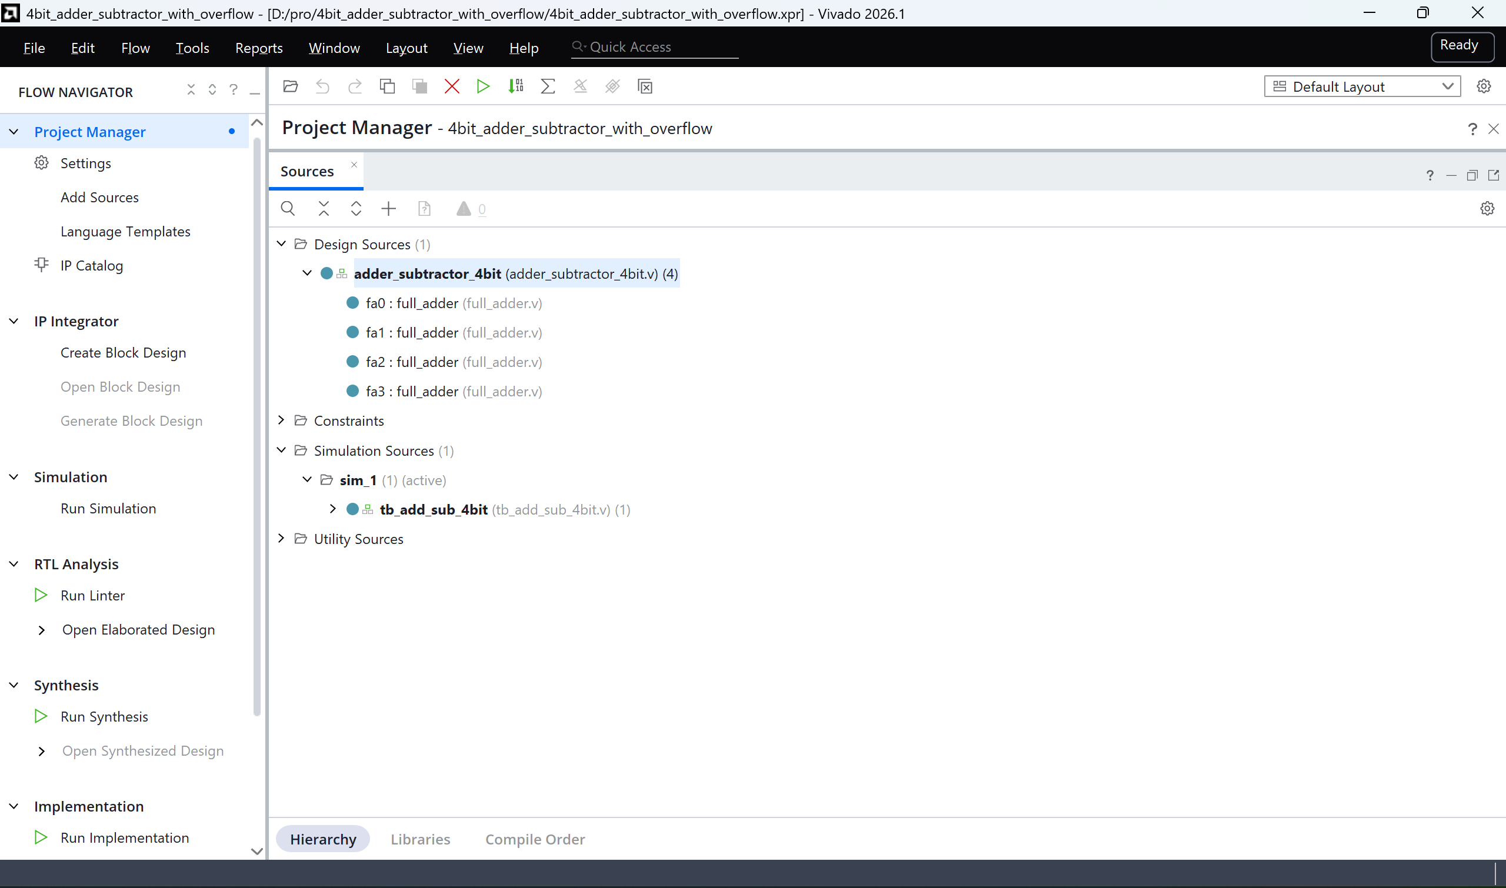
Flow Explanation - Add Sources

Slide 7
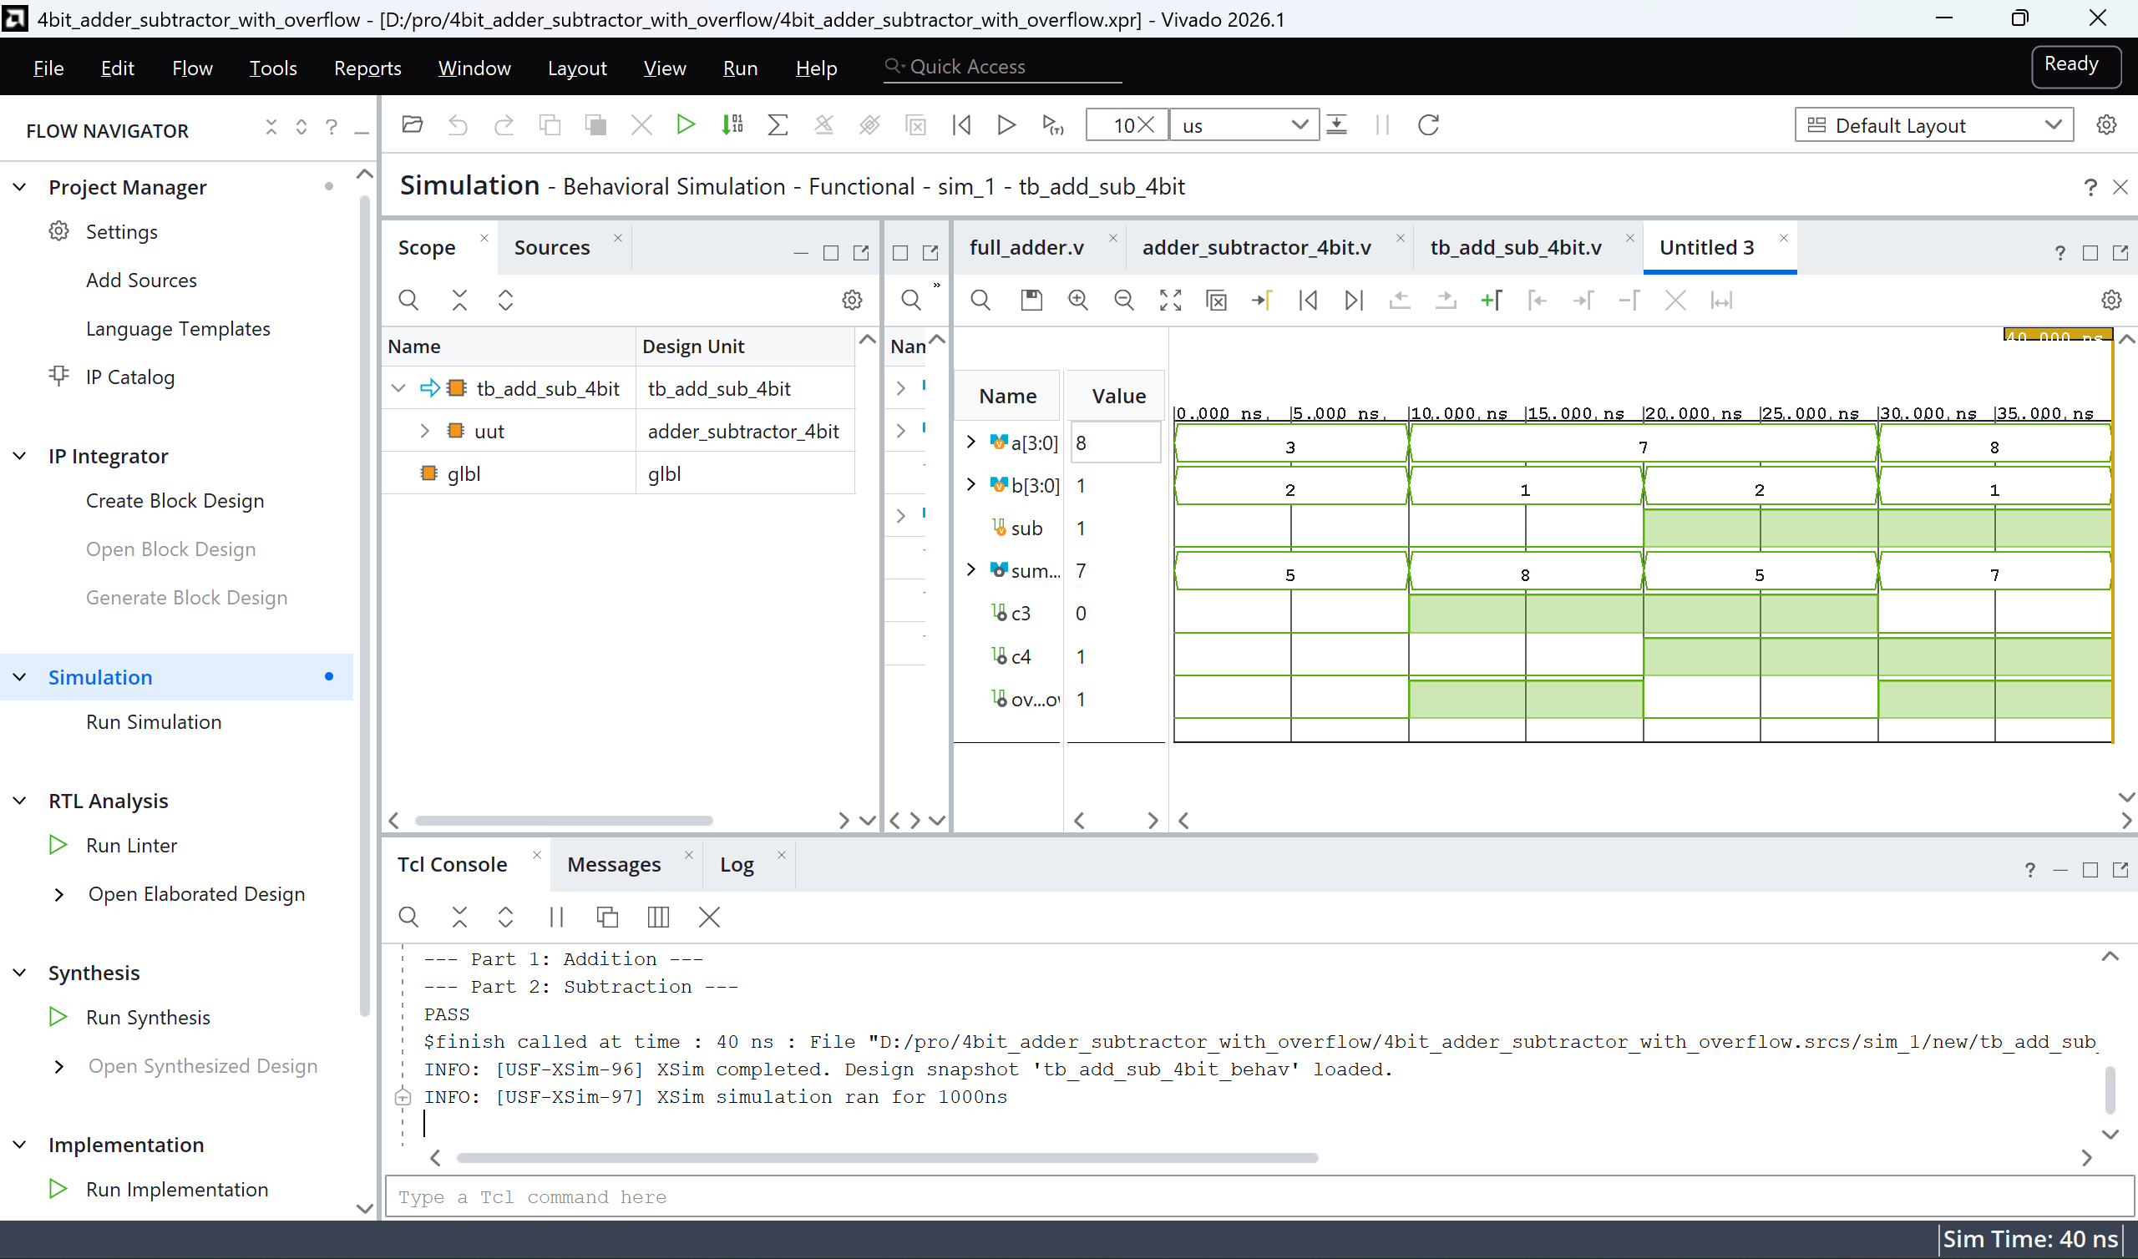
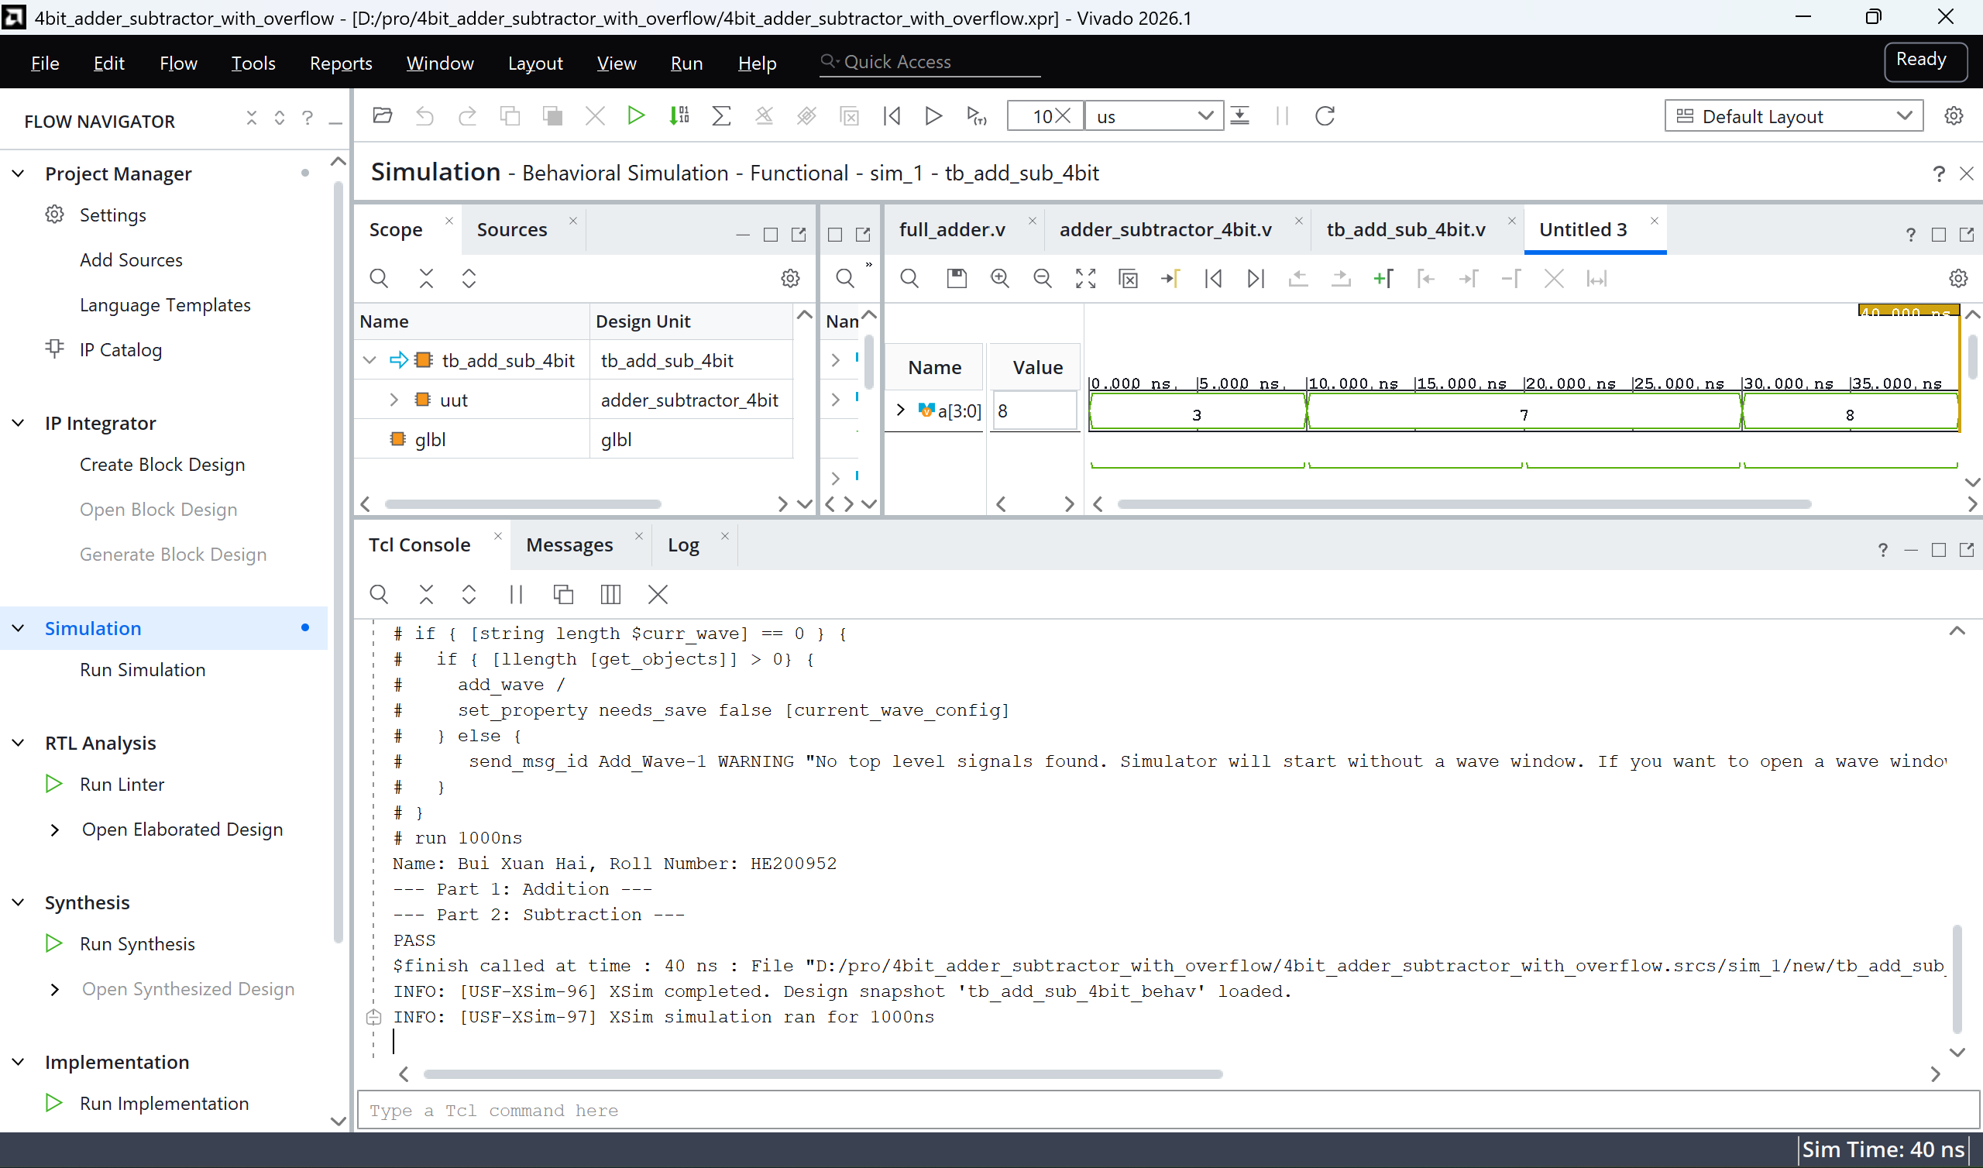
Flow Explanation - Behavioral Simulation

Slide 8
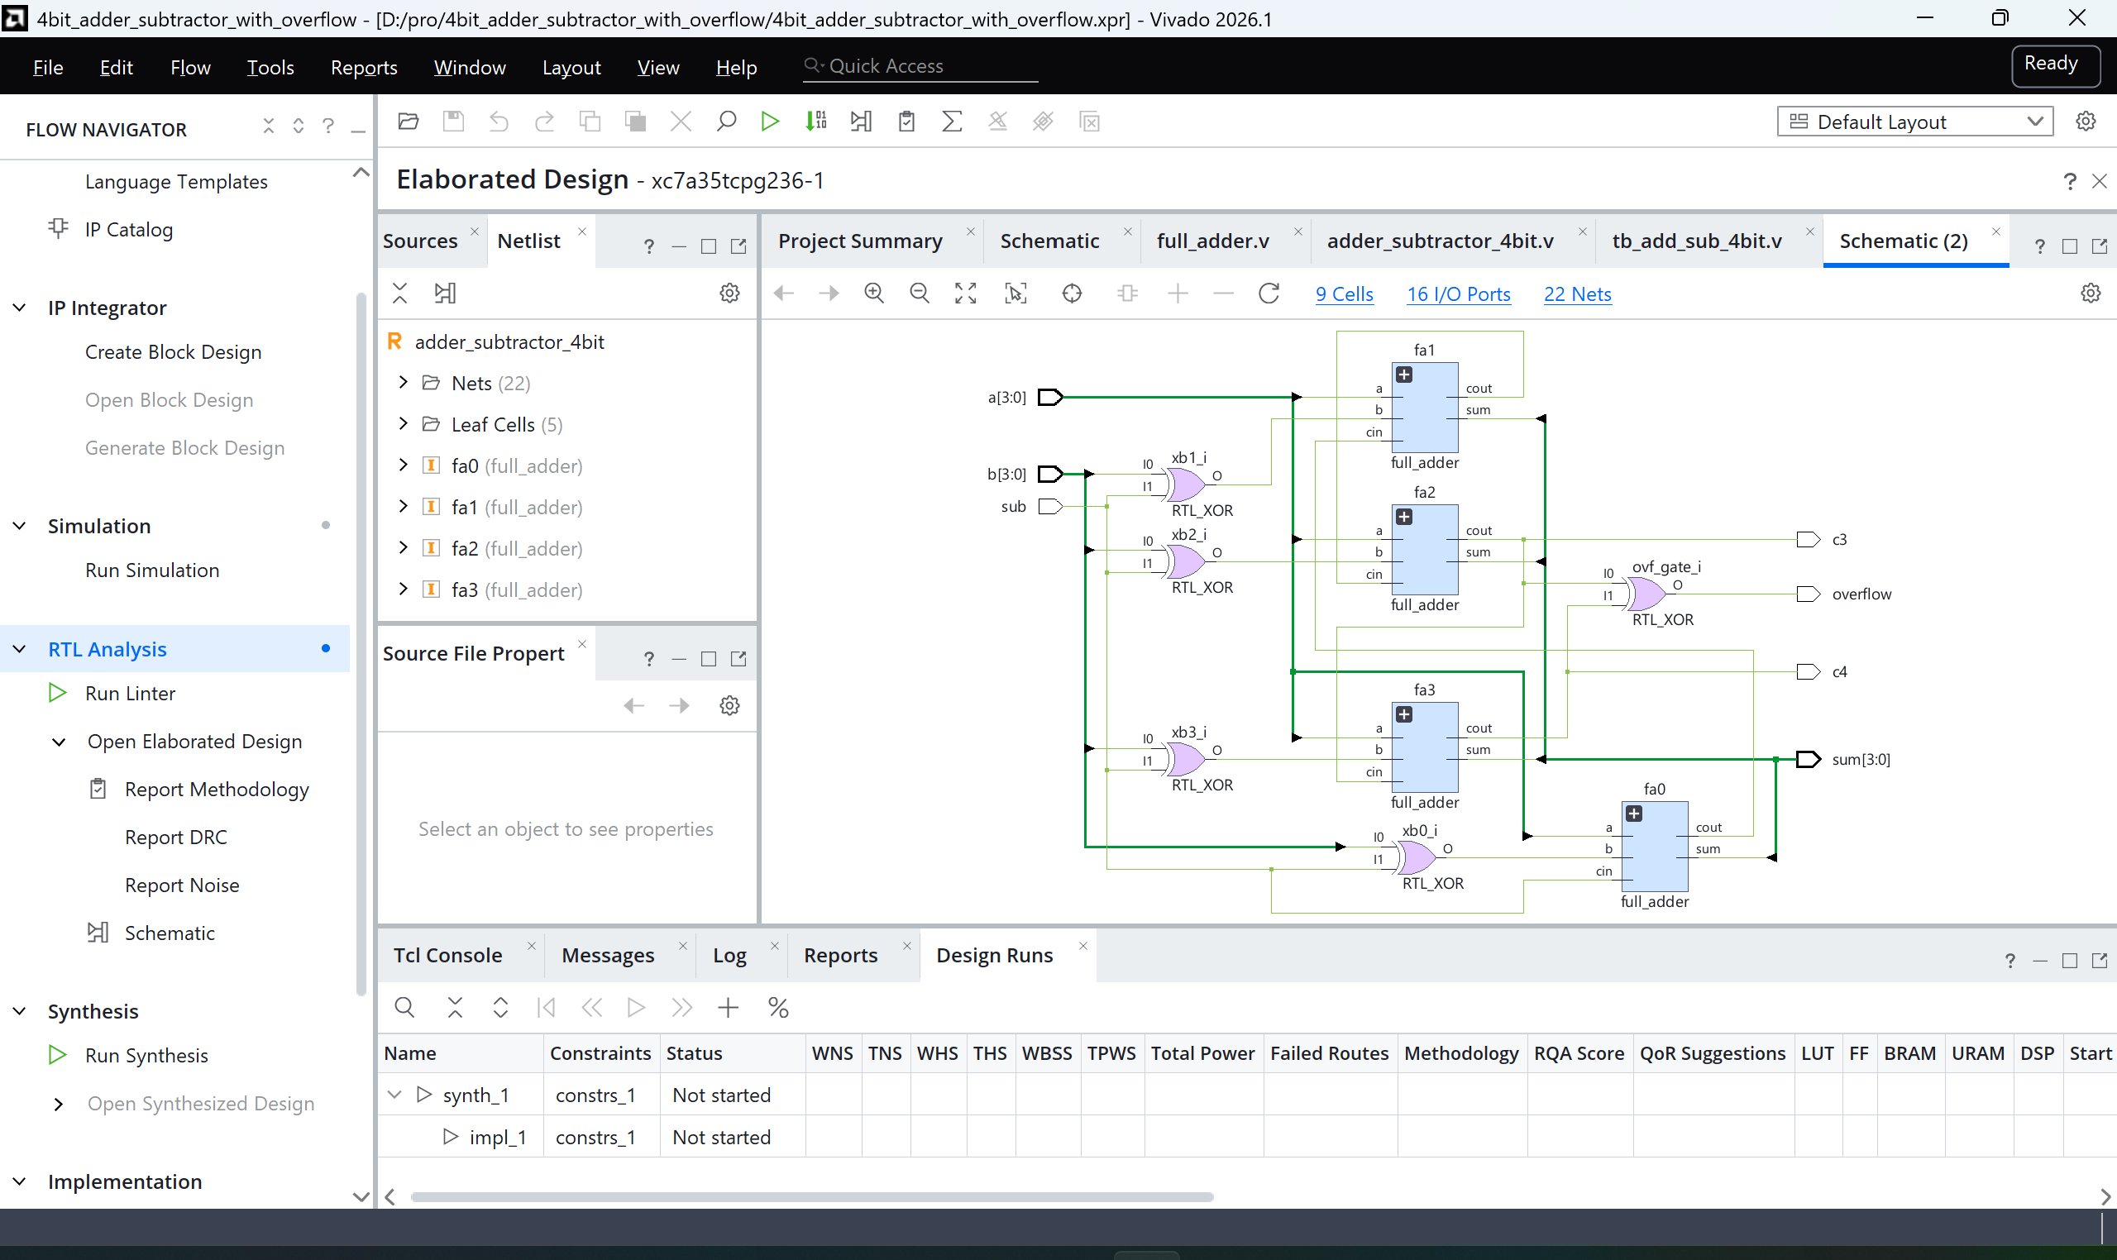
Flow Explanation - RTL Analysis

Slide 9
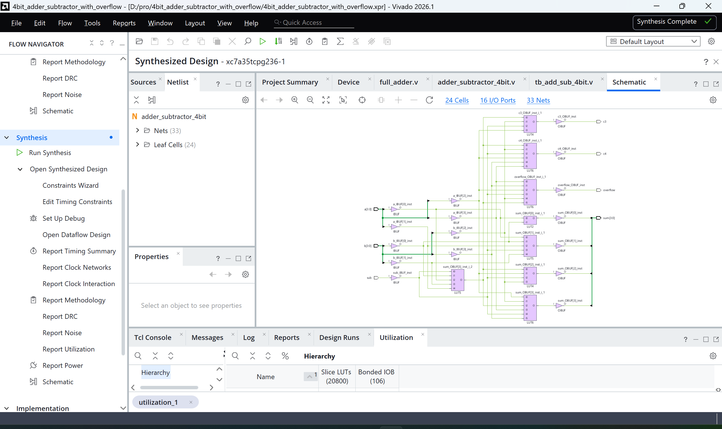
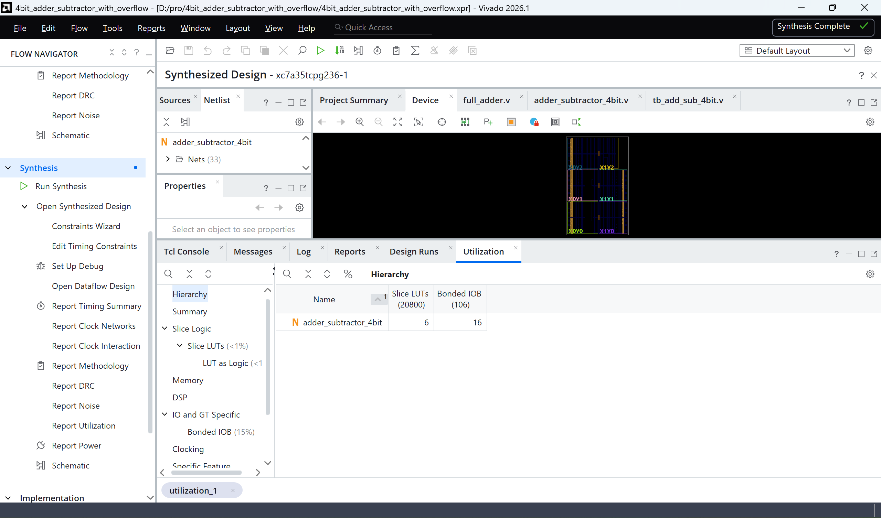
Flow Explanation - Synthesis & Utilization

Slide 10
Thank you !

