Slide 1

Compiler - Lab 4
BUPT-Compiler 1

Slide 2
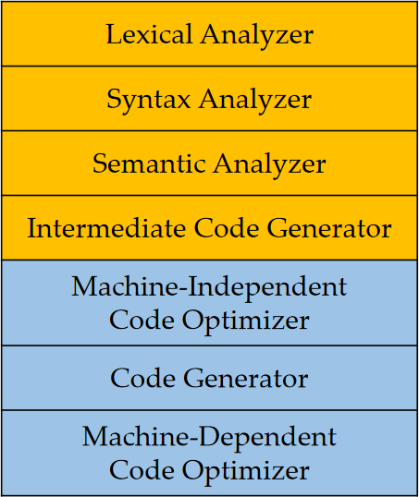
Syntax Analysis
we’re here

Slide 3
Outline
Bottom-up parsing
Conflicts resolution
Error recovery

Slide 4
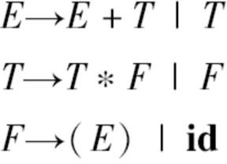
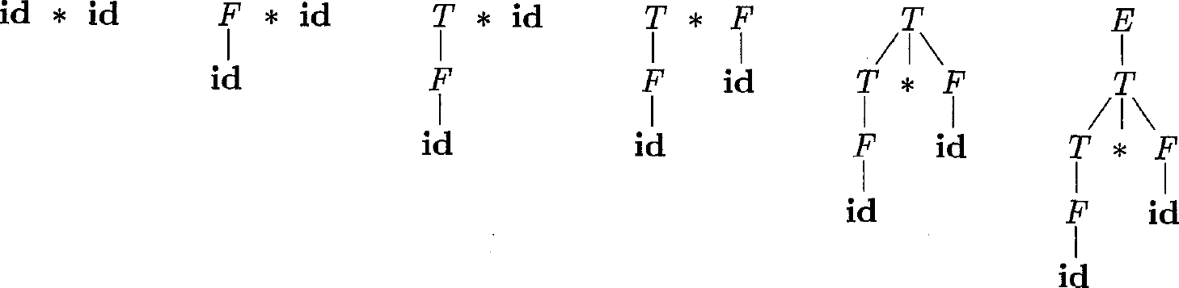
Bottom-Up Parsing
Constructing a parse tree for an input string beginning at the leaves (terminals at the
bottom) and working up towards the root (start symbol at the top)
Shift-reduce parsing (移入-归约分析技术) is a general style of bottom-up parsing

Slide 5
Reductions (归约)
Bottom-up parsing can be seen as a process of “reducing” a string 𝑤 to the start
symbol of the grammar
At each reduction step, a specific substring matching the body of a production is replaced by the nonterminal at the head of the production (the reverse of a step in derivation)
Key decisions in bottom-up parsing:
When to reduce? What production to apply?

Slide 6
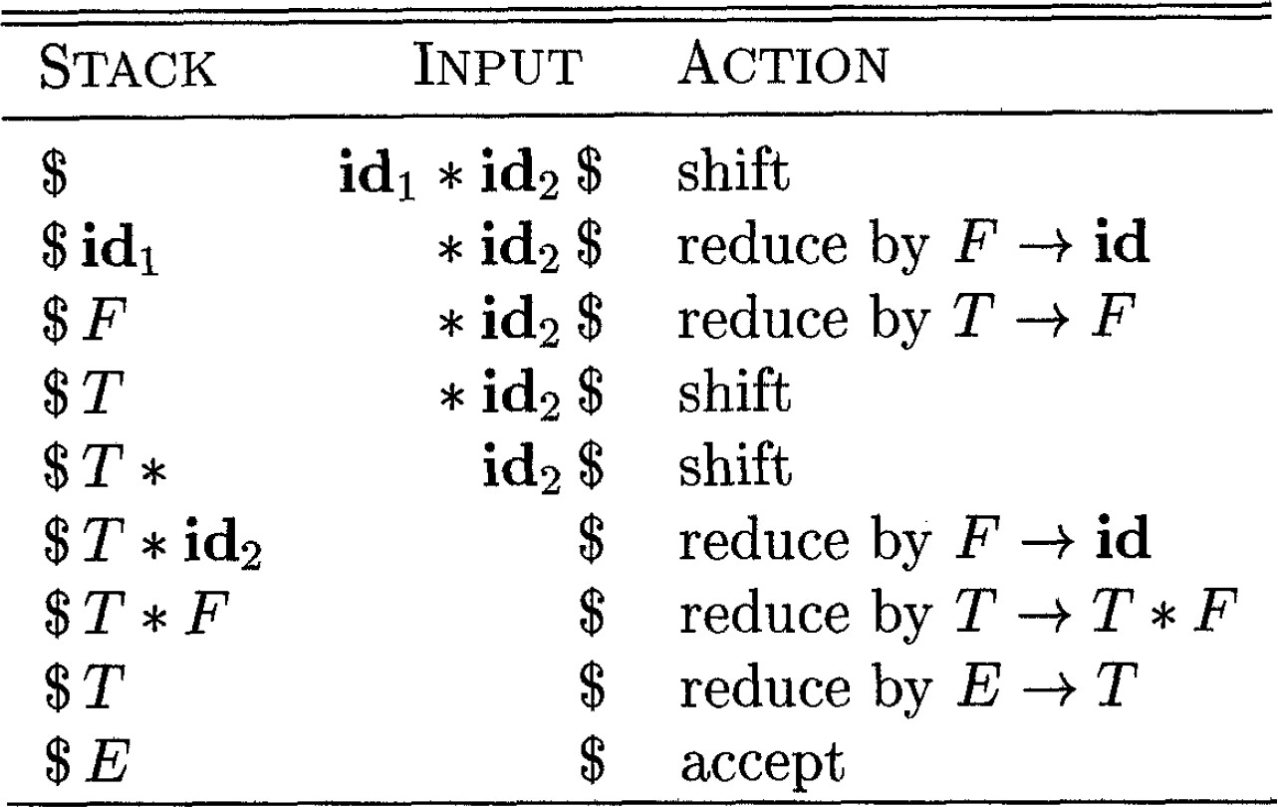
Example
Parsing steps on input 𝐢𝐝₁ ∗ 𝐢𝐝₂

Slide 7
Possible Errors
Possible erroneous states
Multiple actions can be applied? (conflict resolution)
No action can be applied? (error recovery)

Slide 8
Ambiguity
A grammar is ambiguous if it produces more than one parse tree for some sentence (it is very easy to write ambiguous grammars)
Ambiguity in grammars may lead to conflicts in parsing
Shift/reduce conflicts
Reduce/reduce conflicts

Slide 9
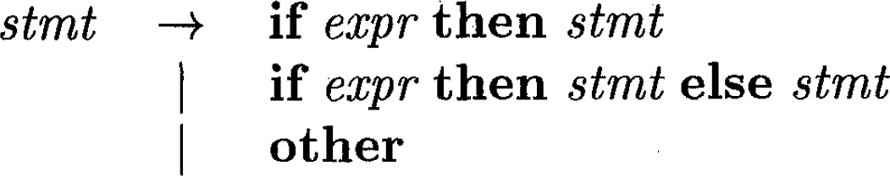
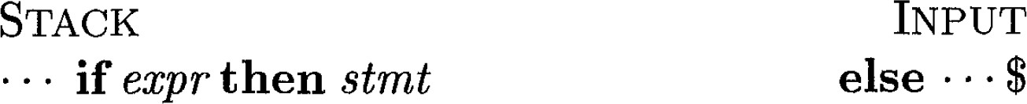

Shift/Reduce Conflict Example
Reduce or shift? What if there is a 𝑠𝑡𝑚𝑡 after 𝐞𝐥𝐬𝐞?

Slide 10
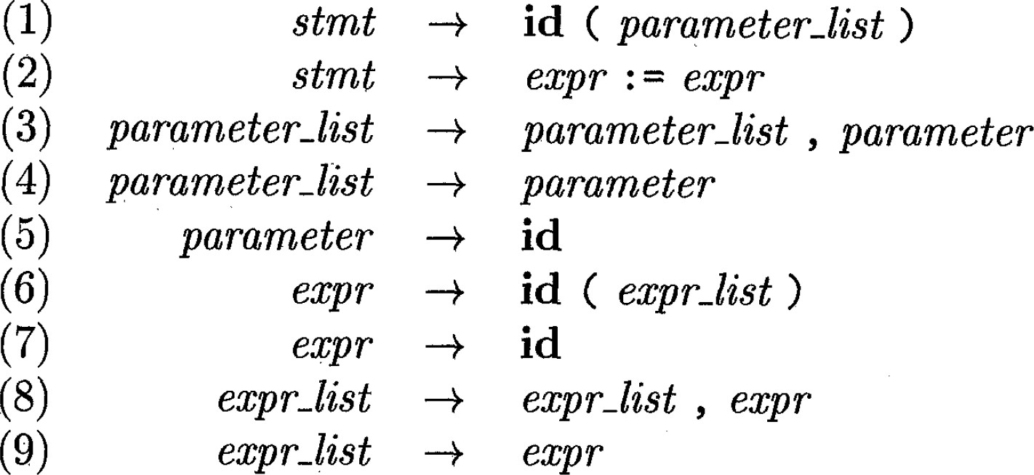
Reduce/Reduce Conflict Example
Parsing input 𝐢𝐝(𝐢𝐝, 𝐢𝐝)
STACK | INPUT
$𝐢𝐝(𝐢𝐝 | , 𝐢𝐝$
Reduce by which production?

Slide 11
How Bison deal with conflicts by default?
For a shift/reduce conflict, always choose to shift
For a reduce/reduce conflict, reducing with the rule declared first
It is not recommended to adopt the default strategy.

Slide 12
Addressing Conflicts
When we see “E1 + E2” on stack, shift or reduce?
E₁ + E₂ * E₃

Slide 13

Addressing Conflicts
Possible solution: rewriting grammar (In lab3)
What if there are more operators? Not only arithmetic operators?

Slide 14

Addressing Conflicts
More practical: use precedence and associativity
Token defined in front has lower precedence.
Using %left, %right and %nonassoc to define associativity.

Slide 15
Addressing Conflicts
To see how associativity addresses the conflict, consider
E₁ + E₂ - E₃
When E1+E2 is on the stack and a minus sign is followed, the parser choose reduce, since + and - are both left-to-right associate.

Slide 16
Addressing Conflicts
To see how associativity addresses the conflict, consider
E₁ + E₂ * E₃
When E1+E2 is on the stack and a multiply sign is followed, the parser choose shift, since * has higher precedence than +.

Slide 17
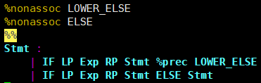
Addressing Conflicts
For dangling-else, use %prec to define precedence
When the parser sees if ( exp ) stmt on stack and the next input symbol is else, it will choose to shift since the else token has a higher precedence than the first production
The key idea: assign precedence to operator/production

Slide 18

Error recovery
Using special error symbol

Slide 19
Error recovery – exercise
JSON parser

