Slide 1
The concept of UI/UX
XIE ZHEN
22408835
Figma LINK:
https://www.figma.com/file/9nGaS62i6J2yVVlmvi0yf8/xiezhen_22408835assgnment?node-id=0%3A1&t=wkEIDVKXnnws8geR-1
xiezhen_22408835assgnment – Figma

Slide 2
An overall introduction to the FIGMA project
This is an educational app designed to help students participate and complete learning tasks online. Through this software, students can buy books, read notices, have one-on-one chats with classmates and teachers, or participate in group chats, watch replays of courses on the software, and participate in classroom quizzes on the software. The application aims to use digital technology to allow students to better participate in the classroom and complete learning tasks more conveniently, reducing the tedious teaching process in the past.This is the embodiment of allowing digital technology to benefit students and teachers and optimize the teaching process.

Slide 3
Find user pain-points
1. By comparing to similar apps and websites. In different area with different teaching system.
2. Based on my own experience as a student, I compared the educational administration learning system in mainland China with that in Hong Kong. Found the user pain point

Slide 4
Pain-points
1. The different functions of the teaching website are too messy
2. There are many kinds of different teaching websites, and there is a lack of unified integrated websites
3. Teachers and students communicate mainly by email. Easy to miss.
4. Unable to set up teacher-student group chats outside of class
5. The functions participating in the online test are not comprehensive

Slide 5
Problem statement and HMW questions
Statement: Students often need to log on to different websites to complete many business and learning processes
HMW questions: How do we integrate a unified application to provide a unified entry point for students' learning business

Slide 6
Brainstorming of the solution of user pain-points
Design a unified application program to integrate all the learning business interfaces needed by students into a unified directory. Click the options of the directory to jump to the corresponding page to complete various learning businesses

Slide 7
Friends feeling about my idea
Integrating all learning services into a unified application and managing them through a unified catalog will greatly improve the participation of students, improve the teaching quality and efficiency of the classroom. It can prevent the phenomenon of missing homework and missing exams

Slide 8
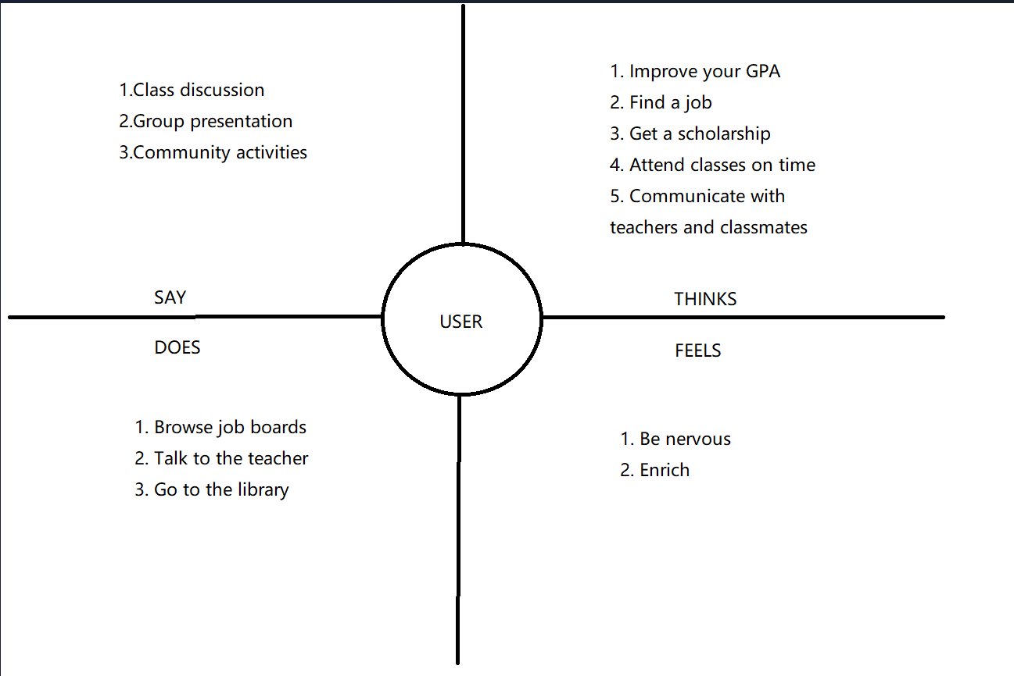
EMPATHY MAP
Target segment: student in university.

Slide 9
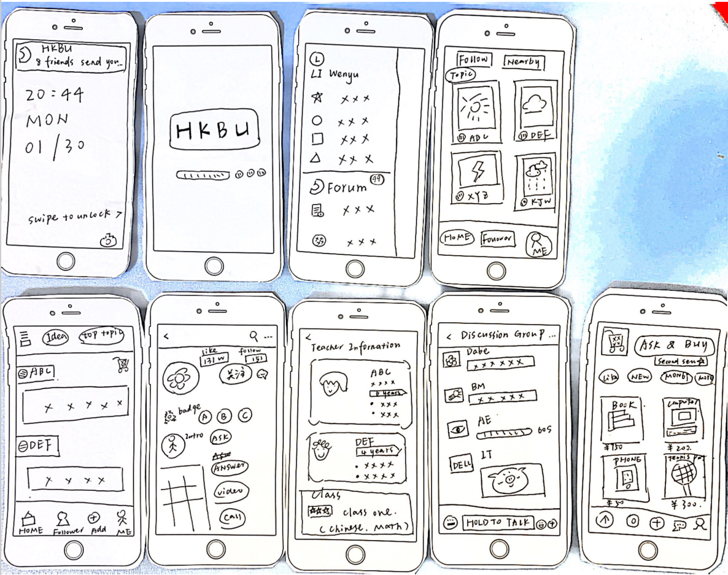
CUSTOMER JOURNEY MAP

Slide 10
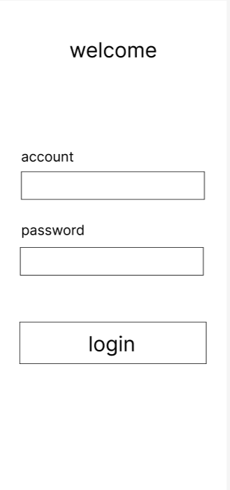
The welcome page
This page I designed is very simple and clear. There are only three boxes that can be entered. Buttons for password, account and login respectively
这一页我设计的非常的简单明了。一共只有三个可以输入的框框。分别是密码、账户和登录的按钮

Slide 11
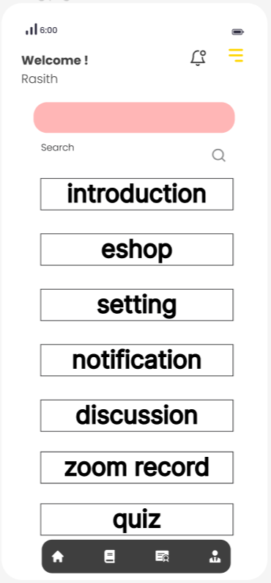
The directory page
This is the directory navigation page. By clicking the 7 buttons on this page. Users can navigate to different functional pages. And after arriving at the function page, the user can also press the return key to return to the catalog page.
The directory page is the key to solving user pain points, which allows all learning services to be integrated into a unified directory. To solve the problem that teaching web pages and programs are too scattered to handle various business
这是目录导航页。通过点击这一页的7个按钮。用户可以导航到不同的功能页面。并且到了功能页面后用户还可以按返回键，返回到目录页。
目录页是解决用户痛点的关键，这能让所有的学习业务集成到统一的目录中。解决教学网页和程序过于分散不利于办理各种业务的问题

Slide 12
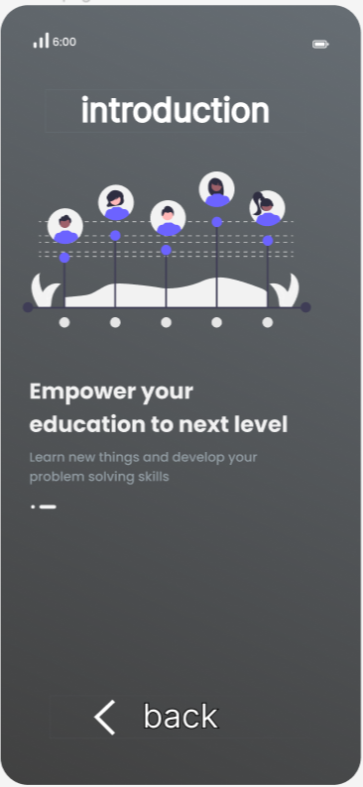
The introduction page
This is the directory navigation page. By clicking the 7 buttons on this page. Users can navigate to different functional pages. And after arriving at the function page, the user can also press the return key to return to the catalog page.
这一页是介绍页面。主要用于向各位用户介绍教学APP的主要功能和设计的初衷。如果有各种疑惑以及使用上的疑问都可以在这里边查找

Slide 13

The Eshop page
This page is a shopping page. Mainly used to sell various e-books. Schools can purchase e-books uniformly. Students can also choose to purchase corresponding e-books on this platform for learning.
这一页是购物页面。主要用于售卖各种电子书。学校可以统一采购电子书。学生也可以选择在此平台上面购买对应的电子书用于学习。

Slide 14

The notification page
This page is a notification page. Students can check the notices sent by the school on this page, keep up with the progress of their studies in time, and get timely contact under special circumstances.
这一页是通知页面。学生可以在这个页面里查看学校发送的通知，及时跟上学习的进度，以及在特殊情况能够获得及时的联络。

Slide 15
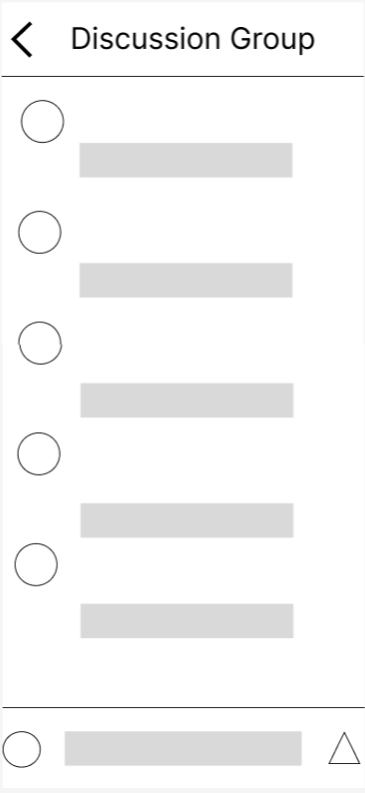
The discussion page
This page is the chat interface of the group, which is used for chatting between students, chatting between students and teachers, and class chatting. This chat is a real-name chat, and everyone corresponds to their student number and real name.
这一页是群组的聊天界面，用于学生之间聊天，学生和老师聊天，以及班级群聊。此聊天为实名制聊天，所有人均对应学号以及真实姓名。

Slide 16
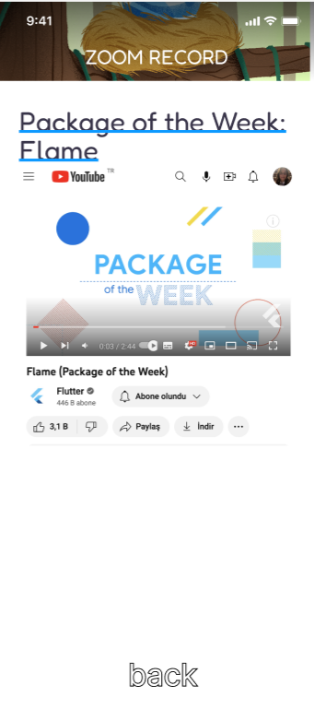
The zoom record page
This page is the ZOOM playback page and other teaching and guidance videos designated by teachers. Allow students to continue to keep up with the teaching progress outside the classroom, or learn other supplementary expanded knowledge.
这一页是ZOOM回放页面以及，其他教师指定的教学辅导视频。让学生可以在课堂外继续跟上教学进度，或者学习其他辅助的拓展知识。

Slide 17
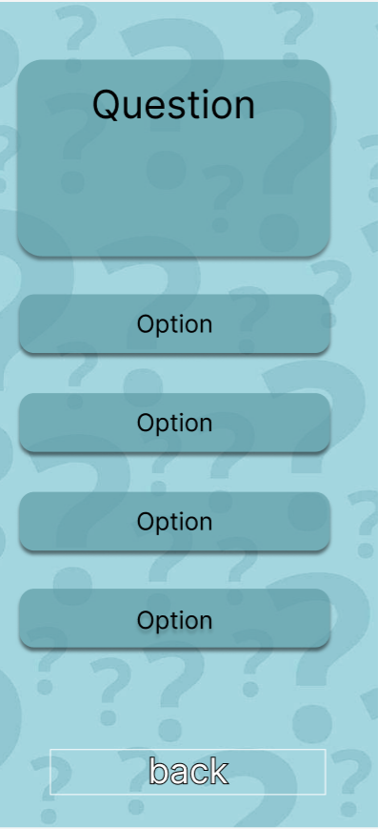
The quiz page
This page is for quizzes or questions in class. It is convenient for students to participate in the inspection and testing of the classroom uniformly. And it is convenient for teachers to collect data in the background for analysis and scoring.
这一页用于课堂的测试或者提问。方便学生统一参与课堂的检查和测试。以及方便老师在后台收集数据进行分析和评分。

Slide 18
Thanks for your watching

