Slide 1
LONDON DATA WEEK 2026 · HACKATHON
Can You Vouch For It?
Evaluating an Artificial Intelligence (AI) enrichment pipeline for 20,685 London datasets — honestly.
Team: BY2 Xinrui QI & Yuyue Xia
Problem 3 · Discovering London's Data

Slide 2
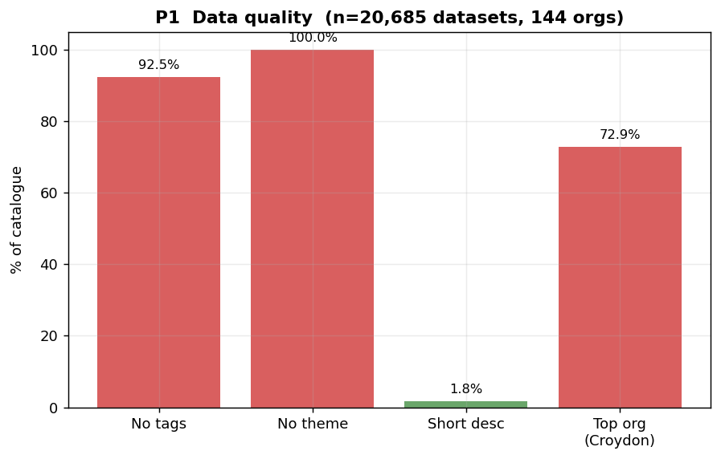
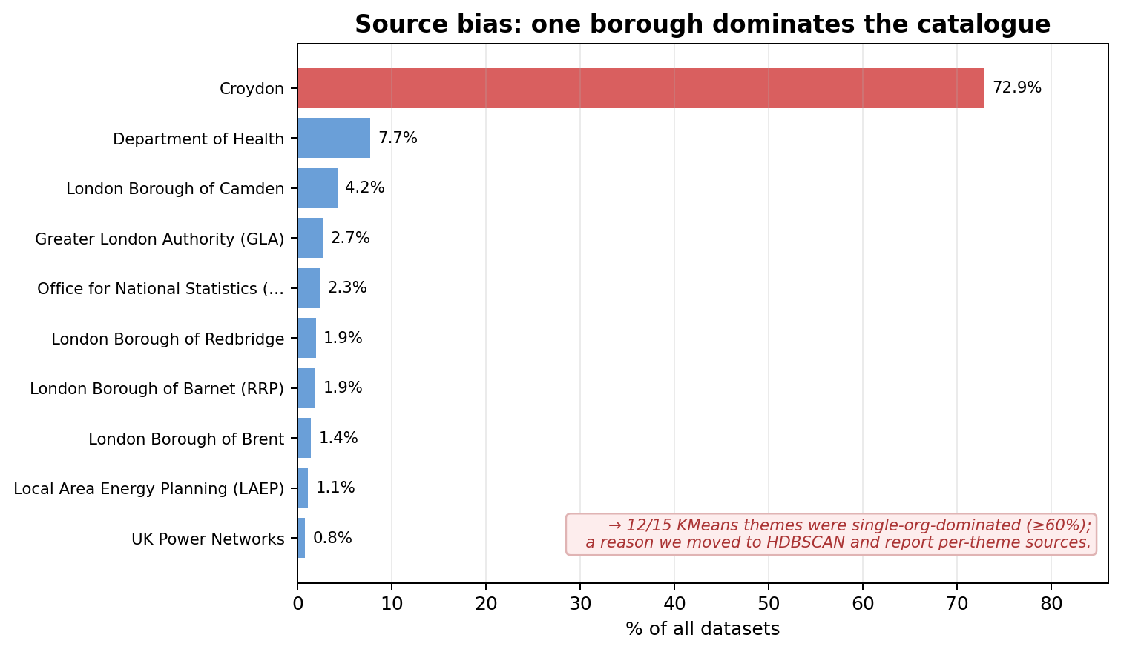
1 · THE HOOK
Good Data, Buried Deep
20,685 datasets. 92.5% have no tags, 100% have no theme, and one borough (Croydon) supplies 72.9% of everything — so today's search is really just a search of Croydon.

Slide 3
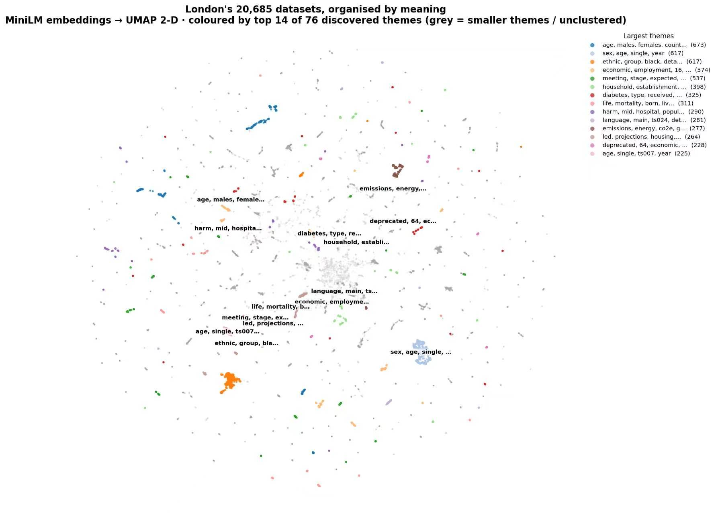
2 · OUR SOLUTION
Turning Text Into Meaning
76
themes discovered automatically — no k chosen by hand
How it works
Each dataset's title + notes become a 384-dimension MiniLM vector. Similar meaning = nearby vectors. HDBSCAN groups the dense areas into themes — grey dots are honestly left unclustered.

Slide 4
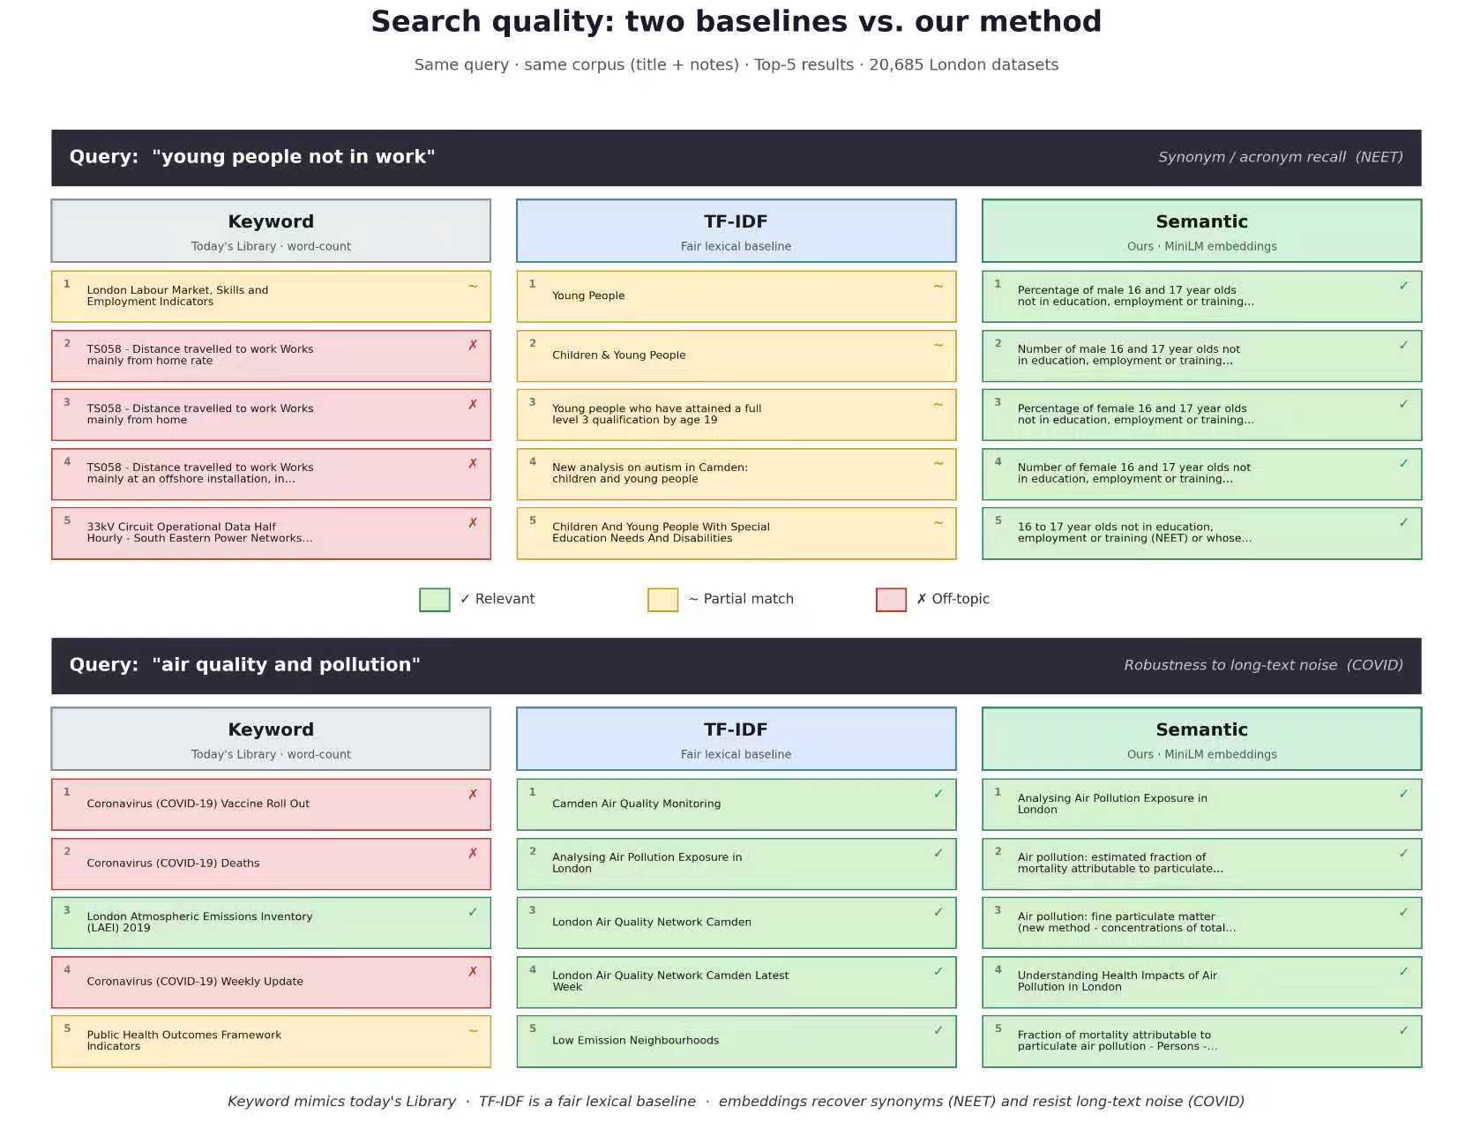
3 · BASELINE + DEMO

Slide 5
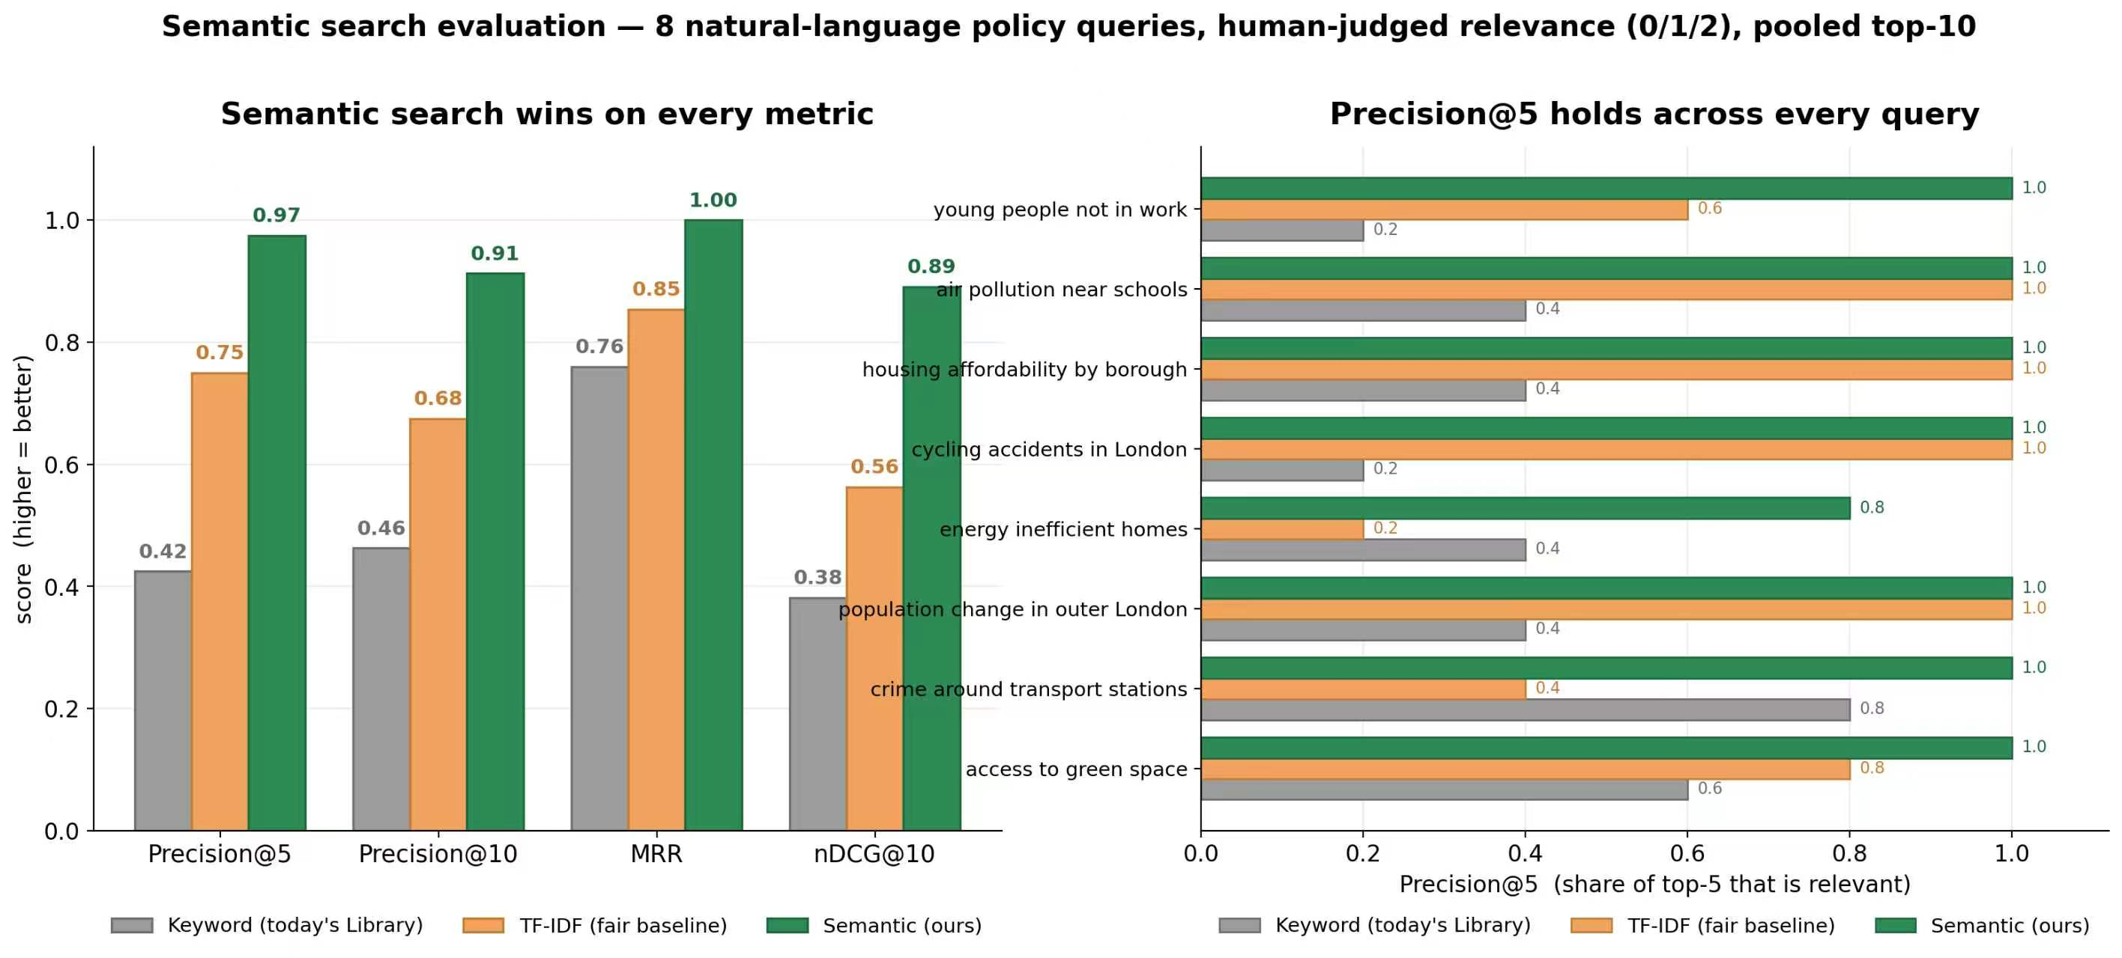
4 · MODEL EVALUATION · SEARCH (THE HEADLINE)
8 real policy questions · human-judged relevance · four industry-standard IR metrics

Slide 6
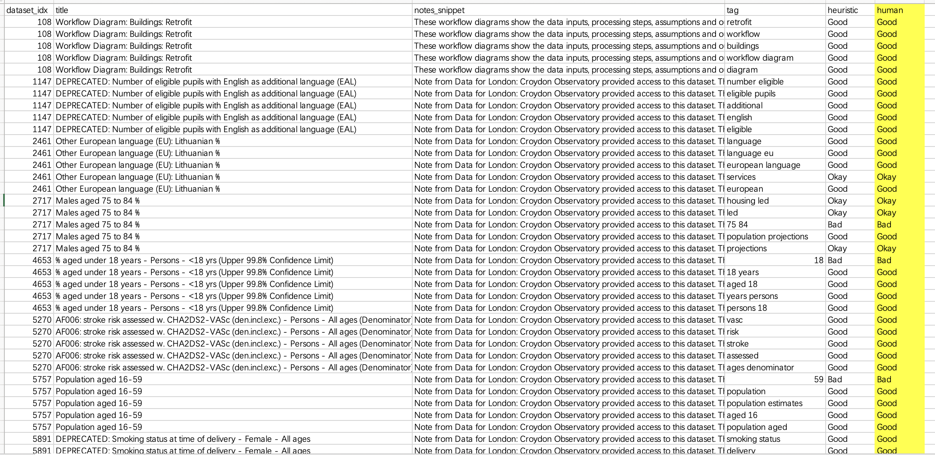
5 · MODEL EVALUATION · AUTO-TAGS
Are the Auto-Generated Tags Any Good?
We manually reviewed a random sample of 30 datasets and their auto-tags.
93.3%
15.8%
7.7%
1.43
of sampled tags were specific and usable as suggestions
of all tags contain stray digits (e.g. '32', '500') — noise to filter
of tags are purely numeric — should be dropped automatically
average words per tag — tags run a little too short/fragmented
Verdict: tags are good enough to suggest, not good enough to auto-publish. A simple digit-filter removes most of the noise before it reaches a human reviewer.

Slide 7
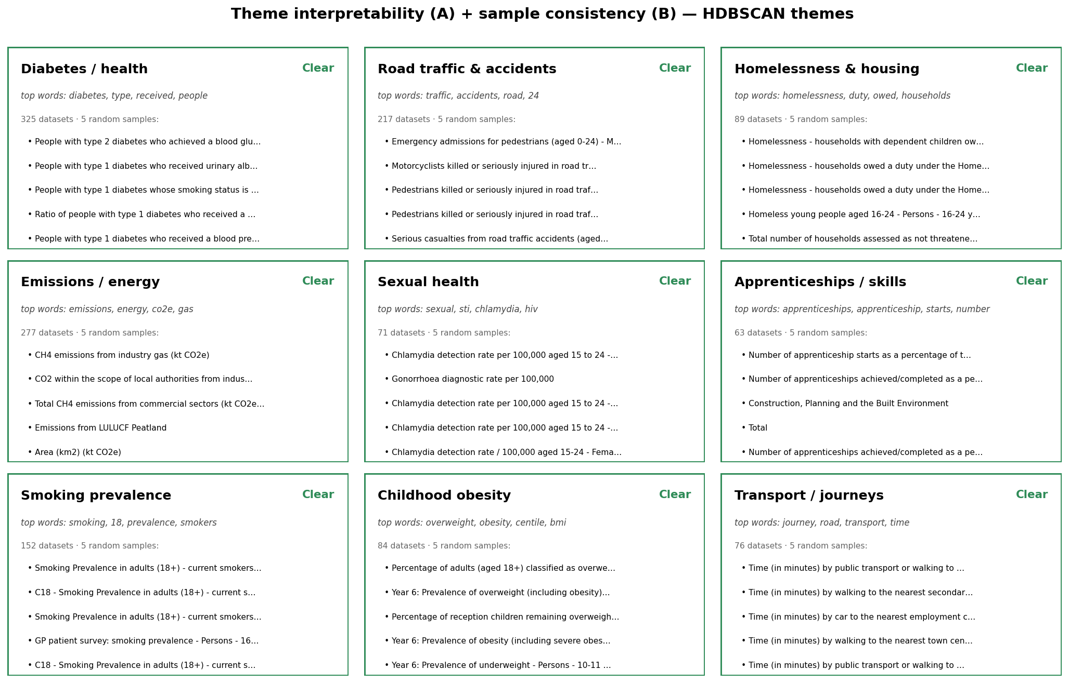
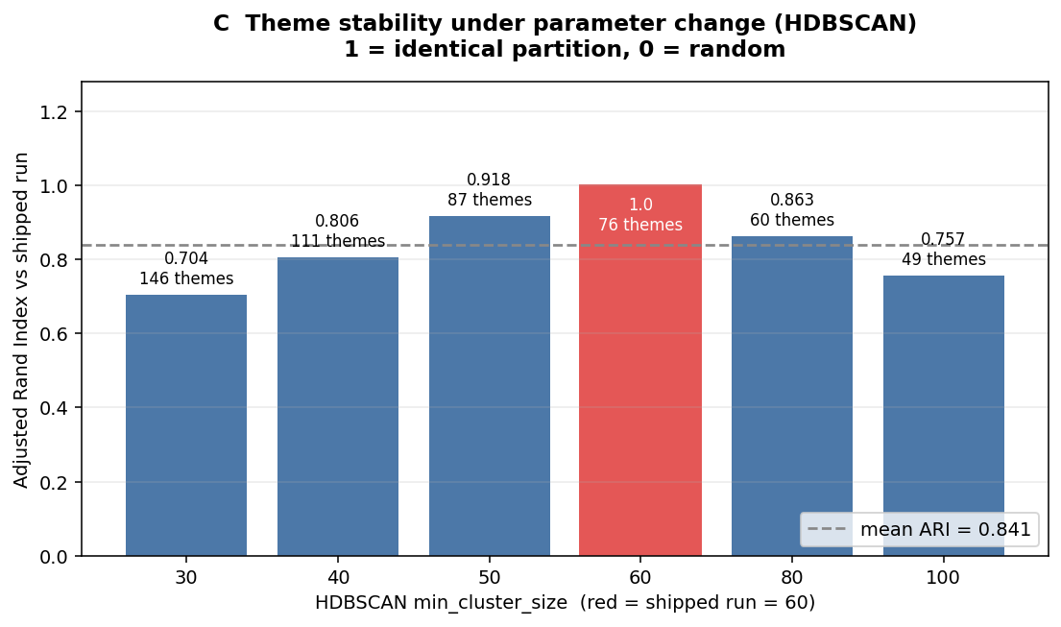
6 · MODEL EVALUATION · THEME INTERPRETABILITY
Do the Themes Make Sense to a Human?
A · Interpretability 71 of 76 themes read as a clear topic
B · Sample consistency 5 random datasets per theme belong together
C · Stability themes hold when parameters change (mean ARI 0.841)

Slide 8
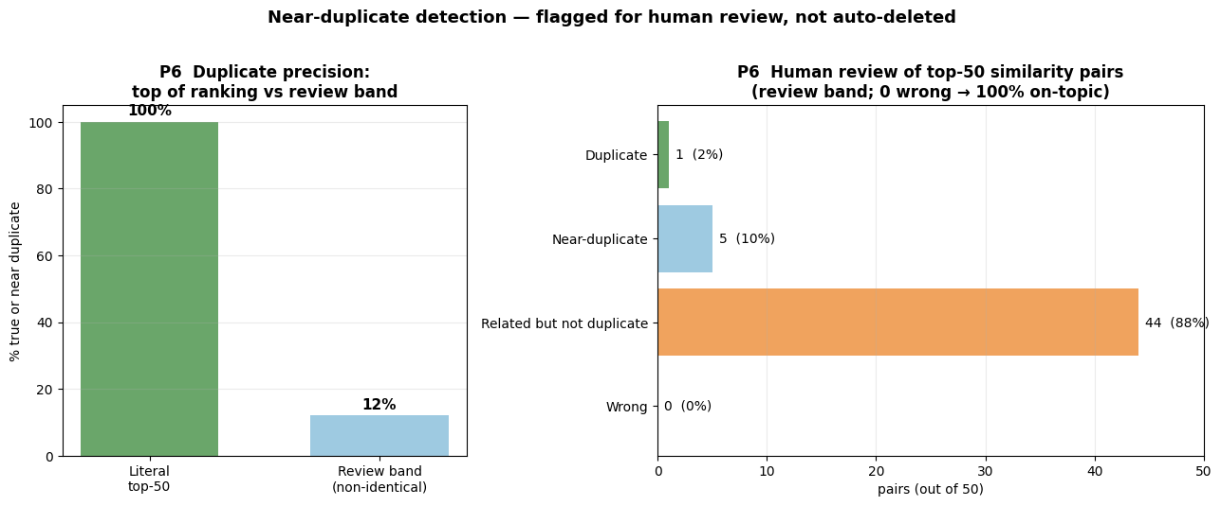
7 · MODEL EVALUATION · DUPLICATE DETECTION
Flagged for Review — Not Auto-Deleted
Honest finding: among non-identical high-similarity pairs, only 12% turn out to be true or near duplicates on human review — 88% are just related, not duplicate.

Slide 9
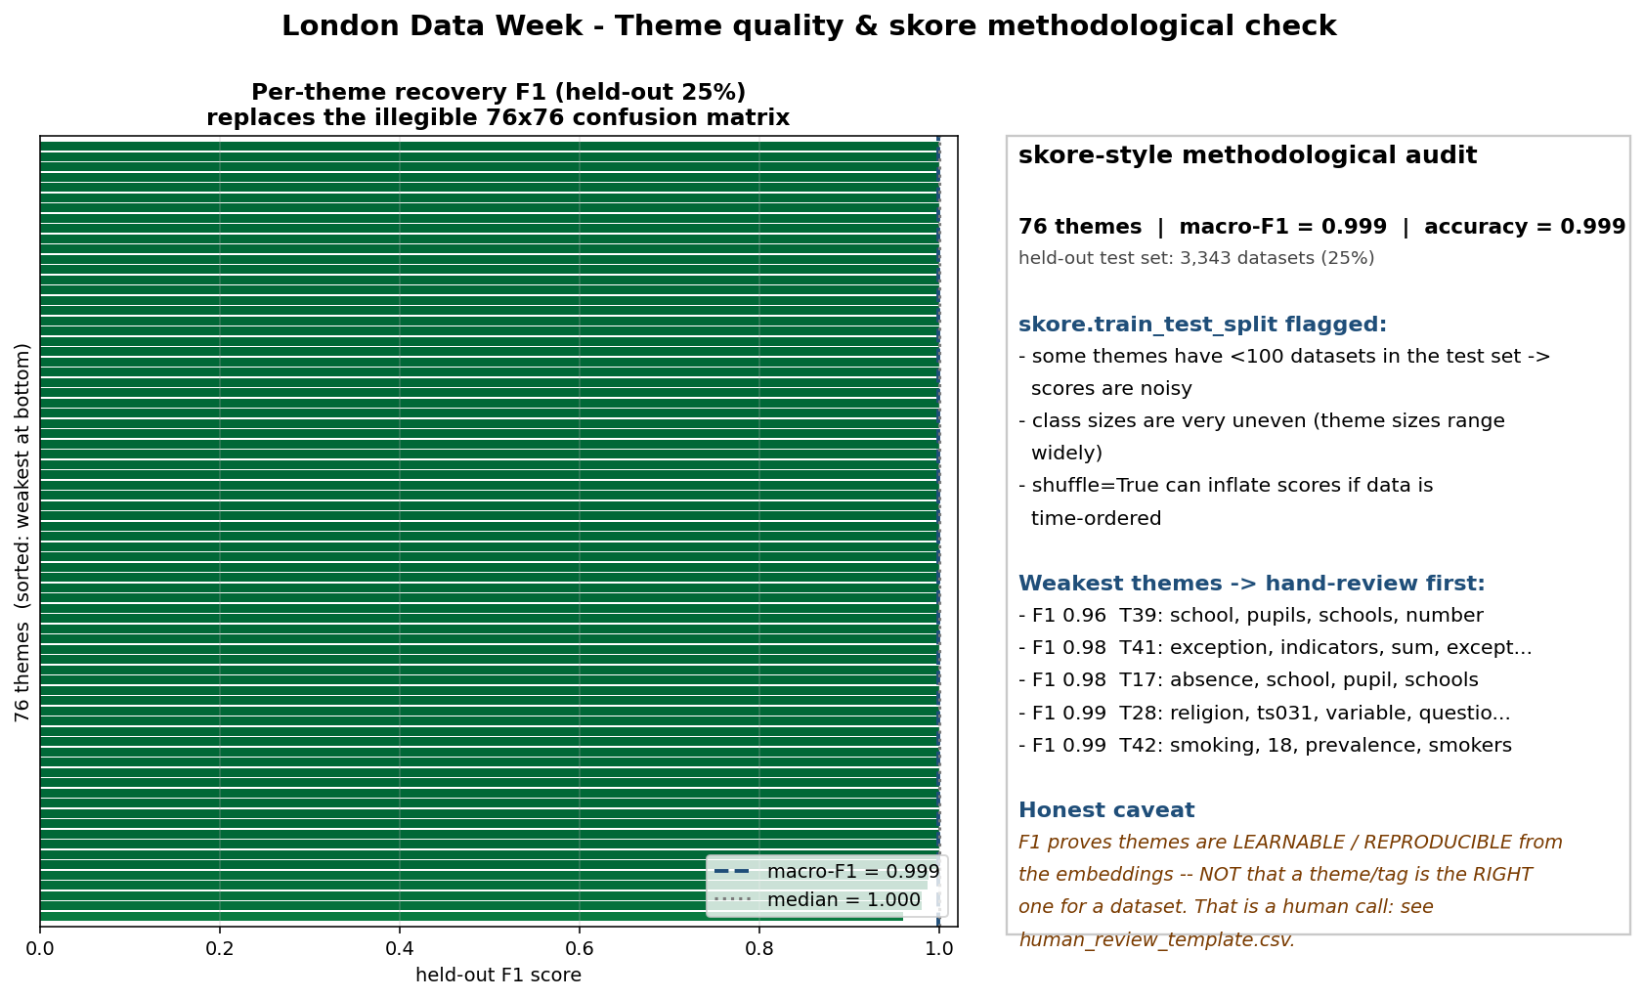
8 · METHODOLOGY · CAN YOU VOUCH FOR IT?
How We Chose — and Checked — Our Method

Slide 10
9 · SUMMARY
What We Trust — and What We Don't
We do not claim the AI-generated metadata is automatically correct.
Can trust
Not yet
• Search: semantic beats keyword on every IR metric (Precision@5 0.97 vs 0.42) — including a synonym it was never told, NEET
• Duplicates: only 12% of non-identical high-similarity pairs are true/near duplicates — needs human review, not auto-merge
• Tags: 93.3% specific and usable as suggestions
• Themes: still some source (borough) bias in a subset of clusters
• Themes: stable under parameter change (ARI 0.841); genuinely interpretable samples
• 35% of datasets are honestly left 'unclustered' — real metadata gaps, not hidden

Slide 11
Thank you.
Trustworthy as a decision-support layer — not an unchecked replacement for human metadata curation.
Team: BY2 Xinrui QI & Yuyue Xia · Problem 3: Discovering London's Data

