Slide 1

Preprocessing Beats Modelling
Predicting Smartphone Addiction · Kaggle Playground S6E8
MH6211
Group 10 · Members A–I
2026-09-08
Notes:
这个项目最大的收益不来自模型，来自预处理——一次数据表示的改动，比我们做过的任何建模改动都值钱。今天用十二分钟讲三件事：先讲并列比较，插补策略乘四种算法；再讲两个后续问题；最后把它收束成一个论断。

Slide 2
Part 1 · Setup
The Metric Decides What Counts as a Good Model
Predict addicted_label from 12 daily-use and routine features.
The classes are not balanced: 70.94% of the training rows are positive.
Accuracy counts rows, one per person.
Accuracy = (TP + TN) / (TP + TN + FP + FN)
Predict "addicted" for every row → Accuracy = 0.7094, the majority rate itself,
earned by a model that separates nobody.
AUC counts pairs, one drawn from each class.
AUC = P(s(x⁺) > s(x⁻)) = (1/n⁺n⁻) · ΣᵢΣⱼ 1[s(x⁺ᵢ) > s(x⁻ⱼ)]
Every term compares one positive with one negative, so the class sizes divide out.
→ Under 70.94% positives, accuracy rewards predicting the majority; AUC cannot be moved that way,
because one class never appears except opposite the other.
→ The competition scores on AUC — and this is why that is the right choice for this data.
MH6211 · Group 10
The Metric Decides
2/16
Notes:
先讲评判标准为什么会改变问题本身。数据里百分之七十点九四是正例，如果只看准确率，一个把所有人判成瘾的模型也有零点七零九四——它一个人都分不开。AUC 不同，它数的是配对：任取一个正例、一个负例，模型给正例打更高分的概率。每一对都来自两个类，这两类的规模就消掉了，猜到多数派骗不了它。比赛用 AUC 评分，对这份数据是对的。

Slide 3
Part 1 · Setup
The Missingness Is MCAR — We Tested It
MCAR: whether a value is missing is independent of the data — of the label and of the feature values.
691,369 training rows · 296,302 test rows · every column missing 4.18%–19.38%
61.06% of rows are missing at least one column.
question asked
how we tested
result
verdict
1
Is missingness related to
addiction rate of the missing vs the
largest gap 0.0042
no
the label?
present group, all 12 columns
2
Do the other columns'
xgboost per column, on rows where the
AUC 0.5012 – 0.5144
no
values predict a column being missing?
other 11 are complete, 5-fold
3
Do the other columns'
same setup, flags only,
AUC 0.5674 – 0.7547
yes ⋆
missing flags predict it?
no values
clusters by row, see →
Missingness is independent of the data — but the columns' missing indicators are not independent of one another: it clusters by row.
→ Test 3 does not refute MCAR — MCAR asks for independence from the data values,
not between the columns' missing flags.
→ Tests 1 and 2 decide the method: nothing about the label lives in the missingness pattern.
MH6211 · Group 10
The Missingness Is MCAR
3/16
Notes:
缺失是否完全随机，我们不靠假设，直接检验。一共三个检验。第一，缺失与标签无关，十二列里缺失组与非缺失组的成瘾率最大差只有零点零零四二。第二，用其余列的值去预测某一列缺不缺，AUC 全部贴在零点五，这是最贴近 MCAR 定义的那个检验。第三，用其余列的缺失标记去预测，AUC 明显高于零点五——注意它说的是缺失按行成群，有些行大部分栏都填了，有些大部分没填。这不反驳 MCAR：MCAR 只要求缺失独立于数据取值，不要求各列缺失标记互相独立。所以结论是：缺失本身不携带标签的信息，只能靠没缺的栏去恢复缺了的栏——这正是下面主实验一条轴线的由来。

Slide 4
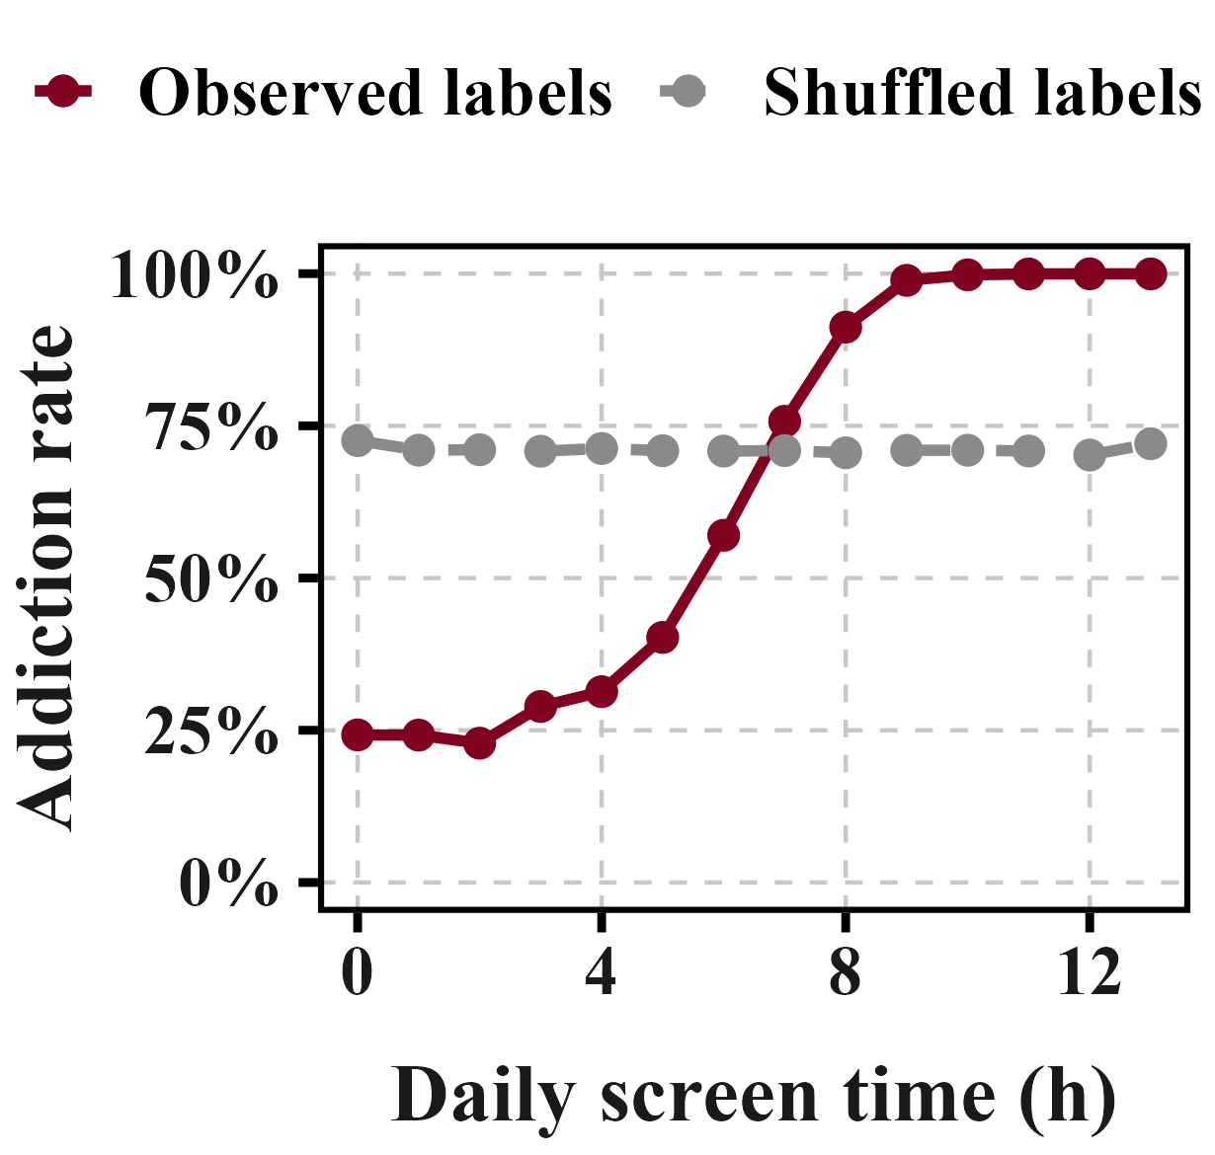
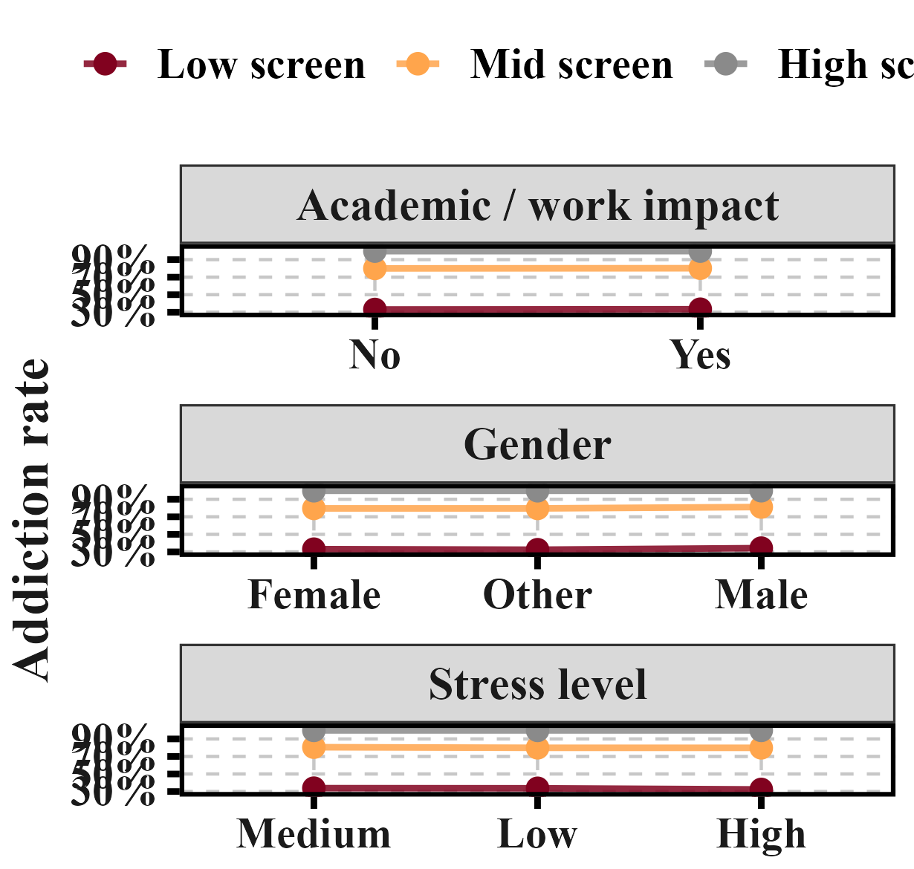
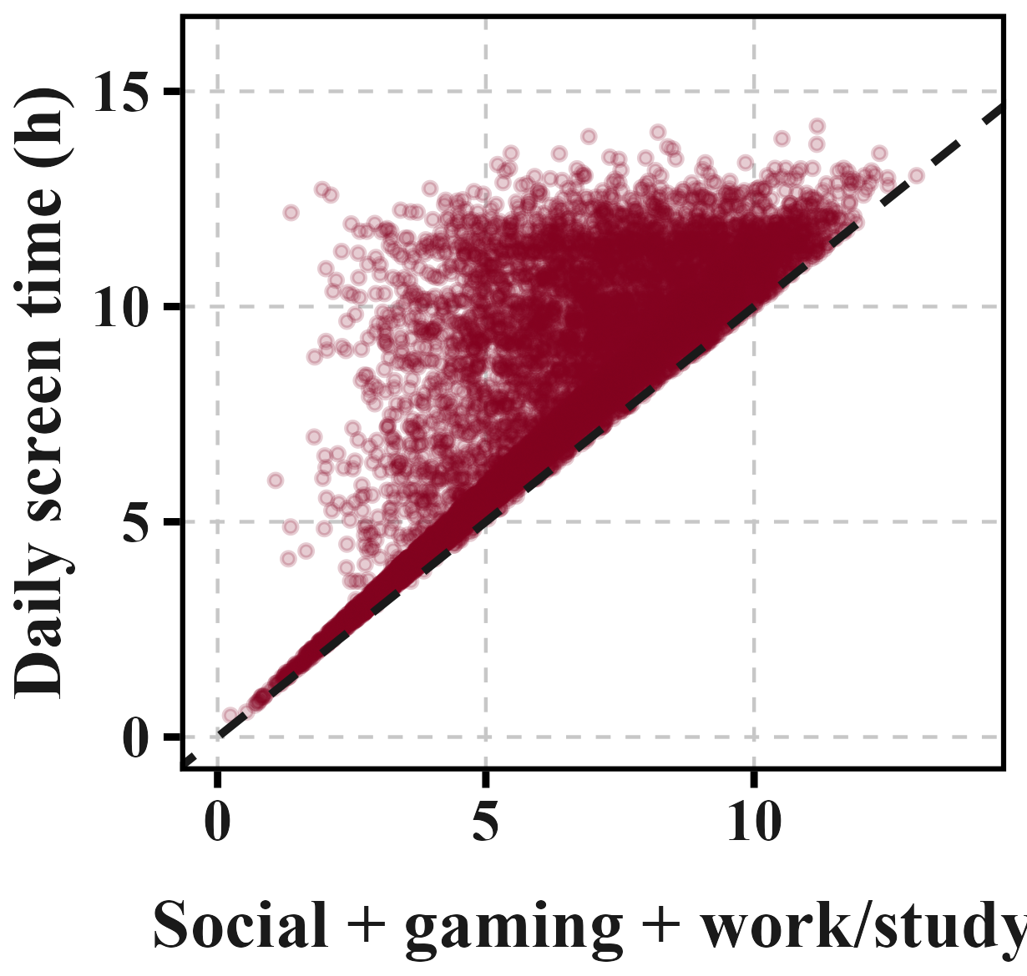
Part 1 · Setup
What the Data Told Us Before Any Model Was Fitted
1 · One column already
2 · Gender, stress, academic
3 · One relation holds
separates the classes.
impact carry nothing.
on every row.
1-h bins: 24.2% → 99.96%
flat within fixed screen-time bands
screen ≥ social + gaming + work/study
FigureA · observed vs shuffled
FigureB · three columns, no signal
FigureC · every point above y = x
→ Shuffled: 0.024 vs real 0.771 —
→ EDA said noise; removing all three
→ Residual min = 0.000 — the true
the trend is real, not binning noise.
costs −0.00003 (d −0.30, 3/5). Dropped.
boundary; it becomes "budget slack".
MH6211 · Group 10
What the Data Told Us
4/16
Notes:
建模前，数据先告诉我们三件事。第一，一个变量就几乎能分开类别——按一小时分箱，屏幕时间的成瘾率从百分之二十四点二一路到百分之九十九点九六；把标签打乱做同样的分箱，极差从零点七七一塌到零点零二四，说明这不是分箱造出来的。第二，性别、压力、学业影响三列毫无信息——在固定屏幕时间分段里，各取值的成瘾率都是平的；消融删掉三列只掉零点零零零零三，五折只有三折同号，删掉。第三，数据里有一条无条件成立的硬关系：屏幕时间不小于社交加游戏加学习，残差最小值是零点零零零——这不是三项版那种被蕴含的推论，保障下限直接触到零点，这就是真正边界。它将成为派生特征预算余量。

Slide 5
Part 1 · Setup
Feature Engineering in Two Steps
Step 1 — five derived features
feature
formula
budget slack
screen − (social + gaming + work/study)
weekend ratio
weekend screen ÷ screen
social share
social ÷ screen
gaming share
gaming ÷ screen
waking-time share
screen ÷ (24 − sleep)
Step 2 — per-value target encoding
Replace each exact value with the positive rate of that value, inside the training fold:
enc(v) = ( positives at v + prior × m ) / ( rows at v + m ), m = 20
→ Every ratio in Step 1 is computed after imputation — a missing component would make the
whole feature missing.
→ Why it fits: values sit on a 0.01 lattice and the exact value carries non-monotone signal —
a split says "> 6.37"; a lookup table can say "= 6.37".
MH6211 · Group 10
Feature Engineering in Two Steps
5/16
Notes:
特征工程分两步。第一步是从结构里读出来的五个比值和差值，包括预算余量、周末比值、社交占比、游戏占比、醒着时间占比。第二步是逐取值目标编码：把一个列的每个精确取值替换成这个取值在训练折内的正例率，平滑系数 m 等于二十。为什么编码对这个数据有用：数值落在生成器的零点零一格点上，第二位小数与正例率相关，精确取值本身携带着信号，而且这个信号不是单调的——一棵树的分裂能说大于六点三七，说不等于六点三七，查表可以。注意比值和差值都必须先插补再算，缺一个分量整个特征就缺。编码的收益不在这一页，在倒数第二页一起讲。

Slide 6
Part 2 · Comparisons
Four Ways to Handle Missing Values × Four Algorithms
L1 keep the missing marker — the model learns which way to send it · L2 fill the column median
L3 regress on the other columns, fill the prediction · L4 PMM: draw one observed value from the 5 nearest donors
Only xgboost and lightgbm handle missing values natively, so L1 exists for those two alone — 14 cells, not 16.
xgboost
lightgbm
ranger
glmnet
L1
0.96784
0.96746
—
—
L2
0.96755
0.96726
0.96324
0.94898
L3
0.94770
0.94081
0.93903
0.95490
L4
0.95443
0.95410
0.95076
0.94559
Best single model: L1_xgboost 0.96784 ± 0.00053, 1,264 boosting rounds
→ All 14 cells run on the same 691,369 rows under one frozen 5-fold split, and every transform that reads the label —
imputer and encoder alike — is fitted inside the training fold. The 14 scores are directly comparable.
MH6211 · Group 10
Four Ways × Four Algorithms
6/16
Notes:
这是主实验：四种处理缺失的方式乘四种算法。L1 保留缺失标记让模型自己学往哪走，L2 填中位数，L3 回归预测，L4 预测均值匹配、从最近的五个真实样本里抽一个观测值。只有 xgboost 和 lightgbm 原生处理缺失，所以是十四格不是十六格。整张网格同跑六十九万行、同一套冻结五折、所有看标签的变换都在折内训练部分拟合，所以十四格可以直接比。我们只有一个结论级的数字：最好的单一模型 L1_xgboost，零点九六七八四。另外注意两个差距的量级：算法之间差约零点零三，插补策略之间只差零点零零一到零点零一。

Slide 7
Part 2 · Comparisons
The Two Model Families Disagree
Trees (xgboost · lightgbm · ranger): L1 > L2 > L4 > L3 (ranger: no L1)
The linear model (glmnet): L3 > L2 > L4
1
On the trees, doing nothing wins.
A boosted tree already learns a default direction for a missing value at every split. Imputation turns "unknown" into a definite number the tree must then trust as evidence.
2
The linear model wants the opposite.
glmnet has no way to represent "unknown" — every row must carry a number. L3's conditional-mean fill preserves the correlation structure a linear model depends on; L4's random draw is noise.
3
Open: why is L4 not better?
L4 fills in real observed values and is the more faithful imputer, yet it sits below the
plain median fill on every tree.
→ Points 1 and 2 carry opposite signs on two model families — the first of three independent
appearances of that pattern.
→ Hypothesis for point 3 (unmeasured): what matters to a tree is whether filled cells can still be told apart —
not how accurately they were filled.
MH6211 · Group 10
The Two Model Families Disagree
7/16
Notes:
把网格读成两句话。三种树完全一致：L1 大于 L2 大于 L4 大于 L3——越对具体数值承诺得多，分越低，因为提升树本来就有缺失的默认走向；插补把未知变成了一个数字，树只能照着信。线性模型相反，L3 大于 L2 大于 L4——glmnet 没有未知的概念，条件均值刚好是它能用的结构。这就是同一个预处理步骤、在两个模型族上符号相反，是后面这个模式的第一次出现。第三点是一个开放问题：L4 填的是真实观测值、更忠实，却在每棵树上都低于一个中位数填充——我们没有测到结论，只说假设：树的得失不在填得准不准，而在被填的格子还分不分得开。

Slide 8
Part 2 · Comparisons
The Same Conclusion at n = 15
The comparisons we wanted to draw conclusions from were re-run on three further fold splits —
5 folds × 3 splits = 15 paired observations instead of 5. Both configurations always see the same rows.
dᵢ = AUC_A(fold i) − AUC_B(fold i), mean Δ = (1/n) Σ dᵢ, Cohen's d = mean(d) / sd(d)
Comparison
mean Δ
Cohen's d
folds agreeing
p
L1 vs L2 (xgboost)
+0.00039
3.42
15/15
< 0.00001
L2 vs L3 (xgboost)
+0.01273
7.74
15/15
< 0.00001
L3 vs L2 (glmnet, opposite)
+0.00617
21.46
15/15
< 0.00001
→ mean Δ says how big the gap is; Cohen's d says how big it is against its own scatter
— unitless, and therefore comparable across pairs a raw AUC difference cannot be.
→ Row 3 is page 7's sign reversal measured directly: the same pair of imputation lines, opposite winners
on the two families — both sides unanimous across 15 folds.
MH6211 · Group 10
The Same Conclusion at n = 15
8/16
Notes:
主结论只用一张冻结折怕评委不踏实，我们把要下结论的三对对比，换另外三套折重跑，配对样本从五提到十五。每对都报三个量：均值差、Cohen's d、同号折数。三行全部十五折同号。第三行是第七页那个符号相反的直测：同一对插补线，在树上 L2 赢，在线性模型上 L3 赢，两边十五折全票。补充说明我们以 Cohen's d 和同号数为主判据，p 值只作参考，因为 n 等于五时配对检验不稳健；这些重复的结果只用于统计检验，主表还是那套冻结折。

Slide 9
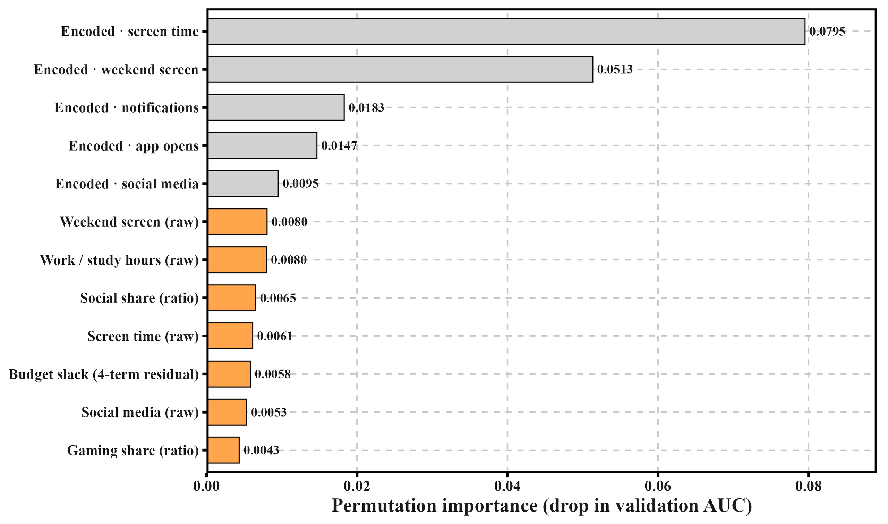
Part 2 · Comparisons
How Important Is a Feature?
It Depends on What Else the Model Has.
Removing notifications_per_day, at two
moments in the project:
moment
cost of removing it
before the per-value encodings
−0.00825
after the per-value encodings
−0.00022
Thirty-seven times smaller — and nothing
about the column itself changed.
te_notifications_per_day now carries the same
information by a second route, so deleting the
raw column stops meaning removing the information.
Permutation importance (all 25 features):
the top five are encoded columns; the first is
Permutation importance — the top five are the encoded columns
ten times the sixth — the highest raw column.
→ Ablation asks whether a column is indispensable; permutation asks whether the fitted model used it —
they diverge exactly when a second column carries the same information.
→ An ablation table is only meaningful together with the feature set it was measured on; quoted alone it will be
read as a property of the column, which it is not.
MH6211 · Group 10
How Important Is a Feature?
9/16
Notes:
这一页讲没有一个特征是孤立重要的。我们删掉每日通知数这一列、整条流程重跑，做了两次：在逐取值编码之前，代价是零点零零八二五；在编码之后，代价是零点零零零二二——缩小了三十七倍，而这列本身什么都没变。原因是它的信息现在有第二条通路 te_notifications_per_day，删掉原始列不再等于拿走信息。右侧的置换重要性，前五名全部是编码列，第一名是第六名的十倍。把两句话连起来：消融问这一列是不是必不可少，置换问模型到底用了它多少，当第二列携带同一份信息时，这两个答案就分道扬镳——所以消融表必须和它当时的那套特征集一起引用。

Slide 10
Part 2 · Comparisons
What Tuning Actually Bought
Number of rounds — the one change that paid.
Early runs used fixed 600 rounds. Letting early stopping choose (near 1,158):
setting
CV AUC
fixed 600 rounds
0.95910
early stopping
0.96088 · +0.00178
Grid search — 18 configurations in two stages
learning rate ∈ {0.03, 0.05, 0.1} × depth ∈ {4, 6, 8}, then min_child_weight × colsample.
setting
CV AUC
default: learning rate 0.05, depth 6
0.96529
best: learning rate 0.03, depth 4
0.96545 · +0.00016
Stage two changed nothing. Depth 4 > 6 > 8 at all three learning rates — the shallower tree wins consistently.
→ Shallow wins because the label is close to a monotone function of a few variables (page 4) — the search confirmed a property
already visible in the data.
→ Tuning was worth 4× more before the encodings (+0.00067 → +0.00016): the encoding hands the model directly what it used to
approximate with more rounds and finer splits.
→ With tuned parameters: L1 > L2 > L3 unchanged — the grid’s conclusions do not depend on the hyper-parameters.
MH6211 · Group 10
What Tuning Actually Bought
10/16
Notes:
调参到底买到什么。先说唯一付了钱的那一项：训练轮数。固定六百轮换成早停，从零点九五九一零涨到零点九六零八八，正零点零零一七八。然后两阶段网格搜索，十八组配置，从默认的零点九六五二九到最好零点九六五四五，只涨零点零零零一六，二阶段什么都没改变，深度四大于六大于八。重要的是这个对比：编码前调参值零点零零零六七，编码后只剩零点零零零一六——调参不是天生没用，是它想逼近的东西被编码直接喂给了模型，剩下的余量自然变小。稳健性一条：用最优参数重跑四条插补线，L1 大于 L2 大于 L3 不变，网格的结论不依赖超参。

Slide 11
Part 2 · Comparisons
Ensembling in Rank Space, +0.00023
14 members · rank correlation between members: min 0.819, median 0.929, max 0.997.
Combination method
CV AUC
vs best single
Rank-space logistic regression
0.96807
+0.00023
Hill climbing
0.96802
+0.00018
Logistic regression in probability space
0.96720
−0.00064
Rank averaging
0.96485
−0.00299
Why rank space.
AUC reads only the ordering — members don't share a scale, so averaging probabilities lets the wide member dominate. Ranking each member first removes the scale.
→ Rank space beats probability space by 0.00087, the largest gap among the four methods — a zero-cost change applied
to predictions we already had.
→ Rank averaging falls below the best single model: it treats all members alike, and 8 of the 14 score under
0.9550.
→ The ceiling is member homogeneity, not the combination rule — page 15 says what to select for instead.
MH6211 · Group 10
Ensembling in Rank Space
11/16
Notes:
集成只买到零点零零零二，我们如实说。成员十四位，相互的秩相关中位数零点九三，接近重复。为什么应该在秩空间加权：AUC 只读排序，而成员没有校准到同一尺度，glmnet 的输出铺得很开、提升树挤在窄带，直接平均概率等于把校准也一起加权了，摊得开的成员不是因为排得好而是数字动得大；换成秩把这个尺度消掉。秩空间比概率空间高零点零零零八七，是四种方法里最大的差距，而且零成本。排序平均反而低于最好的单模型，因为它一视同仁，而十四人里有八个低于零点九五五零。天花板不是合并方法，是同质——第十五页会讲该挑什么样的成员。

Slide 12
Part 3 · Follow-ups
Two Questions the Grid Could Not Answer
The main grid ran on the full data, but virtually every other comparison — ablation, tuning, feature
pricing — ran on a 200,000-row subsample, and the full data was used only for delivery. Two things were
assumed rather than tested:
Q1.
Does a choice made on the subsample survive on the full data?
Q2.
Do two preprocessing steps interact?
Imputation and per-value encoding were designed and measured separately.
Nothing guaranteed they compose.
MH6211 · Group 10
Two Questions the Grid Could Not Answer
12/16
Notes:
到这里叙事换挡。主网格跑在全量上，但其余几乎所有对比——消融、调参、特征定价——都跑在二十万行的子样本上，全量只用于交付。有两个假设从未被检验：第一个，在子样本上做的选择，到全量上还成立吗；第二个，两个预处理步骤会不会互相破坏——插补和逐取值编码是分开设计、分开测量的，没有任何东西保证它们可以组合。

Slide 13
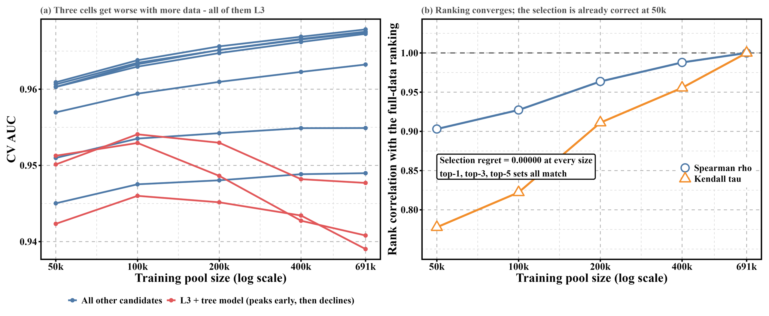
Part 3 · Follow-ups
Selection Transfers Completely. Ranking Does Not.
A nested ladder — 50k ⊂ 100k ⊂ 200k ⊂ 400k ⊂ 691,369 — with the same 10 candidates, the same
25 features and the same folds at every level.
rows
Spearman ρ
winner
selection regret
50,000
+0.903
L1_xgboost ✓
0.00000
100,000
+0.927
L1_xgboost ✓
0.00000
200,000 ←
+0.964
L1_xgboost ✓
0.00000
400,000
+0.988
L1_xgboost ✓
0.00000
The top-5 set is identical to the full-data set at every level.
AUC across the ladder — the three L3 rows decline
→ Selection regret is what screening on this sample costs against picking on the full data — and it is exactly zero everywhere: 50k (7.2% of the data) already finds the
full-data winner.
→ The ranking does not fully transfer, and the deviations are not noise: all six real misrankings involve an L3 cell; the only top-5 inversion
(ranks 2–3) sits below that pair's own resolution floor.
→ The next page says why.
MH6211 · Group 10
Selection Transfers Completely
13/16
Notes:
为了回答第一个问题，我们做了一个样本量阶梯：五万、十万、二十万、四十万、全量，五级嵌套，十候选、二十五特征、同一套折。三个量：Spearman 秩相关、前五名集合、选择遗憾——遗憾是这个小样本筛选相对在全量上挑的代价，它才是真正要付的钱。结果：每一级的前五名集合与全量完全一致，遗憾在每一级都恰好为零；哪怕只用全量百分之七点二的数据，选出来的就是全量最优。完整排名不完全迁移：六次真正的排错无一例外涉及 L3 的三格；唯一一次涉及前五名的交换在第二、第三名之间，低于那一对自身的分辨率下限、判不清。下一页讲为什么排错的都是 L3。

Slide 14
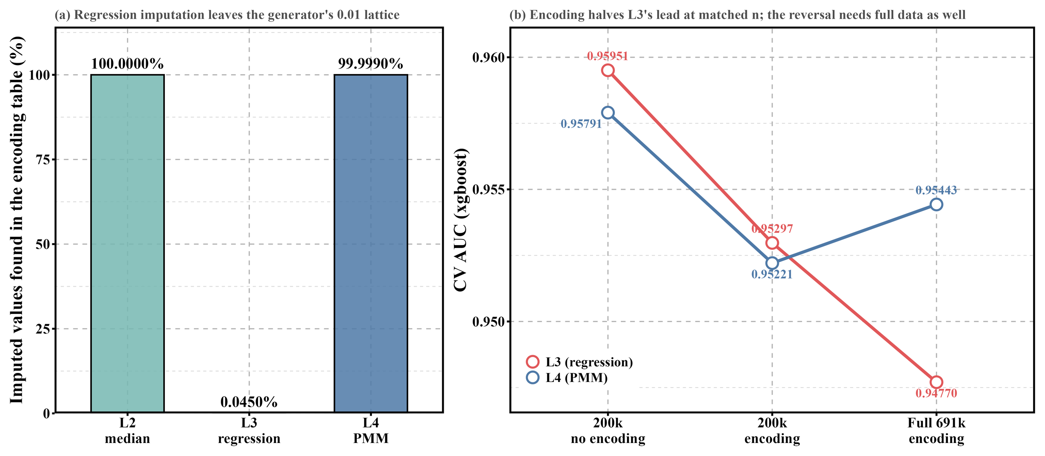
Part 3 · Follow-ups
Imputation Can Destroy the Encoding
The encoding is keyed on exact values, and the data sits on the generator's 0.01 lattice.
lookup hit rate for imputed cells
verification — one variable at a time (xgboost)
line
what it fills in
hit rate
condition
L3
L4
winner
L2 median
observed median — on lattice
100.00%
200k, no encoding
0.95951
0.95791
L3 by 0.00160
L3 regression
arbitrary real number — off lattice
0.045%
200k, with encoding
0.95297
0.95221
L3 by 0.00076
L4 PMM
real donor value — on lattice
99.999%
full, with encoding
0.94770
0.95443
L4 by 0.00673
≥ 61% of rows miss at least one column — an upper bound, since the eight encoded columns are a subset of the twelve features.
With per-value encoding in the pipeline, an imputer must fill values
back onto the lattice.
→ Orthogonal to which imputer is statistically more accurate — L3 estimates better, yet produces something the next step cannot use.
→ Encoding halves L3's lead; the reversal also needs the full data — the last row alone would over-credit the encoding.
MH6211 · Group 10
Imputation Can Destroy the Encoding
14/16
Notes:
这是全场最新的一页，讲两个预处理步骤会互相破坏。编码表按精确取值建立，数据落在零点零一格点上。三级插补的命中率：L2 中位数填的是真实观测值，百分之百；L3 回归预测填的是任意实数，落在格点外，命中率只有百分之零点零四五；L4 预测均值匹配抄的是真实样本值，百分之九十九点九九九。至少缺一列的行占百分之六十一，是这条失败能碰到的行的上界。机制验证：只变一个量，二十万无编码时 L3 领先零点零零一六零；二十万有编码时领先减半到零点零零零七六；全量有编码时 L4 反超零点零零六七三。L4 那一行我们事先写下了预测再测——PMM 抄的是真实观测值，必然留在格点上。结论框住：有逐取值编码的流程里，插补必须填回格点上的值。这也解释了为什么成立需要全量：数据越多，编码表越准，查得到与查不到的差距越大，L3 的损失随样本量放大。

Slide 15
Part 3 · Follow-ups
One Sentence Covers All Three
The value of a preprocessing step equals how hard the downstream model finds it to construct on its own.
preprocessing step
can the model build it itself?
gradient-boosted trees
linear model (glmnet)
Imputation (L2 vs L3)
GBDT represents "unknown" natively;
L2 beats L3: +0.01273
L3 beats L2: +0.00617
glmnet cannot
(n = 15, 15/15)
(n = 15, 15/15)
Derived ratio
GBDT approximates a two-column
ratios absorbed;
— not measured
features
ratio with staircase splits
four-term slack +0.00064 (5/5)
Per-value lookup
GBDT approximates with thousands of
+0.00424
+0.03352
(TE)
splits; glmnet needs a parameter per value
(≈ 8×)
→ What the model can already build, we only duplicate as a redundant column; what it cannot build is the only place new information can enter.
→ "Can it build it" is a property of the model's expressiveness, not of the data — hence opposite signs, or an eightfold difference in value.
→ A linear model can pay for exact-value lookup — one-hot reaches 0.95929 — but not for free.
→ And that answers page 11: choose ensemble members whose preprocessing needs differ, not members whose scores are high.
MH6211 · Group 10
One Sentence Covers All Three
15/16
Notes:
把三件事收成一句话。插补：树能原生表示未知，线性模型不能，所以同一对步子 L2、L3 在两族上谁是赢家相反，各自十五折全票。派生特征：树能用台阶逼近一个两列比值，所以比值进了编码之后没有增量，但四项目的超平面任何深度都铺不出来，预算余量在编码之上仍然值零点零零零六四；这一行是三个实例里最弱的，没有跨模型族测量，我们如实说。逐取值查找：需要上千次分裂去逼近，线性模型则要为每个取值付一个参数，所以编码在树上值零点零零四二四、在 glmnet 上值零点零三三五二，差一个数量级。一句话：一项预处理的价值，等于下游模型自己造出这个变换有多难。这同时回答了第十一页——让集成有价值，要挑对同一份预处理需求不同的成员，而不是分数高的成员。

Slide 16
Part 3 · Follow-ups
Conclusions
What we delivered
Three things worth carrying forward
model
CV AUC
1. The value of a preprocessing step equals how hard the
Best single model, L1_xgboost
0.96784 ± 0.00053
downstream model finds it to construct itself — verified
14-member ensemble (rank-space)
0.96807
three times, always in the same direction.
2. Whether a hand-built feature helps depends on how many
Leaderboard during the competition
0.96627
terms its shape needs — a tree approximates a two-column
ratio but cannot approximate the four-term hyperplane.
3. "How large is significant" is a property of the pair,
not the data — 0.000098 near-twins, 0.000564 across families (≈ 6×).
Limits — said out loud.
5-fold throughout, no 10-fold control. The two post-competition numbers have no leaderboard validation. The size ladder covers 10 of
the 14 candidates. Transfer was verified for model selection and ensemble weights, not for hyper-parameter selection.
→ Given the ordering again, we would do feature engineering before the imputation study: the whole imputation study
spans 0.00297; one feature-engineering step (the encoding + the corrected definition) is worth 0.00455.
MH6211 · Group 10
Conclusions
16/16
Notes:
交付与三个带走的东西。最优单模型零点九六七八四，十四成员秩空间集成零点九六八零七，比赛期间榜单零点九六六二七，赛后两个数字没有榜单验证。值得带走的：一是预处理的价值等于下游模型自己构造它的难度，三个独立实验同向验证；二是手工特征有没有用，取决于它的形状需要几项——树逼近两列比值，但任何深度铺不出四项超平面；三是多大算显著是这一对的性质，不是数据的性质，近乎孪生对零点零零零零九八，跨模型族零点零零零五六四。边界主动说：全程五折、没有十折对照；样本量阶梯只覆盖十四个候选里的十个；迁移只验证了模型选择和集成配权，没有验证超参选择。如果重新来，我们会把特征工程放在插补研究之前——整个插补研究跨度零点零零二九七，一步特征工程值零点零零四五五。

