Slide 1
p_{i,j}
X_{i}
X_{j}
Partial correlation
=
Stength
of that edge
= known

Slide 4
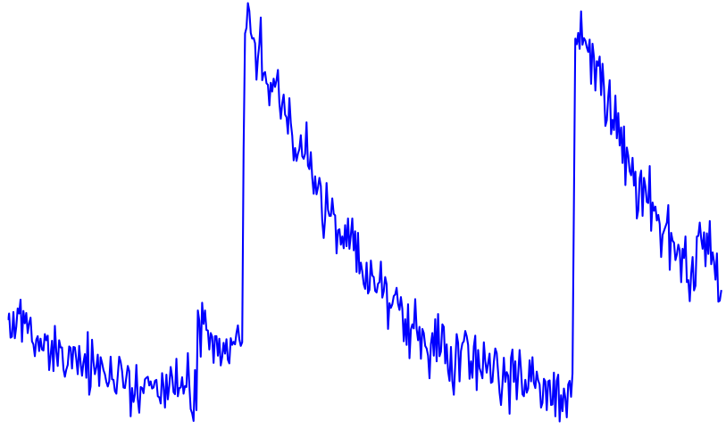
green
red

