Slide 1

History of Architecture
Randomize

Slide 2
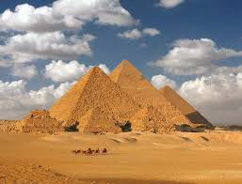
History of Architecture
1)
In Egyptian Architecture, the tomb of the pharaohs are the?
1)
In Egyptian Architecture, the tomb of the pharaohs are the?
A. Stupa
C. Mastaba
A. Stupa
C. Mastaba
B. Pyramids
D. Tumuli
B. Pyramids
D. Tumuli
Randomize

Slide 3
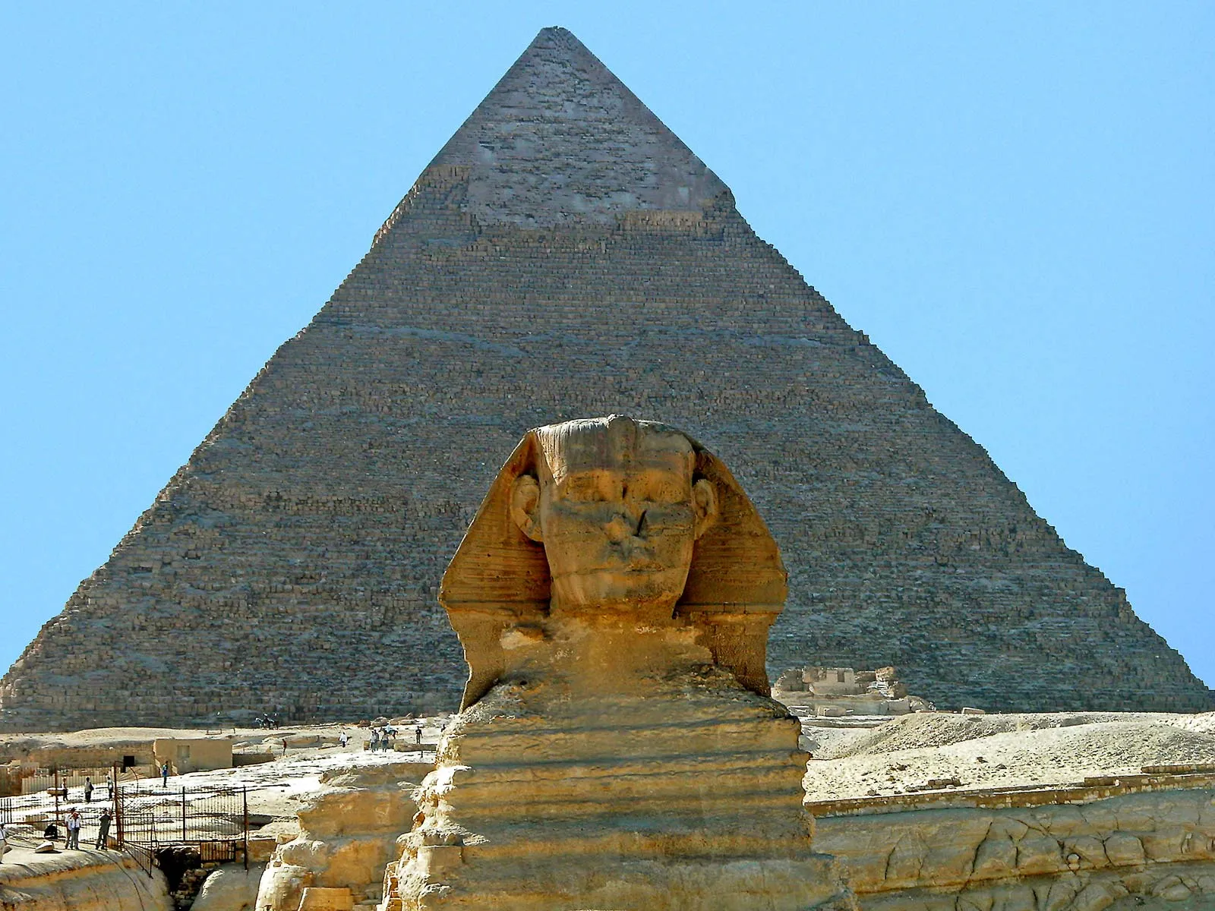
1)
In Egyptian Architecture, the tomb of the pharaohs are the?
2)
The Great Pyramid of Gizeh was built during the 4th dynasty by:
3)
The beginner of the great hypostyle hall at karnak and the founder of the 19th dynasty is who?
A. Stupa
C. Mastaba
A. Cheops
C. Zoser
A. Rameses 1
C. Rameses 3
B. Pyramids
D. Tumuli
B. Senusret
D. Anememhat
B. Rameses 2
D. Rameses 4
Randomize

Slide 4
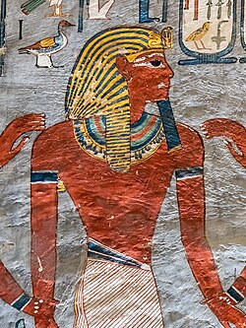
3)
The beginner of the great hypostyle hall at karnak and the founder of the 19th dynasty is who?
3)
The beginner of the great hypostyle hall at karnak and the founder of the 19th dynasty is who?
4)
The Mineral of greatest importance to Greek Architecture of which Greece and her domains had ample supply was?
A. Rameses 1
C. Rameses 3
A. Rameses 1
C. Rameses 3
A. Stone
C. Marble
B. Rameses 2
D. Rameses 4
B. Rameses 2
D. Rameses 4
B. Mica
D. Granite
Randomize

Slide 5
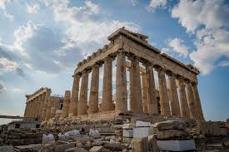
4)
The Mineral of greatest importance to Greek Architecture of which Greece and her domains had ample supply was?
4)
The Mineral of greatest importance to Greek Architecture of which Greece and her domains had ample supply was?
5) Greek Architecture was essentially? (D.K. Ching p. 128)
A. Stone
C. Marble
A. Stone
C. Marble
A. Arch and Vault
C. Ribbed and Paneled Vaulting
B. Mica
D. Granite
B. Mica
D. Granite
B. Columnar and Trabeated
D. Domical Roof Construction
Randomize

Slide 6
5) Greek Architecture was essentially? (D.K. Ching p. 128)
5) Greek Architecture was essentially? (D.K. Ching p. 128)
A. Arch and Vault
C. Ribbed and Paneled Vaulting
A. Arch and Vault
C. Ribbed and Paneled Vaulting
B. Columnar and Trabeated
D. Domical Roof Construction
B. Columnar and Trabeated
D. Domical Roof Construction
Randomize

Slide 7
5) Greek Architecture was essentially? (D.K. Ching p. 128)
5) Greek Architecture was essentially? (D.K. Ching p. 128)
A. Arch and Vault
C. Ribbed and Paneled Vaulting
A. Arch and Vault
C. Ribbed and Paneled Vaulting
B. Columnar and Trabeated
D. Domical Roof Construction
B. Columnar and Trabeated
D. Domical Roof Construction
Randomize

