Slide 1

History of Architecture
1)
In Egyptian Architecture, the tomb of the pharaohs are the?
A. Stupa
C. Mastaba
B. Pyramids
D. Tumuli
Randomize

Slide 2
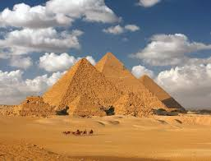
History of Architecture
1)
In Egyptian Architecture, the tomb of the pharaohs are the?
A. Stupa
C. Mastaba
B. Pyramids
D. Tumuli
Randomize

Slide 3
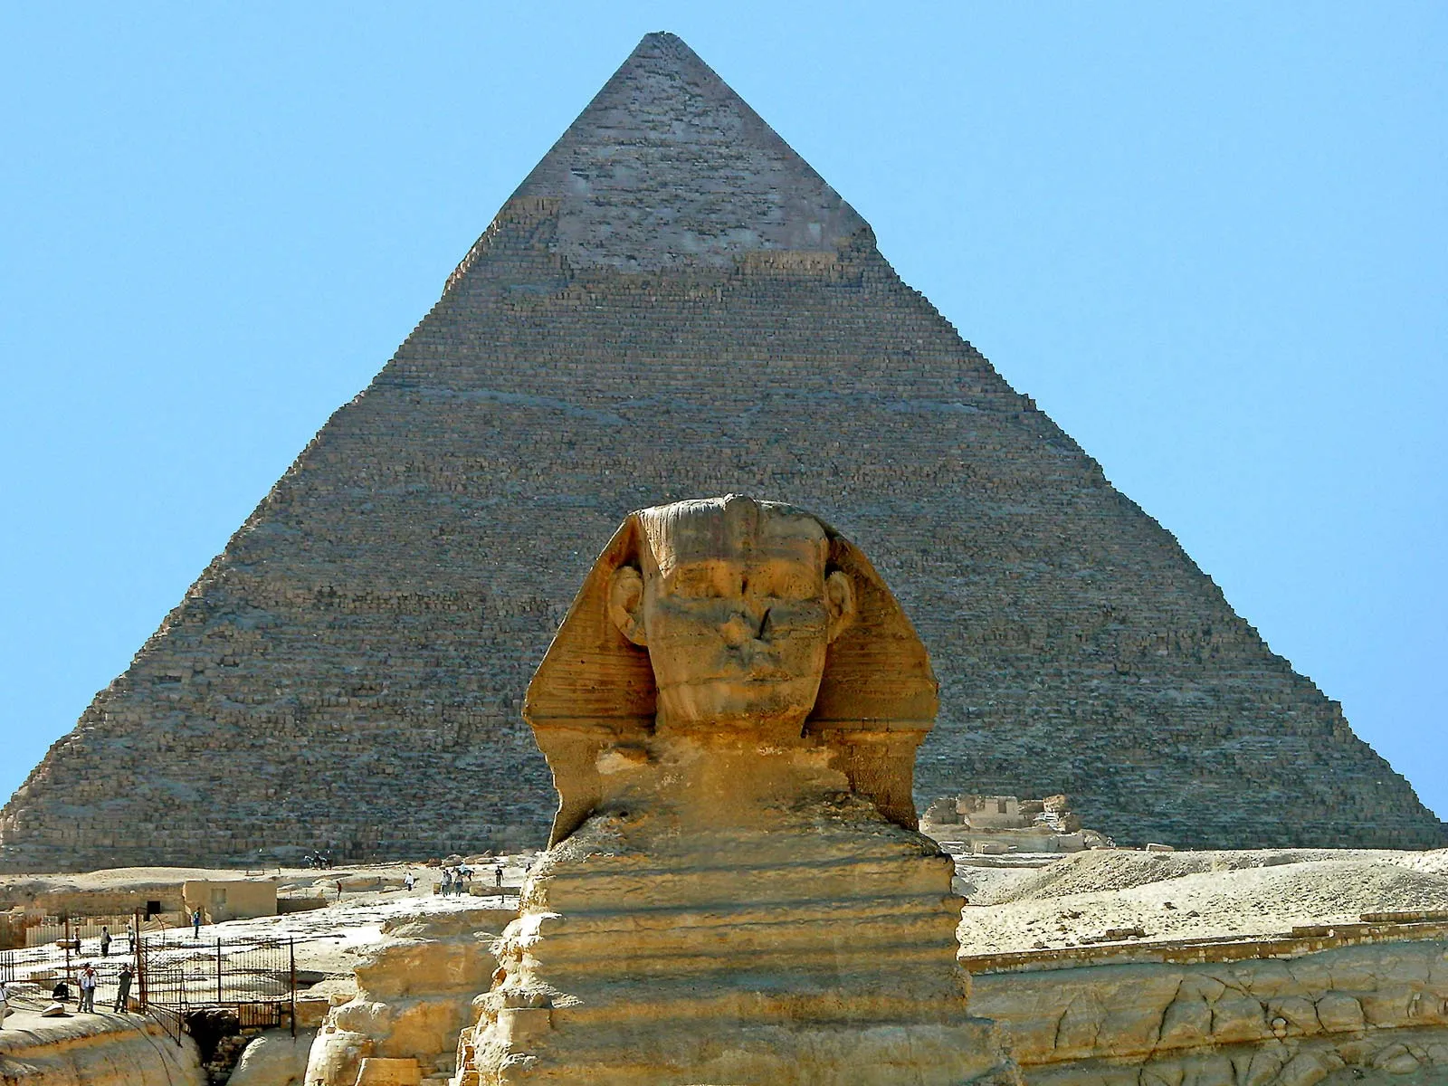
1)
In Egyptian Architecture, the tomb of the pharaohs are the?
2)
The Great Pyramid of Gizeh was built during the 4th dynasty by. [A] Cheops [B] Senusret [C] Zoser [D] Anememhat
A. Stupa
C. Mastaba
A. Stupa
C. Mastaba
B. Pyramids
D. Tumuli
B. Pyramids
D. Tumuli
Randomize

