Slide 1

汇报人：杨东升
汇报时间：2023.11.03

Slide 2
论文题目
Nearest Neighbor-Based Contrastive Learning for
Hyperspectral and LiDAR Data Classification
Meng Wang , Feng Gao

Slide 3
HSI 及LiDAR特点
高光谱图像（HSI）：为识别地面指定对象提供了详细的光谱信息。
LiDAR ：提供了区域的高程信息
HSI和LiDAR数据的联合利用能够让我们以更详细和精确的级别解释地面物体。

Slide 4
主要贡献
提出了一种基于最近邻的数据增强方案，用于利用附近区域之间增强的语义关系，可以更准确地捕捉跨模态语义对齐。还设计了一个双线性注意模块，以利用 HSI 和 LiDAR 数据之间的二阶甚至高阶特征交互。

Slide 5
主要目标
旨在构建一个有效的自监督模型来解决数据增强方案中没有考虑到的正负样本之间的空间距离以及没有利用邻近区域的语义相似性的问题，并填补异构间隙这一问题。

Slide 6
解决方案
1.提出了一个基于最近邻的框架
2.设计了一个双线性注意力融合模块

Slide 7
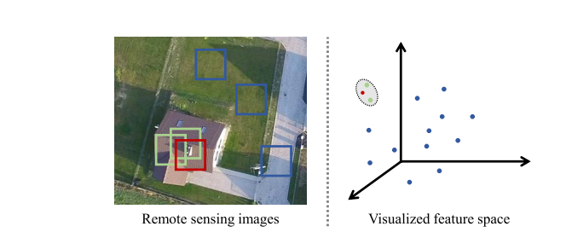
NNC依据
Wang M, Gao F, Dong J, et al. Nearest Neighbor-Based Contrastive Learning for Hyperspectral and LiDAR Data Classification[J]. IEEE Transactions on Geoscience and Remote Sensing, 2023, 61: 1-16

Slide 8
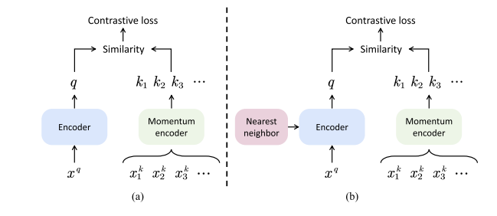
基于最近邻的框架
Wang M, Gao F, Dong J, et al. Nearest Neighbor-Based Contrastive Learning for Hyperspectral and LiDAR Data Classification[J]. IEEE Transactions on Geoscience and Remote Sensing, 2023, 61: 1-16

Slide 9
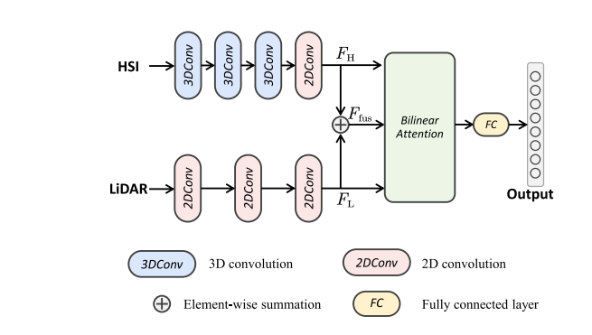
基于双线性注意力的多源编码器
Wang M, Gao F, Dong J, et al. Nearest Neighbor-Based Contrastive Learning for Hyperspectral and LiDAR Data Classification[J]. IEEE Transactions on Geoscience and Remote Sensing, 2023, 61: 1-16

Slide 10
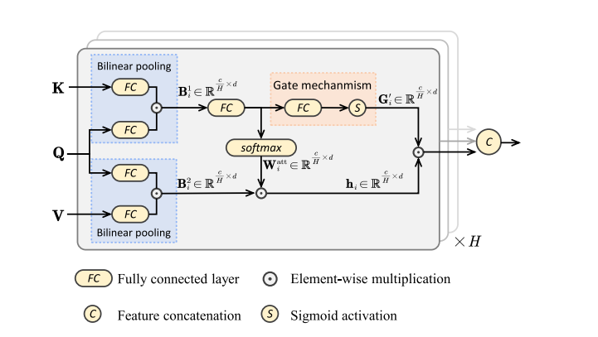
双线性注意力融合模块
Wang M, Gao F, Dong J, et al. Nearest Neighbor-Based Contrastive Learning for Hyperspectral and LiDAR Data Classification[J]. IEEE Transactions on Geoscience and Remote Sensing, 2023, 61: 1-16

Slide 11
Gate Mechanism门控机制
目的是为了自适应地增强信息丰富的部分并抑制无用的部分

Slide 12
双线性注意力融合模块
旨在增强HSI和LiDAR数据的上下文表示。
该模块捕获了多源数据之间的二阶特征交互
Wang M, Gao F, Dong J, et al. Nearest Neighbor-Based Contrastive Learning for Hyperspectral and LiDAR Data Classification[J]. IEEE Transactions on Geoscience and Remote Sensing, 2023, 61: 1-16

Slide 13
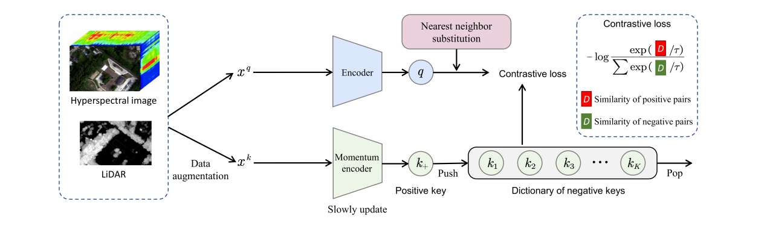
NNCNet
Wang M, Gao F, Dong J, et al. Nearest Neighbor-Based Contrastive Learning for Hyperspectral and LiDAR Data Classification[J]. IEEE Transactions on Geoscience and Remote Sensing, 2023, 61: 1-16

Slide 14
模型评估
通过在Houston 2013、Trento、MUUFL 和 Houston 2018 数据集上的实验，验证了所提出的NNCNet的有效性.

Slide 15
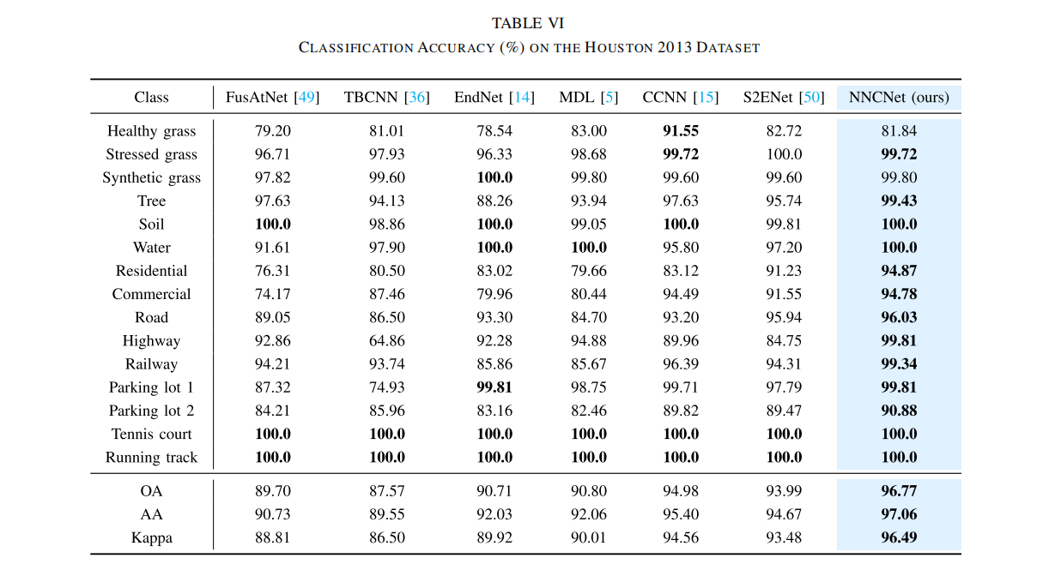
Hous-ton 2013
Wang M, Gao F, Dong J, et al. Nearest Neighbor-Based Contrastive Learning for Hyperspectral and LiDAR Data Classification[J]. IEEE Transactions on Geoscience and Remote Sensing, 2023, 61: 1-16

Slide 16
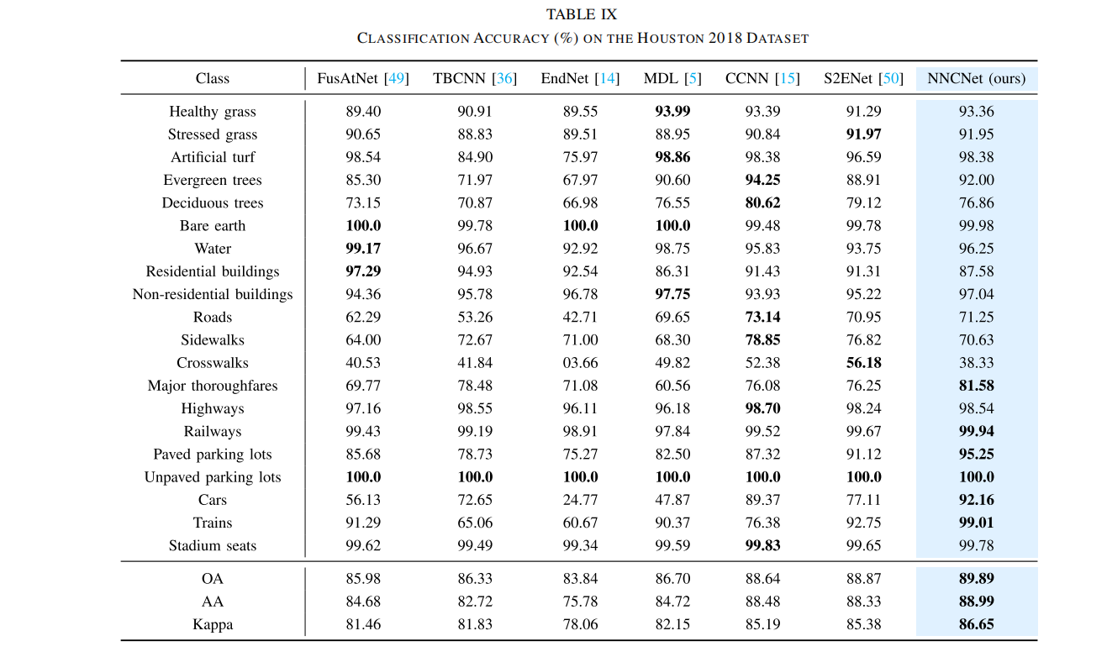
Hous-ton 2018
Wang M, Gao F, Dong J, et al. Nearest Neighbor-Based Contrastive Learning for Hyperspectral and LiDAR Data Classification[J]. IEEE Transactions on Geoscience and Remote Sensing, 2023, 61: 1-16

Slide 17
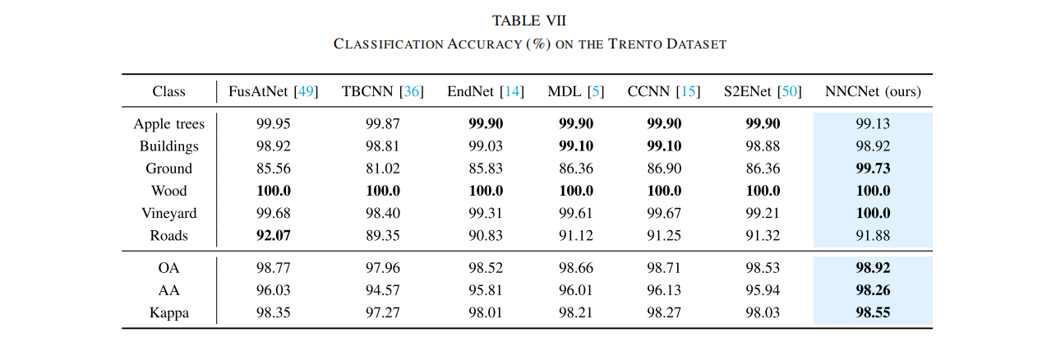
Trento数据集
Wang M, Gao F, Dong J, et al. Nearest Neighbor-Based Contrastive Learning for Hyperspectral and LiDAR Data Classification[J]. IEEE Transactions on Geoscience and Remote Sensing, 2023, 61: 1-16

Slide 18
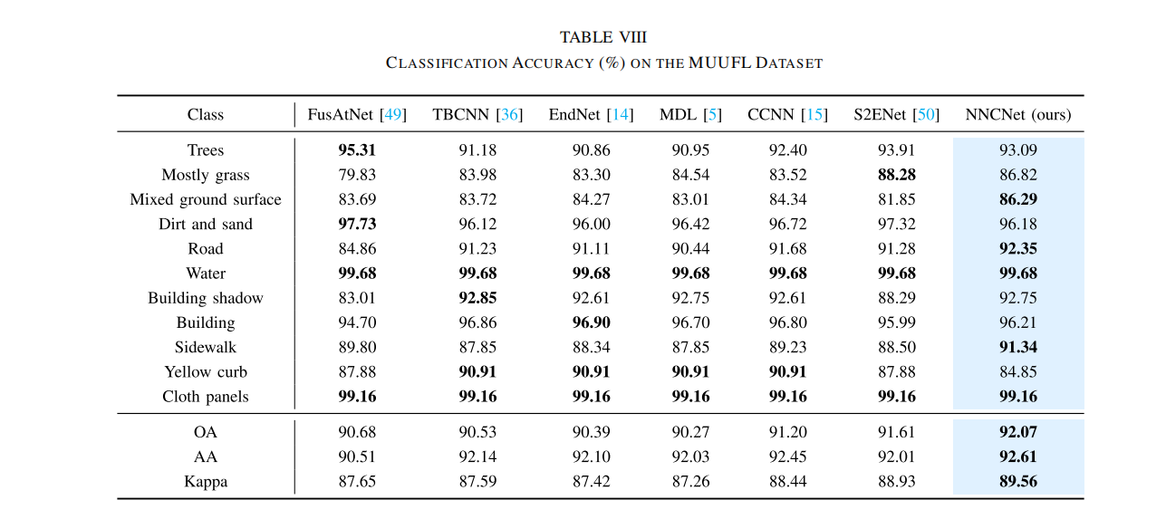
MUUFL数据集
Wang M, Gao F, Dong J, et al. Nearest Neighbor-Based Contrastive Learning for Hyperspectral and LiDAR Data Classification[J]. IEEE Transactions on Geoscience and Remote Sensing, 2023, 61: 1-16

Slide 19
消融研究
通过一系列消融实验验证了每个提出的模块提高分类准确性的有效性

Slide 20
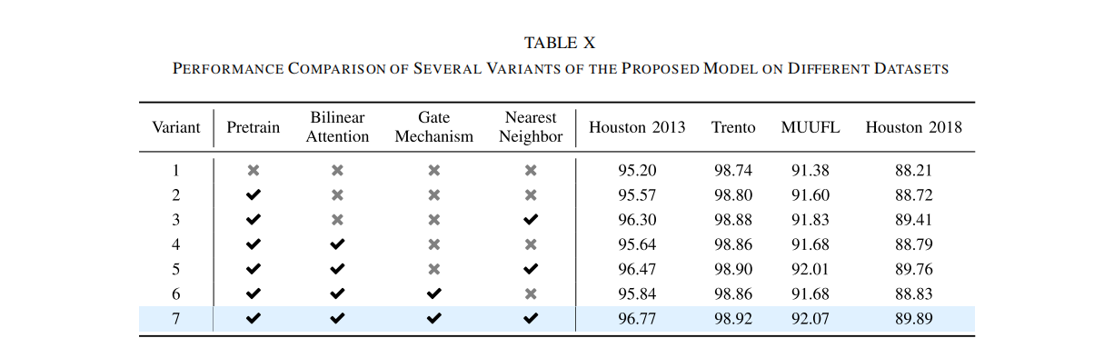
消融研究
Wang M, Gao F, Dong J, et al. Nearest Neighbor-Based Contrastive Learning for Hyperspectral and LiDAR Data Classification[J]. IEEE Transactions on Geoscience and Remote Sensing, 2023, 61: 1-16

Slide 21
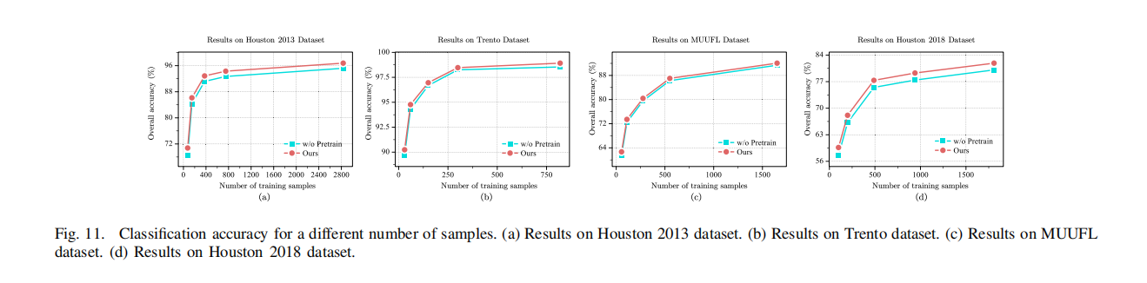
消融研究
Wang M, Gao F, Dong J, et al. Nearest Neighbor-Based Contrastive Learning for Hyperspectral and LiDAR Data Classification[J]. IEEE Transactions on Geoscience and Remote Sensing, 2023, 61: 1-16

Slide 22
最后作者还设置了一系列的参数：包括正负样本之间的最小空间距离，负键字典的大小，关键编码器更新速度，3D卷积的有效性。

