Slide 1
H
H
、
W
W
融合层
卷积层
反卷积层

Slide 2
H
H
W
W
Fusion layer
Convolution layer
Deconvolution layer

Slide 3
Input,4
Conv, 64(3x3)
Conv, 64(3x3)
MaxPool,(2x2)
Conv, 128(3x3)
Conv, 8(3x3)
Conv, 128(3x3)
MaxPool,(2x2)
Conv, 256(3x3)
Conv, 8(3x3)
Conv, 256(3x3)
MaxPool,(2x2)
Conv, 8(3x3)
Conv, 8(3x3)
DConv, 8(3x3)
+
Conv, 8(3x3)
DConv, 8(3x3)
+
Conv, 8(3x3)
DConv, 8(3x3)
+
Softmax

Slide 4
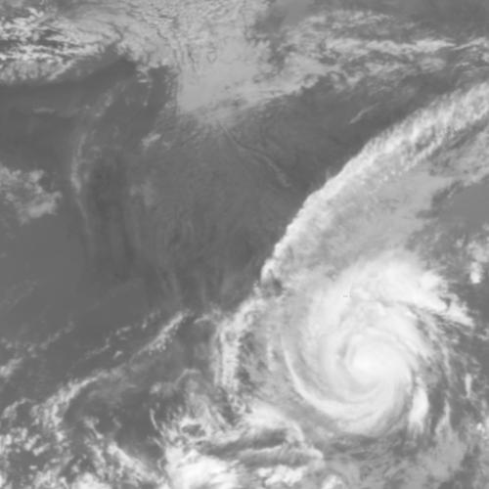
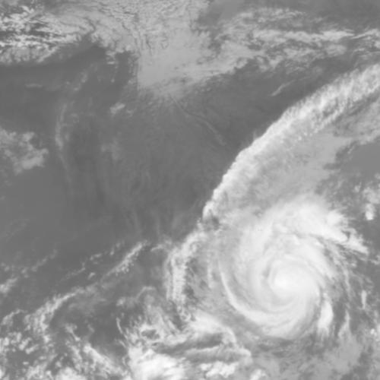
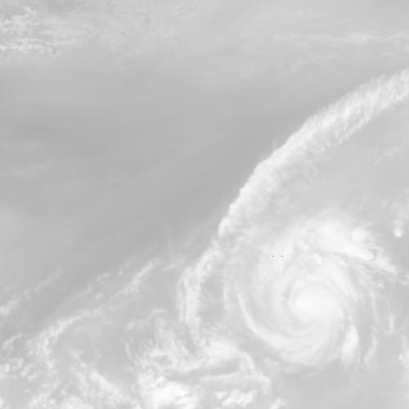
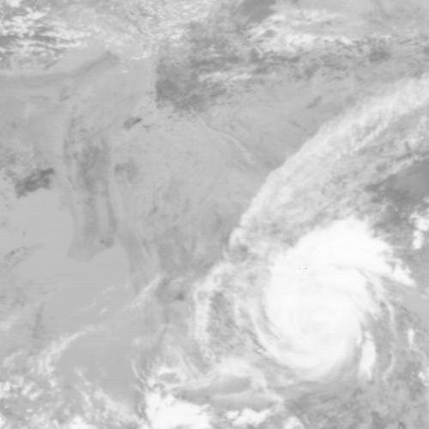
红外通道1
红外通道2
红外通道3
红外通道4

Slide 5
H
H
W
W
Attention layer
Convolution layer
Deconvolution layer
Fusion layer

Slide 6
Input,4
Conv, 64(3x3)
Conv, 64(3x3)
MaxPool,(2x2)
Conv, 128(3x3)
Attention, 8(3x3)
Conv, 128(3x3)
MaxPool,(2x2)
Conv, 256(3x3)
Attention, 8(3x3)
Conv, 256(3x3)
MaxPool,(2x2)
Conv, 8(3x3)
Attention, 8(3x3)
DConv, 8(3x3)
×
+
Conv, 8(3x3)
DConv, 8(3x3)
×
+
Conv, 8(3x3)
DConv, 8(3x3)
×
+
Softmax

Slide 7
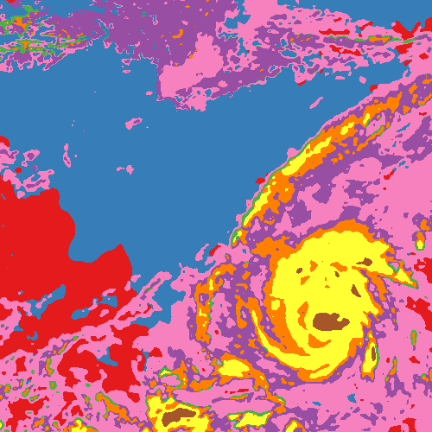
(d)
(a)
(b)
H
H
W
W
Attention layer
Convolution layer
Deconvolution layer
Fusion layer
(c)

Slide 8
Input,4
Conv, 64(3x3)
Conv, 64(3x3)
MaxPool,(2x2)
Conv, 128(3x3)
Attention, 8(3x3)
Conv, 128(3x3)
MaxPool,(2x2)
Conv, 256(3x3)
Attention, 8(3x3)
Conv, 256(3x3)
MaxPool,(2x2)
Conv, 8(3x3)
Attention, 8(3x3)
DConv, 8(3x3)
×
+
Fusion
Conv, 8(3x3)
DConv, 8(3x3)
×
+
Fusion
Conv, 8(3x3)
DConv, 8(3x3)
×
+
Fusion
Softmax

Slide 9
红外通道1
红外通道2
红外通道3
红外通道4

Slide 10
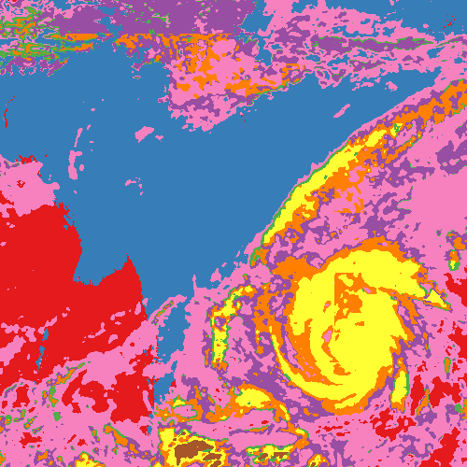

IR1
IR2
Labels
Clear Oceans
Clear Lands
Mixed Pixels
Altostratus
Cirrostratus
Cirrus dens
Cumulonimbus
Stratocumulus
IR3
IR4
Categories

Slide 11
Convolution layer
Combination layer
Deconvolution layer
H
H
W
W

Slide 12
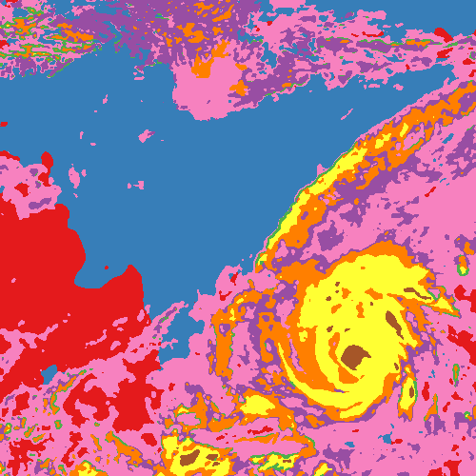
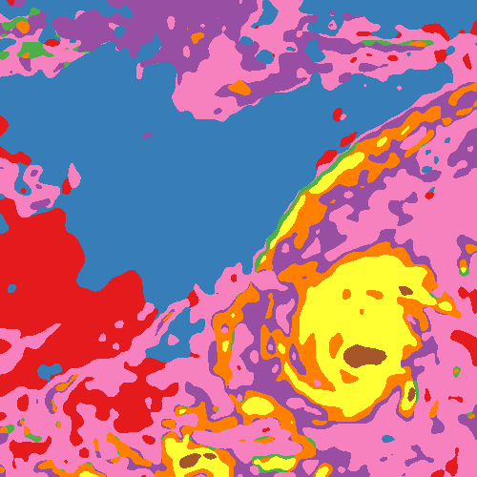
HA-FCN
W/OA-FCN

Slide 13
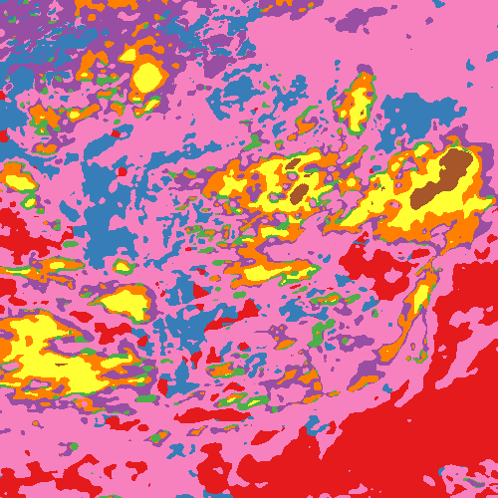
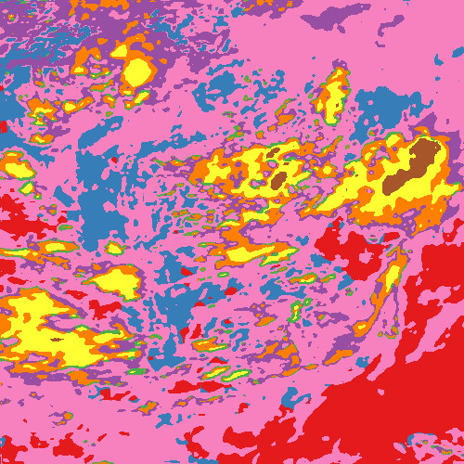
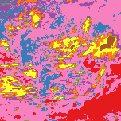
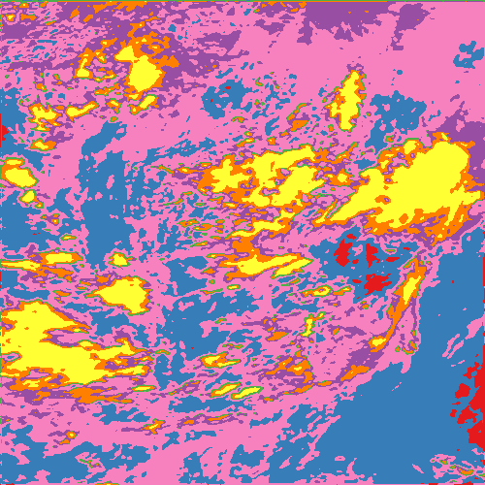
(a)
(b)
(d)
H
H
W
W
Attention layer
Convolution layer
Deconvolution layer
Fusion layer
(c)
(b)
(c)
(d)

Slide 14
(a)
(b)
(d)
H
H
W
W
Attention layer
Convolution layer
Deconvolution layer
Fusion layer
(b)
(c)
(d)
(c)

Slide 15
(a)
(b)
(d)
H
H
W
W
Attention layer
Convolution layer
Deconvolution layer
Fusion layer
(b)
(c)
(d)
(c)

