Slide 1
Easy-Hiring

Slide 2


Way Too Overwhelming and Exhausting!!

Slide 3
What is Easy-Hiring
Applicant:
Matching jobs
Generating electronic resume for career fair
Recruiter/Company:
Collecting electronic resumes
Reviewing resumes

Slide 4
Why Easy-Hring
Career Fair
Applicants need to bring tons of resumes. Also, they may wait in a long line without knowing if they are a good match for the company.
Recruiters need to upload applicants’ resume by hands and read contents to decide whether their skills meet job requirements

Slide 5
How does Easy-Hiring work?
React-Native
Firebase Real-time Database

Slide 6
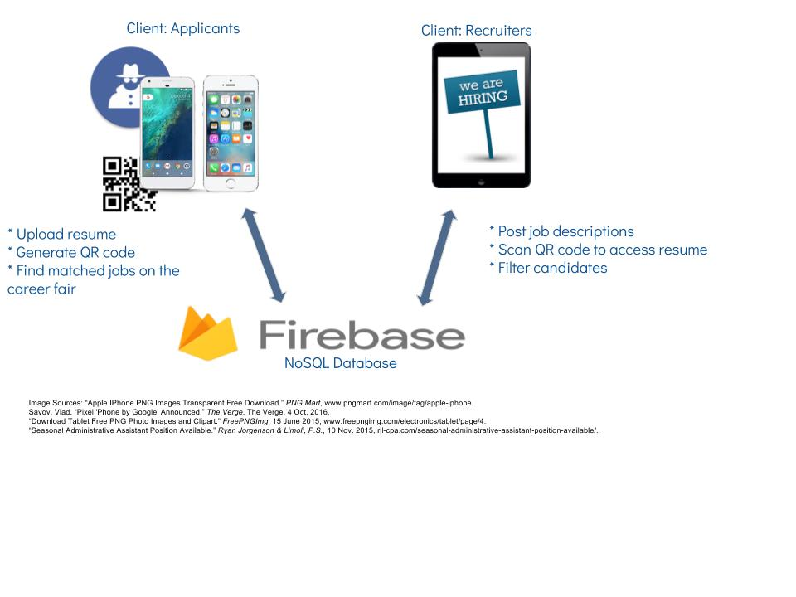
System Architecture

Slide 7
How does Easy-Hiring work?
One single mobile application in two modes:
Recruiter/Company
Applicant
Authentication is required to access career fair data
Map to display locations of attended companies.

Slide 8
How does Easy-Hiring work?
Applicant
Generate QRcode for applicant
Get jobs matched applicants’ skills
Submit job application
Recruiter
Scan QR code to get resume
Post job information
Get applicants’ information

Slide 9
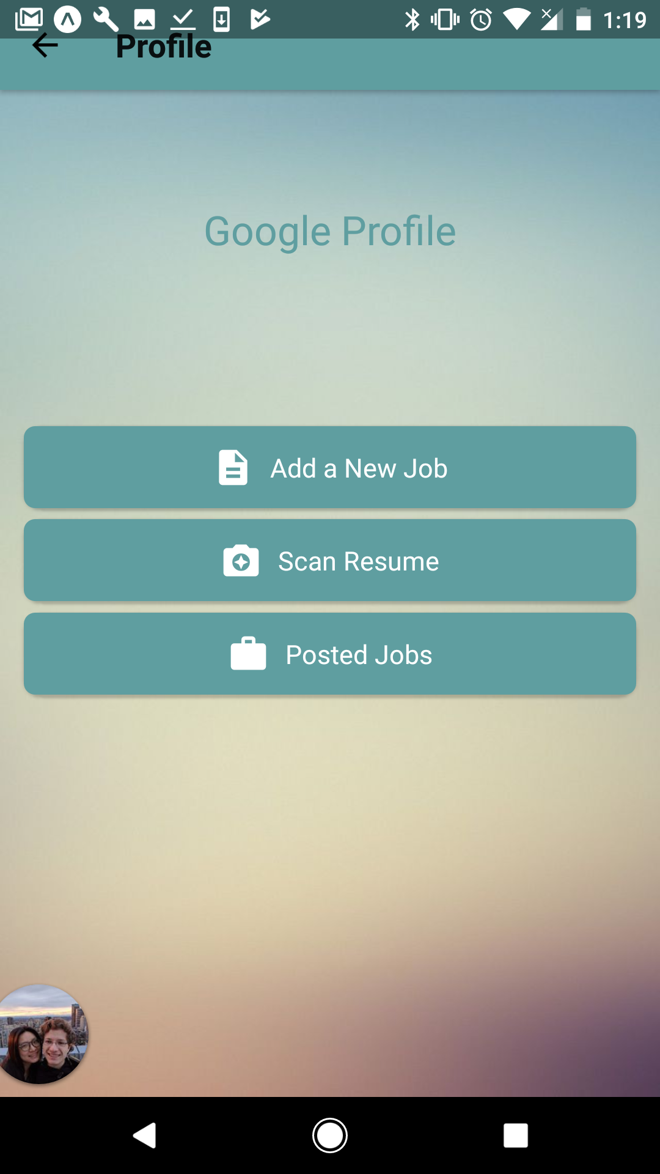
How does Easy-Hiring work?
Recruiter
Create new jobs
Scan applicants resume
Check posted jobs
Overview applied candidates for each job.
Download the selected candidate’s resume on device
Paper resume is no longer needed :D!

Slide 10
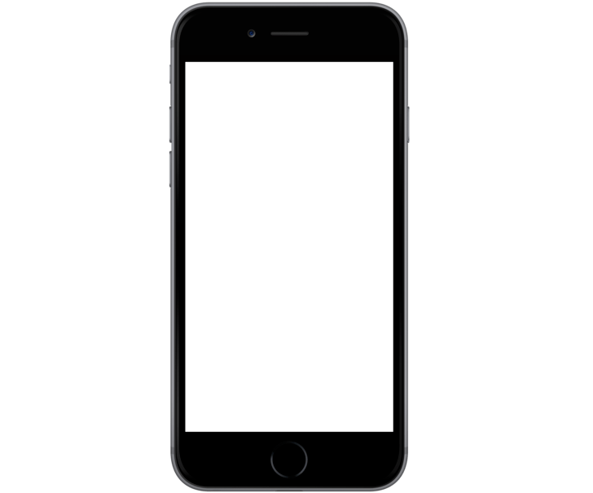
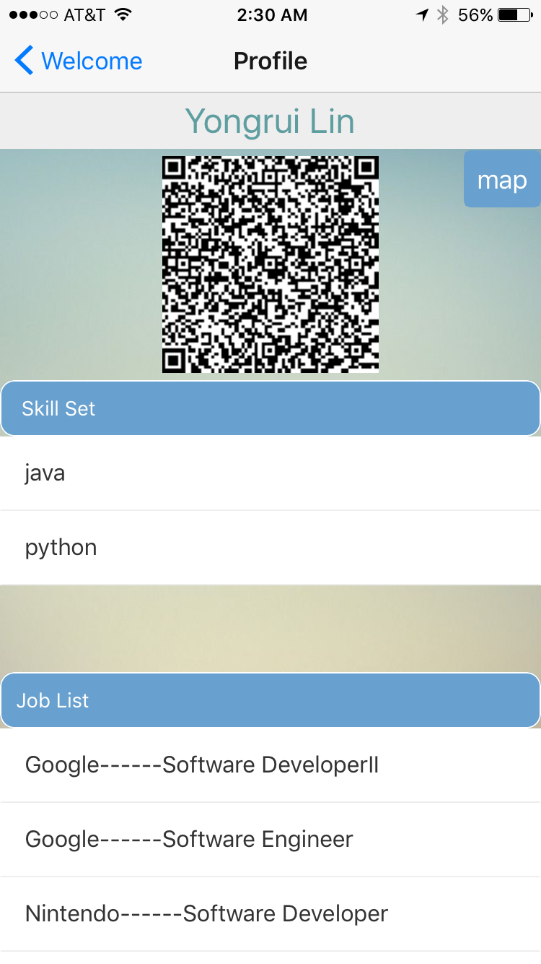
How does Easy-Hiring work?
Applicant
View companies location in the career fair
QR code for other people to access resume
View and apply posted jobs which match applicant’s skills

Slide 11
What we’ve learned
How to use React-Native framework to build application
How to use Firebase reatlime databsee
Explore device indenpendent mobile app development
How to ensure correctness of execution order in asychronous conditions

Slide 12
Future Work
User Interface
Virtual Career Fair
Advanced job filter for applicants
Content analysis on resumes

