Slide 1

Introduction to p5.js
A Beginner's Guide to Creative Coding

Slide 2
What is p5.js?
p5.js is a JavaScript library for creative coding.
It simplifies drawing, animation, and interactivity.
Built for artists, designers, and beginners in programming.

Slide 3
Why Use p5.js?
Open-source and beginner-friendly.
Works directly in web browsers.
Large community and many learning resources.
Ideal for interactive art and generative design.

Slide 4
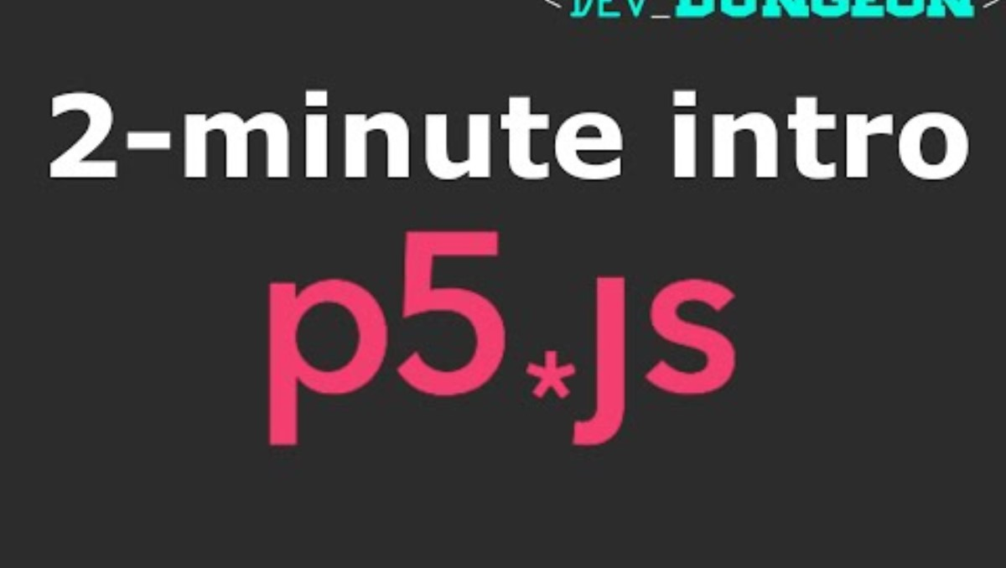
Basic Syntax & Example

Slide 5
Common Uses of p5.js
Interactive art and visualizations.
Generative design and animations.
Web-based games and simulations.
Data visualization and creative experiments.

Slide 6
Getting Started with p5.js
Visit p5js.org to explore documentation.
Try the p5.js web editor for quick coding.
Download and set up a local development environment.
Join the community for learning and collaboration.

