Slide 1
Convergent Genomic Evolution in Echolocating Mammals??
RILAB meeting 21st May 2015
Simon Renny-Byfield

Slide 2


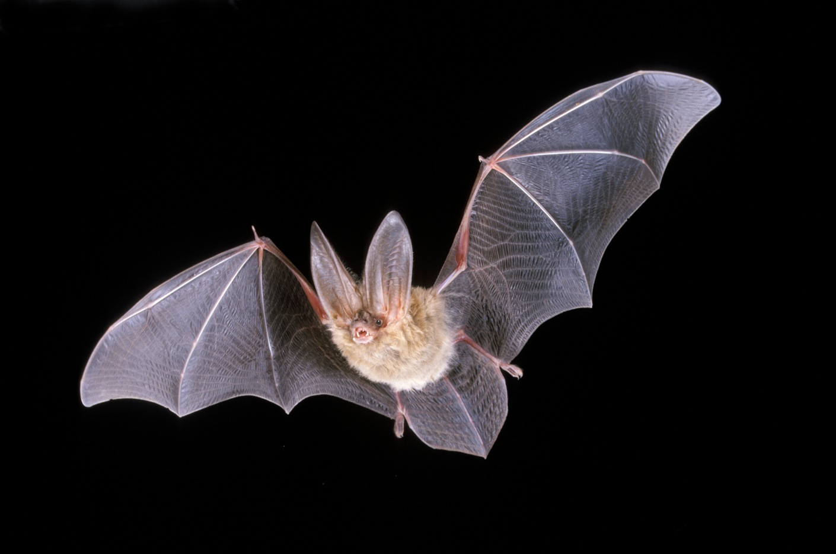

Background
Steve Rossiter
A bat
Joe Parker

Slide 3
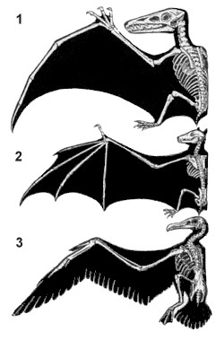
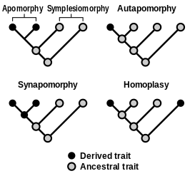
Convergent Evolution
“Convergent evolution is the independent evolution of similar features in species of different lineages”

Slide 4
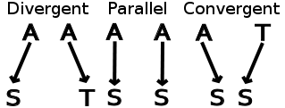
Convergent Evolution
Open Question: is morphological convergence coupled with molecular convergence?

Slide 5
Convergent Evolution
Echolocation has evolved numerous times in mammals:
Once in cetacean whales
once or twice in Chiroptera (bats)

Slide 7
22 mammal species (de novo seq of 4 bats).
Aligned 2,326 CDS regions
Examined AA substitutions

Slide 9
“In this method, we examined each amino acid along the alignment of a given CDS, and measured its fit (site-wise log-likelihood support; SSLS) to the commonly accepted species tree and to two alternative topologies in which we forced echolocating taxa into erroneous monophyletic clades representing different convergence hypotheses.”

Slide 10
ΔSSLS (H1) = SSLS (H0) - SSLS (H1)

Slide 12
Evidence of convergence in ~200 loci
Numerous genes involved with hearing
Most convergence loci seem to show patterns on either purifying or directional selection

Slide 13

but…..

Slide 15
These authors raise several concerns about the study by Parker et al., 2013
the measure of convergence (SSLS) is not actually a measure of convergence.
the suggest an alternative null model based on complete pairwise tests of convergence vs divergence.
Is the convergence seen anything more than neutral evolution?

Slide 16
over 6,000 CDS regions
High correlation between divergence and convergence

Slide 17
More convergence events in Microbat-Cow comparisons…!!
but does no excess of convergence mean that convergent events are not responsible for convergent adaptations?

Slide 18
ancestral state reconstruction
11 genes between dolphins and bats
Also Parker et al., perform not statistical test to compare observed convergence with those under simulation.

Slide 20
Examine ΔSSLS over various different tree topologies

Slide 22
Ancestral state reconstruction
compared rates of convergent substitutions across different branches.
No evidence of excess convergent molecular evolution.

Slide 23
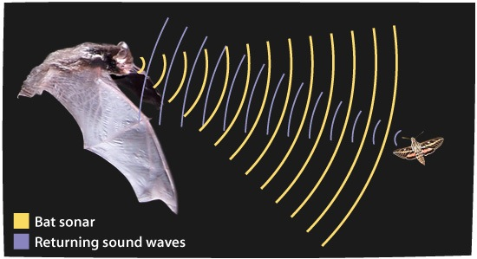
let’s discuss…

