Slide 1
Copy-number variants in a wild population of maize
Simon Renny-Byfield
JRI lab, UC Davis

Slide 2
Introduction
Motivation and expectations.
Our approaches to calling CNVs.
What we know so far (and what we don’t).
Future efforts.

Slide 3
CNVs

Slide 4
Motivation
How prevalent are CNVs in a single wild population of maize?
At what frequency are these CNVs segregating?
Are CNVs of any “selective significance”?
Patterns of π
πN and πS
Tajima’s D
dN/dS

Slide 5
Motivation
Are CNVs more prevalent in maize1 or maize2?
Are the patterns of diversity over CNVs variable between the two sub-genomes.
Patterns of π
πN and πS
Tajima’s D
dN/dS

Slide 6
Expectations at CNV regions
n=40
CNV freq = 1/40
D ~ background level
time
Reduction in N_{e} at CNV locus
CNV freq = 39/40
D > background level
CNV frequency

Slide 7
sfs, Tajima’s D and CNV
New CNV in teosinte pop (deletion)
Reduction in Ne at CNV site.
Less effective selection i.e. drift becomes more important.
Reflected in differing values of Taj D over CNV regions.

Slide 8
Our approach
20 Individuals
Single population: Palmar Chico, Mexico
20-25x coverage

Slide 9
Our approach: using read-depth to estimate CNV
We have tried several methods:
FREEC
control free copy number and genotype caller.
cn.mops
Mixture Of PoissonS for discovering CNVs
custom approach (detailed later).

Slide 10
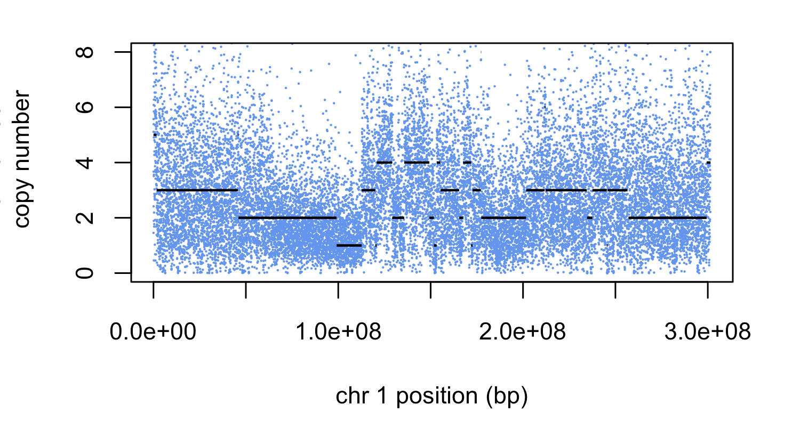
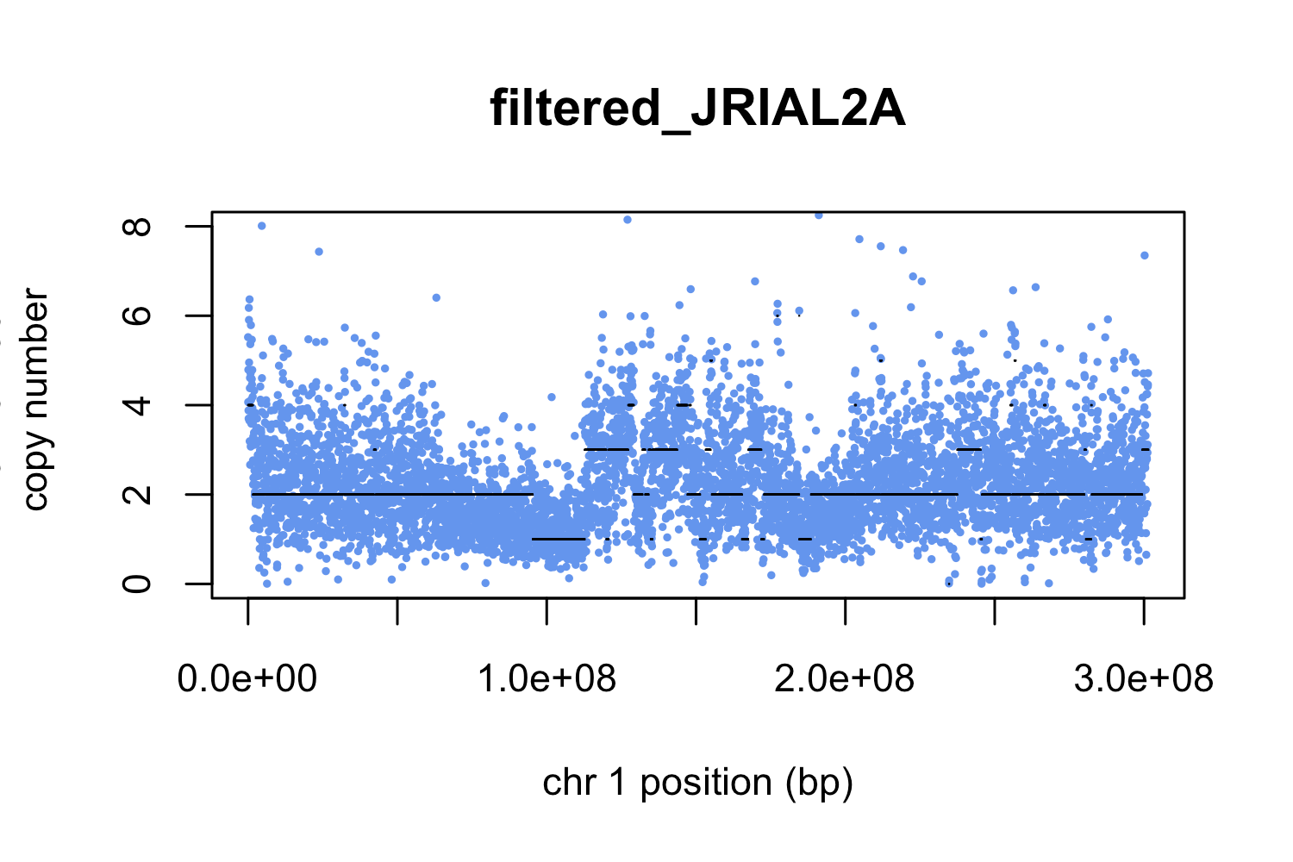
FREEC

Slide 11
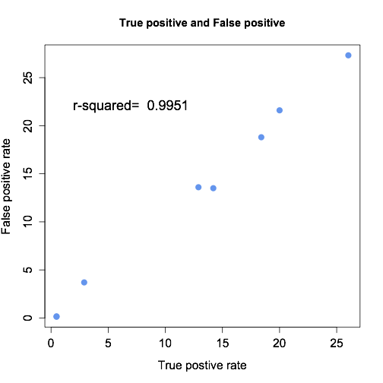
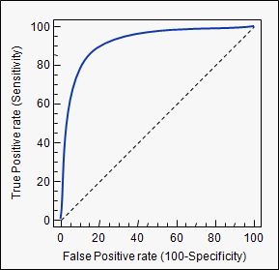
cn.Mops
almost perfect 1:1 relationship between false positive (FP) and true positive rate (TP).
ROC curves

Slide 12
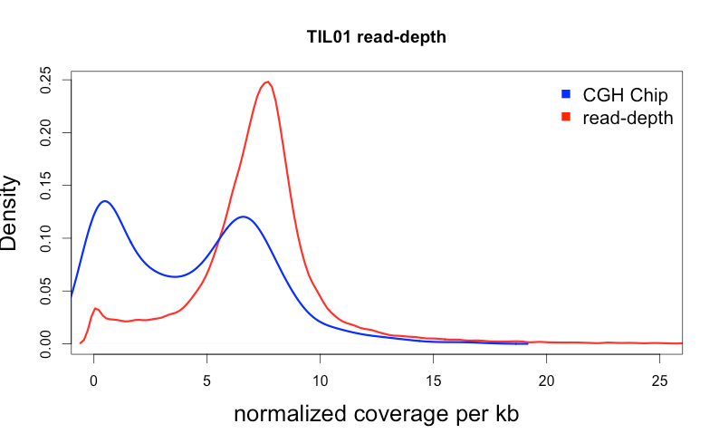
CGH chip vs read-depth
`

Slide 13
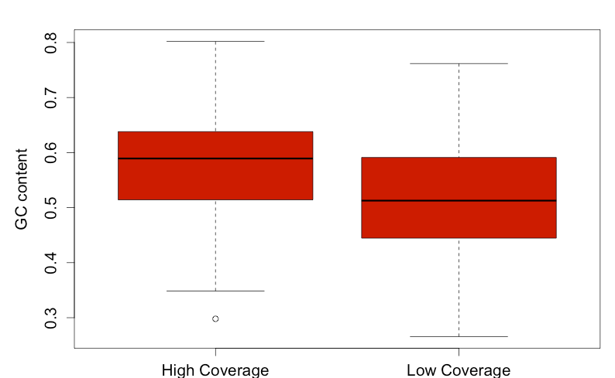
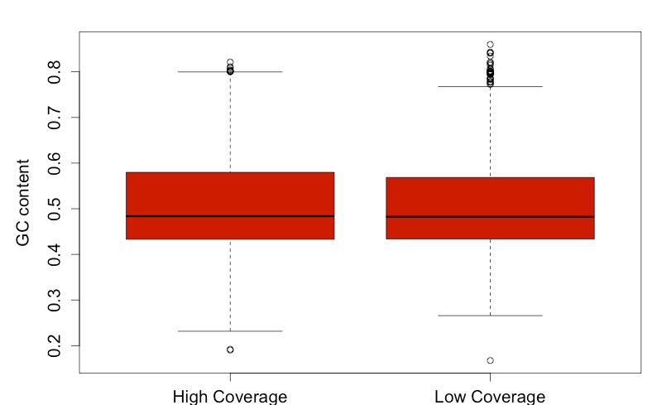
GC content and CGH down CNVs
good CNVs?
CGH chip down CNV
All genes
Bad CNVs?
Good CNVs?

Slide 14
CGH chip vs read-depth
Low GC
High GC
`

Slide 15
custom approach
GC correction of coverage:

Slide 16
read-depth and normalization

Slide 17
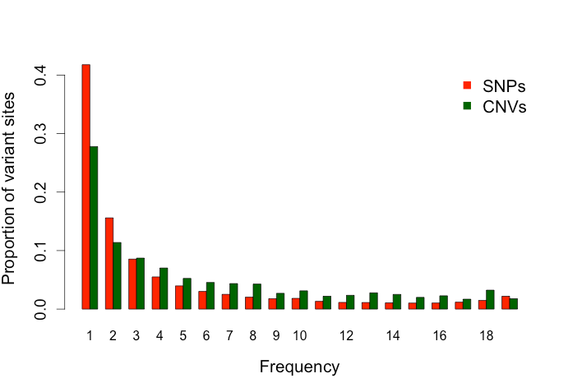
CNV calls and the SFS
As many as 5400 genes segregating as CNV in a single wild population
Most at low copy-number, but apparent excess of medium copy-number variants, neutrality?

Slide 18
CNVs: Pop Gen statistics

Slide 19
maize1 vs maize2
Most CNV cannot be attributed to either sub-genome….
 | CNV | no CNV
maize1 | 248 | 11,942
maize2 | 192 | 6,983
no syntenic ortholog | 4987 | ~15,000
2.0% of genes in maize1 are CNV
2.7% of genes in maize2 are CNV

Slide 20
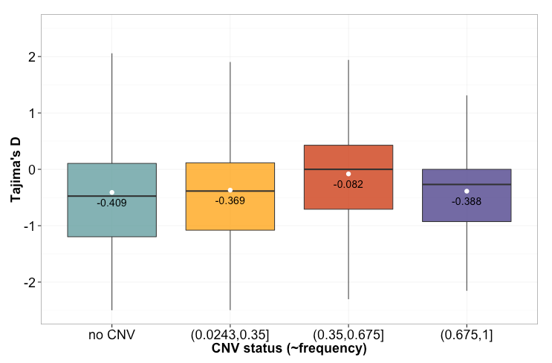
CNVs: Pop Gen statistics
Scored CNV as dominant marker and estimated CNV frequency assuming HWE.
as CNV frequency increases so Tajima’s D becomes more positive..
Surprising down-tick in final category. Is this do do with polarization?

Slide 21
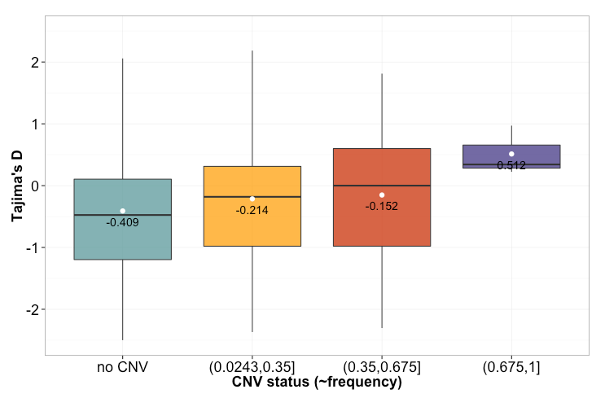
CNVs: Pop Gen statistics
We identified syntenic orthologs in maize and sorghum
Genes in this category described as down CNV are likely deletions in teosinte.

Slide 22
maize1 vs maize2

Slide 23
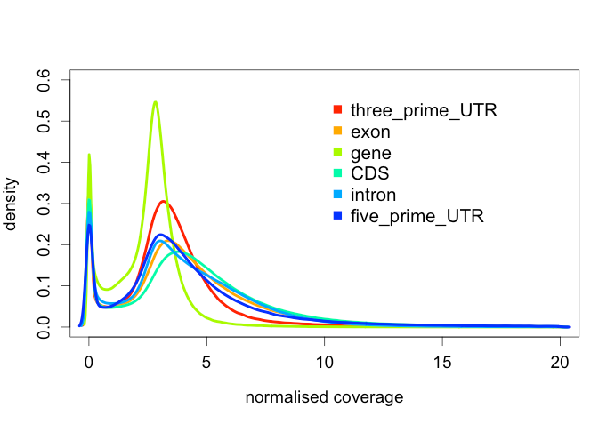
The Future
compare cn.mops to custom approach
use coverage over genes, CDS, exons, introns, UTR ⇒ higher resolution.
looking for selective sweeps using SweepFinder
compare maize1 and maize2 across the above characteristics.

Slide 24
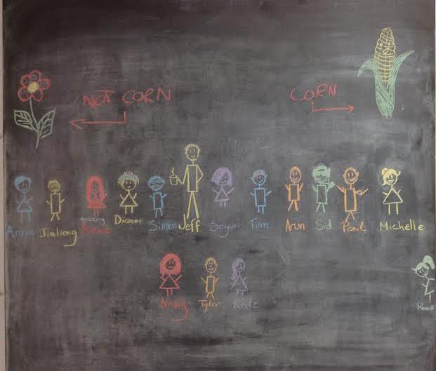
Thank you.. questions/suggestions?

