Slide 1
Differential Privacy Tutorial
Xiaoguang Li

Slide 2
Contents
Intuition and Definition
Common DP Mechanisms
Properties
Numerical Query
Other Composition Theorems
Hierarchy Technique

Slide 3


Intuition and Definition
What is privacy?
Answer: Intuitively, people may consider the privacy as “secret”.
I found smoking leads to lung cancer with high probability
If the hospital reveals the analysis: smoking may lead to cancer, my premium may raise
Hospital
Alice

Slide 4
Intuition and Definition
What is privacy?
Answer: Intuitively, people may consider the privacy as “secret”.
I found smoking leads to lung cancer with high probability
If the hospital reveals the analysis: smoking may lead to cancer, my premium may raise
Hospital
Alice
Question: Does this hospital violate this smoker’s privacy?

Slide 5
Intuition and Definition
What is privacy?
Answer: Intuitively, people may consider the privacy as “secret”.
I found smoking leads to lung cancer with high probability
If the hospital reveals the analysis: smoking may lead to cancer, my premium may raise
Hospital
Alice
If we define “privacy” as this way, no information can be released

Slide 6
Intuition and Definition
What is privacy?
Dwork: Privacy is defined as “opting-out”. The most one can do to protect his privacy is to remove his data out of the dataset.
I found smoking leads to lung cancer with high probability
If the hospital reveals the analysis: smoking may lead to cancer, my premium may raise
Hospital
Alice

Slide 7
Intuition and Definition
What is privacy?
Dwork: Privacy is defined as “opting-out”. The most one can do to protect his privacy is to remove his data out of the dataset.
I found smoking leads to lung cancer with high probability
If the hospital reveals the analysis: smoking may lead to cancer, my premium may raise
Hospital
Alice
Revisit: Does this hospital violate this smoker’s privacy?

Slide 8

Intuition and Definition
What is privacy?
Dwork: Privacy is defined as “opting-out”. The most one can do to protect his privacy is to remove his data out of the dataset.
I found smoking leads to lung cancer with high probability
If the hospital reveals the analysis: smoking may lead to cancer, my premium may raise
Hospital
Any random individual
Revisit: Does this hospital violate this smoker’s privacy?
Dwork: No, the conclusion does not change if the smoker is replaced with any other individual. Thus, the hospital reveals the information about people, but not about the Alice

Slide 9
Intuition and Definition
Revisit: Why is Alice violated even if DP provide privacy guarantee?
I found smoking leads to lung cancer with high probability
If the hospital reveals the analysis: smoking may lead to cancer, my premium may raise
Hospital
Alice

Slide 10
Intuition and Definition
Revisit: Why is Alice violated even if DP provide privacy guarantee?
DP can prevent harm from participation
DP cannot prevent harm from teaching

Slide 11
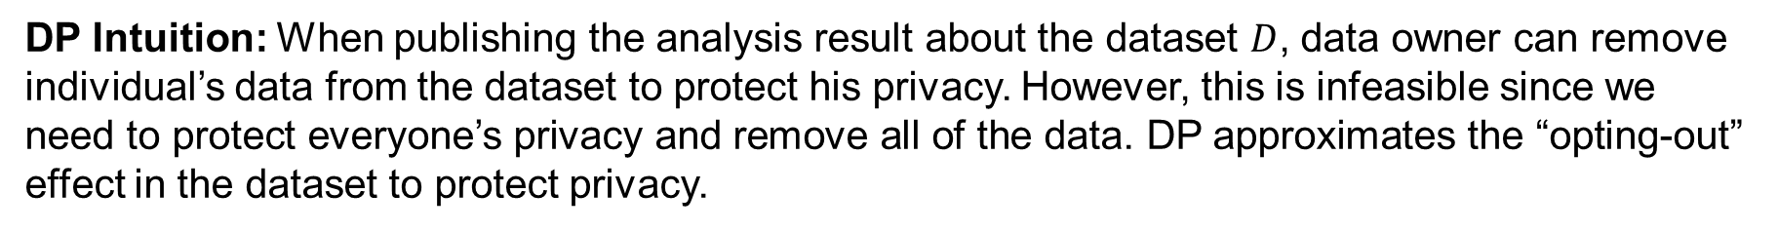
Intuition and Definition
DP Intuition: When publishing the analysis result about the dataset $D$, data owner can remove individual’s data from the dataset to protect his privacy. However, this is infeasible since we need to protect everyone’s privacy and remove all of the data. DP approximates the “opting-out” effect in the dataset to protect privacy.

Slide 12
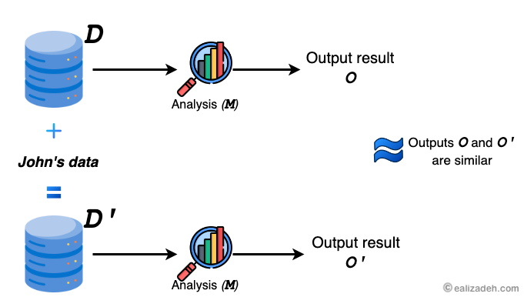
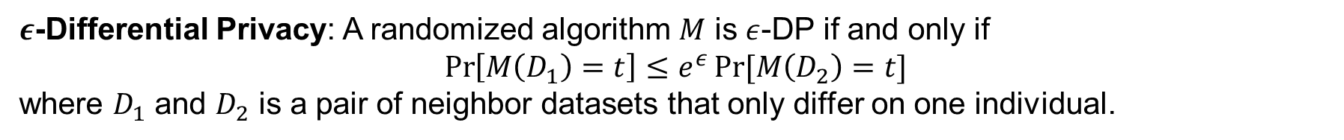
Intuition and Definition
$ε$-Differential Privacy: A randomized algorithm $M$ is $ε$-DP if and only if
$$\operatorname{Pr}\left[M\left(D_{1}\right)=t\right]≤e^{ε}\operatorname{Pr}{[M\left(D_{2}\right)=t]}$$
where $D_{1}$ and $D_{2}$ is a pair of neighbor datasets that only differ on one individual.

Slide 13
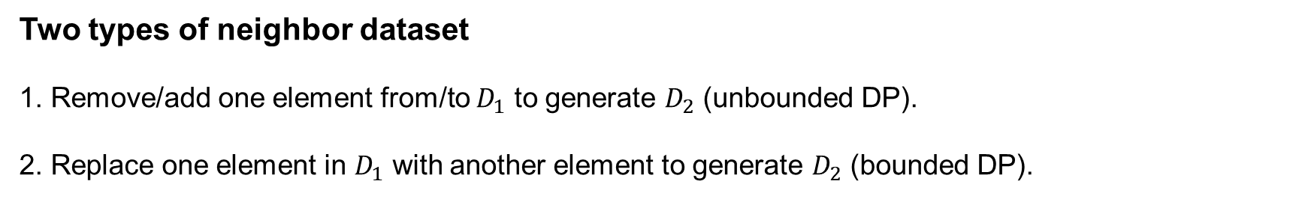
Intuition and Definition
$ε$-Differential Privacy: A randomized algorithm $M$ is $ε$-DP if and only if
$$\operatorname{Pr}\left[M\left(D_{1}\right)=t\right]≤e^{ε}\operatorname{Pr}{[M\left(D_{2}\right)=t]}$$
where $D_{1}$ and $D_{2}$ is a pair of neighbor datasets that only differ on one individual.
Two types of neighbor dataset
1. Remove/add one element from/to $D_{1}$ to generate $D_{2}$ (unbounded DP).
2. Replace one element in $D_{1}$ with another element to generate $D_{2}$ (bounded DP).

Slide 14
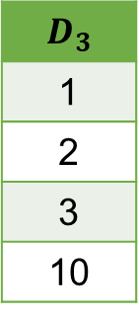
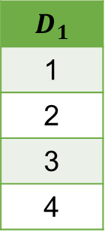
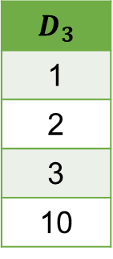
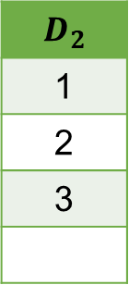
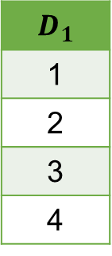
Intuition and Definition
Which definition should we use?
Unbounded DP is a more “fine-grained” definition than bounded DP, since replacing can be achieved by first removing and then adding, but not vice versa.
$$D_{1}$$
1
2
3
4
$$D_{3}$$
1
2
3
10
replace
$$D_{1}$$
1
2
3
4
$$D_{2}$$
1
2
3
$$D_{3}$$
1
2
3
10
remove
add

Slide 15
Intuition and Definition
Which definition should we use?
Theorem 1. Any algorithm $M$ satisfies $ε$-unbounded DP, it also satisfies $2ε$-bounded DP

Slide 16
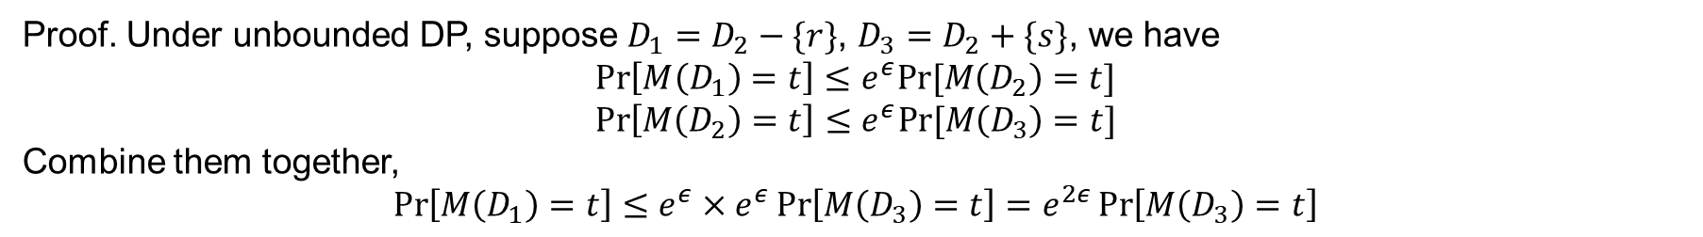
Intuition and Definition
Which definition should we use?
Theorem 1. Any algorithm $M$ satisfies $ε$-unbounded DP, it also satisfies $2ε$-bounded DP
Proof. Under unbounded DP, suppose $D_{1}=D_{2}−\{r\}$, $D_{3}=D_{2}+\{s\}$, we have
$$\operatorname{Pr}\left[M\left(D_{1}\right)=t\right]≤e^{ε}Pr⁡[M\left(D_{2}\right)=t]$$
$$\operatorname{Pr}\left[M\left(D_{2}\right)=t\right]≤e^{ε}Pr⁡[M\left(D_{3}\right)=t]$$
Combine them together,
$$\operatorname{Pr}\left[M\left(D_{1}\right)=t\right]≤e^{ε}×e^{ε}\operatorname{Pr}\left[M\left(D_{3}\right)=t\right]=e^{2ε}\operatorname{Pr}\left[M\left(D_{3}\right)=t\right]$$

Slide 17
Intuition and Definition
Which definition should we use?
Theorem 2. Parallel composition does not hold for bounded DP
Proof. See it later…

Slide 18
Contents
Intuition and Definition
Common DP Mechanisms
Properties
Numerical Query
Other Composition Theorems
Hierarchy Technique

Slide 19
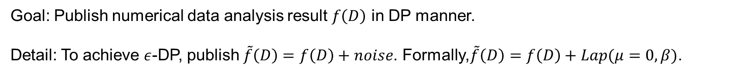
Laplace mechanism
Goal: Publish numerical data analysis result $f\left(D\right)$ in DP manner.
Detail: To achieve $ε$-DP, publish $\tilde{f}\left(D\right)=f\left(D\right)+noise$. Formally,$\tilde{f}\left(D\right)=f\left(D\right)+Lap(μ=0,β)\text{.}$

Slide 20
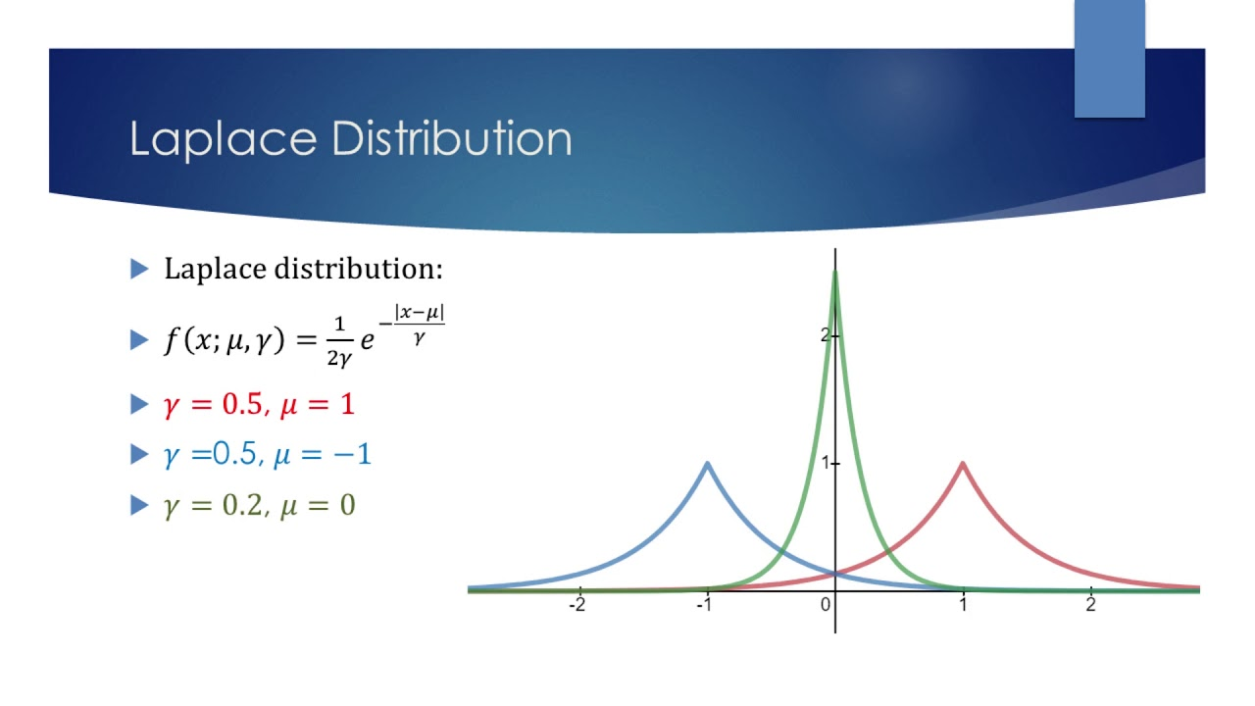
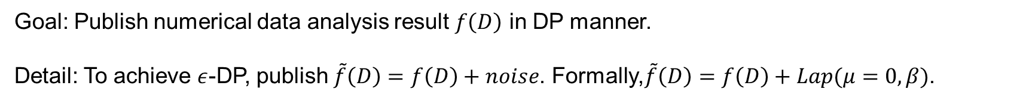
Laplace mechanism
Goal: Publish numerical data analysis result $f\left(D\right)$ in DP manner.
Detail: To achieve $ε$-DP, publish $\tilde{f}\left(D\right)=f\left(D\right)+noise$. Formally,$\tilde{f}\left(D\right)=f\left(D\right)+Lap(μ=0,β)$.

Slide 21


Laplace mechanism
Goal: Publish numerical data analysis result $f\left(D\right)$ in DP manner.
Detail: To achieve $ε$-DP, publish $\tilde{f}\left(D\right)=f\left(D\right)+noise$. Formally,$\tilde{f}\left(D\right)=f\left(D\right)+Lap(β)$.
What parameter $β$ can achieve $ε$-DP?
$$\frac{Pr⁡[\tilde{f}\left(D_{1}\right)=t]}{Pr⁡[\tilde{f}\left(D_{2}\right)=t]}≤e^{ε}$$
$$⇒\frac{Pr⁡[f\left(D_{1}\right)+Lap\left(β\right)=t]}{\operatorname{Pr}{[f\left(D_{2}\right)+Lap\left(β\right)=t]}}≤e^{ε}$$
$$⇒ \frac{Pr⁡[Lap\left(β\right)=t−f\left(D_{1}\right)]}{\operatorname{Pr}{[Lap\left(β\right)=t−f\left(D_{2}\right)]}}≤e^{ε}$$
$$⇒ \frac{Pr⁡[Lap\left(β\right)=x]}{\operatorname{Pr}{[Lap\left(β\right)=x+f\left(D_{1}\right)−f(D_{2})]}}≤e^{ε}$$

Slide 22

Laplace mechanism
Goal: Publish numerical data analysis result $f\left(D\right)$ in DP manner.
Detail: To achieve $ε$-DP, publish $\tilde{f}\left(D\right)=f\left(D\right)+noise$. Formally,$\tilde{f}\left(D\right)=f\left(D\right)+Lap(β)$.
What parameter $β$ can achieve $ε$-DP?
$$\frac{Pr⁡[Lap\left(β\right)=x]}{\operatorname{Pr}{[Lap\left(β\right)=x+f\left(D_{1}\right)−f(D_{2})]}}=\frac{e^{−|x|/β}}{e^{−|x+d|/β}}=e^{\left(\left|x+d\right|−\left|x\right|\right)/β}≤e^{|d|/β}$$
$$d$$

Slide 23

Laplace mechanism
Goal: Publish numerical data analysis result $f\left(D\right)$ in DP manner.
Detail: To achieve $ε$-DP, publish $\tilde{f}\left(D\right)=f\left(D\right)+noise$. Formally,$\tilde{f}\left(D\right)=f\left(D\right)+Lap(β)$.
What parameter $β$ can achieve $ε$-DP?
Denote $Δf=\max_{D_{1},D_{2}}{|f\left(D_{1}\right)−f(D_{2})|}$, we have $d≤Δf$
$$\frac{Pr⁡[Lap\left(β\right)=x]}{\operatorname{Pr}{[Lap\left(β\right)=x+f\left(D_{1}\right)−f(D_{2})]}}=\frac{e^{−|x|/β}}{e^{−|x+d|/β}}=e^{\left(\left|x+d\right|−\left|x\right|\right)/β}≤e^{\frac{\left|d\right|}{β}}≤e^{\frac{Δf}{β}}$$
$$d$$
Let $\frac{Δf}{β}=ε$, noise $Lap(\frac{Δf}{ε})$ can achieve $ε$-DP

Slide 24
Laplace mechanism
We just involve a new term $Δf=\max_{D_{1},D_{2}}{|f\left(D_{1}\right)−f(D_{2})|}$
Global Sensitivity. Let $D_{1}$ and $D_{2}$ are neighbor datasets, global sensitivity of a function $f$ is
$$Δf=\max_{D_{1},D_{2}}{|f\left(D_{1}\right)−f(D_{2})|}$$

Slide 25
Laplace mechanism
We just involve a new term $Δf=\max_{D_{1},D_{2}}{|f\left(D_{1}\right)−f(D_{2})|}$
Global Sensitivity. Let $D_{1}$ and $D_{2}$ are neighbor datasets, global sensitivity of a function $f$ is
$$Δf=\max_{D_{1},D_{2}}{|f\left(D_{1}\right)−f(D_{2})|}$$
Benefits: Global sensitivity is independent of dataset, so the privacy guarantee only depends on the mechanism itself.

Slide 26
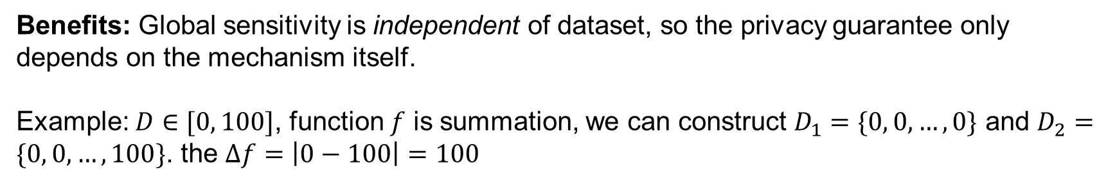
Laplace mechanism
We just involve a new term $Δf=\max_{D_{1},D_{2}}{|f\left(D_{1}\right)−f(D_{2})|}$
Global Sensitivity. Let $D_{1}$ and $D_{2}$ are neighbor datasets, global sensitivity of a function $f$ is
$$Δf=\max_{D_{1},D_{2}}{|f\left(D_{1}\right)−f(D_{2})|}$$
Benefits: Global sensitivity is independent of dataset, so the privacy guarantee only depends on the mechanism itself.
Example: $D∈[0, 100]$, function $f$ is summation, we can construct $D_{1}=\{0, 0,…,0\}$ and $D_{2}=\{0, 0,…,100\}$. the $Δf=\left|0−100\right|=100$

Slide 27

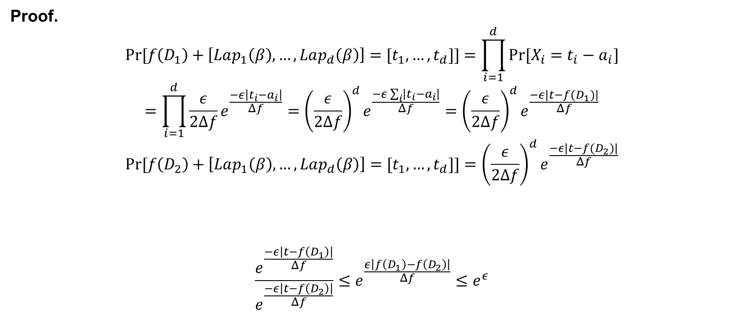
Laplace mechanism—vector case
Laplace mechanism can also be applied to function $f$ that outputs a vector result $[r_{1},…,r_{d}]$
To achieve $ε$-DP, publish $\tilde{f}\left(D\right)=f\left(D\right)+[Lap_{1}\left(β\right),…,Lap_{d}\left(β\right)]$.
Proof.
$$Pr⁡[f\left(D_{1}\right)+\left[Lap_{1}\left(β\right),…,Lap_{d}\left(β\right)\right]=[t_{1},…,t_{d}]]=\prod_{i=1}^{d}{Pr⁡[X_{i}=t_{i}−a_{i}]}$$
$$=\prod_{i=1}^{d}{\frac{ε}{2Δf}e^{\frac{−ε\left|t_{i}−a_{i}\right|}{Δf}}}={\left(\frac{ε}{2Δf}\right)}^{d}e^{\frac{−ε\sum_{i}{\left|t_{i}−a_{i}\right|}}{Δf}}={\left(\frac{ε}{2Δf}\right)}^{d}e^{\frac{−ε|t−f(D_{1})|}{Δf}}$$
$$Pr⁡[f\left(D_{2}\right)+\left[Lap_{1}\left(β\right),…,Lap_{d}\left(β\right)\right]=[t_{1},…,t_{d}]]={\left(\frac{ε}{2Δf}\right)}^{d}e^{\frac{−ε|t−f(D_{2})|}{Δf}}$$
$$\frac{e^{\frac{−ε\left|t−f\left(D_{1}\right)\right|}{Δf}}}{e^{\frac{−ε\left|t−f\left(D_{2}\right)\right|}{Δf}}}≤e^{\frac{ε\left|f\left(D_{1}\right)−f\left(D_{2}\right)\right|}{Δf}}≤e^{ε}$$
$$≤Δf$$

Slide 28
Laplace mechanism—example
Histogram Publish
ID | Age
1 | 10
2 | 21
3 | 35
…
n | 18
DP
0-10
10-20
….
40-50
0-10
10-20
….
40-50

Slide 29
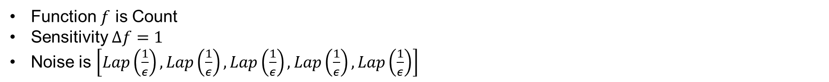
Laplace mechanism—example
Histogram Publish
ID | Age
1 | 10
2 | 21
3 | 35
…
n | 18
DP
0-10
10-20
….
40-50
0-10
10-20
….
40-50
Function $f$ is Count
Sensitivity $Δf=1$
Noise is $\left[Lap\left(\frac{1}{ε}\right),Lap\left(\frac{1}{ε}\right),Lap\left(\frac{1}{ε}\right),Lap\left(\frac{1}{ε}\right),Lap\left(\frac{1}{ε}\right)\right]$

Slide 30
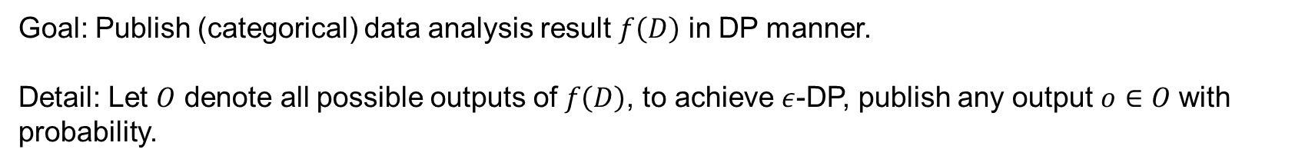
Exponential mechanism
Goal: Publish (categorical) data analysis result $f\left(D\right)$ in DP manner.
Detail: Let $O$ denote all possible outputs of $f\left(D\right)$, to achieve $ε$-DP, publish any output $o∈O$ with probability.

Slide 31

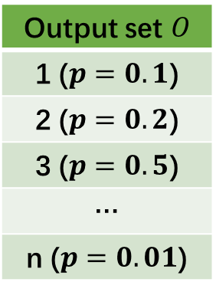
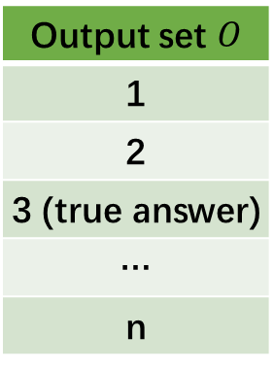

Exponential mechanism—toy example
Goal: Publish (categorical) data analysis result $f\left(D\right)$ in DP manner.
Detail: Let $O$ denote all possible outputs of $f\left(D\right)$, to achieve $ε$-DP, publish any output $o∈O$ with probability.
$f\left(D\right)$: how many people are 20-years-old
ID | Age
1 | 10
2 | 21
3 | 35
…
n | 18
Output set $O$
1
2
3 (true answer)
…
n
Output set $O$
1 ($p=0.1$)
2 ($p=0.2$)
3 ($p=0.5$)
…
n ($p=0.01$)
$f\left(D\right)$
Calculate prob.

Slide 32
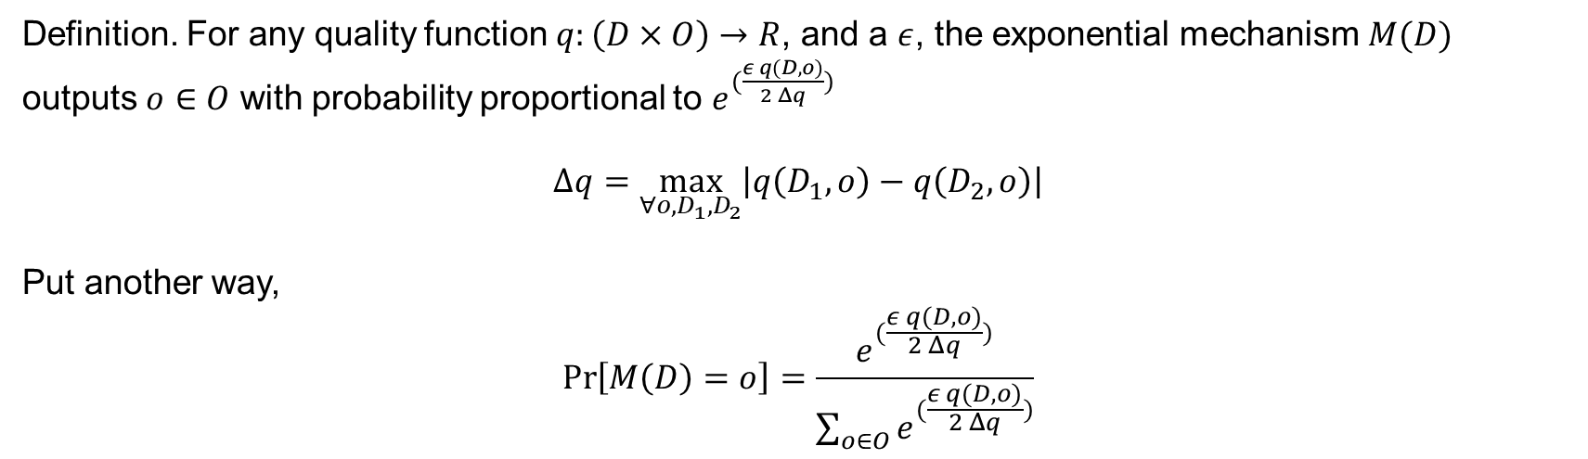
Exponential mechanism
Definition. For any quality function $q:\left(D×O\right)→R$, and a $ε$, the exponential mechanism $M(D)$ outputs $o∈O$ with probability proportional to $e^{(\frac{ε q(D,o)}{2 Δq})}$
$$Δq=\max_{∀o,D_{1},D_{2}}\left|q\left(D_{1},o\right)−q\left(D_{2},o\right)\right|$$
Put another way,
$$\operatorname{Pr}\left[M\left(D\right)=o\right]=\frac{e^{(\frac{ε q(D,o)}{2 Δq})}}{\sum_{o∈O}{e^{(\frac{ε q(D,o)}{2 Δq})}}}$$

Slide 33
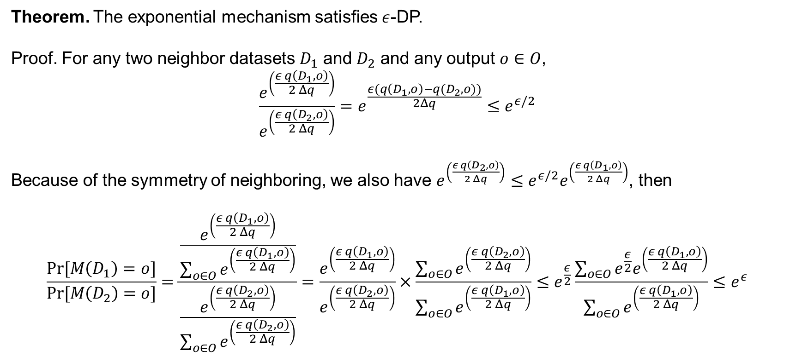
Exponential mechanism
Theorem. The exponential mechanism satisfies $ε$-DP.
Proof. For any two neighbor datasets $D_{1}$ and $D_{2}$ and any output $o∈O$,
$$\frac{e^{\left(\frac{ε q\left(D_{1},o\right)}{2 Δq}\right)}}{e^{\left(\frac{ε q\left(D_{2},o\right)}{2 Δq}\right)}}=e^{\frac{ε(q\left(D_{1},o\right)−q(D_{2},o))}{2Δq}}≤e^{ε/2}$$
Because of the symmetry of neighboring, we also have $e^{\left(\frac{ε q\left(D_{2},o\right)}{2 Δq}\right)}≤e^{ε/2}e^{\left(\frac{ε q\left(D_{1},o\right)}{2 Δq}\right)}$, then
$$\frac{Pr⁡[M\left(D_{1}\right)=o]}{Pr⁡[M\left(D_{2}\right)=o]}=\frac{\frac{e^{\left(\frac{ε q\left(D_{1},o\right)}{2 Δq}\right)}}{\sum_{o∈O}{e^{\left(\frac{ε q\left(D_{1},o\right)}{2 Δq}\right)}}}}{\frac{e^{\left(\frac{ε q\left(D_{2},o\right)}{2 Δq}\right)}}{\sum_{o∈O}{e^{\left(\frac{ε q\left(D_{2},o\right)}{2 Δq}\right)}}}}=\frac{e^{\left(\frac{ε q\left(D_{1},o\right)}{2 Δq}\right)}}{e^{\left(\frac{ε q\left(D_{2},o\right)}{2 Δq}\right)}}×\frac{\sum_{o∈O}{e^{\left(\frac{ε q\left(D_{2},o\right)}{2 Δq}\right)}}}{\sum_{o∈O}{e^{\left(\frac{ε q\left(D_{1},o\right)}{2 Δq}\right)}}}≤e^{\frac{ε}{2}}\frac{\sum_{o∈O}{e^{\frac{ε}{2}}e^{\left(\frac{ε q\left(D_{1},o\right)}{2 Δq}\right)}}}{\sum_{o∈O}{e^{\left(\frac{ε q\left(D_{1},o\right)}{2 Δq}\right)}}}≤e^{ε}$$

Slide 34
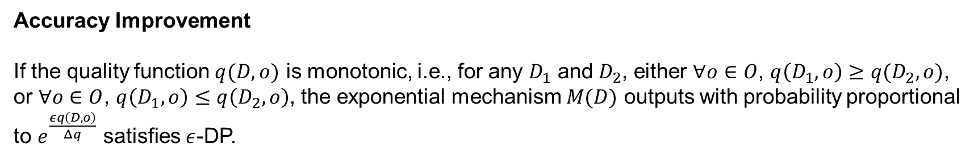
Exponential mechanism
Accuracy Improvement
If the quality function $q(D,o)$ is monotonic, i.e., for any $D_{1}$ and $D_{2}$, either $∀o∈O$, $q\left(D_{1},o\right)≥q(D_{2},o)$, or $∀o∈O$, $q\left(D_{1},o\right)≤q\left(D_{2},o\right)$, the exponential mechanism $M(D)$ outputs with probability proportional to $e^{\frac{εq\left(D,o\right)}{Δq}}$ satisfies $ε$-DP.

Slide 35
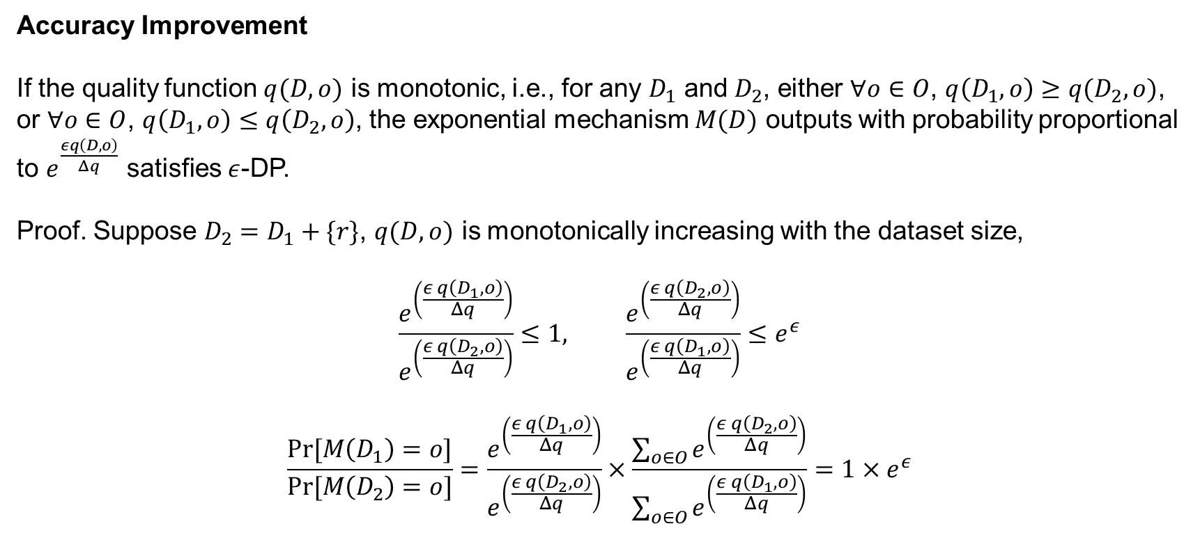
Exponential mechanism
Accuracy Improvement
If the quality function $q(D,o)$ is monotonic, i.e., for any $D_{1}$ and $D_{2}$, either $∀o∈O$, $q\left(D_{1},o\right)≥q(D_{2},o)$, or $∀o∈O$, $q\left(D_{1},o\right)≤q\left(D_{2},o\right)$, the exponential mechanism $M(D)$ outputs with probability proportional to $e^{\frac{εq\left(D,o\right)}{Δq}}$ satisfies $ε$-DP.
Proof. Suppose $D_{2}=D_{1}+\{r\}$, $q(D,o)$ is monotonically increasing with the dataset size,
$$\frac{e^{\left(\frac{ε q\left(D_{1},o\right)}{Δq}\right)}}{e^{\left(\frac{ε q\left(D_{2},o\right)}{Δq}\right)}}≤1, \frac{e^{\left(\frac{ε q\left(D_{2},o\right)}{Δq}\right)}}{e^{\left(\frac{ε q\left(D_{1},o\right)}{Δq}\right)}}≤e^{ε}$$
$$\frac{Pr⁡[M\left(D_{1}\right)=o]}{Pr⁡[M\left(D_{2}\right)=o]}=\frac{e^{\left(\frac{ε q\left(D_{1},o\right)}{Δq}\right)}}{e^{\left(\frac{ε q\left(D_{2},o\right)}{Δq}\right)}}×\frac{\sum_{o∈O}{e^{\left(\frac{ε q\left(D_{2},o\right)}{Δq}\right)}}}{\sum_{o∈O}{e^{\left(\frac{ε q\left(D_{1},o\right)}{Δq}\right)}}}=1×e^{ε}$$

Slide 36
Exponential mechanism—example
Mode Publish
Suppose a dataset $D∈[0, 1000000]$, we want to publish the mode of $D$ using exponential mechanism.

Slide 37
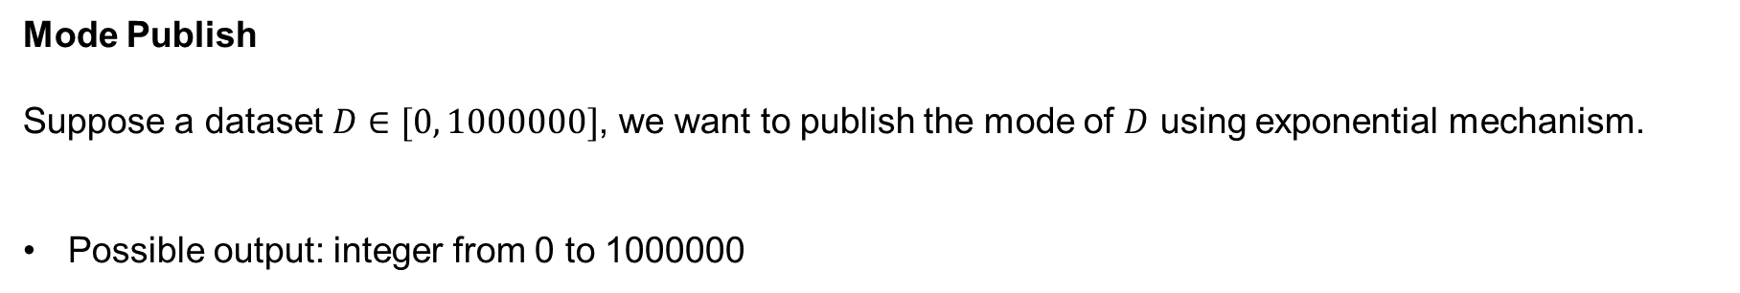
Exponential mechanism—example
Mode Publish
Suppose a dataset $D∈[0, 1000000]$, we want to publish the mode of $D$ using exponential mechanism.
Possible output: integer from 0 to 1000000

Slide 38
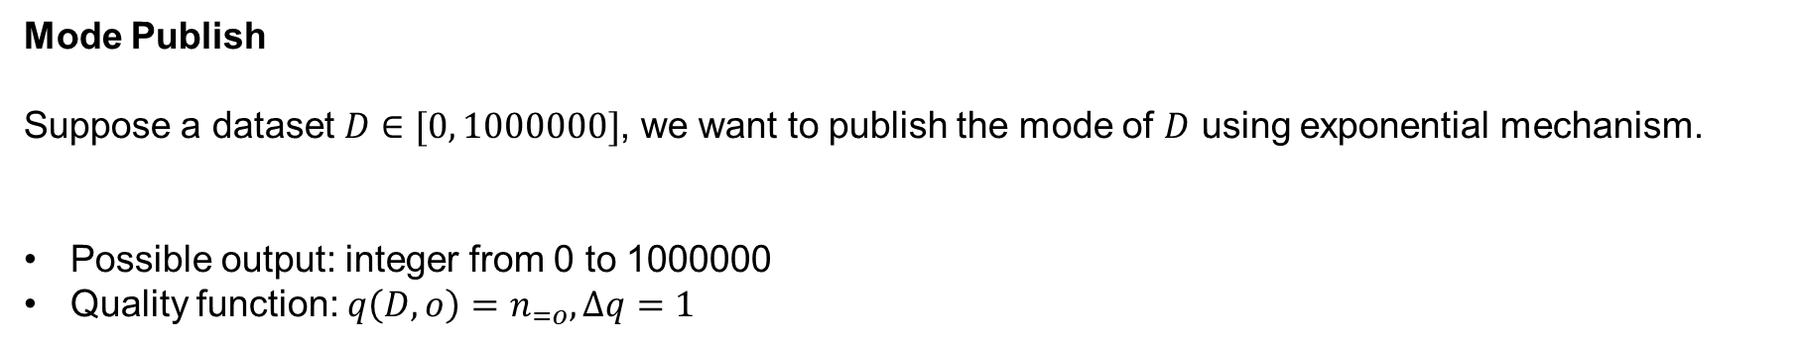
Exponential mechanism—example
Mode Publish
Suppose a dataset $D∈[0, 1000000]$, we want to publish the mode of $D$ using exponential mechanism.
Possible output: integer from 0 to 1000000
Quality function: $q\left(D,o\right)=n_{=o}, Δq=1$

Slide 39
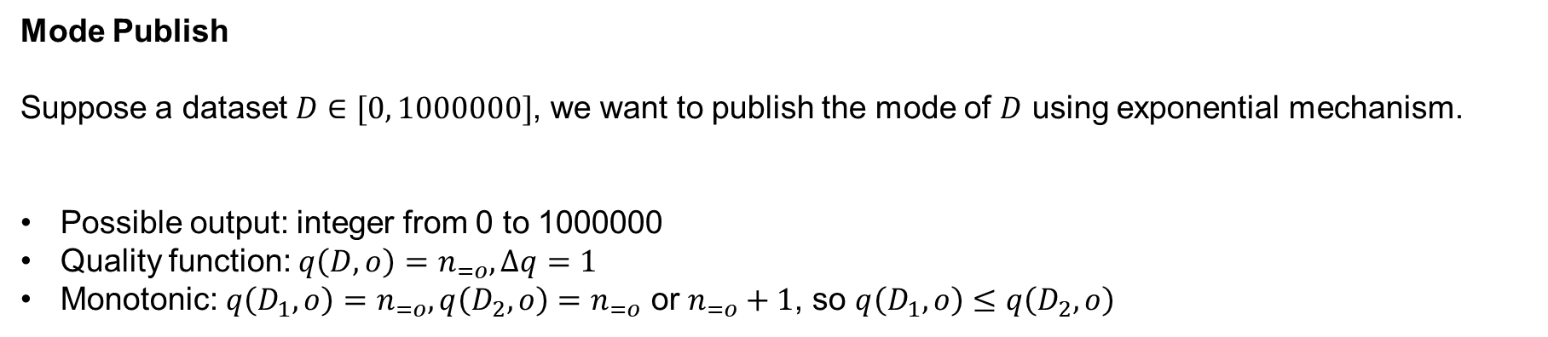
Exponential mechanism—example
Mode Publish
Suppose a dataset $D∈[0, 1000000]$, we want to publish the mode of $D$ using exponential mechanism.
Possible output: integer from 0 to 1000000
Quality function: $q\left(D,o\right)=n_{=o}, Δq=1$
Monotonic: $q\left(D_{1},o\right)=n_{=o},q\left(D_{2},o\right)=n_{=o}$ or $n_{=o}+1$, so $q\left(D_{1},o\right)≤q\left(D_{2},o\right)$

Slide 40
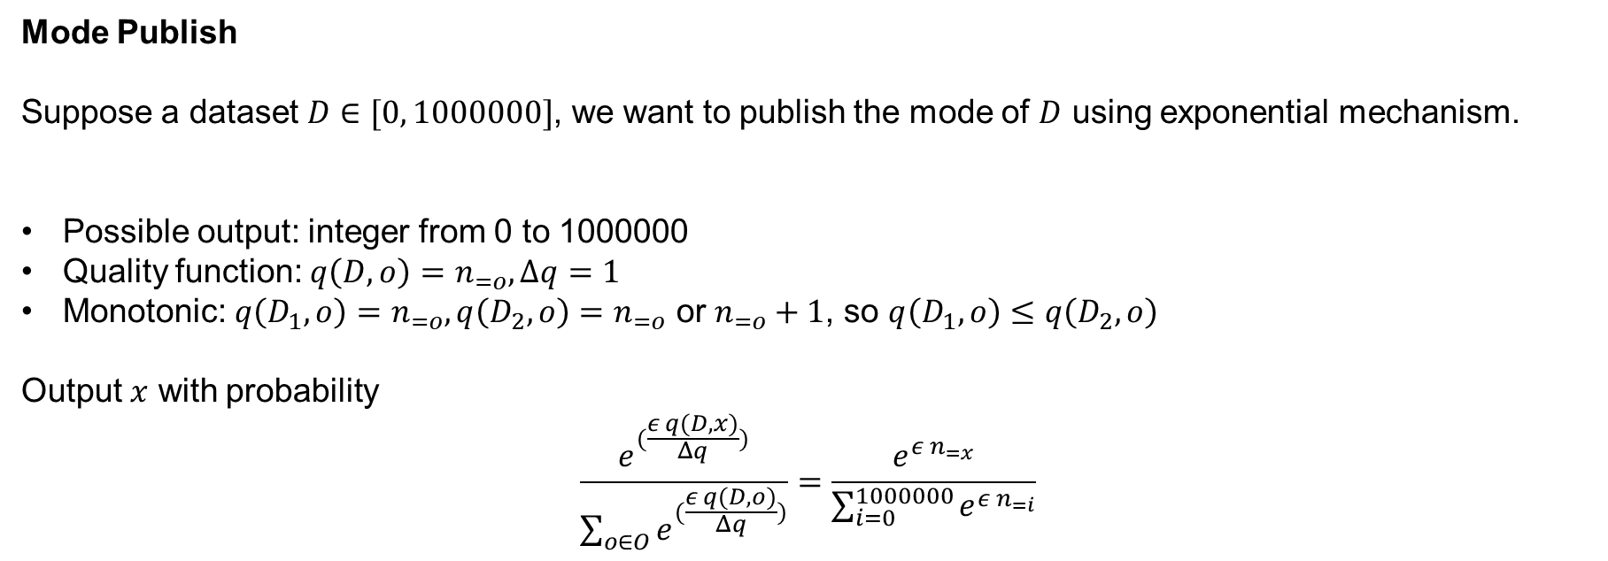
Exponential mechanism—example
Mode Publish
Suppose a dataset $D∈[0, 1000000]$, we want to publish the mode of $D$ using exponential mechanism.
Possible output: integer from 0 to 1000000
Quality function: $q\left(D,o\right)=n_{=o},Δq=1$
Monotonic: $q\left(D_{1},o\right)=n_{=o},q\left(D_{2},o\right)=n_{=o}$ or $n_{=o}+1$, so $q\left(D_{1},o\right)≤q\left(D_{2},o\right)$
Output $x$ with probability
$$\frac{e^{(\frac{ε q(D,x)}{Δq})}}{\sum_{o∈O}{e^{(\frac{ε q(D,o)}{Δq})}}}=\frac{e^{ε n_{=x}}}{\sum_{i=0}^{1000000}{e^{ε n_{=i}}}}$$

Slide 41
Contents
Intuition and Definition
Common DP Mechanisms
Properties
Numerical Query
Other Composition Theorems
Hierarchy Technique

Slide 42
Properties
Question: Can we use differentially private result arbitrarily?

Slide 43
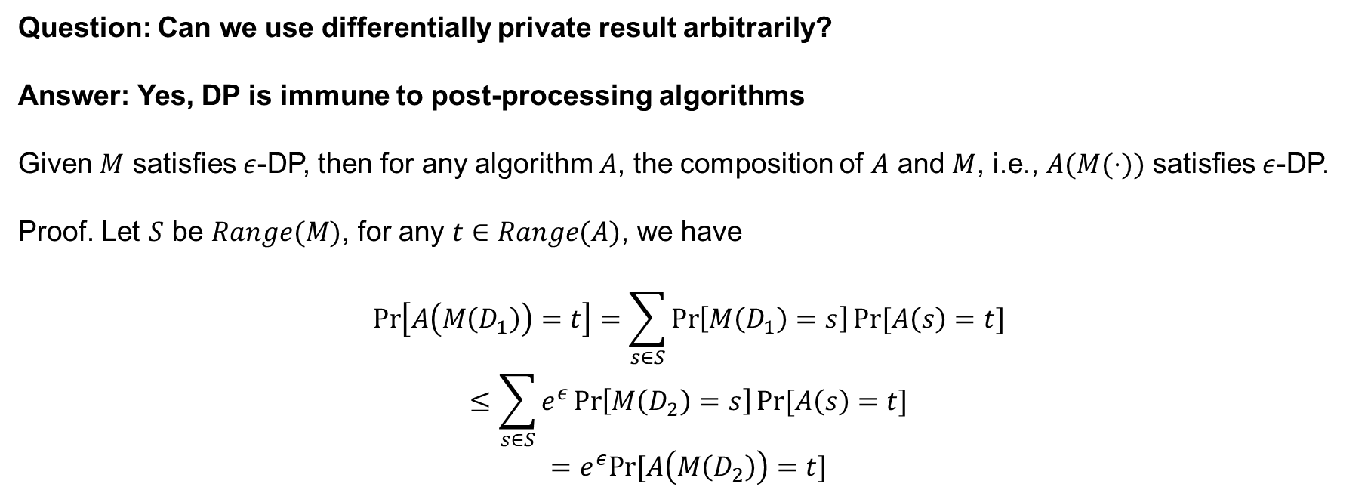
Properties
Question: Can we use differentially private result arbitrarily?
Answer: Yes, DP is immune to post-processing algorithms
Given $M$ satisfies $ε$-DP, then for any algorithm $A$, the composition of $A$ and $M$, i.e., $A(M(⋅))$ satisfies $ε$-DP.
Proof. Let $S$ be $Range(M)$, for any $t∈Range(A)$, we have
$$\operatorname{Pr}\left[A\left(M\left(D_{1}\right)\right)=t\right]=\sum_{s∈S}{\operatorname{Pr}\left[M\left(D_{1}\right)=s\right]Pr⁡[A\left(s\right)=t]}$$
$$≤\sum_{s∈S}{e^{ε}\operatorname{Pr}\left[M\left(D_{2}\right)=s\right]Pr⁡[A\left(s\right)=t]}$$
$$=e^{ε}Pr⁡[A\left(M\left(D_{2}\right)\right)=t]$$
Notice: Algorithm $A$ can only access the output of $M$!

Slide 44



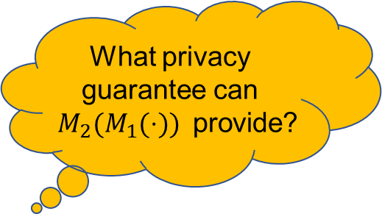
Properties
Question: Can we use DP mechanism multiple times?
What privacy guarantee can $M_{2}(M_{1}(⋅))$ provide?
Dataset
$$M_{1}$$
$$M_{2}$$

Slide 45
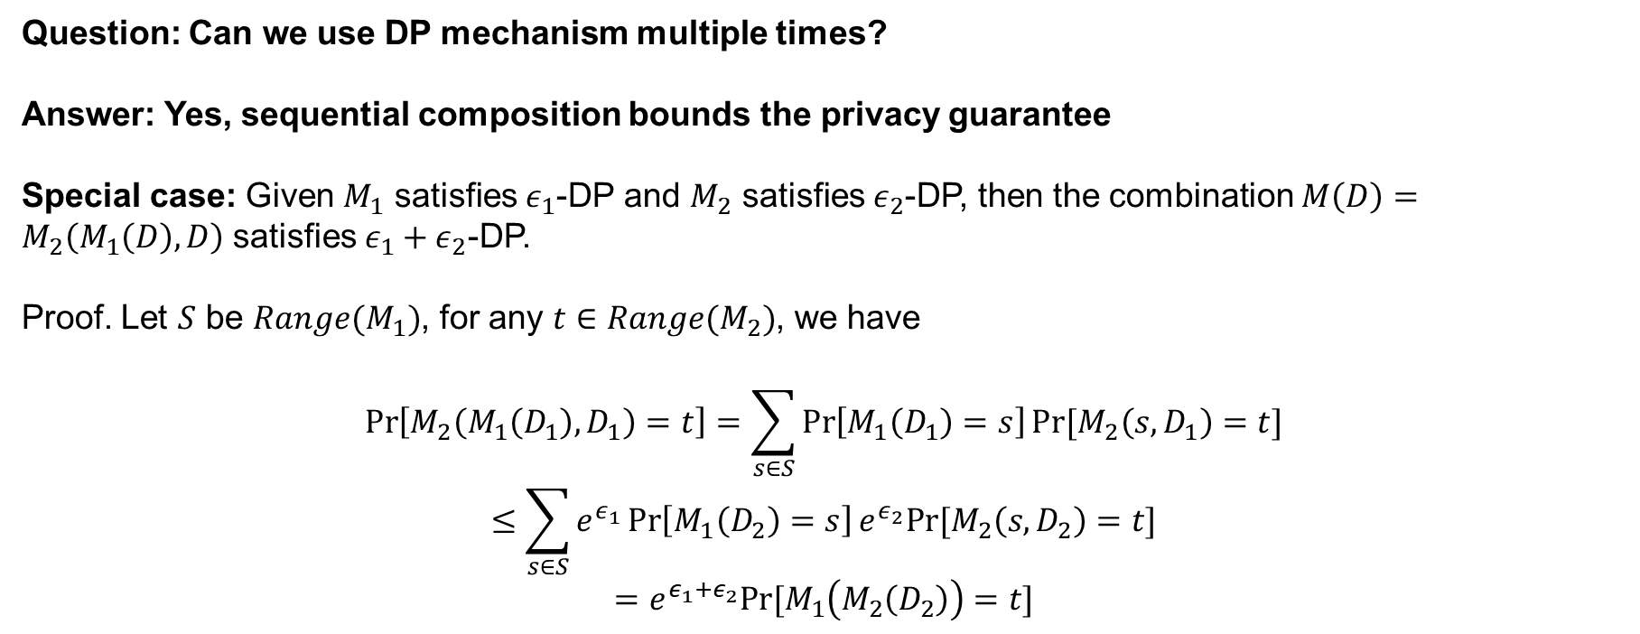
Properties
Question: Can we use DP mechanism multiple times?
Answer: Yes, sequential composition bounds the privacy guarantee
Special case: Given $M_{1}$ satisfies $ε_{1}$-DP and $M_{2}$ satisfies $ε_{2}$-DP, then the combination $M\left(D\right)=M_{2}\left(M_{1}\left(D\right), D\right)$ satisfies $ε_{1}+ε_{2}$-DP.
Proof. Let $S$ be $Range(M_{1})$, for any $t∈Range(M_{2})$, we have
$$\operatorname{Pr}\left[M_{2}\left(M_{1}\left(D_{1}\right),D_{1}\right)=t\right]=\sum_{s∈S}{\operatorname{Pr}\left[M_{1}\left(D_{1}\right)=s\right]Pr⁡[M_{2}\left(s,D_{1}\right)=t]}$$
$$≤\sum_{s∈S}{e^{ε_{1}}\operatorname{Pr}\left[M_{1}\left(D_{2}\right)=s\right]e^{ε_{2}}Pr⁡[M_{2}\left(s,D_{2}\right)=t]}$$
$$=e^{ε_{1}+ε_{2}}Pr⁡[M_{1}\left(M_{2}\left(D_{2}\right)\right)=t]$$

Slide 46
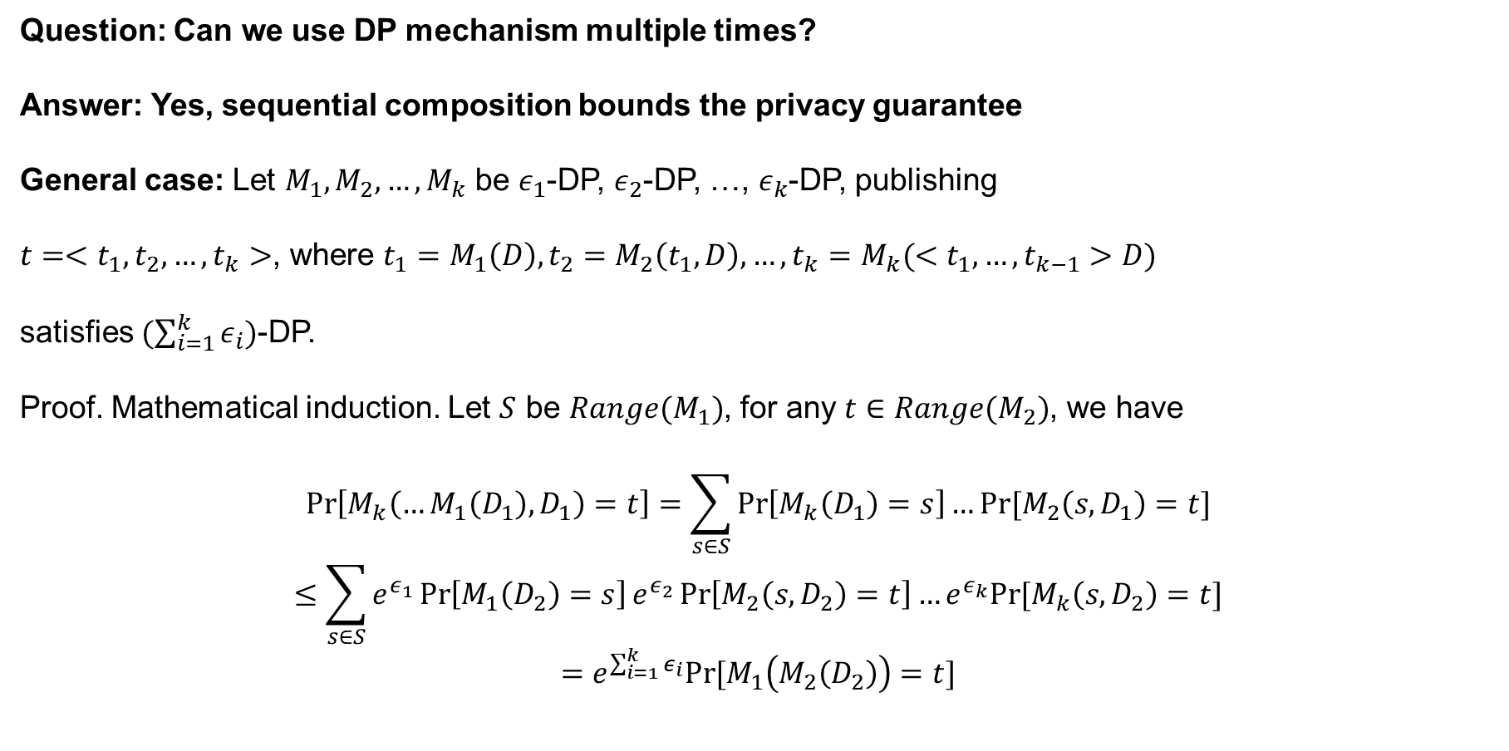
Properties
Question: Can we use DP mechanism multiple times?
Answer: Yes, sequential composition bounds the privacy guarantee
General case: Let $M_{1},M_{2},…,M_{k}$ be $ε_{1}$-DP, $ε_{2}$-DP, …, $ε_{k}$-DP, publishing
$t=<t_{1},t_{2},…,t_{k}>$, where $t_{1}=M_{1}\left(D\right), t_{2}=M_{2}\left(t_{1},D\right),…,t_{k}=M_{k}(<t_{1},…,t_{k−1}>D)$
satisfies $(\sum_{i=1}^{k}{ε_{i}})$-DP.
Proof. Mathematical induction. Let $S$ be $Range(M_{1})$, for any $t∈Range(M_{2})$, we have
$$\operatorname{Pr}\left[M_{k}\left(…M_{1}\left(D_{1}\right),D_{1}\right)=t\right]=\sum_{s∈S}{\operatorname{Pr}\left[M_{k}\left(D_{1}\right)=s\right]…Pr⁡[M_{2}\left(s,D_{1}\right)=t]}$$
$$≤\sum_{s∈S}{e^{ε_{1}}\operatorname{Pr}\left[M_{1}\left(D_{2}\right)=s\right]e^{ε_{2}}\operatorname{Pr}\left[M_{2}\left(s,D_{2}\right)=t\right]…e^{ε_{k}}Pr⁡[M_{k}\left(s,D_{2}\right)=t]}$$
$$=e^{\sum_{i=1}^{k}{ε_{i}}}Pr⁡[M_{1}\left(M_{2}\left(D_{2}\right)\right)=t]$$

Slide 47




Properties
Compare post-processing with sequential composition
Post processing
Sequential composition
Dataset
Dataset
$$M_{1}$$
$$M_{1}$$
$$A$$
$$M_{2}$$
Post-processing cannot access dataset
Sequential composition requires to access dataset

Slide 48





Properties
Question: What if multiple mechanisms access disjoint parts of dataset?
What privacy guarantee can
$M_{4}(…M_{1}(⋅))$
provide?
Part 1
$$M_{1}$$
Part 2
$$M_{2}$$
Part 3
$$M_{3}$$
Part 4
$$M_{4}$$
Dataset

Slide 49
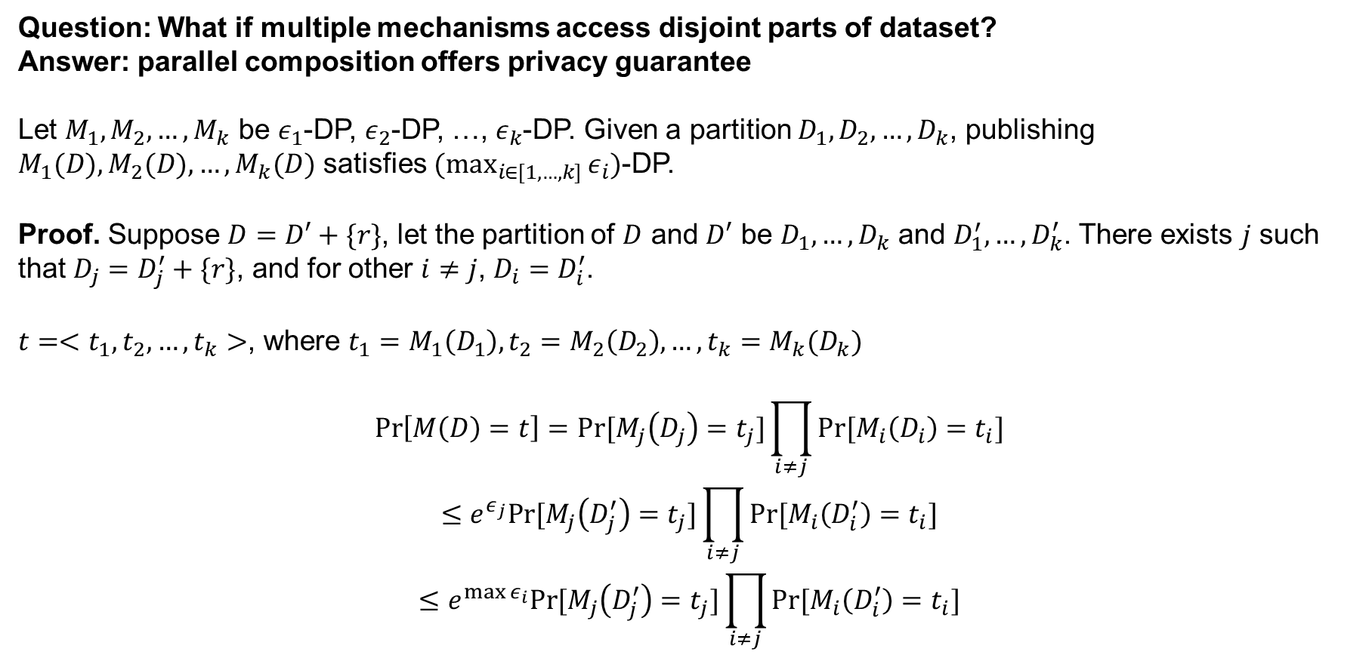
Properties
Question: What if multiple mechanisms access disjoint parts of dataset?
Answer: parallel composition offers privacy guarantee
Let $M_{1},M_{2},…,M_{k}$ be $ε_{1}$-DP, $ε_{2}$-DP, …, $ε_{k}$-DP. Given a partition $D_{1},D_{2},…,D_{k}$, publishing $M_{1}(D),M_{2}(D),…,M_{k}(D)$ satisfies $(\max_{i∈[1,…,k]}{ε_{i}})$-DP.
Proof. Suppose $D=D′+\{r\}$, let the partition of $D$ and $D′$ be $D_{1},…,D_{k}$ and $D_{1}^{′},…,D_{k}^{′}$. There exists $j$ such that $D_{j}=D_{j}^{′}+\{r\}$, and for other $i≠j$, $D_{i}=D_{i}^{′}$.
$t=<t_{1},t_{2},…,t_{k}>$, where $t_{1}=M_{1}\left(D_{1}\right), t_{2}=M_{2}\left(D_{2}\right),…,t_{k}=M_{k}(D_{k})$
$$\operatorname{Pr}\left[M\left(D\right)=t\right]=Pr⁡[M_{j}\left(D_{j}\right)=t_{j}]\prod_{i≠j}{Pr⁡[M_{i}\left(D_{i}\right)=t_{i}]}$$
$$≤e^{ε_{j}}Pr⁡[M_{j}\left(D_{j}^{′}\right)=t_{j}]\prod_{i≠j}{Pr⁡[M_{i}\left(D_{i}^{′}\right)=t_{i}]}$$
$$≤e^{\max{ε_{i}}}Pr⁡[M_{j}\left(D_{j}^{′}\right)=t_{j}]\prod_{i≠j}{Pr⁡[M_{i}\left(D_{i}^{′}\right)=t_{i}]}$$

Slide 50
Properties
Question: What if multiple mechanisms access disjoint parts of dataset?
Answer: parallel composition offers privacy guarantee
Let $M_{1},M_{2},…,M_{k}$ be $ε_{1}$-DP, $ε_{2}$-DP, …, $ε_{k}$-DP. Given a partition $D_{1},D_{2},…,D_{k}$, publishing $M_{1}(D),M_{2}(D),…,M_{k}(D)$ satisfies $(\max_{i∈[1,…,k]}{ε_{i}})$-DP.
Proof. Suppose $D=D′+\{r\}$, let the partition of $D$ and $D′$ be $D_{1},…,D_{k}$ and $D_{1}^{′},…,D_{k}^{′}$. There exists $j$ such that $D_{j}=D_{j}^{′}+\{r\}$, and for other $i≠j$, $D_{i}=D_{i}^{′}$.
$t=<t_{1},t_{2},…,t_{k}>$, where $t_{1}=M_{1}\left(D_{1}\right), t_{2}=M_{2}\left(D_{2}\right),…,t_{k}=M_{k}(D_{k})$
$$\operatorname{Pr}\left[M\left(D\right)=t\right]=Pr⁡[M_{j}\left(D_{j}\right)=t_{j}]\prod_{i≠j}{Pr⁡[M_{i}\left(D_{i}\right)=t_{i}]}$$
$$≤e^{ε_{j}}Pr⁡[M_{j}\left(D_{j}^{′}\right)=t_{j}]\prod_{i≠j}{Pr⁡[M_{i}\left(D_{i}^{′}\right)=t_{i}]}$$
$$≤e^{\max{ε_{i}}}Pr⁡[M_{j}\left(D_{j}^{′}\right)=t_{j}]\prod_{i≠j}{Pr⁡[M_{i}\left(D_{i}^{′}\right)=t_{i}]}$$
Unbounded DP

Slide 51
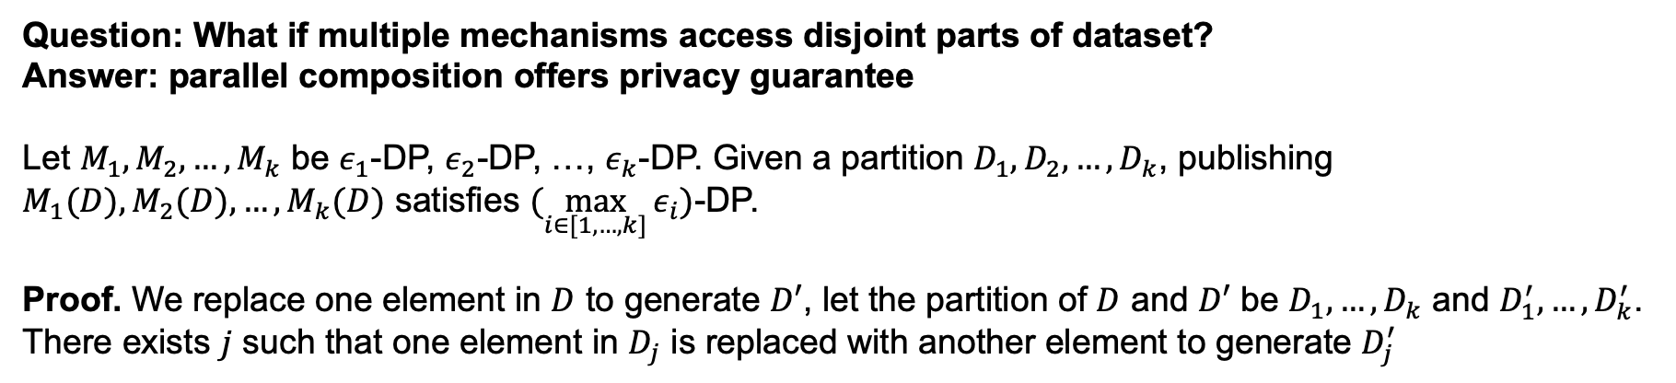
Properties
Question: What if multiple mechanisms access disjoint parts of dataset?
Answer: parallel composition offers privacy guarantee
Let $M_{1},M_{2},…,M_{k}$ be $ε_{1}$-DP, $ε_{2}$-DP, …, $ε_{k}$-DP. Given a partition $D_{1},D_{2},…,D_{k}$, publishing $M_{1}(D),M_{2}(D),…,M_{k}(D)$ satisfies $(\max_{i∈[1,…,k]}{ε_{i}})$-DP.
Proof. We replace one element in $D$ to generate $D′$, let the partition of $D$ and $D′$ be $D_{1},…,D_{k}$ and $D_{1}^{′},…,D_{k}^{′}$. There exists $j$ such that one element in $D_{j}$ is replaced with another element to generate $D_{j}^{′}$

Slide 52
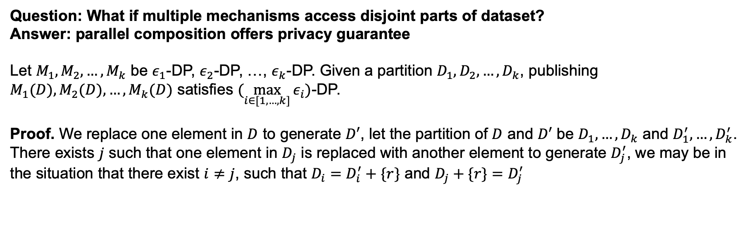
Properties
Question: What if multiple mechanisms access disjoint parts of dataset?
Answer: parallel composition offers privacy guarantee
Let $M_{1},M_{2},…,M_{k}$ be $ε_{1}$-DP, $ε_{2}$-DP, …, $ε_{k}$-DP. Given a partition $D_{1},D_{2},…,D_{k}$, publishing $M_{1}(D),M_{2}(D),…,M_{k}(D)$ satisfies $(\max_{i∈[1,…,k]}{ε_{i}})$-DP.
Proof. We replace one element in $D$ to generate $D′$, let the partition of $D$ and $D′$ be $D_{1},…,D_{k}$ and $D_{1}^{′},…,D_{k}^{′}$. There exists $j$ such that one element in $D_{j}$ is replaced with another element to generate $D_{j}^{′}$, we may be in the situation that there exist $i≠j$, such that $D_{i}=D_{i}^{′}+\{r\}$ and $D_{j}+\{r\}=D_{j}^{′}$

Slide 53



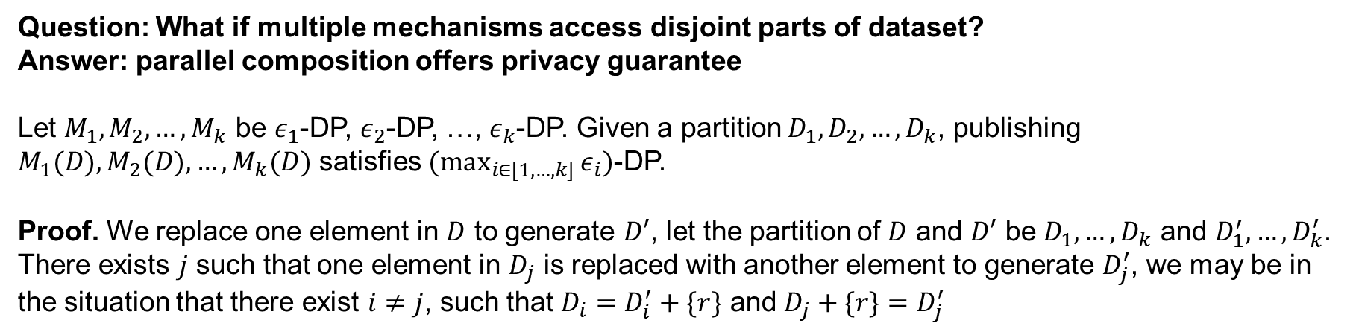



Properties
Question: What if multiple mechanisms access disjoint parts of dataset?
Answer: parallel composition offers privacy guarantee
Let $M_{1},M_{2},…,M_{k}$ be $ε_{1}$-DP, $ε_{2}$-DP, …, $ε_{k}$-DP. Given a partition $D_{1},D_{2},…,D_{k}$, publishing $M_{1}(D),M_{2}(D),…,M_{k}(D)$ satisfies $(\max_{i∈[1,…,k]}{ε_{i}})$-DP.
Proof. We replace one element in $D$ to generate $D′$, let the partition of $D$ and $D′$ be $D_{1},…,D_{k}$ and $D_{1}^{′},…,D_{k}^{′}$. There exists $j$ such that one element in $D_{j}$ is replaced with another element to generate $D_{j}^{′}$, we may be in the situation that there exist $i≠j$, such that $D_{i}=D_{i}^{′}+\{r\}$ and $D_{j}+\{r\}=D_{j}^{′}$
ID | Age
1 | 10
2 | 21
3 | 35
… | …
ID | Age
1 | 30
2 | 21
3 | 35
… | …
0-10
10-20
20-30
0-10
10-20
20-30
$$D_{1}$$
$$D_{2}$$
$$D_{3}$$
$$D_{1}^{′}$$
$$D_{2}^{′}$$
$$D_{3}^{′}$$

Slide 54



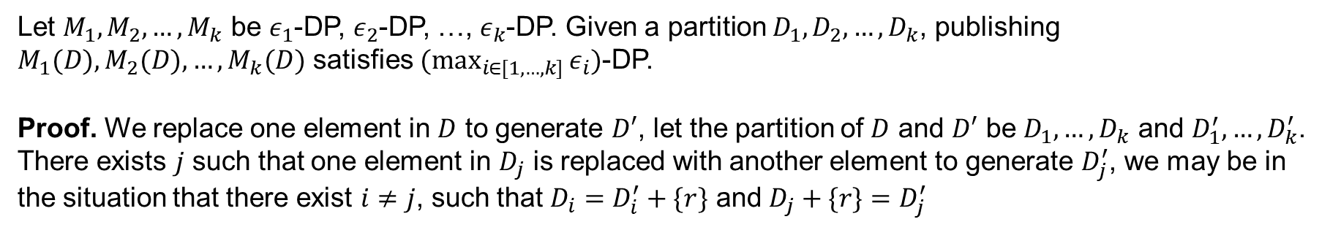



Properties
Let $M_{1},M_{2},…,M_{k}$ be $ε_{1}$-DP, $ε_{2}$-DP, …, $ε_{k}$-DP. Given a partition $D_{1},D_{2},…,D_{k}$, publishing $M_{1}(D),M_{2}(D),…,M_{k}(D)$ satisfies $(\max_{i∈[1,…,k]}{ε_{i}})$-DP.
Proof. We replace one element in $D$ to generate $D′$, let the partition of $D$ and $D′$ be $D_{1},…,D_{k}$ and $D_{1}^{′},…,D_{k}^{′}$. There exists $j$ such that one element in $D_{j}$ is replaced with another element to generate $D_{j}^{′}$, we may be in the situation that there exist $i≠j$, such that $D_{i}=D_{i}^{′}+\{r\}$ and $D_{j}+\{r\}=D_{j}^{′}$
ID | Age
1 | 10
2 | 21
3 | 35
… | …
ID | Age
1 | 30
2 | 21
3 | 35
… | …
0-10
10-20
20-30
0-10
10-20
20-30
$$D_{1}$$
$$D_{2}$$
$$D_{3}$$
$$D_{1}^{′}$$
$$D_{2}^{′}$$
$$D_{3}^{′}$$
Under bounded DP, $\frac{Pr⁡[M_{j}\left(D_{j}\right)=t_{j}]}{Pr⁡[M_{j}\left(D_{j}^{′}\right)=t_{j}]}$ can be unbounded because $D_{j}$ and $D_{j}^{′}$ contain different numbers of elements, and it does not comply with the definition of bounded DP.

Slide 55
Properties
Let $M_{1},M_{2},…,M_{k}$ be $ε_{1}$-DP, $ε_{2}$-DP, …, $ε_{k}$-DP. Given a partition $D_{1},D_{2},…,D_{k}$, publishing $M_{1}(D),M_{2}(D),…,M_{k}(D)$ satisfies $(\max_{i∈[1,…,k]}{ε_{i}})$-DP.
Proof. We replace one element in $D$ to generate $D′$, let the partition of $D$ and $D′$ be $D_{1},…,D_{k}$ and $D_{1}^{′},…,D_{k}^{′}$. There exists $j$ such that one element in $D_{j}$ is replaced with another element to generate $D_{j}^{′}$, we may be in the situation that there exist $i≠j$, such that $D_{i}=D_{i}^{′}+\{r\}$ and $D_{j}+\{r\}=D_{j}^{′}$
Parallel composition does not hold for bounded DP!!!
ID | Age
1 | 10
2 | 21
3 | 35
… | …
ID | Age
1 | 30
2 | 21
3 | 35
… | …
0-10
10-20
20-30
0-10
10-20
20-30
$$D_{1}$$
$$D_{2}$$
$$D_{3}$$
$$D_{1}^{′}$$
$$D_{2}^{′}$$
$$D_{3}^{′}$$
Under bounded DP, $\frac{Pr⁡[M_{j}\left(D_{j}\right)=t_{j}]}{Pr⁡[M_{j}\left(D_{j}^{′}\right)=t_{j}]}$ can be unbounded because $D_{j}$ and $D_{j}^{′}$ contain different numbers of elements, and it does not comply with the definition of bounded DP.

Slide 56
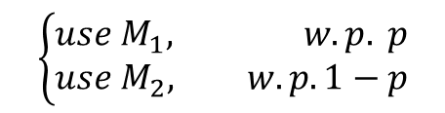
Properties
Question: What if randomly use different DP mechanism?
What privacy guarantee can provide?
Dataset
$$\left\{\begin{aligned}use M_{1}, w.p. p \\ use M_{2}, w.p. 1−p\end{aligned}\right.$$

Slide 57
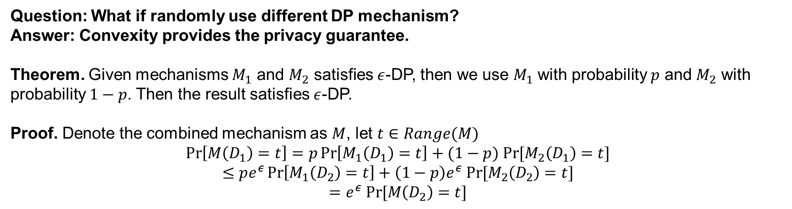
Properties
Question: What if randomly use different DP mechanism?
Answer: Convexity provides the privacy guarantee.
Theorem. Given mechanisms $M_{1}$ and $M_{2}$ satisfies $ε$-DP, then we use $M_{1}$ with probability $p$ and $M_{2}$ with probability $1−p$. Then the result satisfies $ε$-DP.
Proof. Denote the combined mechanism as $M$, let $t∈Range(M)$
$$\operatorname{Pr}\left[M\left(D_{1}\right)=t\right]=p\operatorname{Pr}\left[M_{1}\left(D_{1}\right)=t\right]+(1−p) Pr⁡[M_{2}\left(D_{1}\right)=t]$$
$$≤pe^{ε}\operatorname{Pr}\left[M_{1}\left(D_{2}\right)=t\right]+\left(1−p\right)e^{ε} Pr⁡[M_{2}\left(D_{2}\right)=t]$$
$$=e^{ε} Pr⁡[M\left(D_{2}\right)=t]$$

Slide 58
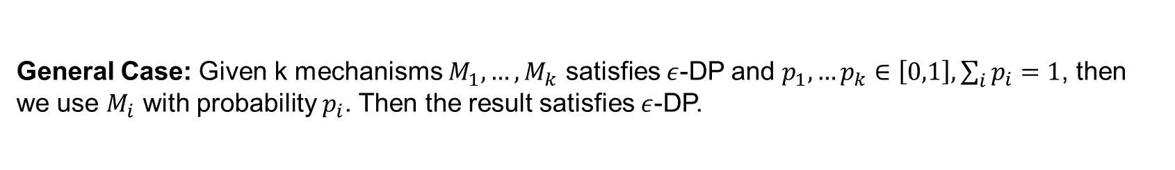
Properties
Question: What if randomly use different DP mechanism?
Answer: Convexity provides the privacy guarantee.
Theorem. Given mechanisms $M_{1}$ and $M_{2}$ satisfies $ε$-DP, then we use $M_{1}$ with probability $p$ and $M_{2}$ with probability $1−p$. Then the result satisfies $ε$-DP.
Proof. Denote the combined mechanism as $M$, let $t∈Range(M)$
$$\operatorname{Pr}\left[M\left(D_{1}\right)=t\right]=p\operatorname{Pr}\left[M_{1}\left(D_{1}\right)=t\right]+(1−p) Pr⁡[M_{2}\left(D_{1}\right)=t]$$
$$≤pe^{ε}\operatorname{Pr}\left[M_{1}\left(D_{2}\right)=t\right]+\left(1−p\right)e^{ε} Pr⁡[M_{2}\left(D_{2}\right)=t]$$
$$=e^{ε} Pr⁡[M\left(D_{2}\right)=t]$$
General Case: Given k mechanisms $M_{1},…,M_{k}$ satisfies $ε$-DP and $p_{1},…p_{k}∈\left[0,1\right], \sum_{i}{p_{i}}=1$, then we use $M_{i}$ with probability $p_{i}$. Then the result satisfies $ε$-DP.

Slide 59
Contents
Intuition and Definition
Common DP Mechanisms
Properties
Other Composition Theorems
Numerical Query
Hierarchy Technique

Slide 60
Numerical Query
Computing Average
Consider the following query:
On average, how many packs of cigarettes do patients who have been smoking for over 15 years smoke?
平均来说，烟龄超过15年的人一天抽几包烟？

Slide 61


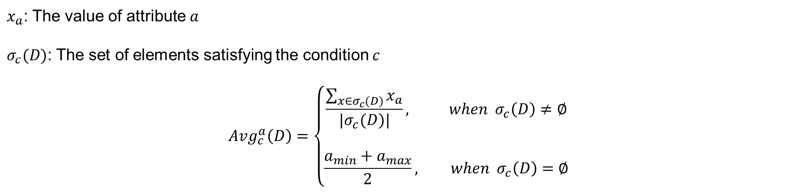
Numerical Query
Formulate this query:
On average, how many packs of cigarettes do patients who have been smoking for over 15 years smoke?
attribute $a$
condition $c$
$x_{a}$: The value of attribute $a$
$σ_{c}(D)$: The set of elements satisfying the condition $c$
$$Avg_{c}^{a}\left(D\right)=\left\{\begin{aligned}\frac{\sum_{x∈σ_{c}(D)}{x_{a}}}{|σ_{c}(D)|}, when σ_{c}\left(D\right)≠∅ \\ \\ \frac{a_{min}+a_{max}}{2}, when σ_{c}\left(D\right)=∅\end{aligned}\right.$$

Slide 62
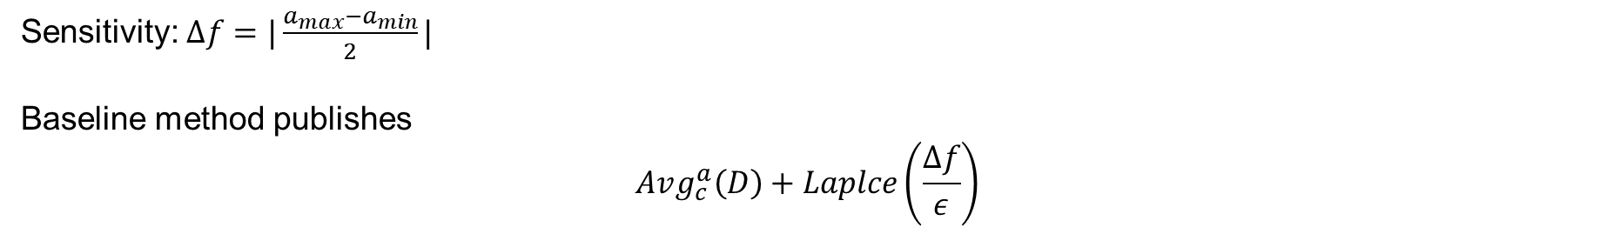
Numerical Query
Baseline: add Laplace noise to $Avg_{c}^{a}\left(D\right)$
Sensitivity: $Δf=|\frac{a_{max}−a_{min}}{2}|$
Baseline method publishes
$$Avg_{c}^{a}\left(D\right)+Laplce\left(\frac{Δf}{ε}\right)$$

Slide 63
Numerical Query
Baseline: add Laplace noise to $Avg_{c}^{a}\left(D\right)$
Sensitivity: $Δf=|\frac{a_{max}−a_{min}}{2}|$
Baseline method publishes
$$Avg_{c}^{a}\left(D\right)+Laplce\left(\frac{Δf}{ε}\right)$$
Drawback: $Δf$ is too large and leads to large noise!

Slide 64
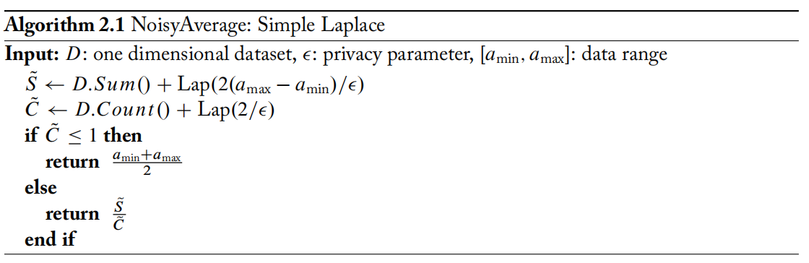
Numerical Query
Solution 1: add noise to sum and count separately
Why this solution works: the sensitivity of average query is calculated under small dataset, and it does not suit large dataset. But the sensitivity for sum and count is consistent across all dataset.

Slide 65
Numerical Query
Solution 1: add noise to sum and count separately
Why this solution works: the sensitivity of average query is calculated under small dataset, and it does not suit large dataset. But the sensitivity for sum and count is consistent across all dataset.
Another question: We are not outputting Count, can we use the actual count to calculate average?

Slide 66
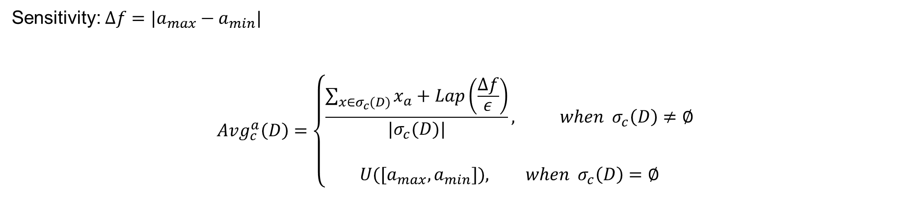
Numerical Query
Attempt: try actual count
Sensitivity: $Δf=|a_{max}−a_{min}|$
$$Avg_{c}^{a}\left(D\right)=\left\{\begin{aligned}\frac{\sum_{x∈σ_{c}(D)}{x_{a}}+Lap\left(\frac{Δf}{ε}\right)}{|σ_{c}(D)|}, when σ_{c}\left(D\right)≠∅ \\ \\ U([a_{max},a_{min}]), when σ_{c}\left(D\right)=∅\end{aligned}\right.$$

Slide 67
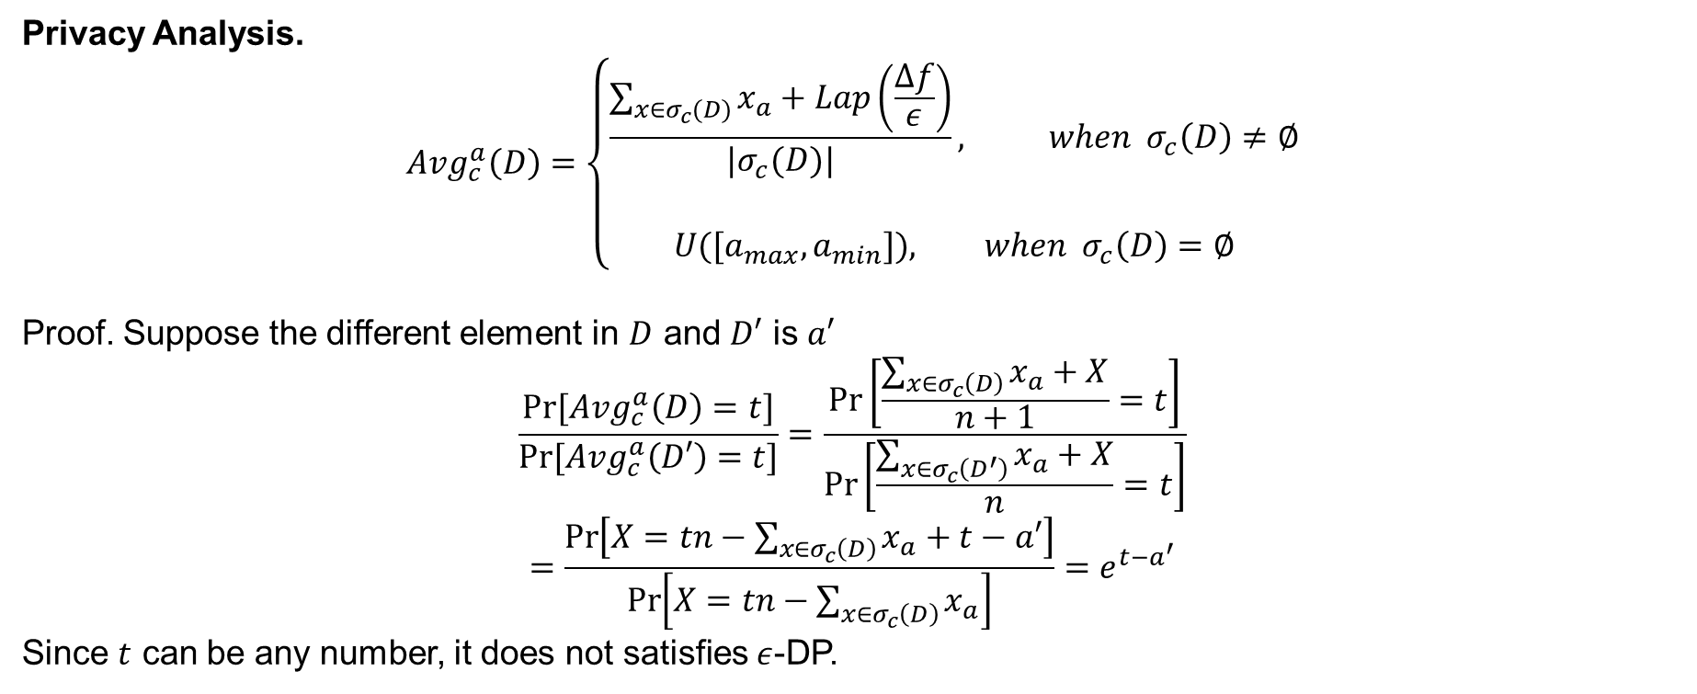
Numerical Query
Attempt: try actual count
Privacy Analysis.
$$Avg_{c}^{a}\left(D\right)=\left\{\begin{aligned}\frac{\sum_{x∈σ_{c}(D)}{x_{a}}+Lap\left(\frac{Δf}{ε}\right)}{|σ_{c}(D)|}, when σ_{c}\left(D\right)≠∅ \\ \\ U([a_{max},a_{min}]), when σ_{c}\left(D\right)=∅\end{aligned}\right.$$
Proof. Suppose the different element in $D$ and $D′$ is $a′$
$$\frac{Pr⁡[Avg_{c}^{a}\left(D\right)=t]}{Pr⁡[Avg_{c}^{a}\left(D′\right)=t]}=\frac{\operatorname{Pr}\left[\frac{\sum_{x∈σ_{c}\left(D\right)}{x_{a}}+X}{n+1}=t\right]}{\operatorname{Pr}\left[\frac{\sum_{x∈σ_{c}\left(D^{′}\right)}{x_{a}}+X}{n}=t\right]}$$
$$=\frac{\operatorname{Pr}\left[X=tn−\sum_{x∈σ_{c}\left(D\right)}{x_{a}}+t−a′\right]}{\operatorname{Pr}\left[X=tn−\sum_{x∈σ_{c}\left(D\right)}{x_{a}}\right]}=e^{t−a^{′}}$$
Since $t$ can be any number, it does not satisfies $ε$-DP.

Slide 68
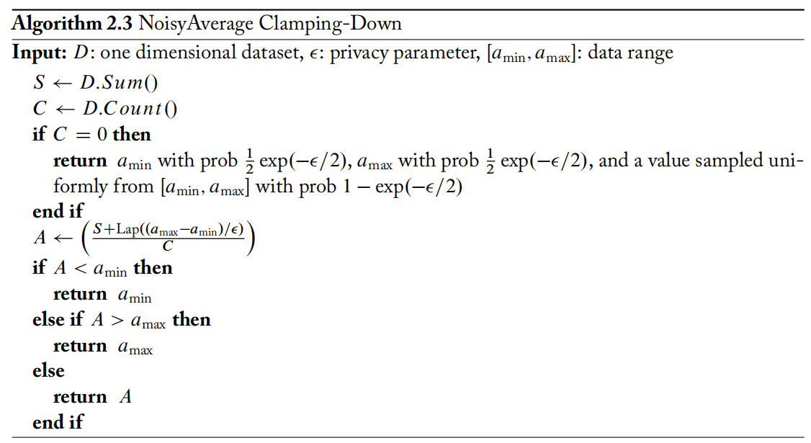
Numerical Query
Solution 2: Bound the output range $t∈[a_{min}, a_{max}]$
Why this solution works: If $t∈[a_{min}, a_{max}]$, we have $|t−a^{′}|≤Δf$ and we could have the desired inequality

Slide 69
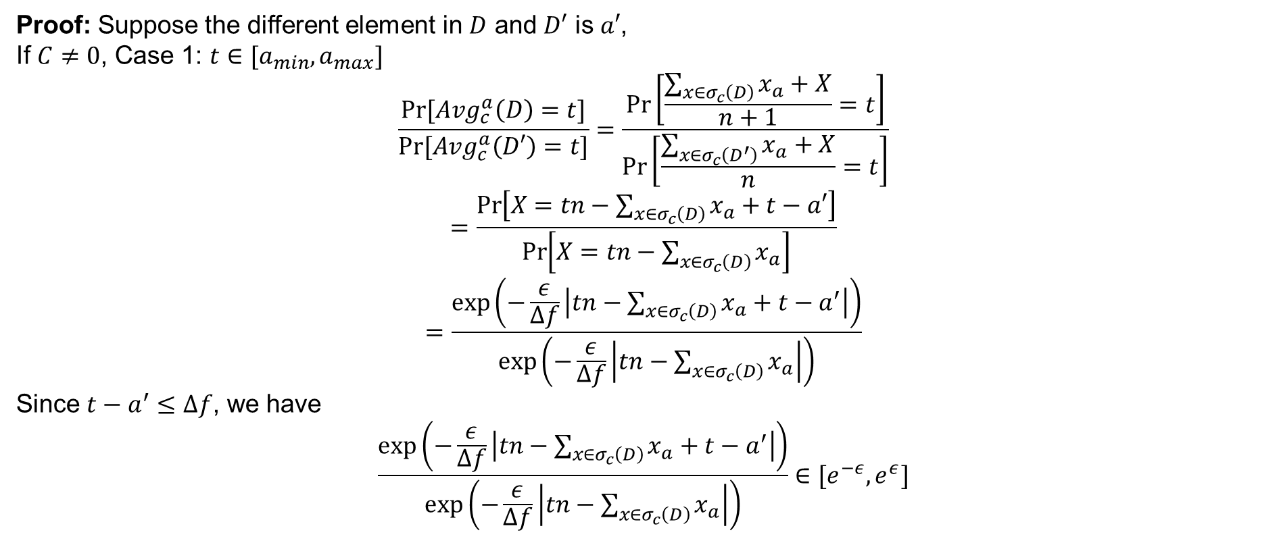
Numerical Query
Solution 2: Bound the output range $t∈[a_{min}, a_{max}]$
Proof: Suppose the different element in $D$ and $D′$ is $a′$,
If $C≠0$, Case 1: $t∈[a_{min}, a_{max}]$
$$\frac{Pr⁡[Avg_{c}^{a}\left(D\right)=t]}{Pr⁡[Avg_{c}^{a}\left(D′\right)=t]}=\frac{\operatorname{Pr}\left[\frac{\sum_{x∈σ_{c}\left(D\right)}{x_{a}}+X}{n+1}=t\right]}{\operatorname{Pr}\left[\frac{\sum_{x∈σ_{c}\left(D^{′}\right)}{x_{a}}+X}{n}=t\right]}$$
$$=\frac{\operatorname{Pr}\left[X=tn−\sum_{x∈σ_{c}\left(D\right)}{x_{a}}+t−a′\right]}{\operatorname{Pr}\left[X=tn−\sum_{x∈σ_{c}\left(D\right)}{x_{a}}\right]}$$
$$=\frac{\exp\left(−\frac{ε}{Δf}\left|tn−\sum_{x∈σ_{c}\left(D\right)}{x_{a}}+t−a^{′}\right|\right)}{\exp\left(−\frac{ε}{Δf}\left|tn−\sum_{x∈σ_{c}\left(D\right)}{x_{a}}\right|\right)}$$
Since $t−a^{′}≤Δf$, we have
$$\frac{\exp\left(−\frac{ε}{Δf}\left|tn−\sum_{x∈σ_{c}\left(D\right)}{x_{a}}+t−a^{′}\right|\right)}{\exp\left(−\frac{ε}{Δf}\left|tn−\sum_{x∈σ_{c}\left(D\right)}{x_{a}}\right|\right)}∈[e^{−ε},e^{ε}]$$

Slide 70
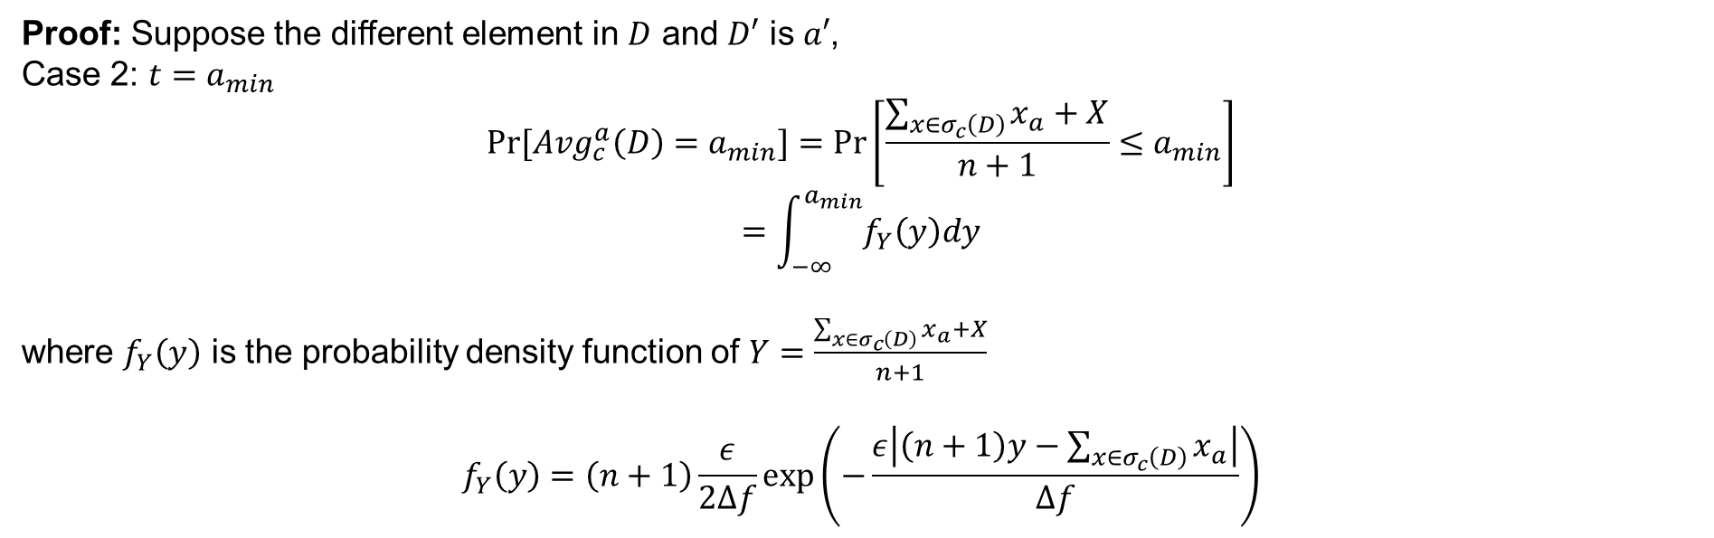
Numerical Query
Solution 2: Bound the output range $t∈[a_{min}, a_{max}]$
Proof: Suppose the different element in $D$ and $D′$ is $a′$,
Case 2: $t=a_{min}$
$$Pr⁡[Avg_{c}^{a}\left(D\right)=a_{min}]=\operatorname{Pr}\left[\frac{\sum_{x∈σ_{c}\left(D\right)}{x_{a}}+X}{n+1}≤a_{min}\right]$$
$$=\int_{−∞}^{a_{min}}{f_{Y}\left(y\right)dy}$$
where $f_{Y}\left(y\right)$ is the probability density function of $Y=\frac{\sum_{x∈σ_{c}\left(D\right)}{x_{a}}+X}{n+1}$
$$f_{Y}\left(y\right)=\left(n+1\right)\frac{ε}{2Δf}\exp\left(−\frac{ε\left|\left(n+1\right)y−\sum_{x∈σ_{c}\left(D\right)}{x_{a}}\right|}{Δf}\right)$$

Slide 71
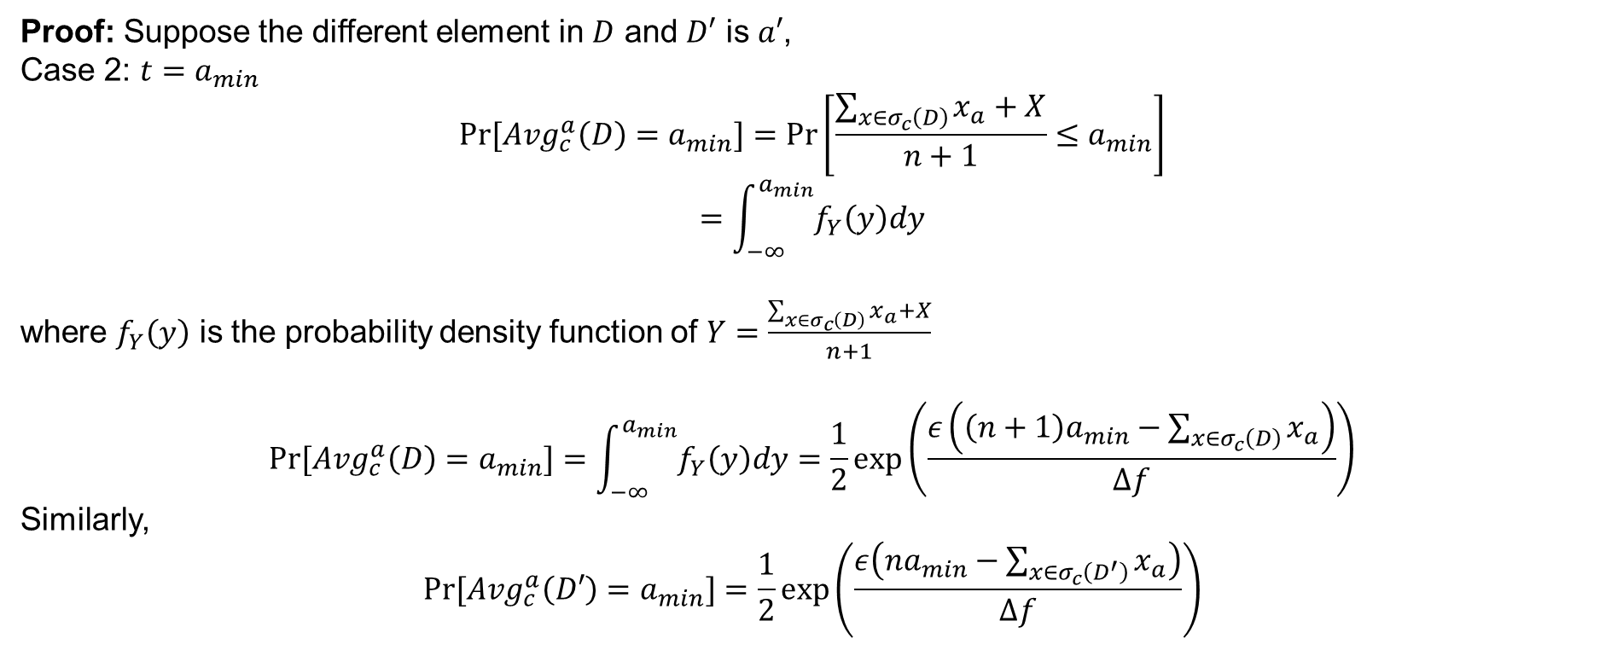
Numerical Query
Solution 2: Bound the output range $t∈[a_{min}, a_{max}]$
Proof: Suppose the different element in $D$ and $D′$ is $a′$,
Case 2: $t=a_{min}$
$$Pr⁡[Avg_{c}^{a}\left(D\right)=a_{min}]=\operatorname{Pr}\left[\frac{\sum_{x∈σ_{c}\left(D\right)}{x_{a}}+X}{n+1}≤a_{min}\right]$$
$$=\int_{−∞}^{a_{min}}{f_{Y}\left(y\right)dy}$$
where $f_{Y}\left(y\right)$ is the probability density function of $Y=\frac{\sum_{x∈σ_{c}\left(D\right)}{x_{a}}+X}{n+1}$
$$Pr⁡[Avg_{c}^{a}\left(D\right)=a_{min}]=\int_{−∞}^{a_{min}}{f_{Y}\left(y\right)dy}=\frac{1}{2}\exp\left(\frac{ε\left(\left(n+1\right)a_{min}−\sum_{x∈σ_{c}\left(D\right)}{x_{a}}\right)}{Δf}\right)$$
Similarly,
$$Pr⁡[Avg_{c}^{a}\left(D′\right)=a_{min}]=\frac{1}{2}\exp\left(\frac{ε\left(na_{min}−\sum_{x∈σ_{c}\left(D^{′}\right)}{x_{a}}\right)}{Δf}\right)$$

Slide 72
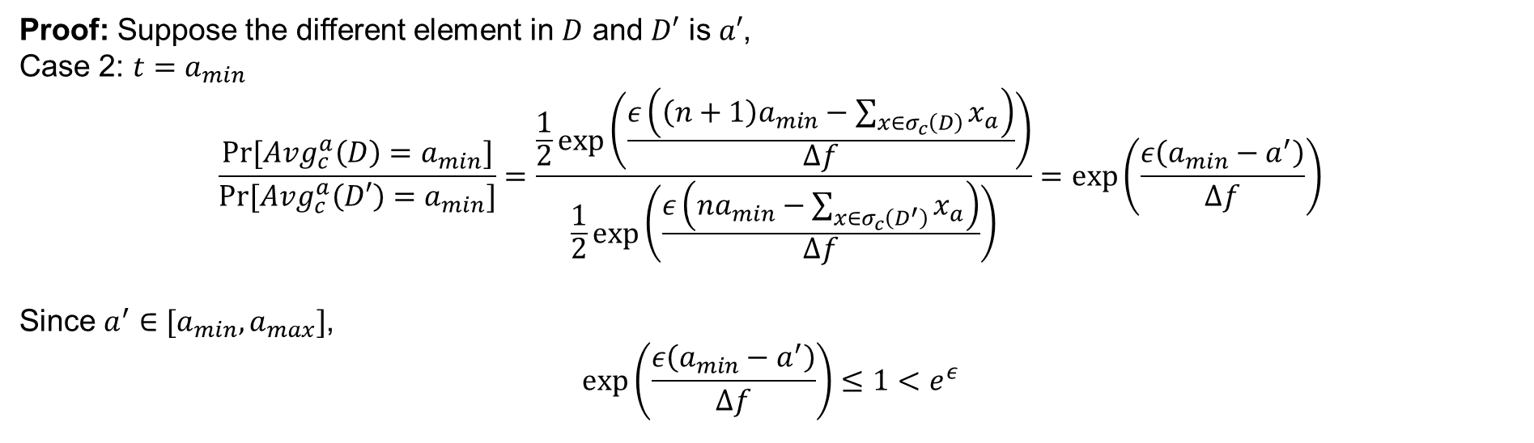
Numerical Query
Solution 2: Bound the output range $t∈[a_{min}, a_{max}]$
Proof: Suppose the different element in $D$ and $D′$ is $a′$,
Case 2: $t=a_{min}$
$$\frac{Pr⁡[Avg_{c}^{a}\left(D\right)=a_{min}]}{Pr⁡[Avg_{c}^{a}\left(D′\right)=a_{min}]}=\frac{\frac{1}{2}\exp\left(\frac{ε\left(\left(n+1\right)a_{min}−\sum_{x∈σ_{c}\left(D\right)}{x_{a}}\right)}{Δf}\right)}{\frac{1}{2}\exp\left(\frac{ε\left(na_{min}−\sum_{x∈σ_{c}\left(D^{′}\right)}{x_{a}}\right)}{Δf}\right)}=\exp\left(\frac{ε\left(a_{min}−a^{′}\right)}{Δf}\right)$$
Since $a^{′}∈[a_{min},a_{max}]$,
$$\exp\left(\frac{ε\left(a_{min}−a^{′}\right)}{Δf}\right)≤1<e^{ε}$$

Slide 73
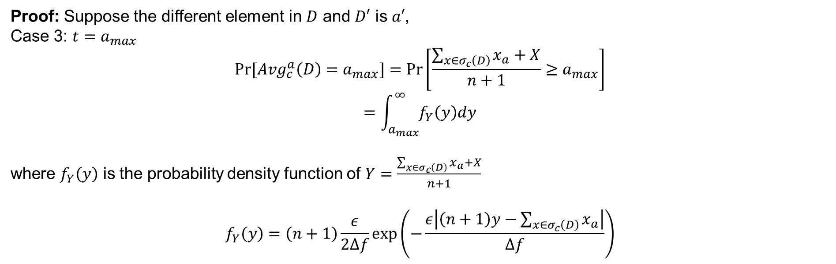
Numerical Query
Solution 2: Bound the output range $t∈[a_{min}, a_{max}]$
Proof: Suppose the different element in $D$ and $D′$ is $a′$,
Case 3: $t=a_{max}$
$$Pr⁡[Avg_{c}^{a}\left(D\right)=a_{max}]=\operatorname{Pr}\left[\frac{\sum_{x∈σ_{c}\left(D\right)}{x_{a}}+X}{n+1}≥a_{max}\right]$$
$$=\int_{a_{max}}^{∞}{f_{Y}\left(y\right)dy}$$
where $f_{Y}\left(y\right)$ is the probability density function of $Y=\frac{\sum_{x∈σ_{c}\left(D\right)}{x_{a}}+X}{n+1}$
$$f_{Y}\left(y\right)=\left(n+1\right)\frac{ε}{2Δf}\exp\left(−\frac{ε\left|\left(n+1\right)y−\sum_{x∈σ_{c}\left(D\right)}{x_{a}}\right|}{Δf}\right)$$

Slide 74

Numerical Query
Solution 2: Bound the output range $t∈[a_{min}, a_{max}]$
Proof: Suppose the different element in $D$ and $D′$ is $a′$,
Case 3: $t=a_{max}$
Similar to the case 2 $t=a_{min}$, we have
$$\frac{Pr⁡[Avg_{c}^{a}\left(D\right)=a_{min}]}{Pr⁡[Avg_{c}^{a}\left(D′\right)=a_{min}]}=\frac{\frac{1}{2}\exp\left(\frac{−ε\left(\left(n+1\right)a_{max}−\sum_{x∈σ_{c}\left(D\right)}{x_{a}}\right)}{Δf}\right)}{\frac{1}{2}\exp\left(\frac{ε\left(na_{max}−\sum_{x∈σ_{c}\left(D^{′}\right)}{x_{a}}\right)}{Δf}\right)}=\exp\left(\frac{−ε\left(a_{max}−a^{′}\right)}{Δf}\right)$$
Since $a^{′}∈[a_{min},a_{max}]$,
$$\exp\left(\frac{ε\left(a_{min}−a^{′}\right)}{Δf}\right)≤1<e^{ε}$$

Slide 75

Numerical Query
Solution 2: Bound the output range $t∈[a_{min}, a_{max}]$
Proof: Suppose the different element in $D$ and $D′$ is $a$,
If $C=0$, $D=\{a\}$ and $D′=\{\}$
$$\operatorname{Pr}\left[Avg_{c}^{a}\left(D\right)=t\right]=\operatorname{Pr}\left[\frac{\sum_{x∈σ_{c}\left(D\right)}{x_{a}}+X}{1}=t\right]=\operatorname{Pr}\left[\frac{a+X}{1}=t\right]=\left\{\begin{aligned}\frac{1}{2}\exp\left(\frac{ε(a_{min}−a)}{Δf}\right), when t=a_{min} \\ \frac{ε}{2Δf}\exp\left(−\frac{ε}{Δf}\left|t−a\right|\right), when t∈[a_{min},a_{max}] \\ \frac{1}{2}\exp\left(−\frac{ε(a_{max}−a)}{Δf}\right), when t=a_{max}\end{aligned}\right.$$
$$\operatorname{Pr}\left[Avg_{c}^{a}\left(D′\right)=t\right]=\left\{\begin{aligned}\frac{1}{2}\exp\left(−\frac{ε}{2}\right), when t=a_{min} \\ \frac{1}{Δf}\left(1−\exp\left(−\frac{ε}{2}\right)\right), when t∈[a_{min},a_{max}] \\ \frac{1}{2}\exp\left(−\frac{ε}{2}\right), when t=a_{max}\end{aligned}\right.$$

Slide 76

Numerical Query
Solution 2: Bound the output range $t∈[a_{min}, a_{max}]$
Proof: Suppose the different element in $D$ and $D′$ is $a$,
If $C=0$, $D=\{a\}$ and $D′=\{\}$
For $t∈[a_{min},a_{max}]$
$$\frac{\operatorname{Pr}\left[Avg_{c}^{a}\left(D\right)=t\right]}{\operatorname{Pr}\left[Avg_{c}^{a}\left(D^{′}\right)=t\right]}=\frac{\frac{ε}{2Δf}\exp\left(−\frac{ε}{Δf}\left|t−a\right|\right)}{\frac{1}{Δf}\left(1−\exp\left(−\frac{ε}{2}\right)\right)}=\frac{\frac{ε}{2}\exp\left(−\frac{ε}{Δf}\left|t−a\right|\right)}{1−\exp\left(−\frac{ε}{2}\right)}$$
$$≤\frac{\frac{ε}{2}}{1−\exp\left(−\frac{ε}{2}\right)}≤e^{ε}$$

Slide 77

Numerical Query
Solution 2: Bound the output range $t∈[a_{min}, a_{max}]$
Proof: Suppose the different element in $D$ and $D′$ is $a$,
If $C=0$, $D=\{a\}$ and $D′=\{\}$
For $t=a_{min}$
$$\frac{\operatorname{Pr}\left[Avg_{c}^{a}\left(D\right)=t\right]}{\operatorname{Pr}\left[Avg_{c}^{a}\left(D^{′}\right)=t\right]}=\frac{\frac{1}{2}\exp\left(\frac{ε(a_{min}−a)}{Δf}\right)}{\frac{1}{2}\exp\left(−\frac{ε}{2}\right)}=\exp\left(ε\left(\frac{a_{min}−a}{Δf}+\frac{1}{2}\right)\right)$$
$$≤e^{ε/2}$$

Slide 78

Numerical Query
Solution 2: Bound the output range $t∈[a_{min}, a_{max}]$
Proof: Suppose the different element in $D$ and $D′$ is $a$,
If $C=0$, $D=\{a\}$ and $D′=\{\}$
For $t=a_{max}$
$$\frac{\operatorname{Pr}\left[Avg_{c}^{a}\left(D\right)=t\right]}{\operatorname{Pr}\left[Avg_{c}^{a}\left(D^{′}\right)=t\right]}=\frac{\frac{1}{2}\exp\left(\frac{−ε(a_{max}−a)}{Δf}\right)}{\frac{1}{2}\exp\left(−\frac{ε}{2}\right)}=\exp\left(ε\left(−\frac{a_{max}−a}{Δf}+\frac{1}{2}\right)\right)$$
$$≤e^{ε/2}$$

Slide 79
Contents
Intuition and Definition
Common DP Mechanisms
Properties
Numerical Query
Other Composition Theorems
Hierarchy Technique

Slide 80

Other Composition Theorem
Question: Sequential composition is great, but the privacy cost grows too fast if we iterate many times.
Especially in machine learning, multiple queries, etc., the privacy cost is too much to tolerate!

Slide 81

Other Composition Theorem
Solution: slack the privacy guarantee
$ε$-Differential Privacy: A randomized algorithm $M$ is $ε$-DP if and only if
$$\operatorname{Pr}\left[M\left(D_{1}\right)=t\right]≤e^{ε}\operatorname{Pr}{[M\left(D_{2}\right)=t]}$$
where $D_{1}$ and $D_{2}$ is a pair of neighbor datasets that only differ on one individual.
$(ε,δ)$-Differential Privacy: A randomized algorithm $M$ is $ε$-DP if and only if
$$\operatorname{Pr}\left[M\left(D_{1}\right)=t\right]≤e^{ε}\operatorname{Pr}{[M\left(D_{2}\right)=t]}+δ$$
where $D_{1}$ and $D_{2}$ is a pair of neighbor datasets that only differ on one individual.
The new parameter $δ$ represents a “failure probability” for the definition
With probability $1−δ$, $\operatorname{Pr}\left[M\left(D_{1}\right)=t\right]≤e^{ε}\operatorname{Pr}{[M\left(D_{2}\right)=t]}$
With probability $δ$, we get no privacy guarantee

Slide 82

Other Composition Theorem
Solution: slack the privacy guarantee
Advanced composition: If each mechanism $M_{1},…,M_{k}$ is $(ε,δ)$-DP, then for any $δ^{′}>0$, the entire k-fold composition satisfies $(ε^{′},kδ+δ′)$-DP, where
$$ε^{′}=ε\sqrt{2k\ln\left(\frac{1}{δ^{′}}\right) }+kε(e^{ε}−1)$$
If $δ=0$, each $M_{i}$ is $ε$-DP

Slide 83


Other Composition Theorem
Compare with basic sequential composition
Basic sequential composition beats advanced composition for smaller $k$.
When $δ′$ is small, we will often compare the $ε$ given by both methods.
Advanced composition derives a much lower bound on $ε$ than sequential composition for the same mechanism.

