Slide 1
Local Differential Privacy Introduction
Xiaoguang Li

Slide 2
Contents
Definition
Frequency Estimation Protocols
Mean Estimation Protocols
Distribution Estimation Protocols
Robustness Analysis

Slide 3
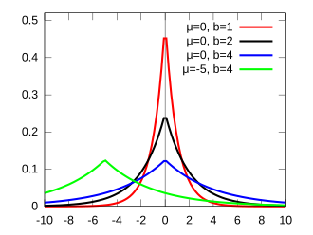




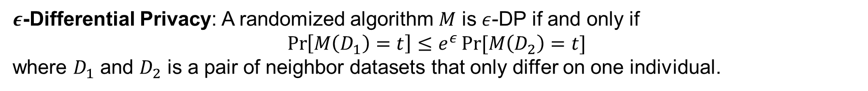
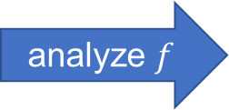
DP Revisit
$ε$-Differential Privacy: A randomized algorithm $M$ is $ε$-DP if and only if
$$\operatorname{Pr}\left[M\left(D_{1}\right)=t\right]≤e^{ε}\operatorname{Pr}{[M\left(D_{2}\right)=t]}$$
where $D_{1}$ and $D_{2}$ is a pair of neighbor datasets that only differ on one individual.
Laplace noise
data
data
analyze $f$
publish
data
Server
Private result
User side
Server side

Slide 4
DP Revisit
$ε$-Differential Privacy: A randomized algorithm $M$ is $ε$-DP if and only if
$$\operatorname{Pr}\left[M\left(D_{1}\right)=t\right]≤e^{ε}\operatorname{Pr}{[M\left(D_{2}\right)=t]}$$
where $D_{1}$ and $D_{2}$ is a pair of neighbor datasets that only differ on one individual.
Laplace noise
data
data
analyze $f$
publish
data
Untrusted Server
Private result
Ops, my data is leaked
The server must be trusted!!!
User side
Server side

Slide 5




LDP Solution
Randomize private data locally
Untrusted server cannot touch the raw data
data
$$R$$
noisy data
data
$$R$$
noisy data
aggregate
noisy data
Untrusted Server
data
$$R$$
Data analyst
User side
Server side

Slide 6
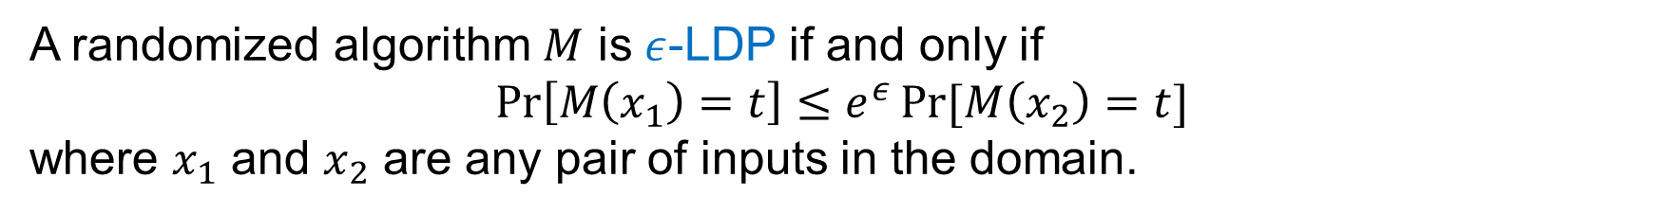
LDP Solution
A randomized algorithm $M$ is $ε$-LDP if and only if
$$\operatorname{Pr}\left[M\left(x_{1}\right)=t\right]≤e^{ε}\operatorname{Pr}{[M\left(x_{2}\right)=t]}$$
where $x_{1}$ and $x_{2}$ are any pair of inputs in the domain.
data
$$R$$
noisy data
data
$$R$$
noisy data
aggregate
noisy data
Untrusted Server
data
$$R$$
Data analyst
User side
Server side

Slide 7
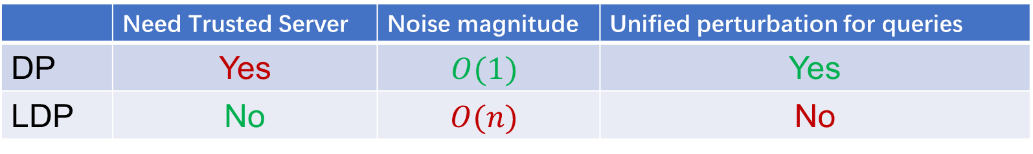
DP vs. LDP
 | Need Trusted Server | Noise magnitude | Unified perturbation for queries
DP | Yes | $$O(1)$$ | Yes
LDP | No | $$O(n)$$ | No
DP relies on a trusted server but LDP does not

Slide 8
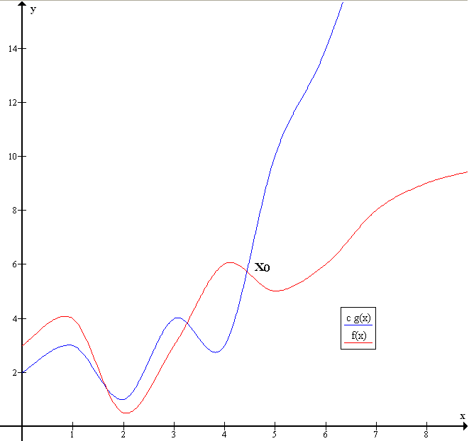
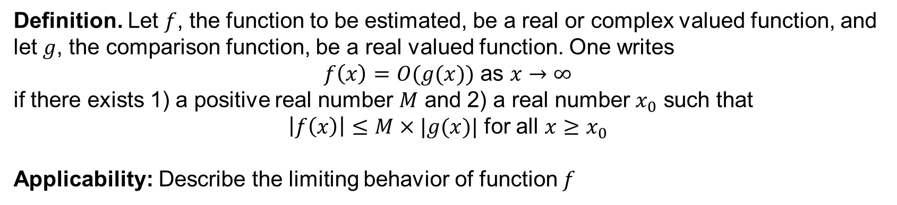
Big O notation
Definition. Let $f$, the function to be estimated, be a real or complex valued function, and let $g$, the comparison function, be a real valued function. One writes
$f\left(x\right)=O(g(x))$ as $x→∞$
if there exists 1) a positive real number $M$ and 2) a real number $x_{0}$ such that
$\left|f\left(x\right)\right|≤M×|g(x)|$ for all $x≥x_{0}$
Applicability: Describe the limiting behavior of function $f$

Slide 9
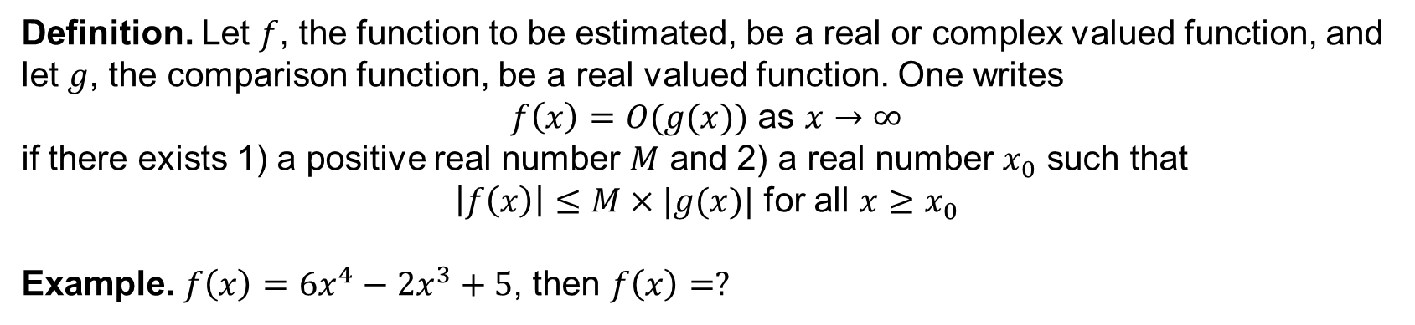
Big O notation
Definition. Let $f$, the function to be estimated, be a real or complex valued function, and let $g$, the comparison function, be a real valued function. One writes
$f\left(x\right)=O(g(x))$ as $x→∞$
if there exists 1) a positive real number $M$ and 2) a real number $x_{0}$ such that
$\left|f\left(x\right)\right|≤M×|g(x)|$ for all $x≥x_{0}$
Example. $f\left(x\right)=6x^{4}−2x^{3}+5$, then $f\left(x\right)=?$

Slide 10
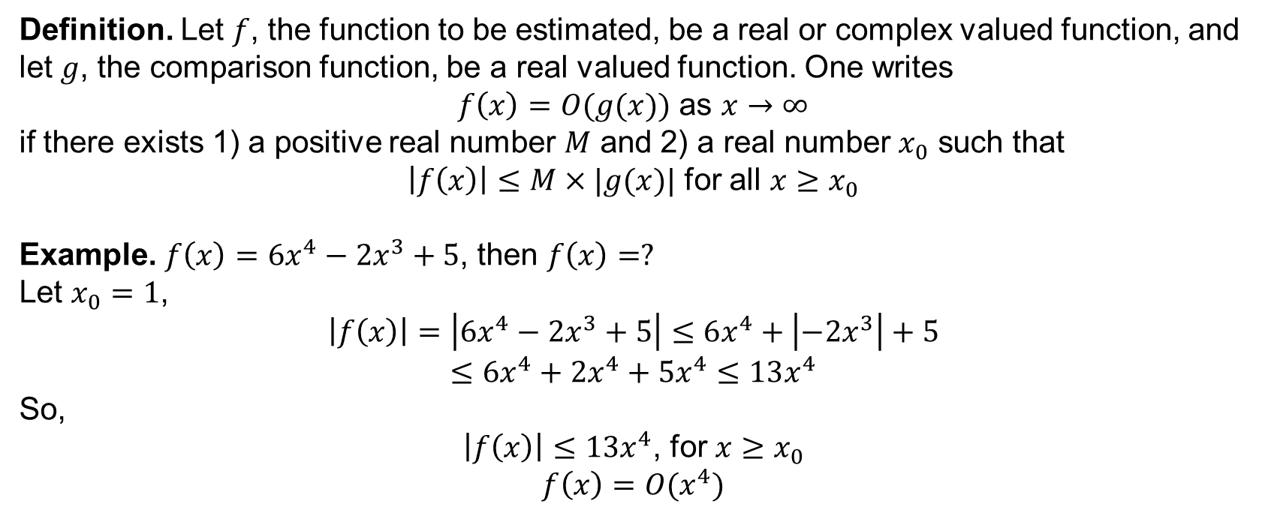
Big O notation
Definition. Let $f$, the function to be estimated, be a real or complex valued function, and let $g$, the comparison function, be a real valued function. One writes
$f\left(x\right)=O(g(x))$ as $x→∞$
if there exists 1) a positive real number $M$ and 2) a real number $x_{0}$ such that
$\left|f\left(x\right)\right|≤M×|g(x)|$ for all $x≥x_{0}$
Example. $f\left(x\right)=6x^{4}−2x^{3}+5$, then $f\left(x\right)=?$
Let $x_{0}=1$,
$$\left|f\left(x\right)\right|=\left|6x^{4}−2x^{3}+5\right|≤6x^{4}+\left|−2x^{3}\right|+5$$
$$≤6x^{4}+2x^{4}+5x^{4}≤13x^{4}$$
So,
$\left|f\left(x\right)\right|≤13x^{4}$, for $x≥x_{0}$
$$f\left(x\right)=O(x^{4})$$

Slide 11
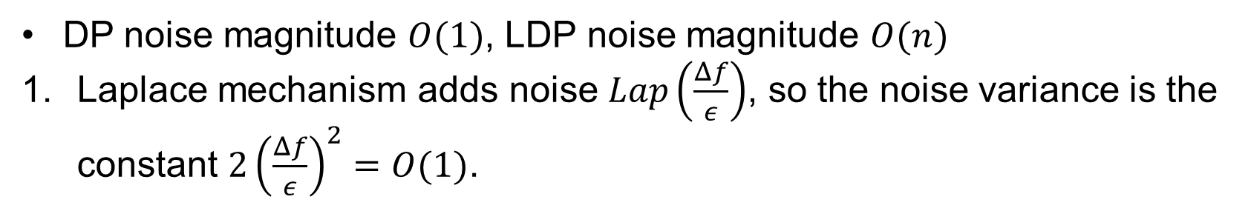
DP vs. LDP
 | Need Trusted Server | Noise magnitude | Unified perturbation for queries
DP | Yes | $$O(1)$$ | Yes
LDP | No | $$O(n)$$ | No
DP noise magnitude $O(1)$, LDP noise magnitude $O(n)$
Laplace mechanism adds noise $Lap\left(\frac{Δf}{ε}\right)$, so the noise variance is the constant $2{\left(\frac{Δf}{ε}\right)}^{2}=O(1)$.

Slide 12
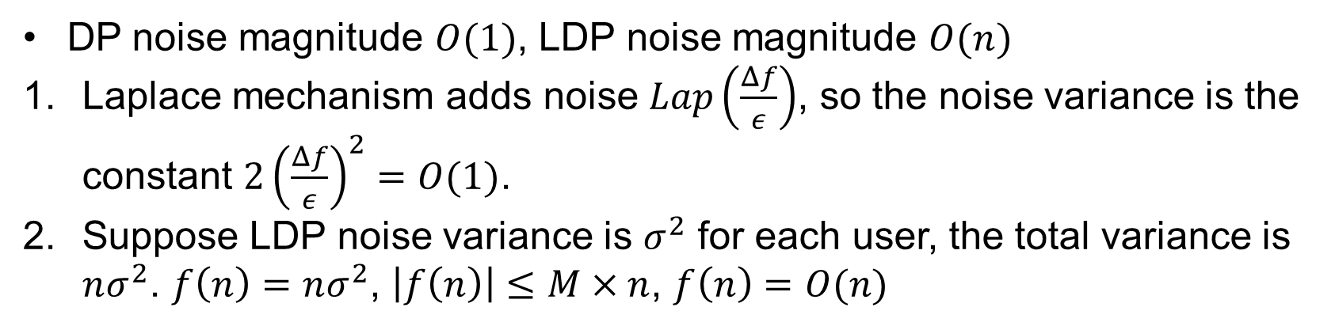
DP vs. LDP
 | Need Trusted Server | Noise magnitude | Unified perturbation for queries
DP | Yes | $$O(1)$$ | Yes
LDP | No | $$O(n)$$ | No
DP noise magnitude $O(1)$, LDP noise magnitude $O(n)$
Laplace mechanism adds noise $Lap\left(\frac{Δf}{ε}\right)$, so the noise variance is the constant $2{\left(\frac{Δf}{ε}\right)}^{2}=O(1)$.
Suppose LDP noise variance is $σ^{2}$ for each user, the total variance is $nσ^{2}$. $f\left(n\right)=nσ^{2}$, $\left|f\left(n\right)\right|≤M×n$, $f\left(n\right)=O(n)$

Slide 13
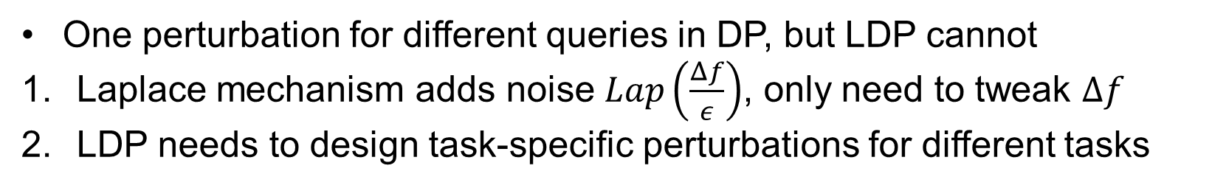
DP vs. LDP
 | Need Trusted Server | Noise magnitude | Unified perturbation for queries
DP | Yes | $$O(1)$$ | Yes
LDP | No | $$O(n)$$ | No
One perturbation for different queries in DP, but LDP cannot
Laplace mechanism adds noise $Lap\left(\frac{Δf}{ε}\right)$, only need to tweak $Δf$
LDP needs to design task-specific perturbations for different tasks

Slide 14
Contents
Definition
Frequency Estimation Protocols
Mean Estimation Protocols
Distribution Estimation Protocols
Robustness Analysis

Slide 15
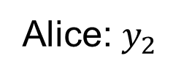

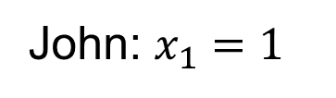
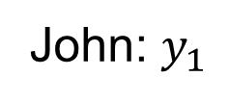

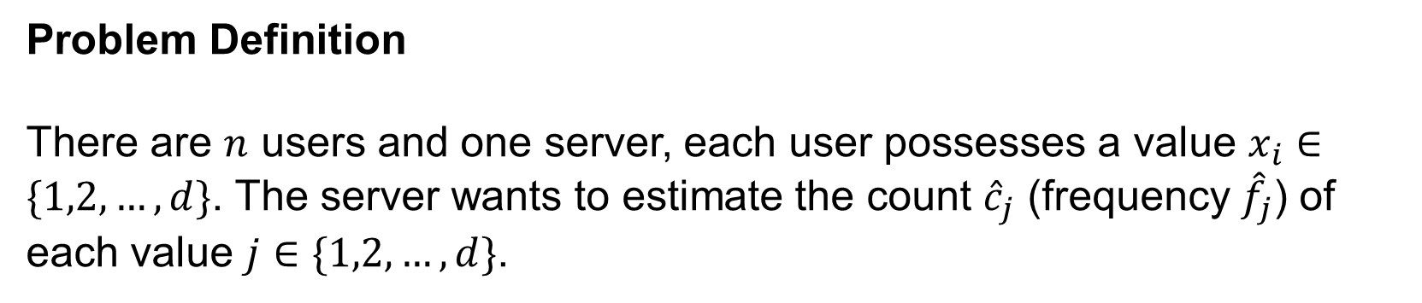
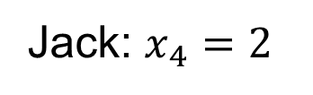
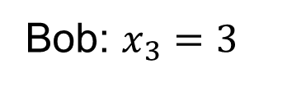
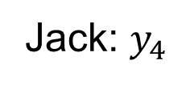
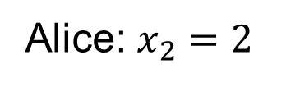
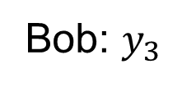

Frequency estimation protocols
Problem Definition
There are $n$ users and one server, each user possesses a value $x_{i}∈\{1,2,…,d\}$. The server wants to estimate the count ${\hat{c}}_{j}$ (frequency ${\hat{f}}_{j}$) of each value $j∈\{1,2,…,d\}$.
John: $x_{1}=1$
LDP Randomizer
John: $y_{1}$
2
Alice: $x_{2}=2$
Alice: $y_{2}$
1
1
Bob: $x_{3}=3$
Bob: $y_{3}$
Untrusted Server
$$j=1$$
$$j=2$$
$$j=3$$
Jack: $x_{4}=2$
Jack: $y_{4}$

Slide 16
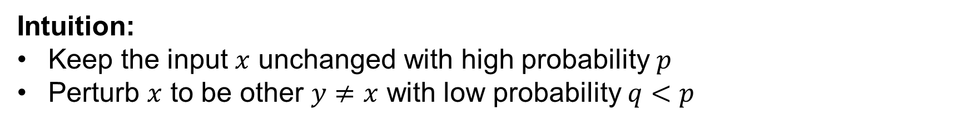
Frequency estimation protocols
Random Response
Intuition:
Keep the input $x$ unchanged with high probability $p$
Perturb $x$ to be other $y≠x$ with low probability $q<p$

Slide 17

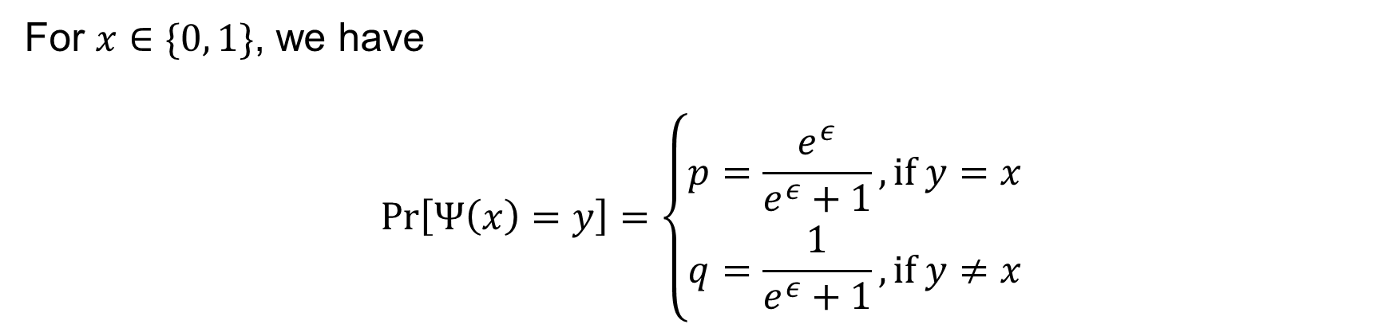



Frequency estimation protocols
Random Response
For $x∈\{0, 1\}$, we have
$$\operatorname{Pr}\left[Ψ\left(x\right)=y\right]=\left\{\begin{aligned}p=\frac{e^{ε}}{e^{ε}+1}, if y=x \\ q=\frac{1}{e^{ε}+1}, if y≠x\end{aligned}\right.$$
$$p$$
$$q$$
$$x=0$$
$$y=$$
0
1

Slide 18


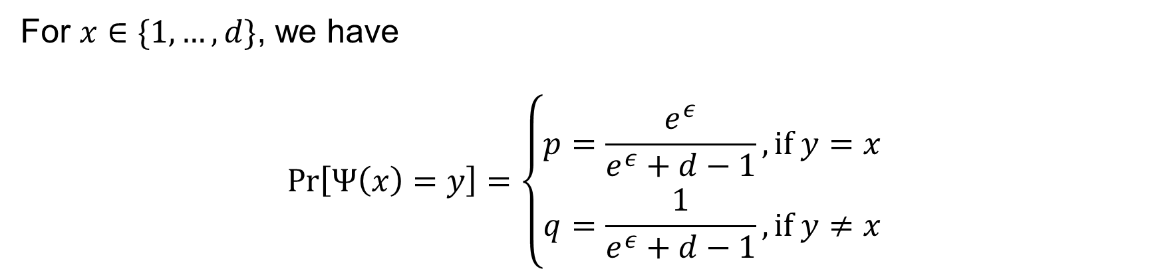


Frequency estimation protocols
General Random Response (GRR)
For $x∈\{1,…,d\}$, we have
$$\operatorname{Pr}\left[Ψ\left(x\right)=y\right]=\left\{\begin{aligned}p=\frac{e^{ε}}{e^{ε}+d−1}, if y=x \\ q=\frac{1}{e^{ε}+d−1}, if y≠x\end{aligned}\right.$$
$$p$$
$$q$$
$$q$$
$$q$$
$$x=1$$
$$y=$$
1
2
3
$$d$$

Slide 19
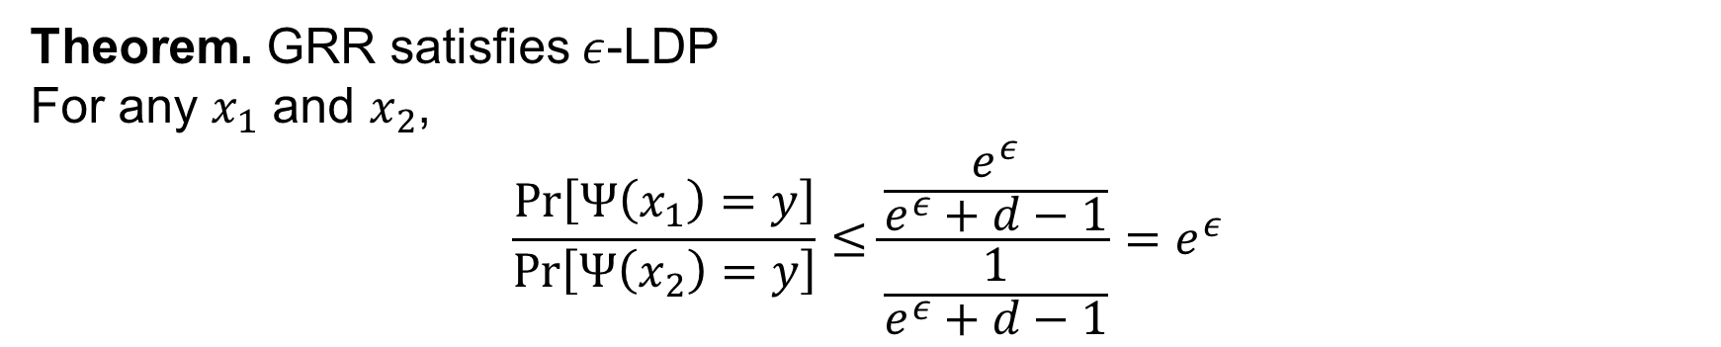
Frequency estimation protocols
Privacy Analysis
Theorem. GRR satisfies $ε$-LDP
For any $x_{1}$ and $x_{2}$,
$$\frac{\operatorname{Pr}\left[Ψ\left(x_{1}\right)=y\right]}{\operatorname{Pr}\left[Ψ\left(x_{2}\right)=y\right]}≤\frac{\frac{e^{ε}}{e^{ε}+d−1}}{\frac{1}{e^{ε}+d−1}}=e^{ε}$$

Slide 20
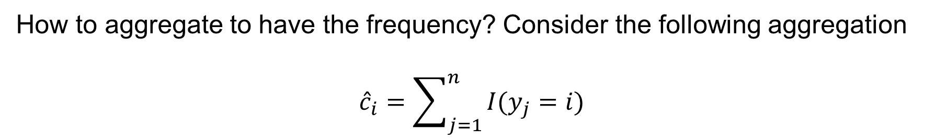
Frequency estimation protocols
General Random Response (GRR)
How to aggregate to have the frequency? Consider the following aggregation
$${\hat{c}}_{i}=\sum_{j=1}^{n}{I(y_{j}=i)}$$

Slide 21
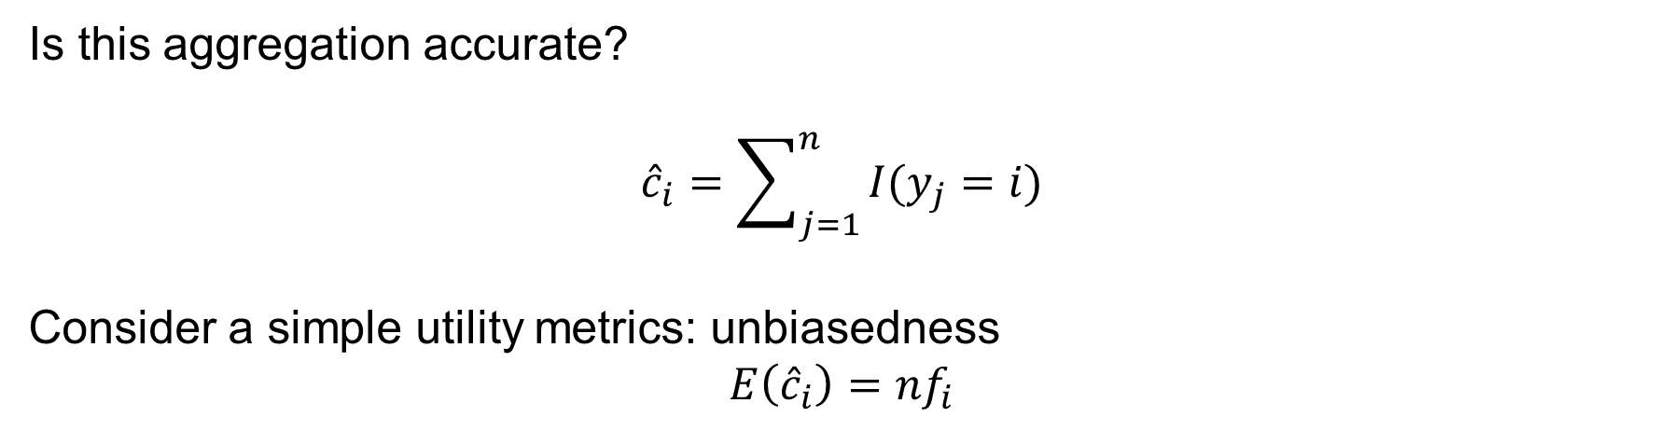
Frequency estimation protocols
General Random Response (GRR)
Is this aggregation accurate?
$${\hat{c}}_{i}=\sum_{j=1}^{n}{I(y_{j}=i)}$$
Consider a simple utility metrics: unbiasedness
$$E\left({\hat{c}}_{i}\right)={nf}_{i}$$

Slide 22
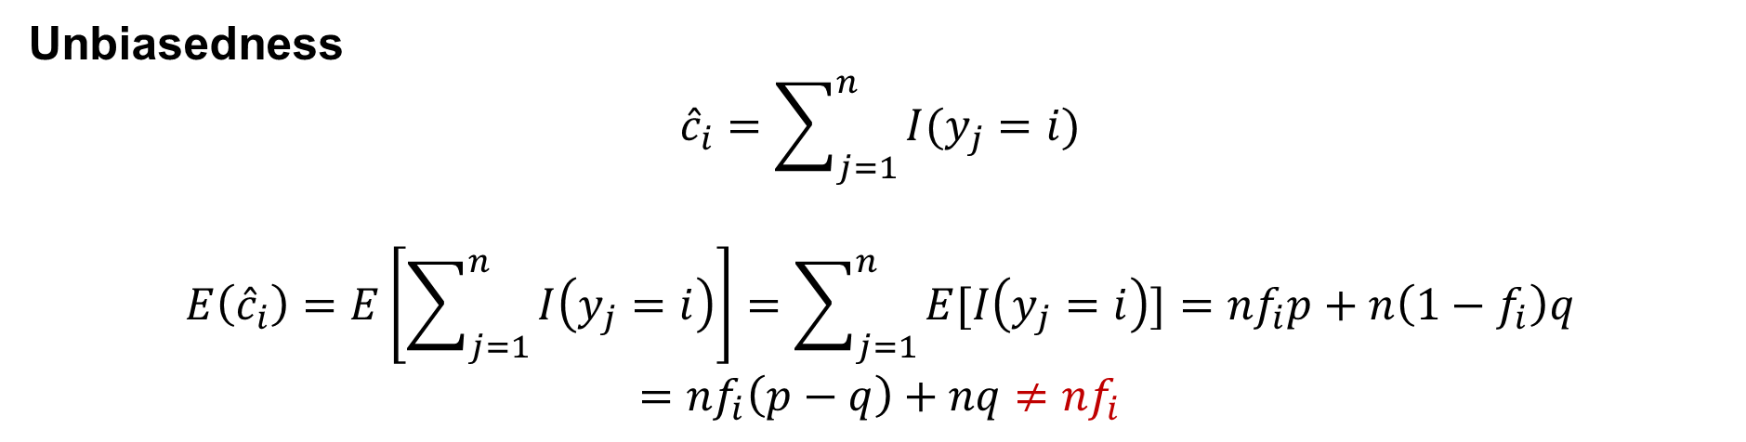
Frequency estimation protocols
General Random Response (GRR)
Unbiasedness
$${\hat{c}}_{i}=\sum_{j=1}^{n}{I(y_{j}=i)}$$
$$E\left({\hat{c}}_{i}\right)=E\left[\sum_{j=1}^{n}{I\left(y_{j}=i\right)}\right]=\sum_{j=1}^{n}{E[I\left(y_{j}=i\right)]}={nf}_{i}p+n\left(1−f_{i}\right)q$$
$$=nf_{i}\left(p−q\right)+nq≠{nf}_{i}$$

Slide 23



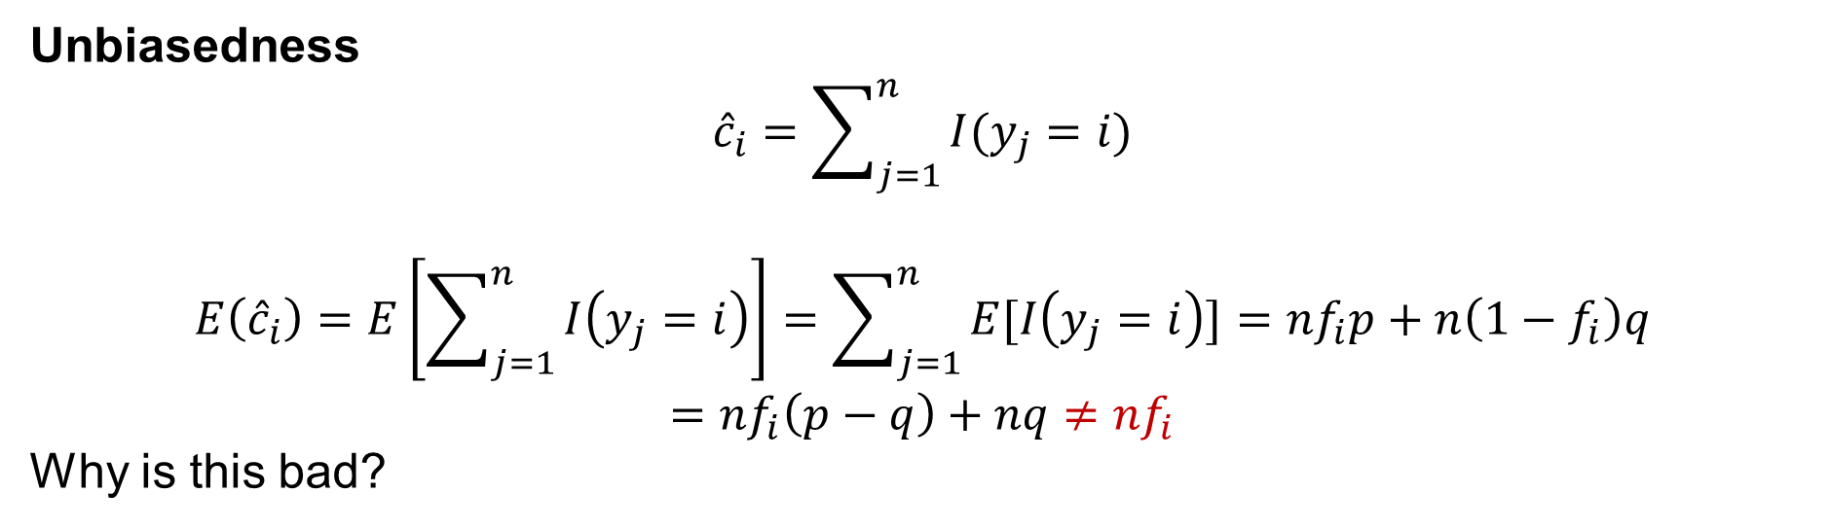






Frequency estimation protocols
General Random Response (GRR)
Unbiasedness
$${\hat{c}}_{i}=\sum_{j=1}^{n}{I(y_{j}=i)}$$
$$E\left({\hat{c}}_{i}\right)=E\left[\sum_{j=1}^{n}{I\left(y_{j}=i\right)}\right]=\sum_{j=1}^{n}{E[I\left(y_{j}=i\right)]}={nf}_{i}p+n\left(1−f_{i}\right)q$$
$$=nf_{i}\left(p−q\right)+nq≠{nf}_{i}$$
Why is this bad?
$$n$$
Lose this part
$$np$$
GRR
$$nq$$
$$nq$$
$$0$$
$$0$$
$$j=1$$
$$j=2$$
$$j=3$$
$$j=1$$
$$j=2$$
$$j=3$$

Slide 24
Frequency estimation protocols
General Random Response (GRR)
Unbiasedness
$${\hat{c}}_{i}=\sum_{j=1}^{n}{I(y_{j}=i)}$$
$$E\left({\hat{c}}_{i}\right)=E\left[\sum_{j=1}^{n}{I\left(y_{j}=i\right)}\right]=\sum_{j=1}^{n}{E[I\left(y_{j}=i\right)]}={nf}_{i}p+n\left(1−f_{i}\right)q$$
$$=nf_{i}\left(p−q\right)+nq≠{nf}_{i}$$
Why is this bad?
Needs normalization
$$n$$
Lose this part
$$np$$
GRR
$$nq$$
$$nq$$
$$0$$
$$0$$
$$j=1$$
$$j=2$$
$$j=3$$
$$j=1$$
$$j=2$$
$$j=3$$

Slide 25
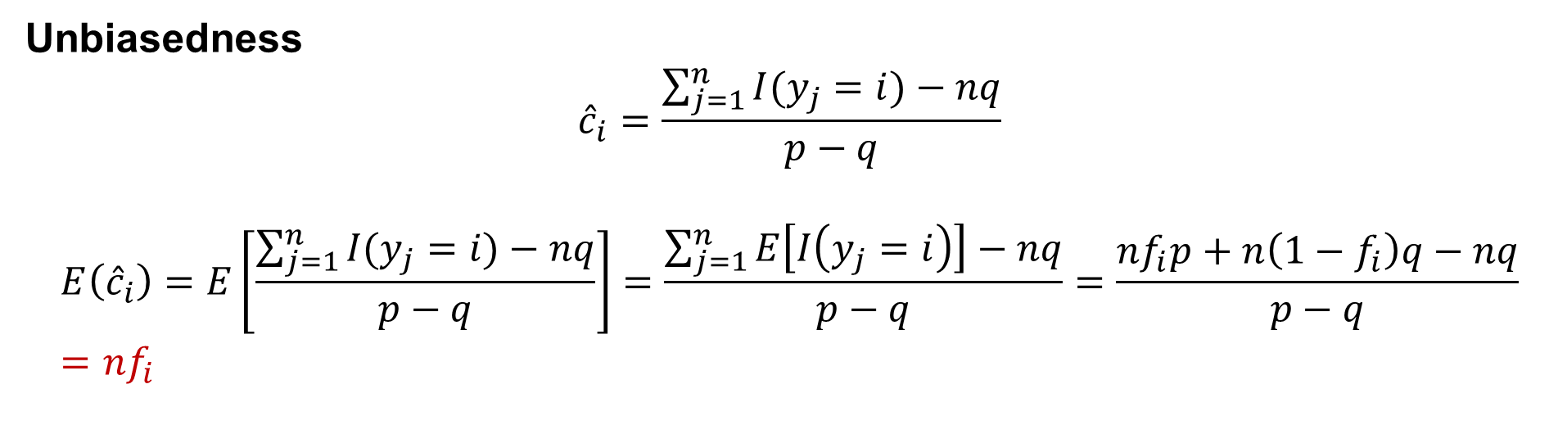
Frequency estimation protocols
General Random Response (GRR)
Unbiasedness
$${\hat{c}}_{i}=\frac{\sum_{j=1}^{n}{I(y_{j}=i)}−nq}{p−q}$$
$$E\left({\hat{c}}_{i}\right)=E\left[\frac{\sum_{j=1}^{n}{I(y_{j}=i)}−nq}{p−q}\right]=\frac{\sum_{j=1}^{n}{E\left[I\left(y_{j}=i\right)\right]}−nq}{p−q}=\frac{nf_{i}p+n\left(1−f_{i}\right)q−nq}{p−q}={nf}_{i}$$

Slide 26
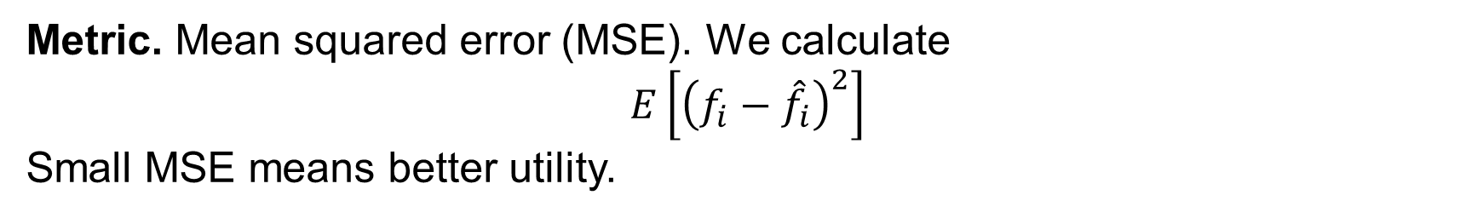
Frequency estimation protocols
Utility Analysis: Analyze the error between the estimated frequency ${\hat{f}}_{i}$ and the ground truth frequency $f_{i}$
Metric. Mean squared error (MSE). We calculate
$$E\left[{\left(f_{i}−{\hat{f}}_{i}\right)}^{2}\right]$$
Small MSE means better utility.

Slide 27
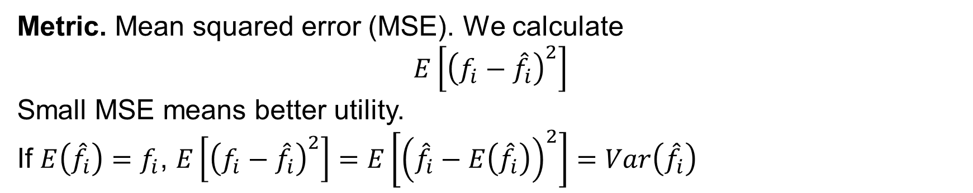
Frequency estimation protocols
Utility Analysis: Analyze the error between the estimated frequency ${\hat{f}}_{i}$ and the ground truth frequency $f_{i}$
Metric. Mean squared error (MSE). We calculate
$$E\left[{\left(f_{i}−{\hat{f}}_{i}\right)}^{2}\right]$$
Small MSE means better utility.
If $E\left({\hat{f}}_{i}\right)=f_{i}$, $E\left[{\left(f_{i}−{\hat{f}}_{i}\right)}^{2}\right]=E\left[{\left({\hat{f}}_{i}−E\left({\hat{f}}_{i}\right)\right)}^{2}\right]=Var\left({\hat{f}}_{i}\right)$

Slide 28
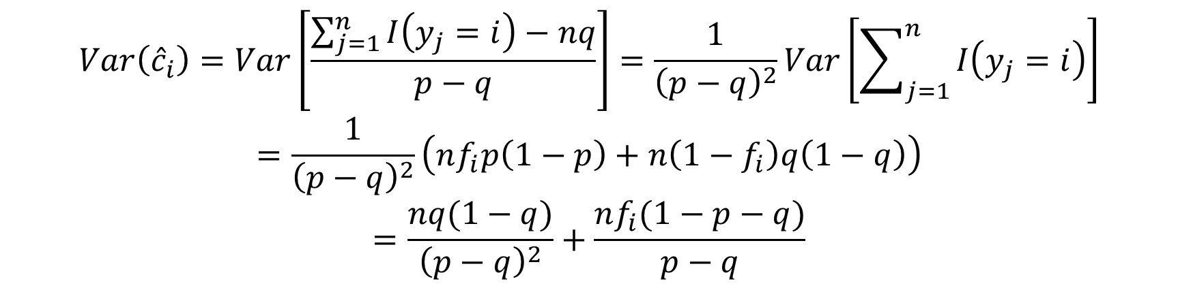
Frequency estimation protocols
Utility Analysis: Analyze the error between the estimated frequency ${\hat{f}}_{i}$ and the ground truth frequency $f_{i}$
$$Var\left({\hat{c}}_{i}\right)=Var\left[\frac{\sum_{j=1}^{n}{I\left(y_{j}=i\right)}−nq}{p−q}\right]=\frac{1}{{\left(p−q\right)}^{2}}Var\left[\sum_{j=1}^{n}{I\left(y_{j}=i\right)}\right]$$
$$=\frac{1}{{\left(p−q\right)}^{2}}\left(nf_{i}p\left(1−p\right)+n\left(1−f_{i}\right)q\left(1−q\right)\right)$$
$$=\frac{nq(1−q)}{{\left(p−q\right)}^{2}}+\frac{nf_{i}(1−p−q)}{p−q}$$

Slide 29
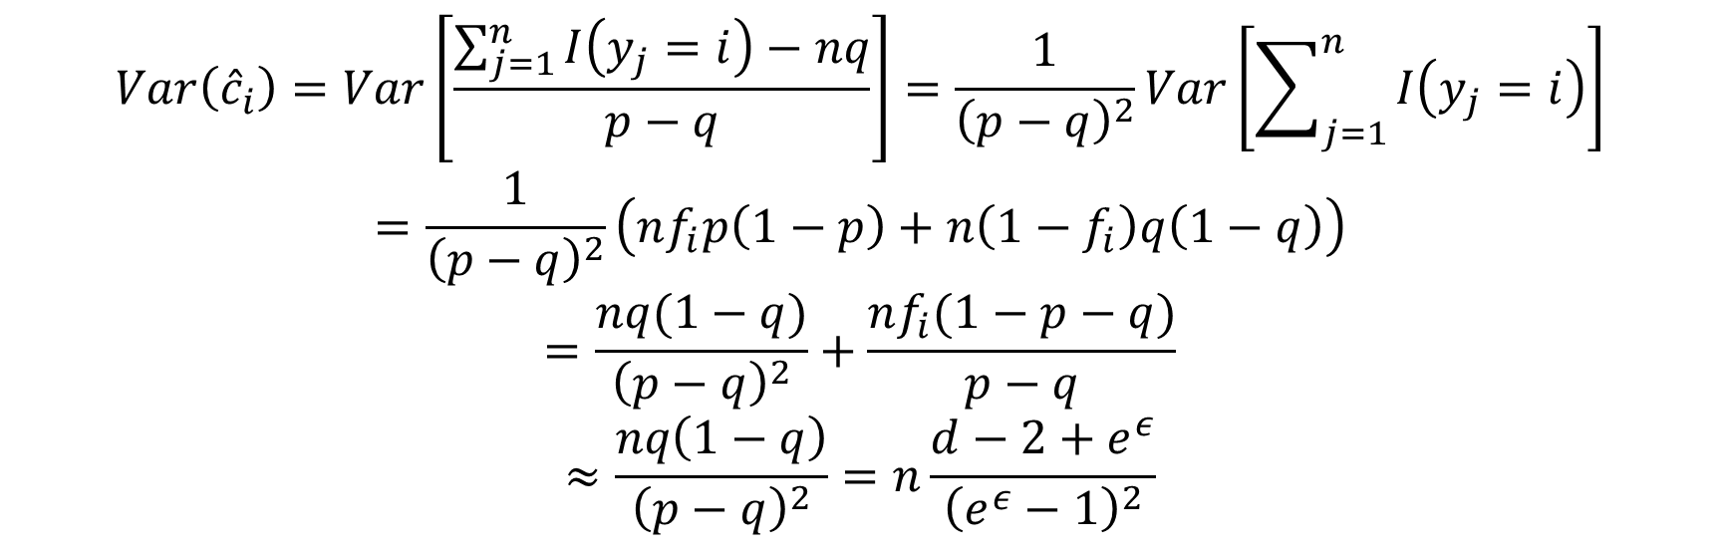

Frequency estimation protocols
Utility Analysis: Analyze the error between the estimated frequency ${\hat{f}}_{i}$ and the ground truth frequency $f_{i}$
$$Var\left({\hat{c}}_{i}\right)=Var\left[\frac{\sum_{j=1}^{n}{I\left(y_{j}=i\right)}−nq}{p−q}\right]=\frac{1}{{\left(p−q\right)}^{2}}Var\left[\sum_{j=1}^{n}{I\left(y_{j}=i\right)}\right]$$
$$=\frac{1}{{\left(p−q\right)}^{2}}\left(nf_{i}p\left(1−p\right)+n\left(1−f_{i}\right)q\left(1−q\right)\right)$$
$$=\frac{nq(1−q)}{{\left(p−q\right)}^{2}}+\frac{nf_{i}(1−p−q)}{p−q}$$
$$≈\frac{nq\left(1−q\right)}{{\left(p−q\right)}^{2}}=n\frac{d−2+e^{ε}}{{\left(e^{ε}−1\right)}^{2}}$$
Omit this since $f_{i}$ is small

Slide 30
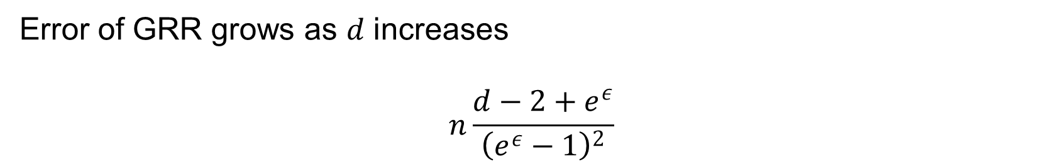
Frequency estimation protocols
Utility Analysis: Analyze the error between the estimated frequency ${\hat{f}}_{i}$ and the ground truth frequency $f_{i}$
Error of GRR grows as $d$ increases
$$n\frac{d−2+e^{ε}}{{\left(e^{ε}−1\right)}^{2}}$$

Slide 31
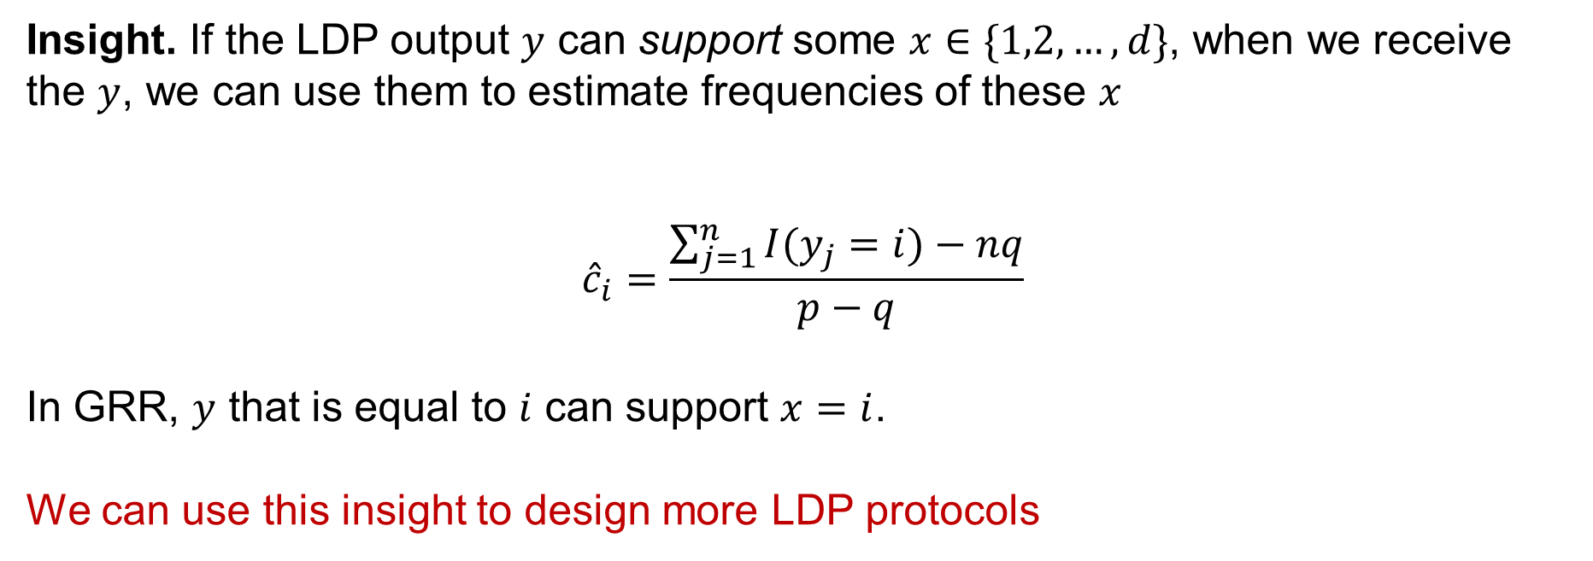
Frequency estimation protocols
Insight. If the LDP output $y$ can support some $x∈\{1,2,…,d\}$, when we receive the $y$, we can use them to estimate frequencies of these $x$
$${\hat{c}}_{i}=\frac{\sum_{j=1}^{n}{I(y_{j}=i)}−nq}{p−q}$$
In GRR, $y$ that is equal to $i$ can support $x=i$.
We can use this insight to design more LDP protocols

Slide 32
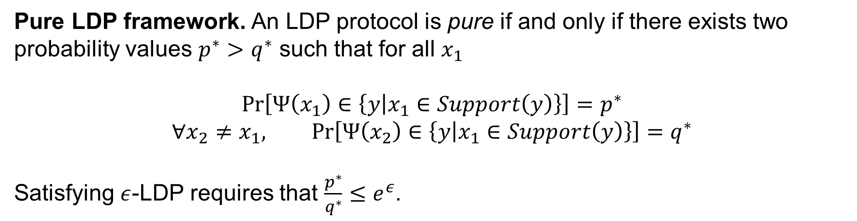
Frequency estimation protocols
Pure LDP framework. An LDP protocol is pure if and only if there exists two probability values $p^{∗}>q^{∗}$ such that for all $x_{1}$
$$\operatorname{Pr}\left[Ψ\left(x_{1}\right)∈\left\{y | x_{1}∈Support\left(y\right)\right\}\right]=p^{∗}$$
$$∀x_{2}≠x_{1}, \operatorname{Pr}\left[Ψ\left(x_{2}\right)∈\left\{y | x_{1}∈Support\left(y\right)\right\}\right]=q^{∗}$$
Satisfying $ε$-LDP requires that $\frac{p^{∗}}{q^{∗}}≤e^{ε}$.

Slide 33
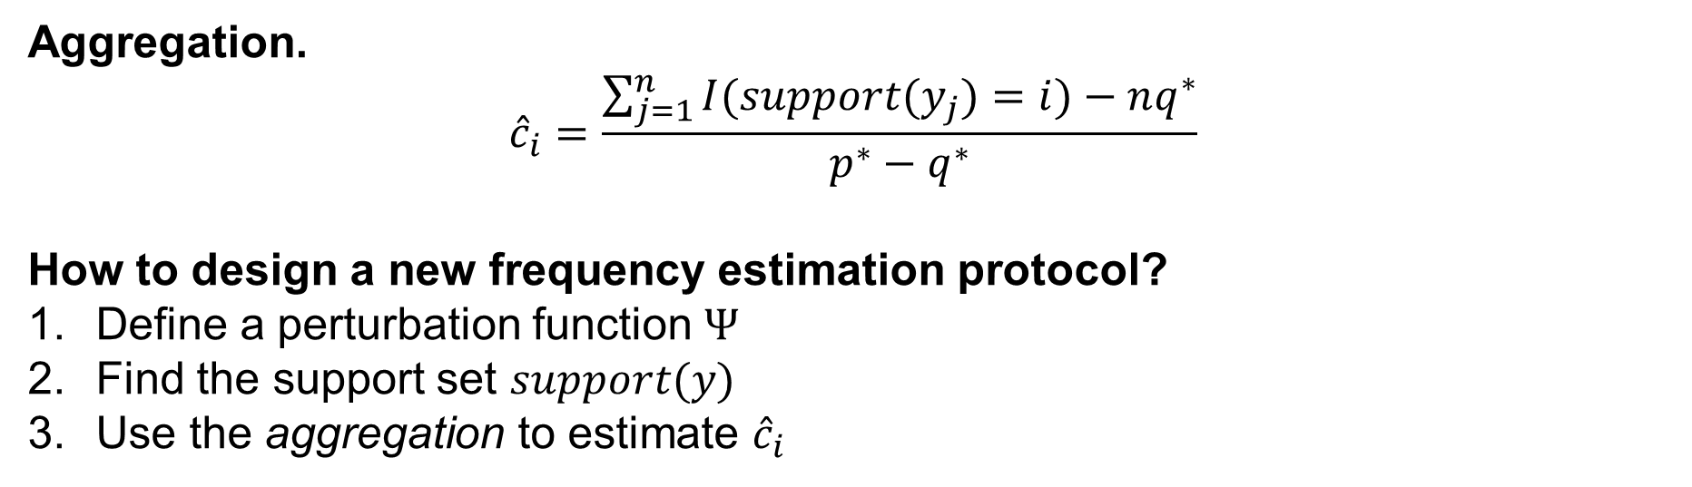
Frequency estimation protocols
Aggregation.
$${\hat{c}}_{i}=\frac{\sum_{j=1}^{n}{I(support(y_{j})=i)}−nq^{∗}}{p^{∗}−q^{∗}}$$
How to design a new frequency estimation protocol?
Define a perturbation function $Ψ$
Find the support set $support(y)$
Use the aggregation to estimate ${\hat{c}}_{i}$

Slide 34
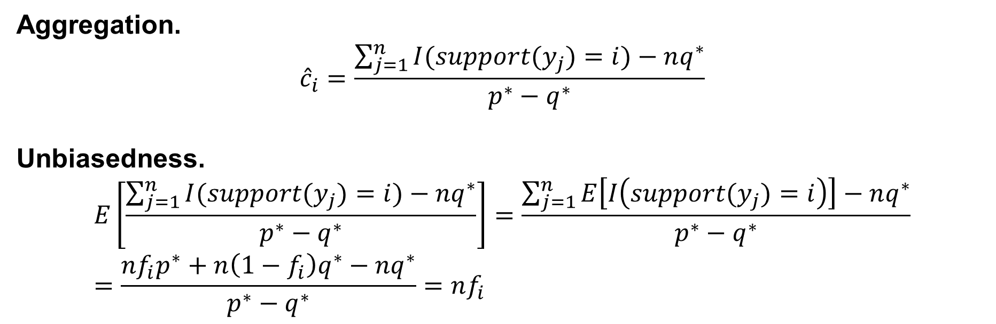
Frequency estimation protocols
Aggregation.
$${\hat{c}}_{i}=\frac{\sum_{j=1}^{n}{I(support(y_{j})=i)}−nq^{∗}}{p^{∗}−q^{∗}}$$
Unbiasedness.
$$E\left[\frac{\sum_{j=1}^{n}{I(support(y_{j})=i)}−nq^{∗}}{p^{∗}−q^{∗}}\right]=\frac{\sum_{j=1}^{n}{E\left[I\left(support(y_{j})=i\right)\right]}−nq^{∗}}{p^{∗}−q^{∗}}=\frac{nf_{i}p^{∗}+n\left(1−f_{i}\right)q^{∗}−nq^{∗}}{p^{∗}−q^{∗}}=nf_{i}$$

Slide 35

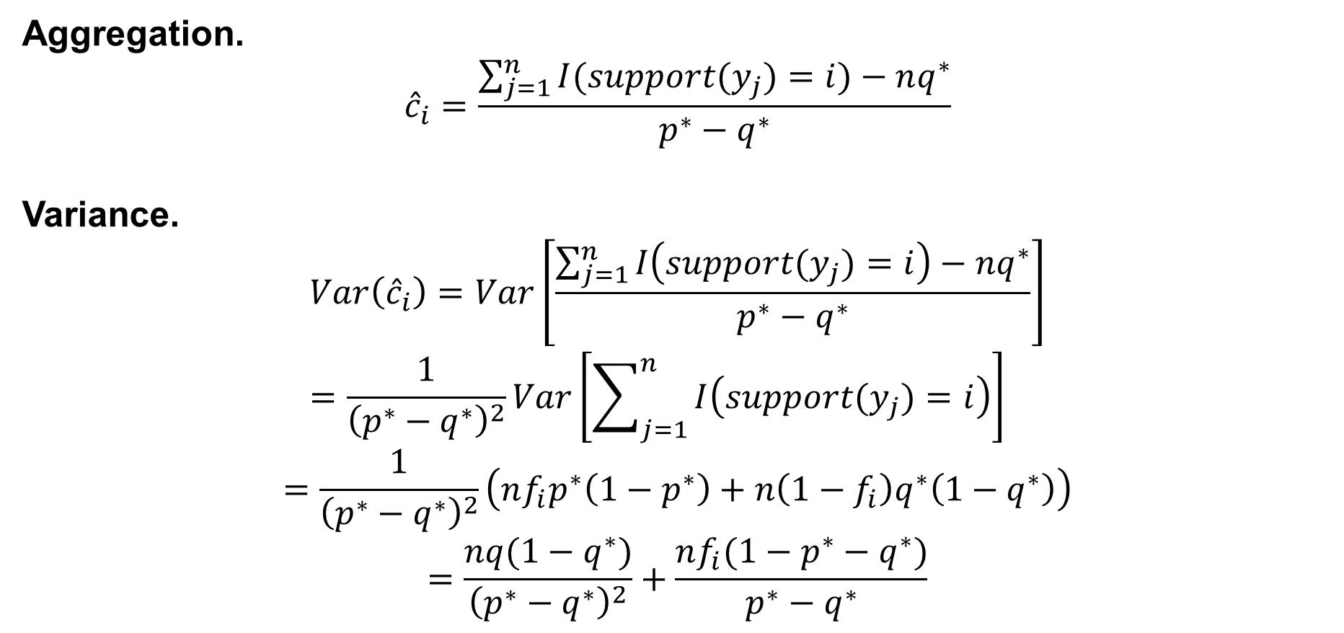
Frequency estimation protocols
Aggregation.
$${\hat{c}}_{i}=\frac{\sum_{j=1}^{n}{I(support(y_{j})=i)}−nq^{∗}}{p^{∗}−q^{∗}}$$
Variance.
$$Var\left({\hat{c}}_{i}\right)=Var\left[\frac{\sum_{j=1}^{n}{I\left(support(y_{j})=i\right)}−nq^{∗}}{p^{∗}−q^{∗}}\right]=\frac{1}{{\left(p^{∗}−q^{∗}\right)}^{2}}Var\left[\sum_{j=1}^{n}{I\left(support(y_{j})=i\right)}\right]$$
$$=\frac{1}{{\left(p^{∗}−q^{∗}\right)}^{2}}\left(nf_{i}p^{∗}\left(1−p^{∗}\right)+n\left(1−f_{i}\right)q^{∗}\left(1−q^{∗}\right)\right)$$
$$=\frac{nq(1−q^{∗})}{{\left(p^{∗}−q^{∗}\right)}^{2}}+\frac{nf_{i}(1−p^{∗}−q^{∗})}{p^{∗}−q^{∗}}$$
Omit this since $f_{i}$ is small

Slide 36
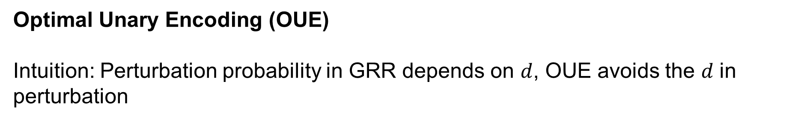
Frequency estimation protocols
Optimal Unary Encoding (OUE)
Intuition: Perturbation probability in GRR depends on $d$, OUE avoids the $d$ in perturbation

Slide 37

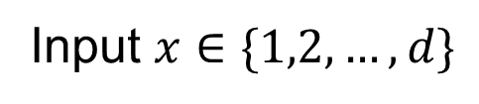
Frequency estimation protocols
Optimal Unary Encoding (OUE)
Step 1: Encoding
Input $x∈\{1,2,…,d\}$
0
0
…
1
…
0
$$x$$

Slide 38


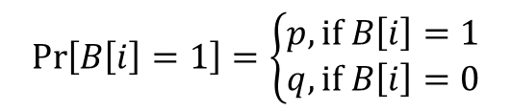
Frequency estimation protocols
Optimal Unary Encoding (OUE)
Step 2: Perturbation
0
0
…
1
…
0
1
0
…
1
…
1
$$x$$
$$\operatorname{Pr}\left[B\left[i\right]=1\right]=\left\{\begin{aligned}p, if B\left[i\right]=1 \\ q,if B\left[i\right]=0\end{aligned}\right.$$
$$x$$

Slide 39

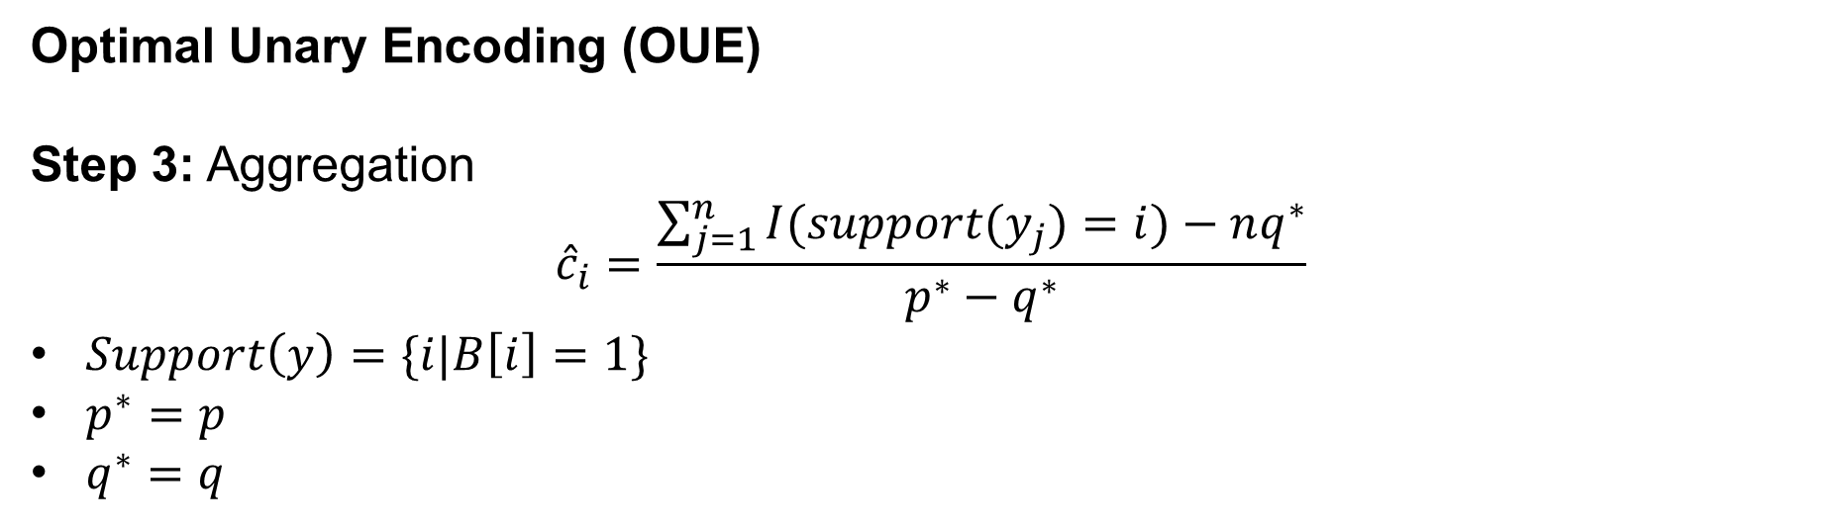
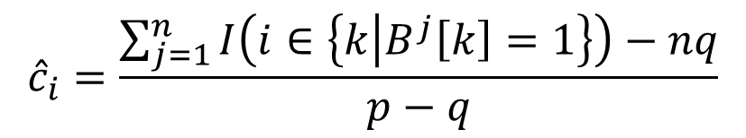
Frequency estimation protocols
Optimal Unary Encoding (OUE)
Step 3: Aggregation
$${\hat{c}}_{i}=\frac{\sum_{j=1}^{n}{I(support(y_{j})=i)}−nq^{∗}}{p^{∗}−q^{∗}}$$
$Support\left(y\right)=\{i|B\left[i\right]=1\}$
$p^{∗}=p$
$q^{∗}=q$
User 1
1
0
…
1
…
1
$${\hat{c}}_{i}=\frac{\sum_{j=1}^{n}{I\left(i∈\left\{k | B^{j}\left[k\right]=1\right\}\right)}−nq}{p−q}$$
User 2
1
1
…
1
…
1
User 3
0
0
…
0
…
0
User 4
1
0
…
0
…
1
$$…$$

Slide 40
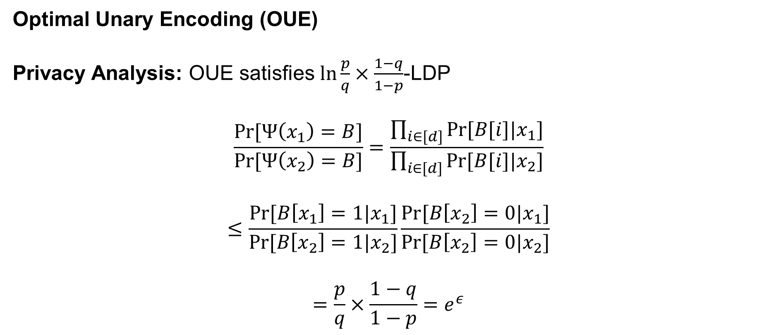
Frequency estimation protocols
Optimal Unary Encoding (OUE)
Privacy Analysis: OUE satisfies $\ln{\frac{p}{q}×\frac{1−q}{1−p}}$-LDP
$$\frac{Pr⁡[Ψ\left(x_{1}\right)=B]}{Pr⁡[Ψ\left(x_{2}\right)=B]}=\frac{\prod_{i∈[d]}{Pr⁡[B[i]|x_{1}]}}{\prod_{i∈[d]}{Pr⁡[B[i]|x_{2}]}}$$
$$≤\frac{Pr⁡[B\left[x_{1}\right]=1|x_{1}]}{Pr⁡[B\left[x_{2}\right]=1|x_{2}]}\frac{Pr⁡[B\left[x_{2}\right]=0|x_{1}]}{Pr⁡[B\left[x_{2}\right]=0|x_{2}]}$$
$$=\frac{p}{q}×\frac{1−q}{1−p}=e^{ε}$$

Slide 41
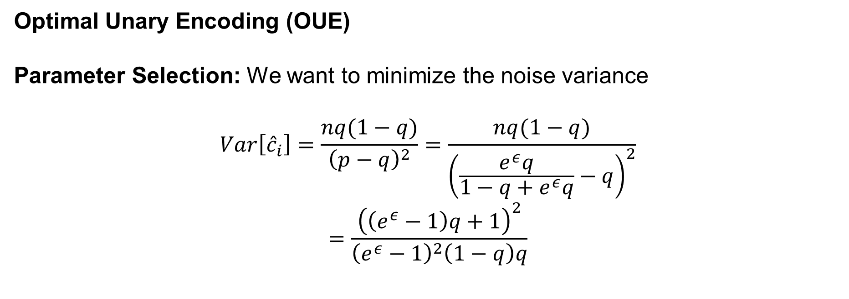
Frequency estimation protocols
Optimal Unary Encoding (OUE)
Parameter Selection: We want to minimize the noise variance
$$Var\left[{\hat{c}}_{i}\right]=\frac{nq(1−q)}{{\left(p−q\right)}^{2}}=\frac{nq(1−q)}{{\left(\frac{e^{ε}q}{1−q+e^{ε}q}−q\right)}^{2}}$$
$$=\frac{{\left(\left(e^{ε}−1\right)q+1\right)}^{2}}{{\left(e^{ε}−1\right)}^{2}\left(1−q\right)q}$$

Slide 42
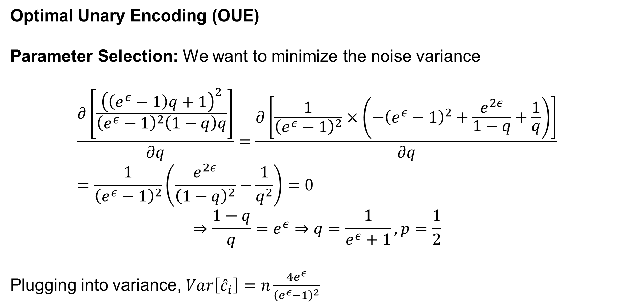
Frequency estimation protocols
Optimal Unary Encoding (OUE)
Parameter Selection: We want to minimize the noise variance
$$\frac{∂\left[\frac{{\left(\left(e^{ε}−1\right)q+1\right)}^{2}}{{\left(e^{ε}−1\right)}^{2}\left(1−q\right)q}\right]}{∂q}=\frac{∂\left[\frac{1}{{\left(e^{ε}−1\right)}^{2}}×\left(−{\left(e^{ε}−1\right)}^{2}+\frac{e^{2ε}}{1−q}+\frac{1}{q}\right)\right]}{∂q}=\frac{1}{{\left(e^{ε}−1\right)}^{2}}\left(\frac{e^{2ε}}{{\left(1−q\right)}^{2}}−\frac{1}{q^{2}}\right)=0$$
$$⇒\frac{1−q}{q}=e^{ε}⇒q=\frac{1}{e^{ε}+1},p=\frac{1}{2}$$
Plugging into variance, $Var\left[{\hat{c}}_{i}\right]=n\frac{4e^{ε}}{{\left(e^{ε}−1\right)}^{2}}$

Slide 43
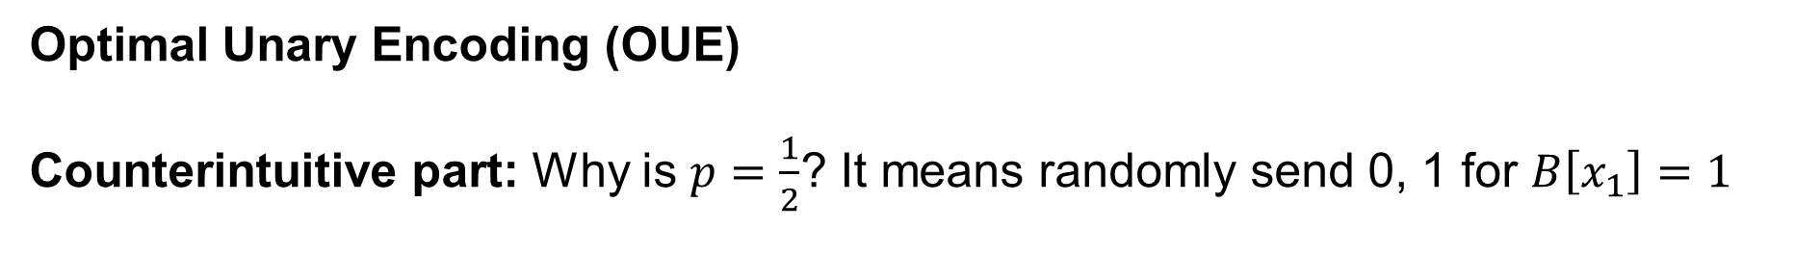
Frequency estimation protocols
Optimal Unary Encoding (OUE)
Counterintuitive part: Why is $p=\frac{1}{2}$? It means randomly send 0, 1 for $B\left[x_{1}\right]=1$

Slide 44

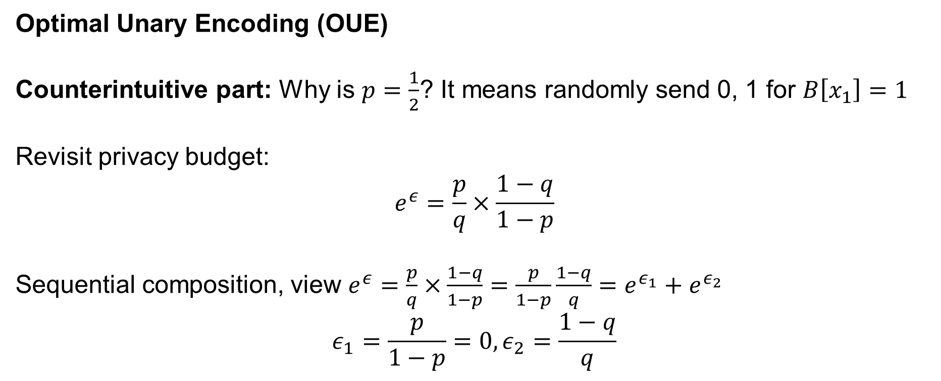

Frequency estimation protocols
Optimal Unary Encoding (OUE)
Counterintuitive part: Why is $p=\frac{1}{2}$? It means randomly send 0, 1 for $B\left[x_{1}\right]=1$
Revisit privacy budget:
$$e^{ε}=\frac{p}{q}×\frac{1−q}{1−p}$$
Sequential composition, view $e^{ε}=\frac{p}{q}×\frac{1−q}{1−p}=\frac{p}{1−p}\frac{1−q}{q}=e^{ε_{1}}+e^{ε_{2}}$
$$ε_{1}=\frac{p}{1−p}=0,ε_{2}=\frac{1−q}{q}$$
$$ε_{1}$$
$$ε_{2}$$
0
0
…
1
…
0

Slide 45

Frequency estimation protocols
Optimal Unary Encoding (OUE)
Communication: $O(d)$
Drawback: The communication cost is too large for large $d$

Slide 46


Frequency estimation protocols
Optimal Local Hashing (OLH)
Intuition: OUE uses one bit to support one item, if we can use one bit to support multiple items, we can save more communication cost!
$$\{1, 2,…,i,…,d\}$$
$$\{1, 2,…,i,…,d\}$$
OUE Encoding
New Encoding
0
0
…
1
…
0
0
…
1
…

Slide 47






Frequency estimation protocols
Optimal Local Hashing (OLH)
Step 1: Encoding
1
2
1
Input $x∈\{1,2,…,d\}$
…
…
$$x$$
$$x_{h}$$
…
$$g$$
$$d$$
Local Hashing $H$

Slide 48









Frequency estimation protocols
Optimal Local Hashing (OLH)
Step 2: Perturbation
1
2
1
$$\operatorname{Pr}\left[Ψ\left(x_{h}\right)=y\right]=\left\{\begin{aligned}p=\frac{e^{ε}}{e^{ε}+g−1} \\ q=\frac{1}{e^{ε}+g−1}\end{aligned}\right.$$
…
…
$$y$$
$$x$$
$$x_{h}$$
…
$$g$$
$$d$$
Local Hashing $H$
GRR
Local Hashing $H$
Perturbed result $y$

Slide 49







Frequency estimation protocols
Optimal Local Hashing (OLH)
Step 3: Aggregation, ${\hat{c}}_{i}=\frac{\sum_{j=1}^{n}{I(support(<H_{j},y_{j}>)=i)}−nq^{∗}}{p^{∗}−q^{∗}}$
1
2
1
…
…
$$support\left(<H,y>\right)=\{i|H\left(i\right)=y\}$$
$$x$$
$$x_{h}$$
…
$$y$$
$$d$$
Local Hashing $H$

Slide 50

Frequency estimation protocols
Optimal Local Hashing (OLH)
Step 3: Aggregation, ${\hat{c}}_{i}=\frac{\sum_{j=1}^{n}{I(support(<H_{j},y_{j}>)=i)}−nq^{∗}}{p^{∗}−q^{∗}}$
$$\operatorname{Pr}\left[Ψ\left(x_{1}\right)∈\left\{y | x_{1}∈Support\left(y\right)\right\}\right]=p^{∗}$$
$$∀x_{2}≠x_{1}, \operatorname{Pr}\left[Ψ\left(x_{2}\right)∈\left\{y | x_{1}∈Support\left(y\right)\right\}\right]=q^{∗}$$
$p^{∗}=p$
$q^{∗}=\frac{1}{g}×p+\frac{g−1}{g}×q=\frac{1}{g}$

Slide 51

Frequency estimation protocols
Optimal Local Hashing (OLH)
How to choose $g$? We want to minimize the variance
$$Var\left[{\hat{c}}_{i}\right]=\frac{nq^{∗}(1−q^{∗})}{{\left(p^{∗}−q^{∗}\right)}^{2}}=n\frac{{\left(e^{ε}−1+g\right)}^{2}}{{\left(e^{ε}−1\right)}^{2}\left(g−1\right)}$$

Slide 52

Frequency estimation protocols
Optimal Local Hashing (OLH)
How to choose $g$? We want to minimize the variance
$$\frac{∂\left[\frac{{\left(e^{ε}−1+g\right)}^{2}}{{\left(e^{ε}−1\right)}^{2}\left(g−1\right)}\right]}{∂g}=\frac{∂\left[\frac{g−1}{{\left(e^{ε}−1\right)}^{2}}+\frac{1}{g−1}×\frac{e^{2ε}}{{\left(e^{ε}−1\right)}^{2}}+\frac{e^{2ε}}{{\left(e^{ε}−1\right)}^{2}}\right]}{∂g}=\frac{1}{{\left(e^{ε}−1\right)}^{2}}−\frac{1}{{\left(g−1\right)}^{2}}×\frac{e^{2ε}}{{\left(e^{ε}−1\right)}^{2}}=0⇒g=e^{ε}+1$$
Plugging this into variance: $Var\left[{\hat{c}}_{i}\right]=n\frac{4e^{ε}}{{\left(e^{ε}−1\right)}^{2}}$

Slide 53


Frequency estimation protocols
Optimal Local Hashing (OLH)
Communication Cost: $O(\log{n})$
Each of $n$ users needs a different local hash $H_{j}$,
There are $n$ hash functions
To represent one $H_{j}$, we need $O(\log{n})$ bits

Slide 54


Frequency estimation protocols
Which one to use?
 | GRR | OUE | OLH
Variance | $$n\frac{d−2+e^{ε}}{{\left(e^{ε}−1\right)}^{2}}$$ | $$n\frac{4e^{ε}}{{\left(e^{ε}−1\right)}^{2}}$$ | $$n\frac{4e^{ε}}{{\left(e^{ε}−1\right)}^{2}}$$
Communication | $$O(\log{d})$$ | $$O(d)$$ | $$O(\log{n})$$
When $d<3e^{ε}+2$, GRR is better
When $d$ is large, and communication cost is acceptable, choose OUE
When $d$ is large, and communication cost is unacceptable, choose OLH

Slide 55
Contents
Definition
Frequency Estimation Protocols
Mean Estimation Protocols
Distribution Estimation Protocols
Robustness Analysis

Slide 56


Mean estimation protocols
Problem Definition
There are $n$ users and one server, each user possesses a value $x_{i}∈[−1,1]$. The server wants to estimate the mean $μ=\frac{1}{n}\sum_{i}{x_{i}}$.
John: $x_{1}=1$
LDP Randomizer
John: $y_{1}$
Alice: $x_{2}=2$
Alice: $y_{2}$
$$μ=2$$
Bob: $x_{3}=3$
Bob: $y_{3}$
Untrusted Server
Jack: $x_{4}=2$
Jack: $y_{4}$

Slide 57

Mean estimation protocols
Stochastic Rounding (SR) Mechanism
Step 1: Perturbation
$$p=\frac{e^{ε}}{e^{ε}+1}, q=1−p=\frac{1}{e^{ε}+1}$$
$$\operatorname{Pr}\left[Ψ\left(x\right)=y\right]=\left\{\begin{aligned}q+\frac{(p−q)(1+x)}{2}, if y=1 \\ q+\frac{(p−q)(1−x)}{2}, if y=−1\end{aligned}\right.$$

Slide 58

Mean estimation protocols
Stochastic Rounding (SR) Mechanism
Step 2: Aggregation
We observe
$$E\left[y\right]=1×\left(q+\frac{\left(p−q\right)\left(1+x\right)}{2}\right)+\left(−1\right)×\left(q+\frac{\left(p−q\right)\left(1−x\right)}{2}\right)=\left(p−q\right)x$$
Then
$$E\left[\frac{y}{p−q}\right]=x$$

Slide 59

Mean estimation protocols
Stochastic Rounding (SR) Mechanism
Step 2: Aggregation
$$E\left[\frac{1}{n}\sum_{i}{\frac{y_{i}}{p−q}}\right]=\frac{1}{n}\sum_{i}{x_{i}}=μ$$

Slide 60

Mean estimation protocols
Stochastic Rounding (SR) Mechanism
Variance Analysis
$$Var\left[\frac{1}{n}\sum_{i}{\frac{y_{i}}{p−q}}\right]=\frac{1}{n^{2}{\left(p−q\right)}^{2}}\sum_{i}{Var[y_{i}]}$$

Slide 61

Mean estimation protocols
Stochastic Rounding (SR) Mechanism
Variance Analysis
$$Var\left[\frac{1}{n}\sum_{i}{\frac{y_{i}}{p−q}}\right]=\frac{1}{n^{2}{\left(p−q\right)}^{2}}\sum_{i}{Var[y_{i}]}$$
$$Var\left[y_{i}\right]=E\left[y_{i}^{2}\right]−E{\left[y_{i}\right]}^{2}$$
Distribution of $y$
$$\operatorname{Pr}\left[y=k\right]=\left\{\begin{aligned}q+\frac{(p−q)(1+x)}{2}, if k=1 \\ q+\frac{(p−q)(1−x)}{2}, if k=−1\end{aligned}\right.$$

Slide 62

Mean estimation protocols
Stochastic Rounding (SR) Mechanism
Variance Analysis
$$Var\left[\frac{1}{n}\sum_{i}{\frac{y_{i}}{p−q}}\right]=\frac{1}{n^{2}{\left(p−q\right)}^{2}}\sum_{i}{Var[y_{i}]}$$
$$Var\left[y_{i}\right]=E\left[y_{i}^{2}\right]−E{\left[y_{i}\right]}^{2}$$
Distribution of $y^{2}$
$$\operatorname{Pr}\left[y^{2}=1\right]=1$$

Slide 63

Mean estimation protocols
Stochastic Rounding (SR) Mechanism
Variance Analysis
$$Var\left[\frac{1}{n}\sum_{i}{\frac{y_{i}}{p−q}}\right]=\frac{1}{n^{2}{\left(p−q\right)}^{2}}\sum_{i}{Var[y_{i}]}$$
$$Var\left[y_{i}\right]=1−{\left(p−q\right)}^{2}x_{i}^{2}$$
$$Var\left[\frac{1}{n}\sum_{i}{\frac{y_{i}}{p−q}}\right]=\frac{1}{n^{2}{\left(p−q\right)}^{2}}\sum_{i}{Var[y_{i}]}=\frac{n−{\left(p−q\right)}^{2}\sum_{i}{x_{i}^{2}}}{n^{2}{\left(p−q\right)}^{2}}$$

Slide 64

Mean estimation protocols
Stochastic Rounding (SR) Mechanism
Variance Analysis
$$Var\left[\frac{1}{n}\sum_{i}{\frac{y_{i}}{p−q}}\right]=\frac{1}{n^{2}{\left(p−q\right)}^{2}}\sum_{i}{Var[y_{i}]}$$
$$Var\left[y_{i}\right]=1−{\left(p−q\right)}^{2}x_{i}^{2}$$
$$Var\left[\frac{1}{n}\sum_{i}{\frac{y_{i}}{p−q}}\right]=\frac{1}{n^{2}{\left(p−q\right)}^{2}}\sum_{i}{Var[y_{i}]}=\frac{n−{\left(p−q\right)}^{2}\sum_{i}{x_{i}^{2}}}{n^{2}{\left(p−q\right)}^{2}}$$
The error is minimal when all $x$ are 1 or -1

Slide 65
Contents
Definition
Frequency Estimation Protocols
Mean Estimation Protocols
Distribution Estimation Protocols
Robustness Analysis

Slide 66


Distribution estimation protocols
Problem Definition
There are $n$ users and one server, each user possesses a value $x_{i}∈[0,1]$. The server wants to estimate the data distribution.
John: $x_{1}=1$
LDP Randomizer
John: $y_{1}$
Alice: $x_{2}=2$
Alice: $y_{2}$
Bob: $x_{3}=3$
Bob: $y_{3}$
Untrusted Server
Jack: $x_{4}=2$
Jack: $y_{4}$

Slide 67


Distribution estimation protocols
Comparison with frequency estimation
Frequency estimation
The server wants to estimate the count ${\hat{c}}_{j}$ (frequency ${\hat{f}}_{j}$) of each value $j∈\{1,2,…,d\}$.
Distribution estimation
There are $n$ users and one server, each user possesses a value $x_{i}∈[0,1]$. The server wants to estimate the data distribution.
2
1
1
$$j=1$$
$$j=2$$
$$j=3$$
No order, exchangeable
Ordinal, unexchangeable

Slide 68
Distribution estimation protocols
Key point in LDP protocol for distribution estimation
Preserve the ordinal information of the data

Slide 69

Distribution estimation protocols
Key point in LDP protocol for distribution estimation
Preserve the ordinal information of the data
Intuition: Output $y$ with high probability if $y$ is close to $x$
We have $x∈[0,1]$, $y∈[−b,1+b]$
$$\operatorname{Pr}\left[Ψ\left(x\right)=y\right]=\left\{\begin{aligned}p, if \left|x−y\right|<b \\ q, if \left|x−y\right|≥b\end{aligned}\right.$$

Slide 70




Distribution estimation protocols
Key point in LDP protocol for distribution estimation
Preserve the ordinal information of the data
Intuition: Output $y$ with high probability if $y$ is close to $x$
But….which one is the best?
$$x$$
$$x$$
$$x$$

Slide 71
Distribution estimation protocols
Solution: As to distinguish different outputs, we want to make the distributions of two outputs $y_{1}=Ψ(x_{1})$ and $y_{2}=Ψ(x_{2})$ largest

Slide 72

Distribution estimation protocols
Solution: As to distinguish different outputs, we want to make the distributions of two outputs $y_{1}=Ψ(x_{1})$ and $y_{2}=Ψ(x_{2})$ largest
Lemma. Given $x_{1},x_{2}(x_{2}>x_{1})$ and $Δ=x_{2}−x_{1}$, the Wasserstein distance between $y_{1}=Ψ(x_{1})$ and $y_{2}=Ψ(x_{2})$ is $Δ(1−\left(2b+1\right)q)$
Proof. See “Estimating Numerical Distributions under Local Differential Privacy. SIGMOD 2020”

Slide 73

Distribution estimation protocols
Solution: As to distinguish different outputs, we want to make the distributions of two outputs $y_{1}=Ψ(x_{1})$ and $y_{2}=Ψ(x_{2})$ largest
Lemma. Given $x_{1},x_{2}(x_{2}>x_{1})$ and $Δ=x_{2}−x_{1}$, the Wasserstein distance between $y_{1}=Ψ(x_{1})$ and $y_{2}=Ψ(x_{2})$ is $Δ(1−\left(2b+1\right)q)$
We want the minimal $q$. By the definition of distribution,
$$1=q+\int_{−b}^{b}{p}dx≤q+2be^{ε}q=\left(1+2be^{ε}\right)q⇒q≥\frac{1}{1+2be^{ε}}$$
$$p=\frac{e^{ε}}{1+2be^{ε}}$$

Slide 74

Distribution estimation protocols
Step 1: Perturbation
We have $x∈[0,1]$, $y∈[−b,1+b]$
$$\operatorname{Pr}\left[Ψ\left(x\right)=y\right]=\left\{\begin{aligned}p=\frac{e^{ε}}{1+2be^{ε}}, if \left|x−y\right|<b \\ q=\frac{1}{1+2be^{ε}}, if \left|x−y\right|≥b\end{aligned}\right.$$
Other question: What is the best width $b$?

Slide 75

Distribution estimation protocols
Other question: What is the best width $b$?
Intuition: To make the output $y$ carry as much information about the input $x$ as possible.
Solution: Consider to use mutual information $I(X;Y)$.

Slide 76

Distribution estimation protocols
Other question: What is the best width $b$?
$$I\left(X;Y\right)=h\left(Y\right)−h\left(Y | X\right)≤h\left(U\right)−h(Y|X)$$
$$h(U)=\log\left(2b+1\right)$$
$$h\left(Y | X\right)=\int_{x}{Pr⁡[X=x]h\left(Y | X=x\right)dx}=−\int_{x}{Pr⁡[X=x](2bp\log{p}+q\log{q})}dx$$
$$=−\left(2bp\log{p}+q\log{q}\right)=−\frac{2bεe^{ε}}{2be^{ε}+1}+\log{(2be^{ε}+1)}$$
$$I\left(X;Y\right)≤\log\left(\frac{2b+1}{2be^{ε}+1}\right)+\frac{2bεe^{ε}}{2be^{ε}+1}$$

Slide 77














Distribution estimation protocols
Step 2: Aggregation
Binning the domain $[−b,1+b]$ and $[0,1]$ to $d$ bins. $n_{j}$ is the number of values falling in the bin $i$.
$$n_{4}$$
$$n_{1}$$
$$n_{3}$$
$$n_{7}$$
$$m_{4}$$
$$n_{2}$$
EMS algorithm
$$m_{1}$$
$$n_{6}$$
$$m_{2}$$
$$m_{3}$$
$$n_{5}$$
$$m_{7}$$
$$m_{6}$$
$$m_{5}$$
-b
0
1
1+b
0
1

Slide 78




















Distribution estimation protocols
EMS algorithm: Find the maximum likelihood estimate with smoothing
$$n_{1}$$
$$n_{2}$$
$$n_{3}$$
$$n_{4}$$
$$n_{5}$$
$$n_{6}$$
$$n_{7}$$
$$−b$$
0
1
$$1+b$$
$$M_{3,4}$$
$$m_{1}$$
$$m_{2}$$
$$m_{3}$$
$$m_{4}$$
$$m_{5}$$
$$m_{6}$$
$$m_{7}$$
$M_{j,i}$ is the probability of the output values falling in bin $B_{j}$, given the input value falling in $B_{i}$.
0
$$v$$
1

Slide 79
Contents
Definition
Frequency Estimation Protocols
Mean Estimation Protocols
Distribution Estimation Protocols
Robustness Analysis

Slide 80

Robustness Analysis
LDP opens a door for attackers to manipulate the report and launch poisoning attack
Robustness: Protocol resilience to the attack

Slide 81

Robustness Analysis
Poisoning attack to frequency estimation (USENIX Security’ 21)
Goal
Increase frequency of targeted items
Attack to OUE
Attacker wants to promote the 1st and the 2nd item
User 1
1
0
…
1
…
1
User 2
1
1
…
1
…
1
User 3
0
0
…
0
…
0
User 4
1
1
…
0
…
1
User 5
1
1
…
0
…
0
User 6
1
1
…
1
…
0
$$…$$

Slide 82




Robustness Analysis
User 1
1
0
…
1
…
1
Poisoning attack to frequency estimation
Goal
Increase frequency of targeted items
Attack to OUE
Attacker wants to promote the 1st and the 2nd item
Privacy-security trade-off
High privacy (smaller $ε$) leads to low security (better attack efficacy)
User 2
1
1
…
1
…
1
User 3
0
0
…
0
…
0
User 4
1
1
…
0
…
1
User 5
1
1
…
0
…
0
User 6
1
1
…
1
…
0
$$…$$
$${\hat{c}}_{i}=\frac{\sum_{j=1}^{n}{I(support(y_{j})=i)}−nq^{∗}}{\frac{1}{2}−\frac{1}{e^{ε}+1}}$$
Getting smaller as $ε$ grows

Slide 83


Robustness Analysis
Poisoning attack to mean/variance estimation (USENIX Security’ 23)
Goal
Manipulate mean and variance to targeted values
Privacy-security consistency
High privacy (smaller $ε$) leads to better security (low attack efficacy)
Xiaoguang Li, Ninghui Li, Wenhai Sun, Neil Zhenqiang Gong, Hui Li. Fine-grained Poisoning Attack to Local Differential Privacy Protocols for Mean and Variance Estimation. USENIX Security 2023.

Slide 84


Robustness Analysis
Poisoning attack to distribution estimation (NDSS’ 25)
Goal
Shift the distribution to the right-most end
Guideline
SW mechanism is preferable!
Zero-shot detection
Detect forged data without prior knowledge
Xiaoguang Li, Zitao Li, Ninghui Li, Wenhai Sun. On the Robustness of LDP Protocols for Numerical Attributes under Data Poisoning Attacks. NDSS 2025.

