Slide 1
THE FUTURE DEMOCRATIC COMMUNITY EXPLORATION
CLOUD MIND
Notes:
http://newsfeed.time.com/2013/12/22/a-snapshot-of-the-cameras-history/

Slide 2
一到两句吸引人注意的话

Slide 5
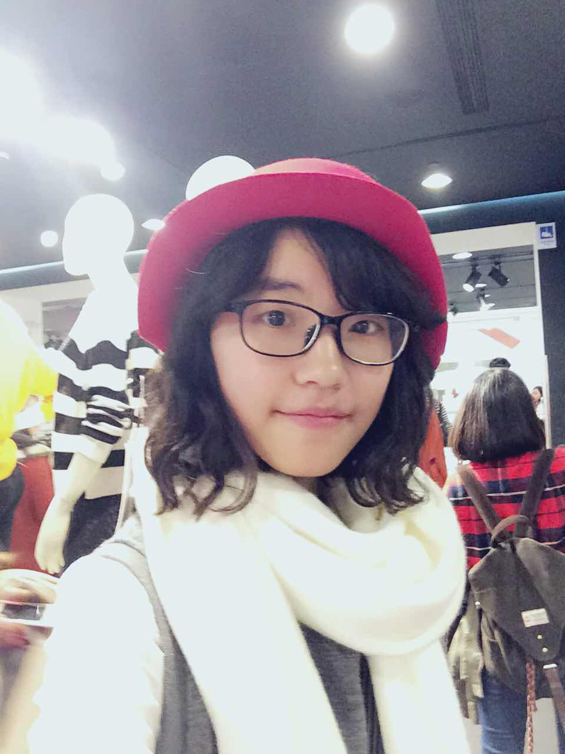
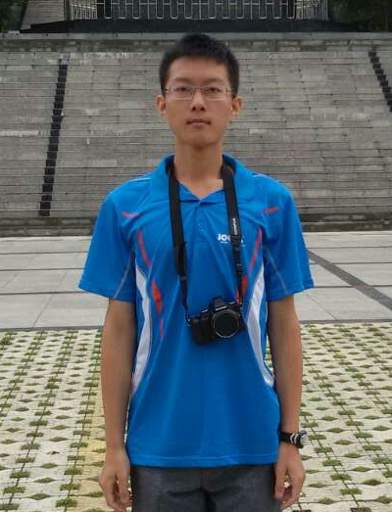
小组成员
张世超，清华大学法学院2014级本科在读学生，就读于清华大学法学院法律专业，外文系外语专业第二学位。清华大学“新雅书院”通识教育项目学员。渴望能够通过降低通信成本，减少信息传递的错误率以及虚拟空间法律规制实现跨越地域、种族、性别、宗教的深层次理解和关怀，推动地球村的民主化，增进人们的互信互联。
宁志禹 来自清华大学生命科学院，大二本科生。毕业于成都七中，自称是逐梦者。会弹钢琴，喜欢开脑洞。一般来说处世任性，但是处事严肃认真。对未来可能的Clonu Mind范式很感兴趣，并提出了不少设想。 .
Barry Cheng study in Mechanical Engineering in NTU. He has learned about Vehicle Design, Powertrain System Design, and Green Power. During his NTU days, he also try to learn about Creative Design in the workshop between NTU and Stanford and design some new inventions to attend Taipei International Cycle Show. He has enlisted in Taiwan Army as second lieutenant as Logistics Officer. His target is to find the balance between industry and nature from designing environmentally friendly vehicle, and he is still going on

