Slide 1

ValoStats
Your Ultimate gambling analytics partner

Slide 2
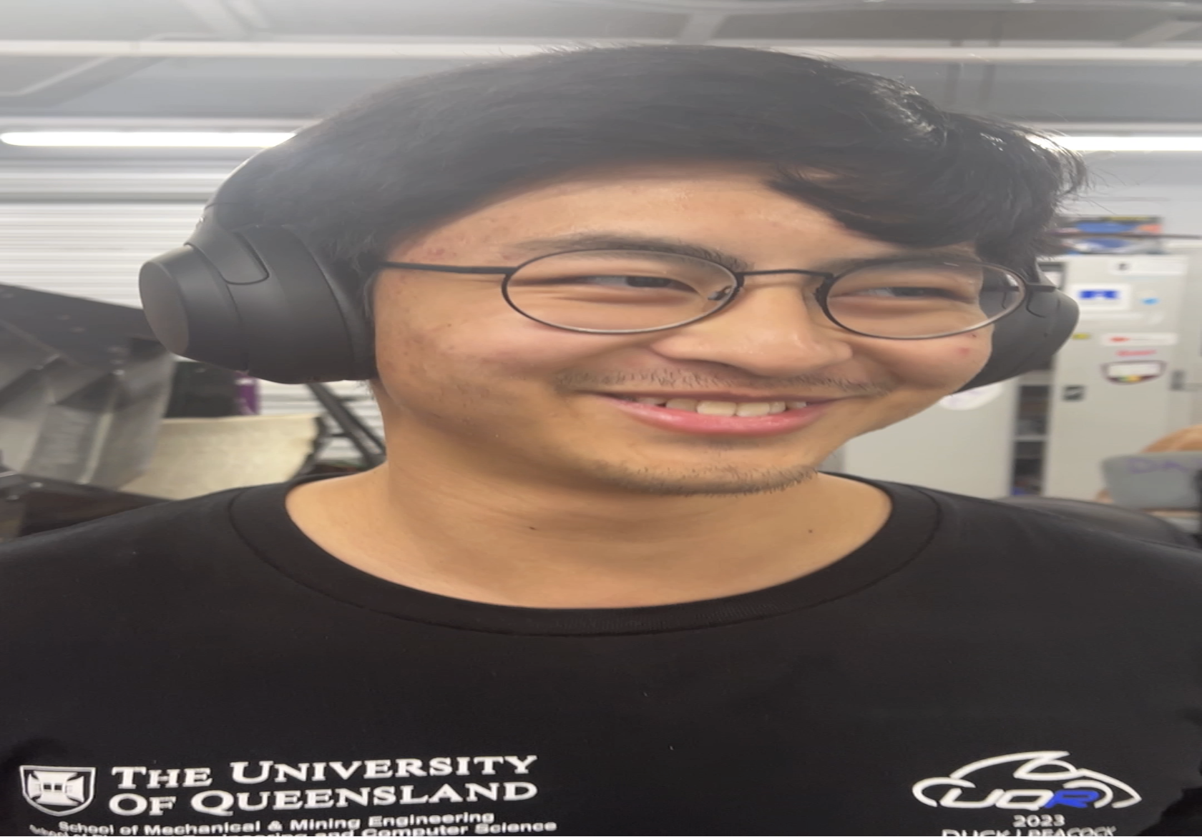
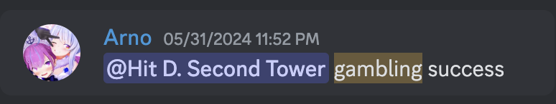
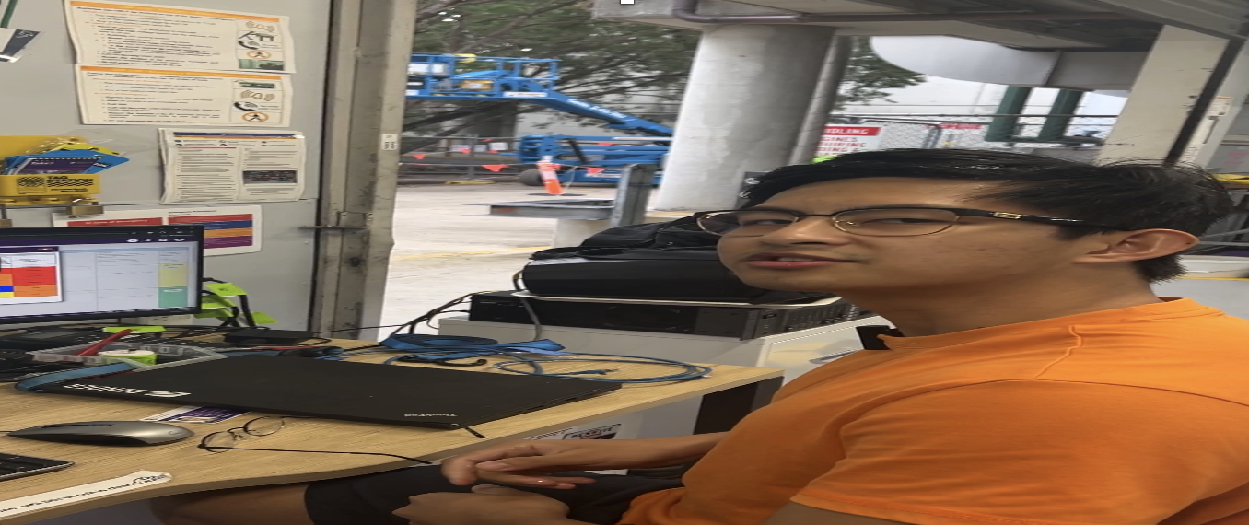
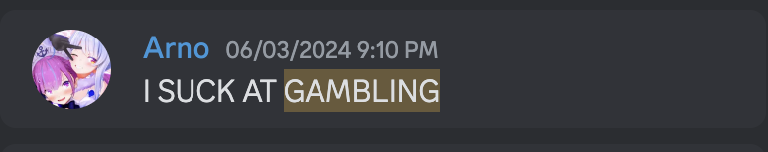
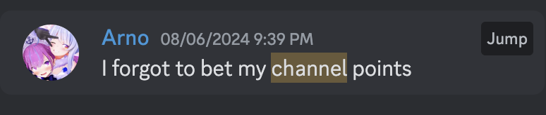
Backstory
Duality of Zedric
Pro Gambler
This is our friend Zedric!
He likes to gamble on esports matches
Recently, he lost all his twitch channel points because he went all in on an upset
Feeling defeated, he continued to gamble with whatever pennies he had left
Zedric is diagnosed with gambling addiction
99% of gamblers quit before a big win, therefore our job is to keep Zedric in the 1% to make sure he never quits
r/wallstreetbets moderator

