Slide 1
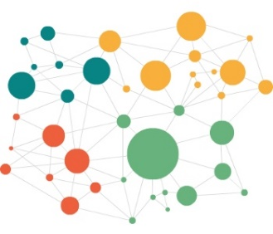
Alignment
Entity Matching/Linking/Linkage
Embeddings
MTransE (linear projection)
KG embeddings
Cross-lingual entity alignment via joint attribute preserving embedding.(ISWC 17)
SIGMOD:
Deep Learning for Entity Matching
(already matched properties)
https://thodrek.github.io/di-ml/sigmod2018/sigmod2018.html
word2vec embedding from wiki text
RESCAL
TransE
HolE
Bootstrapping Entity Alignment with Knowledge Graph Embedding(IJCAI 18)
Paris: Probabilistic alignment of relations, instances, and schema (VLDB 11)
Cross-lingual
Knowledge Graph
mono lingual mapping with lexicon
Linear projection
Projection via CCA
Normalisation transformation
Max-margin and intruders
https://github.com/facebookresearch/MUSE
word embedding
word2vec
glove (window decreaing)
fastText(uses n-grams)
LSA (counting)
generate Sentences
ML?
SVM (source and target features and then prediction? – no scaleable),
Neural Net (src_vector as input, target vector as output?)
linear regression, random forest
Random Walks
Weisfeiler-Lehman Subtree
Random Walks (with literals)
pseudo cross lingual with lexicon
Mapping of translations
….
external knowledge
(html pages about same topic)
cross-lingual training with lexicon
https://gist.github.com/mommi84/07f7c044fa18aaaa7b5133230207d8d4
https://github.com/Hironsan/awesome-embedding-models
Translation-invariant LSA

Slide 2
Related Work
JAPE (ISWC2017)
MTransE?
IJCAI 2018
PARIS
(our previous doc2vec)
Related Datasets
DBpedia (cross lingual)
KG (own)
OAEI? (conference, instance track)
DBpedia-Yago
Focus:
performance
simultanious matching
scalability

Slide 3
http://www.ttic.edu/nchrc/papers/8.pdf

