Slide 1
Singh RNA-Seq Analysis Report
13 May 2026

Slide 2
Context
Sample Info
QC
Alignment
Assignment
Pre-Process
DEGs

Slide 3
Sample Info

Slide 4
QC

Slide 5
Alignment

Slide 6
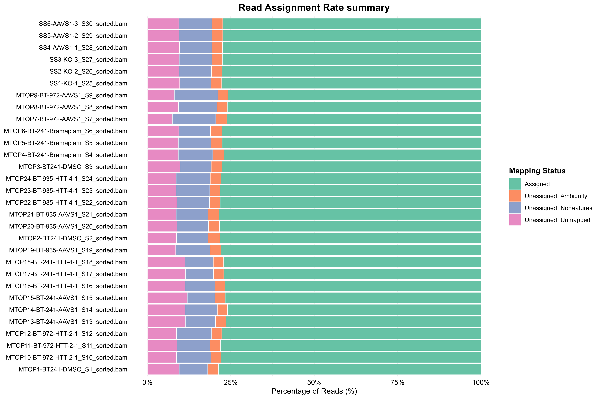
Assignment

Slide 7
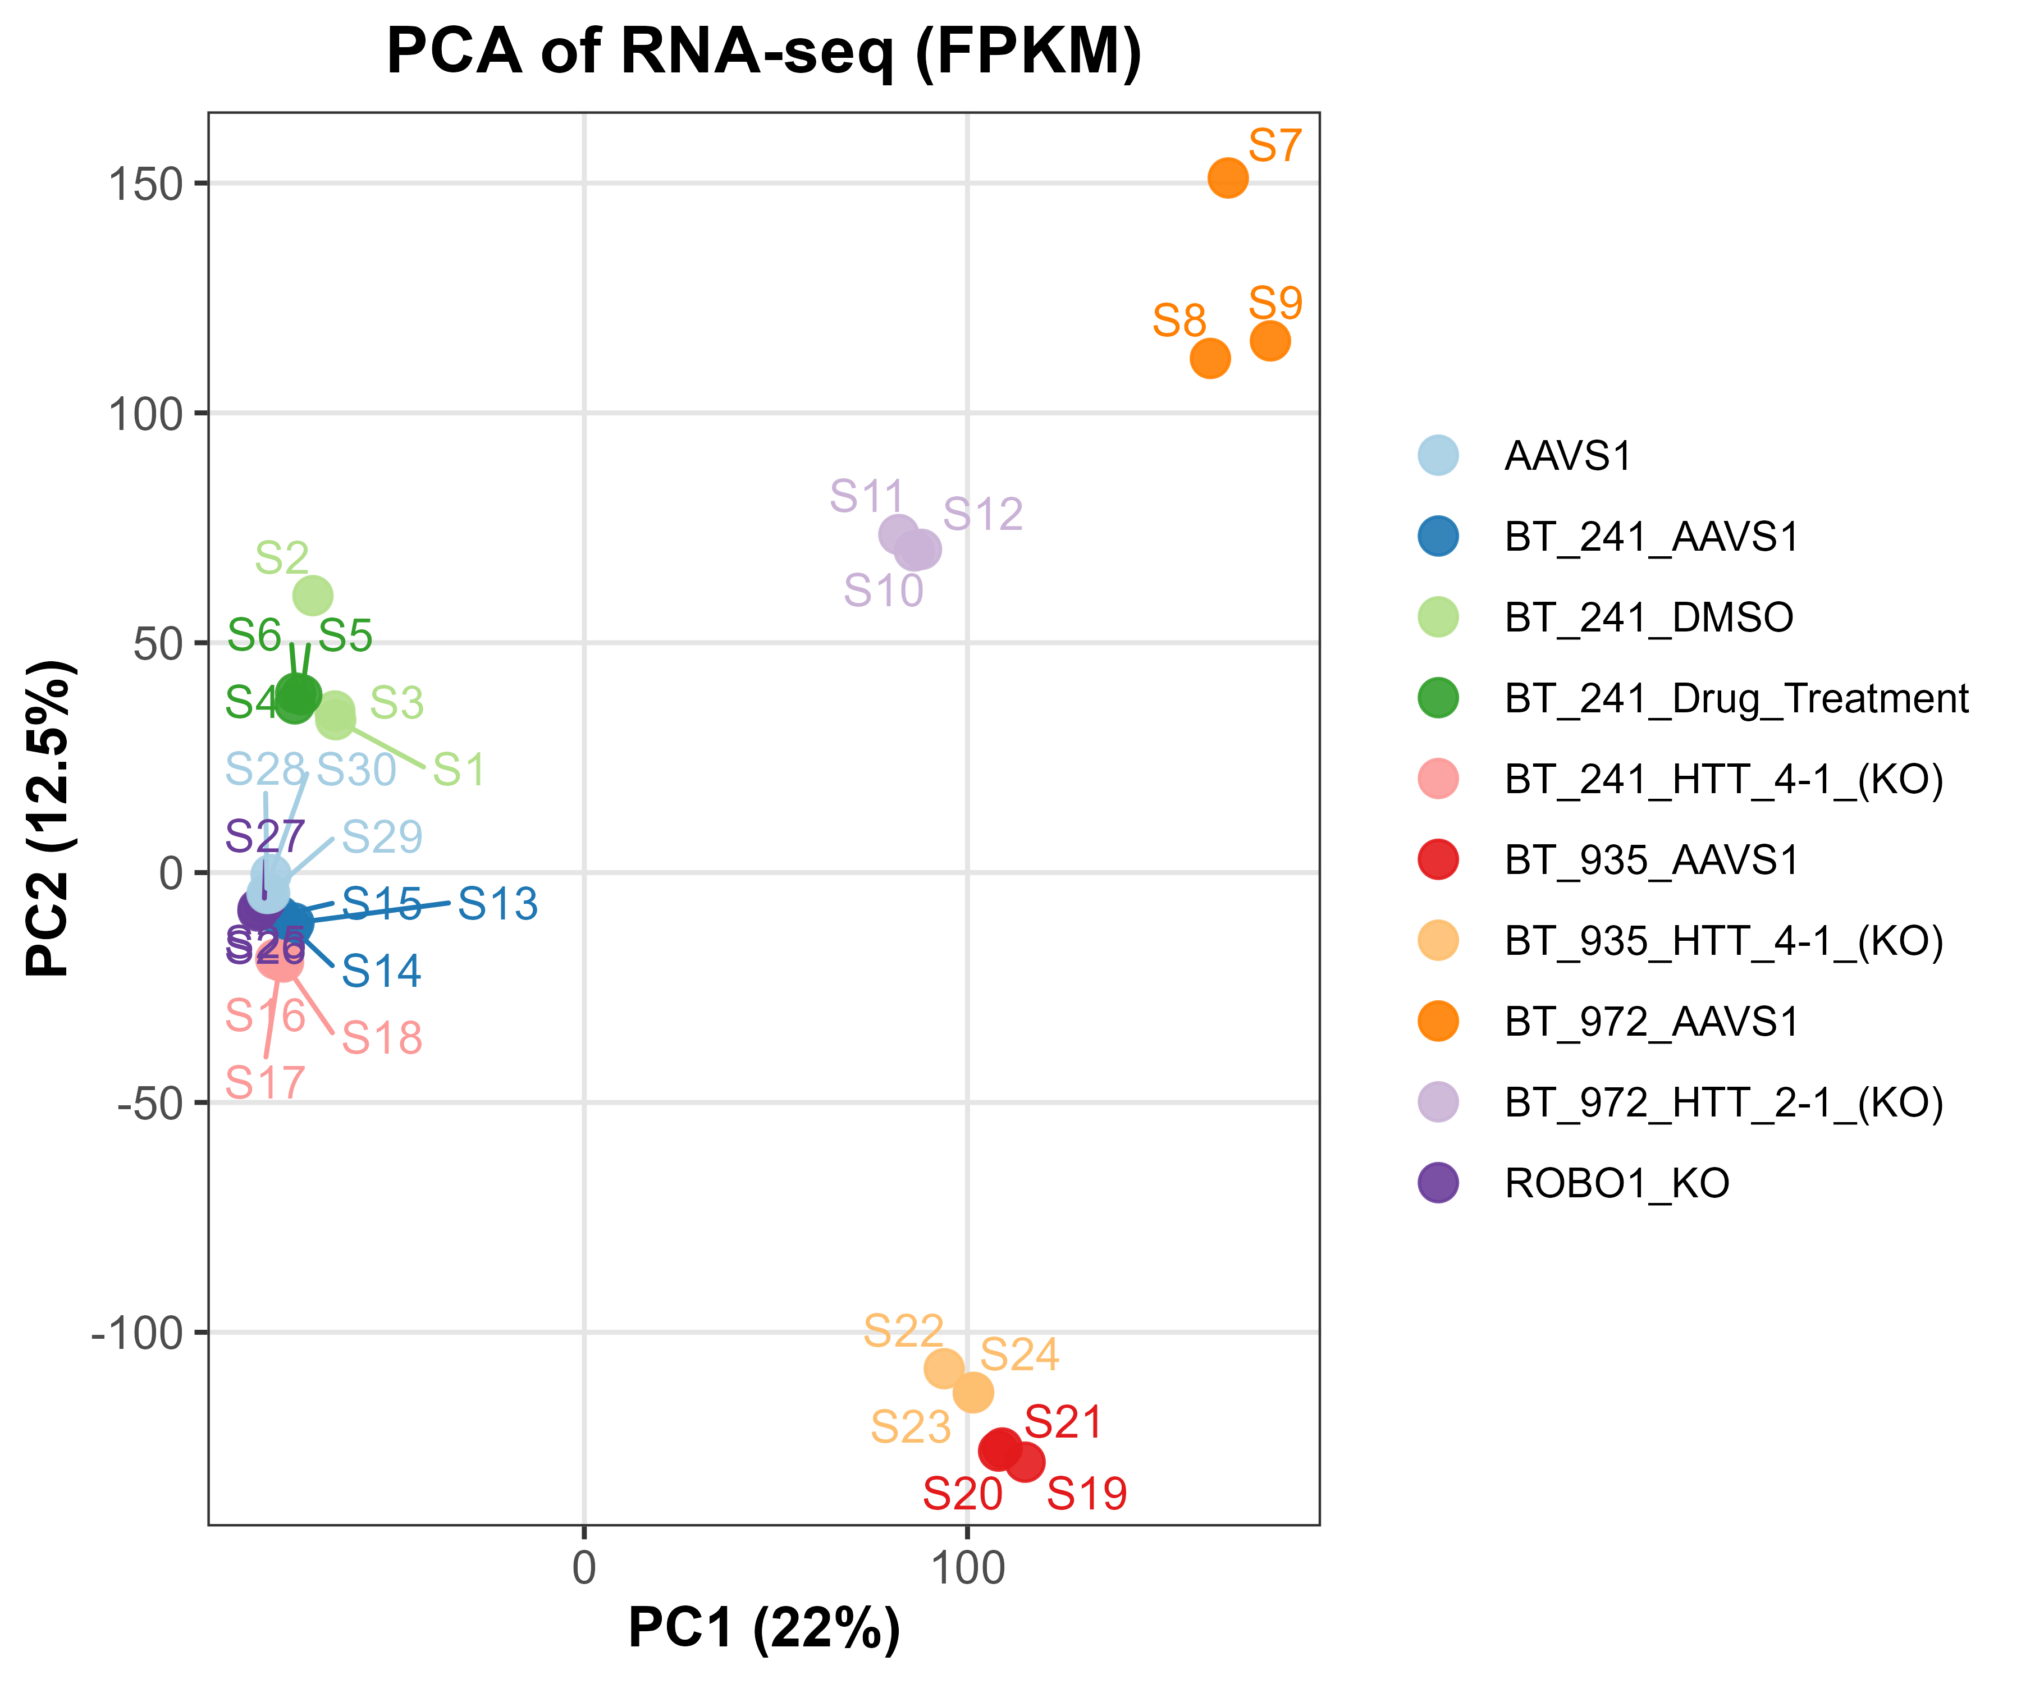
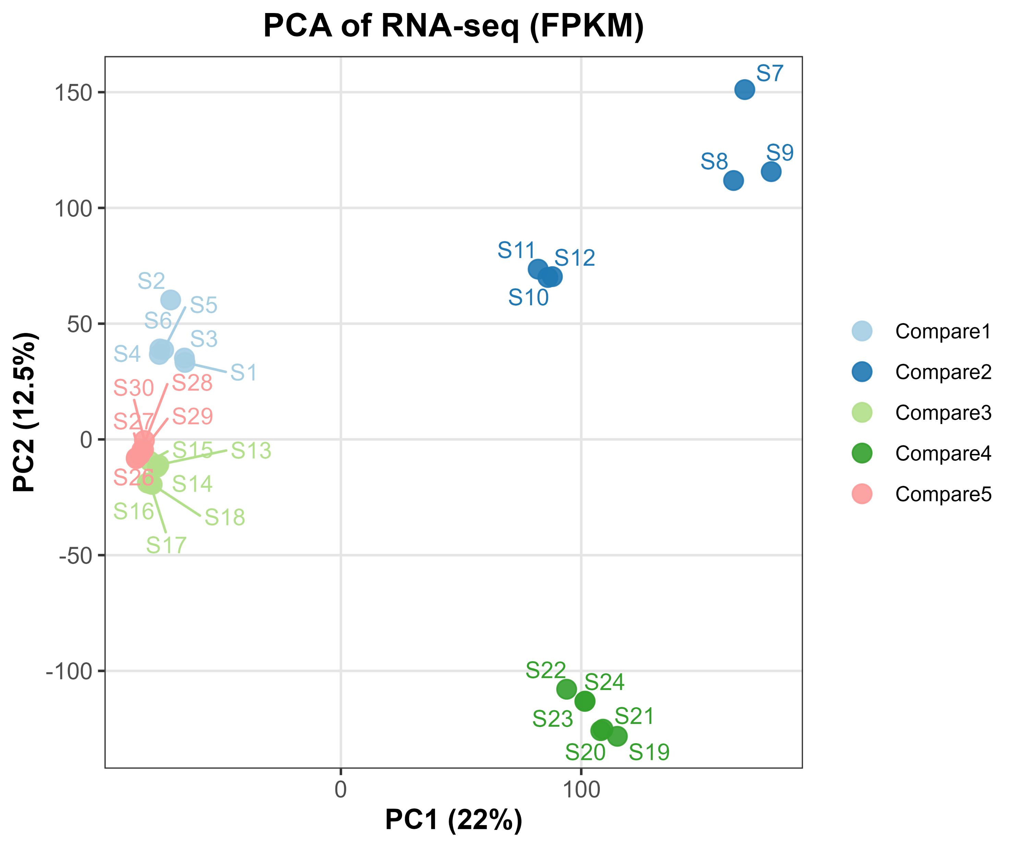
Pre-Process

Slide 8
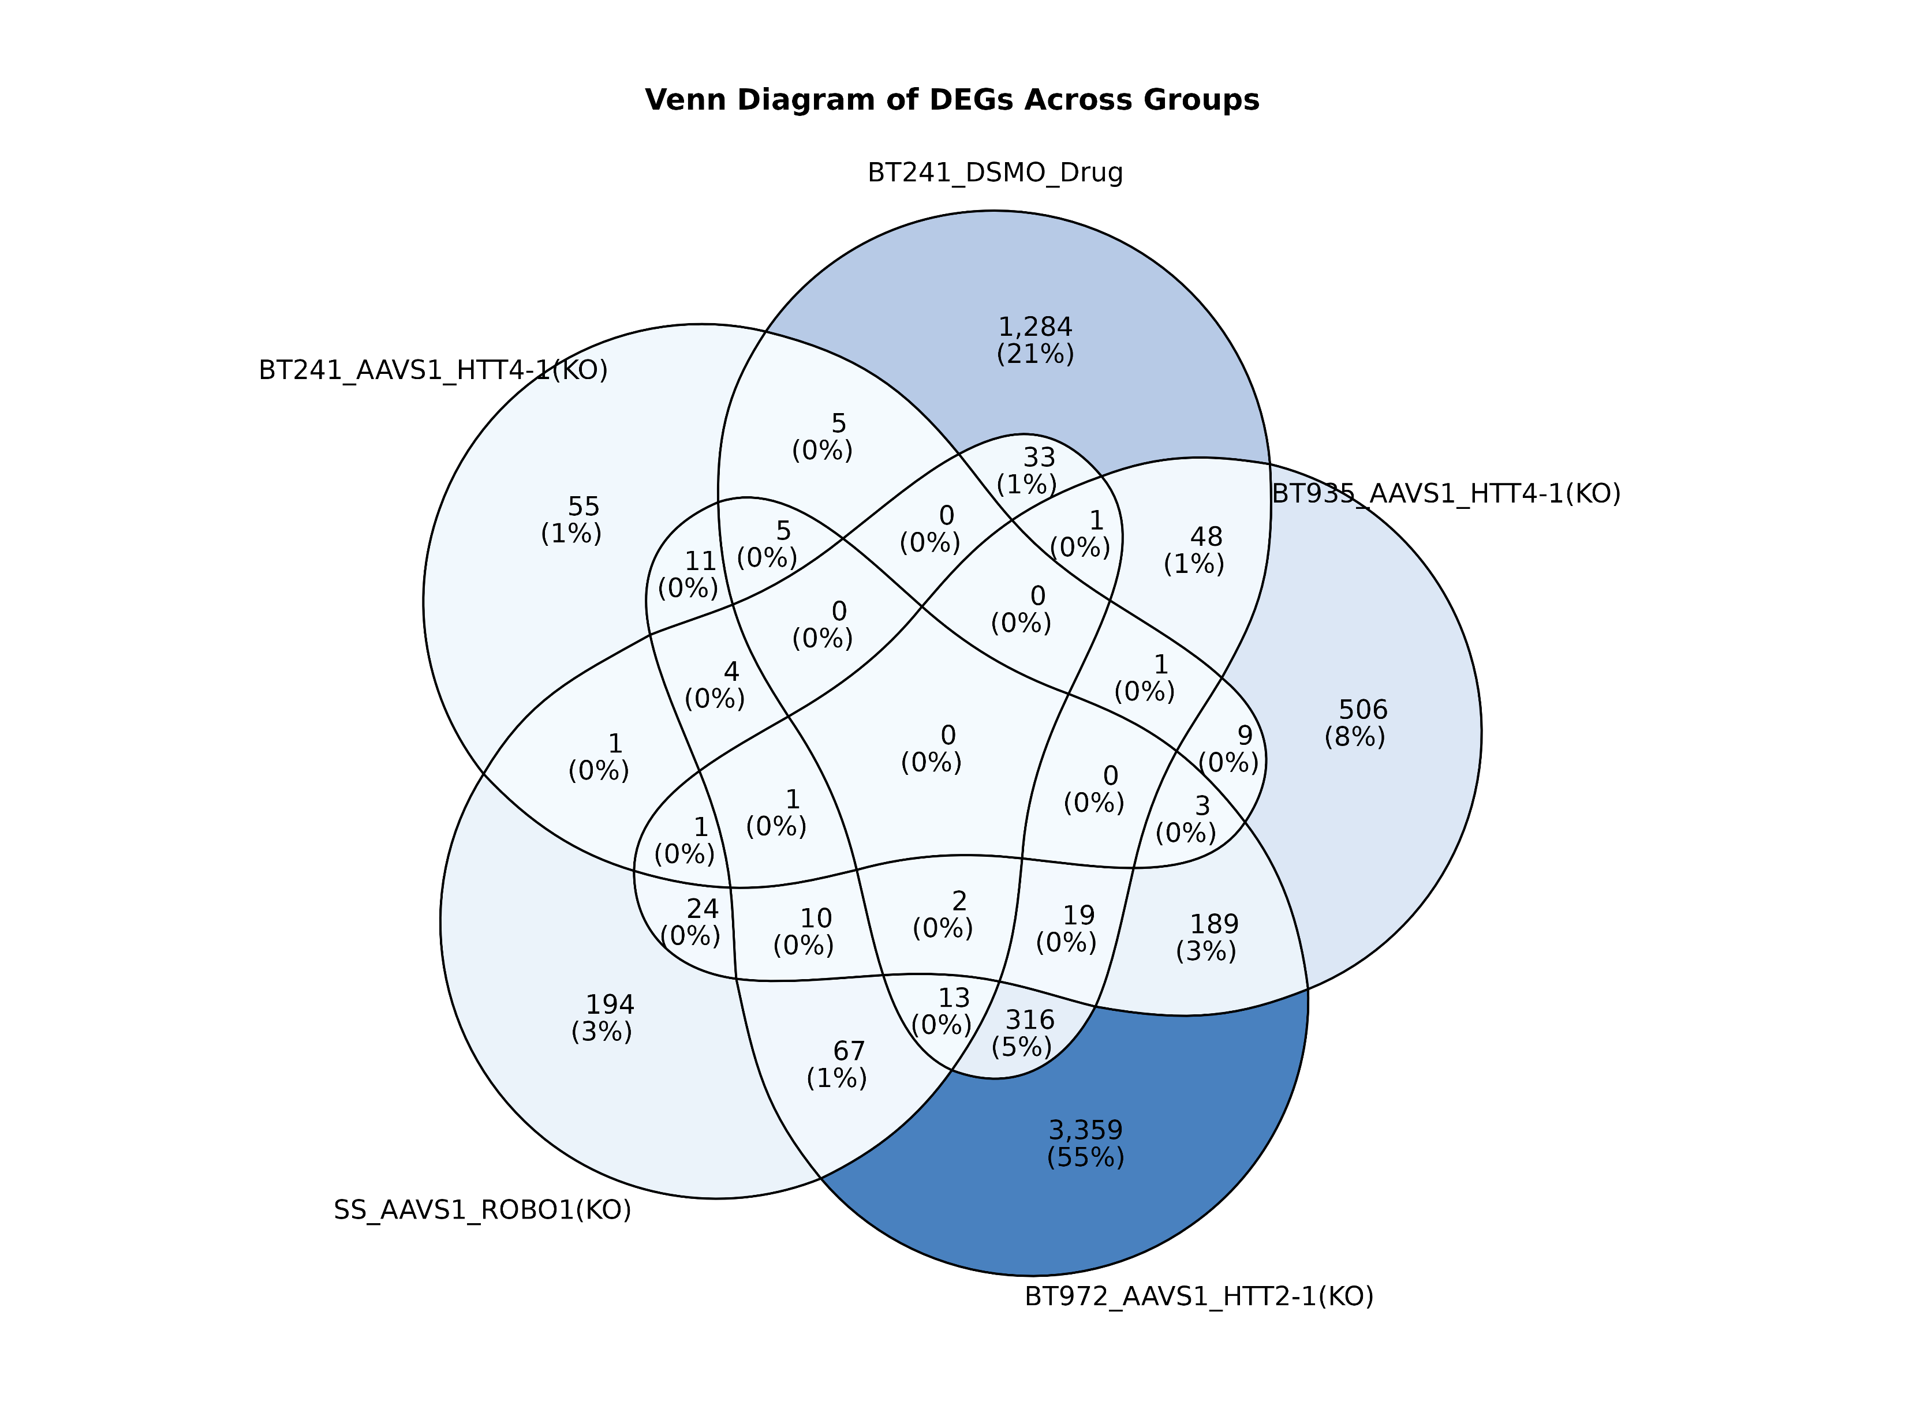
DEGs

