Slide 1
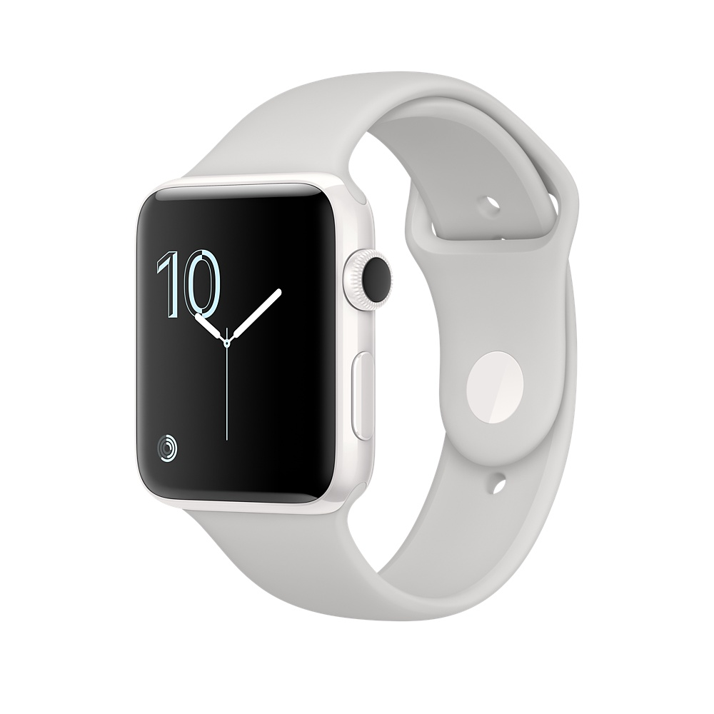
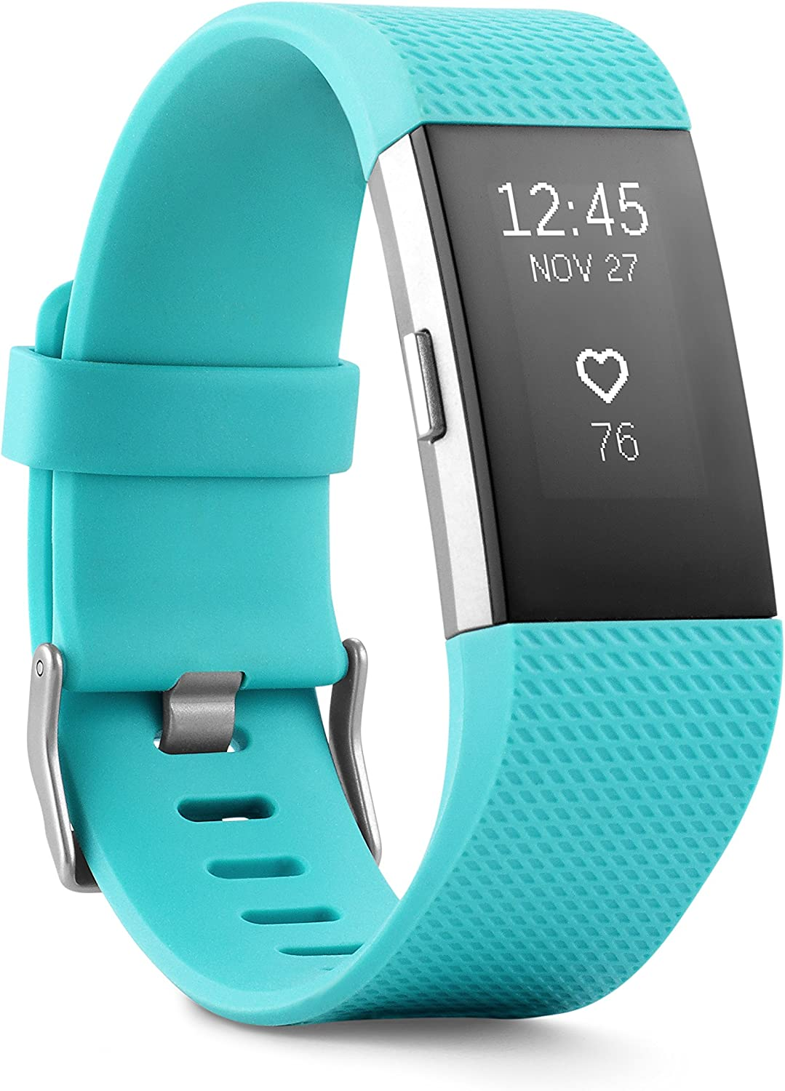
Comparing AppleWatch and FitBit Performance
Xena Adono STAT 574
01
Notes:
Hello my name is Xena Adono and today I will be talking to you guys about my project. So, my project was on comparing Apple Watch and FitBit performance.

Slide 2
Introduction
Objective
Data
Predictor Variables
To examine whether the 2 popular fitness trackers could accurately predict certain activities.
Sample of 49 participants who completed a 65-minute trial.
Datasets:
Apple Watch 3656 minutes
Fitbit 2608 minutes
15 variables
Some noteable ones include: Heart Rate, Calories, Distance, Steps, and Intensity.
How
Response Variable
Using machine learning classification methods to predict physical activity types.
ML Models Used
Activity class
Lying
Sitting
Walking
Running
KNN multinomial classifier
Random Forest multinomial classifier
Rstudio and Python
02
Notes:
An introduction to the topic. Lets start with the objective main topic which was to examine whether the 2 popular fitness trackers could accurately predict certain activities.
We would accomplish this by utilizing the machine learning classification methods we learned throughout the semester and using them to categorize and predict physical activity types.
The study was conducted by faculty at university of Toronto and university of Oregon. Sample included 49 participants both men and women who completed a 65 minute trial while wearing either Apple Watch or the FitBit tracker.
The dataset had 15 predictor variables which you will see throughout the presentation but some of the more important notebale ones include: Heart Rate, Calories, Distance, Steps, and Intesity.
Our outcome target variable is a categorical type named activity with 4 levels: lying, sitting, walking, and running.

Slide 3
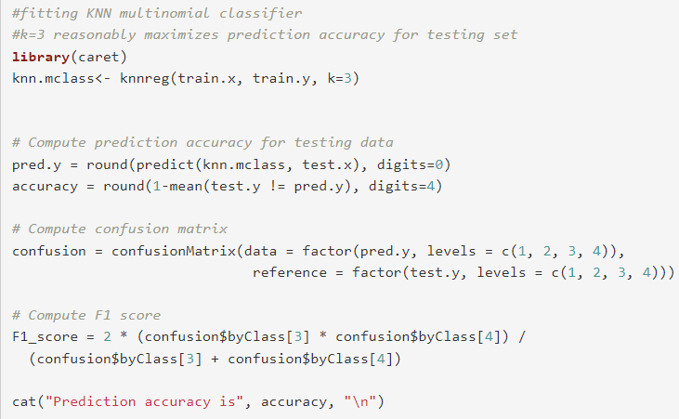
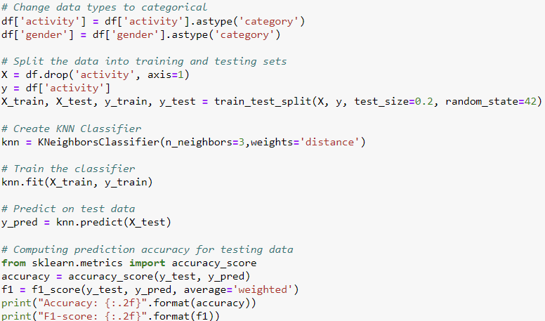
R and Python Code for Apple Watch and Fitbit
KNN Multinomial Classifier
01
02
RStudio KNN
Python KNN
03
Notes:
For all our models we will be using the usual 80% training and 20% testing split.

Slide 4
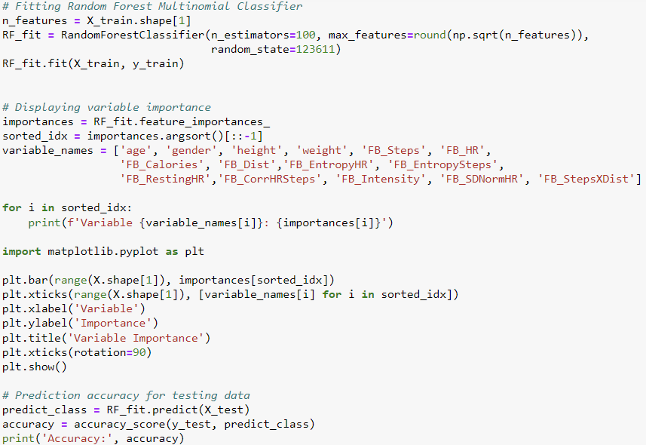
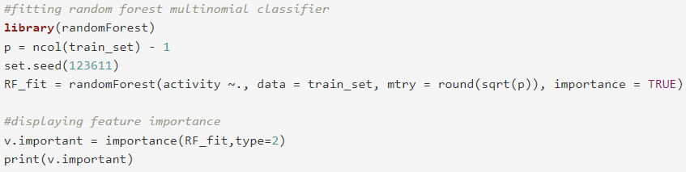

R and Python Code for Apple Watch and Fitbit
Random Forest Multinomial Classifier
02
04
RStudio RF
Python RF
04

Slide 5
Apple Watch
KNN Multinomial Classifier
Nearest-Neighbor
Running
1788
49%
We used k = 3 in both Rstudio and Pyhton.
Lying
787
22%
R Studio
R Studio
Prediction Accuracy: 0.65
F1 Score: 0.56
Sitting
552
15%
Walking
529
14%
Python
Prediction Accuracy: 0.72
F1 Score: 0.72
05
Notes:
Since our dataset is imbalanced, we will also be using the F1 score as another measure of performance for our models.

Slide 6
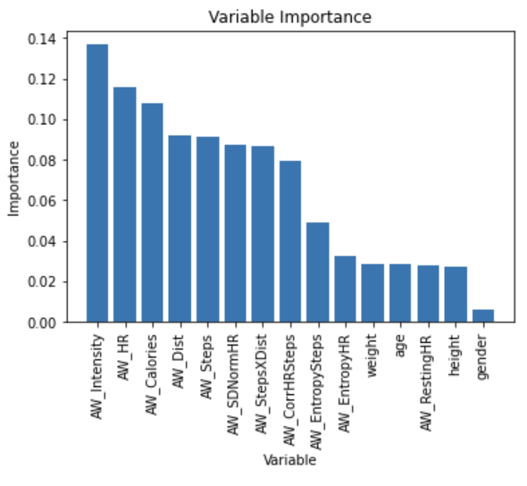
Apple Watch
Random Forest
RStudio
Prediction accuracy:
0.855
Python
Prediction accuracy:
0.847
06
Notes:
Note that for the Apple Watch, intensity and heart rate are the most important variables.

Slide 7
Fitbit
KNN Multinomial Classifier
Nearest-Neighbor
Running
1278
49%
We used k = 3 in both Rstudio and Pyhton
592
23%
R Studio
Lying
R Studio
Prediction Accuracy: 0.77
F1 Score: 0.67
Sitting
378
14%
Walking
360
14%
Python
Python
Prediction Accuracy: 0.83
F1 Score: 0.82
07

Slide 8
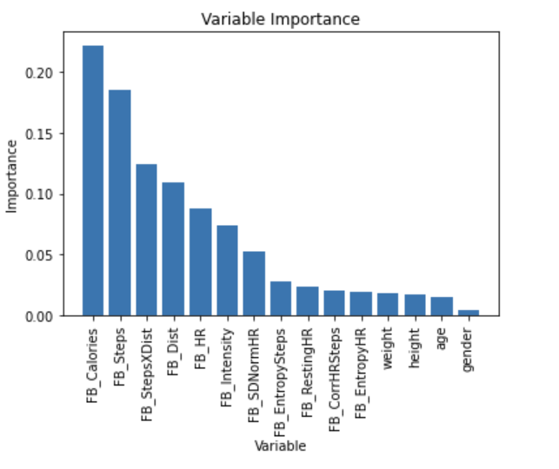
Fitbit
Random Forest
RStudio
Prediction accuracy:
0.9138
Python
Prediction accuracy:
0.9042
08

Slide 9
Summary
Apple Watch
As we can see the Random Forest model has higher classification accuracy for both devices.
Overall accuracy is higher for the Fitbit tracker compared to the Apple Watch.
But in general, both devices do a pretty good job in clasifying and predicting physical activity type.
Fitbit
For our KNN model Accuracy: 0.72
For our Random Forest Accuracy: 0.85
For our KNN model Accuracy: 0.83
For our Random Forest Accuracy: 0.90
09
Notes:
In summary we will be using Python, R’s numbers still hold but the Accuracy and F1 score are closer in range when using python.
As we can see that the random forest model had higher classification accuracy for both devices.
Random Forest models are commonly used in physical activity research.
But we do see that the overall accuracy is higher for Fitbit compared to Apple Watch.

Slide 10
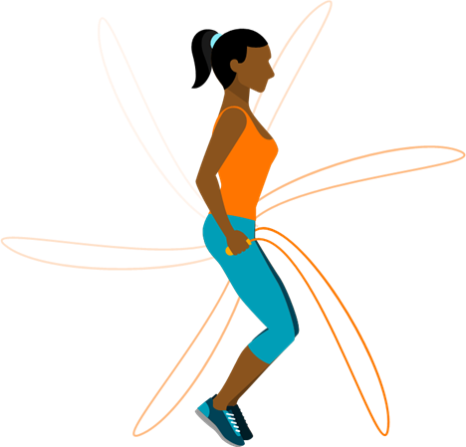
Thanks STAT 574!
10

