Slide 1
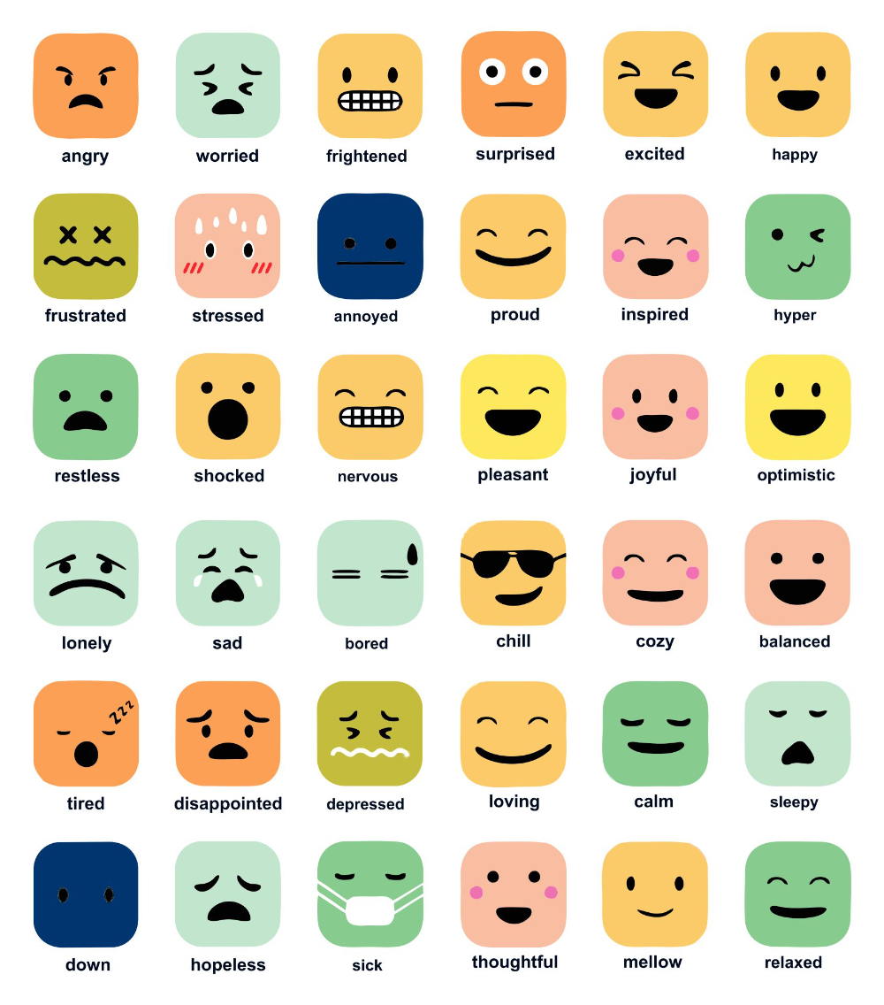

Project Title:
Emotion Classification using Tweets.
9444 night group
Hui Wang(z5562297)
Tao Dong (z5335586)
Haoyang Xu (z5577106)
Nandy Chen (z5500712)
Mingqi Xu (z5532071)
Project ID: 021

Slide 2
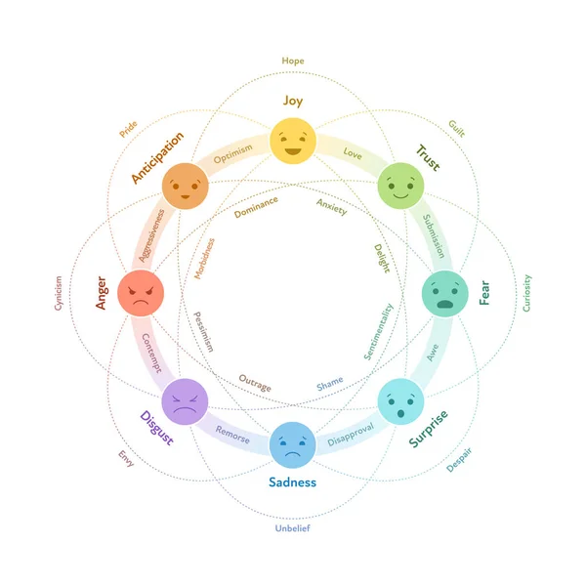
Problem Statement
Twitter is a key platform for users to express emotions and opinions, but tweets are often short, informal, and include slang, abbreviations, or emojis, making emotion expression complex and diverse.
Accurately identifying emotions in tweets is crucial for tasks such as public sentiment monitoring, affective computing, and user profiling.
Presenter: HUI WANG(z5562297)

Slide 3
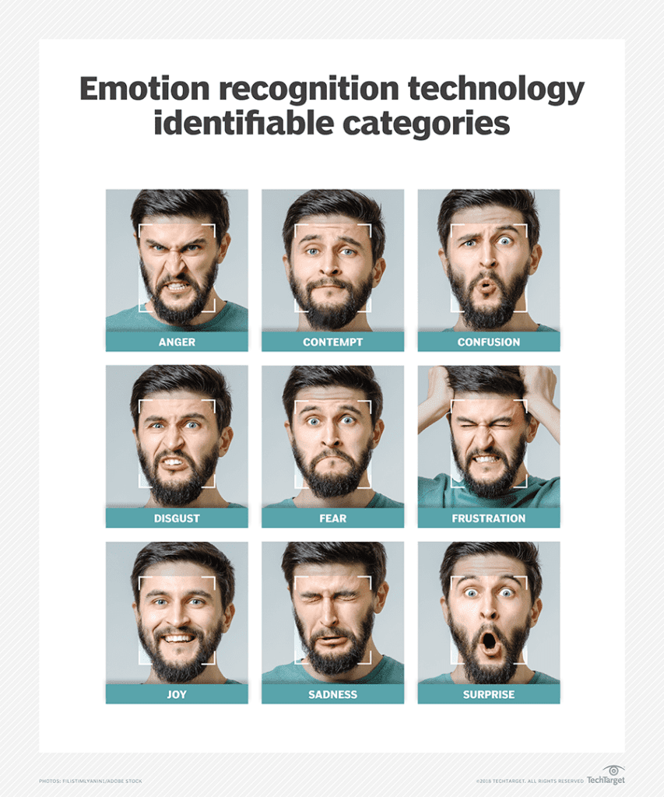
Problem Statement
Goal:
Performing text classification using advanced artificial intelligence algorithms that yield increased performance on relevant metrics. The text classification for this project is correctly labelling a tweet for emotion expressed by the author.
Six basic emotions:
sadness, joy, love, anger, fear, and surprise
Presenter: HUI WANG(z5562297)

Slide 4
Literature Review
Emotion classification systems involve several key stages, including data loading, preprocessing, model design, and training, all of which are supported by relevant research:
🔹 Basic Sequential Models: RNN
Tang et al., 2016 One of the earliest works to apply RNNs for emotion modeling, demonstrating their capability in capturing temporal dependencies in text. However, RNNs struggle with long-range dependencies and are sensitive to vanishing gradients.
🔹 Long-Term Dependency Modeling: LSTM with Attention
Wang et al., 2016 Improved upon RNNs by introducing LSTM cells and attention mechanisms, enabling the model to focus on emotionally salient words and handle longer contexts more effectively.
🔹Enhanced Structure: CNN over LSTM
Baziotis et al., 2018 Proposed combining LSTM with CNN to extract local n-gram emotion features in tweets, improving robustness in short, noisy texts. Also emphasized the importance of tweet normalization (URLs, emojis, usernames).
Presenter: HUI WANG(z5562297)

Slide 5
Literature Review
🔹 Pre-trained Models: BERT
Devlin et al., 2019 BERT revolutionized text classification by introducing bidirectional Transformers and large-scale pretraining. Fine-tuning BERT enabled strong semantic representation, significantly improving emotion detection.
🔹 Fine-tuning Strategies
Sun et al., 2019 Systematically explored various BERT fine-tuning techniques, including learning rates and layer freezing, which guided our training of DistilBERT and Mini-BERT models in this project.
🔹 Lightweight and Ensemble Modeling
Sanh et al., 2019 (DistilBERT) Introduced a distilled version of BERT, retaining most semantic power with fewer parameters and faster inference.
Ensemble strategies, such as soft voting between BERT and DistilBERT, were used to improve model robustness and performance on rare emotion classes.
Presenter: HUI WANG(z5562297)

Slide 6
Literature Review
🔹 Data and Evaluation Standards
Mohammad et al., 2018: Created the SemEval emotion dataset and established standardized train/val/test splits.
Barbieri et al., 2020: Released TweetEval, a benchmark for multi-task tweet classification.
Jabreel & Moreno, 2019: Promoted macro-F1 and Jaccard Index for evaluating multi-label emotion classification.
Presenter: HUI WANG(z5562297)

Slide 7
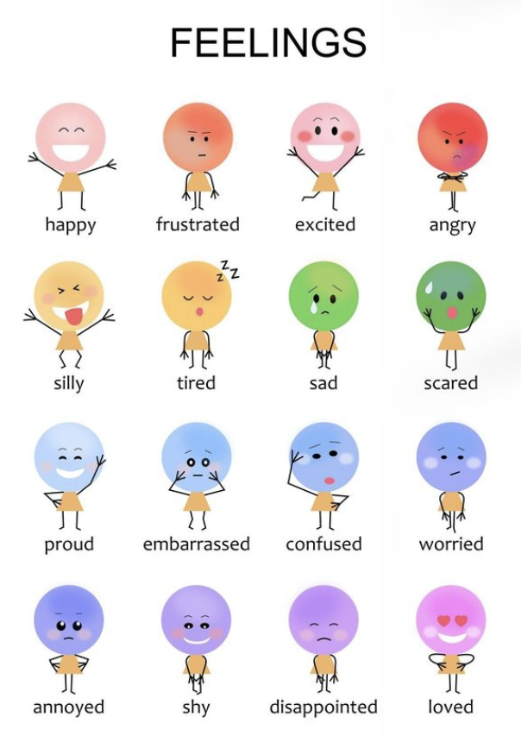
Literature Review
Summary:
The field of emotion classification has developed a mature research framework, covering all key stages from data preparation and preprocessing to deep learning-based model design and evaluation. Building on this foundation, our project implements a comprehensive end-to-end system that processes raw text, learns emotional representations through various models, and evaluates performance using standard metrics.
Presenter: HUI WANG(z5562297)

Slide 8
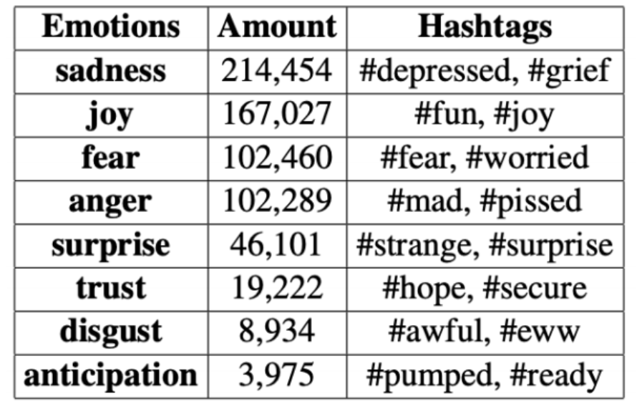
Datasets
Dataset Name:
dair-ai/emotion (from Hugging Face)
Size and Structure:
Total samples: 20,000+ short English sentences
Six types: sadness, joy, love, anger, fear, or surprise
Splits: Training (≈80%), Validation (≈10%), Testing (≈10%)
Preprocessing Steps:
BertTokenizer to split the text into small pieces called tokens.
changed these tokens into numbers.
all the sequences have the same length—exactly 128 tokens.
The emotion labels were also turned into numbers
Presenter: Tao Dong (z5335586)

Slide 9
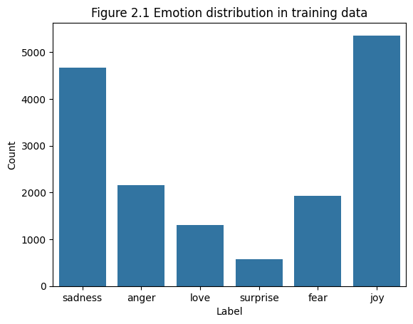
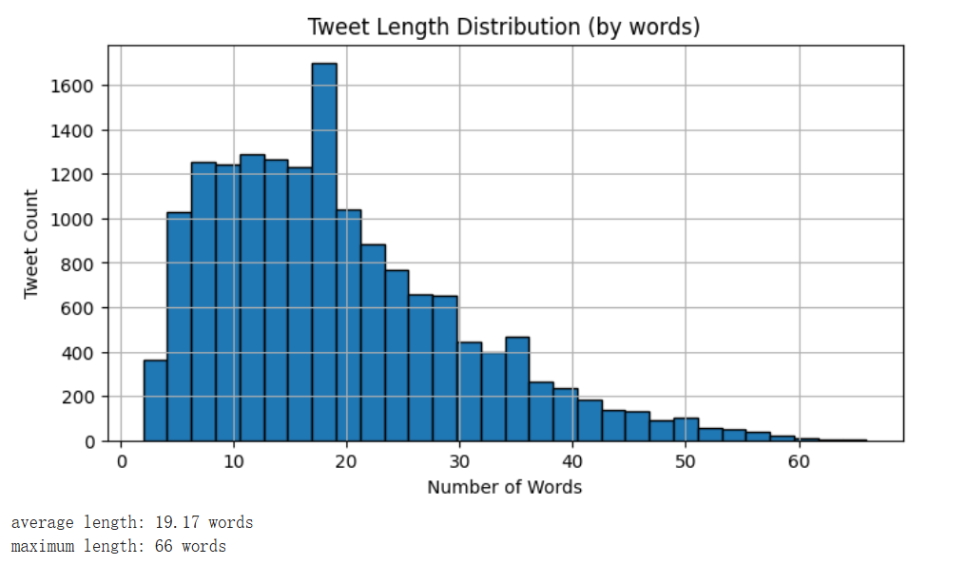
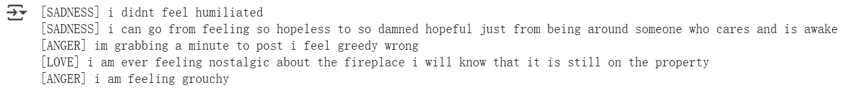
Data Analysis
decide how to set up the input size for the model
Presenter: Tao Dong (z5335586)

Slide 10
Method(s)
🔹 RNN
Recurrent Neural Network (RNN) is a special type of neural network that has memory capabilities and is capable of handling data with time series characteristics.
🔹 BILSTM
Improves on RNN with gating mechanisms to handle long-term dependencies. More stable for capturing contextual emotion signals in noisy short texts.
🔹 LSTM + CNN
Combines sequential context modeling (LSTM) with local phrase extraction (CNN). Well-suited for emotion keywords and enhances robustness against noisy input.
Presenter: Haoyang Xu (z5577106)

Slide 11
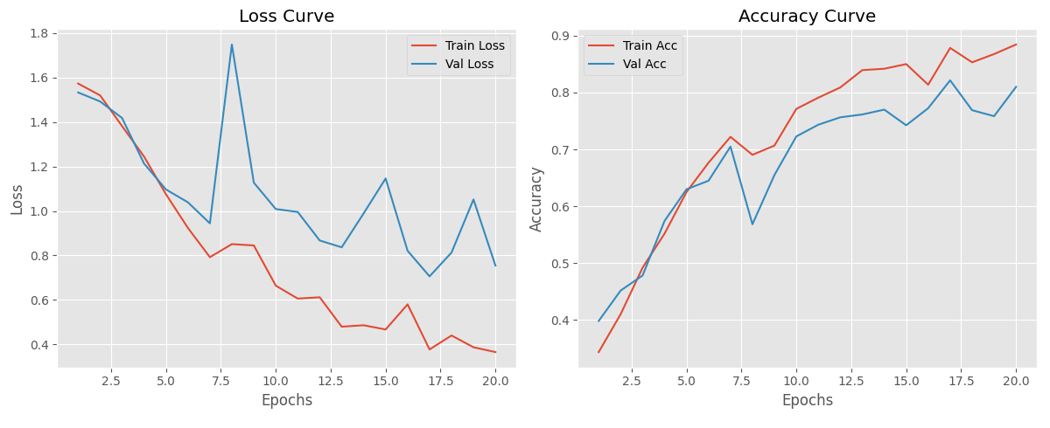
Results-RNN
The 0.4-0.9 y-axis suggests the model reaches at least 90% accuracy
Large gap between training and validation metrics
Presenter: Haoyang Xu (z5577106)

Slide 12
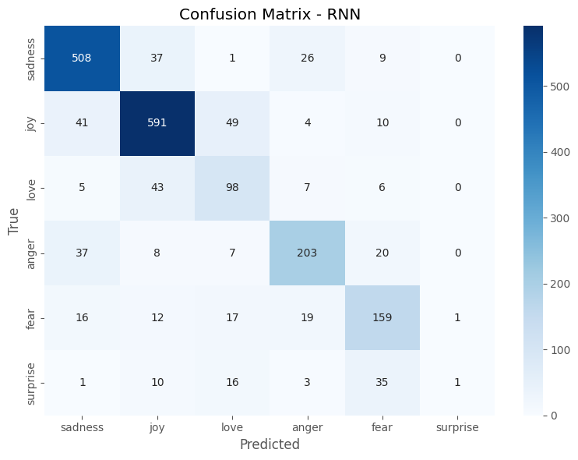
Results-RNN
Love is seriously confused with other categories, especially joy.
The closer the emotions are (such as fear/anger, joy/love), the more likely they are to be confused.
Presenter: Haoyang Xu (z5577106)

Slide 13
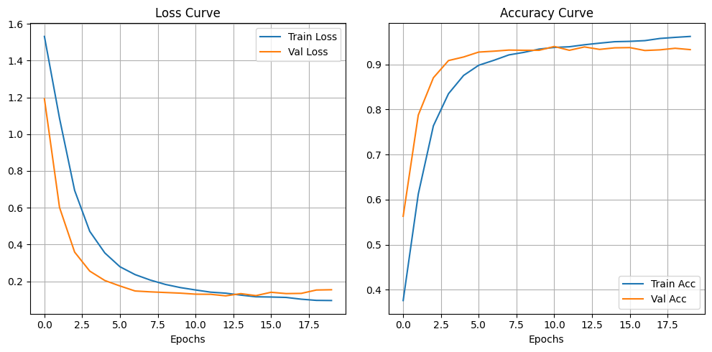
Results-LSTM+CNN
The lost curve eventually remained at around 10%
The accuracy rate is about 94%
If the validation loss increases in the later stage while the training loss continues to decrease.
Presenter: Haoyang Xu (z5577106)

Slide 14
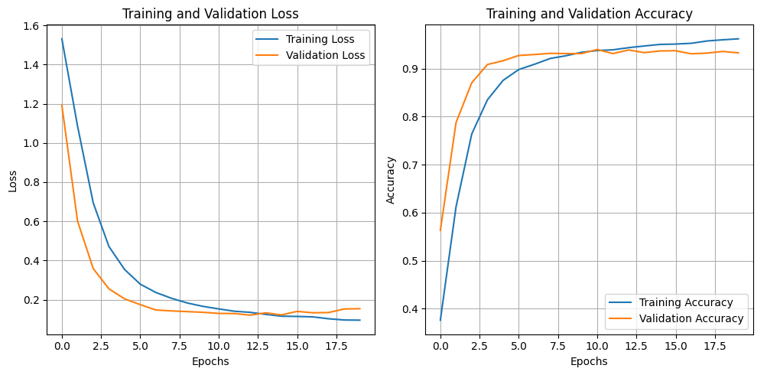
Results-BILSTM
The lost curve eventually remained at around 10%
The accuracy rate is about 94%
If the validation loss increases in the later stage while the training loss continues to decrease.
Presenter: Haoyang Xu (z5577106)

Slide 15
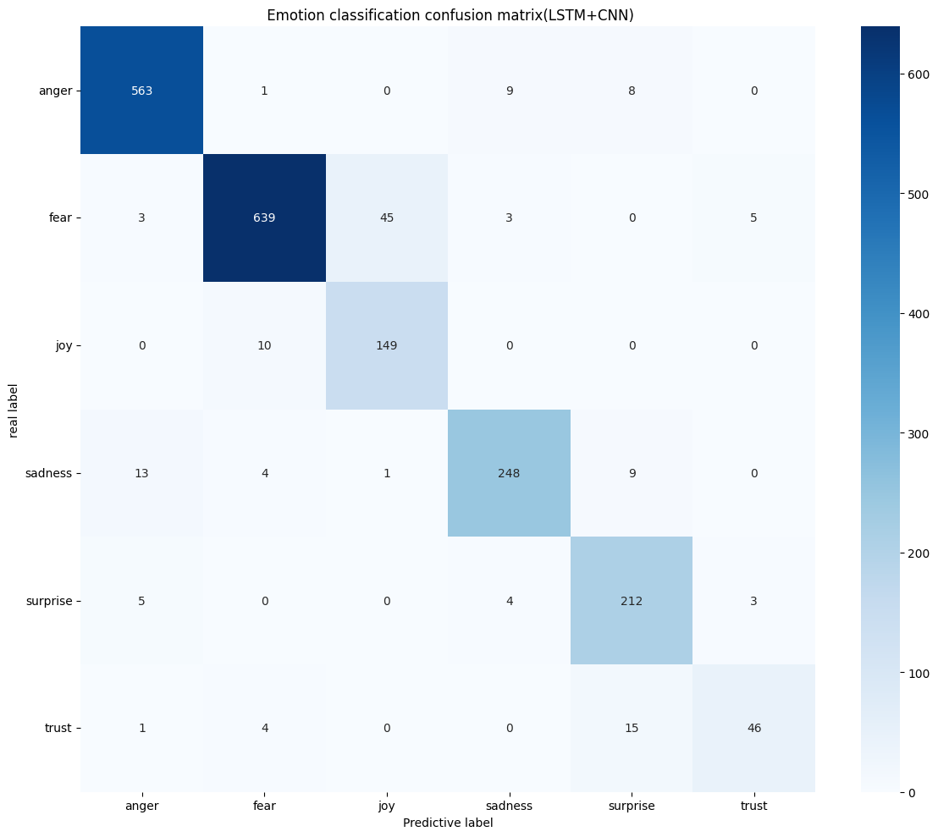
Results-LSTM+CNN
The overall performance of the model is good, especially the classification of anger, fear and sadness is relatively accurate.
There is some confusion between joy and fear, trust and surprise, which might be due to the similarity in the expression of these emotions in text or speech features.
Presenter: Haoyang Xu (z5577106)

Slide 16

Results-BILSTM
The accuracy/recall rates of both anger and fear have improved, indicating that the model has reduced confusion (for example, the misjudgment of anger→fear has changed from 5 to 3).
The F1 of sadness has increased and the classification is more stable.
Presenter: Haoyang Xu (z5577106)

Slide 17
Method(s)
🔹Mini-BERT (custom implementation)
Simplified Transformer inspired by BERT. Retains self-attention for interpretability and cross-sentence reasoning, suitable for low-resource settings.
🔹DistilBERT (HuggingFace fine-tuned)
Lightweight BERT variant with competitive semantic representation power. Excels at global context modeling and is efficient for social media texts.
🔹BERT + DistilBERT (Soft Voting)
An ensemble combining BERT’s depth and DistilBERT’s speed via soft voting. Enhances stability and recall for low-frequency, ambiguous emotion classes.
Presenter: Nandy Chen (z5500712)

Slide 18
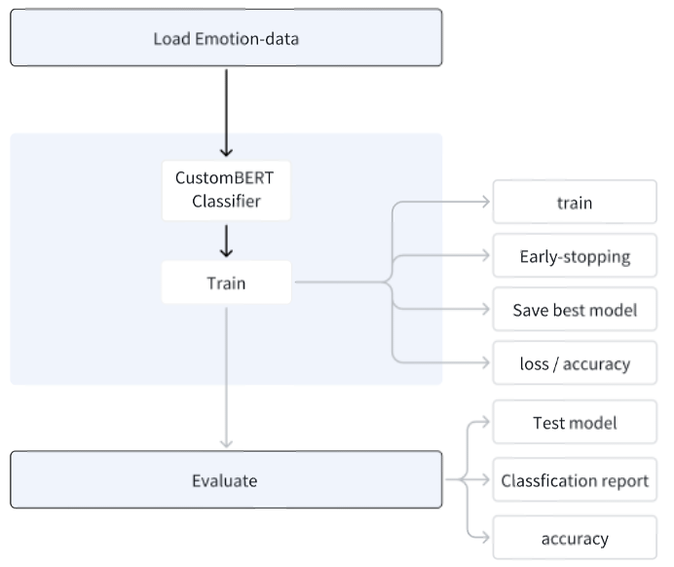

Custom Mini-BERT
Module | Function Description
BertEmbeddings | Input word embeddings + positional embeddings + type ids
MultiHeadedAttention | Simulates multi-head attention mechanism from Transformer
PositionwiseFeedForward | Feed-forward network to enhance feature expression capability
BertLayer | Attention layer + feed-forward + residual + normalization
BertEncoder | Stack of 6 BertLayers to capture sentence-level representations
Classifier | Use [CLS] token representation to predict emotion class
The self-implemented BERT model has a clear and transparent architecture.
BUT…
It lack large-scale pretraining, the accuracy very short compared to light-weight pretrained models like Distil-BERT. However, the Custom mini-BERT model gives us a better understanding of each component how to work and where potential improvements may can be made.
Accuracy ≈ 9-80%
Presenter: Nandy Chen (z5500712)

Slide 19
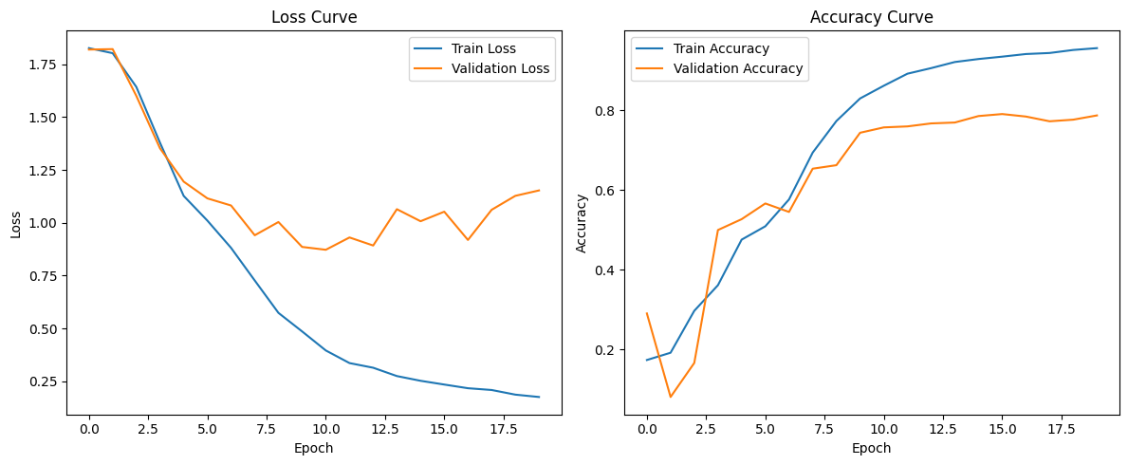
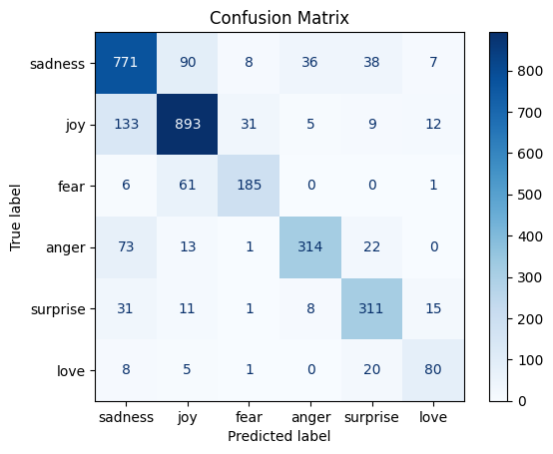
Custom Mini-BERT
Presenter: Nandy Chen (z5500712)

Slide 20
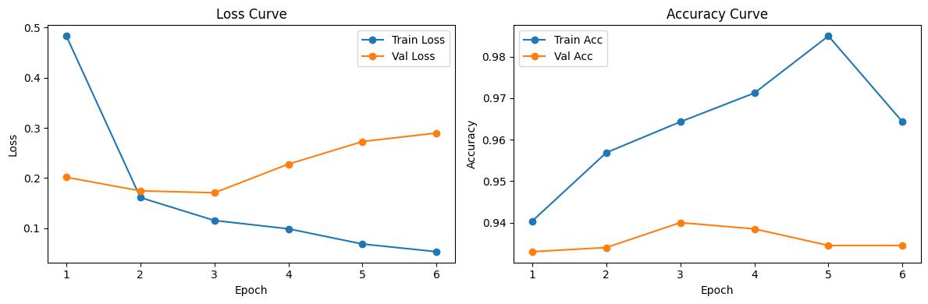
DistilBERT Model (with HuggingFace Trainer)
Presenter: Nandy Chen (z5500712)

Slide 21
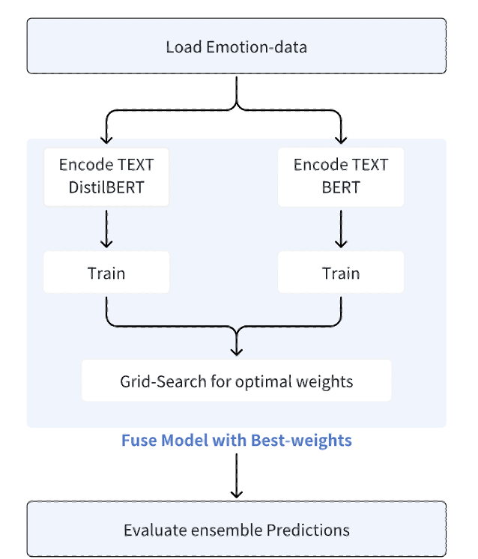
BERT + DistilBERT Ensemble
Presenter: Nandy Chen (z5500712)

Slide 22
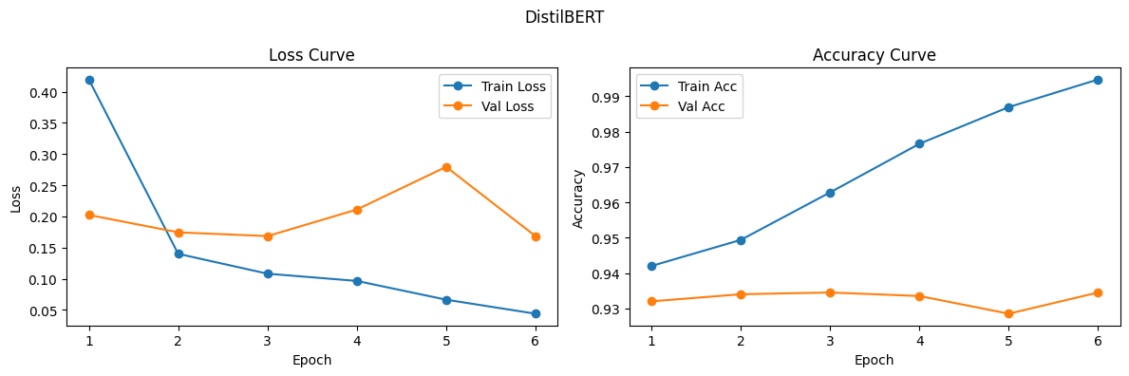
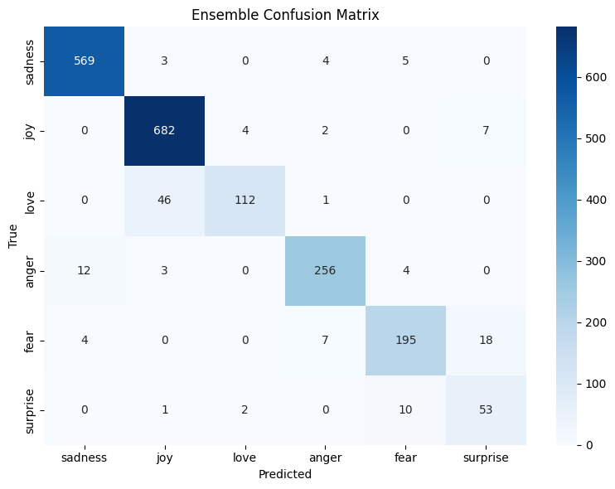
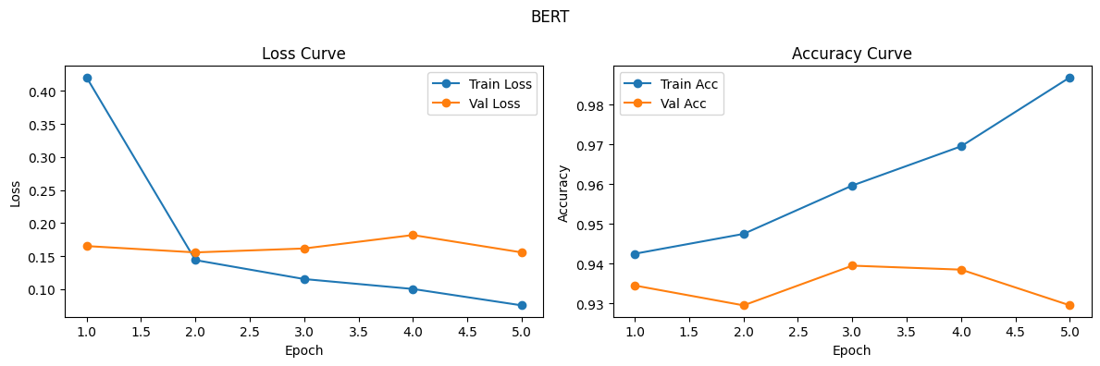
BERT + DistilBERT Ensemble (Result)
Presenter: Nandy Chen (z5500712)

Slide 23
Compare BERT model
Model | Accuracy | Speed | Flexibility | Benefit
Custom Mini-BERT | ❌ Low | ✅ Fast (small) | ✅ Fully customizable | Learning and debugging
Distil-BERT | ✅ Good | ✅ Fast | ❌ Limited | Fast prototyping & deployment
BERT + Distil-BERT | ✅ Good | ❌ Slow | More Complex | Performance-critical tasks
Presenter: Nandy Chen (z5500712)

Slide 24
Result conclusion
DistilBERT and weighted voting integrated model performed best, reflecting strong comprehensive capabilities; LSTM and DistilBERT single-mode models also performed well. In contrast, MiniBERT performed poorly due to its simplified structure and lack of training.
Models | Accuracy | Macro f1 | Precision | Recall
RNN | 0.8125 | 0.8136 | 0.8185 | 0.8125
LSTM | 0.93 | 0.89 | 0.89 | 0.9
LSTM + CNN | 0.9458 | 0.75 | 0.74 | 0.76
Mini Bert | 0.80 | 0.80 | 0.80 | 0.80
DistilBERT | 0.93 | 0.88 | 0.88 | 0.89
DistilBERT + BERT | 0.93 | 0.93 | 0.94 | 0.93
Presenter: Mingqi Xu (z5532071)

Slide 25
Discussion
Traditional sequence model
RNN or LSTM: Simple structure, easy handle, small scale data friendly, but weak in long-term memory and parallelism.
LSTM + CNN: Better feature extraction, captures local and temporal information; but complex structure, high training cost.
Transformer styles models
DistilBert: lightweight deployment, high efficiency, but slightly reduced accuracy.
Mini Bert: flexible structure, strong controllability, customized , but lacks pre-training support;
Bert + DistilBert Ensemble (softing voting): improves the robustness and generalization ability, but cost is large.
Presenter: Mingqi Xu (z5532071)

Slide 26






Further development
Multimodal information fusion：
can be introduced to help improve the accuracy and generalization ability of emotion recognition;
Refined integrated learning strategies:
Such as weighted voting or adaptive integration mechanisms, which enhance the performance stability under different classes.
Presenter: Mingqi Xu (z5532071)

Slide 27

This Photo by Unknown Author is licensed under CC BY-SA

