Slide 1
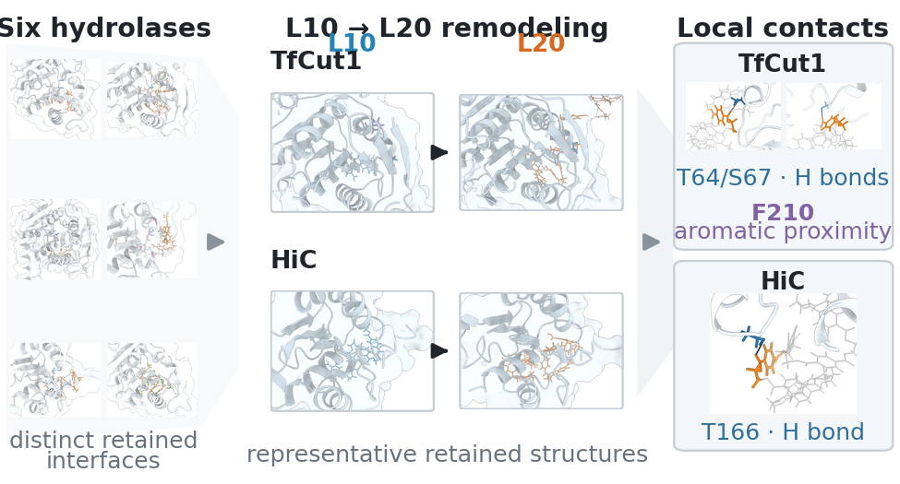
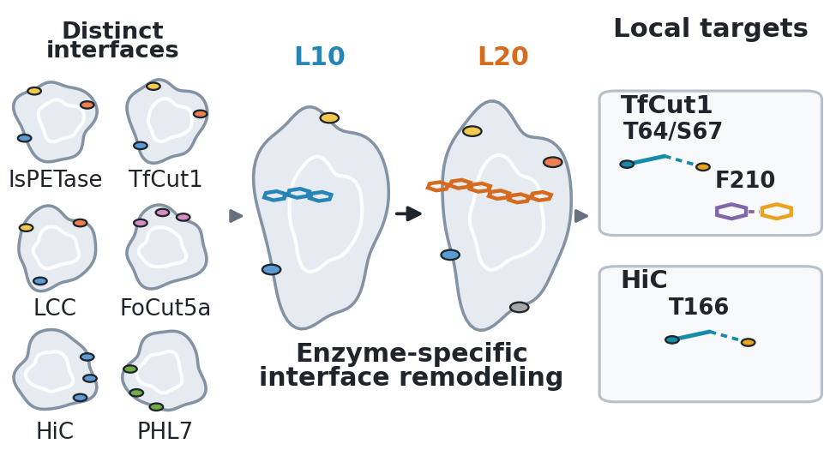
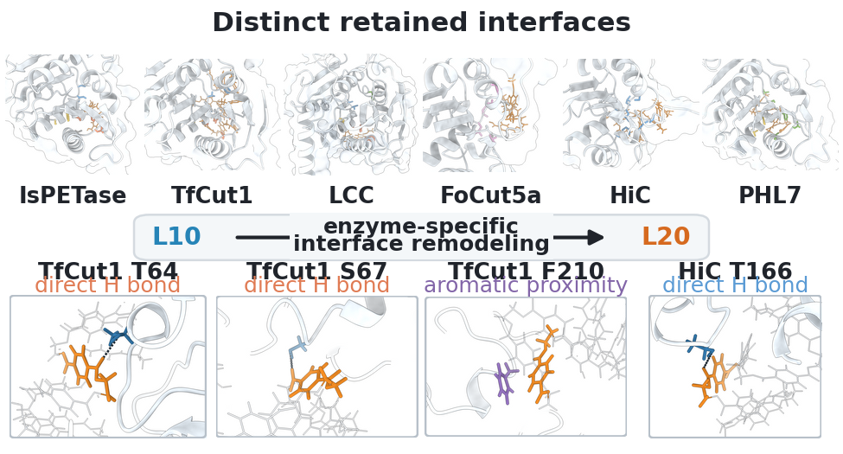
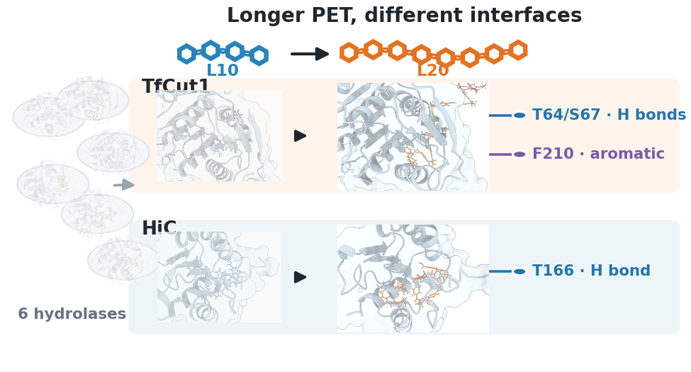
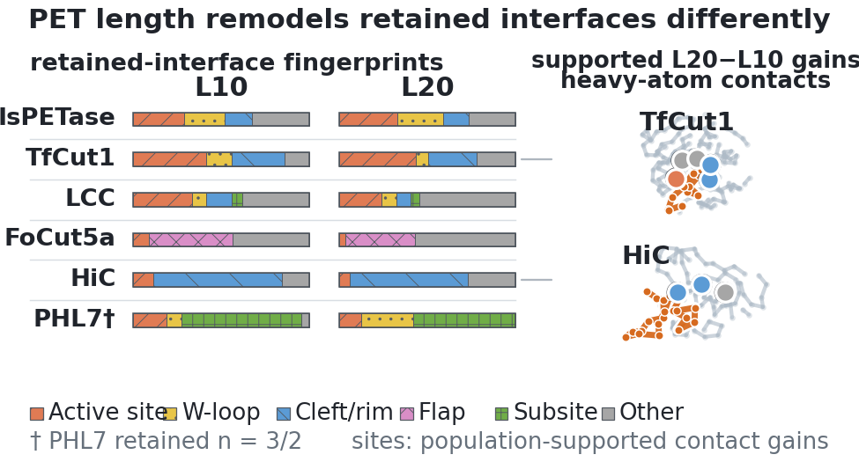
PETase MANUSCRIPT · JCIM TOC GRAPHIC REVIEW
L10
L20
What should readers grasp in 3 seconds?
5 design directions · one evidence standard · one submission recommendation
A
Molecular funnel
B
Icon schematic
C
Molecular grid
D
Hero concept
E
Fingerprints
Core message
PET chain length remodels retained interfaces differently
Not stronger binding, but enzyme-specific remodeling of retained interfaces.
PETase manuscript · TOC graphic review
01
Notes:
This concise review compares five completed TOC directions. The key question is not which looks most dramatic, but which one communicates the paper's main contribution accurately at JCIM thumbnail size without presenting representative frames or local geometry as an established mechanism.

Slide 2
DESIGN CONTRACT
L10
L20
Define the scientific task before styling
126
independent
100-ns MD runs
6
natural PET hydrolases
71
retained trajectories
8
supported contact gains
Study scale
Comparison set
Analysis subset
Site outcome
3-second reading path
1
Retention
2
Interface fingerprint
3
L10 vs L20
4
Supported sites
Filter, not headline
Six distinct interfaces
Length-dependent remodeling
TfCut1/HiC localization
Claims the graphic must not imply
×
Stronger binding
×
Higher activity
×
Established mechanism
×
Solid-PET behavior
A TOC graphic compresses the main conclusion; it should not retell Methods or pre-empt future validation.
PETase manuscript · TOC graphic review
02
Notes:
The manuscript contains four evidence layers: retention, interface architecture, chain-length redistribution, and local geometry. A TOC cannot weight all four equally, so retention is the entry filter, six-enzyme interface redistribution is the main result, and the TfCut1/HiC sites provide the endpoint. Any visual implying affinity, catalytic activity, reaction barriers, or behavior on solid PET should be treated as a risk.

Slide 3
EARLY DIRECTIONS
L10
L20
Options A–B | Molecular funnel vs icon schematic
A
Molecular funnel
B
Icon schematic
Structure-rich
Overloaded
Fastest read
Weak data link
Intent
Six enzymes → TfCut1/HiC → local contacts
Intent
Distinct interfaces + short/long PET + local targets
Appeal
Real coordinates, clear molecular identity, and a complete narrative
Appeal
Clean silhouettes, prominent L10/L20, and fast thumbnail recognition
Main risk
Ten molecular views are unreadable; single frames and local contacts carry too much evidentiary weight
Main risk
Schematic hotspots and H-bond/F210 icons can look mechanistically established
Best use
Useful for an internal overview; not preferred for the final TOC
Best use
Good for a talk cover or concept sketch; weak as a data-led submission graphic
PETase manuscript · TOC graphic review
03
Notes:
Option A offers molecular authenticity and a complete funnel, but six entry structures, four L10/L20 structures, and local contacts create more than ten visual focal points within 975 × 525 pixels. Option B compresses the story into icons and reads faster, yet those icons do not directly carry population statistics and can turn supported sites into an apparently established mechanism. The two options represent information overload and excessive abstraction, respectively.

Slide 4
MOLECULAR GRID
L10
L20
Option C | Molecular grid: most complete, most crowded
C
Six structures + four local events
Structure-rich
Poor thumbnail
Intent
Six interfaces, chain-length shifts, and four local events.
Strength
Rich in real structures; easy to audit internally.
Risk
Flat hierarchy; close-ups overpower population evidence; labels compete at final size.
Verdict
A miniature results figure, not a single-message TOC graphic.
Scientific fidelity
3.0
3-second clarity
2.5
Thumbnail clarity
2.0
PETase manuscript · TOC graphic review
04
Notes:
Option C comes closest to compressing manuscript Figures 4, 5, and 7 into one image. It feels complete to the authors, but a first-time reader notices the four local-interaction panels before the six-enzyme population-level redistribution. At TOC size, completeness becomes the absence of a clear visual subject.

Slide 5
VISUAL HERO
L10
L20
Option D | Hero concept: strongest first impression
D
Longer PET, different interfaces
Visual winner
Moderate risk
Strength
Blue/orange PET chains make length visible; TfCut1 and HiC become the heroes.
Appeal
Clear visual verb and whitespace; it feels like a classic molecular TOC.
Risk
Arrows imply temporal conversion; four enzymes fade; local labels outrun population evidence.
Verdict
Most eye-catching, but conversion and mechanism cues need softening.
Visual appeal
4.5
3-second clarity
4.5
PETase manuscript · TOC graphic review
05
Notes:
Option D is the strongest visual design: PET-chain icons explain L10 and L20 immediately, the blue/orange pairing is memorable, and only the TfCut1 and HiC structure pairs dominate. However, the six-enzyme comparison recedes into the background, while L10-to-L20 arrows can be misread as a temporal conversion within one trajectory. Local labels may also make intermittent hydrogen bonds or aromatic proximity appear mechanistically established.

Slide 6
EVIDENCE-LED DESIGN
L10
L20
Option E | Population fingerprints + site maps: most defensible
E
Retained-interface fingerprints
Science winner
Recommended
Takeaway
Six interfaces differ; L10/L20 remodeling differs; supported sites map to TfCut1/HiC.
Strength
Population statistics lead; contact classes enable cross-enzyme comparison; structures only locate sites.
Risk control
No arrows, bond lines, or effect-size cues; sparse PHL7 sampling is disclosed.
Further refinement
Analytical rather than pictorial; add a non-directional length cue and simplify the legend.
Scientific fidelity
5.0
Low reviewer risk
4.5
PETase manuscript · TOC graphic review
06
Notes:
Option E places the manuscript's population-level evidence first. The twelve bands on the left show L10/L20 contact-class composition across six enzymes; the right side maps only eight supported sites back onto TfCut1 and HiC. Representative structures no longer imply occupancy or persistence, and no hydrogen-bond or pi-interaction lines are drawn. It is therefore closest to the paper's defensible conclusion, although its analytical look can still receive light visual refinement.

Slide 7
RECOMMENDATION
L10
L20
Conclusion | Submit E; borrow D's visual strengths
Weighted score / 5
Fidelity 35% · 3-second clarity 25% · Appeal 15% · Thumbnail 15% · Reviewer safety 10%
A
Molecular funnel
3.0
Recommendation: E for JCIM
B
Icon schematic
3.5
It uniquely preserves all three
01
Six-enzyme comparison stays central
C
Molecular grid
2.7
02
L10/L20 remodeling stays comparable
D
Hero concept
3.6
03
Sites are not drawn as mechanisms
E
Fingerprints
4.3
E+: borrow only D's visual strengths
Add direction-free length cues; simplify the legend; enlarge site maps. Keep bond lines and effect scaling out.
Scores are a design aid, not experimental results.
For a talk cover, D wins attention; for a defensible JCIM TOC, E is the stronger choice.
PETase manuscript · TOC graphic review
07
Notes:
The recommendation is not simply to choose the prettiest option. D is the visual winner and works well for a talk or concept cover. E is the submission winner because population data remain the subject, the six-enzyme comparison is preserved, and structural/site interpretation stays constrained. The best next step is an E+ refinement that borrows only a little of D's visual language—for example, non-directional short/long-chain cues and a simpler title—without restoring local bond lines or mechanistic symbols.

