Slide 1


学习报告
Black: Normal & Title
Blue: Subtitle
Red: Important
Purple: Explanation
Green: Methods & Solution
Dark Blue: URL

Slide 2
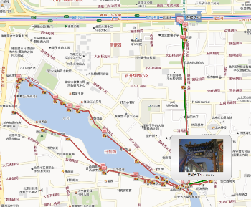
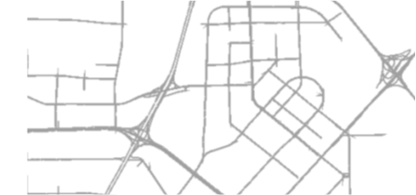
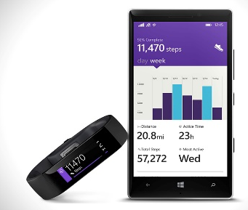

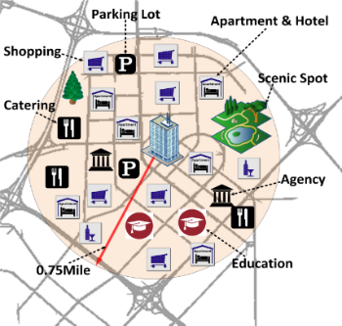
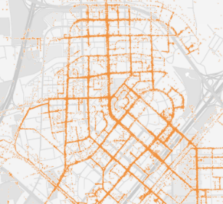
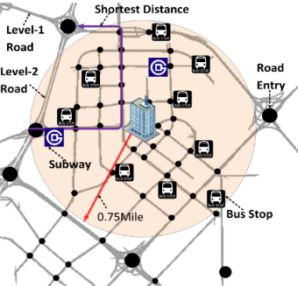
1.轨迹数据分析（Trajectory data analysis）
1.Sources of Trajectory Data
Human mobility
Active recording
Passive recording
Mobility of
transportation vehicles
Sport analysis
Travel logs
Check-ins
Mobility of Animals
Mobility of
natural phenomena
Credit card transactions
Public transit records
Mobile phone signal, Wi-Fi…

Slide 3
1.轨迹数据分析（Trajectory data analysis）
2.Some Trajectory Datasets
2.1 GeoLife Trajectory Dataset
https://www.microsoft.com/en-us/download/details.aspx?id=52367
这个GPS轨迹数据集由182位用户在（Microsoft Research Asia）Geolife项目中收集，为期三年（2007年4月至2012年8月）。该数据集的GPS轨迹由一系列时间戳点表示，每个点包含纬度，经度和高度的信息。该数据集包含17,621个轨迹，总距离约为120万公里，总持续时间为48,000+小时。这些轨迹由不同的GPS记录仪和GPS电话记录，并具有各种采样率。91％的轨迹以密集的形式记录，例如每1~5秒或每点5~10米。该数据集记录了广泛的用户户外运动，不仅包括回家和上班等生活习惯，还包括一些娱乐和体育活动，如购物，观光，餐饮，远足和骑自行车。该轨迹数据集可用于许多研究领域，例如移动模式挖掘，用户活动识别，基于位置的社交网络，位置隐私和位置推荐。

Slide 4
1.轨迹数据分析（Trajectory data analysis）
2.Some Trajectory Datasets
2.2 T-Drive Taxi Trajectories
https://www.microsoft.com/en-us/research/publication/
t-drive-driving-directions-based-on-taxi-trajectories/
配备GPS的出租车可以被视为探测道路表面交通流量的移动传感器，出租车司机通常会根据他们的知识找到到达目的地的最快（最快）路线。在本文中，我们从大量出租车的历史GPS轨迹中挖掘智能驾驶方向，并在给定的出发时间为用户提供到达给定目的地的实际最快路线。在我们的方法中，我们提出了一个时间相关的地标图，其中节点（地标）是出租车经常穿越的路段，用于模拟出租车司机的智能和动态道路网络的属性。然后，设计基于方差 - 熵的聚类方法来估计不同时隙中两个地标之间的旅行时间的分布。根据此图表，我们设计了一个两阶段路由算法来计算实际上最快的路由。我们根据超过33,000辆出租车在3个月内生成的真实轨迹数据集构建我们的系统，并通过合成实验和现场评估来评估系统。因此，我们的方法建议的60-70％的路线比竞争方法快，并且20％的路线共享相同的结果。平均而言，我们50％的航线比竞争方法至少快20％。我们的方法建议的60-70％的路线比竞争方法快，20％的路线共享相同的结果。平均而言，我们50％的航线比竞争方法至少快20％。我们的方法建议的60-70％的路线比竞争方法快，20％的路线共享相同的结果。平均而言，我们50％的航线比竞争方法至少快20％。

Slide 5
1.轨迹数据分析（Trajectory data analysis）
2.Some Trajectory Datasets
2.3 GPS Trajectory with Transportation Labels
https://www.microsoft.com/en-us/research/publication/
gps-trajectories-with-transportation-mode-labels/
这是（Microsoft Research Asia）GeoLife项目中收集的GPS轨迹数据集的一部分。每个轨迹都有一套运输模式标签，例如驾车，乘公共汽车，骑自行车和步行。存在与存储用户轨迹的每个文件夹相关联的标签文件。虽然这只是以下论文中使用的数据集的一部分，但此发布的数据集的规模仍然可以支持交通模式学习。
该数据集的GPS轨迹由一系列时间戳点表示，每个点包含纬度，经度，高度，速度和航向等信息。这些轨迹由不同的GPS记录仪或GPS电话记录，并有各种采样率。95％的轨迹以密集的表示记录，例如，每2~5秒或每点5~10米，而其中一些没有这样的高密度受到设备的约束。

Slide 6
1.轨迹数据分析（Trajectory data analysis）
2.Some Trajectory Datasets
2.4 Movebank animal tracking data
https://www.movebank.org/
Movebank是由马克斯普朗克鸟类学研究所主办的免费在线动物追踪数据库。他们帮助动物追踪研究人员管理，共享，保护，分析和存档他们的数据。Movebank中的动物追踪数据属于世界各地的研究人员，他们选择是否以及如何与公众分享他们的数据。

Slide 7
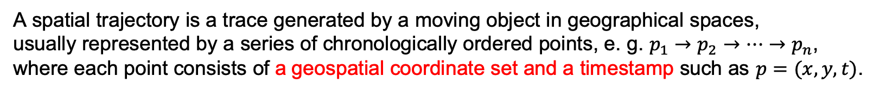
1.轨迹数据分析（Trajectory data analysis）
3. Spatial Trajectories
A spatial trajectory is a trace generated by a moving object in geographical spaces,
usually represented by a series of chronologically ordered points, e. g. $p_{1}→p_{2}→…→p_{n}$,
where each point consists of a geospatial coordinate set and a timestamp such as $p=(x, y, t)$.
空间轨迹是由地理空间中的移动物体产生的轨迹，通常由一系列按时间顺序排列的点表示。例如：
𝑝_1→𝑝_2→...→𝑝_𝑛，其中每个点由地理空间坐标集和时间戳组成，如𝑝=（𝑥，𝑦，𝑡）。

Slide 8
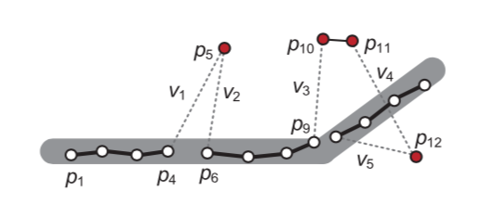
1.轨迹数据分析（Trajectory data analysis）
4. Four basic tenchniques of processing trajectory
4.1 noise filtering(噪声过滤)
We need to fiter some noises like p5 from
trajectories before starting a mining task.
Though this problem has not been completely
solved, existing methods fall into three major
categories.
Mean (or Median) Filter [平均（或中位数）过滤器]
For a measured point zi , the estimate of the
(unknown) true value is the mean (or median)
of zi and its n-1 predecessors in time. The
mean (median) filter can be thought of as a
sliding window covering n temporally adjacent
values of zi .
Because of sensor noise and other factors(receiving
poor positioning signals in urban canyons), Spatial
trajectories are never perfectly accurate.Some are
acceptable(They can be fixed by map-matching
algorithms),while others are unfixable.

Slide 9
1.轨迹数据分析（Trajectory data analysis）
4. Four basic tenchniques of processing trajectory
4.1 noise filtering(噪声过滤)
3. When dealing with multiple consecutive(连续) noise
points, for example:p10,p11 and p12,a larger size of
sliding window is needed. This results in a bigger error
between the calculated mean (or median) value and a
point’s true position. When the sampling rate of
trajectory is very low (the distance between two
consecutive points could be longer than several
hundred meters), the mean and median filters are
not good choices anymore.
Mean (or Median) Filter [平均（或中位数）过滤器]
Some points:
1.The median filter is more robust than the
mean filter when handling extreme errors.
2. The mean (median) filters are practical
for handling individual noise points like p5
in a trajectory with a dense(密集的)
representation.

Slide 10
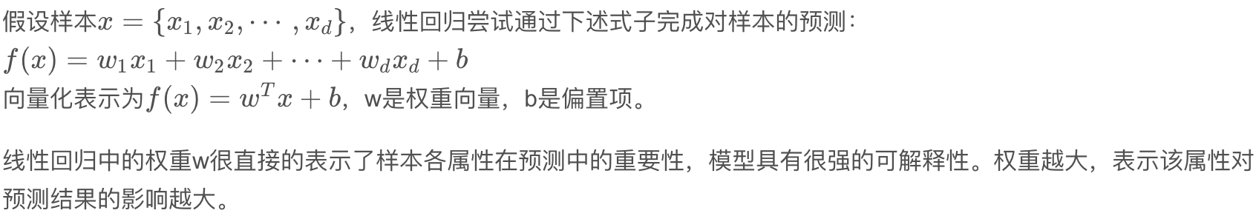
1.轨迹数据分析（Trajectory data analysis）
4. Four basic tenchniques of processing trajectory
4.1 noise filtering(噪声过滤)
The differences between Kalman Filters and
Particle Filters
While the Kalman filter gains efficiency by
assuming linear models plus Gaussian noise,
the particle filter relaxes these assumptions for
sa more general, but less efficient, algorithm.
Particle Filters:
Nonlinear
b. Kalman and Particle Filters[卡尔曼和粒子滤波器]
Kalman Filters:
Linear
Explanation:
The trajectory estimated from the Kalman filter
is a trade-off between the measurements and a
motion model. Besides giving estimates that
obey the laws of physics, the Kalman filter gives
principled estimates of higher order motion states
like speed.
Linear models:

Slide 11
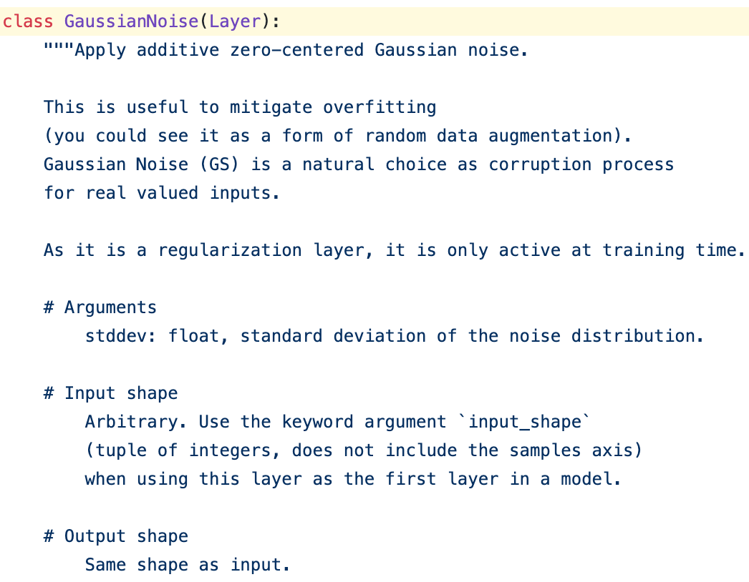
1.轨迹数据分析（Trajectory data analysis）
4. Four basic tenchniques of processing trajectory
4.1 noise filtering(噪声过滤)
Official Document:
b. Kalman and Particle Filters[卡尔曼和粒子滤波器]
Explanation:
Gaussian noise:
The Gaussian noise data centered at 0 and
whose standard deviation is sigma is added
to the input data. This is to alleviate the
over-fitting phenomenon(过拟合现象), which
can be understood as adding a small random
number to the input. Adding Gaussian noise is
a natural treatment for real input values. Only
valid during training.

Slide 12
1.轨迹数据分析（Trajectory data analysis）
4. Four basic tenchniques of processing trajectory
4.1 noise filtering(噪声过滤)
c. Heuristics-Based Outlier Detection
[基于启发式的异常值检测]
This method removes noise points directly
from a trajectory by using outlier detection
Algorithms(异常检测算法).
b. Kalman and Particle Filters[卡尔曼和粒子滤波器]
Explanation:
Outlier detection Algorithms
http://www.rdatamining.com/examples/
outlier-detection
Some points:
both Kalman and particle filters depend on the
measurement of an initial(最初的) location. If
the first point in a trajectory is noisy, the
effectiveness of the two filters drops significantly.
1.Statistic-based(基于统计)
2.Distance-based(基于距离)
3.Density-based(基于密度)
4.Clustering-based(基于聚类)。

Slide 13
1.轨迹数据分析（Trajectory data analysis）
4. Four basic tenchniques of processing trajectory
4.1 noise filtering(噪声过滤)
c. Heuristics-Based Outlier Detection
[基于启发式的异常值检测]
Some distance-based outlier detection can easily
find the number of p5’s neighbors within a distance
d is smaller than p proportion(比例)of the points in
the entire trajectory. Likewise,p10, p11, and p12 can
be filtered. While such algorithms can handle the
initial error in a trajectory and data sparsity(稀疏)
problems, setting the threshold(阈值) d and p is still
based on heuristics.

Slide 14
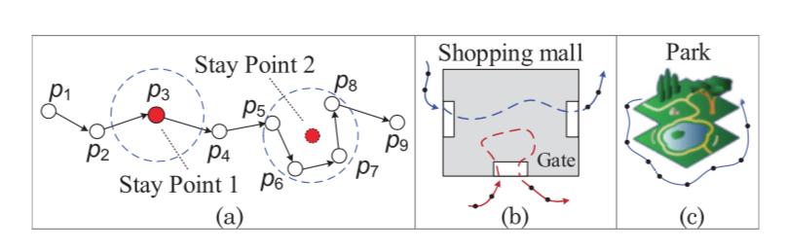
1.轨迹数据分析（Trajectory data analysis）
4. Four basic tenchniques of processing trajectory
4.2 stay point detection(停留点检测)
Two types of stay points:
a. Stay Points 1:
A user remains stationary for a while. This
situation is very rare, because a user’s
positioning device usually generates
different readings even in the same location.
Explanation:
Stay point(P1、P2):
b. Stay Points 2:
Spatial points(空间点) are not equally important
in a trajectory. Some points denote(表示) locations
where people have stayed for a while, such as
shopping malls and tourist attractions, or gas
stations where a vehicle(车辆) was refueled(加油). We call this kind of points “Stay Points.”
It is more generally observed in trajectories,
representing the places where people move
around (as depicted(描述) in Figures 3(b)
and 3(c)) or remain stationary but with
positioning readings shifting around.

Slide 15
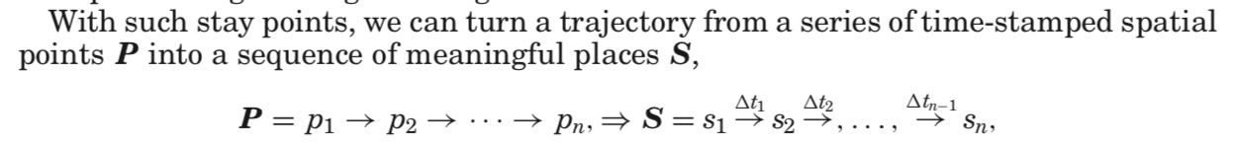
1.轨迹数据分析（Trajectory data analysis）
4. Four basic tenchniques of processing trajectory
4.2 stay point detection(停留点检测)
a candidate stay point (using p5 as an anchor
point), their algorithm further checks the
successor points from p6. For instance, if the
distance from p9 to p6 is smaller than the
threshold, p9 will be added into the stay point.
Explanation:
density clustering
https://www.cnblogs.com/pinard/p/6208966.html
stay point detection algorithm
This algorithm first checks if the distance between an anchor point[锚点] (p5) and its successors
(后继者) is in a trajectory larger than a given threshold (100 m). It then measures the time span
between the anchor point and the last successor (p8) that is within the distance threshold. If the time
span(跨度) is larger than a given threshold, a stay point (characterized by p5, p6, p7, and p8) is
detected(检测); the algorithm starts detection the next stay point from p9. Yuan improved this stay
point detection algorithm based on the idea of density clustering(密度聚类). After finding p5 to p8 is

Slide 16
1.轨迹数据分析（Trajectory data analysis）
4. Four basic tenchniques of processing trajectory
4.3 trajectory compression(轨迹压缩)
Basically, we can record a time-stamped geographical coordinate every second for a moving object.
But, this costs a lot of battery power and the overhead(开销) for communication, computing, and data
storage. In addition, many applications do not really need such a precision of location.
To address this issue, two categories of trajectory compression strategies(策略) (based on the shape
of a trajectory) have been proposed:
a. offline compression(batch mode) [离线压缩（也就是批量模式）]
It reduces the size of trajectory after the trajectory has been fully generated.
b. online compression [在线压缩]
It compressed a trajectory instantly as an object travels.

Slide 17
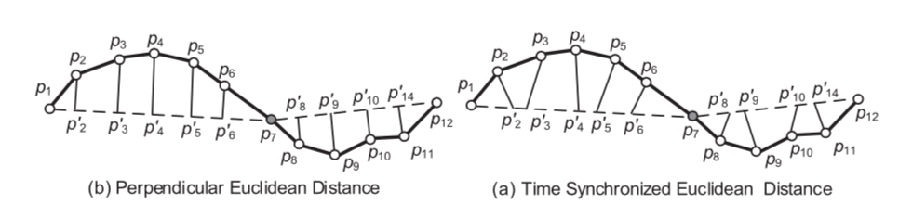
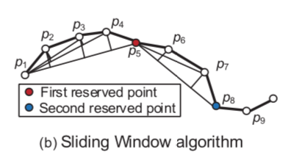
1.轨迹数据分析（Trajectory data analysis）
4. Four basic tenchniques of processing trajectory
4.3 trajectory compression(轨迹压缩)
1.window-based algorithms
(Sliding Window algorithm )
c.Distance Metric [距离度量]
Sliding Window algorithm is to fit
the spatial points in a growing
sliding window with a valid line
segment(有效线段) and continue
to grow the sliding window until
the approximation error exceeds
some error bound.
1. perpendicular Euclidean distance [垂直欧氏距离]
2. time synchronized Euclidean distance [时间同步欧氏距离]
Some points:
a. offline compression(batch mode) [离线压缩（也就是批量模式）]
As many applications require one to transmit trajectory data in a
timely fashion, a series of online trajectory compression techniques
have been proposed to determine whether a newly acquired
spatial(空间)point should be retained in a trajectory. There are two
major categories of online compression methods.

Slide 18
1.轨迹数据分析（Trajectory data analysis）
4. Four basic tenchniques of processing trajectory
4.3 trajectory compression(轨迹压缩)
1.Trajectory Simplification (TS) algorithm
2. Open Window algorithm
(based on the speed and direction of a moving object.)
TS considers both the shape skeleton(形状
的骨架) and the aforementioned(提到的)
special points. TS first divides a trajectory
into walking and nonwalking segments(段)
using a trajectory segmentation algorithm.
A point is weighted by its heading change
degree and the distance to its neighbors.
key factors:
speed and directions
It derived from the last two locations and a given threshold,
to determine whether a newly acquired point contains
important information. If the new data point is located
within the safe area, then this location point is considered
as redundant(冗余) and thus can be discarded; otherwise,
it is included in the approximated trajectory.
d. Compression with Semantic Meaning.[压缩与语义]
{Trajectory Simplification (TS) algorithm 轨迹简化(TS)算法}
{trajectory compression with the constraints of transportation networks}
Some special points where a user stayed, took photos, or
changed direction greatly, would be more significant than
other points in presenting semantic meanings of a trajectory.

Slide 19
1.轨迹数据分析（Trajectory data analysis）
4. Four basic tenchniques of processing trajectory
4.3 trajectory compression(轨迹压缩)
d. Compression with Semantic Meaning.[压缩与语义]
2. Trajectory compression with the constraints of transportation networks
We can reduce the redundant points on the same road segment. We can
even discard all the newly acquired points after an anchor point[锚点], as
long as the moving object is traveling on the shortest path from the anchor
point to its current location. This branch of work usually needs the support
of map-matching algorithms.
map-matching algorithms:
Map matching is a process to convert a sequence of raw latitude/longitude
(原始纬度/经度坐标)coordinates to a sequence of road segments. Knowledge of which road a vehicle was/is on is important for assessing traffic flow, guiding the vehicle’s navigation, predicting where the vehicle is going, and detecting the most frequent travel path between an origin and a destination, and so forth.

Slide 20
1.轨迹数据分析（Trajectory data analysis）
4. Four basic tenchniques of processing trajectory
4.3 trajectory compression(轨迹压缩)
map-matching algorithms:
According to the additional information used:
1. geometric [几何]: consider the shape of individual links in a road network(matching a GPS point
to the nearest road)
topological [拓扑]: pay attention to the connectivity(连通性) of a road network(Fre ́chet distance to
measure the fit between a GPS sequence and candidate road sequence )
probabilistic [概率] : To deal with noisy and low-sampling rate[低采样率]trajectories,it makes explicit
provisions for GPS noise and consider multiple possible paths through the road network to find the
best one()
4. other advanced techniques: These algorithms find a sequence of road segments that simultaneously(同时) come close to the noisy trajectory data and form a reasonable route through the road network.

Slide 21
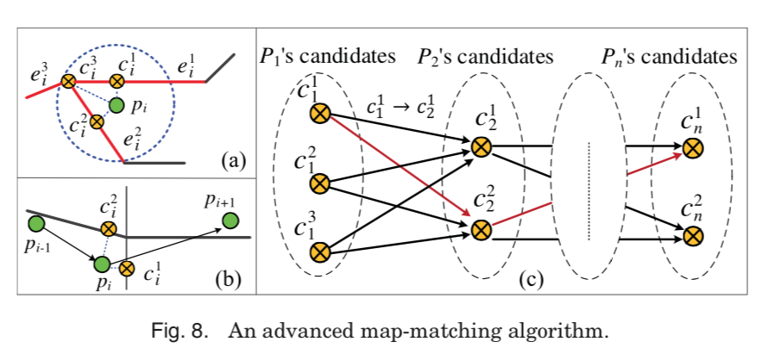
1.轨迹数据分析（Trajectory data analysis）
4. Four basic tenchniques of processing trajectory
4.3 trajectory compression(轨迹压缩)
map-matching algorithms:
According to the range of sampling points considered:
1. local/incremental and global methods[局部/增量和全局方法]:
The local/ incremental algorithms[本地/增量算法]: It follows a greedy strategy of sequentially(
按顺序) extending the solution from an already matched portion.
Other advanced techniques:

Slide 22
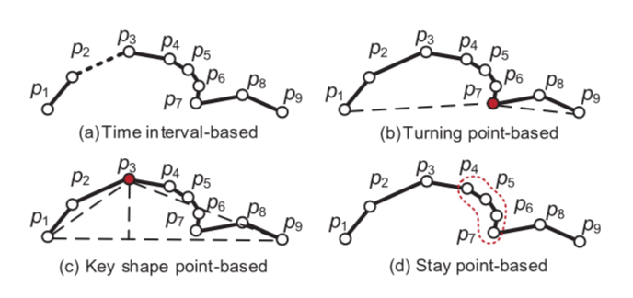
1.轨迹数据分析（Trajectory data analysis）
4. Four basic tenchniques of processing trajectory
4.4 trajectory segmentation(轨迹分割).
a. based on time interval(时间间隔)
If the time interval between two consecutive(连续) sampling(抽样) points is larger than a given
threshold, a trajectory is divided into two parts at the two points.
b. based on the shape of a trajectory
We can partition a trajectory by the turning points with heading direction changing over a threshold.
line simplification algorithms
(Douglas-Peucker algorithm)
https://en.wikipedia.org/wiki/Ramer%E2%80%93Douglas%E2%80%93Peucker_algorithm

Slide 23
1.轨迹数据分析（Trajectory data analysis）
4. Four basic tenchniques of processing trajectory
4.4 trajectory segmentation(轨迹分割).
c. based on the semantic meanings of points in a trajectory.
Whether we should keep the stay points in the divided results depends on applications. For example,
in a task of travel speed estimation, we should remove the stay points (from a taxi’s trajectory) where
a taxi was parked to wait for passengers.On the contrary, to estimate the similarity between two users,
we can only focus on the sequences of stay points, while skipping other raw trajectory points between
two consecutive(连续) stay points.

Slide 24
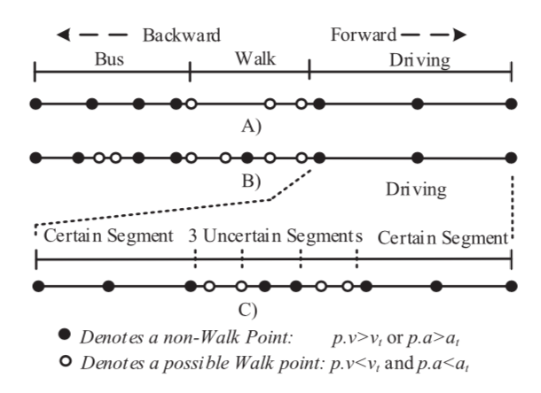
1.轨迹数据分析（Trajectory data analysis）
4. Four basic tenchniques of processing trajectory
4.4 trajectory segmentation(轨迹分割).
d. divide a trajectory into segments of different
transportation modes
Examples: driving, taking a bus, and walking
A walk-based segmentation method: The key insight is
that people have to walk through the transition between two different transportation modes.
Consequently, we can first distinguish walk points from
non-walk points in a trajectory, based on a point’s speed
( p · v) and acceleration ( p · a). The trajectory can then
be divided into alternate Walk Segments and non-Walk
Segments, as illustrated in Figure (A).

Slide 25
1.轨迹数据分析（Trajectory data analysis）
5. Trajectory Data Management(轨迹数据管理)
Mining massive trajectories is very time consuming, as we need to access different samples of the trajectories or different parts of a trajectory many times. This calls for effective data management techniques that can quickly retrieve the trajectories (or parts of a trajectory) needed.

Slide 26
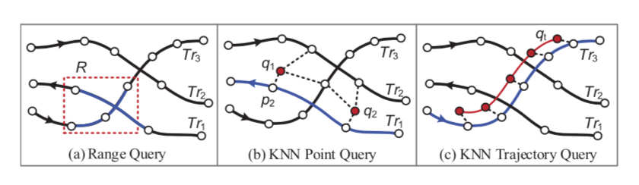
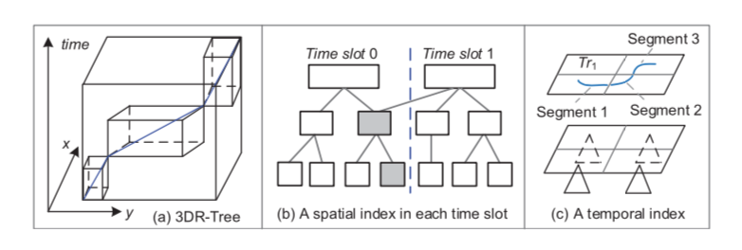
1.轨迹数据分析（Trajectory data analysis）
6. Trajectory Indexing and Retrieval (轨迹索引与检索)
a. Range queries
Range queries retrieve the trajectories falling into (or intersecting(交叉)) a spatial(空间) (or
Spatiotemporal(时空)) range.
The retrieved trajectories (or segments) can then be used to derive features, such as the travel speed
and traffic flow, for data mining tasks like classification and prediction.

Slide 27
1.轨迹数据分析（Trajectory data analysis）
6. Trajectory Indexing and Retrieval (轨迹索引与检索)
a. Range queries
regards the time as the third dimension besides the 2D geographical space, building a 3D-Rtree
based on trajectories Figure Left[b]
The 3D-Rtree works well for indexing trajectories generated in the near recent (in the past few hours).
When the time span of the trajectories to be indexed lasts for a long period (more segments of newly generated trajectories will be inserted into a 3D-Rtree index) the overlap among 3D boxes bounding segments of different trajectories occurs more often.

Slide 28
1.轨迹数据分析（Trajectory data analysis）
6. Trajectory Indexing and Retrieval (轨迹索引与检索)
a. Range queries
2. divides a time period into multiple time intervals, building an individual spatial index like R-tree for
the trajectories generated in each interval
The part of indexing structure that does not change over time is shared by two time slots.
Examples: R-tree, Rt-Tree, HR-Tree, H+R-Tree(Figure Left[b])
Given a spatiotemporal(时空) range query, such an index first finds the time slots(间隙) falling in the temporal range, and then retrieves the trajectories intersecting the spatial query range from each spatial index of these time slots.

Slide 29
1.轨迹数据分析（Trajectory data analysis）
6. Trajectory Indexing and Retrieval (轨迹索引与检索)
a. Range queries
3. partitions a geographical space into grids, and then builds a temporal index for the trajectories falling in each grid.
CSE- tree divides a trajectory into several segments by the grids. Each segment falling in a grid[网格]
is represented by a 2D point whose coordinates are the starting time and ending time of the segment.
These points are then indexed by a hybrid[混合动力] B+tree. When retrieving trajectories
satisfying a spatiotemporal query, CSE-tree first finds the grids intersecting the spatial range of the
query, and then searches the hybrid B+tree of these grids for the segments of trajectories falling in
the temporal range of the query. Finally, CSE-tree merges the IDs of trajectory segments (and their
starting and ending times) retrieved from different grids.

Slide 30
1.轨迹数据分析（Trajectory data analysis）
6. Trajectory Indexing and Retrieval (轨迹索引与检索)
b. K-Nearest Neighbor (KNN) queries
KNN queries retrieve[检索] the top-K trajectories with the minimum aggregate distance[最小聚合距离]
to a few points.
The KNN point queries concern more about whether a trajectory provides a good connection to query
locations rather than whether the trajectory is similar to the query in shape. Additionally, the number of
query points is usually very small and can be far away from each other in applications. As a result, we
cannot connect these query points sequentially to formulate a trajectory and then call the solution
designed for the KNN trajectory query to solve it.

Slide 31
1.轨迹数据分析（Trajectory data analysis）
6. Trajectory Indexing and Retrieval (轨迹索引与检索)
b. K-Nearest Neighbor (KNN) queries
KNN trajectory query
KNN trajectory query can find the GPS logs[GPS日志] of people traveling through a specific route. To
answer such a query, the first step is to define a similarity/distance function between two trajectories.
Then efficient query processing algorithms are designed to address the problem of searching over a
large set of candidate trajectories.

Slide 32
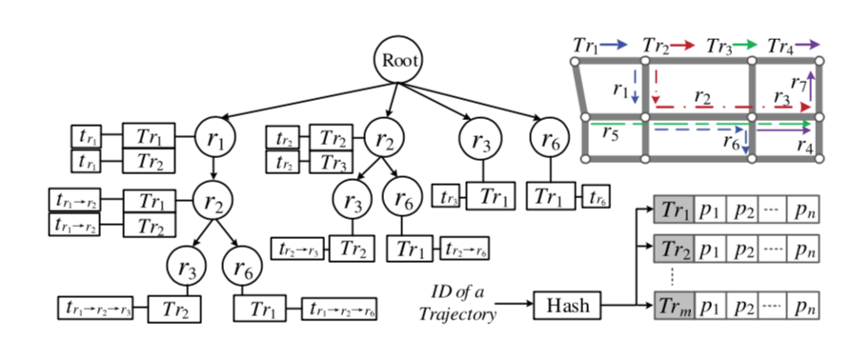
1.轨迹数据分析（Trajectory data analysis）
6. Trajectory Indexing and Retrieval (轨迹索引与检索)
b. K-Nearest Neighbor (KNN) queries
query processing algorithms
1. regard a path on a road network as a trajectory and use the KNN trajectory query to detect the
trajectories that are close to the path
2. convert a trajectory into a sequence of road segments by using a map-
matching algorithm. Some indexing structures are then built to manage the relationship between
paths and the trajectories passing them.

Slide 33
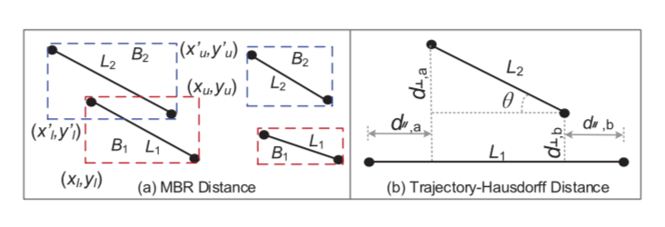
1.轨迹数据分析（Trajectory data analysis）
7. Distance/Similarity of Trajectories (轨迹的距离/相似性)
Explanation:
Longest Common Subsequence (LCSS)[最长公共子序列]
The LCSS-based distance allows one to skip some noise points when calculating the distance of
trajectories, using a threshold δ to control how far in time we can go in order to match one point from
a trajectory to a point in another trajectory. Another threshold ε is used to determine whether two points
(from two different trajectories) are matched.
Explanation:
Edit Distance on Real Sequence (EDR) distance[编辑实际序列距离（EDR）距离]
It is similar to LCSS in using a threshold ε to determine a match, while assigning penalties[分配的惩罚] to the gaps between two matched sub trajectories.
Both LCSS and Edit Distance were proposed for matching strings

Slide 34
1.轨迹数据分析（Trajectory data analysis）
7. Distance/Similarity of Trajectories (轨迹的距离/相似性)
K-BCT
It is a parameter-free[无参数] similarity metric[度量] for trajectories, combining the merits of DTW and
LCSS. During the matching process, K-BCT can repeat some trajectory points and skip unmatched
trajectory points including outliers[异常值].The Distance between Two Trajectory Segments: A distance
measure for trajectory segments is based on the Minimum Bounding Rectangles (MBR) of segments
Explanation:
Minimum Bounding Rectangles (MBR)
https://en.wikipedia.org/wiki/Minimum_bounding_box

Slide 35
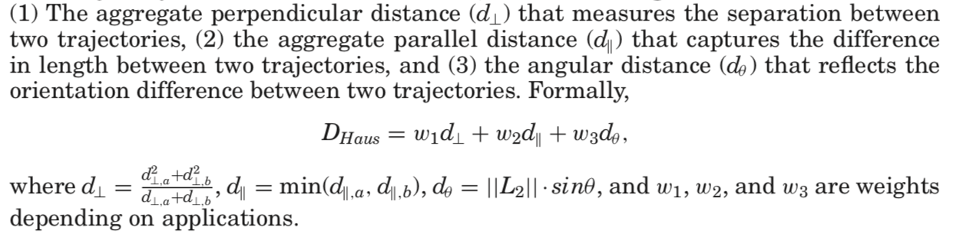
1.轨迹数据分析（Trajectory data analysis）
7. Distance/Similarity of Trajectories (轨迹的距离/相似性)
K-BCT
Explanation:
Trajectory-Hausdorff Distance (DHaus)
It is a weighted sum of three terms:

Slide 36
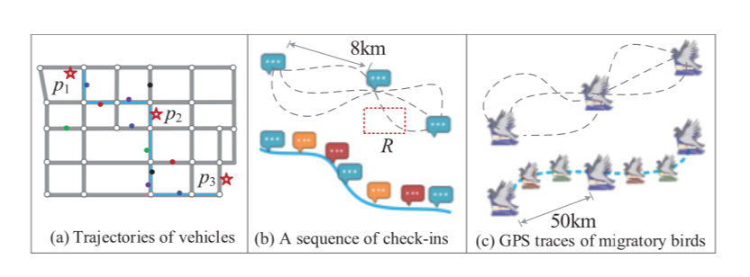
1.轨迹数据分析（Trajectory data analysis）
8. Uncertainty in a Trajectory(在轨迹上的不确定性)
8.1 Reducing Uncertainty from Trajectory Data.
8.1.1 Modeling Uncertainty of a Trajectory for Queries
We do not know whether the trajectory formulated by the three blue check-ins should be retrieved or
not by the range query R, without modeling the uncertainty of the trajectory. Many of these techniques
aim at providing conservative bounds[保守的界限] for the positions of uncertain objects between two
sampling points. This is usually achieved by employing geometric objects, such as cylinders [圆柱体]
or beads [珠], as trajectory approximations. These models concern little about data mining。

Slide 37
1.轨迹数据分析（Trajectory data analysis）
8. Uncertainty in a Trajectory(在轨迹上的不确定性)
8.1 Reducing Uncertainty from Trajectory Data.
8.1.2 Path Inference[推断] from Uncertain Trajectories.
it is possible to interpolate[插入] an uncertain trajectory by cross-referring other trajectories on (or
partially on) the same/similar route, that is, “uncertain + uncertain → certain.”
Reducing the uncertainty of trajectories can support scientific studies and enable many applications,
such as travel recommendation and traffic management.

Slide 38
1.轨迹数据分析（Trajectory data analysis）
8. Uncertainty in a Trajectory(在轨迹上的不确定性)
8.1 Reducing Uncertainty from Trajectory Data.
8.1.2 Path Inference[推断] from Uncertain Trajectories.
There are two categories of methods to complement an uncertain trajectory:
map-matching algorithms
The other is to construct a route that can approximate a bunch of relevant trajectories

Slide 39
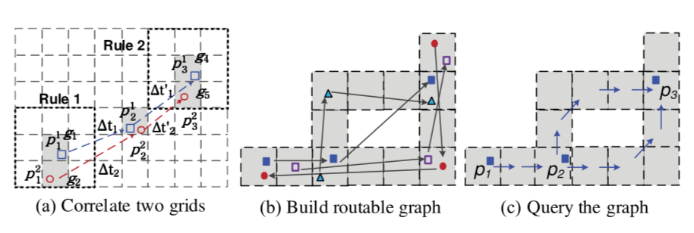
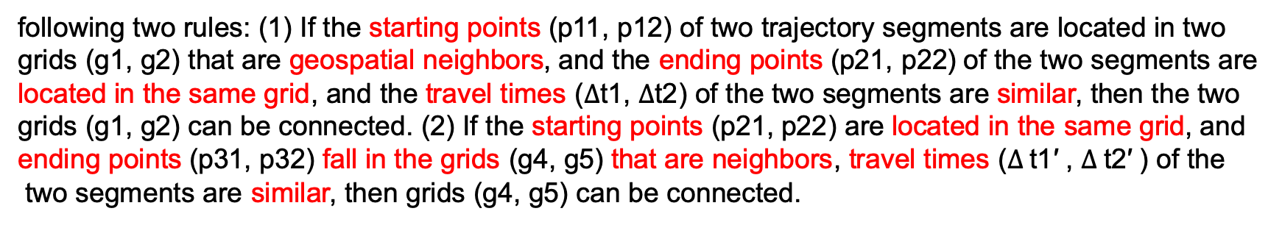
1.轨迹数据分析（Trajectory data analysis）
8. Uncertainty in a Trajectory(在轨迹上的不确定性)
8.1 Reducing Uncertainty from Trajectory Data.
8.1.2 Path Inference[推断] from Uncertain Trajectories.
Construct a route that can approximate a bunch of relevant trajectories
1.partitions a geospacer[分区] into uniform
grids (the size of a grid depends on the
required inference accuracy)
2.maps trajectories onto these grids. Some
grids can be connected to form a region if the
trajectories passing them satisfy one of the
following two rules: (1) If the starting points (p11, p12) of two trajectory segments are located in two
grids (g1, g2) that are geospatial neighbors, and the ending points (p21, p22) of the two segments are
located in the same grid, and the travel times ($∆$t1, $∆$t2) of the two segments are similar, then the two
grids (g1, g2) can be connected. (2) If the starting points (p21, p22) are located in the same grid, and
ending points (p31, p32) fall in the grids (g4, g5) that are neighbors, travel times ($∆$t1′ , $∆$t2′ ) of the
two segments are similar, then grids (g4, g5) can be connected.

Slide 40
1.轨迹数据分析（Trajectory data analysis）
8. Uncertainty in a Trajectory(在轨迹上的不确定性)
8.1 Reducing Uncertainty from Trajectory Data.
8.1.2 Path Inference[推断] from Uncertain Trajectories.
Construct a route that can approximate a bunch of relevant trajectories
3.After turning disjoint grids into connected
region(s), as demonstrated in Figure (b), we
can build a routable graph where a node
is a grid. The direction and travel time
between two adjacent[相邻] grids in the graph
is inferred based on the trajectories passing
the two grids.
4.as depicted in Figure (c), given three query points, we can find the most likely route on the graph
based on a routing algorithm. To find a more detailed path, a regression[回归] can be performed over
the trajectories passing the identified route.
Anchor-based calibration system[基于锚的校准系统]: that aligns[对齐] trajecto- ries to a set of fixed
anchor points. The approach considers the spatial relationship between anchor points and trajectories.
It also trains inference models from historical trajectories to improve the calibration.

Slide 41
1.轨迹数据分析（Trajectory data analysis）
8. Uncertainty in a Trajectory(在轨迹上的不确定性)
8.2 Privacy of Trajectory Data.
This kind of technology tries to blur[模糊] a user’s location,while ensuring the quality of a service or the
utility of the trajectory data. There are two major scenarios[方案] that we need to protect a user’s trajectory data from the privacy leak.
8.2.1 Real-time continuous location-based services.
Spatial cloaking [空间隐藏]:
http://www.doc88.com/p-7798292339865.html
Mix zones [混合区]:
http://www.doc88.com/p-5438951297054.html
Path confusion [路径混乱]:
https://www.docin.com/p-1594723594.html
Euler histogram based on short IDs [基于短ID的欧拉直方图]:
http://www.docin.com/p-690646500.html
Dummy trajectories [虚拟轨迹]:
https://www.docin.com/p-1626940049.html

Slide 42
1.轨迹数据分析（Trajectory data analysis）
8. Uncertainty in a Trajectory(在轨迹上的不确定性)
8.2 Privacy of Trajectory Data.
8.2.1 Publication of historical trajectories.
Clustering-based [基于聚类] approaches:
Abul, F. Bonchi, and M. Nanni. 2008. Never walk alone: Uncertainty for anonymity in moving objects databases. In Proceedings of the 24th IEEE International Conference on Data Engineering. IEEE, 376– 385.
Generalization-based [基于泛化] approaches:
Nergiz, M. Atzori, Y. Saygin, and B. Guc. 2009. Towards trajectory anonymization: A generalization- based
approach. Transactions on Data Privacy 2, 1 (2009), 47–75.
Suppression-based [基于抑制] approaches:
Terrovitis and N. Mamoulis. 2008. Privacy preservation in the publication of trajectories. In Proceedings the 9th
IEEE International Conference on Mobile Data Management. IEEE, 65–72.
Grid-based [基于网格]approaches:
Gid’ofalvi, X. Huang, and T. B. Pedersen. 2007. Privacy-preserving data mining on moving object tra- jectories.
In Proceedings of the 8th IEEE International Conference on Mobile Data Management. IEEE, 60–68.

Slide 43
介绍完毕，请指正！
汇报人：盛德明

