Slide 1

XM_HeatForecast
Documentation

Slide 2
Overview
1. How to install the software
2. How to launch XM_HeatForecast
3. Modules
3.1 - Forecaster
3.2 - GUI
3.3 - Overview
4. Overview of folders and files

Slide 3
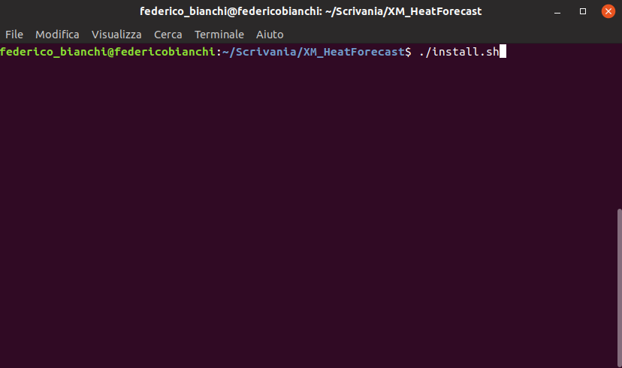
1. How to install the software
To use XM_HeatForecast, Python 3.X has to be installed.
Launch the script “install.sh” to install the libraries required, typing “./install.sh” on the terminal
Example

Slide 4
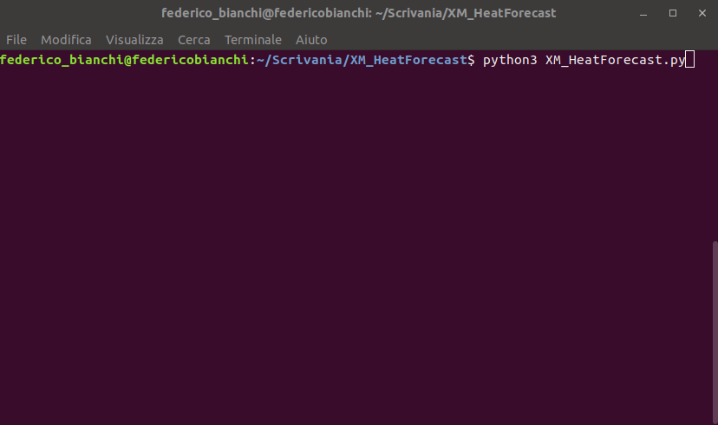
2. How to launch XM_HeatForecast
In order to launch XM_HeatForecast, the user has to simply type the command “python3 XM_HeatForecast.py” on terminal opened in the tool folder
Example

Slide 5

2. How to launch XM_HeatForecast
A new window should appear in the middle of the screen.
Type a “forecasting horizon” between 24 or 48 hours
Example

Slide 6
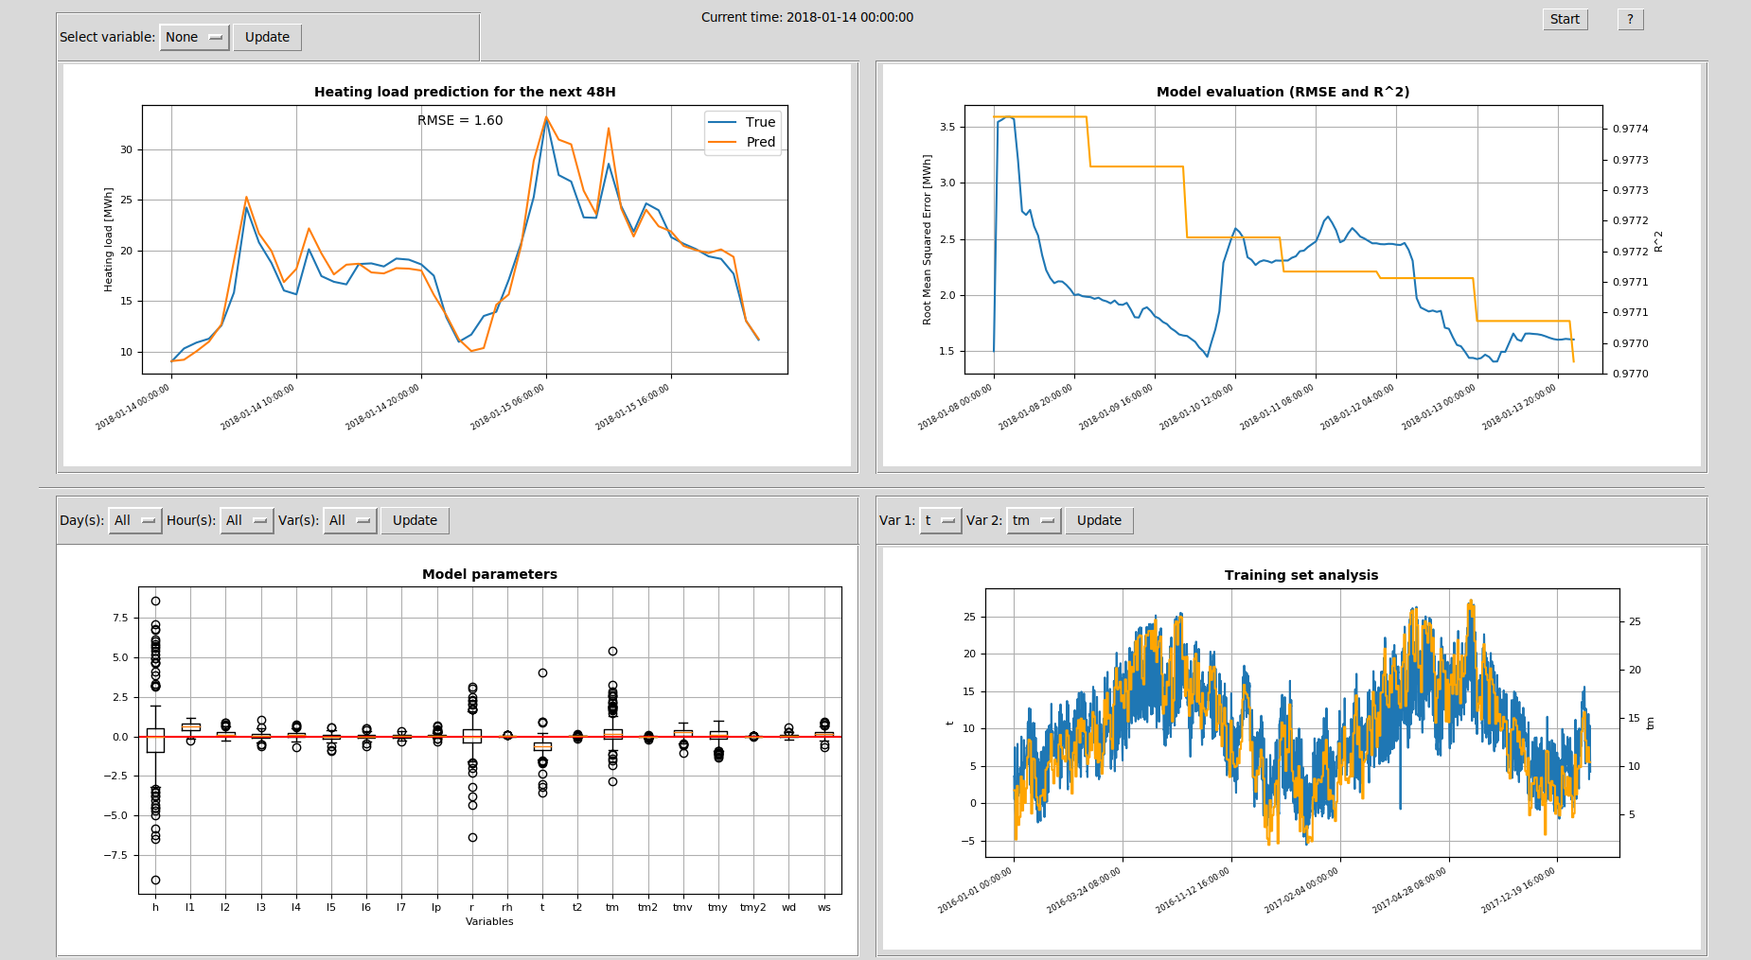
2. How to launch XM_HeatForecast
To launch XM_HeatForecast press “Start” button

Slide 7
3. Modules

Slide 8
3.1 - Forecaster

Slide 9
Weather forecast
W
T
RH
Wind
Forecaster
W
Runs every hour
...
Data
Processing
W
Forecast files
Pasta data
F
From Mon. at 12:00 AM
l
T
RH
Wind
l₁
F
From Mon. at 1:00 AM
Forecasting
...
F
From Wed. at 6:00 AM
Training
Current model
Runs every 24 hours
M
Monday 12:00 AM
M
Monday 1:00 AM
Parameters
...
h: Forecasting horizon
Performance
M
Sunday 11:00 PM
D
Parameters
D
Rsquared
D
RMSE
D

Slide 10
3.2 - GUI

Slide 11
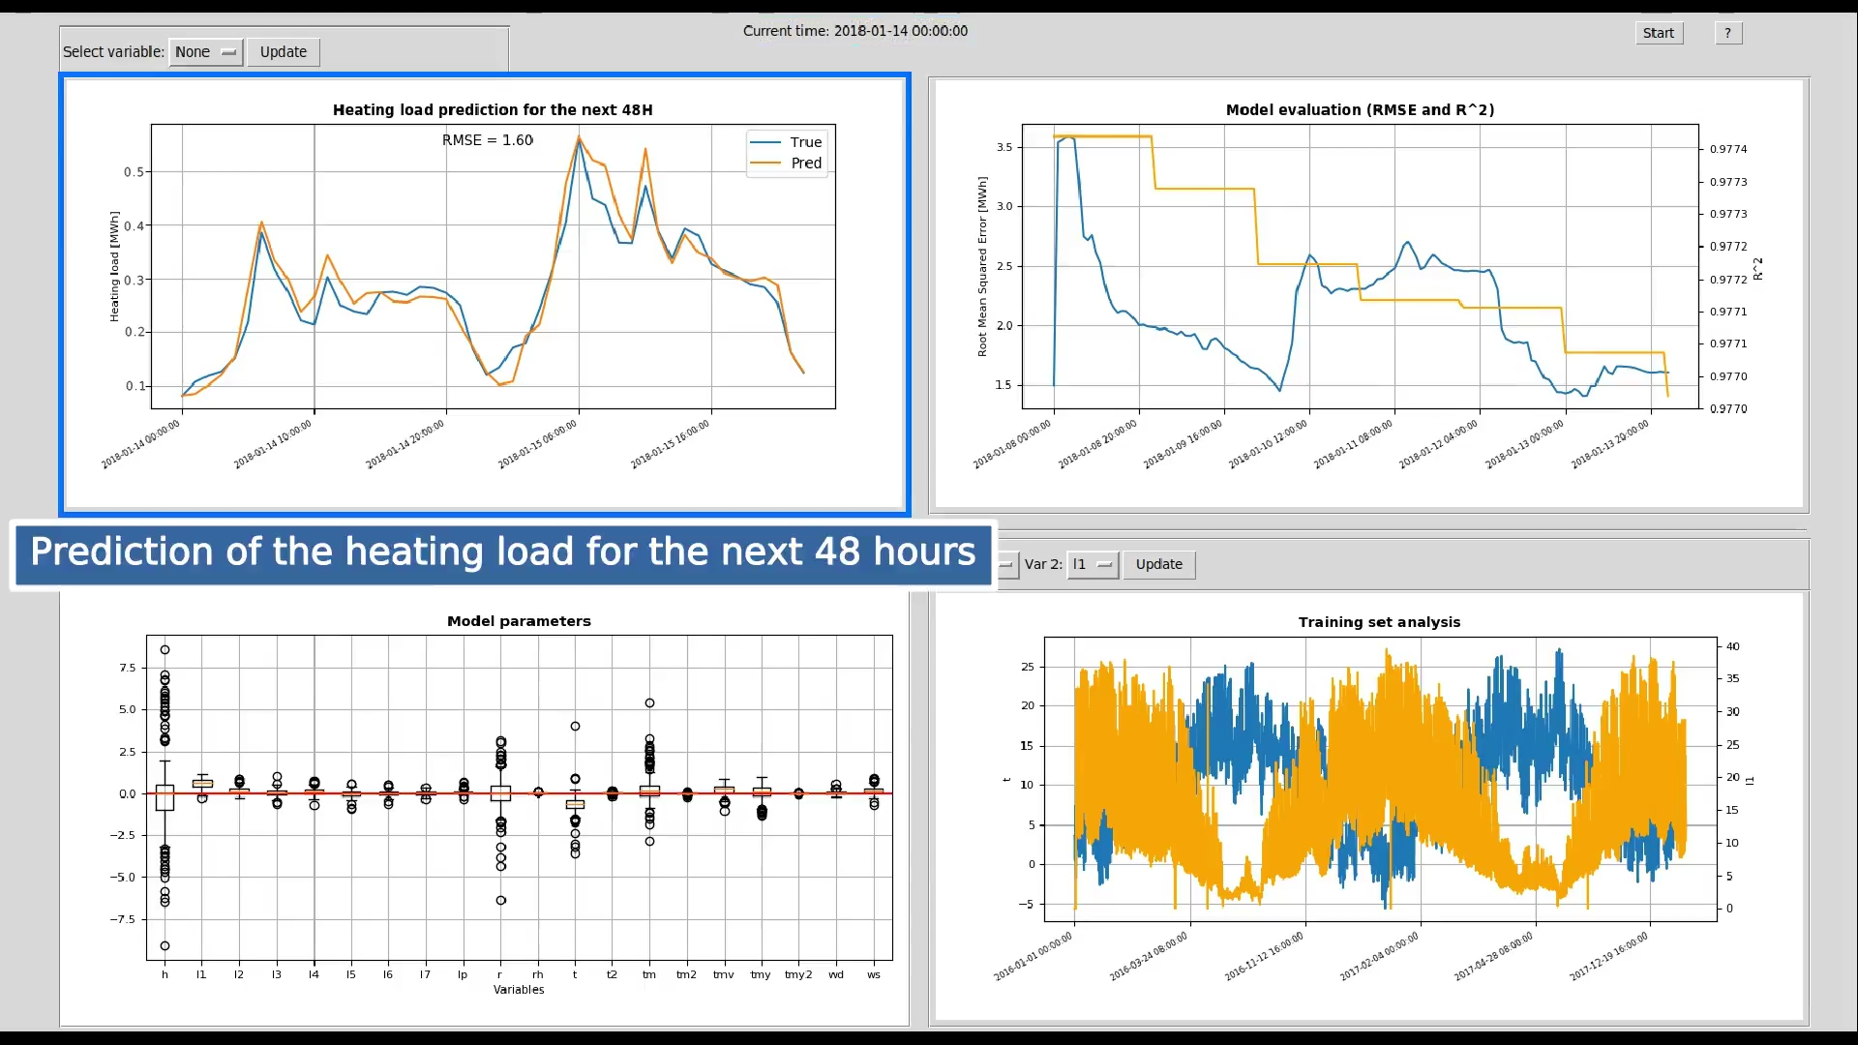
Forecast files
Pasta data
Performance
F
From Mon. at 12:00 AM
l
T
RH
Wind
l₁
D
Parameters
F
From Mon. at 1:00 AM
D
Rsquared
...
D
RMSE
F
From Wed. at 6:00 AM

Slide 12
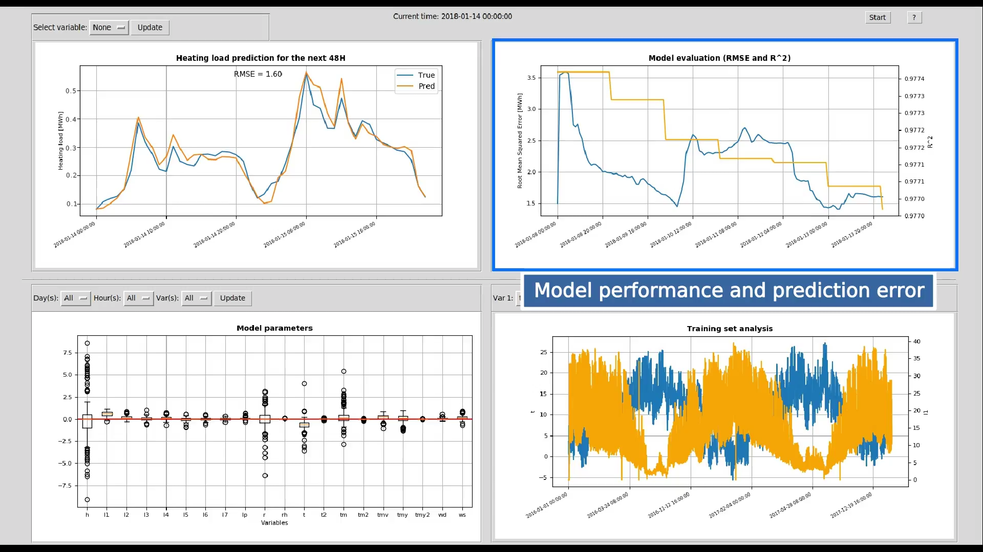
Forecast files
Pasta data
Performance
F
From Mon. at 12:00 AM
l
T
RH
Wind
l₁
D
Parameters
F
From Mon. at 1:00 AM
D
Rsquared
...
D
RMSE
F
From Wed. at 6:00 AM

Slide 13
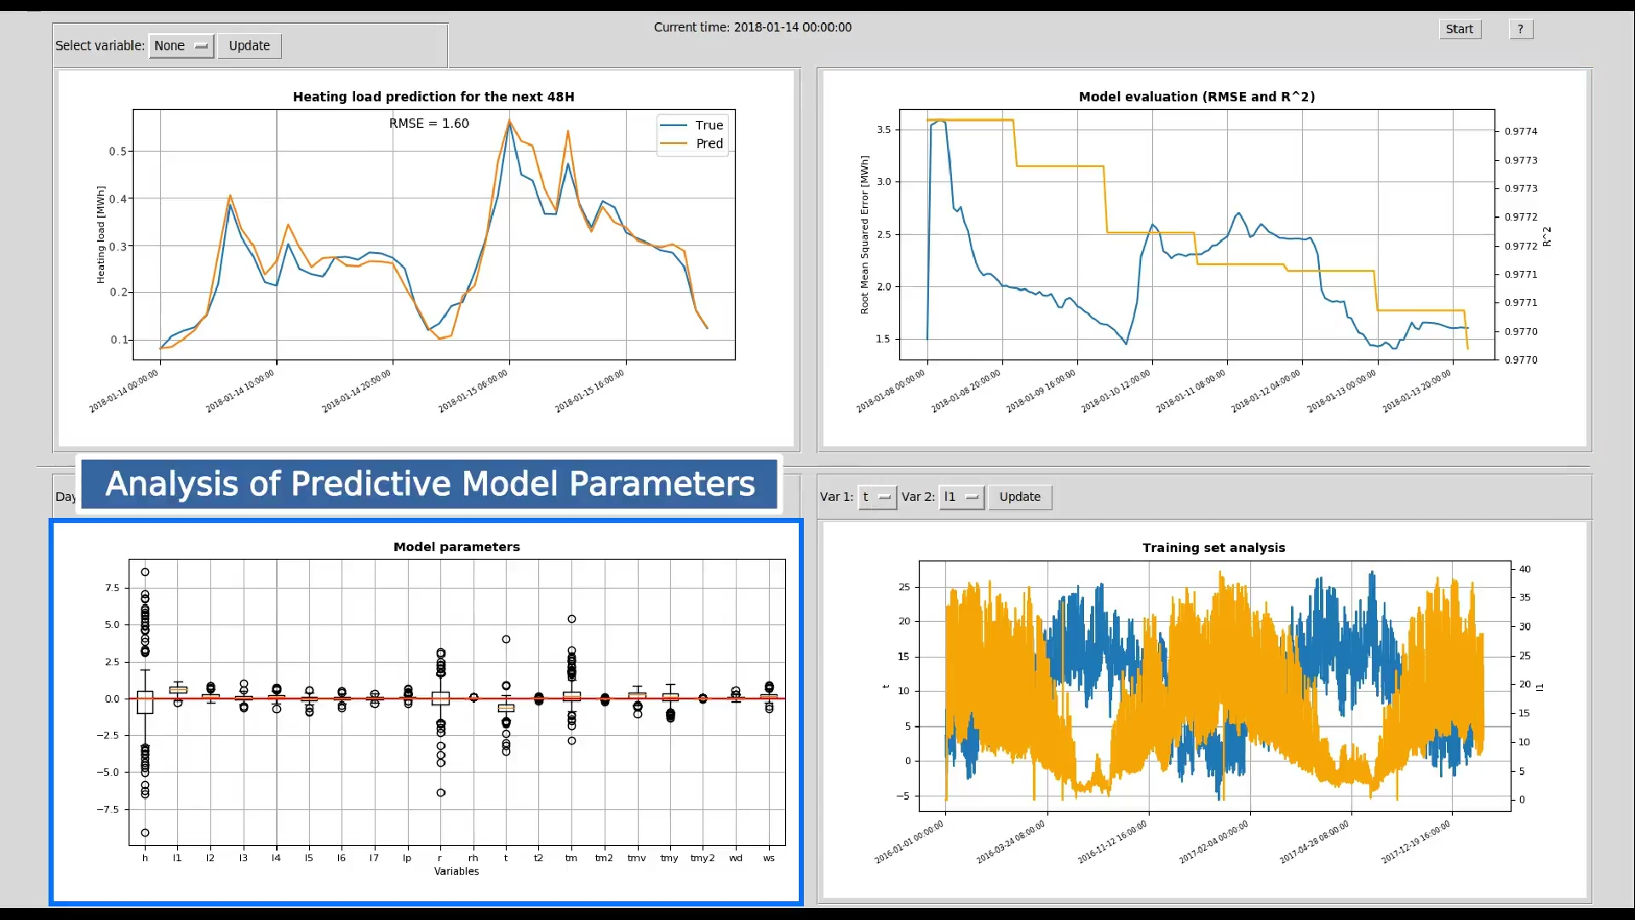
Forecast files
Pasta data
Performance
F
From Mon. at 12:00 AM
l
T
RH
Wind
l₁
D
Parameters
F
From Mon. at 1:00 AM
D
Rsquared
...
D
RMSE
F
From Wed. at 6:00 AM

Slide 14
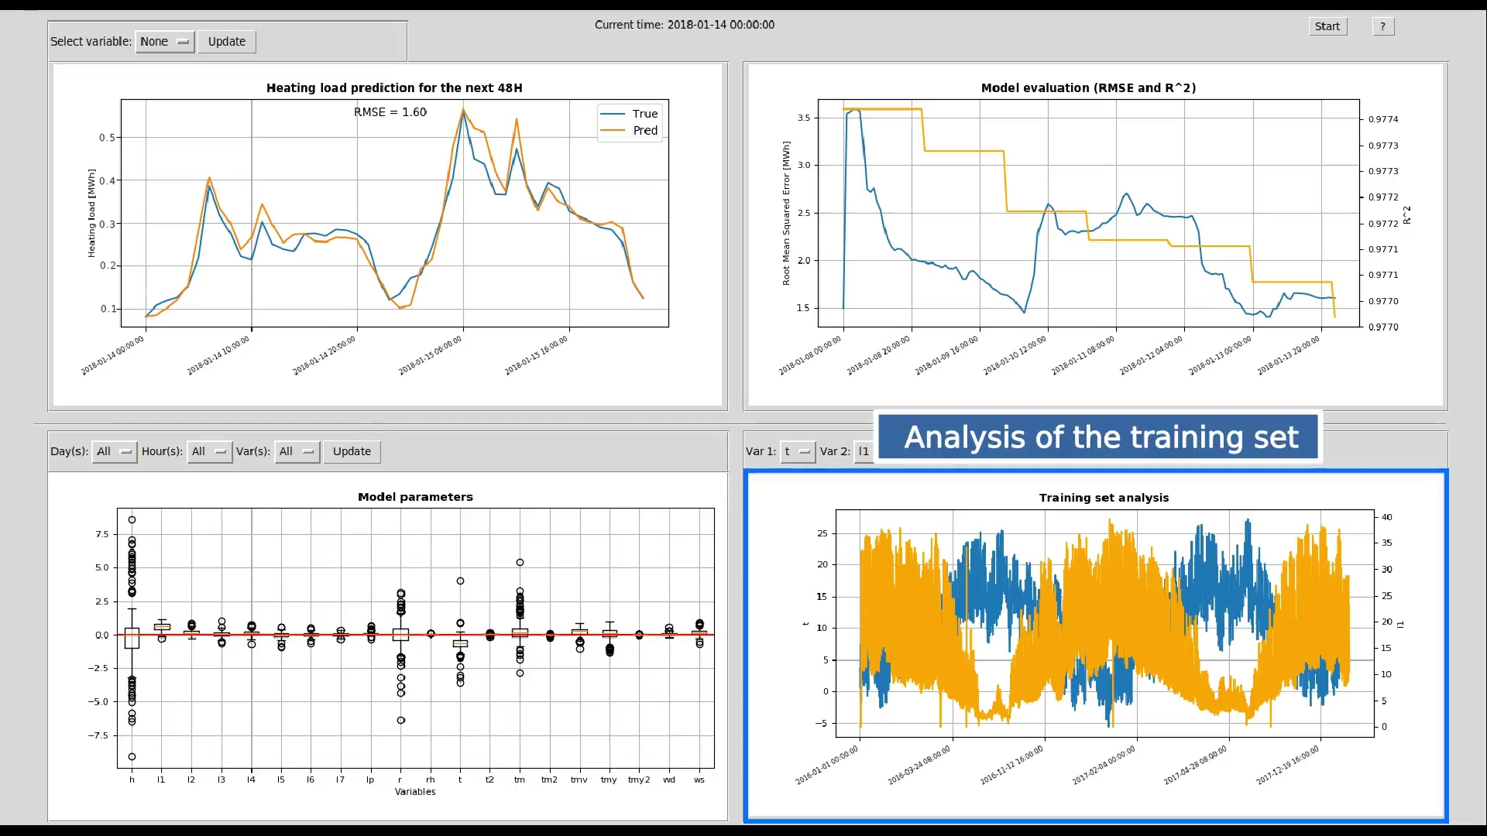
Forecast files
Pasta data
Performance
F
From Mon. at 12:00 AM
l
T
RH
Wind
l₁
D
Parameters
F
From Mon. at 1:00 AM
D
Rsquared
...
D
RMSE
F
From Wed. at 6:00 AM

Slide 15
3.3 - Overview

Slide 16
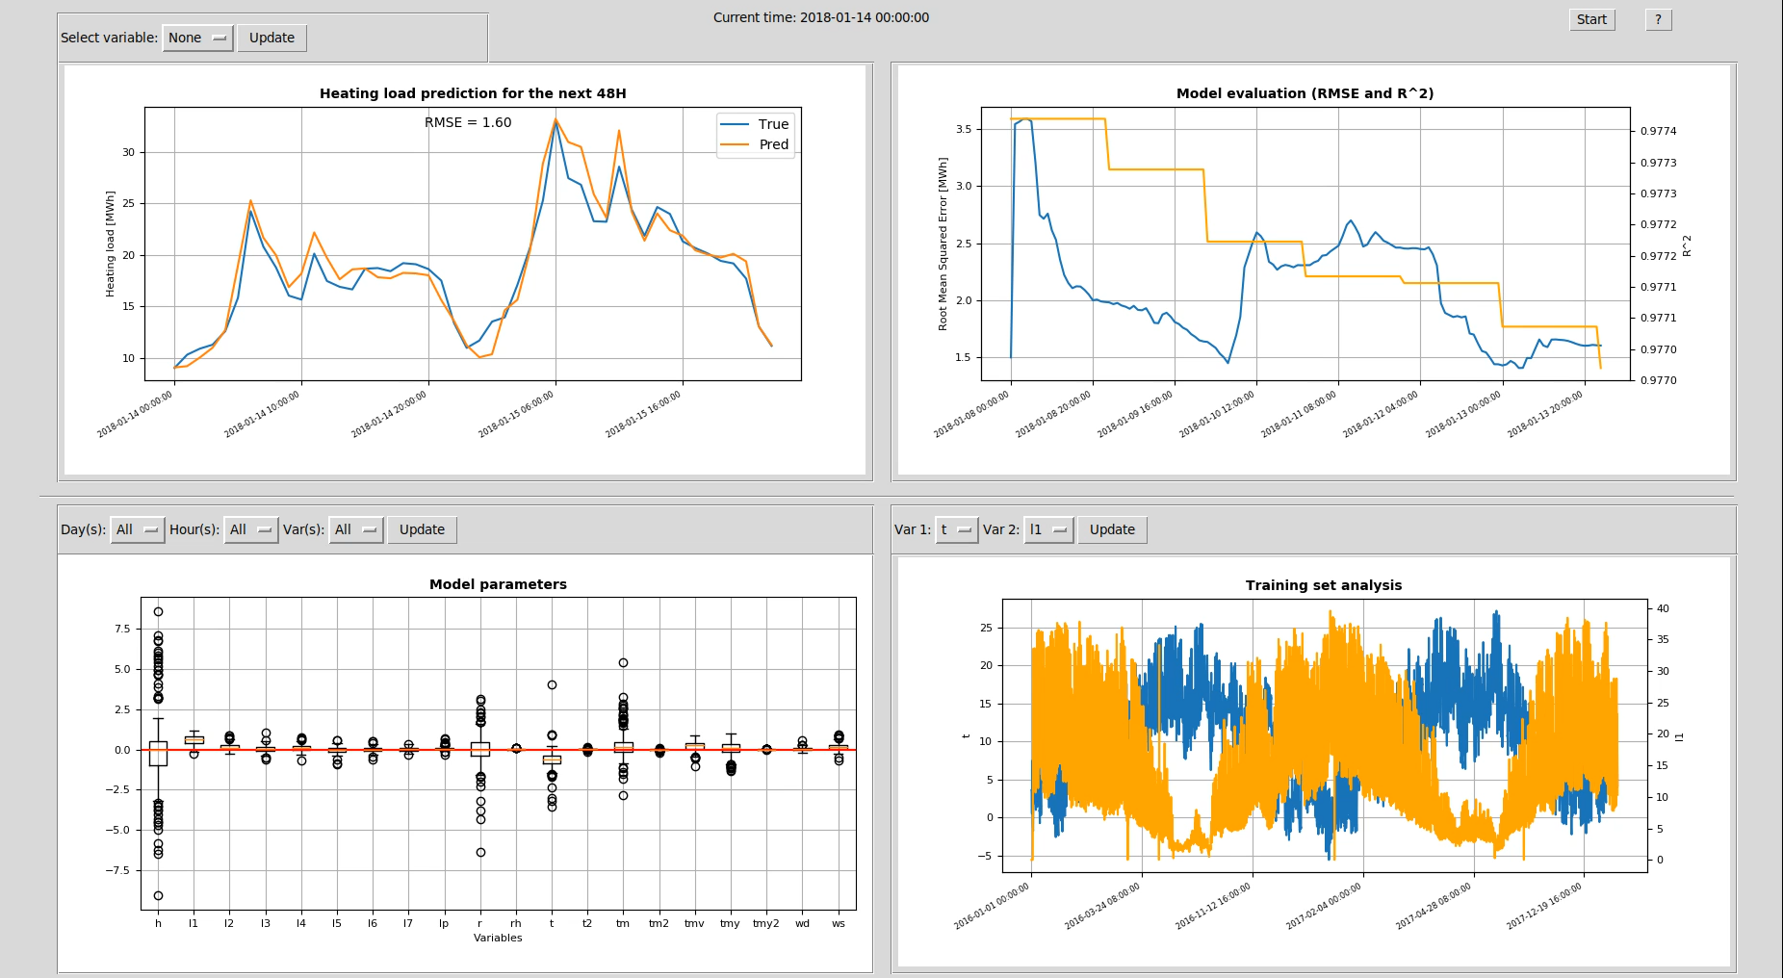

“Data Processing” takes in input every hour a “Weather forecast” files with date yyyy-mm-dd hh:mm
and “Pasta data” until yyyy-mm-dd hh:mm in order to process the information
GUI
Weather forecast
Forecaster
Pasta data
Data
Processing
Forecasting
Training
Current model
Parameters
R2
RMSE
Performance
Forecast files
Folders

Slide 17
“Training” module trains a model each 24 hours using past data and saves it in the folder “Current model”
GUI
Weather forecast
Forecaster
Pasta data
Data
Processing
Forecasting
Training
Current model
Parameters
R2
RMSE
Performance
Forecast files
Folders

Slide 18
“Forecasting” module predicts the next 24 or 48 hours of heating load every hour, using the current model, data processed until yyyy-mm-dd hh:mm
and saves the result in the folder “Forecast files”
GUI
Weather forecast
Forecaster
Pasta data
Data
Processing
Forecasting
Training
Current model
Parameters
R2
RMSE
Performance
Forecast files
Folders

Slide 19
Each 24 hours parameters of the current model, R² coefficient and RMSE are computed
GUI
Weather forecast
Forecaster
Pasta data
Data
Processing
Forecasting
Training
Current model
Parameters
R2
RMSE
Performance
Forecast files
Folders

Slide 20
GUI fetches data from the folders “Past data”, “Performance” and “Forecast files”, creating graphic visualizations in order to support
the interpretability of results
GUI
Weather forecast
Forecaster
Pasta data
Data
Processing
Forecasting
Training
Current model
Parameters
R2
RMSE
Performance
Forecast files
Folders

Slide 21
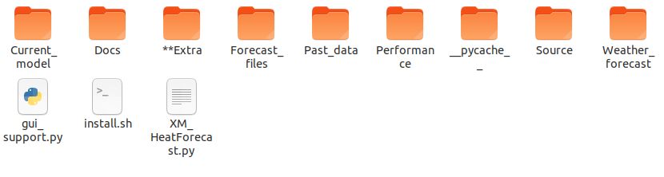
4. Overview of folders and files
Model folder
This folder contains weather forecasting files
Documentation folder
This folder contain past data
used in forecasting process
XM_HeatForecast
launcher
This folder contains the files with parameters of the model, R² and RMSE
This folder contains
prediction files

Slide 22
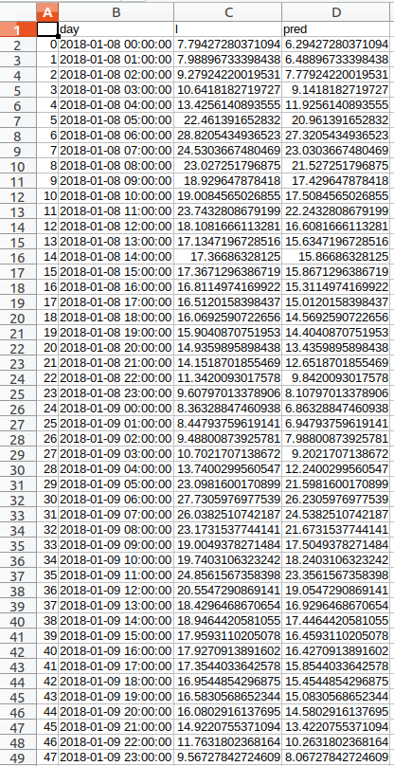
4. View of a forecasting file
XM_HeatForecast generates a .csv file each 24 hours
Predictions of the
next 24 or 48 hours
Date and hour of prediction
Real load
Predicted
load

