Slide 1

Diamonds are forever
Jancel Adiong
Sagar Bora
Helena Chen
Caroline Grant

Slide 2

Project scope
The aim of our project is to uncover relationships in the quality and features of gem diamonds and their impact on selling prices.
In doing so, we aim to create a tool where a user can select different diamond features and a predicted estimated price of the diamond will be displayed.

Slide 3
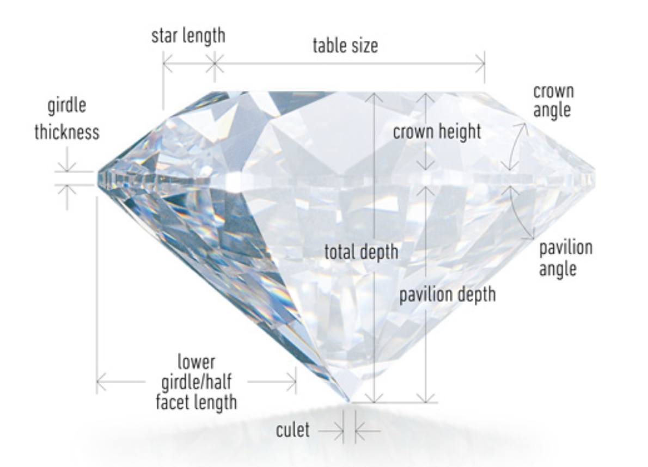
Data set
The largest diamond dataset currently on Kaggle
This dataset was created and consists of 219,703 graded gem diamonds. Note – this is ready-made data, not live
Original Feature list
Cut
Colour
Clarity
Carat weight
Cut quality
Symmetry
Polish
Lab
Eye clean
Depth percent
Table percent
Length measure
Width measure
Depth measure
Girdle min
Girdle max
Culet size
Culet condition
Fluorescence color
Fluorescence intensity
Fancy color – dominant color
Fancy color– secondary color
Fancy color – overtone
Fancy color - intensity
https://www.kaggle.com/datasets/hrokrin/the-largest-diamond-dataset-currely-on-kaggle/data

Slide 4

Project overview
Stages:
Data Cleaning
Data analysis
Modelling
Web page designing
Programs and Libraries used in the data cleaning, analysis and modelling tasks:
Python
Pandas
Pathlib
Matplotlib
Hvplot.pandas
Numpy
Seaborn
Pickle
scikit-learn (sklearn)
Statsmodels

Slide 5

Data Cleaning
Data Cleaning Process:
Data Review and Initial Cleaning:
Removed all rows with missing data (zero data).
Outlier Detection and Removal:
Identified and removed rows with outlier data.
Example:
Removed rows with culet condition values "chipped" and "abraded" (counts of 18 and 8, respectively).
Binning for Data Reduction:
Grouped similar values together to minimize the impact on feature logic.
Example:
Binned "Clarity" values I1, I2, and I3 (counts of 6717, 921, and 84, respectively) as "Included" to represent flaws in the diamond.
Result:
The original dataset of 219,703 rows was cleaned, resulting in a diamond dataset with 213,134 rows.
The dataset consists of 6 numerical features and 18 categorical features.

Slide 6
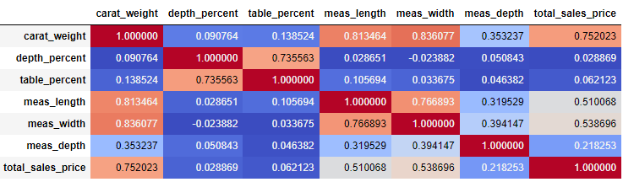
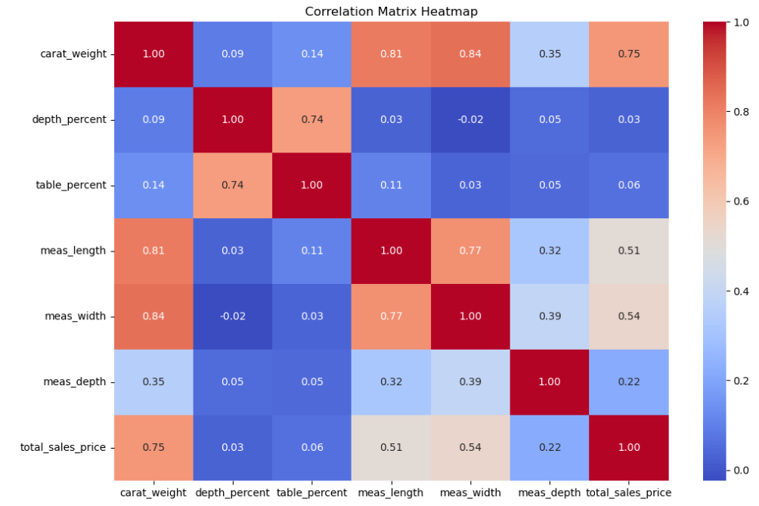
Data Analysis
Pearson correlation
We wanted to understand how strongly each numerical feature is related to the target variable “total sales price” and Pearson correlation is suitable for identifying linear relationships.
Heatmap
We then ran a heatmap to visualize the Pearson correlation, making it easier to identify and interpret relationships between the features.
The strong positive correlation of 0.75 between carat weight and total sales price suggests that, in this dataset, larger diamonds tend to command higher prices. This finding underscores the significance of carat weight as a key determinant of a diamond's value, potentially reflecting consumer preferences for larger, more substantial stones.

Slide 7
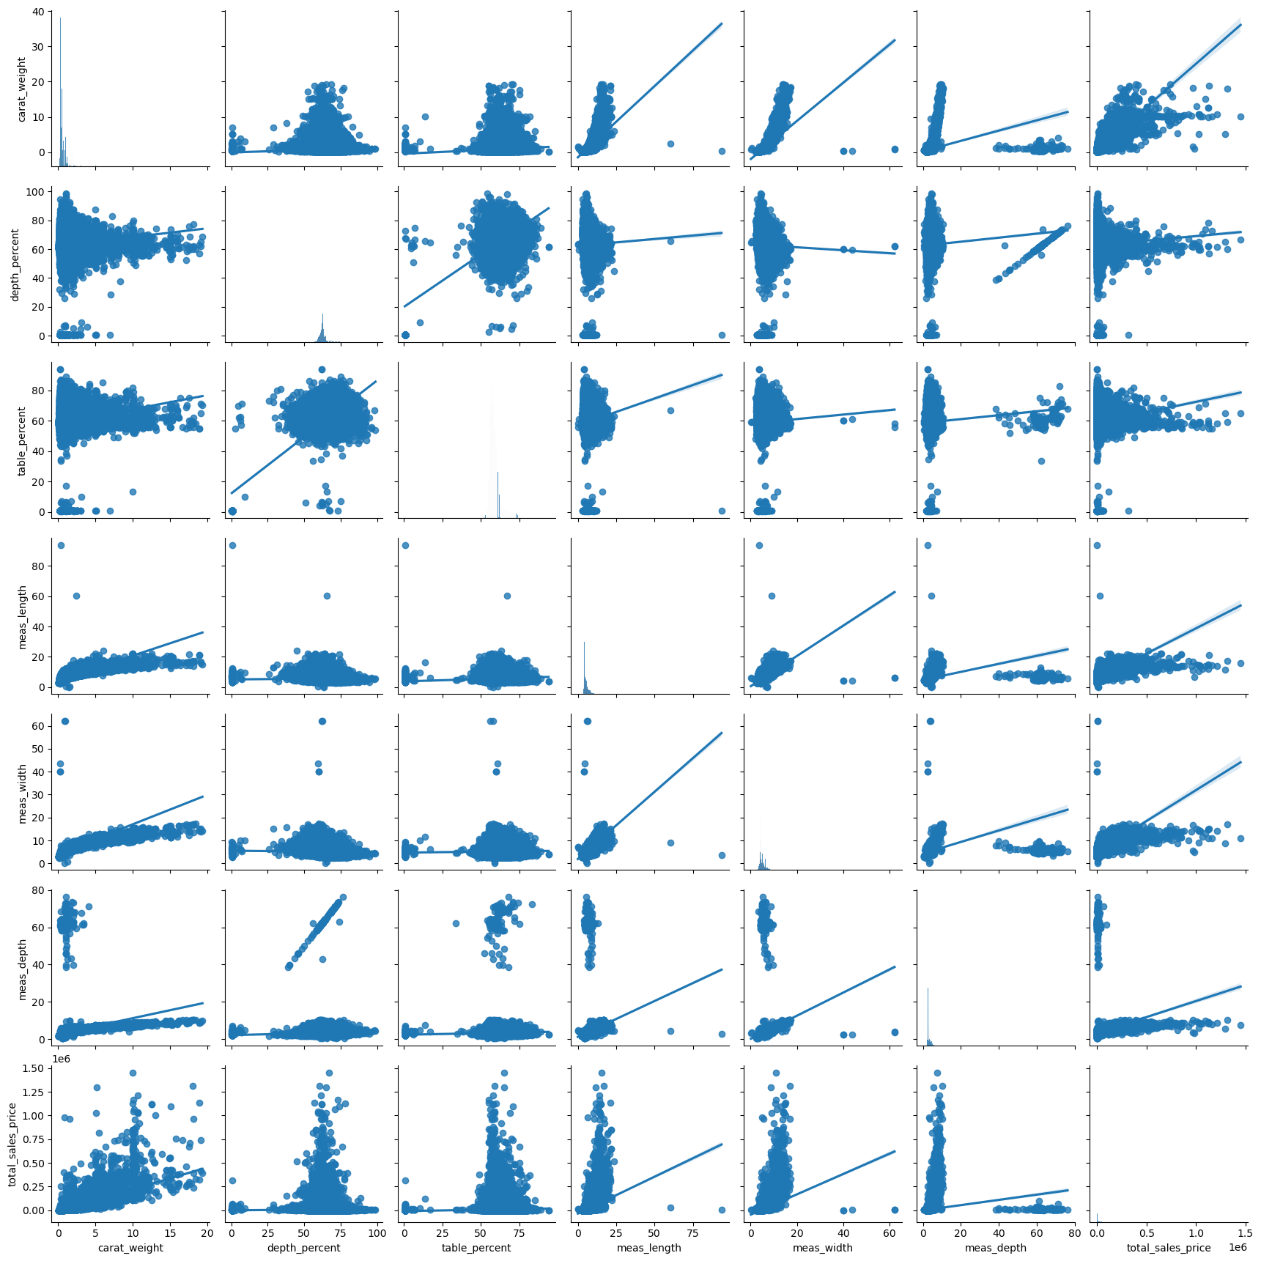
Data Analysis
Seaborn pair plot
A Seaborn pair plot was created to visualize relationships among the features.

Slide 8
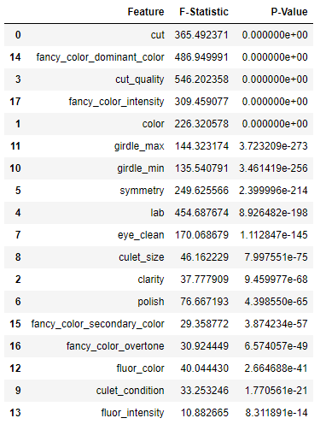
Data Analysis
Analysis of Variance (ANOVA)
We performed ANOVA as we wanted to investigate whether the different categories within the categorical features have a statistically significant impact on the target variable (total sales price). This is a statistical method used to assess whether there are statistically significant differences between the means of two or more groups.
These results show that Cut, Cut quality, Color, Fancy color-dominant color and Fancy color intensity are significant categories in relation to the sales price (target variable).

Slide 9
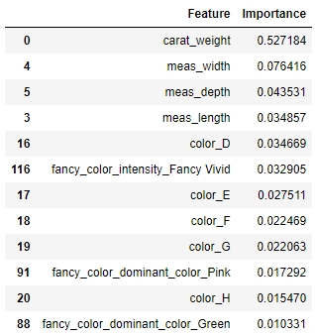
Data Analysis
Machine learning model - Extra Trees Regressor (One-Hot Encoding)
The categorical features are encoded using one-hot encoding for use with the Extra Trees Regressor.
The Extra Trees Regressor model was created, and we fit the data.
To the right is the top 12 features displayed by importance from the trained the Extra Trees Regressor.

Slide 10
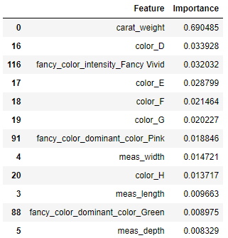
Data Analysis
Machine learning model – Random Forest Regressor (One-Hot Encoding)
The categorical features are encoded using one-hot encoding for use with the Random Forest Regressor.
The Random Forest Regressor model was created, and we fit the data.
To the right is the top 12 features displayed by importance from the trained the Random Forest Regressor.

Slide 11
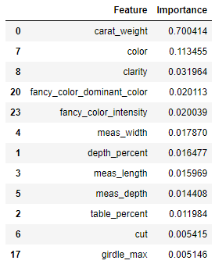
Data Analysis
Machine learning model – Random Forest Regressor (Label Encoding)
The categorical features are encoded using label encoding for use with the Random Forest Regressor.
The Random Forest Regressor model was created, and we fit the data.
To the right is the top 12 features displayed by importance from the trained the Random Forest Regressor.

Slide 12
Feature Selection
The significant features in Extra Trees and Random Forest Regressor based on the same hot encoding of categorical features are similar. Random Forest Regressor using label-encoded categorical features has a different set of important features.
Carat-weight had the highest importance by far in all 3 methods used, with the importance of other features dropping heavily in significance.
We considered the interpretability of the models and determined we are not interested in understanding how each category within a categorical variable impacts the total sales price (target variable) and therefore decided the model with label-encoding was more appropriate in this scenario. The increase in dimensionality using one-hot ended data on an already large dataset would impact model complexity, training time and performance.

Slide 13
The steps involved in training models
Step 1 - Setting up features and target
Step 2 - Building a powerful pipeline
Linear Regression
Decision Tree
Random Forest
K-Nearest Neighbors
Step 3 - Fitting models on the training data
Step 4 - Cross-Validation score analysis
Step 5 - Selecting the model with best performance
Step 6 -Testing the Random Forest
Saving the model

Slide 14
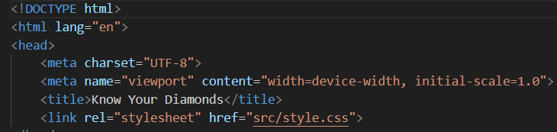
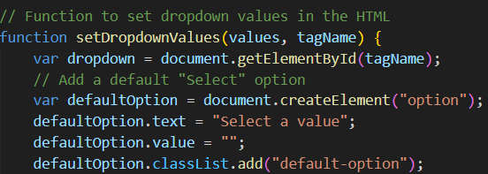
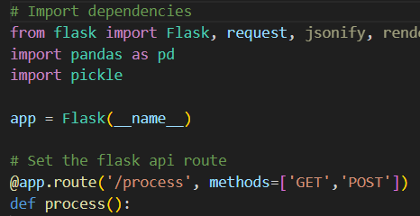
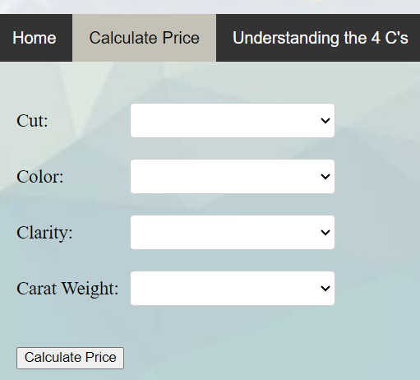
Web Page Designing and Prediction
Tools and steps involved in web page design, development and making predictions:
HTML, CSS and JavaScript is used for creating the structure, style and interactivity of the web page
HTML form element i.e. dropdown is used to collect user input.
Python and Flask is used to create a web server and API endpoint to handle HTTP requests and responses.
The webpage data is sent to the API endpoint and server will load the pre-trained model, process the data by running the user inputs through the model and make predictions.
The server then send the result back to web page and display it.

Slide 15
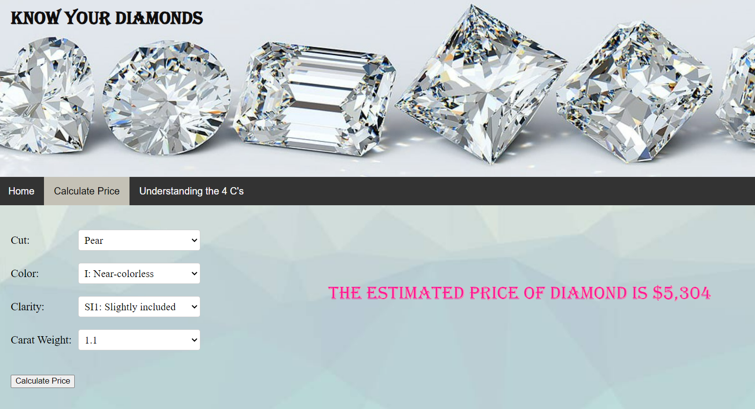
The Final Product
The final product is a web page which will be used to predict the price of the Diamond.
The user will select the values for the top four features from a pre-defined list and the model will predict the price and show it on the screen.

