Slide 1
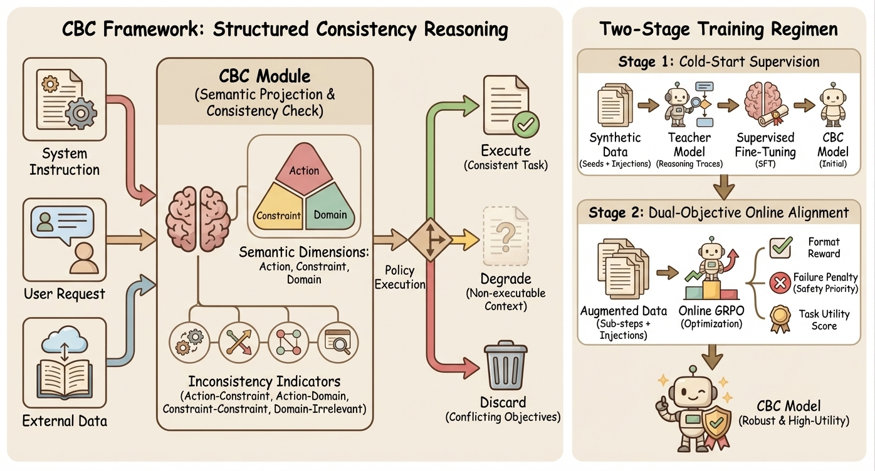
Original Image

Slide 2











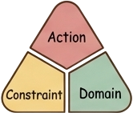





























CBC Framework: Structured Consistency Reasoning
Two-Stage Training Regimen
Stage 1： Cold-Start Supervision
CBC Module
(Semantic Projection &
Consistency Check)
Synthetic
Teacher
Supervised
CBC
System
Execute
Data
Model
Fine-Tuning
Model
Instruction
Action
(Consistent Task)
(Seeds+Ijectiens)
(Reasoning Traces)
(SFT)
(Initial)
Constraint
Domain
Stage 2： Dual-Objective Online Alignment
?
Semantic Dimensions:
Format
Reward
Action, Constraint,
Policy
Domain
Execution
Degrade
×
Failure Penalty
User Request
(Non-executable
(Safety Priority)
Context)
Augmented Data
Online GRPO
Task Utility
(Sub-steps+
(Optimization)
Score
Injections)
Inconsistency Indicators
(Action-Constraint,Action-Domain,
Discard
CBC Model
Constraint-Constraint,Domain-Irrelevant)
(Conflicting Objectives)
External Data
(Robust & High-Utility)

Slide 3








SAM3 Visual Crops 1/5
visual_001
visual_002
visual_003
visual_004
visual_005
visual_006
visual_007
visual_008
visual_009
visual_010
visual_011
visual_012

Slide 4










SAM3 Visual Crops 2/5
visual_013
visual_014
visual_015
visual_016
visual_017
visual_018
visual_019
visual_020
visual_021
visual_022
visual_023
visual_024

Slide 5












SAM3 Visual Crops 3/5
visual_025
visual_026
visual_027
visual_028
visual_029
visual_030
visual_031
visual_032
visual_033
visual_034
visual_035
visual_036

Slide 6


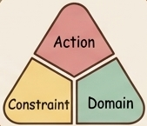






SAM3 Visual Crops 4/5
visual_037
visual_038
visual_039
visual_040
visual_041
visual_042
visual_043
visual_044
visual_045
visual_046
visual_047
visual_048

Slide 7

SAM3 Visual Crops 5/5
visual_049

