Slide 1
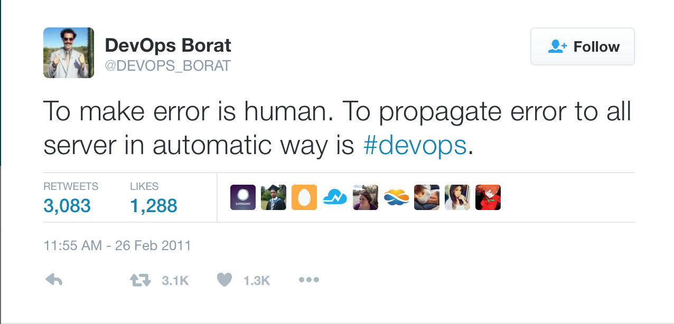

Slide 2
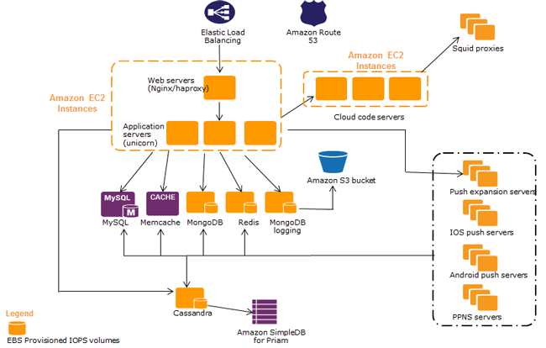
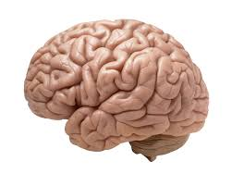
2
Notes:
2

Slide 3
Do DevOps Like
LANCE ARMSTRONG!
Yahya Poonawala ShopSocially @meetykp
Siddharth Kulkarni ThoughtWorks @sid_thinketh

Slide 4
THE INFRASTRUCTURE is
CODE
4
Notes:
4

Slide 5
WITHOUT IAC (GAMING COMPANY)
WITH IAC (AMAZON)
40 People Involved
Once A Month Deployment
2 Hours Downtime
Deployment To 60 Servers
Mostly manual
No tests
Single Person Can Deploy
Deployment every 11.6 secs
No Downtime
Deployment to 30k servers
Everything automated
Completely tested
5
Notes:
5

Slide 6
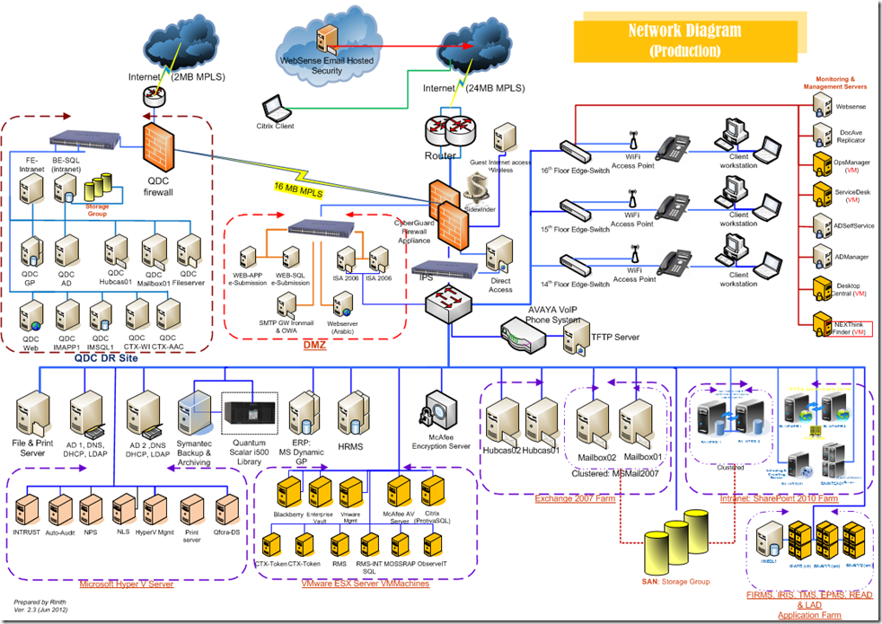
UNTINTED PHOTO
Use with care.
6
Notes:
6

Slide 7
IN A NUTSHELL…
Faster time to market
Increased organizational agility
Higher quality
7
Notes:
7

Slide 8
WHY DO WE NEED TO TEST OUR INFRASTRUCTURE?
High confidence in changes
Quick and immediate feedback
Shorter release cycle for applications
Maintain sanity of the infrastructure
8
Notes:
8

Slide 9
WHAT DO WE NEED TO TEST??
9
Notes:
9

Slide 10
CASE STUDY
REQUIREMENTS
Customer is able to visit the site and browse the products available.
The website should be available 24*7 and should be able to sustain high traffic.
Products should not be accessible before the launch date.
We want to launch new features on a regular basis.
The administrators should have detailed knowledge of the health of the system and issues should be resolvable quickly.
10
Notes:
10

Slide 11
THINK ABOUT THESE DOMAINS!!
SERVERS AND SERVICES
NETWORK CONNECTIONS
DATABASE SETUP
DEPLOYMENT STRATEGY
HYBRID INFRASTRUCTURE
USER MANAGEMENT
LOGGING AND MONITORING SETUP
11
Notes:
11

Slide 12

12
Notes:
12

Slide 13
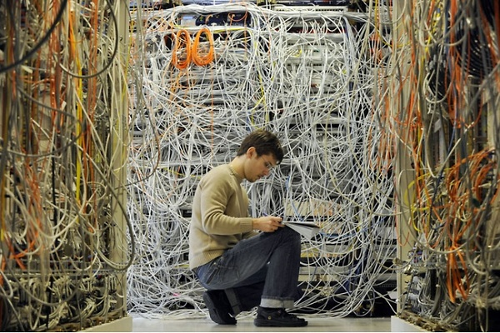
13
Notes:
NETWORK CONNECTIONS
Is the web server reachable from the outside world?
Is the app server reachable only from the web server?
Is the database secure and not reachable from the outside world?
Are the protocols in place?
13

Slide 14
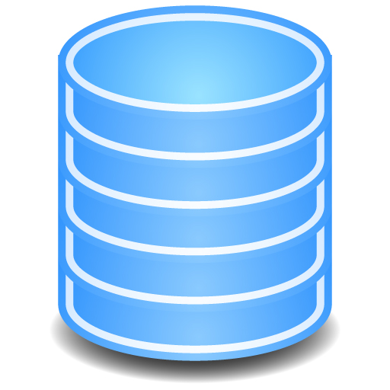
14
Notes:
14

Slide 15

15
Notes:
15

Slide 16

16
Notes:
16

Slide 17

17
Notes:
17

Slide 18

18
Notes:
18

Slide 19
SHOW SOME CODE !

Slide 20
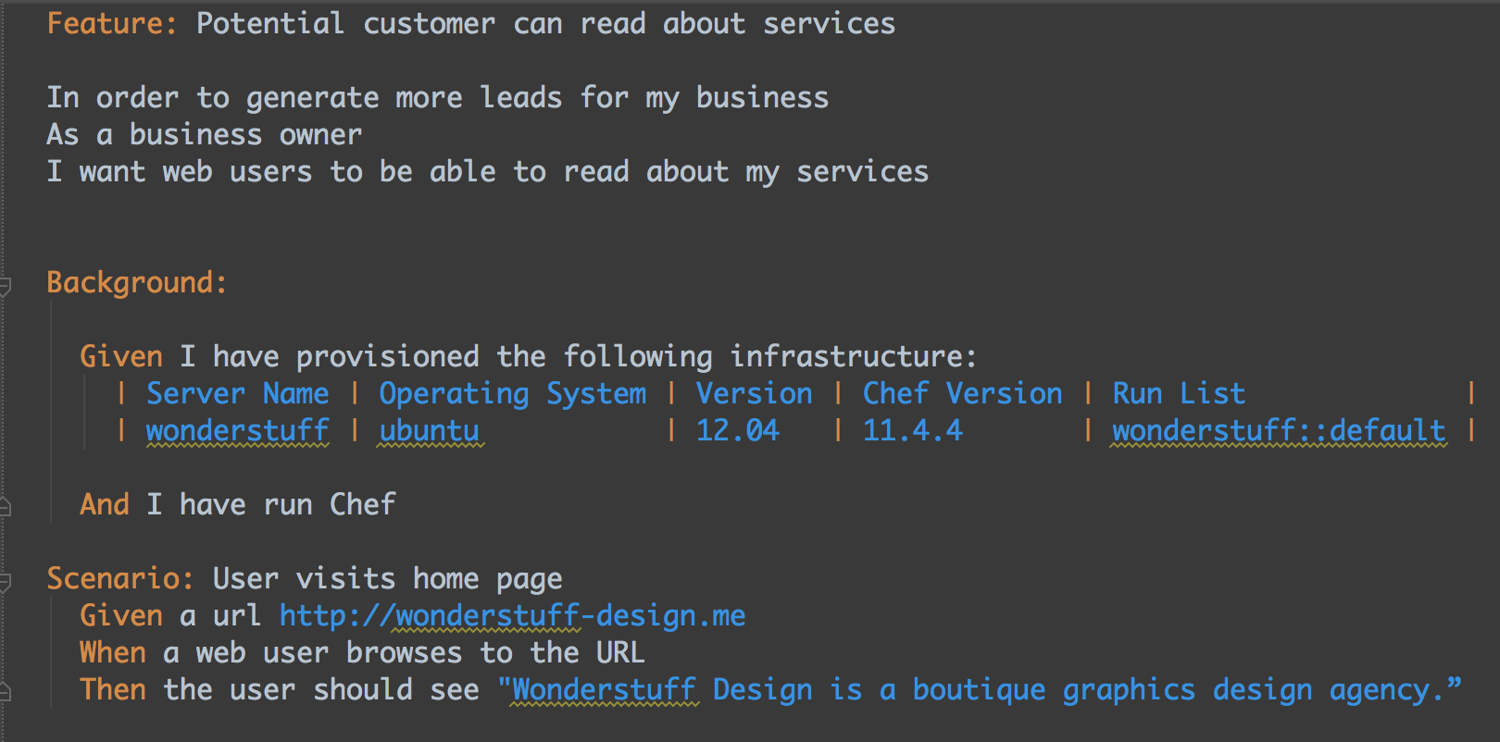
ACCEPTANCE TESTS
20

Slide 21
AUR DIKHAO !
AUR DIKHAO !!
Notes:
21

Slide 22
REFERENCES
Test-Driven Infrastructure with Chef :
http://shop.oreilly.com/product/0636920030973.do
Infrastructure as Code :
http://shop.oreilly.com/product/0636920039297.do
22

Slide 23
THANK YOU
@meetykp
@sid_thinketh
Notes:
23

