Slide 2
CHARACTERISTICS OF BEHAVIOR DRIVEN DEVELOPMENT (BDD)
M S Banu Prakash Raje Urs
Senior Agile Technical, DevOps Coach
Societe Generale Global Solution Centre Pvt Ltd

Slide 3
AGENDA
PEAK INTO BDD WITH AN ACTIVITY
SCENARIOS WITH GERKHIN LANGUAGE
KATA
BDD IN AGILE WORLD
CHARACTERISTICS AND BENEFITS OF BDD
TESTING IN BDD
DEMO OF BDD TESTING IN JAVA

Slide 4
PEAK INTO BDD WITH AN ACTIVITY
Gathering requirement or Testing framework?

Slide 5
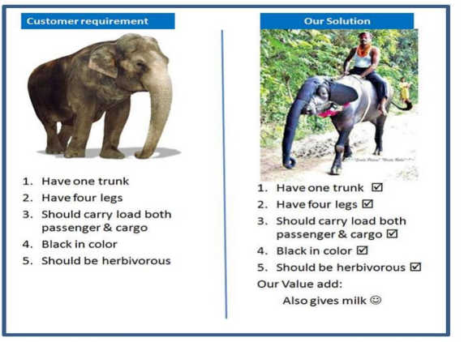
PEAK INTO BDD WITH AN ACTIVITY
Gathering requirement or Testing framework?

Slide 6
SCENARIOS WITH GERKHIN LANGUAGE
Common Language
Feature files
Keywords
Feature, Scenario, Given, When, Then, And,
But, Scenario Outline, Examples…

Slide 7
SCENARIOS WITH GERKHIN LANGUAGE
Feature: Add two numbers
Scenario: two positive integers
Given numbers 10 and 20
When add the numbers
Then resultant sum is 30
Scenario: two negative integers
Given numbers -15 and -30
When add the numbers
Then resultant sum is -45
…..

Slide 8
KATA
Check Out feature in a Shopping Cart
Check out one item in the cart
Check out multiple items in the cart
Add items in wish list if available when Check out happens
Check out with discounts on some products
Check out with discount coupons on some products
Check out handling change in product price after adding to cart

Slide 9
BDD in Agile World
How does it fit into Agile World?
3 Amigos
Acceptance Criteria

Slide 10
CHARACTERISTICS AND BENEFITS OF BDD
Common understanding of Requirement across stake holders thru Collaboration
Everyone in the team contributes to refine requirement, enhances ownership and knowledge
Together explore the behaviors
Deliver what user wants
Clear, precise examples as Acceptance Criteria, no ambiguity
Segregate Behavior and Implementation
Team has a living document
Team delivers behaviors (possibly on a daily basis), enables faster feedback cycle
Test the Behavior daily!

Slide 11
TESTING IN BDD
Test Pyramid
Use plugins like Cucumber, Jbehave in Java, SpecFlow in .Net
StepDefintions
Integrate with CI

Slide 12
DEMO OF BDD TESTING IN JAVA
Java App - Shopping Cart’s Check Out Feature
Demo Code available @ https://github.com/XP2016India/The-Characteristics-of-BDD

Slide 13
References
Pic:
Customer Requirement vs Our Solution – Unknown Source
Books:
Specification by example - Gojko Adzic
The Cucumber for Java Book - Seb Rose, Matt Wynne, Aslak Hellesoy

Slide 14
Q & A

Slide 15
THANK YOU

