Slide 1

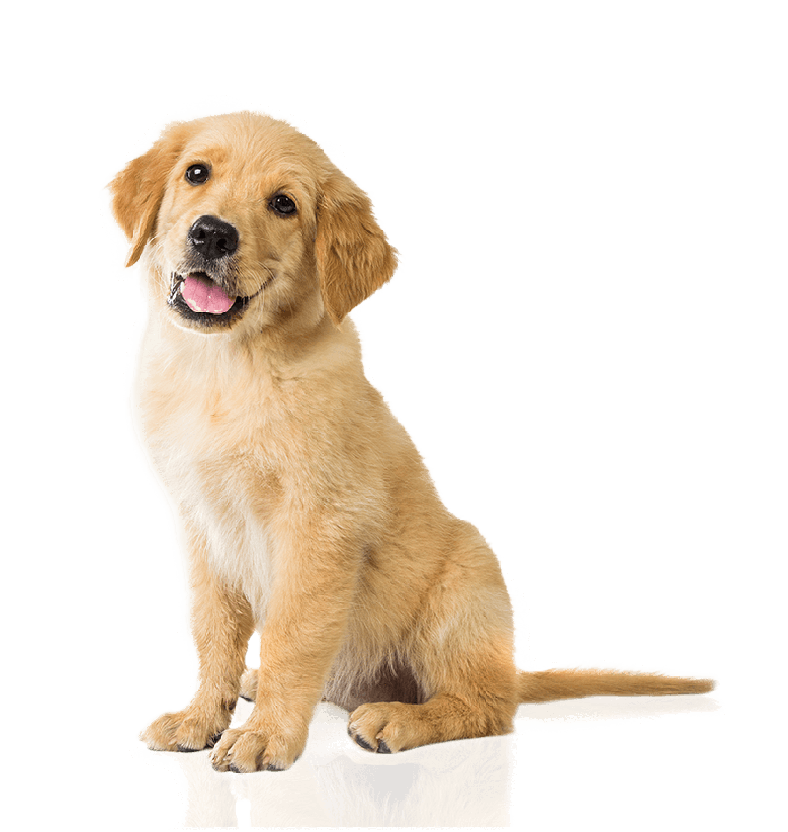
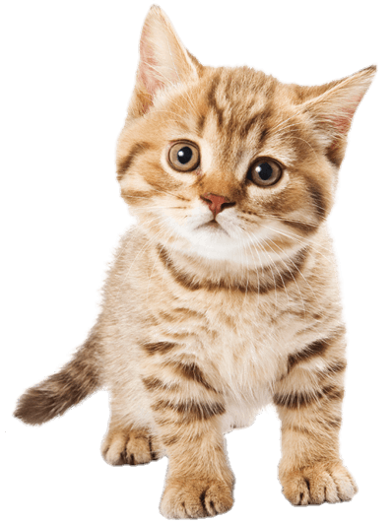
Animal Biometrics
Using Convolutional Neural Networks
Submitted by : -
Pallav Purbia
211230037
Submitted to : -
Dr. Preeti Mehta

Slide 2
Table of contents
01
02
03
04
Introduction
to the problem
Self made architecture vs
VGG-16 architecture
Results
Problems Faced

Slide 3
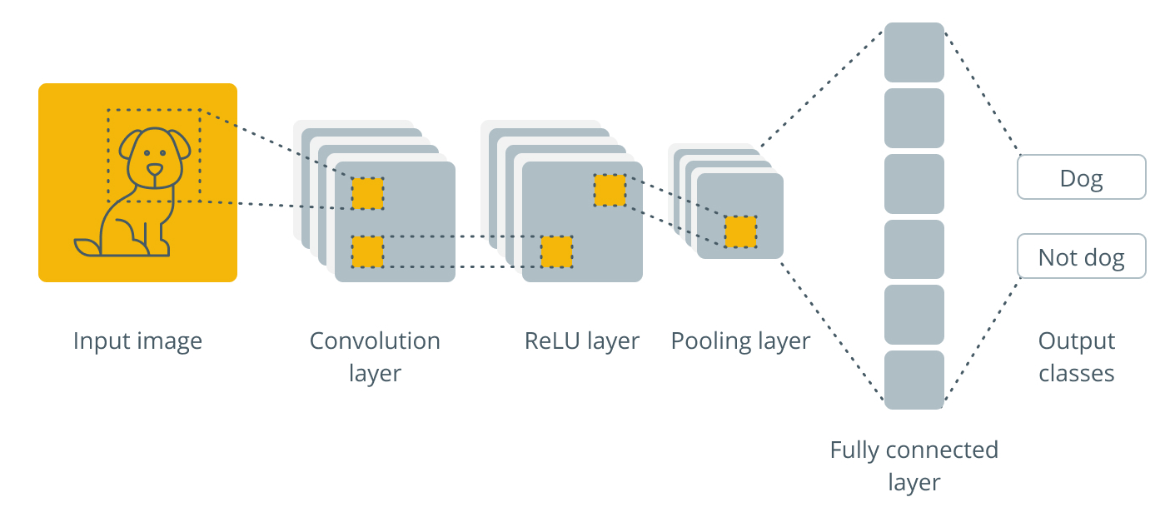
Problem Statement: To classify the input image into cat or dog.
Cat

Slide 4
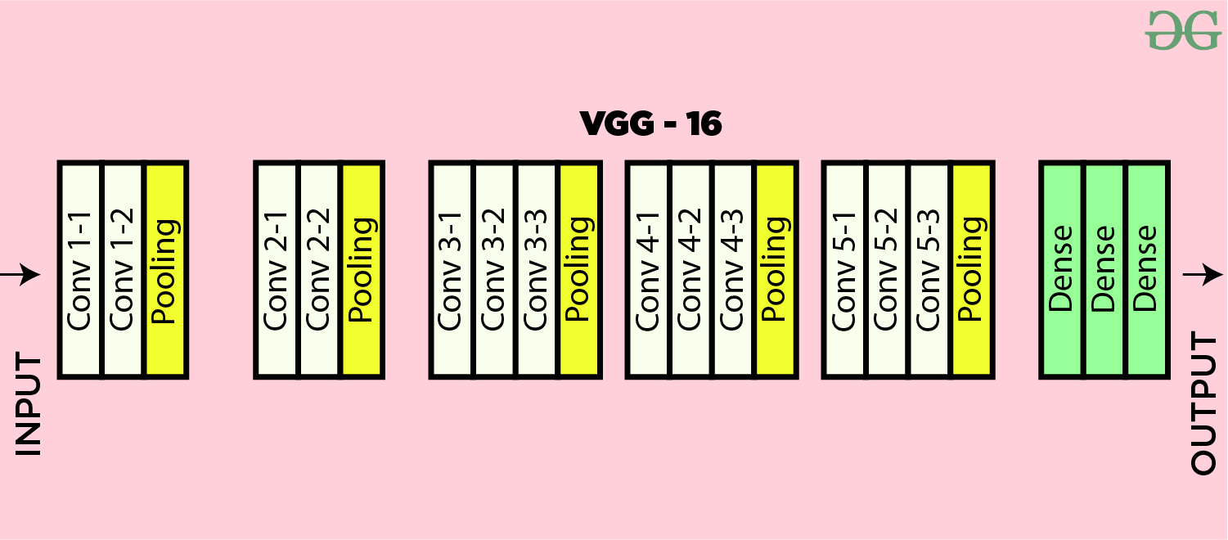
VGG-16 architecture
Three fully connected layers and 13 convolutional layers.
Trained on over one million images from the ImageNet visual database,
Able to classify images into 1,000 different categories with 92.7 percent top-5 test accuracy.

Slide 5
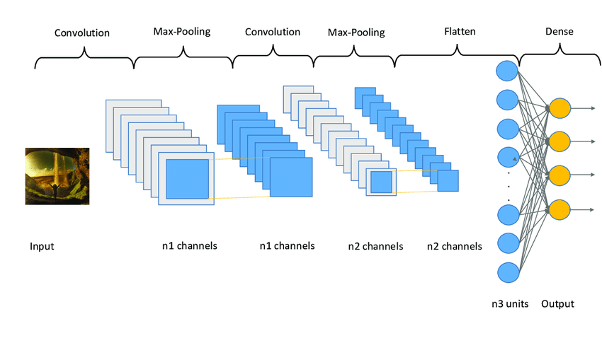
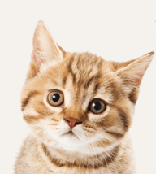
My CNN architecture
3 convolutional layers
First layer with 32 filters
Second layer with 64 filters
Third layer with 128 filters

Slide 6
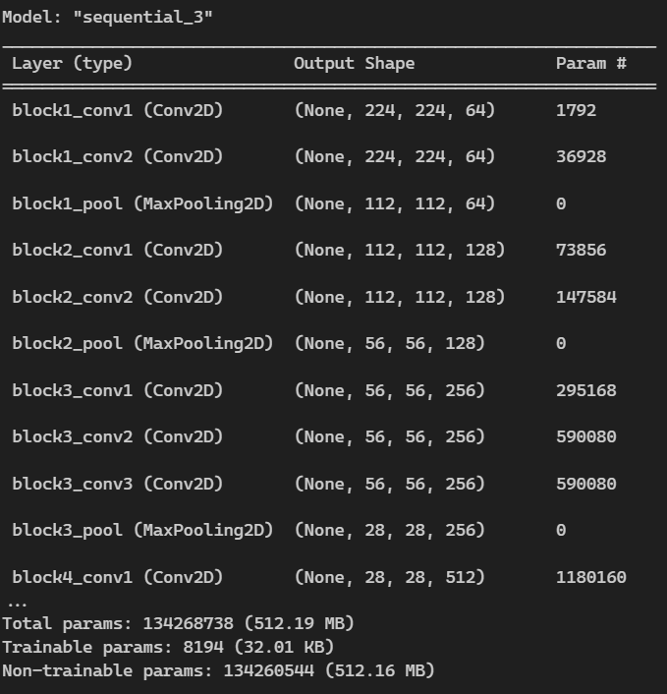
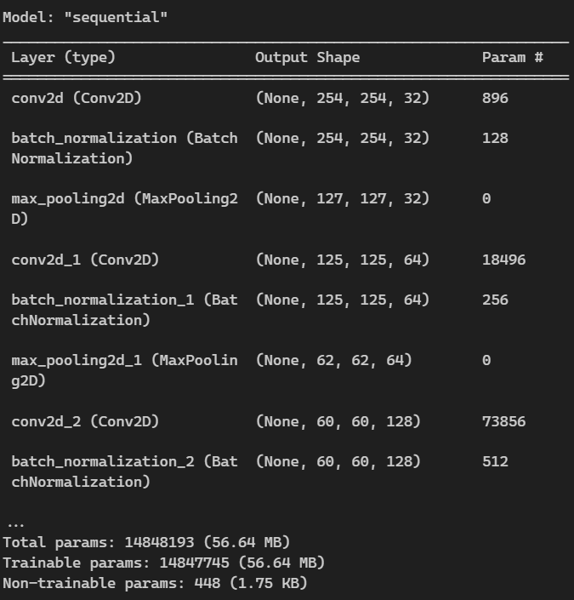
Architecture Summary:- VGG-16 My architecture

Slide 7
Comparison of the two architectures :
My CNN architecture VGG-16
96.63 % 99.98 %
669 seconds(10 epochs) 572 seconds (5 epochs)
0.0929 0.0030
56.64 MB 512.19 MB
Accuracy:
Training time:
Loss:
Memory:

Slide 8
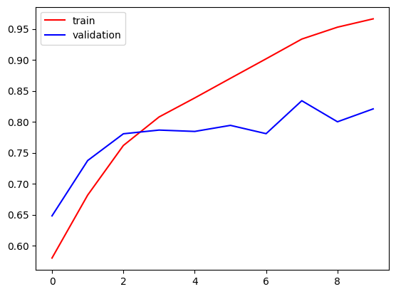
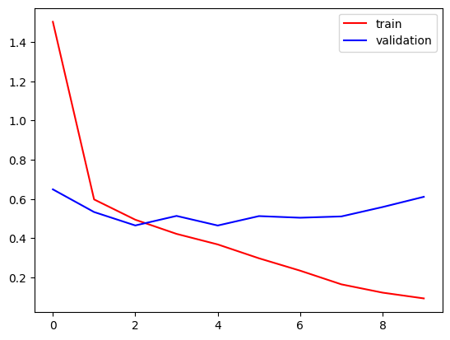
Graphs: My architecture
Accuracy vs Epochs Loss vs Epochs

Slide 9
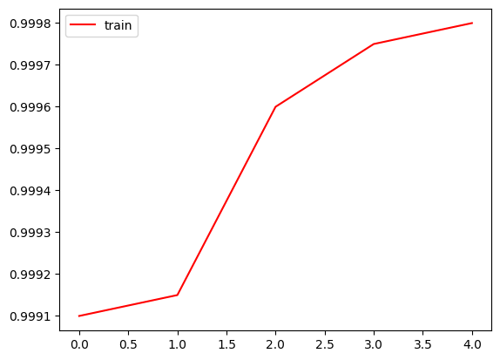
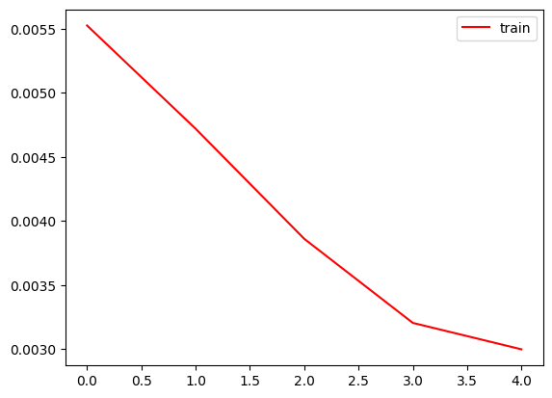
Graphs: VGG-16 Architecture
Accuracy vs Epochs Loss vs Epochs

Slide 10
Problems I faced:
Problem of overfitting in My own architecture.
Ways to reduce overfitting: 1. Add more data
2. Data Augmentation
3. L1/L2 Regularizer
4. Dropout
5. Batch Norm
6. Reduce complexity
I Solved this problem by using Dropout and reducing epochs.
My laptop was taking large amount of time to extract the zip file of the dataset.
Solved this using Kaggle API to download it on Google Colab

Slide 11

Thanks
Do you have any questions?
211230037@nitdelhi.ac.in
+91 9414191837

