Slide 1

ABROADLY
Helvetica
CONNECTING INDIAN STUDENTS ABROAD...

Slide 2
Problem Statement
Indian students aspiring to study abroad face various challenges and uncertainties throughout their educational journey. These challenges include navigating complex application processes, understanding foreign education systems, financial planning, and coping with the emotional and cultural adjustments of studying in a foreign land. Additionally, many students lack access to a supportive community of peers who share similar aspirations and experiences.
Problems faced by the student:
Information Gap
Isolation
Lack Of Guidance
Community Building
Information Overload

Slide 3
Our Solution - Abroadly
Our Solution:* We propose to create a web app that provides Indian students studying abroad with a platform to:
Connect with like-minded individuals.
Build communities based on universities, courses, and interests.
Engage in discussions, share experiences, and seek guidance.
Access valuable resources and information.
A forum page is present for questioning thier doubts.
User-Friendly Interface: The app will feature an intuitive and user-friendly interface, making it easy for students to connect, collaborate, forum page and access the support they need.

Slide 4
Market Demand
Over the past decade, there has been a steady annual growth of approximately 15% in the number of Indian students enrolling in international universities which is an industry is of 13 billion USD.
A significant portion of these students face challenges in terms of information gaps, cultural adaptation, and the lack of a strong support network.
Our platform will cater exclusively to Indian students, offering them a sense of familiarity and comfort in a foreign setting.
As the Indian economy continues to grow and more families can afford international education, the market is expected to expand even further.
Unlike general social platforms, our app's primary goal is to facilitate community building. Users can create or join communities based on universities, courses, and interests, fostering a sense of belonging.

Slide 5
Architecture Of Our Idea
Front-End: HTML, CSS.
Back-End: NodeJS, ExpressJS, MongoDB.
Authentication and Security: OAuth and Encryption protocols to secure user data
.
Community Building: Users can create or join communities, post discussions, and share resources. Real-time chat functionality for instant communication.
Scalability: Cloud hosting on AWS or Google Cloud Platform for scalability and reliability as the user base grows.

Slide 6
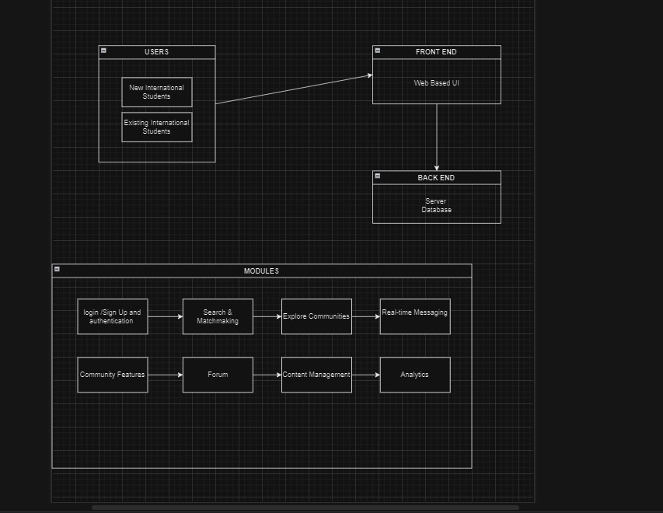

Slide 7
THANK YOU

