Slide 1
PMD
Jemy

Slide 2
Agenda
What’s PMD
How to use
Rules of PMD
Best Practices
Shortage(discussion)
Code conventions
References
Q&A

Slide 3
Before PMD
Bad smell
  Duplicated Code
  Long Method
  Large Class
  Long Parameter List
  Data Clumps
  Switch Statements
  Temporary Field
  Feature Envy
  Divergent Change
  Shotgun Surgery

Slide 4
What’s PMD_1
What’s PMD
  PMD is a static code analyzer. PMD comes with a number of ready-to-run rules that you can run on your own source code to find unused variables, unnecessary object creation, empty catch blocks, and so forth.
Potential problem detector
  Possible bugs - empty try/catch/finally/switch statements
  Dead code - unused local variables, parameters and private methods
  Suboptimal code - wasteful String/StringBuffer usage
  Overcomplicated expressions - unnecessary if statements
  Duplicate code - copied/pasted code means copied/pasted bugs

Slide 5
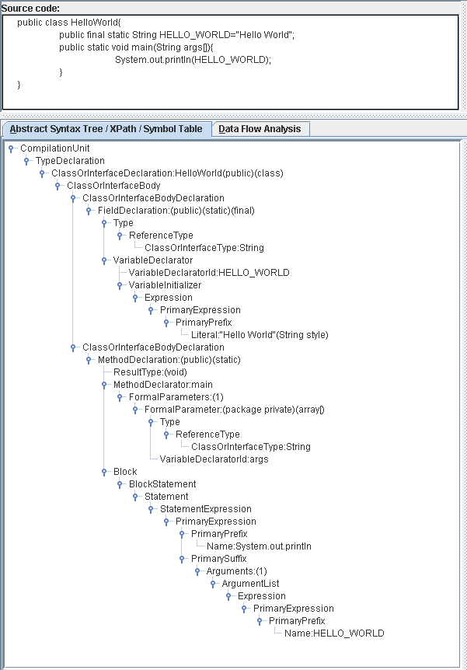
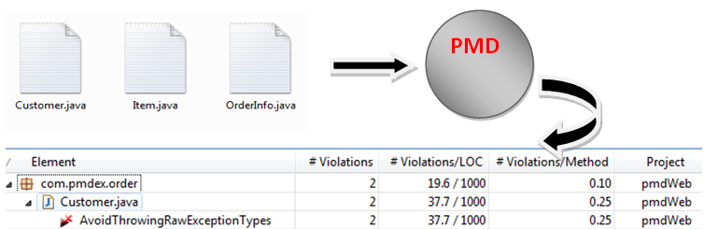
What’s PMD_2
How does it works
Core technology
  JavaCC
  EBNF
  JTtree

Slide 6
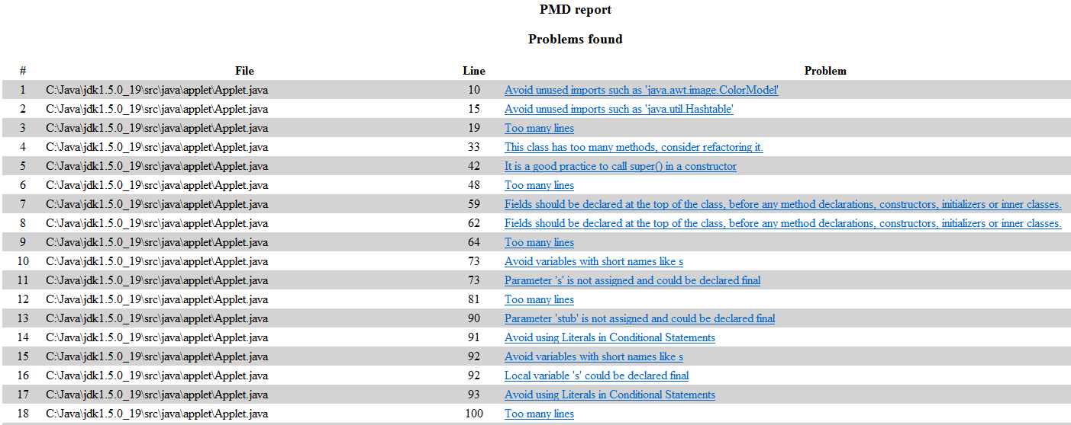
How to use
Plugin: Eclipse, IntelliJ, NetBeans, Maven
Ant

Slide 7
Rules of PMD_1
RuleSet/Rule
  There are 26 rulesets in version 5.0, including Basic, Design, Coupling, Comments, Naming, Braces, Logging and so forth. Rule is the basic detective Unit of PMD, a ruleset has at least one rule.
User-defined ruleset/rule
  Java：extends AbstractRule or AbstractJavaRule
  Xpath: XPathRule

Slide 8
Rules of PMD_2
  Rule examples
  Basic : contains base rules that need to be followed, such as empty catch/nested if statements/
  String: identifies problems that occur while using String and StringBuffer.
  Optimization: covers certain optimization conditions.
  Naming: tests for the standard Java naming conventions.

Slide 9
Rules of PMD_3
  Controversial rules
  LocalVariableCouldBeFinal
  BooleanGetMethodName
  ShortVariable
  NullAssignment
  AtLeastOneConstructor
  ExcessivePublicCount
  TooManyFields
  SignatureDeclareThrowsException

Slide 10
Best practices
Select the rules that are right for you
Use “//NOPMD”, “supress” annotation to ignore PMD detection, such as @SuppressWarning(“unused”)
Use PMD plug-in when coding and use ant to call PMD in CI environment

Slide 11
Shortage(discussion)
Difficult to find some kind of bad smell, such as Divergent Change/Shotgun Surgery
Difficult to write User-defined rule

Slide 12
Code conventions
A set of guidelines for a specific programming language that recommend programming style, practices and methods for each aspect of a piece program written in this language.
It covers indentation, comments, declarations, braces, statements, white space, line wrapping, naming conventions, etc.
Improve readability, maintainability
Java conventions & apm-formatter

Slide 13
References
PMD forum
  http://sourceforge.net/projects/pmd/forums/forum/188192/index/page/2
JavaCC
http://javacc.java.net/
EBNF: Extended Backus-Naur Form
http://en.wikipedia.org/wiki/Extended_Backus%E2%80%93Naur_Form
Xpath
http://pmd.sourceforge.net/pmd-5.0.0/xpathruletutorial.html
http://www.w3schools.com/xpath/default.asp
JJTree
http://javacc.java.net/doc/JJTree.html

Slide 14
    QA

