Slide 1


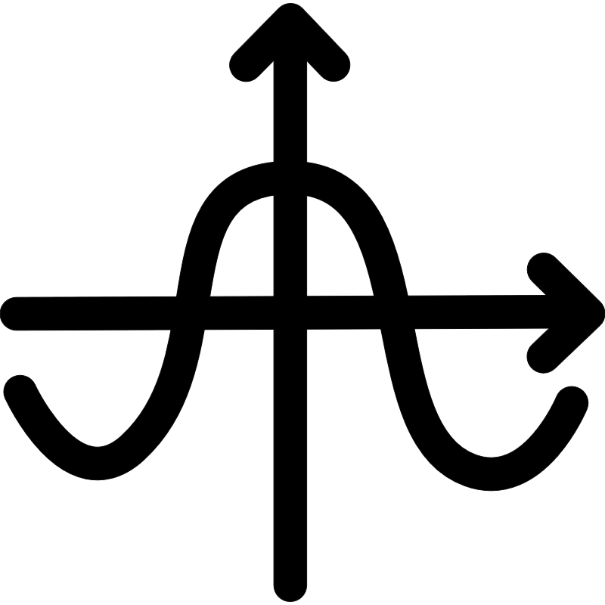




input image
like( )=0
negative ( )
init proposals
? most like ( )
best proposal without
like( )≥1
positive ( )
proposals with some noise

Slide 2



input image
SSW
SAM
CG
AF
&
Conv_P
GAP
init proposals
&
best proposal without
SAM
Agg
Fusion
proposals with some noise
(a) CBRPN
(b) ARFM
? most blue ( )
CBRPN
ARFM
Stage 1
Stage 2
1.
2.
1.
2.
Conv_P
&
GAP
CBRPN
ARFM
MIDN
&
SAM
Agg
Fusion
proposals without any polyp
proposals with
some polyp
input image
proposals with
the most polyp
MIDN
& must be included in the network
（a）
（b）
CBRPN

Slide 3
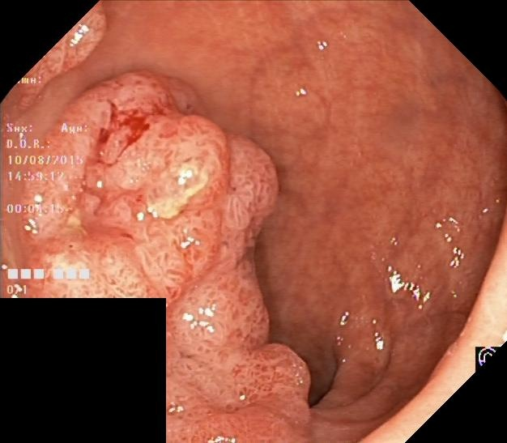

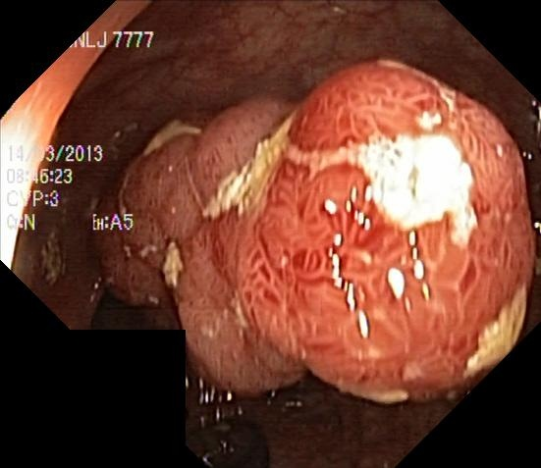
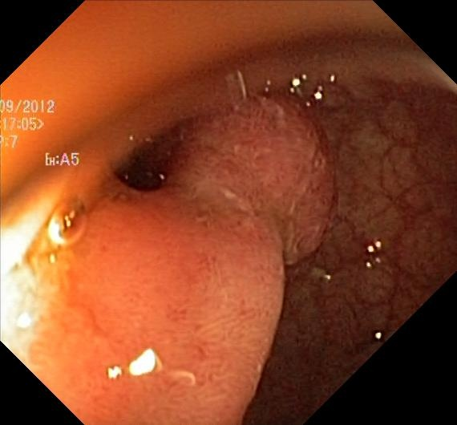

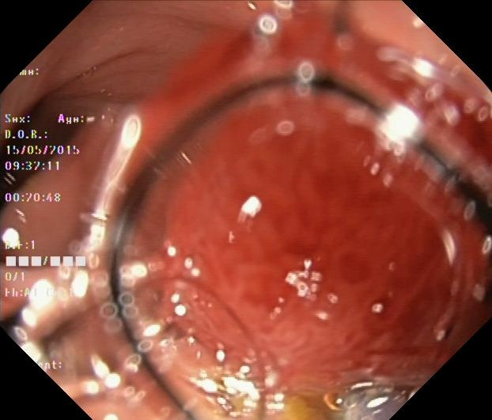
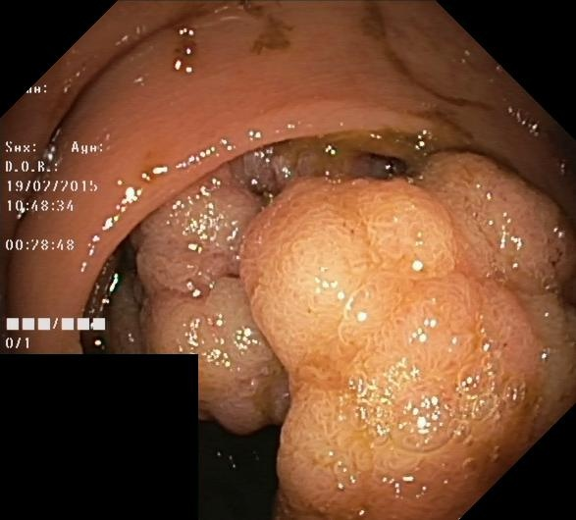

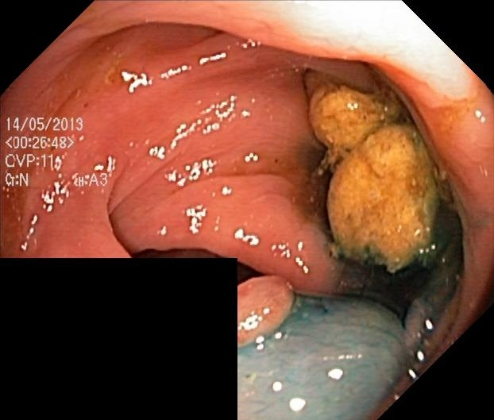
cju6uzxk0v83p0801rcwnexdu
cju87tyddnnad0755bj0wxahe
cju7bf1lp1shi081835vs84lc
cju1hmff8tkp809931jps6fbr
cju1egx9pvz2n0988eoy8jp23

Slide 4
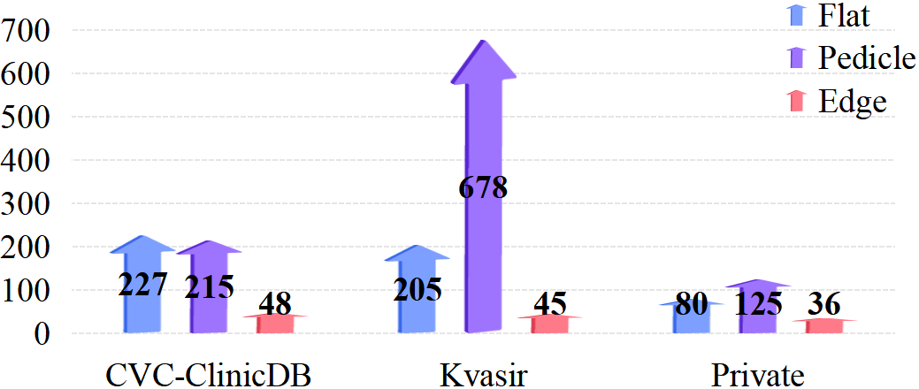
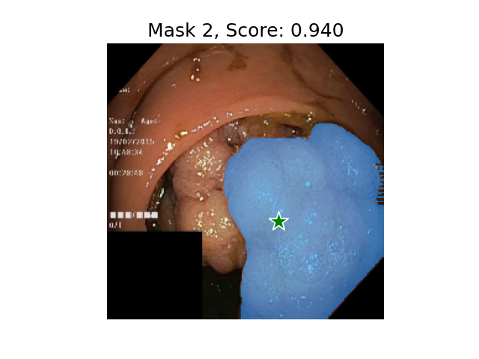
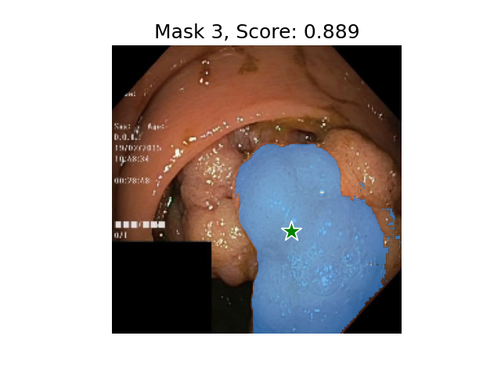
473
633
（a） （b）
（b）challenges in dataset
highlight
excrement
bubble

Slide 5
pseudo-labels
TP
473
FP
633
prediction
FP
FN
（a） （b）

Slide 6
SSW
SAM
CG
AF
&
Conv_P
GAP
&
SAM
Agg
Fusion
(a) CBRPN
(b) ARFM
（a） （b）

