Slide 1
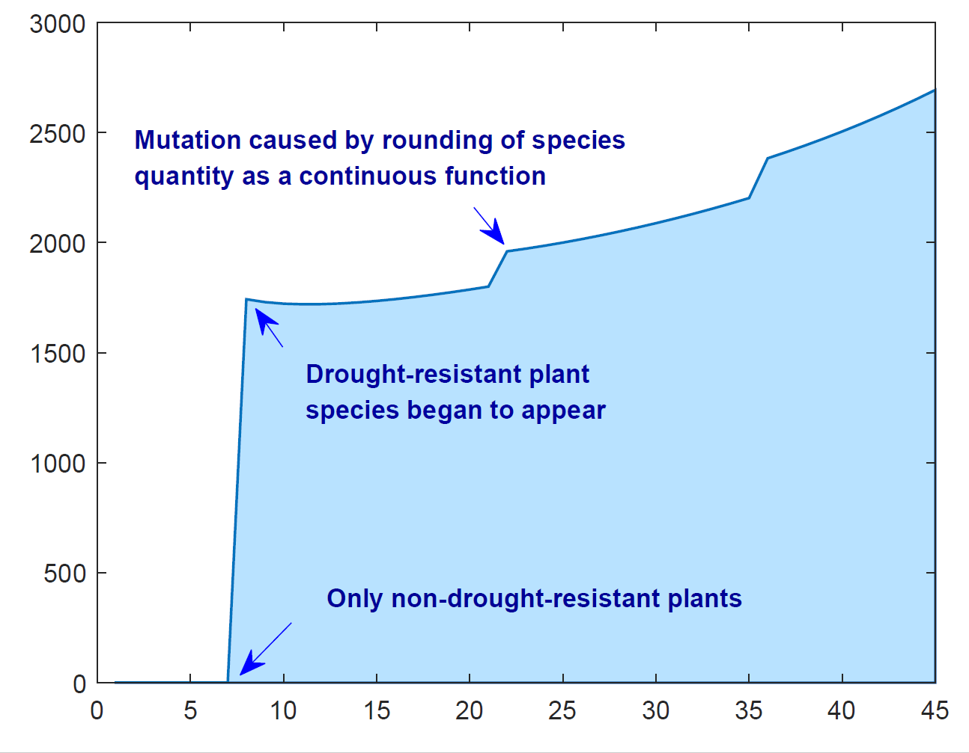
Mutations arising from kN
reaching an integer
Drought Resistance \mm
The number of species

