Slide 1
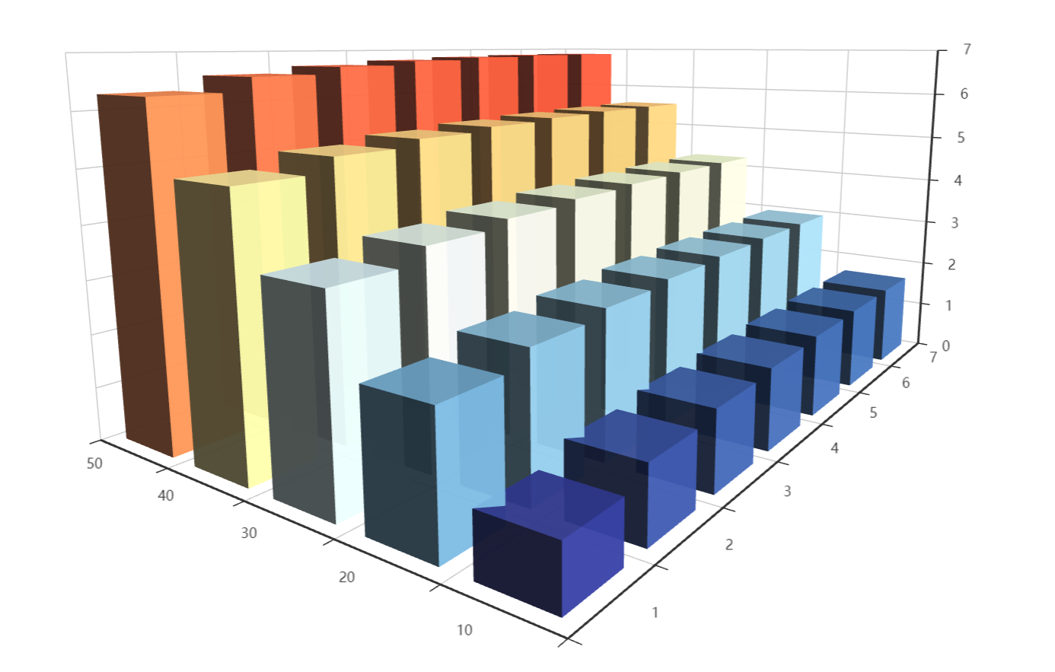





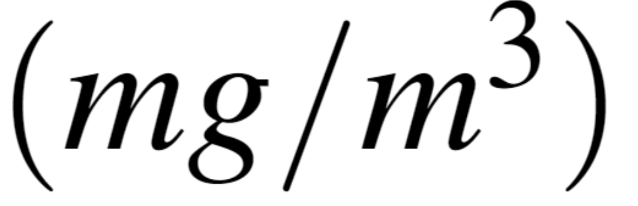

Slide 2
// prettier-ignorevar pH = ['1', '2', '3', '4', '5', '6', '7'];// prettier-ignorevar Concentration = ['10', '20', '30', '40', '50'];// prettier-ignorevar data = [[4, 0, 6.29357594828443], [4, 1, 6.55984383768920], [4, 2, 6.69814653585548], [4, 3, 6.78169258730555],[4, 4, 6.83284510975294],[4, 5, 6.86087383335318], [4, 6, 6.86982867600610], [3, 0, 4.98546003893728], [3, 1, 5.25172792834205], [3, 2, 5.39003062650833], [3, 3, 5.47357667795841],[3, 4, 5.52472920040579],[3, 5, 5.55275792400603], [3, 6, 5.56171276665896], [2, 0, 3.67734412959014], [2, 1, 3.94361201899491], [2, 2, 4.08191471716119], [2, 3, 4.16546076861127],[2, 4, 4.21661329105865],[2, 5, 4.24464201465889], [2, 6, 4.25359685731182], [1, 0, 2.36922822024300], [1, 1, 2.63549610964776], [1, 2, 2.77379880781405], [1, 3, 2.85734485926412],[1, 4, 2.90849738171150],[1, 5, 2.93652610531175], [1, 6, 2.94548094796467], [0, 0, 1.06111231089585], [0, 1, 1.32738020030062], [0, 2, 1.46568289846690], [0, 3, 1.54922894991698],[0, 4, 1.60038147236436],[0, 5, 1.62841019596460], [0, 6, 1.63736503861753]]option = { feature: { saveAsImage: { show:true, excludeComponents :['toolbox'], pixelRatio: 2 }}, tooltip: {}, visualMap: { max: 1, min: 8, inRange: { color: [ '#313695', '#4575b4', '#74add1', '#abd9e9', '#e0f3f8', '#ffffbf', '#fee090', '#fdae61', '#f46d43', '#d73027', '#a50026' ] } }, xAxis3D: { type: 'category', data: pH, nameGap:'1000' }, yAxis3D: { type: 'category', data: Concentration, nameGap:'1000', nameLocation : 'center' }, zAxis3D: { type: 'value', nameRotate : '90', nameGap:'1000' }, grid3D: { boxWidth: 210, boxDepth: 150, light: { main: { intensity: 1.2, shadow: true }, ambient: { intensity: 0.3, shadow: true } } }, itemStyle: { normal: { shadowBlur: 200, shadowColor: 'rgba(0, 0, 0, 0.5)' } }, series: [ { type: 'bar3D', data: data.map(function (item) { return { value: [item[1], item[0], item[2]] }; }), shading: 'lambert', label: { // show:true, fontSize: 12, borderWidth: 10 }, itemStyle: { opacity: 0.95 }, emphasis: { label: { fontSize: 20, color: '#900' }, itemStyle: { color: '#900' } } } ]};

Slide 3
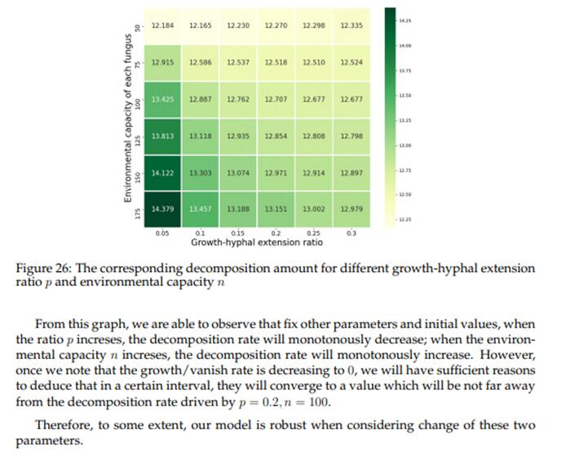
asda

Slide 4
4.07 | 4.26 | 4.68 | 4.32 | 4.18
4.26 | 5.73 | 6.42 | 6.43 | 5.28
5.58 | 6.84 | 6.83 | 6.79 | 5.73
5.53 | 6.72 | 6.92 | 6.87 | 5.79
5.73 | 6.09 | 6.80 | 6.42 | 5.15
4.07 | 4.26 | 4.68 | 4.32 | 4.18
4.26 | 5.73 | 6.42 | 6.43 | 5.28
5.58 | 6.84 | 6.83 | 6.79 | 5.73
5.53 | 6.72 | 6.92 | 6.87 | 5.79
5.73 | 6.09 | 6.80 | 6.42 | 5.15
asda
6.73

Slide 5
4.40 | 4.81 | 4.92 | 5.86 | 5.89
4.87 | 5.95 | 6.71 | 6.87 | 6.91
5.61 | 6.86 | 6.87 | 6.9 | 6.92
5.68 | 5.72 | 6.80 | 6.87 | 6.97
5.39 | 6.29 | 6.37 | 6.75 | 6.73
4.40 | 4.81 | 4.92 | 5.86 | 5.89
4.87 | 5.95 | 6.71 | 6.87 | 6.91
5.61 | 6.86 | 6.87 | 6.9 | 6.92
5.68 | 5.72 | 6.80 | 6.87 | 6.97
5.39 | 6.29 | 6.37 | 6.75 | 6.73

