Slide 1
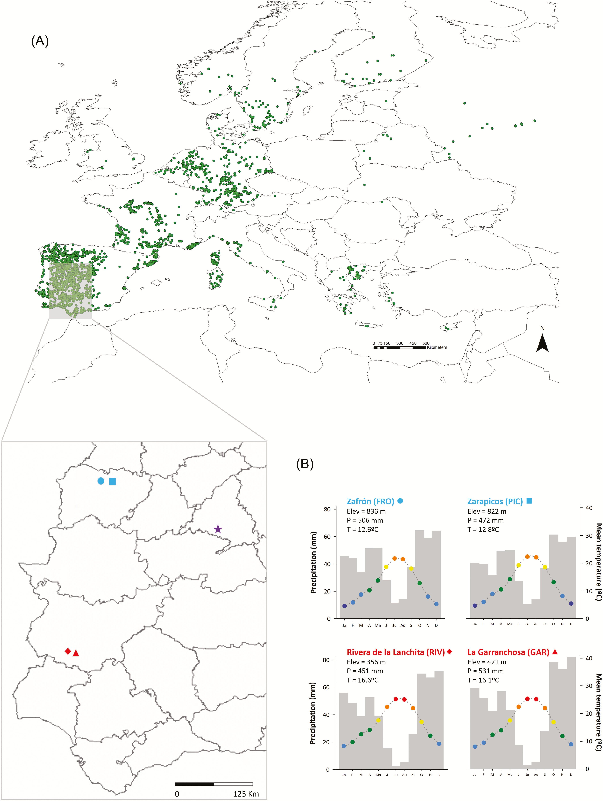

Figure 1. (A) Natural distribution of Lupinus angustifolius; each dot corresponds to records of presence of the species ...
Notes:
Figure 1. (A) Natural distribution of Lupinus angustifolius; each dot corresponds to records of presence of the species (source: GBIF.org (27 November 2018) GBIF Occurrence Download https://doi.org/10.15468/dl.4ka9lc). The location of the two northern (blue) and southern (red) populations of the species in the Iberian Peninsula, and of the common garden (purple star) is presented in the enlarged area; (B) climographs showing monthly precipitation and mean temperature, based on climatic data from 1979 to 2013 (see text for details). Note that the precipitation range is equal to twice the temperature scale. Elevation, mean annual precipitation and temperature are also shown for each population. Each colour in the temperature graph represents a 5 °C range (purple: 0–5 °C; blue: 5–10 °C; green: 10–15 °C; yellow: 15–20 °C; orange: 20–25 °C and red: 25–30 °C).
Unless provided in the caption above, the following copyright applies to the content of this slide: © The Author(s) 2020. Published by Oxford University Press on behalf of the Annals of Botany Company.This is an Open Access article distributed under the terms of the Creative Commons Attribution License (http://creativecommons.org/licenses/by/4.0/), which permits unrestricted reuse, distribution, and reproduction in any medium, provided the original work is properly cited.

