Slide 1
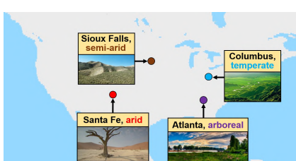
递四方速递

Slide 2
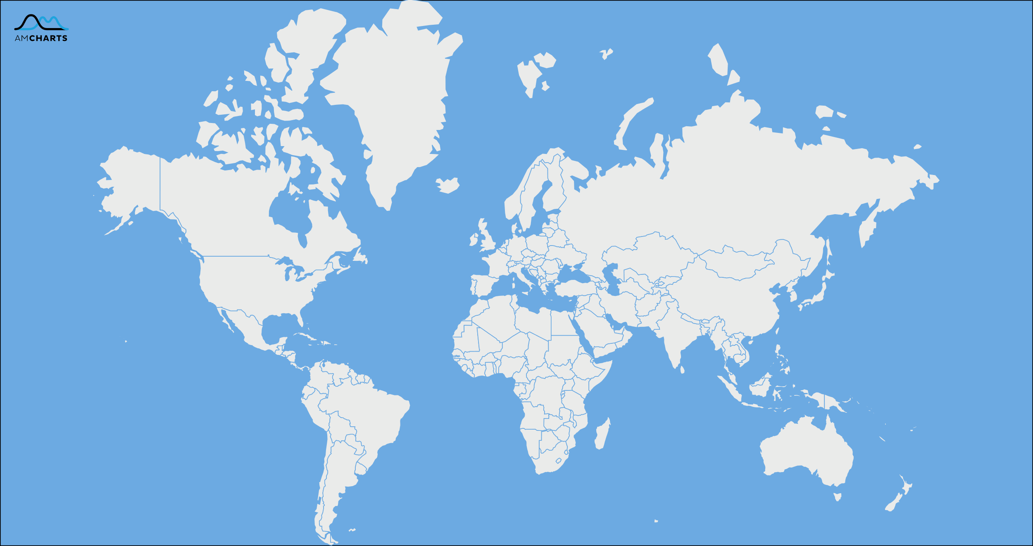
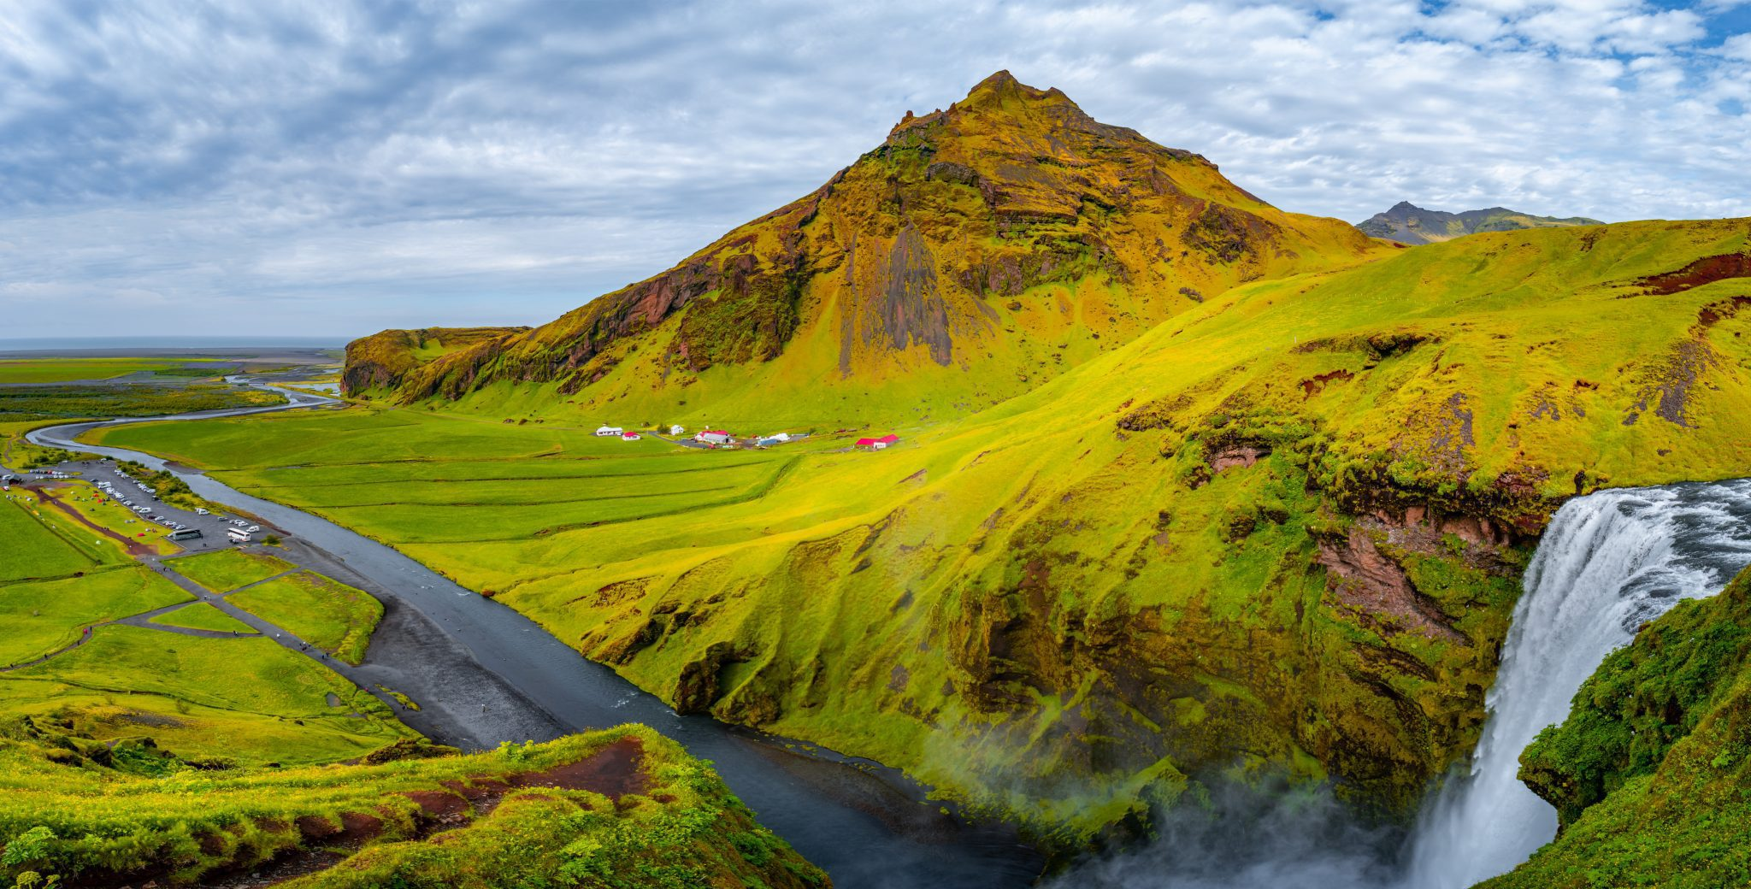
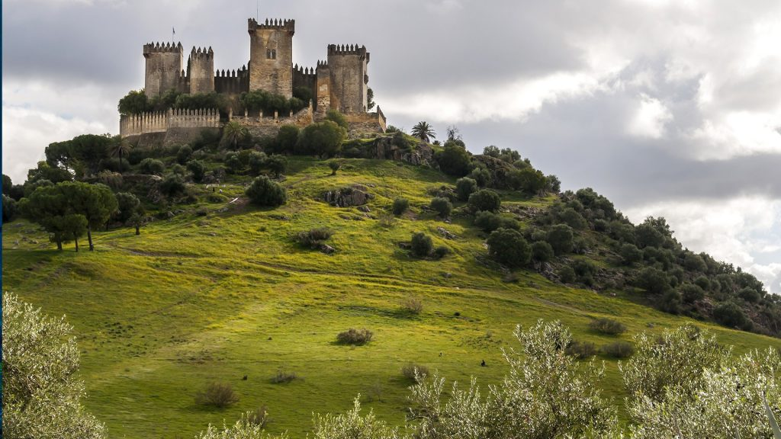
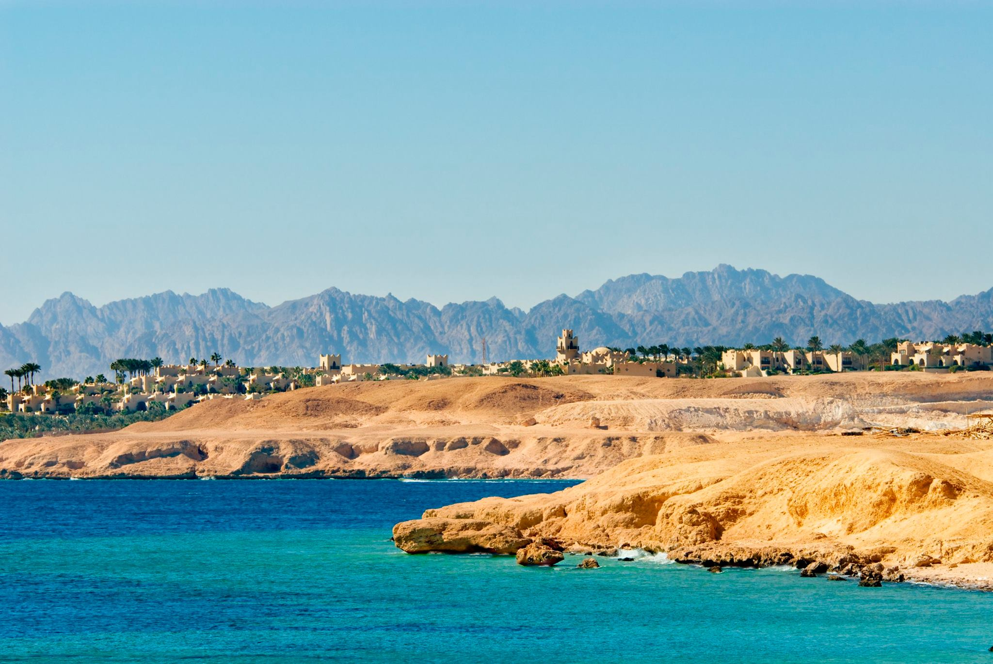
Skogafoss
Arctic area
Almodóvar del Río Castle
warm temperate
Port Ghalib
arid climate

Slide 3
Port Ghalib
arid climate
Almodóvar del Río Castle
Port Ghalib
arid climate
warm temperate

Slide 4


