Slide 1
Low Cost Cluster Administration
[DATE]
[LOCATION]
[PRESENTER]
[PRESENTER INSTITUTION]

Slide 2
Code of Conduct
XSEDE has an external code of conduct for XSEDE sponsored events which represents XSEDE's commitment to providing an inclusive and harassment-free environment in all interactions regardless of gender, sexual orientation, disability, physical appearance, race, or religion. The code of conduct extends to all XSEDE-sponsored events, services, and interactions.
Code of Conduct: https://www.xsede.org/codeofconduct
Contact:
Event organizer: Dina Tandabany (dtandabany@cau.edu)
XSEDE ombudspersons:
Linda Akli, Southeastern Universities Research Association (akli@sura.org)
Lizanne Destefano, Georgia Tech (lizanne.destefano@ceismc.gatech.edu)
Ken Hackworth, Pittsburgh Supercomputing Center (hackworth@psc.edu)
Bryan Snead, Texas Advanced Computing Center (jbsnead@tacc.utexas.edu)

Slide 3
Workshop Outline
Brief discussion of HPC
Hands-on cluster build
Configure headnode
Set up basic services on compute nodes
Install and configure SLURM (Scheduler)
Manage users with slurmdbd
Explore the modules (lmod) system
Build software with Spack
Run jobs!
Configure the cluster for Elasticity (optional)
<number>

Slide 4
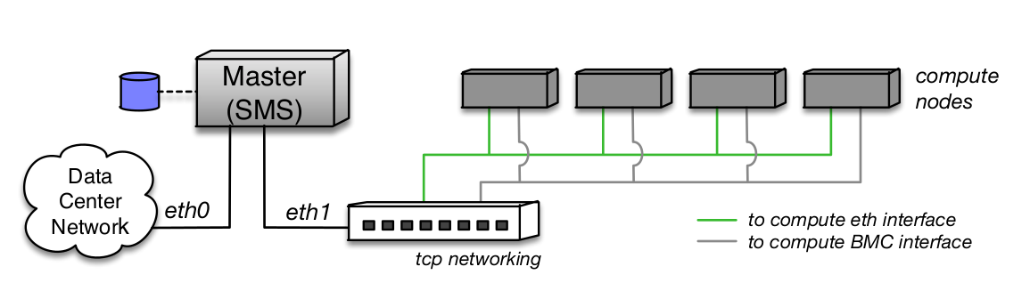
What is HPC?
Anything that is more “powerful” than a laptop!
Traditionally refers to clustered commodity hardware, or purpose-build machines (Cray)
Not all clusters are high performance, but old hardware is still useful!
<number>
Notes:
“Extramural” means people from other institutions.
Starting to see uptake of the simpler web single sign-on

Slide 5
Why HPC?
Many scientific problems do not parallelize well
The ones that do are more appropriate for High Throughput Computing
Imagine solving a jigsaw puzzle in a group, vs. a ‘spot-the-difference’ puzzle
<number>

Slide 6
Two Main areas to handle in an HPC resource:
Hardware Management
Hardware configuration
Resource Availability
User Management
Software
User Environments
<number>

Slide 7
What are we going to do?
Build a cluster in the cloud, piece by piece (the hard way!)
Learn to manage scientific apps and users
Run benchmarks!
<number>

Slide 8
HPC: The Pieces
The machinery:
Headnode
Login nodes
Monitoring/web nodes
Compute nodes
Network
Storage system
GPU/Visualization, FPGAs, etc.
<number>

Slide 9
HPC: The Pieces
The software:
Scheduler
Node Management (Provisioner)
Module system
Monitoring
Build systems
Actual apps for users
<number>

Slide 10
HPC In the Cloud
In this tutorial, we will be using Jetstream.
Jetstream is an NSF funded openstack cloud.
We will have a headnode VM and 2 Compute vms.
Possible to build elastic virtual clusters, but we’ll keep things simple…
<number>

Slide 11
The OpenHPC Project
https://openhpc.community
In short, a yum repo + set of recipes
Building blocks for HPC Systems
Offers system tools, libraries, compiler + mpi toolchains, and apps for HPC management
We’re going to start with just SLURM and gradually use more blocks
<number>

Slide 12
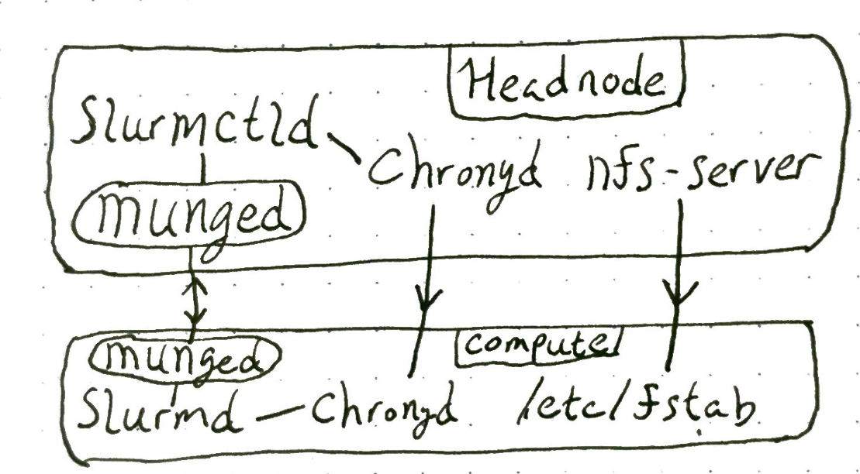
A Barebones, Cloudy Cluster
<number>

Slide 13
Disk Sharing (NFS)
No need to transfer data during a job
Rely on NFS or similar mechanisms
Parallel filesystems for greater performance
Separate network ideal!
<number>

Slide 14
Resource Manager / Scheduler (SLURM)
Maintains list of nodes and partitions (queues)
Can control access by user or group
Handles timing and distribution of jobs across nodes
Main daemon runs on headnode, with client daemons across computes
Can submit from anywhere!
<number>

Slide 15
HPC Build Part 1: The Cloud
https://github.com/XSEDE/CRI_JS_Cluster_Tutorial
- tutorial describing step-by-step how to build a basic SLURM cluster using Jetstream – requires JS Account!
<number>

Slide 16
SLURM In Detail
https://slurm.schedmd.com/slurmctld.html
https://slurm.schedmd.com/slurmd.html
https://slurm.schedmd.com/sbatch.html
https://slurm.schedmd.com/scontrol.html
<number>

Slide 17
Slurm Scheduling
Default is backfill: first in, first out, with small jobs allowed to run in the margins (backfill)
Controlled by “SchedulerType” Parameter
SelectType parameter controls which (and whether) resources (CPU, Mem, etc.) are allowed to be shared across nodes
<number>

Slide 18
Slurm Partitions
Basically, a group of nodes
Can have a priority and Quality of Service setting
Nodes can be in multiple partitions
Useful for condo models, and for aggregating by node type
<number>

Slide 19
Slurm Priorities
Partitions have priority factors
Jobs in higher priority partitions can preempt those in lower priority partitions
This also applies to scheduling decisions
Different from QoS, which is used to filter on User/Group
<number>

Slide 20
Slurm Accounting
Two main options: flat file, or database
Flat file
Simple, straightforward, lacking in detail
DB is controlled by the SLURM Database Daemon (slurmdbd)
Gives fine-grained control over users and detailed job reporting
<number>

Slide 21
Slurm Accounting
Interact with the SLURM DB via `sacctmgr`
https://slurm.schedmd.com/sacctmgr.html
Preferred to store user/group hierarchy in a file, and update as new users are added
<number>

Slide 22
Slurm Associations
Set within the SLURM DB
Basically a separate form of groups controlled by SLURM
Allows setting QoS per-user and association
Allows enforcement of any of a huge variety of limits on user or association
<number>

Slide 23
Module systems
Allow users near-automatic control of their environment
Manages paths and dependencies from a user standpoint
Helpful for building software with a particular toolchain
LMOD: Lua Modules https://github.com/TACC/Lmod
<number>

Slide 24
Software Management
Share software to compute nodes via mounted filesystems
Provide ‘blessed’ builds; allow users to build in /home
Build systems like spack, or DIY with provided tools (Makefiles, etc.)
<number>

Slide 25
Spack
Handles software dependencies in a scripted fashion
Comes with recipes for ~2000+ pieces of software
Builds the entire world if you’re not careful!
Creates modules for spack-built software
`module load spack`
<number>

Slide 26
Please fill out the survey before you go:
[LINK TO SURVEY]
If you have questions about this presentation: https://xsede.org/ecosystem/xcri-mission
https://github.com/XSEDE
help@xsede.org SUBJECT: XCRI
<number>

