Slide 1

Exercise 1:
Build, share and run a container
PEARC 20
July/26/2020
Eric Coulter
Indiana University, XCRI Engineer
Supported by OAC 15-48562.
Notes:
Greetings everyone. I’m Steve. I’m an XCRI Engineer along with jecoulte. (If he’s in the office.).

Slide 2
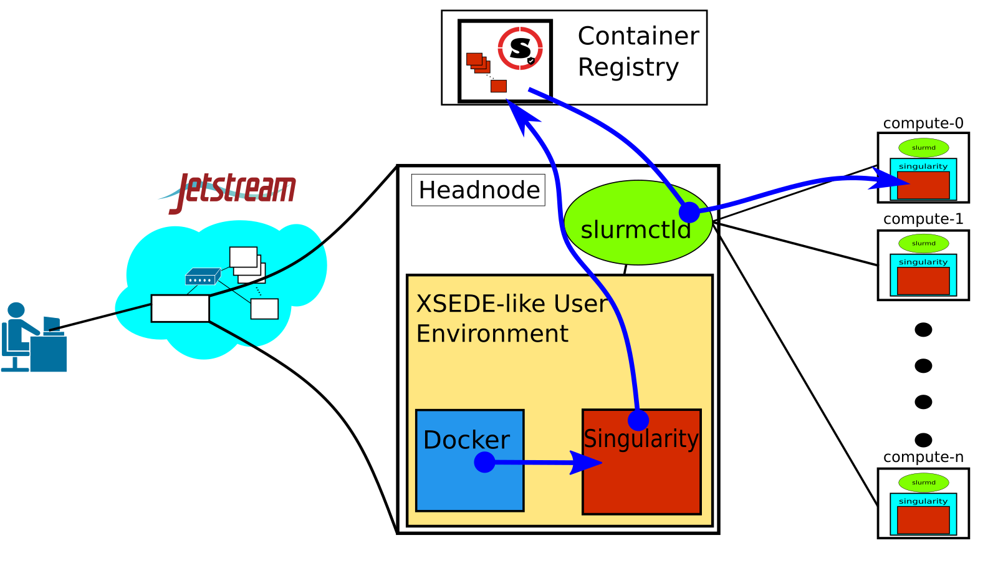
What we’re doing to do:
Take a Dockerfile, build it into an image
Convert that image into a Singularity image (SIF file)
Upload that SIF file to a Singularity Registry
Run a job on an HPC system using that container and registry
Notes:
Who’s heard of XCRI? We have helped numerous universities in setting up HPC. We now do cloud installs as well. (Openstack).

Slide 3
Link to Exercise materials:
https://bit.ly/3hTjXFV
Notes:
As you can see here, we have a lot of software at play.

