Slide 1
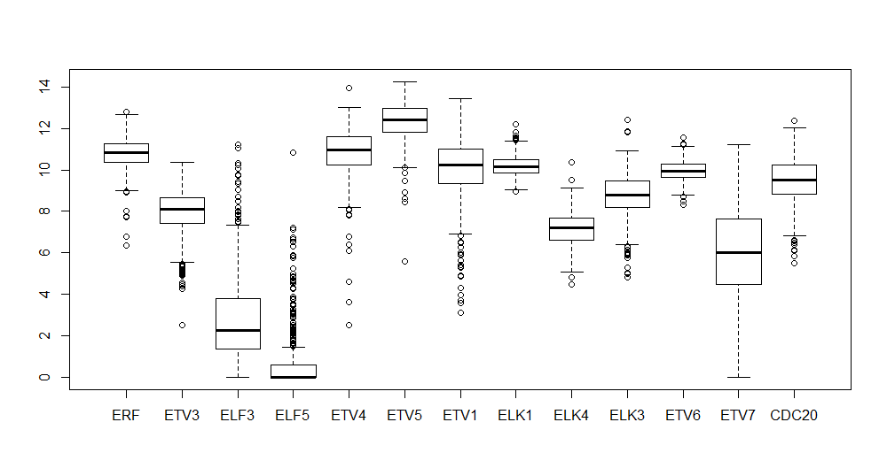
Normalized FPKM

Slide 2
