Slide 1

DESIGN PATTERNS
Introduction,Importance and Examples

Slide 2






Contents
Overview
Description
When to use
Classification
Motivation
Relationships
Template Method
Observer
Examples

Slide 3
OVERVIEW
”Each pattern describes a problem which occurs over and over again in our environment, and then describes the core of the solution to that Problem, in such a way that you can use this solution a million times over, without ever doing it the same way twice.”
- Christopher Alexander
Four essential elements :
1) Pattern Name
2) Problem
3) Solution
4) Consequences

Slide 4
Things we should consider before learning a Design Patterns
A short statement that answers the following questions:
1) What does the design pattern do?
2) What is its rationale and intent? What particular design issue or problem does it address?
Motivation
What are the situations in which the design pattern can be applied?
What are examples of poor designs that the pattern can address?
How can you recognize these situations?
Participants
The classes and/or objects participating in the design pattern and their responsibilities.
Collaborations
How the participants collaborate to carry out their responsibilities.
Consequences
How does the pattern support its objectives?
What are the trade-offs and results of using the pattern?
What aspect of system structure does it let you vary independently?

Slide 5
Describing Design Patterns
How does the pattern support its objectives?
What are the trade-offs and results of using the pattern?
What aspect of system structure does it let you vary independently?
Implementation
What pitfalls, hints, or techniques should you be aware of when implementing the pattern? Are there language-specific issues?
Sample Code
Code fragments that illustrate how you might implement the pattern in C++ or
Smalltalk.
Known Uses
Examples of the pattern found in real systems.
Related Patterns
What design patterns are closely related to this one?
What are the important differences?
With which other patterns should this one be used?

Slide 6
Catalog/Classification of Design Patterns
Creational Design Pattern
Factory Pattern
Abstract Factory Pattern
Singleton Pattern
Prototype Pattern
Builder Pattern.
Structural Design Pattern
Adapter Pattern
Bridge Pattern
Composite Pattern
Decorator Pattern
Facade Pattern
Flyweight Pattern
Proxy Pattern

Slide 7
Classification
Behavioral Design Pattern
Chain Of Responsibility Pattern
Command Pattern
Interpreter Pattern
Iterator Pattern
Mediator Pattern
Memento Pattern
Observer Pattern
State Pattern
Strategy Pattern
Template Pattern
Visitor Pattern

Slide 8
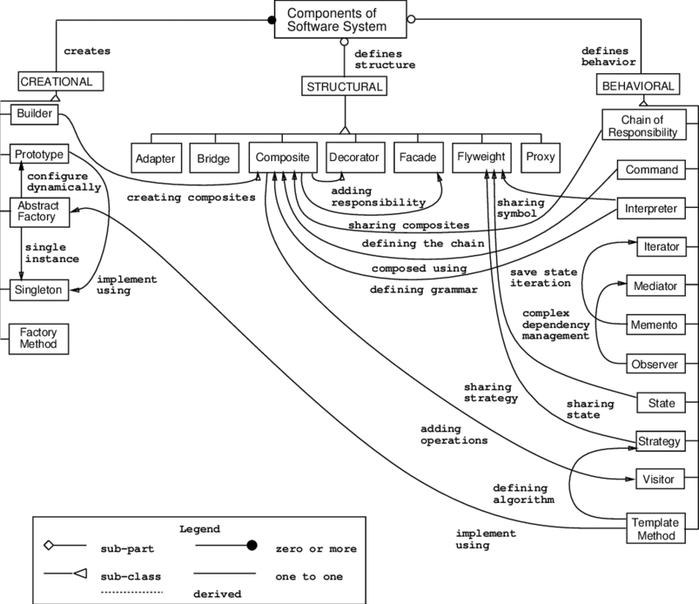
Design pattern relationships

Slide 9
Motivation
Finding Appropriate Objects
Determining Object Granularity
Specifying Object Interfaces
Specifying Object Implementations
Class versus Interface Inheritance
Programming to an Interface, not an Implementation
Putting Reuse Mechanisms to Work
Inheritance versus Composition
Delegation
Inheritance versus Parameterized Types
Relating Run-Time and Compile-Time Structures
Designing for Change
How
Design Patterns Solve
Design Problems

Slide 10
How to Select a Design Pattern
Consider how design patterns solve design problems.
Scan Intent sections.
Study how patterns interrelate.
Study patterns of like purpose.
Examine a cause of redesign.
Consider what should be variable in your design.

Slide 11
Template
Method
Template Method is a behavioral design pattern that defines the skeleton of an algorithm in the superclass but lets subclasses override specific steps of the algorithm without changing its structure.
Intent
Define the skeleton of an algorithm in an operation, deferring some steps to client subclasses. Template Method lets subclasses redefine certain steps of an algorithm without changing the algorithm's structure.
Base class declares algorithm 'placeholders', and derived classes implement the placeholders.

Slide 12
Problem
Two different components have significant similarities, but demonstrate no reuse of common interface or implementation. If a change common to both components becomes necessary, duplicate effort must be expended.
Notes:
Consider talking about:
UML class and object diagram
UML class diagram
‹#›

Slide 13
Solution
The component designer decides which steps of an algorithm are invariant (or standard), and which are variant (or customizable).
The invariant steps are implemented in an abstract base class, while the variant steps are either given a default implementation, or no implementation at all.
The variant steps represent "hooks", or "placeholders", that can, or must, be supplied by the component's client in a concrete derived class.
Notes:
Consider talking about:
UML class and object diagram
UML class diagram
‹#›

Slide 14
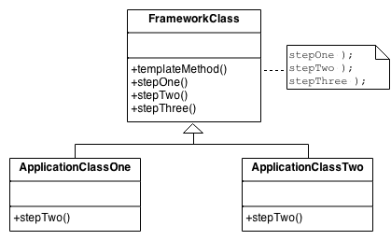
Structure
Notes:
Consider talking about:
UML class and object diagram
UML class diagram
‹#›

Slide 15
Rules of thumb
Strategy is like Template Method except in its granularity.
Template Method uses inheritance to vary part of an algorithm. Strategy uses delegation to vary the entire algorithm.
Strategy modifies the logic of individual objects. Template Method modifies the logic of an entire class.
Factory Method is a specialization of Template Method.
Notes:
Consider talking about:
UML class and object diagram
UML class diagram
‹#›

Slide 16
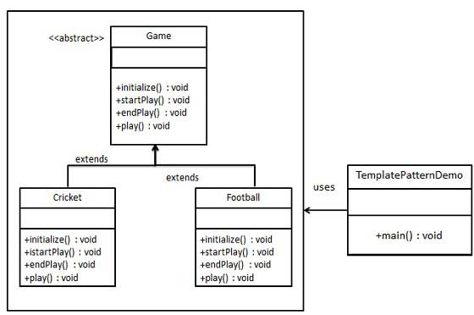
Example
Notes:
Consider talking about:
UML class and object diagram
UML class diagram
‹#›

Slide 17
Observer Design Pattern
Problem
A large monolithic design does not scale well as new graphing or monitoring requirements are levied.
Intent
Define a one-to-many dependency between objects so that when one object changes state, all its dependents are notified and updated automatically.

Slide 18
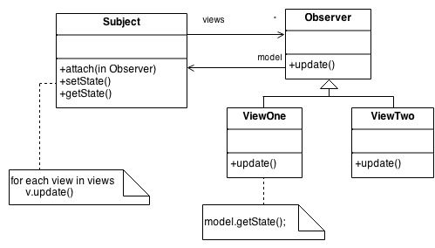
Structure
Notes:
Consider talking about:
UML class and object diagram
UML class diagram
‹#›

Slide 19
Rules of thumb
Mediator and Observer are competing patterns. The difference between them is that Observer distributes communication by introducing "observer" and "subject" objects, whereas a Mediator object encapsulates the communication between other objects. We've found it easier to make reusable Observers and Subjects than to make reusable Mediators.
On the other hand, Mediator can leverage Observer for dynamically registering colleagues and communicating with them.
Notes:
Consider talking about:
UML class and object diagram
UML class diagram
‹#›

Slide 20
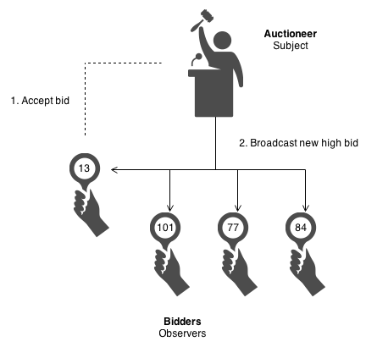
Example
The Observer defines a one-to-many relationship so that when one object changes state, the others are notified and updated automatically. Some auctions demonstrate this pattern. Each bidder possesses a numbered paddle that is used to indicate a bid. The auctioneer starts the bidding, and "observes" when a paddle is raised to accept the bid. The acceptance of the bid changes the bid price which is broadcast to all of the bidders in the form of a new bid.
Notes:
Consider talking about:
UML class and object diagram
UML class diagram
‹#›

Slide 21
References
Design Patterns -Elements of reusable Object-Oriented Software
https://www.javatpoint.com/design-patterns-in-java
https://www.geeksforgeeks.org › template-method-design-pattern
http://www.newthinktank.com/2012/08/observer-design-pattern-tutorial/
https://www.youtube.com/watch?v=jDX6x8qmjbA
https://www.tutorialspoint.com/design_pattern/template_pattern.htm
Next Session :
Remaining Patterns.
Notes:
Consider talking about:
UML class and object diagram
UML class diagram
‹#›

