Slide 1


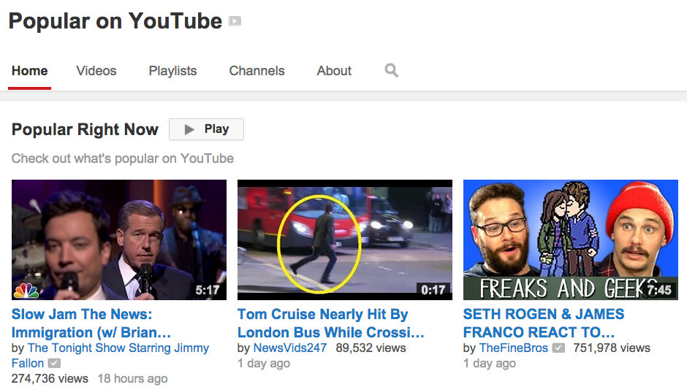
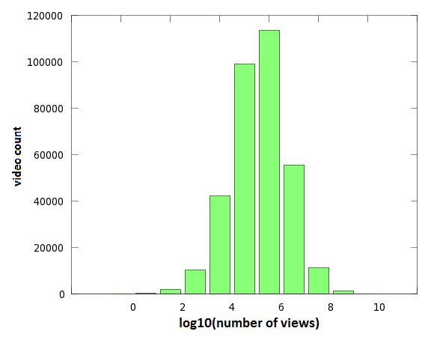
Ranking YouTube Videos’ Popularity
Loc Do and Joseph Richardson
Carnegie Mellon University, Computer Science Department
PROBLEM STATEMENT
Two methods
Given two YouTube videos, can we predict which one attract more views based on the metadata?
Challenges
  Sparseness in the training set
  Over a millions video ➔ computational challenge
RANKING BY CLASSIFICATION
RANKING BY REGRESSION
One method of ranking is to use logistic regression on X (features extracted from two videos) and Y (their ordering) under a Gaussian process prior:
Because there are many features, we use gradient descent to find an optimal weight parameter w:
The values of the elements of w should give a good indication of the best predictors of video success.
An alternate method is to first predict the number of views of a video and then using that to compare. While this is likely to perform slightly worse at the ranking problem:, a benefit is that it can be used stand-alone to give predictions about the order of magnitude for a video's popularity.
Treating observed view counts as a linear function of the video's features, plus Guassian noise, we seek a function of the form
Because there are many features, we use gradient descent to find an optimal weight parameter B, rather than solving directly. Letting A = [X … X ], Y = [Y … Y ] ,
MOTIVATION
Enhance the video recommendation system
  Return a list of “popular” and “relevant” videos to users’ interests.
Figure out which features correlate most highly to the popularity of a YouTube video.
1 n 1 n
T T
1 n 1 n
Accuraccy results:
Graph of bins' accuracy
(note less accuracy the older it gets)
Show one example plot of X*B vs Y (likely with the comment that it's just not linear)
DATASET
We crawled massive amounts of data over the course of months, which a lot of variability within the data.
  1,432,213 videos crawled
  628,072 unique uploaders crawled
  “bag of words” dictionary size: 2,447,603 words
  Localization issues, missing data, banned uploaders...
FEATURE EXTRACTION
CONCLUSIONS
We experimented with a lot of features, including:
      Uploader's subscriber count
      Number of videos previously uploaded by uploader
      Bag-of-words model on the title
      Video runtime
      Upload date
  Traffic limits
  High variance in observations, ranging between zero and as many as:
    2,104,518,656 views
    8,639,650 likes
    4,184,769 dislikes
Comparison of the two regressions; overall accuracy percentages
Graph showing some of the most popular words

