Slide 1



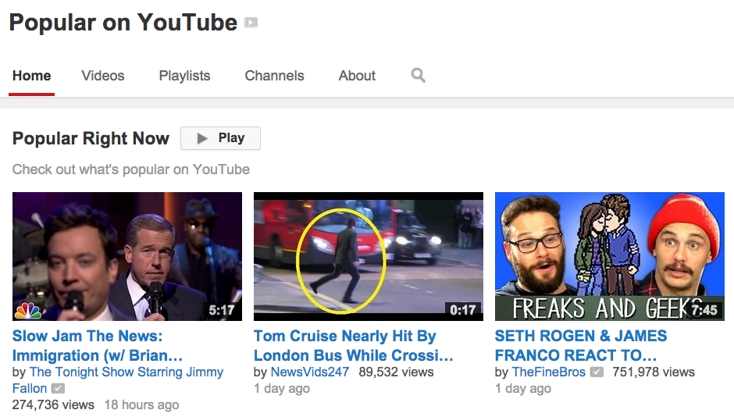
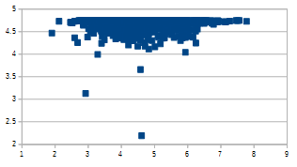
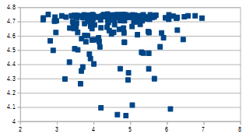
Ranking YouTube Videos’ Popularity
Loc Do and Joseph Richardson
Carnegie Mellon University, Computer Science Department
PROBLEM STATEMENT
TWO METHODS
Given two YouTube videos, can we predict which one will attract more views based on the metadata
Challenges
Complex problem by nature
Sparseness in the training set
Over a million videos ➔ computational challenge
RANKING BY CLASSIFICATION
RANKING BY REGRESSION
1. Problem Formulation
Given two videos i and j, each is associated with a feature vectors X and X . Let Y denote a binary class indicating which video is more popular.
Finding the more popular video is equivalent to predicting the binary class.
2. Approach
Demote X as representative feature vector X = X – X
Apply logistic regression on X vs Y
Ill-conditioning optimization problem: Stochastic Gradient Descent with regularization.
Large number of videos: Bagging methods by training different classifiers on different parts of the data and using a majority voting scheme on the test set.
3. Results
Accuracy on pairwise comparison in the test set varies with video age:
1. Problem Formulation
Predict the view count of the videos one at a time and then compare, rather than comparing one pair at a time.
While this will likely perform slightly worse at the ranking problem, it allows us to make stand-alone to give predictions about the order of magnitude for a video's popularity.
2. Approach
Linear Regression
Stochastic Gradient Descent
Log scale
Order of magnitude matter most
Avoid dominance of most popular
3. Results
Typically correct only within an order of magnitude
High error in both training and testing suggests that this problem is not linearly separable
Ranking accuracy just over 50%
More sophisticated models needed
j ij
i
MOTIVATION
Enhance the video recommendation system
Return a list of “popular” and “relevant” videos to users’ interests.
Figure out which features correlate most highly to the popularity of a YouTube video.
ij ij
ij i j
Viewcount vs Predicted Viewcount (log scale)
DATASET
Training
Testing
Data was crawled from YouTube in Oct-Nov, 2014
1,432,213 videos with metadata (title, view counts, no of likes, no of dislikes, etc.)
628,072 unique YouTube uploaders
Distributions of videos and uploaders:
FEATURE EXTRACTION
FUTURE WORK AND STRETCH GOALS
Features are extracted from video’s metadata, including:
Video features
Bag-of-words model on the title (2,447,603 unique words)
Video length [1 second, 107373 second] (in seconds)
Days since first uploaded: [1, 3423]
Ratio of Likes/Dislikes
Like [1, 8M]
Dislike [1, 4M]
Uploader features
Subscriber count
Number of videos previously uploaded by uploader
Bag-of-features are not good indicators of ranking videos popularity
Find more features such as mining videos’ comments.
Both linear models show bad results on separating the two classes
Apply non-linear models such as Gaussian Processes
Predicting the popularity of videos over time
Capturing different snapshots of a video over a period of time
Examine the effect “the rich get richer” by YouTube recommendation system on the video popularity.

