Slide 1
Examples LCE
LCE interactions could look like this for the student.
In grey the answers are given.

Slide 2

lceDrawingInteration
Question 1: Points
Draw the points A (2,3) and B (-1,-2) on the given paper.
Did you draw the x-axis and y-axis?
A (2,3) means the point with x=2 and y=3.

Slide 3
lceGapMatch
Question 2: Richard III
Darg and drop the missing words in this famous quote from Shakespeare's Richard III.
spring summer autumn winter
Now is the _winter_ of our discontent
Made glorious _summer_ by this sun of York;
And all the clouds that lour'd upon our house
In the deep bosom of the ocean buried.

Slide 4
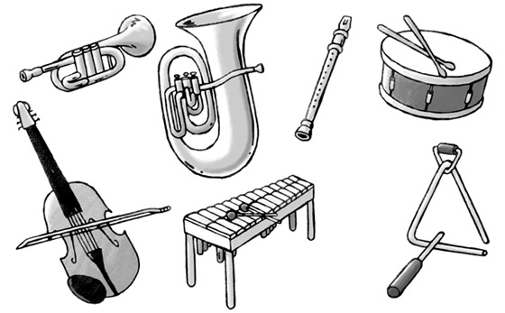
lceGraphicGapMatch
Question 3: Instruments
Do you know the following instruments?
Drag and drop the right names to the instruments.
trumpet
trumpet
xylophone
drum
drum
violin
violin
xylophone

Slide 5
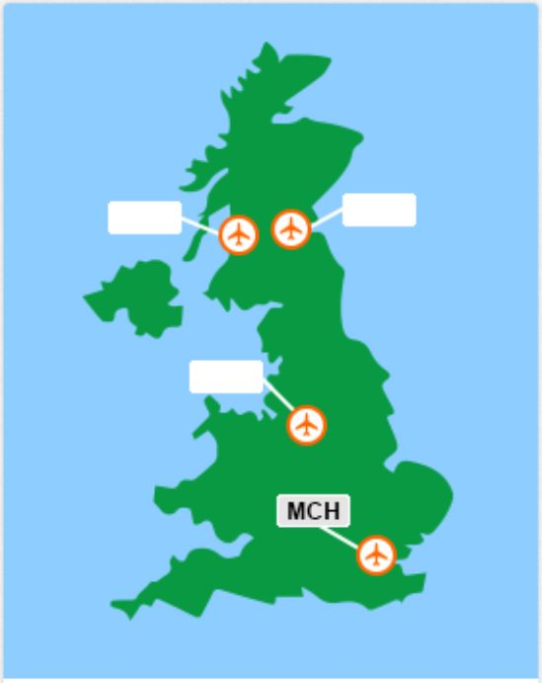
lceGraphicTextEntry
Question 4: Airport tags
The International Air Transport Association assigns three-letter codes to identify airports worldwide. For example, London Heathrow has code LHR.
Some of the labels on the following diagram are missing: can you fill in the correct three-letter codes for the unlabeled airports?
GLA
EDI
MAN

Slide 6
lceHottext
Question 5: Olympic Games sponsors
Select the error in the following passage of text (or No Error if there is none).
Sponsors of the Olympic Games who bought advertising time on United States television includes at least a dozen international firms whose names are familiar to American consumers.
No Error

Slide 7
lceInlineChoice
Question 6: Richard III
Choose the missing word in this famous quote from Shakespeare's Richard III.
Now is the winter of our discontent
Made glorious summer by this sun of ________
And all the clouds that lour'd upon our house
In the deep bosom of the ocean buried.
Gloucester
Lancaster
York

Slide 8
lceMultipleMatch
Question 7: Shakespeare
Match the following characters to the Shakespeare play they appeared in. Draw lines.
Capulet A Midsummer-Night's Dream
Demetrius Romeo and Juliet
Lysander The Tempest
Prospero

Slide 9
lcePerformQuestion
Question 8: Write a manual
Some people call an user guide "manual".
Write a manual about a task you choose. Write it in MS Word and upload it.
[Upload]
Done

Slide 10
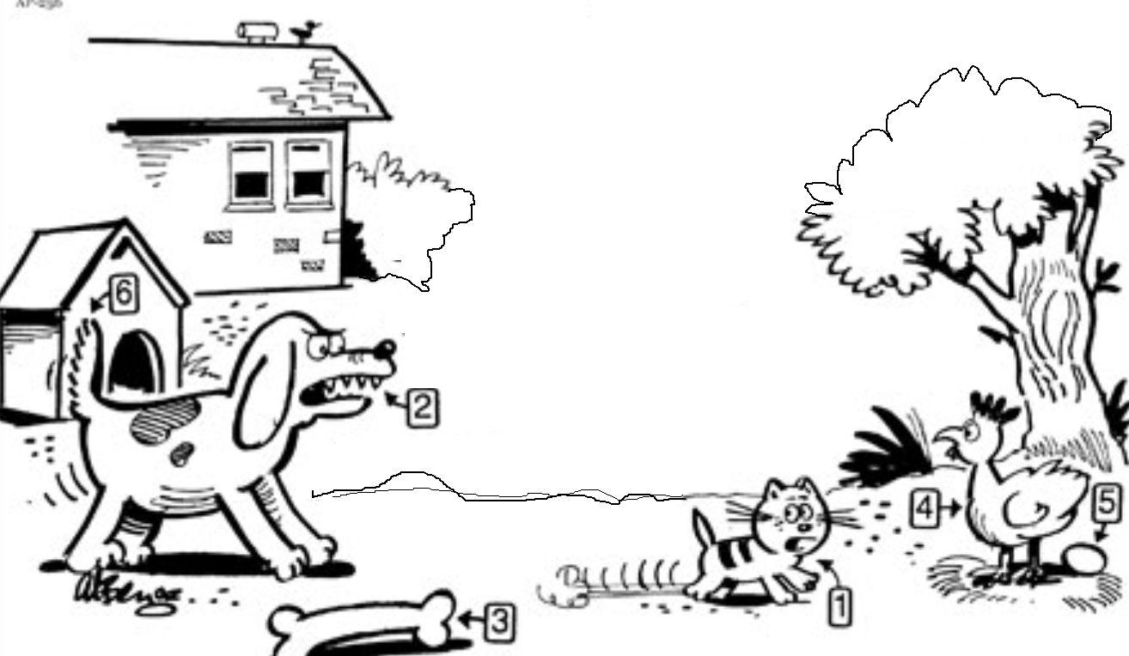
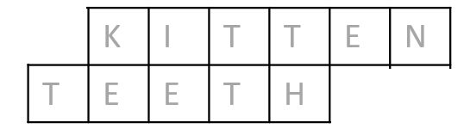
lceAcrosticPuzzle
Question 9: Animals
Follow the pictures clues, fill in the grid, and the arrowed column will reveal a key word related to this scene.
Animal 1 is a ...
Animal 2 is a ...
The key word is __KE________

Slide 11
lceCrossWordPuzzle
B | R | U | S | S | E | L | S | S | P | R | O | U | T | S
 |  |  |  |  |  |  |  |  |  | H
 |  |  |  |  |  |  |  |  |  | U
 |  |  |  |  |  |  |  |  |  | B
 |  |  |  |  |  |  |  |  |  | A
 |  |  |  |  |  |  |  |  |  | R
 |  |  |  |  |  |  |  |  |  | B
Question 10: Vegetables
Fill in the crossword puzzle.
Horizontal
Small cabbage-like heads or buds growing along a stalk
Vertical
Long pinkish sour leafstalks usually eaten cooked and sweetened
The word looking for is: _R______________
1
2
1

Slide 12

lceTextEntry
Question 11: Mrs. White
Present Simple vs Present Continuous.
Fill in the right form of the verb.
This is Mrs. White. She _is_ (be) a primary school teacher.
She _teachs_ (teach) English, Math and Geography.
At the moment she _is teaching_ (teach) Math.

