Slide 1
Interaction visual examples (including DITA L&T and LCE)
Interactions possibly could look like this for the students.
In grey the answers are given.

Slide 2
lcelearningContent topics
Objectives
Theory

Slide 3
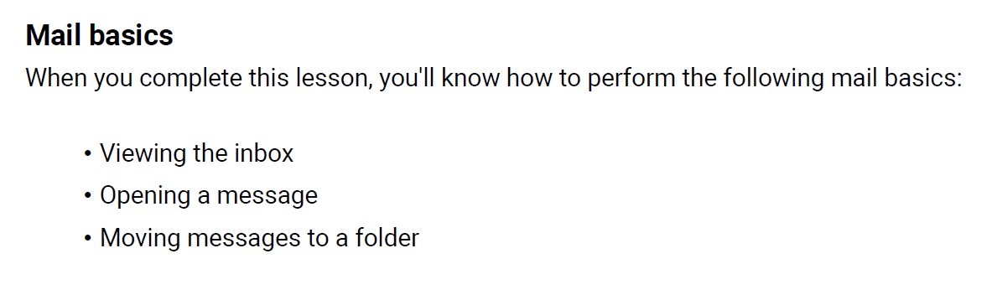
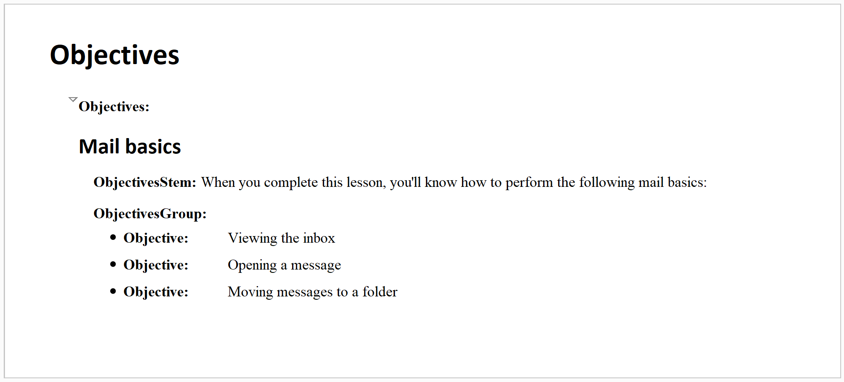
lceLearningContent > lcObjectives
or

Slide 4
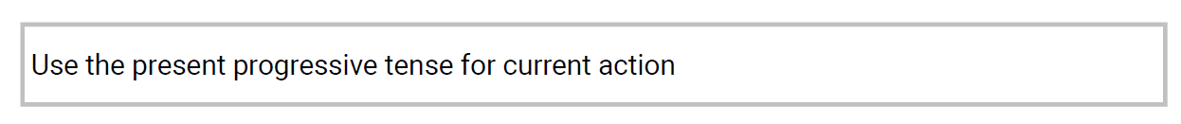
lceLearningContent – special content
lq contentclass="poem"
My bounty is as boundless as the sea,
My love as deep; the more I give to thee,
The more I have, for both are infinite.
Shakespeare: Romeo and Juliet
lceBox

Slide 5
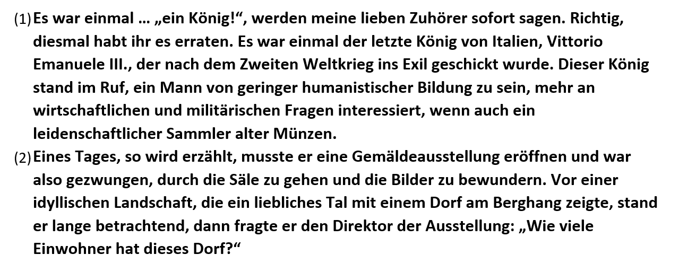
lceLearningContent – special content
section contentclass="excerpt" outputclass=“paranumbers"
Umberto Eco Im Wald der Fiktionen. Sechs Streifzüge durch die Literatur

Slide 6
lce open interactions
lceDrawing
lcePerformQuestion

Slide 7

lceDrawing
Points
Draw the points A (2,3) and B (-1,-2) on the given paper.
Did you draw the x-axis and y-axis?
A (2,3) means the point with x=2 and y=3.

Slide 8
lcePerformQuestion
Write a manual
Some people call an user guide "manual".
Write a manual about a task you choose. Write it in MS Word and upload it.
[Upload]
Done

Slide 9
lce inline interactions
lceGapMatch
lceHottext
lceInlineChoice
lceTextEnry

Slide 10
lceGapMatch
Richard III
Drag and drop the missing words in this famous quote from Shakespeare's Richard III.
spring summer autumn winter
Now is the _winter_ of our discontent
Made glorious _summer_ by this sun of York;
And all the clouds that lour'd upon our house
In the deep bosom of the ocean buried.

Slide 11
lceHottext
Olympic Games sponsors
Select the error in the following passage of text (or No Error if there is none).
Sponsors of the Olympic Games who bought advertising time on United States television includes at least a dozen international firms whose names are familiar to American consumers.
No Error

Slide 12
lceInlineChoice
Richard III
Choose the missing word in this famous quote from Shakespeare's Richard III.
Now is the winter of our discontent
Made glorious summer by this sun of ________
And all the clouds that lour'd upon our house
In the deep bosom of the ocean buried.
Gloucester
Lancaster
York

Slide 13
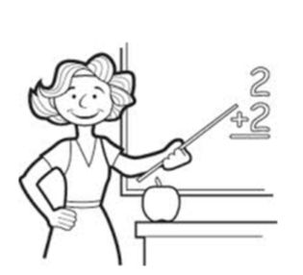
lceTextEntry
Mrs. White
Present Simple vs Present Continuous.
Fill in the right form of the verb.
This is Mrs. White. She _is_ (be) a primary school teacher.
She _teaches_ (teach) English, Math and Geography.
At the moment she _is teaching_ (teach) Math.

Slide 14
lce matching interactions
lceChainMatching
lceMultipleMatch

Slide 15
lceChainMatch
Shakespeare
Combine the correct kind, play and person.
Kind of play | Name of play | Person in play
Comedy | Othello | Titania
History | Midsummer Night's Dream | Desdemona
Tragedy | King John | Lady Faulconbridge

Slide 16
lceMultipleMatch
Shakespeare
Match the following characters to the Shakespeare play they appeared in. Draw lines.
Capulet A Midsummer-Night's Dream
Demetrius Romeo and Juliet
Lysander The Tempest
Prospero

Slide 17
lce graphic interactions
lceGraphicAssociate
lceGraphicGapMatch2 / lceGaphicGapMatch
lceGraphicHotspot
lceGraphicTextEntry

Slide 18
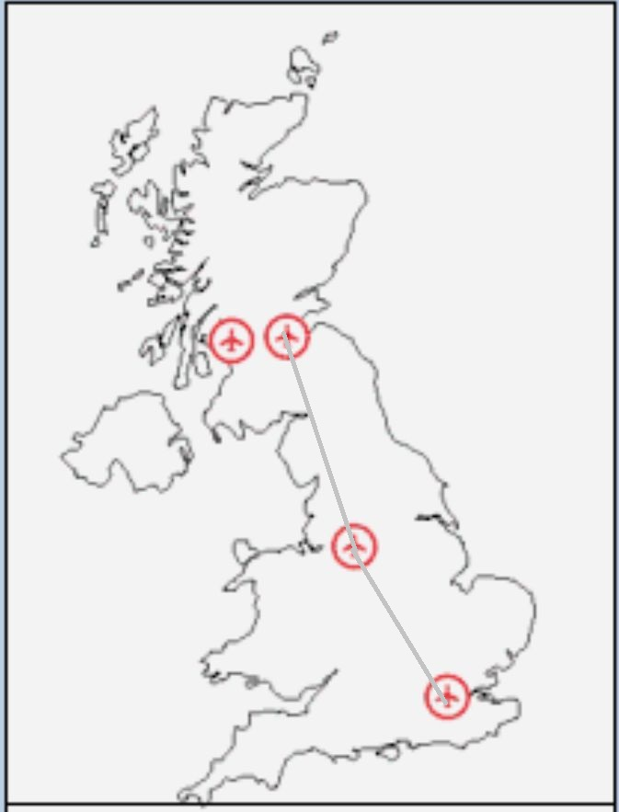
lceGraphicAssociate
New routes
Frizz, a new low-cost airline, already operates a service connecting Manchester and Edinburgh but has recently opened two new routes: a service between London and Edinburgh and one between London and Manchester.
Mark the airline's new routes on the airport map:

Slide 19
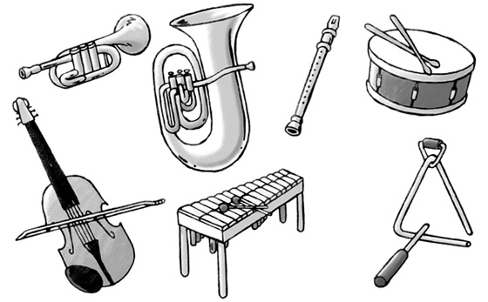
lceGraphicGapMatch2 / lceGraphicGapMatch
Instruments
Do you know the following instruments?
Drag and drop the right names to the instruments.
trumpet
trumpet
xylophone
drum
drum
violin
violin
xylophone

Slide 20
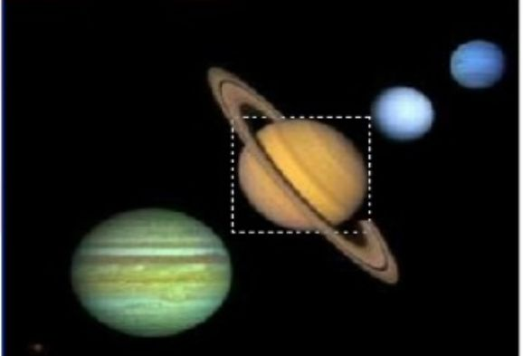
lceGraphicHotspot
Planets
Which of these planets is Saturn?
Click on it.

Slide 21
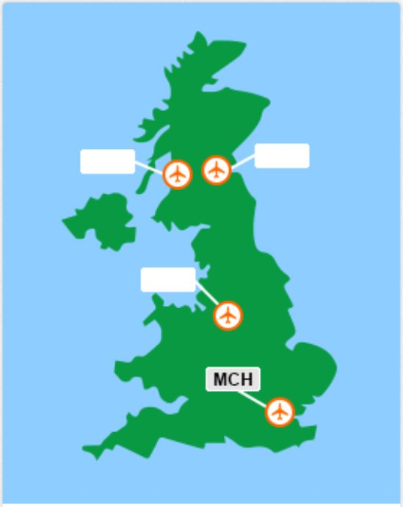
lceGraphicTextEntry
Airport tags
The International Air Transport Association assigns three-letter codes to identify airports worldwide. For example, London Heathrow has code LHR.
Some of the labels on the following diagram are missing: can you fill in the correct three-letter codes for the unlabeled airports?
GLA
EDI
MAN

Slide 22
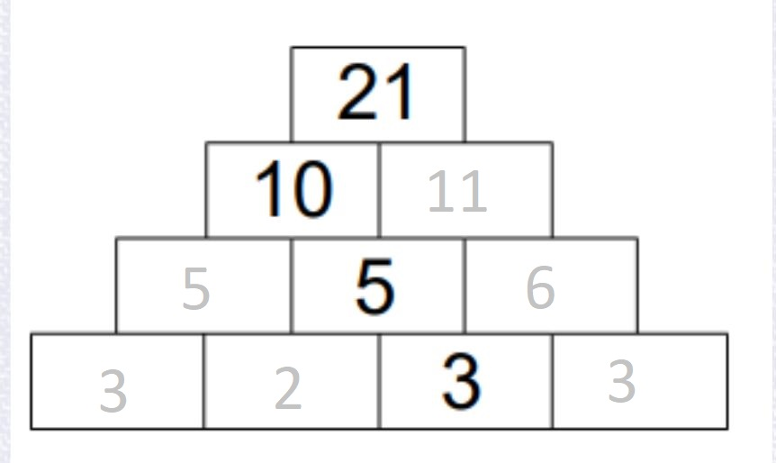
lceGraphicTextEntry (with @answertype=“fixed”)
Number pyramid
The number pyramid is built as follows: add two number in one row, which are standing next to each other. The result of this is the number above.
Fill in the missing numbers.

Slide 23
lce puzzle interactions
lceAcrosticPuzzle
lceCrossWordPuzzle

Slide 24
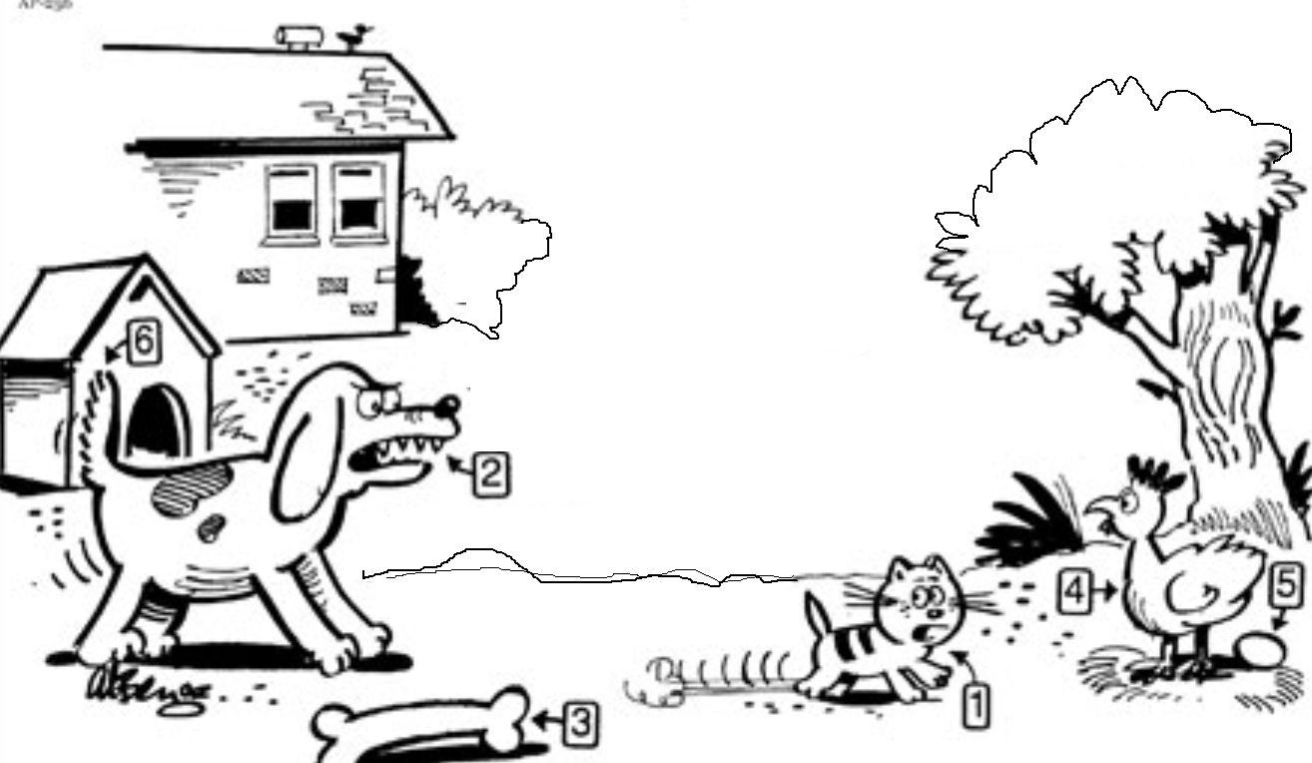
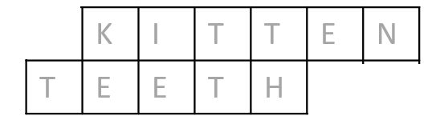
lceAcrosticPuzzle
Animals
Follow the pictures clues, fill in the grid, and the arrowed column will reveal a key word related to this scene.
1.
2.
The key word is __KE________

Slide 25
lceCrossWordPuzzle
B | R | U | S | S | E | L | S | S | P | R | O | U | T | S
 |  |  |  |  |  |  |  |  |  | H
 |  |  |  |  |  |  |  |  |  | U
 |  |  |  |  |  |  |  |  |  | B
 |  |  |  |  |  |  |  |  |  | A
 |  |  |  |  |  |  |  |  |  | R
 |  |  |  |  |  |  |  |  |  | B
Vegetables
Fill in the crossword puzzle.
Horizontal
Small cabbage-like heads or buds growing along a stalk
Vertical
Long pinkish sour leafstalks usually eaten cooked and sweetened
The word looking for is: _R______________
1
2
1

Slide 26
lce other interactions
lceChoiceInteraction
lceOrderInteraction

Slide 27


lceChoiceInteraction
Capitols
How good do you know the capitols of different countries?
Netherlands:
Amsterdam
Rotterdam
Den Haag
Germany:
Berlin
Bonn
Frankfurt a.M.
UK:
Liverpool
Manchester
London

Slide 28
lceOrderInteration
Sentencens
Put the words in the right order.
Plays guitar Ben the Ben plays the guitar
singer Rita is the Rita is the singer
John the songs writes John writes the songs

Slide 29
DITA L&T interaction
lcOpenQuestion2
lcSingleSelect2
lcMultipleSelect2
lcTrueFalse2
lcMatching2
lcHotspot2
lcSequencing2

Slide 30
lcOpenQuestion2
Postcard
Read this postcard from your English pen-friend, Sam.
“Here is a postcard of my town. Please send me a postcard from your town. What size is your town? What is the nicest part of your town? Where do you go in the evenings? Sam.”
Write Sam a postcard. Answer the questions. Write 25-35 words.
“Hi Sam, in my town are living around 50.000 people. The nicest part is the neighbourhood near to the park. Sometimes I go to a pub in the town center. Dave”

Slide 31
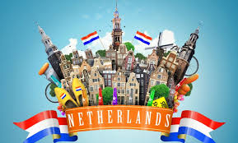
lcSingleSelect2
The Netherlands
What is the capital of The Netherlands?
Den Hague
Amsterdam
Rotterdam
Utrecht
x

Slide 32
lcMultipleSelect2
Water
Which of the following elements are used to form water?
Hydrogen
Helium
Carbon
Oxygen
Nitrogen
Chlorine
x
x

Slide 33
lcMatching2
City and country
Match the following characters to the Shakespeare play they appeared in. Draw lines.
Paris Germany
London Italy
Berlin Great Britain
Rome France

Slide 34
lcSequencing2
Bremer Stadtmusikanten
In the fairy tale "Die Bremer Stadtmusikanten" there are four animals which are get off and sing together.
In which order does they build their pyramid?
Sort who is standing below and then up to the top.
Cat Donkey
Dog Dog
Cock Cat
Donkey Cock

Slide 35
lceHotspot
Planets
Which of these planets is Saturn?
Click on it.

Slide 36
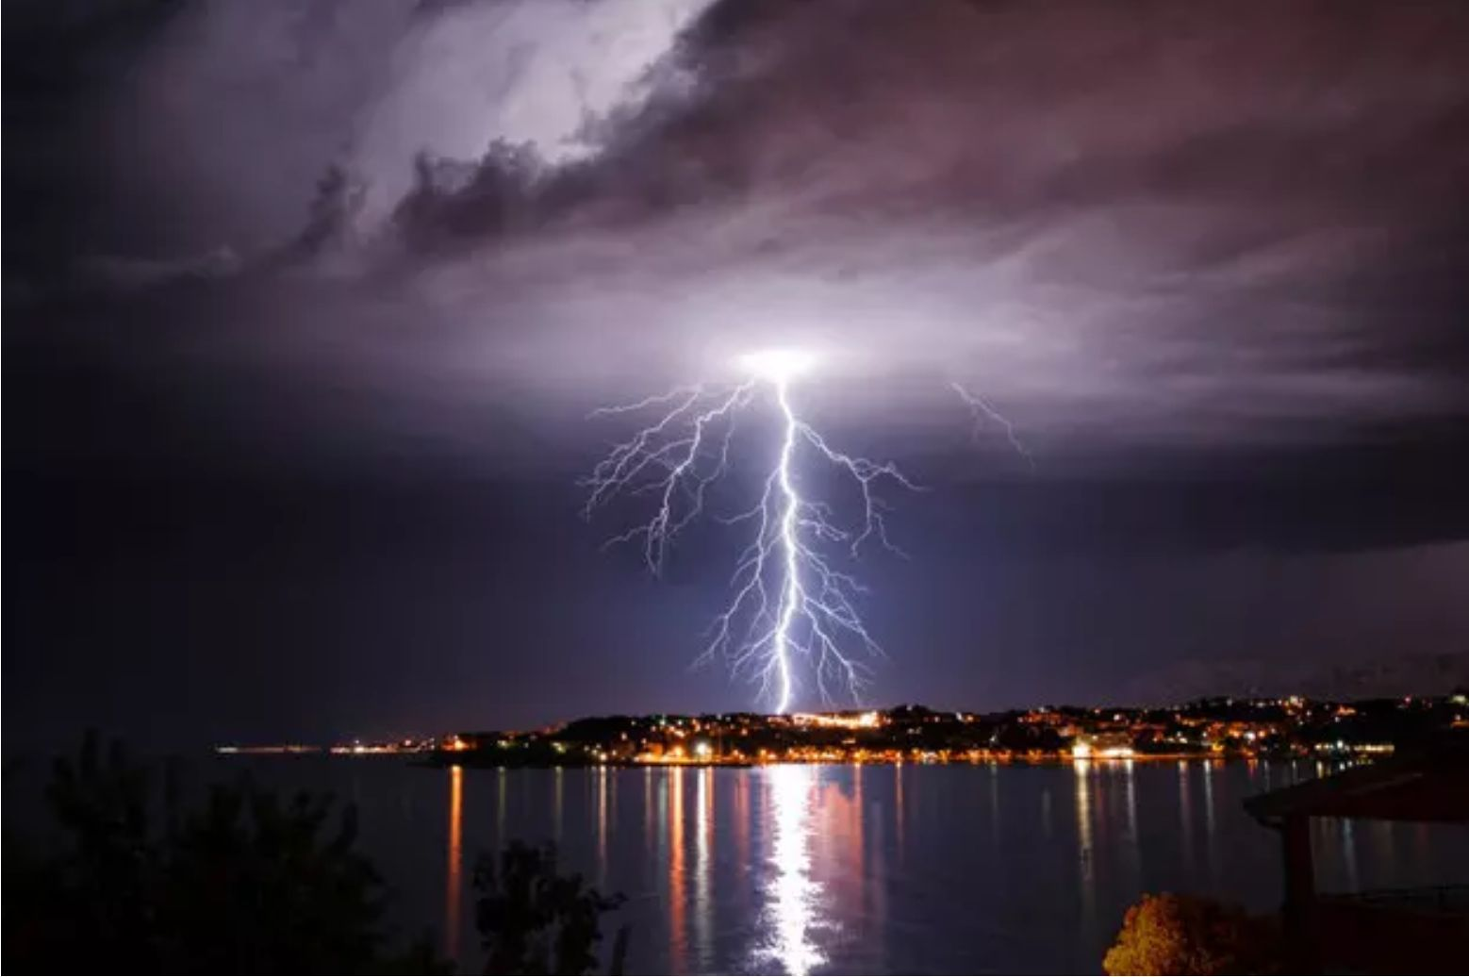
lcTrueFalse2
Quiz
Not everything you thought you knew might be true...
 | True | False
Lightning never strikes in the same place twice.
The top of the Eiffel Tower leans away from the sun.
Twinkies have an infinite shelf life.
x
x
x

