Slide 1
GIT Workshop

Slide 2
GIT is a Distributed version control that focuses on sharing changes.
GITHUB is a web page on which you can publish your git repositories and collaborate with other people.

Slide 3
Git & Github
Git is a version control system; think of it as a series of snapshots (commits) of your code. You see a path of these snapshots, in which order they where created. You can make branches to experiment and come back to snapshots you took.
GitHub, is a web-page on which you can publish your Git repositories and collaborate with other people.
Installation :
Windows : Download the setup from the https://windows.github.com/ and run the installer.
Mac : http://git-scm.com/downloads -> Download the Mac installer and run it.

Slide 4

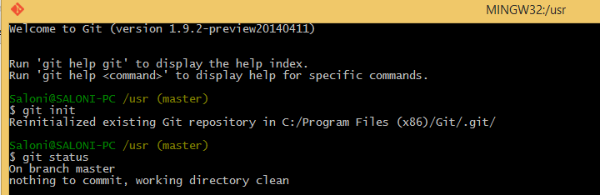
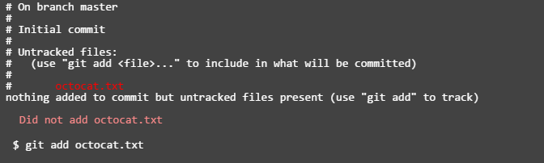
Git : Commands
Initializing a Git repository
Current state of our project
Adding a file

Slide 5
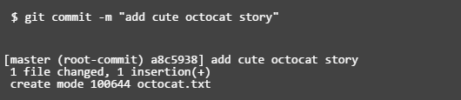
Git : Simple Commands
Git add command basically adds the files to the staging area, We could add or remove files from the stage before we store them in the repository.
Now, to commit the file, we have to run
git commit –m “meaningful message for the commit”
Advice : Run git status command regularly to keep a check on the repository.
It tells you the number of changes and the number of the changed files.

Slide 6

Git : Commands
We can also use commands like :
git add ‘*.txt’
git log : Git's log as a journal that remembers all the changes we've committed so far, in the order we committed them.
By following these steps, we have created a new local repo, but to push the local repo to the server, we need to push it using a remote name and a remote repo URL.
Most Important : Pushing our files to the server
The push command tells Git where to put our commits when we're ready. The name of our remote is origin and the default local branch name is master.
Notes:
The -u tells Git to remember the parameters, so that next time we can simply run git push and Git will know what to do. Go ahead and push it!

Slide 7

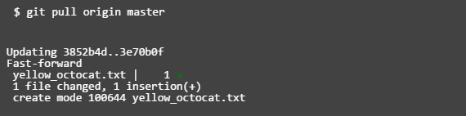
Git : The Final Push!!
After pushing the files to the server :
After several commits by other people : We can check for changes on our GitHub repository and pull down any new changes by running:
After some additions and deletions to the code, you can check the most recent commit differences by using the command :
git diff HEAD
Notes:
The -u tells Git to remember the parameters, so that next time we can simply run git push and Git will know what to do. Go ahead and push it!

Slide 8
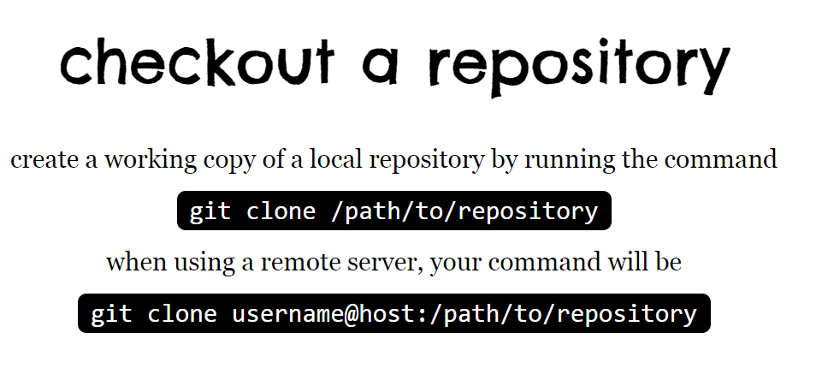

Slide 9
