Slide 1
Recurrent Neural Network (RNN)

Slide 2
Slide credits
Most of these slides were adapted from:
Hung-yi Lee (National Taiwan University)
Kris Kitani (Carnegie Mellon University).
Noah Snavely (Cornell University).
Fei-Fei Li (Stanford University).

Slide 3

Example Application
Slot Filling
I would like to arrive Taipei on November 2nd.
ticket booking system
Destination:
Taipei
Slot
time of arrival:
November 2nd
Notes:
https://catalog.ldc.upenn.edu/docs/LDC93S4B/corpus.html

Slide 4
Example Application
Solving slot filling by Feedforward network?
Input: a word
(Each word is represented as a vector)
Taipei

Slide 5
1-of-N encoding
How to represent each word as a vector?
1-of-N Encoding
lexicon = {apple, bag, cat, dog, elephant}
The vector is lexicon size.
apple = [ 1 0 0 0 0]
bag = [ 0 1 0 0 0]
Each dimension corresponds to a word in the lexicon
cat = [ 0 0 1 0 0]
The dimension for the word is 1, and others are 0
dog = [ 0 0 0 1 0]
elephant = [ 0 0 0 0 1]
Notes:
Can be very large

Slide 6
Beyond 1-of-N encoding
Dimension for “Other”
Word hashing
apple
0
a-a-a
0
bag
0
a-a-b
0
…
…
cat
0
a-p-p
1
dog
0
…
…
…
26 X 26 X 26
elephant
0
p-l-e
1
…
…
p-p-l
1
“other”
1
…
…
w = “apple”
w = “Gandalf”
w = “Sauron”

Slide 7
Example Application
time of departure
dest
Solving slot filling by Feedforward network?
Input: a word
(Each word is represented as a vector)
Output:
Probability distribution that the input word belonging to the slots
Taipei

Slide 8
Example Application
time of departure
dest
arrive Taipei on November 2nd
other
dest
other
time
time
Problem?
leave Taipei on November 2nd
place of departure
Neural network needs memory!
Taipei

Slide 9
Recurrent Neural Network (RNN)
The output of hidden layer are stored in the memory.
store
Memory can be considered as another input.

Slide 10





Example
Input sequence:
$$\left[\begin{aligned}1 \\ 1\end{aligned}\right]$$
$$\left[\begin{aligned}1 \\ 1\end{aligned}\right]$$
$$\left[\begin{aligned}2 \\ 2\end{aligned}\right]$$
$$……$$
output sequence:
$$\left[\begin{aligned}4 \\ 4\end{aligned}\right]$$
4
4
store
2
2
given Initial values
0
0
All the weights are “1”, no bias
1
1
All activation functions are linear

Slide 11

Example
Input sequence:
$$\left[\begin{aligned}1 \\ 1\end{aligned}\right]$$
$$\left[\begin{aligned}1 \\ 1\end{aligned}\right]$$
$$\left[\begin{aligned}2 \\ 2\end{aligned}\right]$$
$$……$$
output sequence:
$$\left[\begin{aligned}4 \\ 4\end{aligned}\right]$$
$$\left[\begin{aligned}12 \\ 12\end{aligned}\right]$$
12
12
store
6
6
2
2
All the weights are “1”, no bias
1
1
All activation functions are linear

Slide 12

Example
Input sequence:
$$\left[\begin{aligned}1 \\ 1\end{aligned}\right]$$
$$\left[\begin{aligned}1 \\ 1\end{aligned}\right]$$
$$\left[\begin{aligned}2 \\ 2\end{aligned}\right]$$
$$……$$
output sequence:
$$\left[\begin{aligned}4 \\ 4\end{aligned}\right]$$
$$\left[\begin{aligned}12 \\ 12\end{aligned}\right]$$
$$\left[\begin{aligned}32 \\ 32\end{aligned}\right]$$
Changing the sequence order will change the output.
32
32
store
16
16
6
6
All the weights are “1”, no bias
2
2
All activation functions are linear

Slide 13
RNN
The same network is used again and again.
Probability of “arrive” in each slot
Probability of “Taipei” in each slot
Probability of “on” in each slot
y¹
y²
y³
store
store
a¹
a²
a³
a¹
a²
x¹
x²
x³
arrive Taipei on November 2nd
Notes:
General idea

Slide 14
RNN
Different
Prob of “leave” in each slot
Prob of “Taipei” in each slot
Prob of “arrive” in each slot
Prob of “Taipei” in each slot
y²
……
y²
……
y¹
y¹
store
store
a¹
a²
a¹
a²
a¹
……
a¹
……
x¹
x²
……
x¹
x²
……
leave
Taipei
arrive
Taipei
The values stored in the memory is different.
Notes:
Output y^{i} depends on x¹, x², …… x^{i}
The same input can have totoally different output.

Slide 15
Of course it can be deep …
y^{t}
y^{t+1}
y^{t+2}
……
……
……
……
……
……
……
……
……
x^{t}
x^{t+1}
x^{t+2}

Slide 16
Elman Network & Jordan Network
Elman Network
Jordan Network
y^{t}
y^{t+1}
y^{t}
y^{t+1}
W^{h}
Wº
Wº
Wº
Wº
……
……
……
……
W^{h}
W^{i}
W^{i}
W^{i}
W^{i}
x^{t}
x^{t+1}
x^{t}
x^{t+1}

Slide 17
Bidirectional RNN
……
x^{t}
x^{t+1}
x^{t+2}
……
y^{t}
y^{t+1}
y^{t+2}
……
……
x^{t}
x^{t+1}
x^{t+2}
Notes:
To determine yi, you have to consider a lot ……
You should see the whole sequence

Slide 18
Long Short-term Memory (LSTM)
Other part of the network
Special Neuron:
4 inputs,
1 output
Signal control the output gate
Output Gate
(Other part of the network)
Memory
Cell
Forget Gate
Signal control the forget gate
(Other part of the network)
Signal control the input gate
Input Gate
LSTM
(Other part of the network)
Other part of the network
Notes:
Normal neuron
1 input, 1 output
This one
4 input, 1 output

Slide 19
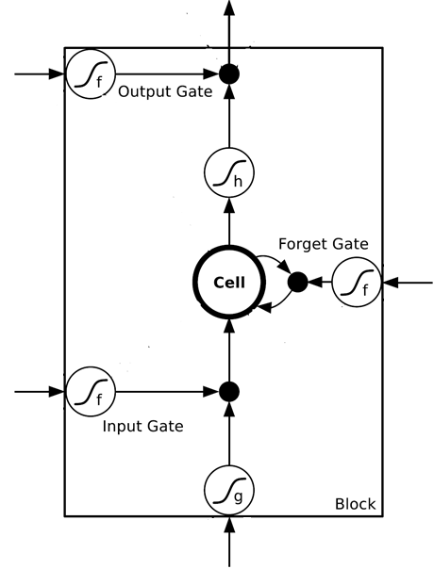
$$a$$
$$=h\left(c^{′}\right)f\left(z_{o}\right)$$
$$z_{o}$$
multiply
Activation function f is usually a sigmoid function
$$f\left(z_{o}\right)$$
$$h\left(c^{′}\right)$$
Between 0 and 1
Mimic open and close gate
$$c$$
$$f\left(z_{f}\right)$$
c
$$c^{′}$$
$$z_{f}$$
$$cf\left(z_{f}\right)$$
$$c^{′}=g\left(z\right)f\left(z_{i}\right)+cf\left(z_{f}\right)$$
$$f\left(z_{i}\right)$$
$$g\left(z\right)f\left(z_{i}\right)$$
$$z_{i}$$
multiply
$$g\left(z\right)$$
$$z$$

Slide 20




LSTM - Example
0
0
3
3
7
7
7
0
6
$$x_{1}$$
1
0
0
3
1
0
2
0
0
4
1
0
2
0
0
1
0
1
3
-1
0
6
1
0
1
0
1
$$x_{2}$$
$$x_{3}$$
$$y$$
0
0
0
0
0
7
0
0
6
When x₂ = 1, add the numbers of x₁ into the memory
When x₂ = -1, reset the memory
When x₃ = 1, output the number in the memory.
Notes:
Can you find the rule?

Slide 21




x₁
0
y
$$y$$
0
0
0
7
0
x₂
0
+
x₃
100
0
x₁
1
-10
100
0
0
+
x₂
x₁
0
x₃
x₂
100
+
10
1
x₃
0
1
-10
+
$$x_{1}$$
3
1
0
4
1
0
2
0
0
1
0
1
3
-1
0
1
0
0
0
$$x_{2}$$
x₁
x₂
x₃
1
$$x_{3}$$
Notes:
Look at the sequence first

Slide 22
3
0
≈0
y
$$y$$
0
0
0
7
0
1
0
+
≈0
3
0
100
0
3
1
-10
0
100
0
3
+
1
3
≈1
0
0
100
≈1
3
1
+
10
1
3
0
0
1
-10
+
$$x_{1}$$
3
1
0
4
1
0
2
0
0
1
0
1
3
-1
0
1
0
0
0
$$x_{2}$$
3
1
0
1
$$x_{3}$$

Slide 23
4
0
≈0
y
$$y$$
0
0
0
7
0
1
0
+
≈0
7
0
100
0
4
1
-10
7
100
0
3
+
1
4
≈1
0
0
100
≈1
4
1
+
10
1
4
0
0
1
-10
+
$$x_{1}$$
3
1
0
4
1
0
2
0
0
1
0
1
3
-1
0
1
0
0
0
$$x_{2}$$
4
1
0
1
$$x_{3}$$

Slide 24
2
0
≈0
y
$$y$$
0
0
0
7
0
0
0
+
≈0
7
0
100
0
2
1
-10
7
100
0
+
0
2
≈1
0
0
100
≈0
0
0
+
10
1
2
0
0
1
-10
+
$$x_{1}$$
3
1
0
4
1
0
2
0
0
1
0
1
3
-1
0
1
0
0
0
$$x_{2}$$
2
0
0
1
$$x_{3}$$

Slide 25
1
0
≈7
y
$$y$$
0
0
0
7
0
0
0
+
≈1
7
1
100
0
1
1
-10
7
100
0
+
0
1
≈1
0
1
100
≈0
0
0
+
10
1
1
1
0
1
-10
+
$$x_{1}$$
3
1
0
4
1
0
2
0
0
1
0
1
3
-1
0
1
0
0
0
$$x_{2}$$
1
0
1
1
$$x_{3}$$

Slide 26
3
0
≈0
y
$$y$$
0
0
0
7
0
-1
0
+
≈0
0
0
100
0
3
1
-10
0
100
0
7
+
-1
3
≈0
0
0
100
≈0
0
-1
+
10
1
3
0
0
1
-10
+
$$x_{1}$$
3
1
0
4
1
0
2
0
0
1
0
1
3
-1
0
1
0
0
0
$$x_{2}$$
3
-1
0
1
$$x_{3}$$

Slide 27




Original Network:
Simply replace the neurons with LSTM
……
……
$$a_{1}$$
$$a_{2}$$
$$z_{1}$$
$$z_{2}$$
x₁
x₂
Input
Notes:
Use a same set of information
Note about the memory

Slide 28


$$a_{1}$$
$$a_{2}$$
+
+
+
+
+
+
+
+
4 times of parameters
x₁
x₂
Input
Notes:
Use a same set of information
Note about the memory

Slide 29
LSTM
c^{t-1}
……
vector
z^{f}
z^{i}
z
zº
4 vectors
x^{t}
Notes:
C is vector

Slide 30

LSTM
y^{t}
zº
c^{t-1}
$$×$$
$$＋$$
$$×$$
z^{f}
$$×$$
z^{i}
z^{f}
z^{i}
z
zº
x^{t}
z
Notes:
Identiy
C is vector

Slide 31
LSTM
Extension: “peephole”
y^{t}
y^{t+1}
c^{t-1}
c^{t}
c^{t+1}
$$×$$
$$＋$$
$$×$$
$$×$$
$$＋$$
$$×$$
$$×$$
$$×$$
z^{f}
z^{i}
z
zº
z^{f}
z^{i}
z
zº
c^{t-1}
h^{t-1}
x^{t}
c^{t}
h^{t}
x^{t+1}
Notes:
Identiy
C is vector

Slide 32
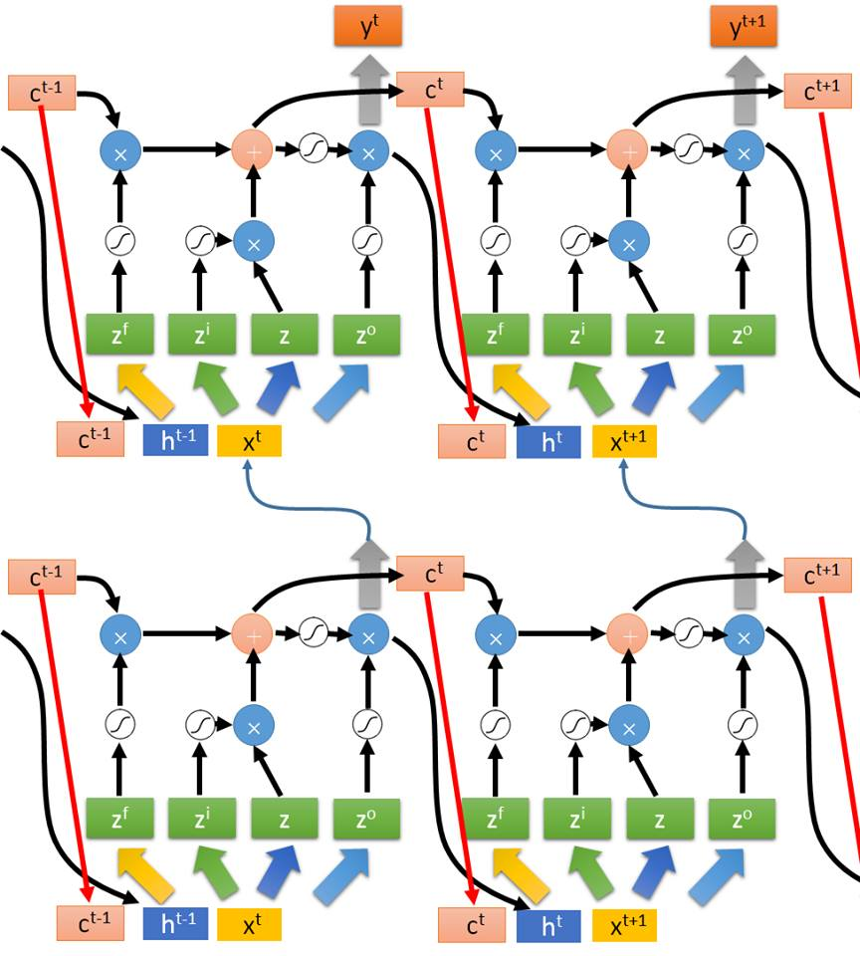
Multiple-layer
LSTM
What is this?
Don’t worry if you cannot understand this. Keras can handle it.
Keras supports
“LSTM”, “GRU”, “SimpleRNN” layers
This is quite standard now.
https://img.komicolle.org/2015-09-20/src/14426967627131.gif
Notes:
Usually when people say RNN, they mean LSTM!

Slide 33
Learning Target
other
dest
other
0
…
1
…
0
…
…
…
…
0
1
0
0
1
0
y¹
y²
y³
copy
copy
a¹
a²
a³
a¹
a²
W^{i}
x¹
x²
x³
Training
Sentences:
arrive Taipei on November 2nd
other
dest
other
time
time
Notes:
General idea

Slide 34


Learning
Backpropagation through time (BPTT)
copy
$$w$$
$$w←w−η∂L∕∂w$$

Slide 35
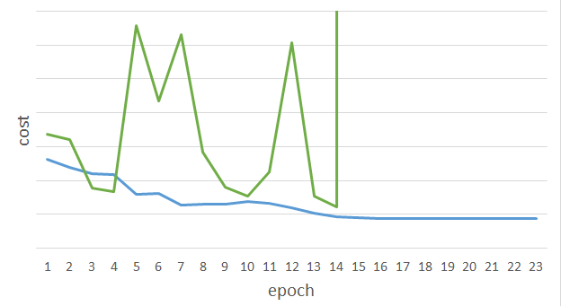
Unfortunately ……
RNN-based network is not always easy to learn
Real experiments on Language modeling
sometimes
Total Loss
Lucky
Epoch
Notes:
Not because you have bug haha

Slide 36
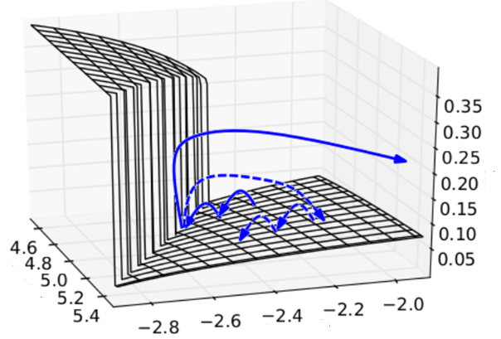

The error surface is rough.
The error surface is either very flat or very steep.
Clipping
Cost
Total Loss
w₂
w₁
[Razvan Pascanu, ICML’13]
Notes:
Even adagrad can not handle this problem, maybe RMS prop is better
Source: http://jmlr.org/proceedings/papers/v28/pascanu13.pdf
Large or small is fine. Change quickly is bad

Slide 37



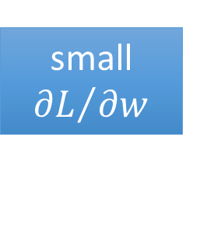

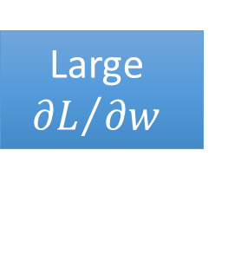




Why?
$$w=1$$
$$y^{1000}=1$$
Large
$${∂L}/{∂w}$$
Small Learning rate?
$$w=1.01$$
$$y^{1000}≈20000$$
$$w=0.99$$
$$y^{1000}≈0$$
small ${∂L}/{∂w}$
Large Learning rate?
$$w=0.01$$
$$y^{1000}≈0$$
=w⁹⁹⁹
y¹
y²
y³
y¹⁰⁰⁰
Toy Example
1
1
1
1
……
w
w
w
1
1
1
1
1
0
0
0
Notes:
Gradient Explode/Gradient Vanishing
Echo state network -> …..

Slide 38
Helpful Techniques
Long Short-term Memory (LSTM)
Can deal with gradient vanishing (not gradient explode)
Memory and input are added
The influence never disappears unless forget gate is closed
No Gradient vanishing
add
(If forget gate is opened.)
Gated Recurrent Unit (GRU):
simpler than LSTM
[Cho, EMNLP’14]
Notes:
Reference: http://colah.github.io/posts/2015-08-Understanding-LSTMs/

Slide 39
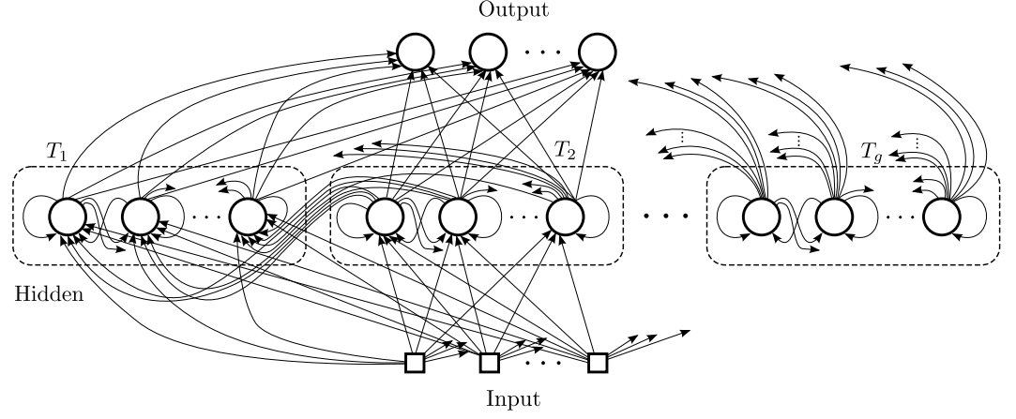
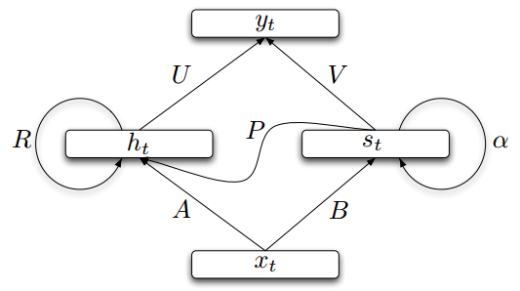
Helpful Techniques
Structurally Constrained Recurrent Network (SCRN)
Clockwise RNN
[Jan Koutnik, JMLR’14]
[Tomas Mikolov, ICLR’15]
Vanilla RNN Initialized with Identity matrix + ReLU activation function [Quoc V. Le, arXiv’15]
Outperform or be comparable with LSTM in 4 different tasks
Notes:
Gated Recurrent Unit (GRU):
http://www.wildml.com/2015/10/recurrent-neural-network-tutorial-part-4-implementing-a-grulstm-rnn-with-python-and-theano/
Structurally Constrained Recurrent Network (SCRN).
Cloclwise RNN

Slide 40
More Applications ……
Probability of “arrive” in each slot
Probability of “Taipei” in each slot
Probability of “on” in each slot
y¹
y²
y³
Input and output are both sequences with the same length
store
store
a¹
a²
a³
a¹
a²
RNN can do more than that!
x¹
x²
x³
arrive Taipei on November 2nd

Slide 41
Many to one
Input is a vector sequence, but output is only one vector
Sentiment Analysis
Awesome
Good
Feel great after watching this movie …….
This movie is too bad
…….
This movie is awesome …….
Normal
Bad
Positive
Negative
Positive
Terrible
……
This
movie
is
……
really
too
bad

Slide 42

Demo: Image Caption Generation
Input an image, but output a sequence of words
[Kelvin Xu, arXiv’15][Li Yao, ICCV’15]
A vector for whole image
a
woman
is
===
CNN
……
Input image
Caption Generation
Notes:
A woman is throwing a Frisbee in a part.

Slide 43
To Learn More ……
The Unreasonable Effectiveness of Recurrent Neural Networks
http://karpathy.github.io/2015/05/21/rnn-effectiveness/
Understanding LSTM Networks
http://colah.github.io/posts/2015-08-Understanding-LSTMs/

