Slide 1

ROSE XU / UWCSEA DOVER
SL + HL
From noise to a creative brief
Generative AI for image creation · UWCSEA Dover
Can an image
look right
and still be wrong?
Tianruo Rose Xu
IB cover; Rose website
01
Notes:
SCOPE: SL + HL
SAY
Hi everyone, and thank you to Irene and Mayuri for inviting me. I'm Rose. Today we're going to work through your case study on generative AI for image creation. Imagine a design company asks you to choose the system behind its next advertising campaign. Making one impressive image is only the beginning. Can you control it? Can you repeat the result? Can you afford to produce a hundred versions? And should you use the result at all? Those are the questions we'll answer. You can pause whenever a decision appears.
DO
Smile. Let the opening question sit for a moment.
SOURCES
IB cover; Rose website

Slide 2
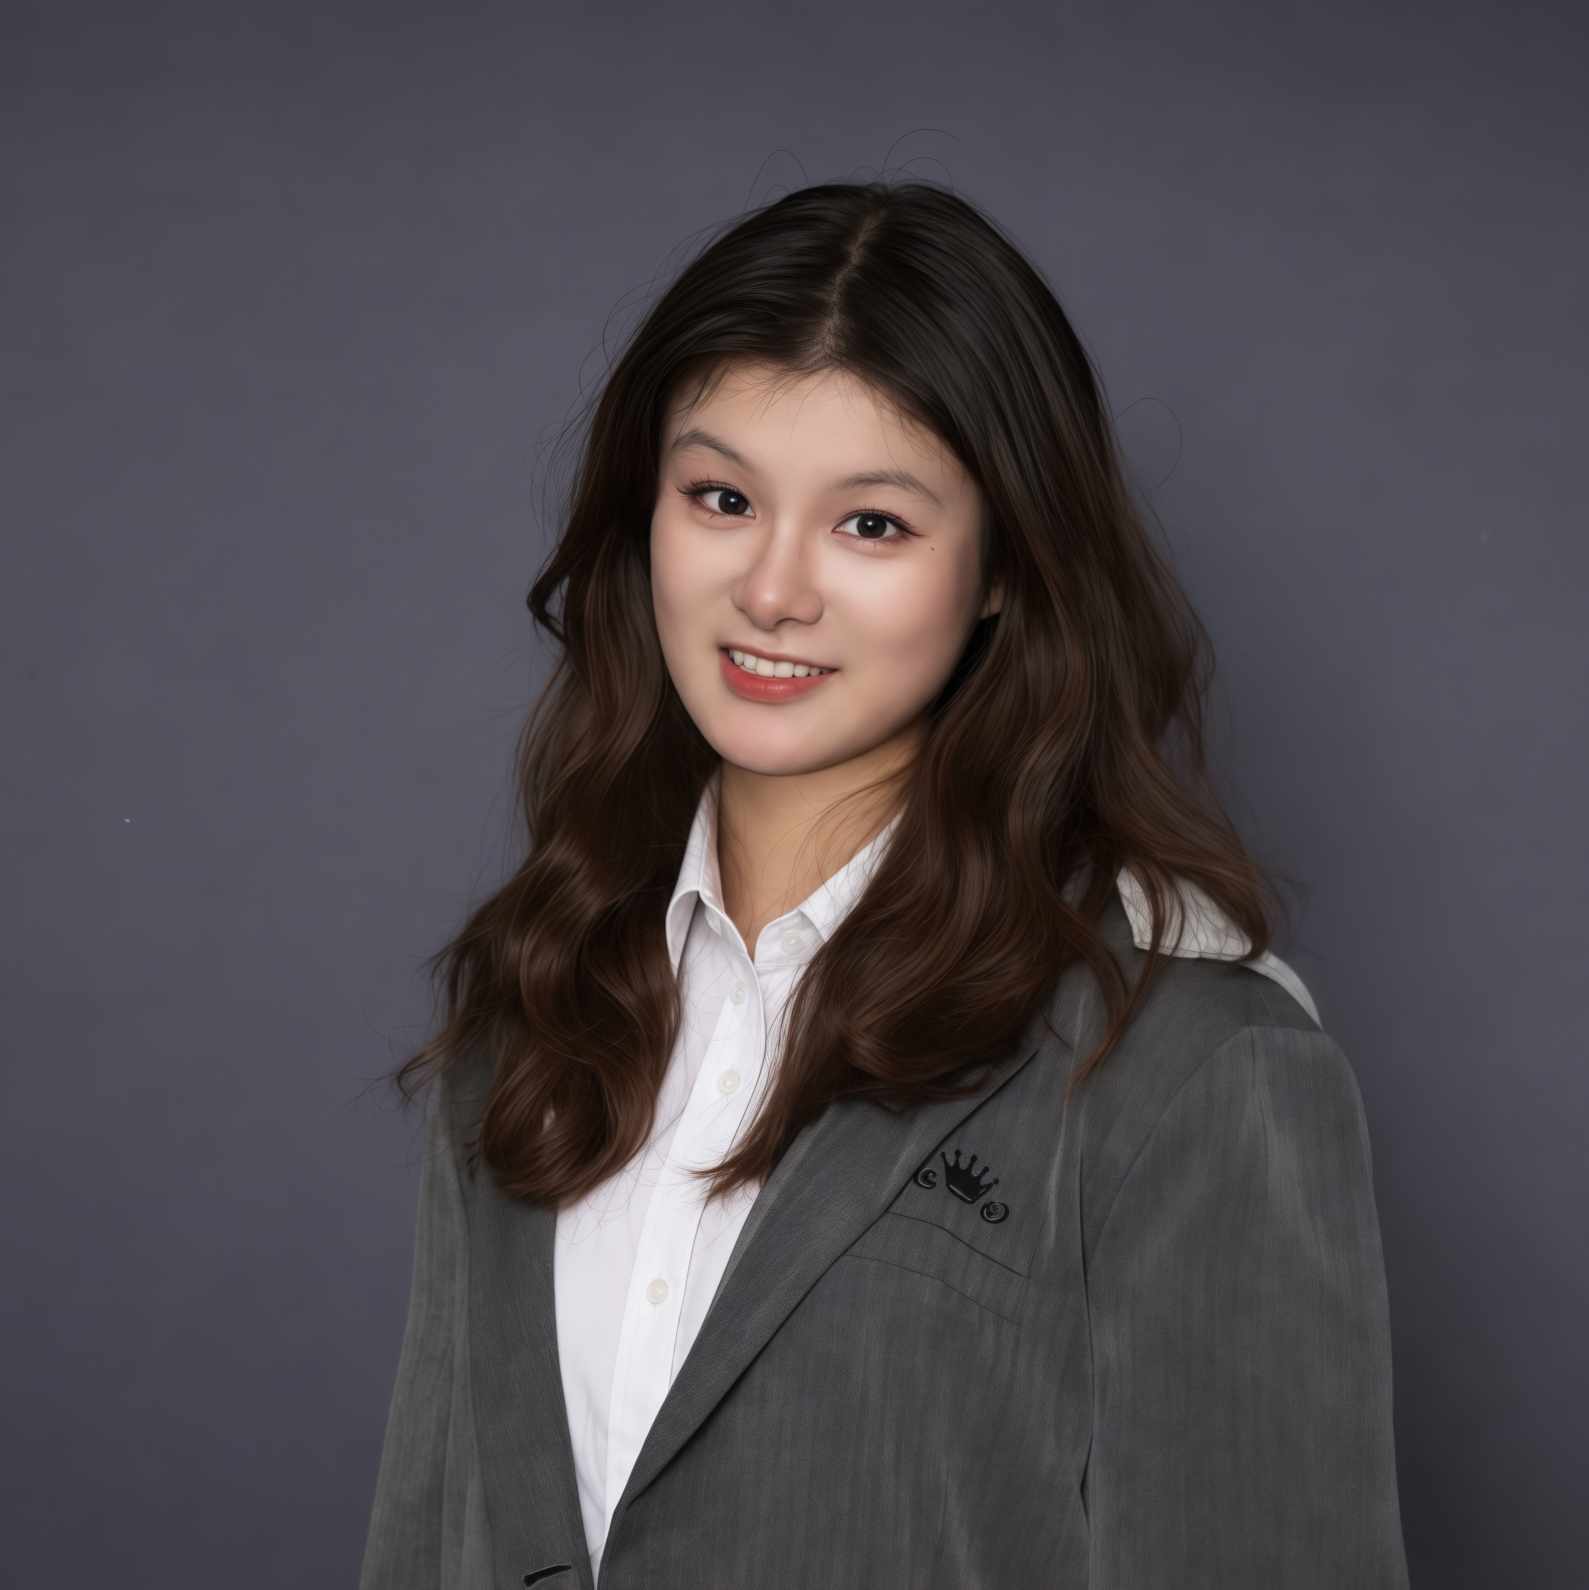
ROSE XU / UWCSEA DOVER
SL + HL
Hi, I’m Rose.
From UWCSEA Dover to Cornell
Personal website · https://xtrose29.github.io/
UWCSEA Dover
Cornell University
Graduated May 2024
Computer Science & Mathematics
Undergraduate
Expected graduation · May 2027
MY RESEARCH
Trustworthy AI
Uncertainty, factual accuracy and how we evaluate AI
Multimodal AI
Connecting language, images and intelligent agents
Tianruo Rose Xu
SimWorld / RT-SAFE
Rawlings Presidential
Research Scholar
Testing agent safety in a world that keeps moving
Rose’s supplied education dates; https://xtrose29.github.io/
02
Notes:
SCOPE: SL + HL
SAY
Before we start, a little about me. I'm Tianruo Rose Xu, and I graduated from UWCSEA Dover in May 2024. I'm now an undergraduate at Cornell studying computer science and mathematics, and I expect to graduate in May 2027. It's lovely to be back sharing some of what I've been working on since leaving Dover. My research focuses on AI we can understand and trust. One part asks whether AI systems know when they are uncertain, and how we can evaluate the accuracy of their answers. Another connects language, images, and agents that make decisions. In my recent SimWorld-related work on RT-SAFE, we test how safely an agent acts when the world keeps moving while it thinks. I'll show you a short example later. I'm also a Rawlings Presidential Research Scholar and a head teaching assistant for Introduction to Machine Learning. Today, I want to connect those research questions to your case study: how do we decide whether an AI-generated result is actually useful and reliable?
DO
Introduce yourself warmly. Point from UWCSEA to Cornell, then briefly walk through the three research areas.
SOURCES
Rose’s supplied education dates; https://xtrose29.github.io/

Slide 3
ROSE XU / UWCSEA DOVER
SL + HL
One question. Five steps.
Which image-generation workflow should Visionary Studios trust?
1
Brief & control
What must our image do?
2
How diffusion works
How does noise become an image?
3
Evidence & trust
What makes a result usable?
4
Model choices · HL
Which design fits the bottleneck?
ONE CAMPAIGN
Control → evidence → choice
5
Your recommendation
What should the studio pilot?
IB case study · Visionary Studios · original teaching framework
03
Notes:
SCOPE: SL + HL
SAY
Here is the route through today's talk. Keep one question in mind: which image-generation workflow should Visionary Studios trust for its campaign? First, we turn the client's brief into things we can control. Second, we open up diffusion and see how it makes an image. Third, we decide what evidence makes an output useful and responsible. Fourth, in the higher-level section, we compare model designs. Finally, you will recommend a pilot for the studio. Our reusable water bottle campaign is the running example for all five steps. The world demos each have one job: Genie raises the consistency question, Marble shows control over layout, and my SimWorld work shows why our tests must match the real task. They all lead back to the same studio decision.
DO
Use the route to connect the previous idea to the next decision.
SOURCES
IB case study · Visionary Studios · original teaching framework

Slide 4
ROSE XU / UWCSEA DOVER
SL + HL
01 Brief & control
02 How diffusion works
03 Evidence & trust
04 Model choices · HL
05 Your recommendation
Your brief: one campaign, many decisions
Visionary Studios · a fictional bottle campaign
01 · Advert
Match the brief
02 · Concept art
Explore alternatives
03 · Campaign
Repeat consistently
IB pp. 3, 7
04
Notes:
SCOPE: SL + HL
SAY
Visionary Studios wants to use generative AI for advertising, concept art, and digital media. We will use a fictional reusable-bottle campaign to make its choices concrete. The bottle on our opening slide is an AI-generated classroom example, not a real product photograph. We will also look beyond still images: at Google DeepMind's Genie, World Labs' Marble, and my SimWorld-related research. Each example gives us a different way to ask what an AI system can control and how we should test it. This is one combined lesson. We will build the shared foundations first, then compare model families. GANs and hybrids belong to the booklet's higher-level requirements; their slides are labelled so you can distinguish required knowledge from enrichment.
DO
Point to the campaign image, then the three deliverables.
SOURCES
IB pp. 3, 7

Slide 5

ROSE XU / UWCSEA DOVER
SL + HL
01 Brief & control
02 How diffusion works
03 Evidence & trust
04 Model choices · HL
05 Your recommendation
What if you could enter the image?
Google DeepMind · Genie 3 · official demonstration
01
Actions guide what comes
next
02
Does the world stay
consistent?
03
A demo is a starting point
for testing
Watch the short clip.
What would you test?
Google DeepMind · Genie 3 · Amazon aviator demo excerpt
deepmind.google/models/genie/ · recorded official demo; not a live interaction
05
Notes:
SCOPE: SL + HL
SAY
Imagine the image on your screen becomes somewhere you can explore. This is an excerpt from Google DeepMind's Genie 3 demonstration. Genie generates interactive worlds that respond to actions. As you watch the bird fly through the scene, choose one object or landmark and follow what happens to it. [WATCH] That is a different challenge from making one attractive still image. The next view must respond to movement while keeping the scene coherent. Our recording cannot let you control it; we are watching an official demonstration. A short impressive clip also cannot prove long-term consistency or accurate physics. What would you test if the camera turned around and returned to the same place? Keep that question in mind. For our studio's bottle campaign, the smaller version of the same problem is keeping a product recognizable across different views and backgrounds.
DO
Read to [WATCH], then stay silent for the 18-second clip. Resume with “That is a different challenge”. Invite students to track a landmark.
SOURCES
deepmind.google/models/genie/ · recorded official demo; not a live interaction

Slide 6
ROSE XU / UWCSEA DOVER
SL + HL
01 Brief & control
02 How diffusion works
03 Evidence & trust
04 Model choices · HL
05 Your recommendation
Learning ≠ generating
Watch what changes: the weights or the inputs?
TRAIN
Update weights
error → learning
USE
Prompt + noise
Weights fixed
IB pp. 3–6; foundational model papers
06
Notes:
SCOPE: SL + HL
SAY
Training is when a model changes its internal numerical parameters, usually called weights, using many examples. A training objective measures an error, and an optimization process updates those weights. Inference is when we use a trained model to produce an output. The weights are usually fixed during an ordinary generation request. A new prompt does not normally retrain the whole system. Think of learning to draw over several years versus making a drawing this afternoon. The analogy has limits: a neural network learns statistical structure, not a human life experience. Also, learning patterns does not guarantee that a model never memorizes training material. That possibility matters when we later discuss dataset curation and intellectual property.
DO
Trace training on the top row and inference on the bottom; only the top updates weights.
SOURCES
IB pp. 3–6; foundational model papers

Slide 7
ROSE XU / UWCSEA DOVER
SL + HL
01 Brief & control
02 How diffusion works
03 Evidence & trust
04 Model choices · HL
05 Your recommendation
Three ways to steer an image
Words · shapes · regions
TEXT
SKETCH
SEGMENTATION
“Teal bottle,
morning light”
Conditioning guides the result. Unconditional generation has no requested-content condition.
IB pp. 3–4, 8
07
Notes:
SCOPE: SL + HL
SAY
Conditional generation means that some supplied information guides the output. Text-to-image is one example: a prompt gives information about what we want. A class label such as landscape is a simpler condition. A sketch can guide shape, and a segmentation map can specify which image regions should contain which categories. Unconditional generation does not receive a requested subject or layout. It still uses a trained model and usually a random input, so unconditional does not mean that literally nothing goes into the computer. It means there is no external content condition of that kind. These are categories of tasks, not mutually exclusive model architectures. A diffusion model, for example, can be conditional or unconditional.
DO
Move from words to outline to region labels. Mention that unconditional generation has no requested-content condition.
SOURCES
IB pp. 3–4, 8

Slide 8
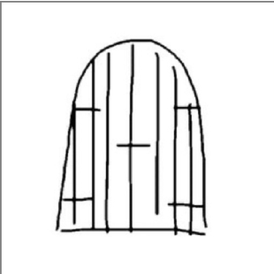
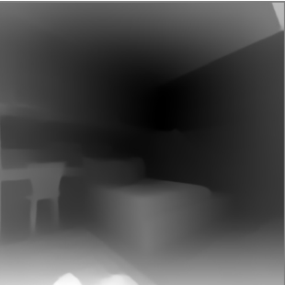
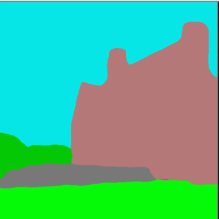
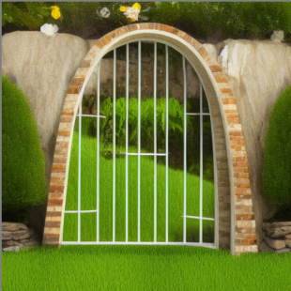
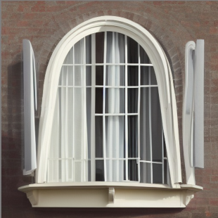
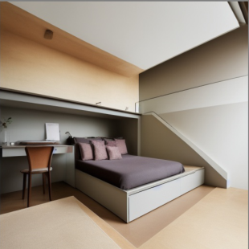
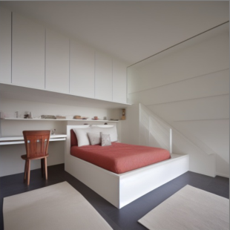
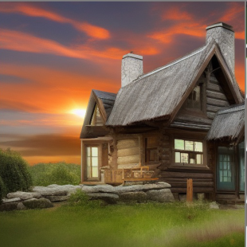
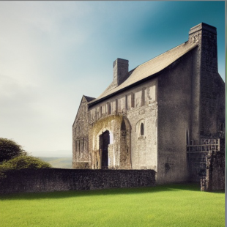
ROSE XU / UWCSEA DOVER
SL + HL
01 Brief & control
02 How diffusion works
03 Evidence & trust
04 Model choices · HL
05 Your recommendation
One condition. Several possible images.
ControlNet · published examples with empty text prompts
Sketch
Depth
Segmentation
Top: condition. Below: two generated possibilities.
Zhang, Rao & Agrawala (2023), ControlNet, Fig. 7 excerpts, p. 6 · arxiv.org/abs/2302.05543v3
08
Notes:
SCOPE: SL + HL
SAY
These are actual examples from the ControlNet paper. Each group begins with a different condition: a sketch, a depth map, or a segmentation map. The images underneath are generated outputs. In this particular experiment, the authors used empty text prompts, so the spatial condition supplies the guidance. Follow the house-shaped regions in the segmentation example. A segmentation map labels categories by region; its colors do not specify the final paint colors. The depth map instead supplies information about distance, while a sketch mainly supplies outlines. Notice that the same condition can lead to different plausible images. This connects to our studio brief: if the bottle must stay on the right, a spatial condition may be more useful than adding another adjective to the prompt. Image-to-image translation is the wider task of producing a related image from an input image. A plausible output still needs checking against what the client actually requested.
DO
Follow each input down to its two generated examples. Compare the segmentation colors with the generated house colors; do not call the input a photograph.
SOURCES
Zhang, Rao & Agrawala (2023), ControlNet, Fig. 7 excerpts, p. 6 · arxiv.org/abs/2302.05543v3

Slide 9
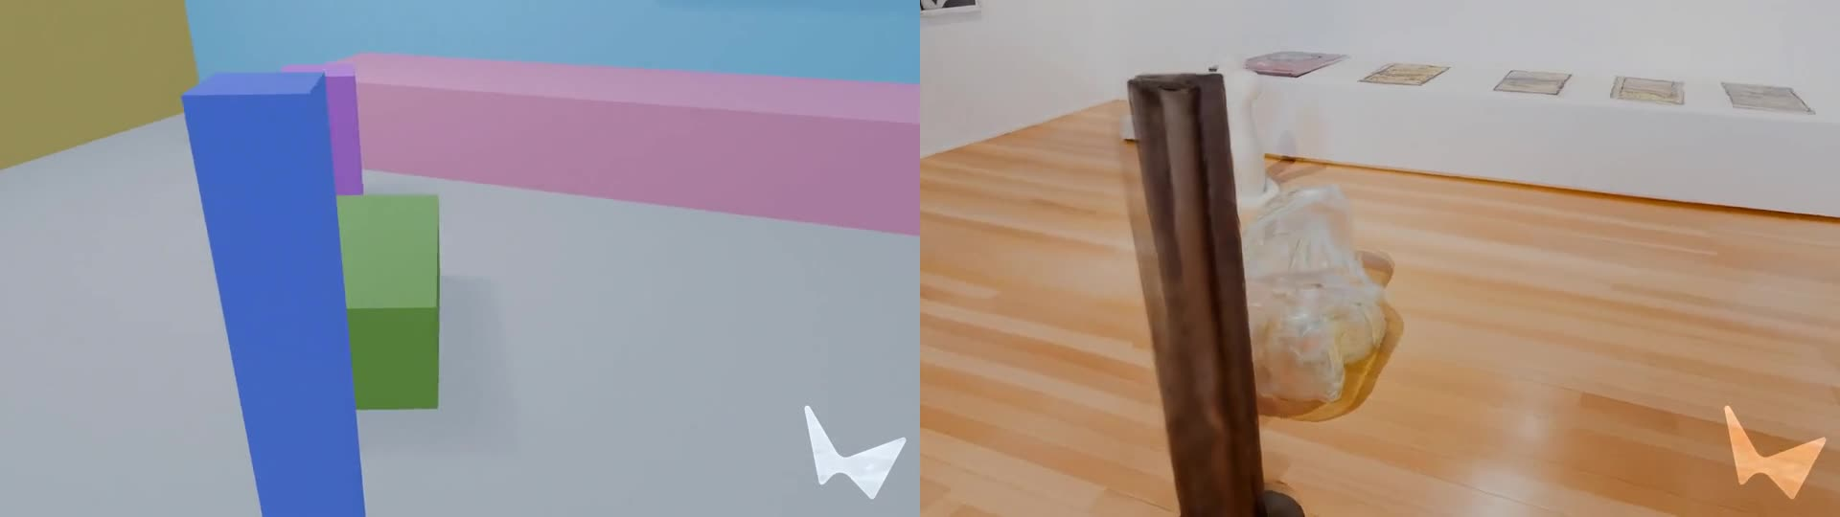
ROSE XU / UWCSEA DOVER
SL + HL
01 Brief & control
02 How diffusion works
03 Evidence & trust
04 Model choices · HL
05 Your recommendation
Build the layout. Then generate the world.
World Labs · Marble / Chisel · structure and appearance
COARSE 3D LAYOUT
GENERATED WORLD
Conditioning: specify structure and appearance, then check the result.
World Labs · Marble / Chisel · paired official gallery demonstration
worldlabs.ai/blog/marble-world-model · source demos shown side by side
09
Notes:
SCOPE: SL + HL
SAY
Text is useful, but what if you care exactly where things go? World Labs' Marble can generate a 3D world. Its Chisel tool lets you supply a rough 3D layout and a text description of the appearance. Here are two views from the official gallery example. Watch how the simple blocks relate to objects in the finished space. [WATCH] The useful distinction is structure versus style. The layout supplies spatial information; the prompt describes appearance. This is related to our segmentation-map example, although a 3D layout and a pixel-wise class map are different kinds of input. For our bottle brief, compare “make a cool advert” with “place one teal bottle on the right and leave the left side empty for a headline”. The second is easier to test. It still needs checking. When comparing results, change one condition at a time and record the prompt, model version, references, settings, and seed if available. A seed helps reproduce randomness within a compatible setup; it does not guarantee identity.
DO
Read to [WATCH]. Leave 10 seconds for the paired clip. Resume with “The useful distinction”. The recorded views illustrate a workflow, not our own controlled experiment.
SOURCES
worldlabs.ai/blog/marble-world-model · source demos shown side by side

Slide 10
ROSE XU / UWCSEA DOVER
SL + HL
01 Brief & control
02 How diffusion works
03 Evidence & trust
04 Model choices · HL
05 Your recommendation
02 / Open the model
We know what to ask for. How can a system make it?
Specify the result
Explain the mechanism
VISIONARY STUDIOS
IB case study · Visionary Studios · original teaching framework
10
Notes:
SCOPE: SL + HL
SAY
So far, we have described the result we want and the inputs that can guide it. Now we need the mechanism. How can a model turn random noise into a new image? Understanding diffusion will also explain a practical problem for our studio: why more generation steps can mean more waiting.
DO
Use the route to connect the previous idea to the next decision.
SOURCES
IB case study · Visionary Studios · original teaching framework

Slide 11
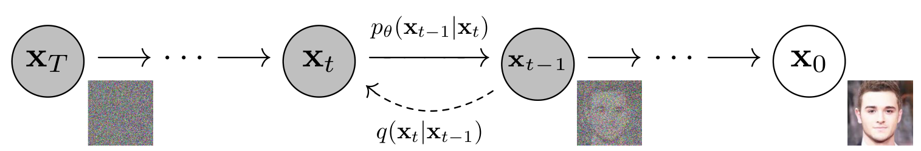
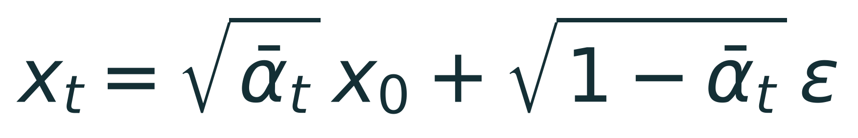
ROSE XU / UWCSEA DOVER
SL + HL
01 Brief & control
02 How diffusion works
03 Evidence & trust
04 Model choices · HL
05 Your recommendation
Diffusion: the paper behind the idea
DDPM · Ho, Jain & Abbeel (2020) · read the equation as “signal + noise”
ORIGINAL FIGURE 2 · learned generation runs left → right
FORWARD NOISING · sampling form of Eq. 4, typeset for this lesson
Our example: signal level = 0.64
0.8 × image + 0.6 × noise
x₀ · clean image
ε · random noise
ᾱₜ · signal level
The training example
A known training target
Controls the noise balance
Earlier diffusion foundation: Sohl-Dickstein et al. (2015), ICML. Equations are enrichment.
Ho, Jain & Abbeel (2020), DDPM, Fig. 2 (p. 2); Eq. 4 sampling form (p. 3) · arxiv.org/abs/2006.11239v2
11
Notes:
SCOPE: SL + HL
SAY
Here is Figure two from Ho, Jain, and Abbeel's DDPM paper. Earlier diffusion-model work appeared in 2015; this is the influential 2020 formulation. The diagram puts noise on the left and a clean image on the right. The forward process adds noise; generation follows learned reverse steps. Read the formula as signal plus noise. X zero is a clean training image, epsilon is random Gaussian noise, and x t is the corrupted image. Alpha bar controls the balance. In our numerical example, alpha bar is point six four, giving point eight times the image plus point six times the noise. These are scale factors, not percentages. During training, the noise is known, so a network can learn to predict it. The formula creates a training input; it is not itself the learned denoiser.
DO
Trace the diagram directions carefully. Point to the two equation terms and the numerical example. Students do not need to derive the formula.
SOURCES
Ho, Jain & Abbeel (2020), DDPM, Fig. 2 (p. 2); Eq. 4 sampling form (p. 3) · arxiv.org/abs/2006.11239v2

Slide 12
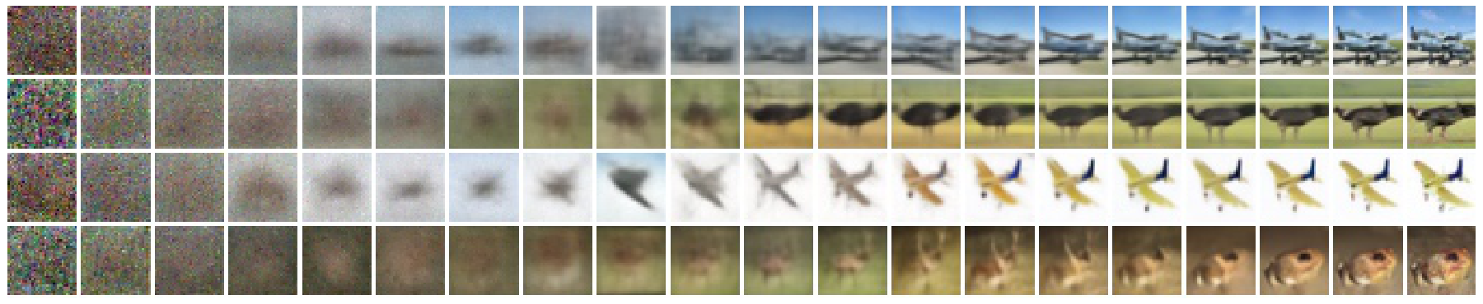
ROSE XU / UWCSEA DOVER
SL + HL
01 Brief & control
02 How diffusion works
03 Evidence & trust
04 Model choices · HL
05 Your recommendation
What generation looked like in the paper
DDPM · Figure 6 · actual published CIFAR-10 examples
Predicted clean images during sampling · read each row left → right
Original 32 × 32 CIFAR-10 examples, enlarged. These are clean-image estimates, not raw noisy states.
Early: broad structure
A published demonstration
Later: finer detail
Still test your own task and constraints
Ho, Jain & Abbeel (2020), Denoising Diffusion Probabilistic Models, Fig. 6, p. 7 · arxiv.org/abs/2006.11239v2
12
Notes:
SCOPE: SL + HL
SAY
These are the paper's published examples. Read each row from left to right: broad structure becomes recognizable before finer detail. The panels show predicted clean images during sampling, not the raw noisy states. Generation begins with fresh noise and repeatedly applies learned updates. The model is producing a new sample, not recovering an original photograph hidden in the noise. These small CIFAR-ten examples demonstrate a mechanism; they do not establish that a modern advertising brief will be followed.
DO
Follow one row across the original figure. Emphasize predicted clean image versus noisy state. The original examples are 32 × 32 pixels; enlargement adds no detail.
SOURCES
Ho, Jain & Abbeel (2020), Denoising Diffusion Probabilistic Models, Fig. 6, p. 7 · arxiv.org/abs/2006.11239v2

Slide 13
ROSE XU / UWCSEA DOVER
SL + HL
01 Brief & control
02 How diffusion works
03 Evidence & trust
04 Model choices · HL
05 Your recommendation
How a CNN sees local patterns
A filter moves; its weights are reused
Local patch
Shared filter
Feature map
Noisy state + timestep + optional condition → denoiser
IB p. 4; Peebles & Xie, Diffusion Transformers
13
Notes:
SCOPE: SL + HL
SAY
The denoiser is a neural network, not a hand-written list of rules for drawing leaves and bottles. Your booklet describes a convolutional neural network, or CNN. A convolution applies learned filters across local image regions. Reusing a filter lets the network detect useful patterns at different positions. Multiple layers combine simpler patterns into more complex features. A common diffusion network has a U-Net structure, which processes information at several spatial scales. Keep one qualification in mind: diffusion is the generation method, while a CNN is a possible network architecture inside it. Research also uses transformer denoisers. For this case study, understand the CNN explanation, but avoid claiming that every diffusion system must use a CNN or that every commercial image product has the same internal design.
DO
Trace the outlined local patch into the filter and then the feature map.
SOURCES
IB p. 4; Peebles & Xie, Diffusion Transformers

Slide 14
ROSE XU / UWCSEA DOVER
SL + HL
01 Brief & control
02 How diffusion works
03 Evidence & trust
04 Model choices · HL
05 Your recommendation
Quick check: what changes the model?
Choose before revealing your answer.
A · A user changes a prompt
B · Training updates the weights
C · A user chooses another random seed
PAUSE → choose → explain why
IB pp. 3–4
14
Notes:
SCOPE: SL + HL
SAY
Which of these directly describes learning in the model: changing the prompt, updating weights during training, or choosing another seed? Pause and choose, then explain why. [Pause for discussion.] The answer is B. A different prompt changes the condition. A different seed changes the random starting state. Neither necessarily changes the learned weights. There are workflows that fine-tune a model, which do update weights, but that is a separate operation from an ordinary generation request. Second question: does a text-to-image diffusion model count as conditional? Yes. Text supplies a condition. If you can explain those two distinctions, you already have a strong foundation for the rest of the case study.
DO
Pause before saying the answer.
SOURCES
IB pp. 3–4

Slide 15
ROSE XU / UWCSEA DOVER
SL + HL
01 Brief & control
02 How diffusion works
03 Evidence & trust
04 Model choices · HL
05 Your recommendation
03 / Test the whole workflow
An attractive image is a candidate. Approval needs evidence.
Generate a candidate
Decide whether it works
VISIONARY STUDIOS
IB case study · Visionary Studios · original teaching framework
15
Notes:
SCOPE: SL + HL
SAY
We now have the mechanism: a trained network helps turn noise into structure through repeated updates. But our client needs a campaign, not just one successful sample. In this section, we follow the image through cost, consistency, data, and review. At the end, SimWorld will show why choosing the right test matters even beyond image generation.
DO
Use the route to connect the previous idea to the next decision.
SOURCES
IB case study · Visionary Studios · original teaching framework

Slide 16
ROSE XU / UWCSEA DOVER
SL + HL
01 Brief & control
02 How diffusion works
03 Evidence & trust
04 Model choices · HL
05 Your recommendation
Why can one image take so much compute?
Repeated denoiser evaluations add up.
40
20
sampling steps
sampling steps
≈ 3.2 seconds
≈ 1.6 seconds
Assume 0.08 s / step. Other costs omitted. Fewer steps may affect quality.
Illustrative arithmetic · not measured performance
IB pp. 4, 6; illustrative calculation
16
Notes:
SCOPE: SL + HL
SAY
A simple way to reason about diffusion cost is to multiply the number of sampling steps by the time per step, then remember that other work also takes time. If one denoiser evaluation took eight hundredths of a second, forty evaluations would take about three point two seconds. Twenty would take about one point six seconds. Those numbers are invented for arithmetic, not measurements of a product. Fewer steps can reduce latency, but the effect on image quality depends on the model and sampler. Higher resolution and larger models can also increase compute and memory demands. Training cost is a different budget again. Visionary Studios may use a pretrained service rather than train a large model from scratch, but it still needs to account for generation volume and review time.
DO
SOURCES
IB pp. 4, 6; illustrative calculation

Slide 17
ROSE XU / UWCSEA DOVER
SL + HL
01 Brief & control
02 How diffusion works
03 Evidence & trust
04 Model choices · HL
05 Your recommendation
Count approved images
Generation is only one part of the workflow
REVIEW + REVISE
Drafts → review → approved assets · classroom illustration
IB pp. 4, 6–7; lesson workflow analysis
17
Notes:
SCOPE: SL + HL
SAY
Suppose system A generates an image twice as quickly as system B, but most of A's outputs fail the brief. Which system saves the studio time? You cannot answer from generation speed alone. Measure the cost and time per approved asset, including rejected outputs and human edits. Low-resolution drafts can help during exploration, with a more expensive final render only after a direction is chosen. Batching may improve throughput, meaning images produced per unit time, even if one person's request waits longer. Efficient samplers and smaller or compressed representations can help, but each needs testing. The company should also consider hardware memory, energy use, service availability, and the cost of maintaining a workflow as demand grows.
DO
Follow the rejected drafts through review to approved outputs; no timing benchmark is depicted.
SOURCES
IB pp. 4, 6–7; lesson workflow analysis

Slide 18
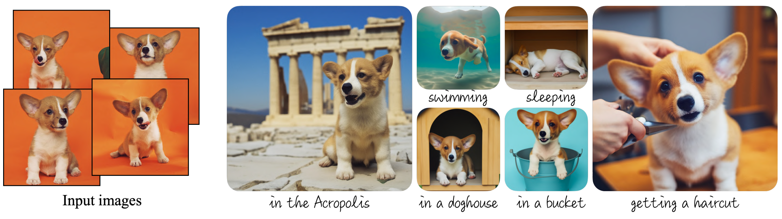
ROSE XU / UWCSEA DOVER
SL + HL
01 Brief & control
02 How diffusion works
03 Evidence & trust
04 Model choices · HL
05 Your recommendation
Same subject. Different scenes.
DreamBooth · a real personalization example
Identity: which subject?
Style: how is it rendered?
Ruiz et al. (2023), DreamBooth, Fig. 1, p. 1 · arxiv.org/abs/2208.12242v2
18
Notes:
SCOPE: SL + HL
SAY
Here is a more concrete consistency example from the DreamBooth paper. The photographs on the left are reference images of one dog. The images on the right place that subject in different situations. DreamBooth fine-tunes a pretrained model using subject images; this is different from simply changing a prompt with fixed weights. Look for the dog's defining features as the scene changes. Character consistency asks whether we recognize the same subject. Style adherence asks whether the visual treatment matches what we requested. An embedding-based approach uses numerical representations to convey or compare information such as identity or style, but an embedding is not a guarantee of sameness. DreamBooth is one personalization example, not a synonym for every embedding-based method. For our bottle campaign, make a reference sheet, then test shape, cap and loop across several backgrounds and lighting conditions. Published successful examples show what is possible; your studio still needs a systematic test, including failures.
DO
Point from the reference photos to the new contexts. Ask what identifies this particular dog. Separate identity from artistic style.
SOURCES
Ruiz et al. (2023), DreamBooth, Fig. 1, p. 1 · arxiv.org/abs/2208.12242v2

Slide 19
ROSE XU / UWCSEA DOVER
SL + HL
01 Brief & control
02 How diffusion works
03 Evidence & trust
04 Model choices · HL
05 Your recommendation
Build a test sheet
One brief · several outputs · five criteria
Quality
Matches the brief
Consistency
Same identity / style
Efficiency
Time / accepted asset
Stability
Training evidence
Judge the set, not the winner.
Flexibility
New briefs / larger loads
IB p. 6
19
Notes:
SCOPE: SL + HL
SAY
The booklet gives us output quality, computational efficiency, training stability, flexibility and scalability, and consistency. Turn each into a test. Give candidate systems the same briefs and ask reviewers to assess them without knowing which model produced which image. Check identity and style across sets. Log latency, memory where available, rejection rate, and cost. Test easy and difficult prompts, rather than only the most photogenic ones. Training stability means whether learning behaves reliably across runs; do not confuse it with consistently drawing the same face. If the studio only has access to a hosted model, it may need documentation or provider evidence about training behavior. It can directly measure output behavior, but should not claim to have observed a training process it never saw.
DO
Choose one row of the blank evaluation sheet and say what evidence belongs there.
SOURCES
IB p. 6

Slide 20
ROSE XU / UWCSEA DOVER
SL + HL
01 Brief & control
02 How diffusion works
03 Evidence & trust
04 Model choices · HL
05 Your recommendation
Curate before you train
Quality · labels · duplicates · provenance
Clean
Label
Document
copy A
copy A
“red shoe”
source: ?
Separate evaluation data before testing. · illustrative records
IB pp. 6–7
20
Notes:
SCOPE: SL + HL
SAY
Look at the illustrated inbox: repeated images, a mismatched label, and an item with no recorded source. These are classroom examples of issues to catch before training. Dataset curation means deliberately selecting, cleaning, organizing, and documenting the examples a model learns from. For Visionary Studios, that could mean approved product photographs, accurate captions, and documented permissions. Remove corrupt files, misleading labels, inappropriate personal data, and unnecessary duplicates. Keep track of where images came from and what uses are allowed. A large dataset can still omit important groups or situations. It can also contain repeated images that dominate learning. For evaluation, keep suitable examples separate from training so that success does not simply reflect memorization. If a vendor supplies the model, the studio should ask what evidence the vendor provides about data practices. Lack of visibility is itself part of the decision, rather than a reason to assume that everything is fine.
DO
Point to the duplicate, mismatched label and unknown source before the curated set.
SOURCES
IB pp. 6–7

Slide 21
ROSE XU / UWCSEA DOVER
SL + HL
01 Brief & control
02 How diffusion works
03 Evidence & trust
04 Model choices · HL
05 Your recommendation
Who—or what—is missing?
An audit loop, illustrated with a fictional dataset
Coverage now
Coverage to investigate
Inspect
Revise → retest → listen
Fictional situations, not demographic data or measured model outputs.
IB pp. 6–7; lesson scenario
21
Notes:
SCOPE: SL + HL
SAY
The colored tiles are a fictional coverage audit, not measured outputs or demographic categories. A small collection can repeatedly cover the same situations while missing others. Imagine asking for an engineer, a nurse, or a successful entrepreneur. If the outputs repeatedly connect those roles with one demographic group, a campaign may reinforce stereotypes or exclude its audience. Bias mitigation starts with asking which representation matters for the intended use. Review datasets and test varied prompts across relevant groups and contexts. Then improve data coverage, captions, model behavior, or review procedures, and test again. Changing a prompt can improve one image without fixing the underlying pattern. Likewise, a balanced count in a dataset is not proof that every output is fair. Use both measurable checks and feedback from people affected by the images. The studio should report the scope of its tests and remaining limitations, rather than claiming to have removed all bias.
DO
Compare repeated colored tiles with broader coverage. Colors represent arbitrary situations, not groups of people.
SOURCES
IB pp. 6–7; lesson scenario

Slide 22
ROSE XU / UWCSEA DOVER
SL + HL
01 Brief & control
02 How diffusion works
03 Evidence & trust
04 Model choices · HL
05 Your recommendation
Follow the image’s journey
Three places to check rights
DATA
OUTPUT
CLIENT USE
source / permission
similarity / rights
consent / terms
A cleared input does not automatically clear every output or use.
IB p. 6; IPOS computational data analysis guidance; US Copyright Office AI reports
22
Notes:
SCOPE: SL + HL
SAY
The case study emphasizes avoiding problematic copyrighted training material. A practical starting point is a curated collection the studio owns or is licensed to use for the intended purpose. But the wider legal question is more nuanced than saying that all copyrighted training material is always forbidden. Rules and exceptions depend on jurisdiction and facts. For example, Singapore's Intellectual Property Office describes a computational data analysis exception with conditions, including lawful access. That does not automatically clear every generated output for advertising. Keep three questions separate: the use of training inputs, rights in or risks from the resulting image, and the intended client use. Also consider privacy, consent, trademarks, contracts, and disclosure. This is a decision framework for the case study, not a universal legal conclusion.
DO
Follow dataset → generated image → client use; name the different check at each stage.
SOURCES
IB p. 6; IPOS computational data analysis guidance; US Copyright Office AI reports

Slide 23
ROSE XU / UWCSEA DOVER
SL + HL
01 Brief & control
02 How diffusion works
03 Evidence & trust
04 Model choices · HL
05 Your recommendation
Show how the image was made
Disclosure + a production record
Prompt
AI-GENERATED CONCEPT
Model + version
References + edits
Named reviewer
A label + a traceable workflow
IB p. 6; lesson production disclosure
23
Notes:
SCOPE: SL + HL
SAY
Transparency means giving people meaningful information about how content was made. For a concept pitch, the studio might label an image as AI-generated concept art and explain which parts a designer edited. For an image that looks like documentary evidence, disclosure becomes especially important because viewers might mistake a fictional scene for something that happened. Keep records of the model, version, prompts, references, and edits so the team can investigate a problem later. A label does not repair a misleading claim, remove bias, or settle copyright questions. It supports accountability alongside those other checks. Notice that we are applying the same principle here: the bottle is identified as AI-generated and the paper figures have citations and our own diagrams are labelled as teaching examples.
DO
Point to the visible concept label, then prompt/version/reference/reviewer fields.
SOURCES
IB p. 6; lesson production disclosure

Slide 24
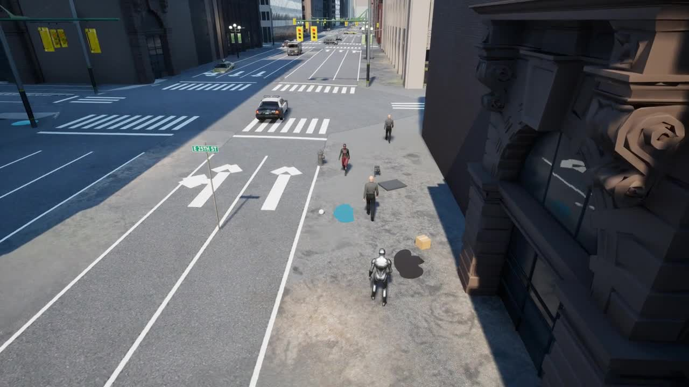
ROSE XU / UWCSEA DOVER
SL + HL
01 Brief & control
02 How diffusion works
03 Evidence & trust
04 Model choices · HL
05 Your recommendation
SimWorld: the world moves while AI thinks
My RT-SAFE research · from attractive scenes to agent evaluation
01
Observe the current
scene
02
Think while the world
moves
03
Act on information that
may be old
Watch the short clip.
What would you test?
Rose Xu · RT-SAFE project media · illustrative Unreal Engine city scene
xtrose29.github.io/RT-SAFE/ · illustrative footage, not a benchmark result
24
Notes:
SCOPE: SL + HL
SAY
Our studio examples show that realism, consistency, and safe use are different things. My own research takes that evaluation problem into a moving world. In my SimWorld-related work on RT-SAFE, we study agents making decisions in a simulated urban environment. Imagine a robot observes a crossing and spends several seconds deciding what to do. Does the world politely pause while it thinks? In a real street, it does not. Watch this city scene and notice what changes while you are looking. [WATCH] By the time a decision is executed, a pedestrian or vehicle may have moved. So we care about the timing of a decision as well as the action selected. This footage comes from my project's illustrative Unreal Engine city materials. It is a simulation, and this clip is not a measured benchmark run. We are not claiming that Genie or Marble generated this city. The research connection is the question we ask: what evidence would show that an AI system works reliably in the conditions where we want to use it?
DO
Read to [WATCH]. Stay silent for the 12-second city clip. Resume with “By the time”. Stress the difference between illustrative footage and experimental evidence.
SOURCES
xtrose29.github.io/RT-SAFE/ · illustrative footage, not a benchmark result

Slide 25
ROSE XU / UWCSEA DOVER
SL + HL
01 Brief & control
02 How diffusion works
03 Evidence & trust
04 Model choices · HL
05 Your recommendation
Three worlds. Three tests.
Match the evidence to the claim
GENIE
MARBLE
SIMWORLD
Revisit a landmark?
Match the layout?
Act safely in time?
Different claims need different tests.
Google DeepMind Genie 3; World Labs Marble; Rose Xu RT-SAFE project
25
Notes:
SCOPE: SL + HL
SAY
These examples share a visual theme, but their outputs and evaluation questions differ. Genie demonstrates action-responsive generated worlds. Marble produces a 3D representation you can inspect from different viewpoints. Our SimWorld-related work evaluates agent behavior in simulation. We should not assume they share one architecture or treat a realistic image as evidence of reliable geometry or physics. For Genie, one useful test would revisit a landmark. For Marble, compare the generated layout with the requested structure. For an agent, test actions when the environment changes during its decision. These are proposed tests, not results established by the clips. The same habit applies to Visionary Studios: evaluate identity, usable composition, cost, and failure rates across many outputs. In my research, and in an independent collaboration with mentorship from an Oracle Cloud scientist, careful evaluation is a recurring concern. A good-looking example gets our attention; a well-designed test tells us what to trust. That is why these three projects belong in our story: they connect control, consistency, and evaluation to the same studio decision.
DO
Point to each real demo poster and ask its one test question.
SOURCES
Google DeepMind Genie 3; World Labs Marble; Rose Xu RT-SAFE project

Slide 26
ROSE XU / UWCSEA DOVER
HL TRANSITION
01 Brief & control
02 How diffusion works
03 Evidence & trust
04 Model choices · HL
05 Your recommendation
04 / Choose a model for a reason
HL model comparison · keep the studio brief and test sheet in view
Know the failure to measure
Choose a design to test
VISIONARY STUDIOS
IB pp. 3–7; lesson synthesis
26
Notes:
SCOPE: HL TRANSITION
SAY
Our evidence checklist tells us what success means. It does not yet tell us which model design to choose. That is the purpose of the next section, which covers the higher-level material in the case study. We will compare GANs, compressed latent representations, reversible flows, and hybrids by asking what each component does and what trade-off it introduces. Standard-level students can treat this as enrichment, or use the chapter markers to rejoin us at Your recommendation. Whichever route you take, our final task stays the same: advise the studio using evidence.
DO
Connect the test sheet to the model choice. The final recommendation is shared SL + HL.
SOURCES
IB pp. 3–7; lesson synthesis

Slide 27

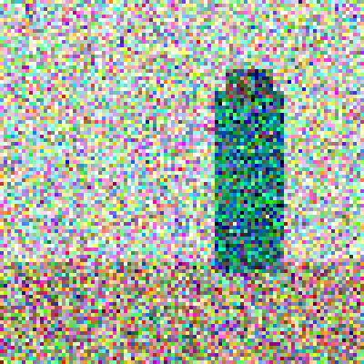

ROSE XU / UWCSEA DOVER
HL ONLY
01 Brief & control
02 How diffusion works
03 Evidence & trust
04 Model choices · HL
05 Your recommendation
Choose a route to an image
HL · same brief, different trade-offs
DIFFUSION
GAN
HYBRID
Refine
Compete
Combine
Mechanism first. Trade-off second.
IB pp. 5, 7–8
27
Notes:
SCOPE: HL ONLY
SAY
We now reach the higher-level model comparison within our combined lesson. Your booklet asks you to go deeply into diffusion, GANs, and hybrid models, with a broad understanding of variational autoencoders and flow-based models. We will keep the mathematical detail light, but be precise about what each part does. Diffusion improves a sample over a sequence of denoising steps. A GAN uses a different training setup: two networks with competing objectives. A hybrid combines useful components or objectives. Do not assume the most complicated option is the best. Our question is still whether a particular design helps Visionary Studios meet a measurable need.
DO
Preview the three mechanism sketches without ranking all models universally.
SOURCES
IB pp. 5, 7–8

Slide 28
ROSE XU / UWCSEA DOVER
HL ONLY
01 Brief & control
02 How diffusion works
03 Evidence & trust
04 Model choices · HL
05 Your recommendation
GAN: two networks, opposing objectives
Goodfellow et al. (2014) · the original minimax objective
ORIGINAL EQUATION 1 · read the roles before the symbols
G · generator
D · discriminator
E · expectation
Random vector → image
Minimizes this objective
Scores real vs. generated
Maximizes this objective
Average over examples
Real data + generated data
Training: update both networks. Generation: normally use the trained G.
This is the foundational minimax form; the paper also discusses an alternative generator loss.
Goodfellow et al. (2014), Generative Adversarial Nets, Eq. 1, p. 3 · arxiv.org/abs/1406.2661v1
28
Notes:
SCOPE: HL ONLY
SAY
This equation is copied from the original GAN paper by Ian Goodfellow and colleagues. You do not need to calculate the logarithms. Look first at the two players. G is the generator: it transforms a random vector z into an image. D is the discriminator: it scores whether an image came from the real data. The first term concerns real examples, while the second concerns generated examples. The expectation symbols mean averages over samples. Max D says the discriminator tries to increase this objective, while min G says the generator tries to decrease it. The competing objectives provide learning signals for both networks. In practice the paper also describes a different generator loss that gives stronger gradients early in training, so this displayed objective is the foundational idea, not every implementation. At generation time, the basic GAN normally needs only its trained generator. The discriminator is a training partner, not a permanent approval system. Its score does not verify product accuracy, fairness, or copyright clearance.
DO
Read min G / max D aloud, then point to the real-data and generated-data terms. Explain the averages verbally; no calculus is required.
SOURCES
Goodfellow et al. (2014), Generative Adversarial Nets, Eq. 1, p. 3 · arxiv.org/abs/1406.2661v1

Slide 29
ROSE XU / UWCSEA DOVER
HL ONLY
01 Brief & control
02 How diffusion works
03 Evidence & trust
04 Model choices · HL
05 Your recommendation
A noise vector is a list of numbers
A small input can generate a whole image
0.2
−1.1
0.7
…
D values
Generator
Latent input values ≠ output pixels · teaching schematic
IB p. 5
29
Notes:
SCOPE: HL ONLY
SAY
The phrase D-dimensional noise vector sounds more intimidating than it is. A vector is an ordered list of numbers, and D tells you how many numbers are in that list. For example, the generator might receive a hundred random values. They are not a hundred output pixels. A learned function transforms them into an entire image. Changing the vector can change the result, but individual coordinates do not necessarily correspond to neat controls such as smile, color, or camera angle. In a conditional GAN, additional information such as a class label or image can also guide generation. So GAN is an architectural and training idea, while conditional describes what information the generation process receives.
DO
Follow random values → generator → picture. D counts input values, not pixels.
SOURCES
IB p. 5

Slide 30
ROSE XU / UWCSEA DOVER
HL ONLY
01 Brief & control
02 How diffusion works
03 Evidence & trust
04 Model choices · HL
05 Your recommendation
Six inputs. Six lookalikes?
Mode collapse: plausible images, limited variety
Useful variety
Mode collapse
Original teaching drawings: many inputs can still produce very similar outputs.
IB p. 5; Salimans et al., Improved Techniques for Training GANs
30
Notes:
SCOPE: HL ONLY
SAY
Suppose a generator discovers one kind of bottle image that repeatedly fools the discriminator. If it keeps returning variations of that same result, it may neglect other patterns in the training data. That is mode collapse: insufficient diversity, even when individual images appear sharp. Training instability is broader. The networks may oscillate, one may dominate, or progress may be unreliable. A weak discriminator can give poor guidance, while an overly strong discriminator can make learning difficult under some objectives. Potential mitigations include better-balanced update schedules, appropriate learning rates, regularization, and methods that reward diversity. None is an automatic cure. For the studio, inspect batches and diverse prompts, and track training runs when training is within scope. Do not judge a GAN from its best sample.
DO
Compare the two sample grids. They are deliberately constructed teaching drawings.
SOURCES
IB p. 5; Salimans et al., Improved Techniques for Training GANs

Slide 31
ROSE XU / UWCSEA DOVER
HL ONLY
01 Brief & control
02 How diffusion works
03 Evidence & trust
04 Model choices · HL
05 Your recommendation
Compress, sample, reconstruct
VAE · a probabilistic latent representation
Encoder
Decoder
Sample z
Reconstruction + regularization · teaching schematic, not model output
IB p. 5; Kingma & Welling, Auto-Encoding Variational Bayes
31
Notes:
SCOPE: HL ONLY
SAY
We have seen the GAN approach. A different design asks whether we can work in a compact representation. Follow the picture from left to right: image, compact representation, reconstruction. The dots suggest a distribution over codes. The missing loop is an illustrative reconstruction error, not a measured model result. A variational autoencoder, or VAE, has an encoder and a decoder. The encoder maps an image to a distribution over latent codes, rather than simply storing a perfect copy of the image. A code is sampled and the decoder reconstructs an image. Training balances reconstruction with a regularization term that encourages a structured latent distribution. That makes sampling and interpolation possible. You can think of latent space as a compressed working space for useful image information, although its coordinates are learned and need not have tidy human meanings. The compression is generally lossy. A basic VAE can lose fine detail, depending on its design and objective. Its value in a hybrid is often the compact representation, not a promise that it always makes the sharpest final image.
DO
Trace the compression path and sampled latent code; explain that reconstruction can lose detail.
SOURCES
IB p. 5; Kingma & Welling, Auto-Encoding Variational Bayes

Slide 32
ROSE XU / UWCSEA DOVER
HL ONLY
01 Brief & control
02 How diffusion works
03 Evidence & trust
04 Model choices · HL
05 Your recommendation
A reversible change of coordinates
Flow · forward and inverse transforms
f
f⁻¹
Simple distribution
Transformed distribution
Original schematic: reversible coordinates do not guarantee interpretable meaning.
IB p. 5; Dinh et al., Real NVP
32
Notes:
SCOPE: HL ONLY
SAY
A VAE generally loses information when it compresses. What if a design needs a reversible mapping instead? The two point clouds are an original schematic of a reversible mapping. The arrows show the two directions; they are not before-and-after research measurements. A flow-based model learns an invertible transformation between a simple distribution and a more complex data distribution. In principle, we can map a represented input forward and invert the mapping to recover its starting point, subject to numerical precision and preprocessing. This differs from the generally lossy compression in a VAE. It can also support exact density calculations under the model's assumptions. But an exact mapping is not the same as perfect realism, fairness, or a human-readable explanation of why a scene looks a certain way. Reproducibility still requires the model, input, and implementation settings. Some newer generation methods use the word flow in other ways; for the booklet, focus on its described invertible model and the practical strengths and constraints of that design.
DO
Follow both arrows. Reversible coordinates do not imply interpretable meaning.
SOURCES
IB p. 5; Dinh et al., Real NVP

Slide 33
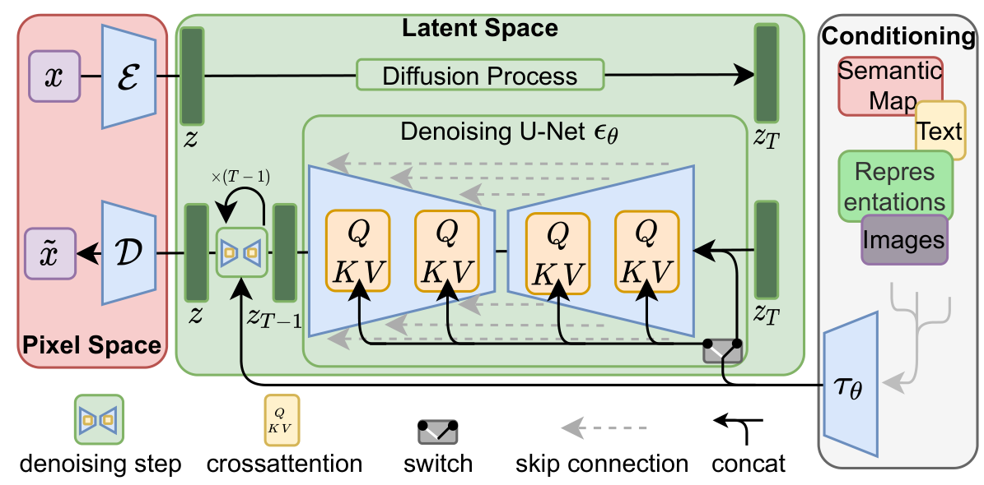
ROSE XU / UWCSEA DOVER
HL ONLY
01 Brief & control
02 How diffusion works
03 Evidence & trust
04 Model choices · HL
05 Your recommendation
Latent diffusion: read a real architecture
Rombach et al. (2022) · Figure 3 · High-Resolution Image Synthesis
01 · Represent
Pink: encode / decode pixels
02 · Generate
Green: denoise in latent space
03 · Condition
Right: guide with text or maps
Text-to-image sampling
starts from latent noise.
Original Figure 3, cropped to the diagram. Reading hints at right are ours.
Rombach et al. (2022), High-Resolution Image Synthesis with Latent Diffusion Models, Fig. 3, p. 4 · arxiv:2112.10752v2
33
Notes:
SCOPE: HL ONLY
SAY
Now we can connect the model comparison back to diffusion: generate in a compact space, then decode an image. This is Figure three from the latent-diffusion paper by Robin Rombach and colleagues. The figure is reproduced from the paper; the three reading hints beside it are ours. Start with the pink pixel-space section. The encoder E compresses an image into a latent representation, and the decoder D maps a latent representation back to pixels. The large green section shows diffusion working in that smaller representation. On the right, conditioning can bring in information such as text or a semantic map. You do not need to unpack the attention matrices today. Notice that the diagram includes representation learning as well as generation. For text-to-image sampling, we start from latent noise; we do not need an input photograph for the encoder. Denoising updates the latent, then the decoder makes the image. This is a concrete hybrid: different components perform different jobs. The smaller working space can reduce computation, but compression may lose useful detail. Test both the saving and the output quality on the studio's actual brief.
DO
Point to pink → green → right conditioning, then describe generation as latent noise → denoiser → decoder. D here means decoder; D on the GAN slide meant discriminator.
SOURCES
Rombach et al. (2022), High-Resolution Image Synthesis with Latent Diffusion Models, Fig. 3, p. 4 · arxiv:2112.10752v2

Slide 34
ROSE XU / UWCSEA DOVER
HL ONLY
01 Brief & control
02 How diffusion works
03 Evidence & trust
04 Model choices · HL
05 Your recommendation
Give each component a job
A useful hybrid earns its extra complexity
Represent
Generate
Decode
Compact code
Latent denoising
Back to pixels
Added component → measurable benefit?
IB pp. 5–7; foundational model papers
34
Notes:
SCOPE: HL ONLY
SAY
When evaluating a hybrid, name the job of every component. A VAE can provide a compact latent representation. Diffusion can generate in that representation. An adversarial objective can encourage perceptual realism, but may introduce the stability problems associated with adversarial training. A flow component could provide an invertible transformation where that property is useful, but it does not automatically make the whole pipeline reversible. If another stage discards information, the full system still loses information. The right evaluation compares the combination with a simpler baseline using the same tasks and budget. Ask whether the added component improves quality, control, efficiency, or consistency enough to justify more training, maintenance, and debugging. A hybrid is a design choice with trade-offs, not a guarantee of better results.
DO
Name the job represented by each block before discussing costs.
SOURCES
IB pp. 5–7; foundational model papers

Slide 35
ROSE XU / UWCSEA DOVER
HL ONLY
01 Brief & control
02 How diffusion works
03 Evidence & trust
04 Model choices · HL
05 Your recommendation
Match the model to the bottleneck
Compare actual systems on the same brief
Explore many briefs
Diffusion
Iterative sampling
Produce at volume
GAN
Training stability
Reduce working size
Latent diffusion
Compression loss
IB pp. 5–7; lesson synthesis
35
Notes:
SCOPE: HL ONLY
SAY
If the studio needs broad prompt-guided concept exploration, a suitable pretrained conditional diffusion system is a reasonable pilot. If it needs large volumes from a narrower, well-defined distribution, a well-trained GAN could be worth testing because generation can be efficient. If full-resolution computation is the bottleneck, a latent-diffusion hybrid offers a concrete alternative. These are hypotheses to evaluate, not a universal ranking. Performance depends on the actual model, training data, hardware, and task. For your higher-level recommendation, identify the bottleneck first, explain the mechanism of your chosen approach, and name a disadvantage. Then propose a fair comparison. The strongest answer makes clear why a particular trade-off matters to this company's workflow. We have compared the mechanisms. Next, we will return to the client and turn those trade-offs into a pilot recommendation.
DO
Follow each bottleneck to its candidate model and its trade-off.
SOURCES
IB pp. 5–7; lesson synthesis

Slide 36
ROSE XU / UWCSEA DOVER
SL + HL
01 Brief & control
02 How diffusion works
03 Evidence & trust
04 Model choices · HL
05 Your recommendation
05 / Return to the client
Same bottle. Same brief. Now make a defensible recommendation.
Compare the trade-offs
Choose a pilot
VISIONARY STUDIOS
IB case study · Visionary Studios · original teaching framework
36
Notes:
SCOPE: SL + HL
SAY
We can now bring the whole story back to Visionary Studios. We know what the client wants, how generation works, what to measure, and which model choices might address a bottleneck. The final step is a small pilot, not an unconditional promise. Let's compare three fictional candidates, then build an explanation for the creative director.
DO
Use the route to connect the previous idea to the next decision.
SOURCES
IB case study · Visionary Studios · original teaching framework

Slide 37
ROSE XU / UWCSEA DOVER
SL + HL
01 Brief & control
02 How diffusion works
03 Evidence & trust
04 Model choices · HL
05 Your recommendation
Your studio has a deadline. Choose a pilot.
Fictional evaluation data for discussion.
A
B
C
2 s
5 s
8 s
per generated image
per generated image
per generated image
25% accepted
75% accepted
90% accepted
Generation time per accepted asset ≈ seconds per image ÷ acceptance rate
Missing: review time, price, rights, consistency and uncertainty in the estimates.
Lesson exercise: invented data, not model benchmark
37
Notes:
SCOPE: SL + HL
SAY
Let's return to Visionary Studios. These numbers are invented for a classroom exercise. Candidate A takes two seconds per image and has a twenty-five percent acceptance rate. B takes five seconds and has a seventy-five percent acceptance rate. C takes eight seconds and has a ninety percent acceptance rate. Pause now and choose a candidate. [Pause for discussion.] If the rates remain stable, divide generation time by acceptance probability to estimate generation seconds per accepted image. A is eight seconds, B is about six point seven, and C is about eight point nine. So B looks promising on that one measure. It is not automatically the best overall choice. We have not included human review, per-image price, licensing, identity consistency, or how those acceptance rates were measured. Choose a pilot and name one piece of missing evidence that could change your choice.
DO
Pause for 60–90 seconds. Then work through the arithmetic.
SOURCES
Lesson exercise: invented data, not model benchmark

Slide 38
ROSE XU / UWCSEA DOVER
SL + HL
01 Brief & control
02 How diffusion works
03 Evidence & trust
04 Model choices · HL
05 Your recommendation
Build an explanation
Mechanism → consequence → decision
More steps
More waiting
Test fewer steps
Repeated network calls
Production delay
Check quality again
Claim → mechanism → consequence → trade-off
IB pp. 4, 6–7; original practice guidance
38
Notes:
SCOPE: SL + HL
SAY
Follow the visual chain: more denoising steps mean more network evaluations, which can mean more waiting, which suggests a test of fewer steps. Here is a useful way to build an answer to a case-study question. Make a claim, explain the mechanism, and connect it to Visionary Studios. For example: diffusion may require substantial computation because generation repeatedly evaluates a denoiser. That could delay producing a large set of advertising assets. The company could test a more efficient sampling configuration, but should check whether its output quality remains acceptable. Notice the trade-off and the context. A list of words such as noise, CNN, and quality is weaker than a connected explanation. This is our practice structure, not an official IB marking scheme. When you recommend a system, also explain what evidence would make you reconsider.
DO
Trace the arrows while speaking the causal explanation.
SOURCES
IB pp. 4, 6–7; original practice guidance

Slide 39
ROSE XU / UWCSEA DOVER
SL + HL
01 Brief & control
02 How diffusion works
03 Evidence & trust
04 Model choices · HL
05 Your recommendation
Your turn: advise the studio
A recommendation that can be tested
01 Choose a workflow
02 Explain two trade-offs
03 Add two safeguards
04 Design a test
Teacher request: consolidation activity; IB challenges
39
Notes:
SCOPE: SL + HL
SAY
Your post-session task is to advise Visionary Studios in about two hundred words, or in a one-page diagram with explanatory notes. Choose a generation workflow, explain two technical trade-offs, and propose two concrete safeguards. Then state a test that might show your recommendation is wrong. You can use the provided fictional data and campaign image, so you do not need an account with an image-generation service. If your teacher permits a tool-based extension, change one prompt feature at a time and record the results, including failures. Higher-level students should also explain whether a hybrid would justify its added complexity. The important result is a defensible decision, not the most attractive picture in the room.
DO
Use the worksheet picture to explain the four parts of the recommendation.
SOURCES
Teacher request: consolidation activity; IB challenges

Slide 40
ROSE XU / UWCSEA DOVER
SL + HL WRAP-UP
01 Brief & control
02 How diffusion works
03 Evidence & trust
04 Model choices · HL
05 Your recommendation
Defend your design
Choose · test · reconsider
Choose
Test
Reconsider
Questions → Irene & Mayuri → Rose
IB challenges; teacher request
40
Notes:
SCOPE: SL + HL WRAP-UP
SAY
For the final challenge, imagine the creative director says: I only care that the images look amazing. How would you respond? You might say that the studio also needs consistent assets, predictable production time, responsible data practices, and a process for handling mistakes. Then connect those needs to the mechanism of the model you recommend. Explain how a generator and discriminator interact, or why a compressed latent representation can reduce diffusion computation. Finish by naming a test that could overturn your choice. That willingness to inspect evidence is one of the most useful habits you can bring from computer science into real work. Thank you for listening. Please pass your remaining questions to Irene and Mayuri, and I look forward to reading them.
DO
Point to the design choice, the test and the reconsideration arrow. Invite questions for Irene and Mayuri.
SOURCES
IB challenges; teacher request

Slide 41
ROSE XU / UWCSEA DOVER
REFERENCE
Sources & further exploration
Primary sources · full links in the teacher pack
IB
International Baccalaureate (2026). Generative AI for image creation—a diffuse vision. May / November 2027 case
study. User-supplied d_4_comsc_css_2606_1_e.pdf.
BIO
Tianruo Rose Xu. Personal website. Accessed 7 October 2026 (America/New_York).
DDPM
Ho, Jain & Abbeel (2020). Denoising Diffusion Probabilistic Models. NeurIPS. Figs. 2, 6; Eq. 4.
GAN
Goodfellow et al. (2014). Generative Adversarial Nets. NeurIPS. Eq. 1.
GAN-TRAIN
Salimans et al. (2016). Improved Techniques for Training GANs.
VAE
Kingma & Welling (2013). Auto-Encoding Variational Bayes.
Independent teaching material; not an official IB publication.
41
Notes:
SCOPE: REFERENCE
SAY
Reference appendix. Not part of the narration.
DO
SOURCES
Independent teaching material; not an official IB publication.

Slide 42
ROSE XU / UWCSEA DOVER
REFERENCE
Sources & further exploration
Primary sources · full links in the teacher pack
FLOW
Dinh, Sohl-Dickstein & Bengio (2016). Density estimation using Real NVP.
LDM
Rombach et al. (2022). High-Resolution Image Synthesis with Latent Diffusion Models. CVPR. Fig. 3.
DIT
Peebles & Xie (2023). Scalable Diffusion Models with Transformers.
CONTROL
Zhang, Rao & Agrawala (2023). Adding Conditional Control to Text-to-Image Diffusion Models. ICCV. Fig. 7.
I2I
Isola et al. (2017). Image-to-Image Translation with Conditional Adversarial Networks.
IDENTITY
Ruiz et al. (2023). DreamBooth: Fine Tuning Text-to-Image Diffusion Models for Subject-Driven Generation. CVPR. Fig.
1.
Independent teaching material; not an official IB publication.
42
Notes:
SCOPE: REFERENCE
SAY
Reference appendix. Not part of the narration.
DO
SOURCES
Independent teaching material; not an official IB publication.

Slide 43
ROSE XU / UWCSEA DOVER
REFERENCE
Sources & further exploration
Primary sources · full links in the teacher pack
IPOS
Intellectual Property Office of Singapore. Can I use copyright works for text and data mining and machine learning?
Accessed 7 October 2026.
USCO
U.S. Copyright Office. Copyright and Artificial Intelligence reports. Jurisdiction-specific reference, not a universal rule.
Accessed 7 October 2026.
RT-SAFE
Xu et al. (2026). RT-Safe: Benchmarking Agent Safety in Real-Time Embodied Environment. Preprint.
RT-WEB
RT-SAFE project website and illustrative Unreal Engine media.
SIMWORLD
SimWorld project. Context for simulated embodied environments.
GENIE
Google DeepMind. Genie 3: interactive world generation. Official demonstration and model description. Accessed 10
October 2026.
Independent teaching material; not an official IB publication.
43
Notes:
SCOPE: REFERENCE
SAY
Reference appendix. Not part of the narration.
DO
SOURCES
Independent teaching material; not an official IB publication.

Slide 44
ROSE XU / UWCSEA DOVER
REFERENCE
Sources & further exploration
Primary sources · full links in the teacher pack
MARBLE
World Labs. Marble: A Multimodal World Model (12 November 2025). Chisel gallery demonstration. Accessed 10
October 2026.
DIFFUSION-2015
Sohl-Dickstein et al. (2015). Deep Unsupervised Learning using Nonequilibrium Thermodynamics. ICML.
Independent teaching material; not an official IB publication.
44
Notes:
SCOPE: REFERENCE
SAY
Reference appendix. Not part of the narration.
DO
SOURCES
Independent teaching material; not an official IB publication.

