Slide 1
Unsupervised Selective Labeling for More Effective Semi-Supervised Learning

Slide 2
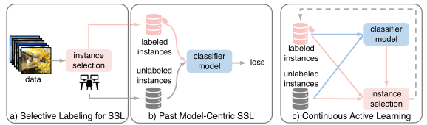
Introduction
The lower the annotation level, the more important what the labeled instances are to SSL.
Random sampling: Fail to cover all semantic classes
Stratified sampling: Unlabeled instances
Notes:
SSL为模型优化选择正确样本进行标记是主动学习的重点：给定一组初始标记数据，目标是选择一个额外的数据子集进行标记，以便通过这些部分标记数据训练的模型接近于完全标记数据的结果。通过结合AL和SSL，还可以利用未标记的数据进行模型训练，产生了一系列被称为半监督主动学习(SSAL)的方法。
存在问题：开始需要随机采样的标记数据；大量的标签开销；很难将AL集成到现有的SSL代码实现；每当用AL/SAL训练模型时需要重新收集标签。

Slide 3
Given only an annotation budget and an unlabeled dataset, select a fixed number of instances for labeling, which way would lead to the best SSL model performance when it is trained on such partially labeled data?

Slide 4
Representative: facilitate label propagation to unlabeled data
Diverse: ensure coverage of the entire dataset
STEP1: Unsupervised feature learning that maps data into a discriminative feature space.
STEP2: Select instances for labeling for maximum representativeness and diversity, without or with additional optimization.
STEP3: Apply SSL to the labeled data and the rest unlabeled data.
Notes:
1)将数据映射到一个鉴别特征空间的无监督特征学习
2)选择实例进行标记，以获得最大的代表性和多样性
3)将SSL应用于标记数据和其他未标记数据

Slide 5
Selective Labeling for Semi-supervised Learning
Dataset: unlabeled dataset of n instances
Task: select m (m ≪ n) instances for labeling, so that a SSL model trained on such a partially labeled dataset produces the best classification performance.

Slide 6

1.Unsupervised Representation Learning
Obtain lower-dimensional and semantically meaningful features with unsupervised contrastive learning
Map $x_{i}$ onto a d-dimensional hypersphere with $L^{2}$ normalization, denoted as $f\left(x_{i}\right)$

Slide 7

2-1. Unsupervised Selective Labeling (USL)
We study the relationships between data instances using a weighted graph.
Nodes $\{V_{i}\}$ : instances in the (normalized) feature space $\{f\left(x_{i}\right)\}$
Edges $\frac{1}{D_{ij}}$ :
Notes:
Edges衡量节点间的相似度，即衡量特征间的相似度

Slide 8



Representativeness: Select Density Peaks
The K-nearest neighbor density (K-NN) estimation
Where is the volume of a unit d-dimensional ball, k(i) instance i’s kth nearest neighbor.
For robustness, we replace it with the average distance

Slide 9

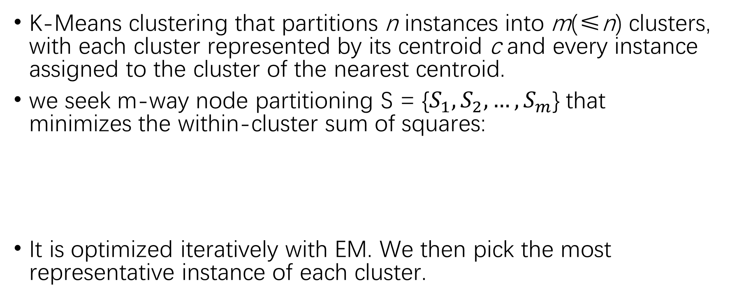
Diversity: Pick One in Each Cluster
K-Means clustering that partitions n instances into m(≤n) clusters, with each cluster represented by its centroid c and every instance assigned to the cluster of the nearest centroid.
we seek m-way node partitioning S = {$S_{1},S_{2},…,S_{m}$} that minimizes the within-cluster sum of squares:
It is optimized iteratively with EM. We then pick the most representative instance of each cluster.

Slide 10
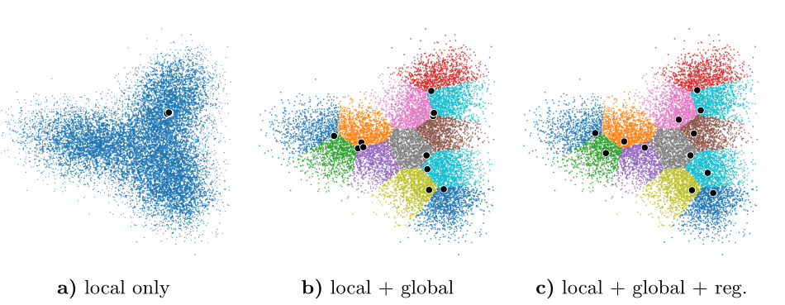

Slide 11


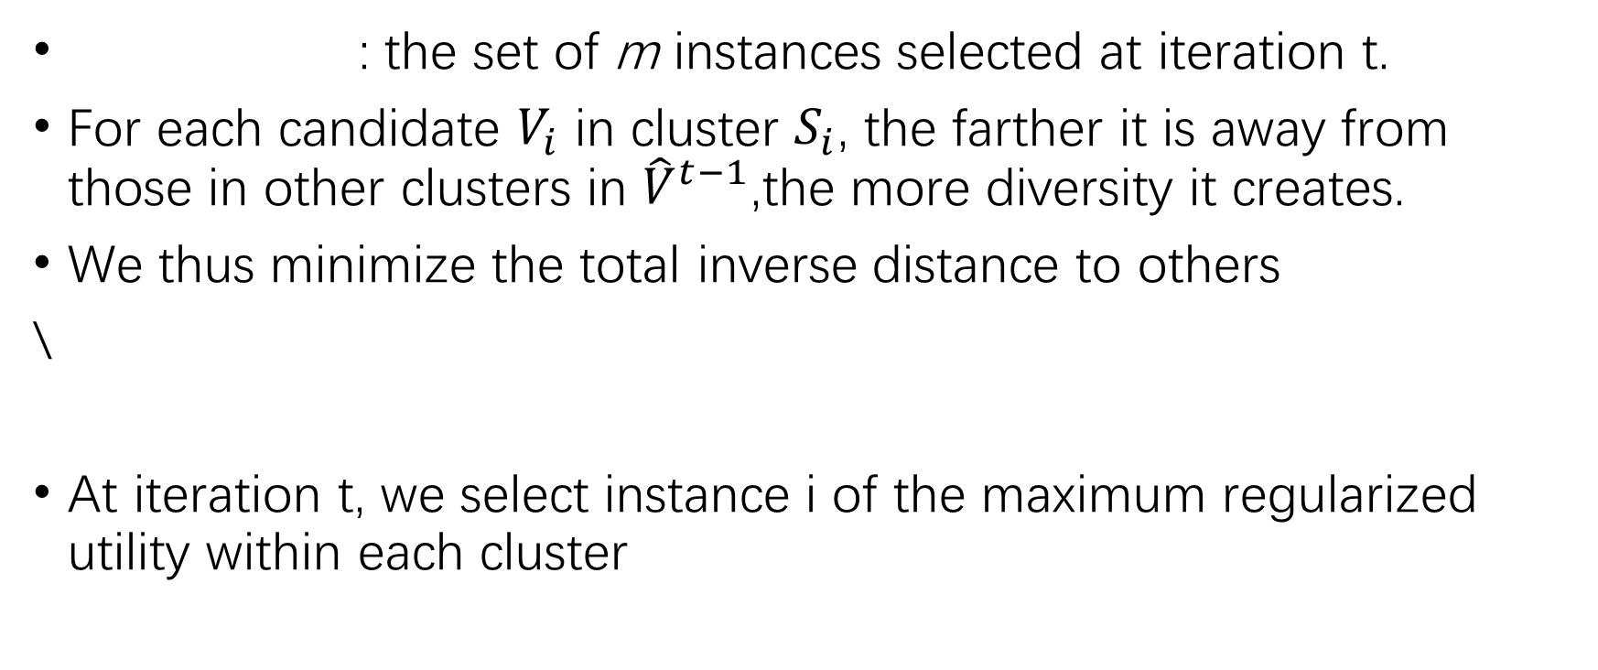
Regularization: Inter-cluster Information Exchange
: the set of m instances selected at iteration t.
For each candidate $V_{i}$ in cluster $S_{i}$, the farther it is away from those in other clusters in ${\hat{V}}^{t−1}$,the more diversity it creates.
We thus minimize the total inverse distance to others
\
At iteration t, we select instance i of the maximum regularized utility within each cluster

Slide 12


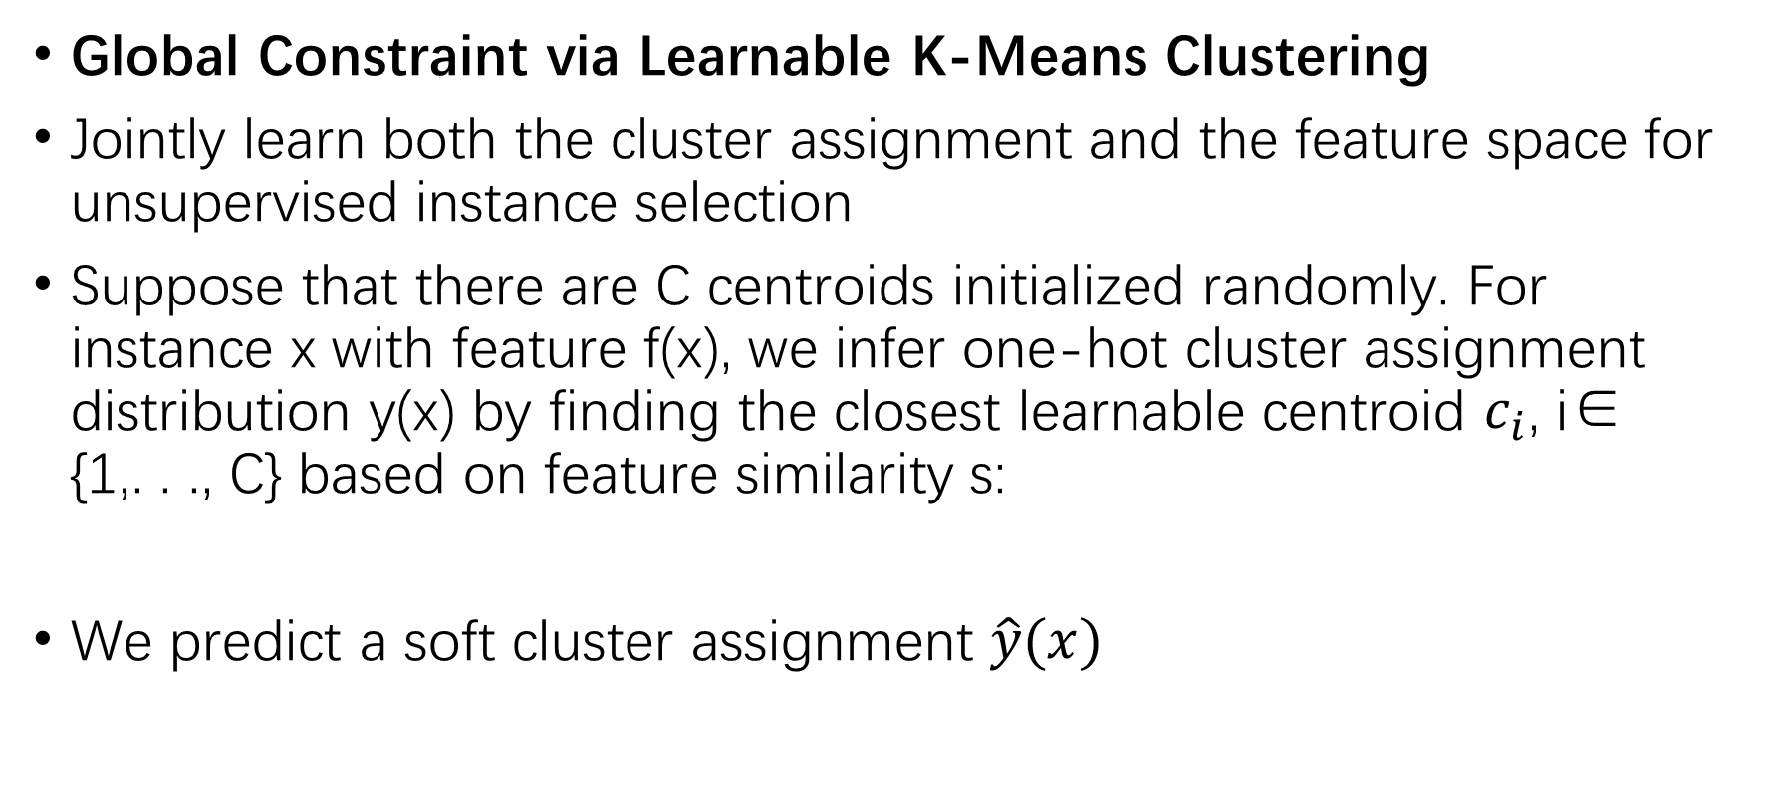
2-2. Training-Based Unsupervised Selective Labeling (USL-T)
Global Constraint via Learnable K-Means Clustering
Jointly learn both the cluster assignment and the feature space for unsupervised instance selection
Suppose that there are C centroids initialized randomly. For instance x with feature f(x), we infer one-hot cluster assignment distribution y(x) by finding the closest learnable centroid $c_{i}$, i∈ {1,. . ., C} based on feature similarity s:
We predict a soft cluster assignment $\hat{y}(x)$
Notes:
integrates instance selection into representation learning（将实例选择集成到表示学习中）
y(x) can be regarded as pseudo-labels

Slide 13

Minimizing the KL divergence between soft and hard assignments
Each instance to become more similar to its centroid (adjust f(x))
The learnable centroid to become a better representative of instances in the cluster (adjust c)
Notes:
我们不仅鼓励每个实例与它的形心更加相似，而且鼓励可学习形心更好地代表集群中的实例。在软预测中，每个实例对所有的质心都有影响。

Slide 14

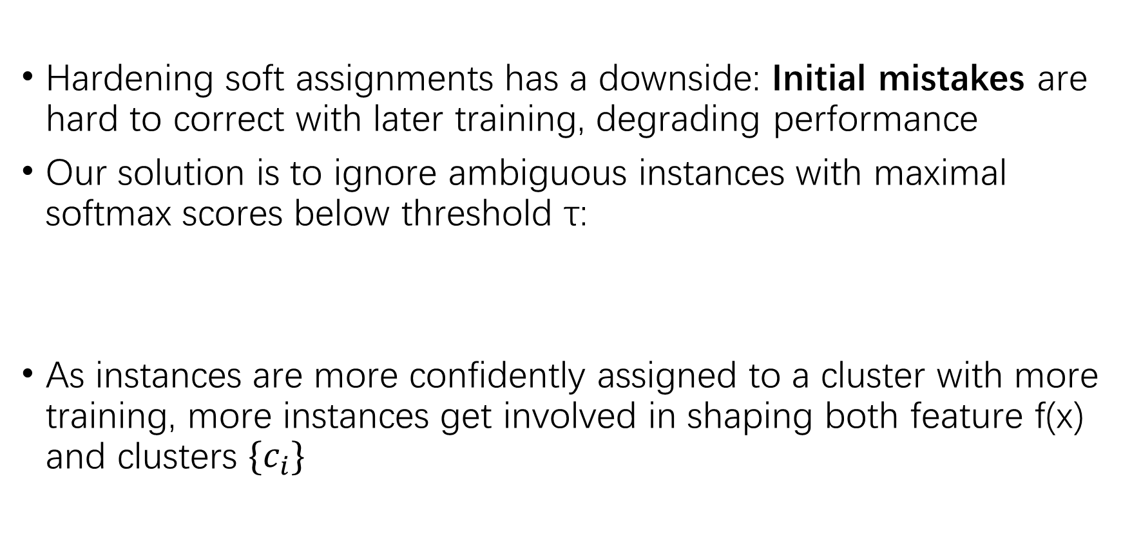
Hardening soft assignments has a downside: Initial mistakes are hard to correct with later training, degrading performance
Our solution is to ignore ambiguous instances with maximal softmax scores below threshold τ:
As instances are more confidently assigned to a cluster with more training, more instances get involved in shaping both feature f(x) and clusters $\{c_{i}\}$

Slide 15
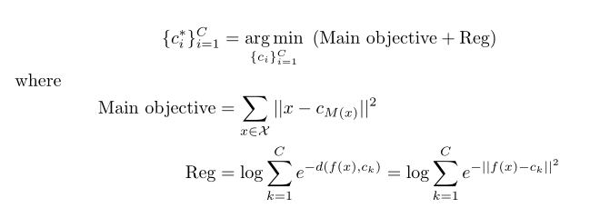

Our global loss can be readily related to K-Means clustering
For τ = 0 and fixed feature f, optimizing $L_{global}$ is equivalent to optimizing K-Means clustering with a regularization term on inter-cluster distances that encourage additional diversity.
s(.,.) = - L2 distance
Notes:
M(x)是与f(x)最接近的类；上式与K-Means聚类具有相同的目标，并附加了一个正则化项，即最大限度地提高簇间样本距离以实现簇多样性

Slide 16
Local Constraint with Neighbor Cluster Alignment
Soft assignments usually have low confidence scores for most instances at the beginning
Assigning an instance to the same cluster of its neighbors’ in the unsupervisedly learned feature space to prepare confident predictions for the global constraint to take effect
Two types of collapses:
(1) Predicting one big cluster for all the instances
(2) Predicting a soft assignment that is close to a uniform distribution for each instance
Notes:
然而，由于软赋值在开始时对于大多数实例通常有较低的信心分数，收敛可能非常缓慢，有时无法实现。我们提出了一个额外的局部平滑性约束，将一个实例分配到非监督学习特征空间中相邻的同一集群（所以后续方法的改动是在标签的赋值方式上进行的），为全局约束的生效准备自信的预测。

Slide 17


For one-cluster collapse
we adopt a trick for long-tailed recognition and adjust logits to prevent their values from concentrating on one cluster:
For even-distribution collapse
we use a sharpening function to encourage the cluster assignment to approach a one-hot probability distribution.
Notes:
上面的是为了不让其集中在某一个类中
下面的是为了不让其在类间有所区分

Slide 18


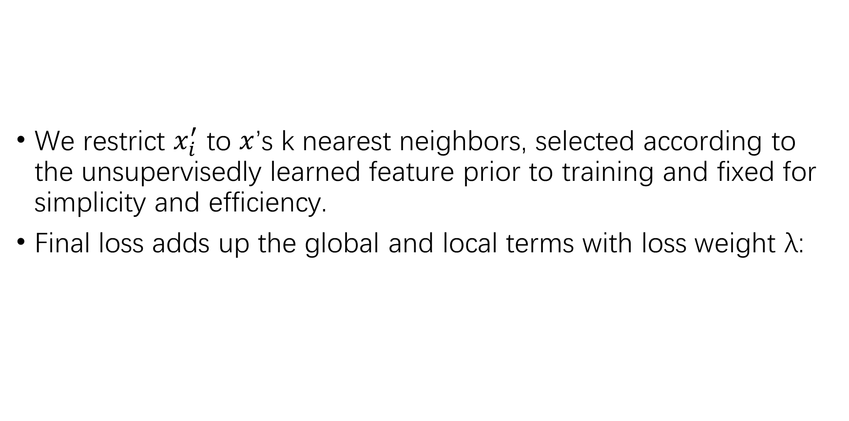
We restrict $x_{i}^{′}$ to $x$’s k nearest neighbors, selected according to the unsupervisedly learned feature prior to training and fixed for simplicity and efficiency.
Final loss adds up the global and local terms with loss weight λ:
Notes:
我们的USL-T是一种端到端无监督特征学习方法，它直接输出m个集群来选择m个不同的实例。然后，我们为每个聚类选择最具代表性的实例，其特征是最高的置信度得分，即maxˆy (x)。与USL一样，USL- T通过选择不同的代表性实例进行标记，而不需要任何标签监督，从而提高了模型学习效率。

Slide 19

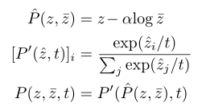
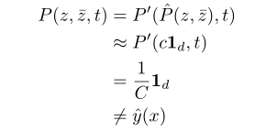
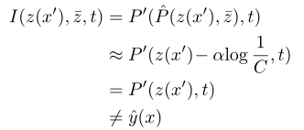
Neither one-cluster nor even-distribution collapse is optimal to our local constraint, i.e.,
For one-cluster collapse For even distribution collapse
Notes:
在我们的模型之下，能有效地避免one-cluster和even-distribution，因为损失函数不会是最优的

Slide 20

Our USL-T is an end-to-end unsupervised feature learning method that directly outputs m clusters for selecting m diverse instances.
For each cluster, we then select the most representative instance, characterized by its highest confidence score
Just as USL, USL-T improves model learning efficiency by selecting diverse representative instances for labeling, without any label supervision

Slide 21


 | MAK | USL-T
Dataset | unlabeled seed training dataset + sampling dataset | unlabeled dataset, without external data
Task | retrieve an extra set to enhance self-supervised representation learning | select partial instances for labeling, so that a SSL produces the best classification performance
Training Framework | contrastive learning | semi-supervised learning
Principles | Tailness Proximity Diversity | Representative for each cluster Diversity

