Slide 1


AttnMove: History Enhanced Trajectory Recovery via Attentional Network
Tong Xia, Yunhan Qi, Jie Feng, Fengli Xu, Funing Sun, Diansheng Guo, Yong Li
Tsinghua University, China
xia-t17@mails.tsinghua.edu.cn

Slide 2
01
Background
CONTENTS
02
Challenge
03
Model Design
04
Experiment Results
05
Discussion & Conclusion

Slide 3




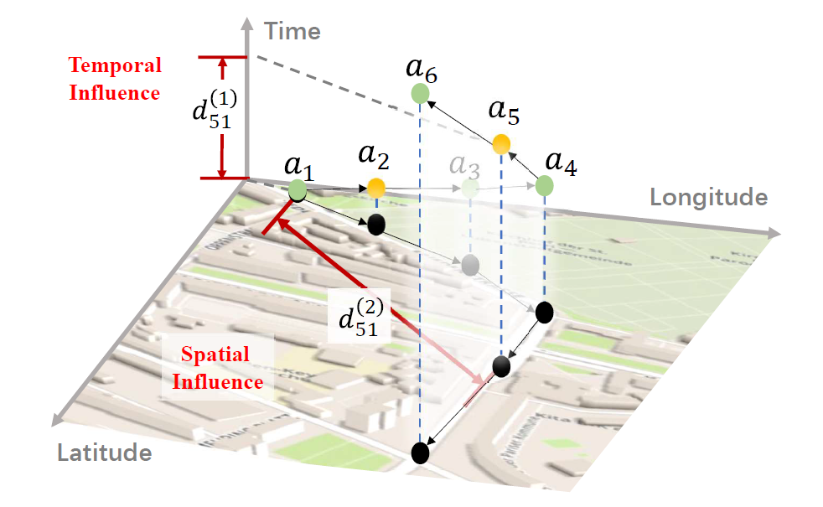

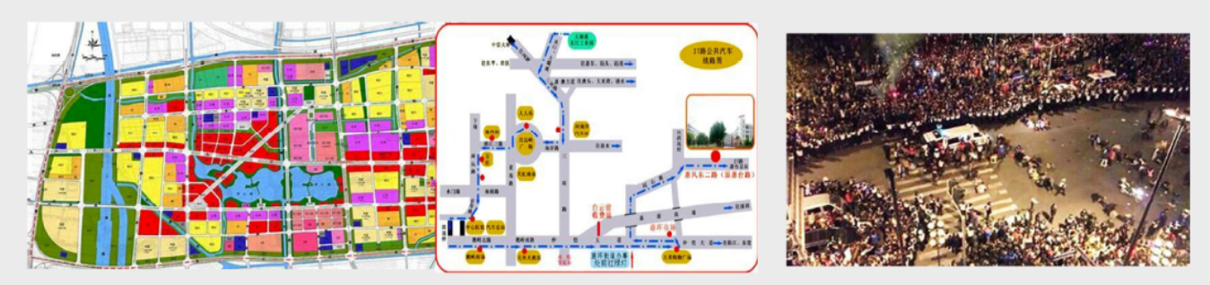
Background
Mobility Data
Observed
Missing
High sparsity!
Uneven distribution.
City Plan
Location Recom.
Emergence
Notes:
The popularity of smartphones and widely adapted location based services like online map and location sharing have enabled the collection of large-scale mobility data, which is great value in various applications, such as point of interest recommendation, transportation planning and emergence response. However, because users may not allow the continues access to their locations due to privacy or battery consuming concerns, this kind of data is usually sparse in term of individual trajectory, and the location records of a user are unevenly distributed in time. This issue inevitably harms the utilization of the mobility data.

Slide 4

Background
Months and years
Observed
Day
Missing
Observed
Observed
Missing
Missing
Observed
Missing
Observed
Observed
Missing
Missing
Observed
Observed
Missing
Missing
High sparsity.
Uneven distribution.
Long-term！-- Periodical
Notes:
Luckily, it can cover a long time period as users need to use smartphone every day, which encourages us to utilize historical mobility behavior to better densify a future trajectory.

Slide 5

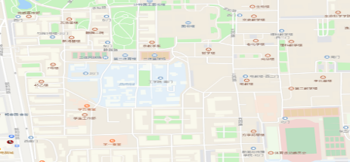

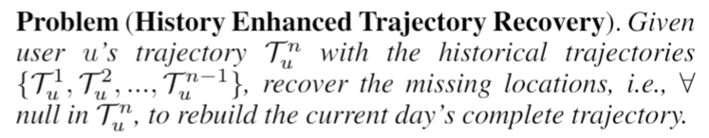





Background
Problem: Combine current spatio-temporal constrains and historical period to
recover overall mobility trajectory
user1
$$T_{u}^{1}$$
user1
user2
$$\hat{T_{n}^{n}}$$
$$T_{u}^{2}$$
user1
user1
Day1
user2
Day2
user2
user2
$$T_{u}^{n−1}$$
Day3
DayN
…
History sparse trajectories
Current dense trajectories
user1
$$T_{u}^{n}$$
user2
DayN
Current sparse trajectories
Notes:
In light of this, in this paper, we studied the problem of trajectory recovery from multiple sparse and unevenly distributed historical trajectories.

Slide 6
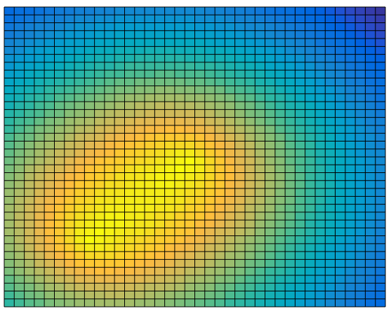

Challenges
High sparsity results in weak spatial-temporal constrains
Periodical feature is hard to distill from noisy history trajectories
How to combine historical pattern with observed locations.
Location uncertainty increases with longer time span of missing data
Historical trajectories are also sparse and contains a lot of occasional visits
The importance of history varies with time, user, etc.
Notes:
It sounds promising but to get a favorable recovery accuracy, there are some challenges.
First of all, because of the sparsity and uneven distribution, the spatial-temporal constrains provided by observed locations become weak. As shown in this figure, the user was likely to visit a large range of area in missing hours.
In addition, we hope to exploit long-term history, but historical trajectories are also sparsity and contain occasionally visited locations. So it is intractable to distill useful periodical patterns.
Last but not least, when we introduce history, which provides some extra information, we need to determine how to fuse history with observed locations. It is not easy because there are various scenarios and the importance of history is different.

Slide 7
Background
Literature Overview
Physical laws of human mobility:
Continuous: smoothing filters, linear interpolation (Alwan and Roberts 1998)
Periodic: key location detection, historical frequency (Scheider et al. 2013)
Spatial-temporal correlation: entropy and radius (Li et al. 2019)
Machine learning for trajectory modelling:
Geo-matric based classifier (Li et al. 2019)
RNN based next location prediction (Feng et al. 2018)
Either fail to utilize long-term history or unable to handle the sparsity.
Notes:
Before giving our solution, we first conduct literature overview and summary the findings as follows. Existing trajectory modeling works can be divided two categories. One is physical law-based statistical methods and others is deep learning especially RNN-based models. However, those either fail to utilize long-term history or are insufficient to handle the sparsity.

Slide 8
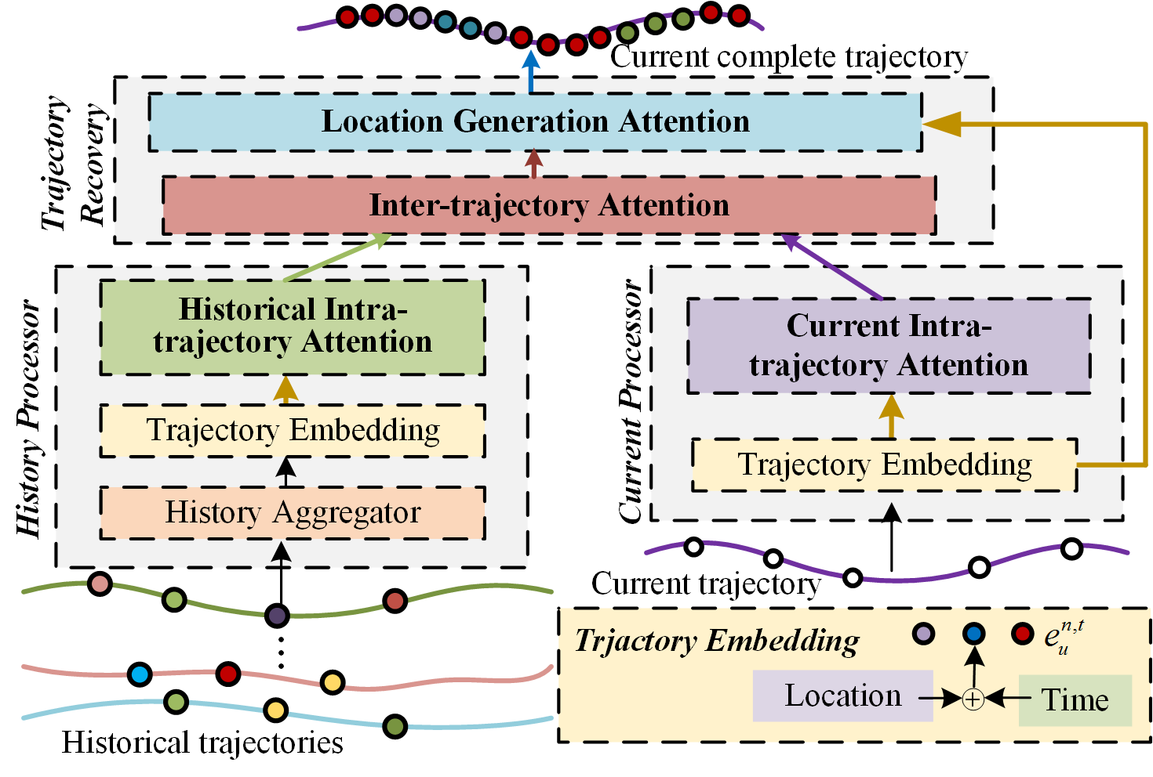
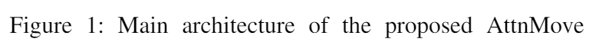
Solution
Steps:
1.Mobility representation
2. Current constrain learning
3. Historical pattern learning
4. Fusing and reconstruction
Notes:
To tackle those challenges, wo propose a novel attentional neural network-based model. It first process current and historical trajectories separately based on the spatial-temporal representations, and then fuse them to generate the missing locations. Now let me show some details for each module one by one.

Slide 9

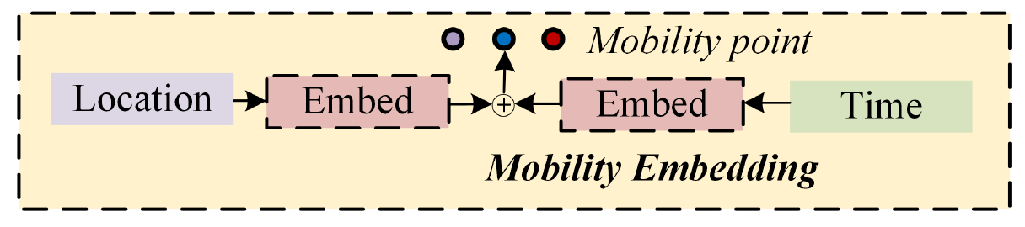
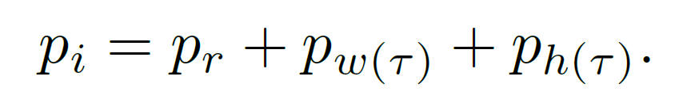
Solution
Fixed position embedding
1. Mobility Embedding
Trainable mobility embedding
Location
Embedding
(Including null.)
Time slot
Embedding
Weekday/weekend
Embedding
Temporal context
Notes:
The first module is learning representation of each time slot, which is used as input to all following modules. The representation consists of three parts, location embedding, time slot embedding and day embedding. As we denote the missing location as null, we also set up a unique location embedding to present this.

Slide 10
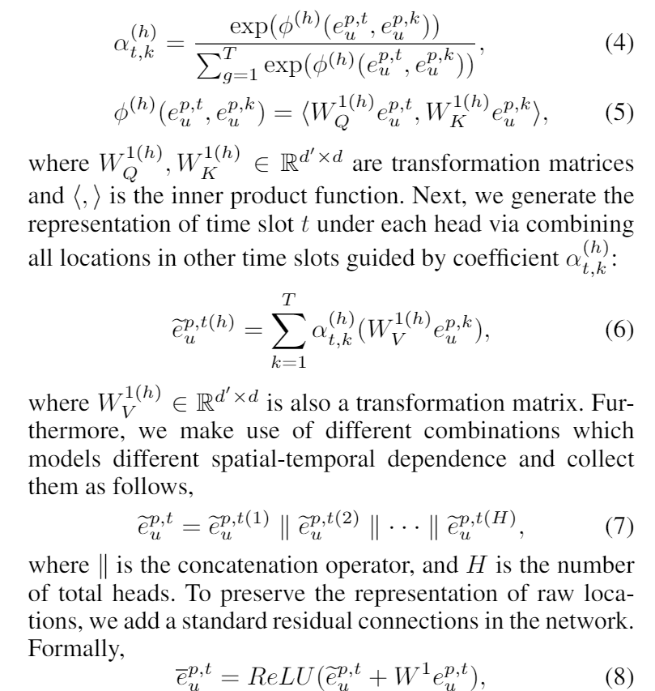
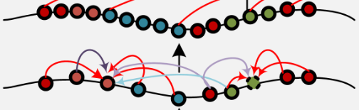
Solution
2. Current Processor
Intra-trajectory attention:
Multi-head:
Observed location
Missing location
Notes:
The second module is to initially fill in the trajectory which we want to recovery. To enhance the spatial-temporal constrains from the observed locations, we propose an intra-trajectory attention mechanism. For each time slot t, we learn a weighted summation of its adjacent time slot, where the weights represent the spatial-temporal dependence. In order to learn various dependence, follow Transformer, we also learn multiple heads and take a concatenation of them.

Slide 11
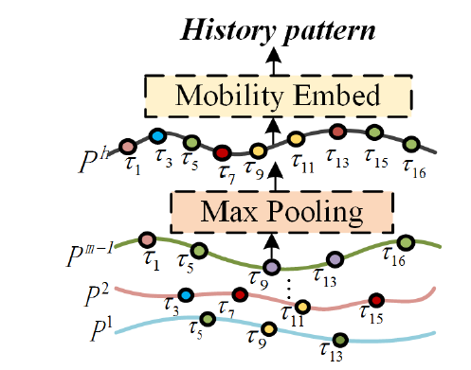
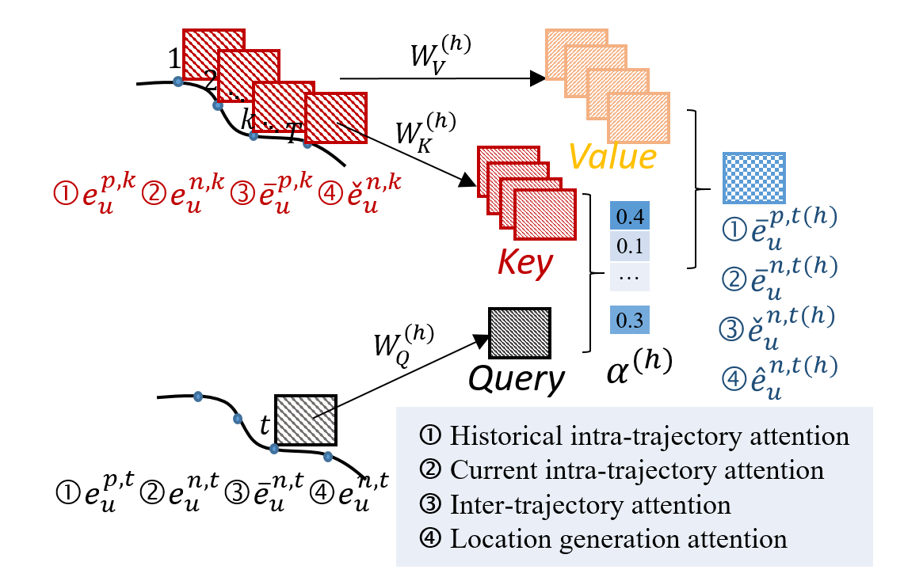
Solution
3. History Encoder
Insufficient History information
Still spares after aggregation
Most frequently visited location in each time slot
Attentional smooth
(1) Multiple historical trajectories
(2) Historical intra-trajectory attention
Notes:
For the history trajectories, we first aggregate them by preserving the most frequently visited locations in corresponding time slot, which forms the periodical pattern. But there are still two limitations: the history is utilized insufficiently and some time slot can be missing even when aggregated. So we further use the intra-trajectory attention to better smooth the distilled trajectory. The structure is the same with the one we used for current trajectory, except that both query and key are from history.

Slide 12
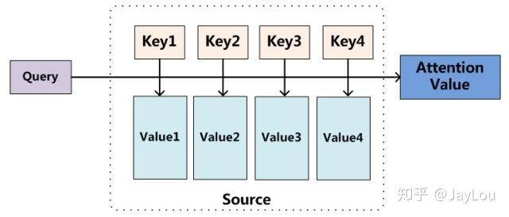





Solution
4. Trajectory recovery module
Historical trajectory
Current trajectory
$$τ^{2}$$
$$τ^{3}$$
$$τ^{4}$$
$$τ^{5}$$
$$τ^{1}$$
Fuse history and current observed location based on spatial-temporal similarity.
Notes:
Then, we get the distilled historical trajectory and the preliminary filled current trajectory, we design the final recovery module to fuse them. First, each time slot in current trajectory is used as query to calculate the attentional weights of time slots in history trajectories, this achieves the dynamic fusion of two kinds of trajectories. After that, an intra-trajectory attention is conducted to generate the location embedding for time slots without observation. Therefore, a complete trajectory can be recovered.

Slide 13
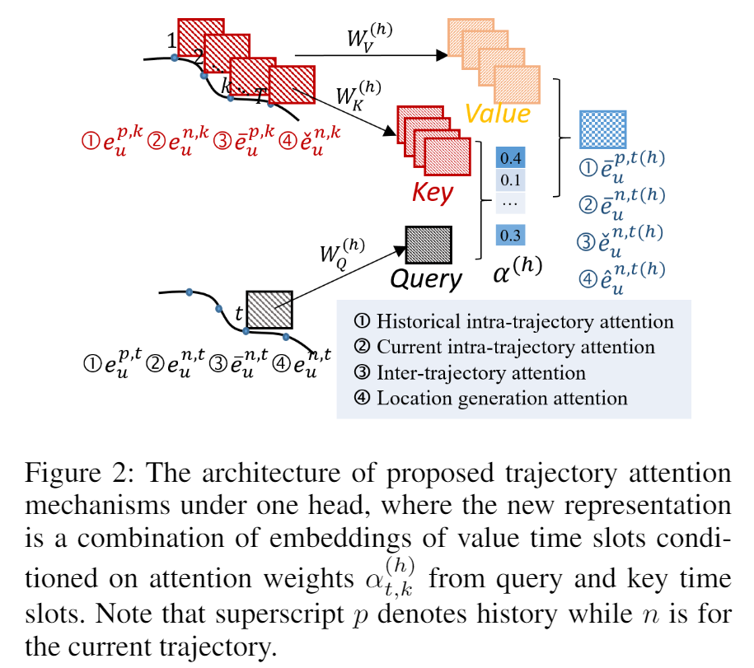
Solution
Challenge1: sparsity
Intra-trajectory attention
Challenge2: Noisy history
Max aggregation and attentional smoothing
Challenge3: Varied history importance
Inter-trajectory attention
Notes:
Overall, three key designs including intra-trajectory attention, history aggregation and attentional smoothing, as well as inter-trajectory attention are proposed in our AttnMove framework to handle the challenges of the studied problem.

Slide 14
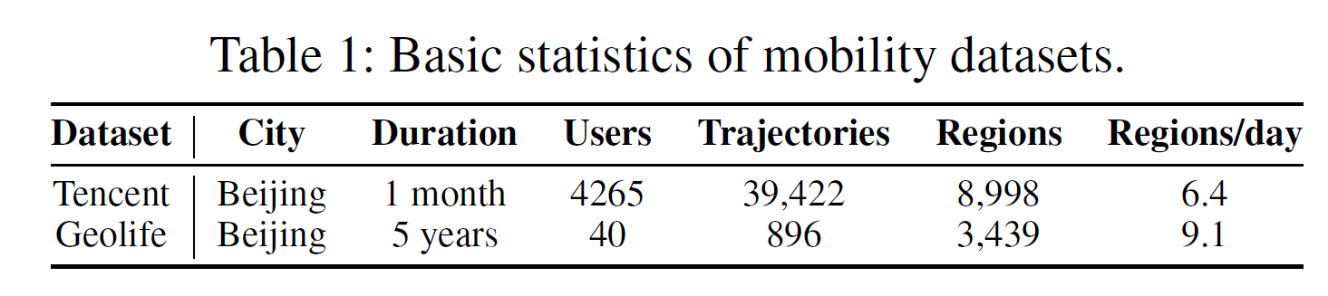
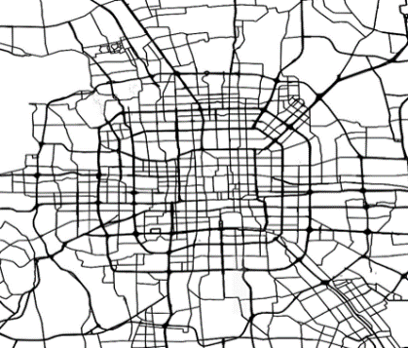
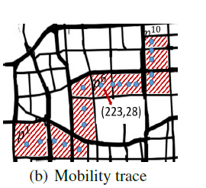
Experiments
Dataset
Spatial and temporal granularity
Evaluation methodology
30min
Randomly mask 30 and 10 time intervals of each, the overall remained number is less than 10 (i.e., 20% of one day).
Sparse trajectories as the input, and masked locations as ground truth
Sort each user’s trajectory by time, 7:1:2 for train, validation and test
Metric
MAP：Average precision
Recall: Top1 hit-ration
Distance: Average geographical error
Notes:
To evaluate the performance, we conduct extensive experiments based on two real world mobility dataset. One is from Tencent Inc, collected by its mobility-related services. And the second is an open trajectory data. Both were collected in Beijing, the capital of china.
For each trajectory, we map the GPS location into urban regions and discrete time into 30 minutes. Regions are defined by urban blocks demarcated by road networks. We randomly mask 70% of the records in each trajectory as ground truth for training and testing. Map, recall are reported to show the accuracy of recovery. In addition, distance, a geo-distance between the ground truth and the location we recovery is also reported. The smaller it is, the better the performance,

Slide 15
Results
Baselines:
Rule-based methods:
Top: Most frequently visited locations for each user.
History: Most frequently visited locations of the same time in histories.
Linear: connecting each pair of consecutive records by straight interpolation.
Machine learning methods:
RF: Entropy, radius, the missing time, the former and the latter trajectory point are extracted as feature to train a random forest.
Deep learning methods:
LSTM: RNN for sequence modeling to capture the forward sequentiality.
BiLSTM: Improved RNN to model the bidirectional sequentiality.
DeepMove: Attentional LSTM for next location prediction (WWW2018)
Bi-STDDP: DNN to model the bi-directional dependence and user preference to identify the missing PoIs in check-in trajectories. (AAAI2019)
Notes:
As for the baseline, we compare our model to three physical rule based methods, one typical machine learning algorithm and four state-of-the-art deep learning models, among which, DeepMove is a RNN-based next location prediction works taking history into consideration, so we adopt it to solve our problem. Bi-STDDP is a representation learning based model for missing check-in prediction.

Slide 16
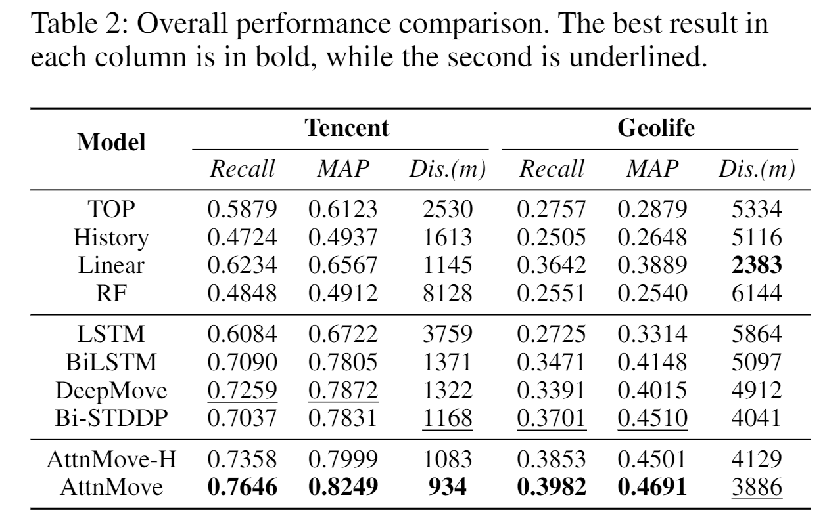
Results
Performance
4.0%~7.6% performance gain compared to SOTA
Superiority of Attentional Network
Better utilization of history
Notes:
This table shows the overall performance, our AtteMove achieve favorable improvement against the state-of-the-art. Particularly, when comparing AttnMove to RNN based models, we can demonstrate the superiority of attentional neural network in handling sparse and long sequence. When we compare AttnMove to its variant with history removed, we can also justify that a better utilization of history can significantly improve the accuracy.

Slide 17
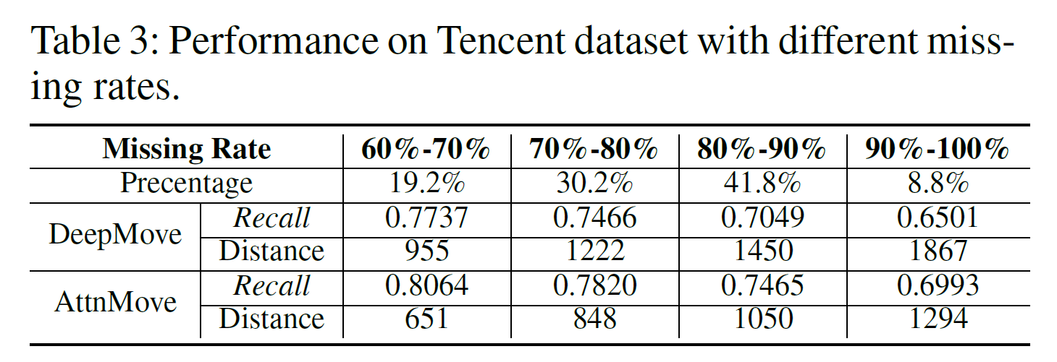
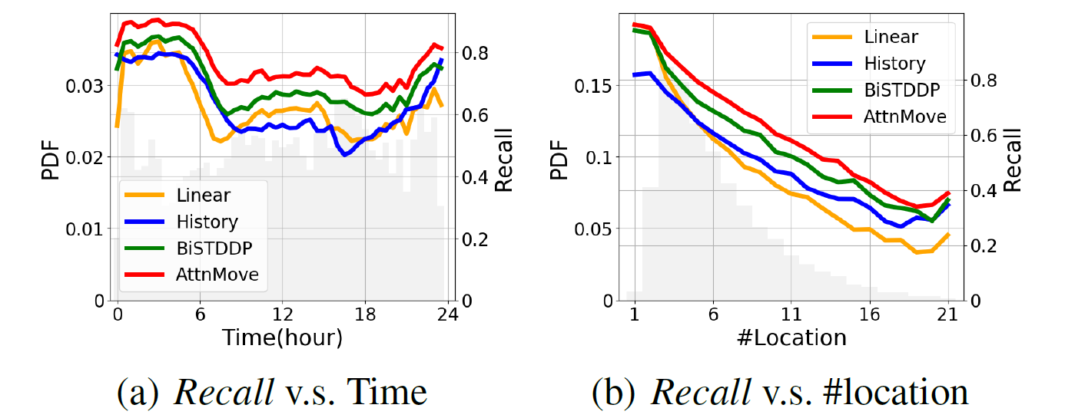
Results
Robustness
SOTA
>3%
Our
>10%
>10%
Notes:
To demonstrate the robustness of our model, we also report the comparison in terms of different missing rate. The more locations are missed, the more difficult to recovery accurately. But from the results, we can find that our model can always keep the performance gain. In addition, we compare the performance under different spatial-temporal context, the conclusion is similar, that our model is always the best.

Slide 18
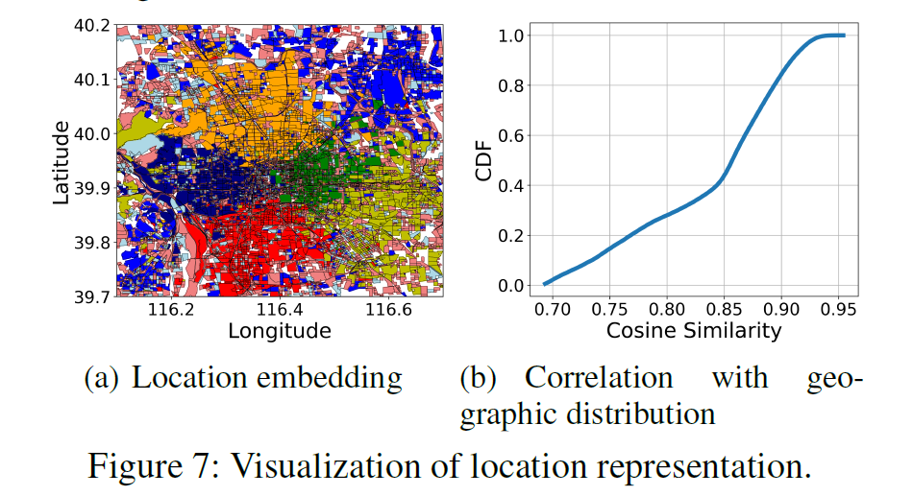
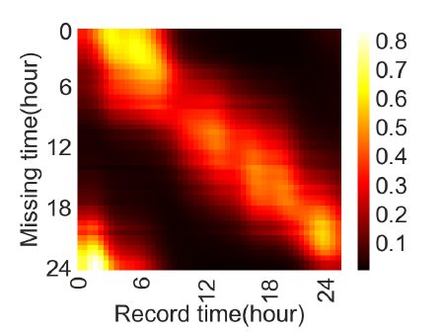
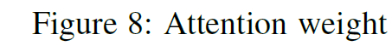
Results
Visualization Analysis
(>0.85,60%)
Clustering by embedding
Notes:
Last but not least, we visualize the locations on the map, where color represent kmeans clustering results according to the learned location embedding vectors. It is easy to find that geo-adjacent relation has been captured. We also show one head of the final intra-trajectory attention weight, where we can see adjacent time slots and home hours are highly related. All those indicates that we learn explainable mobility patterns.

Slide 19
Conclusion
We study the problem of personal trajectory reconstruction from sparse and long-term mobility data.
We propose a novel attentional neural network which can better capture spatial-temporal correlation and fully exploit history.
Attention/Transformer is promising in mobility modelling. Others trajectory-related problems are also worth to be explored.
Notes:
Finally, here comes our conclusion,
We study the problem of personal trajectory reconstruction from sparse and long-term mobility data.
We propose a novel attentional neural network which can better capture spatial-temporal correlation and fully exploit history.
Some takeaways:
Attention is promising in mobility modelling. This is the first work for trajectory recovery. But related problems are also worth to be explored.

Slide 20

Tong Xia
https://xtxiatong.github.io/
Code and data: https://github.com/XTxiatong/AttnMove
Notes:
Thanks for your listen, your can find our codes and data here if those are of interest to you.

